Slide 1

November 27, 2012
Scott Niederjohn, Ph.D.
Lakeland College Center for Economic Education

Slide 2

Overview
Why Saving and Investing Matters
Overview of LEIG
Lesson 20: The Language of Financial Markets
Lesson 6 What Are Mutual Funds?
Overview of the Gen i Revolution

Slide 3
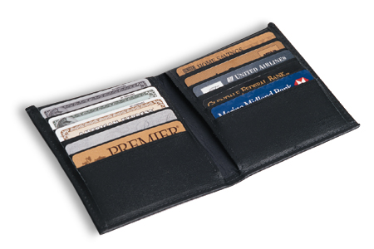
Why It Matters

Slide 4
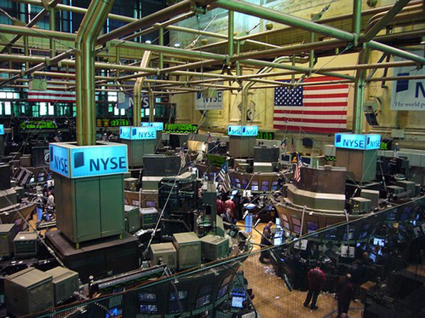
Why Invest?
You can earn income.
  Owning stock is like a job.
Rewards last a lifetime.
  Investing provides good assets
  Stocks, bonds, mutual funds

Slide 5
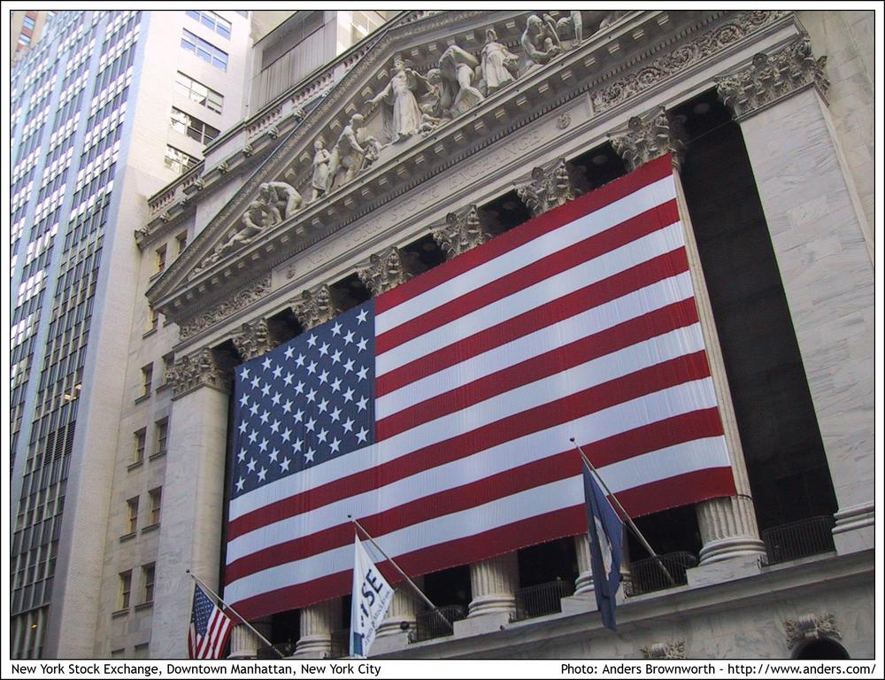
Why Invest?
Time is on your side.
  Stock prices rise over time.
Beat inflation.
  Overtime, investments in stock have good returns.

Slide 6

Why Invest?
Own corporate America--it’s not greed.
  Investing helps companies to grow and provide more jobs and income.
  Investing helps create new goods and services for consumers.
  Investing illustrates a basic principle of economics - - the invisible hand of Adam Smith.

Slide 7




But, It’s Scary Out There

Slide 8

Why Worry?
I have all the money I’ll ever need…
As long as I die at 4:00 p.m. today.
Henny Youngman

Slide 9

Economic and Financial Literacy is Important
Citizens must understand basic economics to:
  Fully participate in our nation’s market economy.
  Understand policy issues and cast informed votes in federal and state elections.
Citizens must understand personal finance to:
  Plan for retirement.
  Make saving and investing choices.
  Purchase insurance.
  Buy a home.

Slide 10
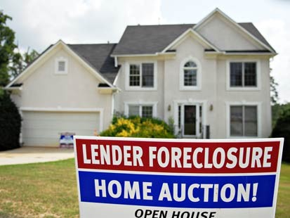
Problems Caused by Economic and Financial Illiteracy
Recent Financial Crisis
  Consumers’ lack of knowledge about mortgages, interest rates, debt and credit played a part.
  “Take the greed and the financial misrepresentation out of it, and the root cause of this crisis is massive levels of financial illiteracy”– John Bryant.

Slide 11

Problems Caused by Economic and Financial Illiteracy
An estimated 7.7 percent of U.S. households, approximately 9 million people, are unbanked.
21.7 percent of African American and 19.3 percent of Hispanic households are unbanked.

Slide 12
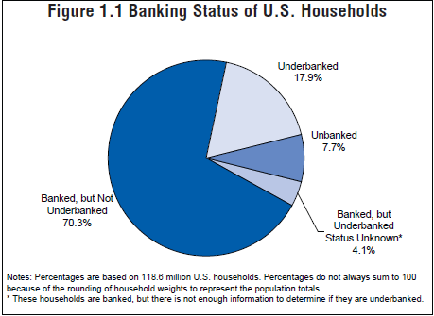
Problems Caused by Economic and Financial Illiteracy
An estimated 17.9 percent of U.S. households, roughly 21 million people, are underbanked.
An estimated 31.6 percent of African American and 24 percent of Hispanics households are underbanked

Slide 13


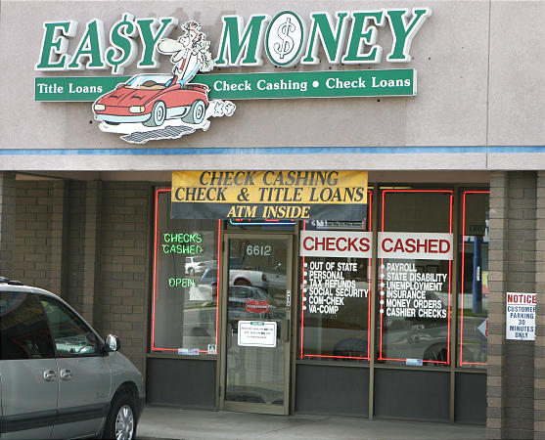
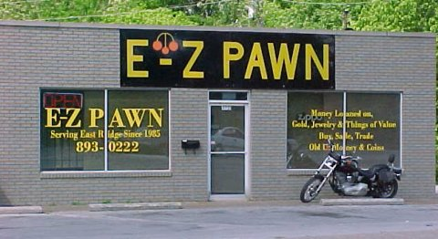
Where Do the Unbanked and Underbanked Go for Financial Services?

Slide 14

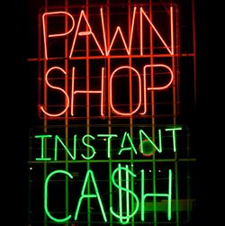
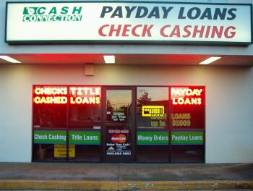
Non-Mainstream Financial Institutions
Unbanked/Underbanked households depend on:
  Check-cashing outlets
  Short-term lenders: Payday loans
  Pawnshops
  Rent-to-own stores
Unbanked families pay higher fees for using these financial services and face higher risk losses due to dealing in cash.

Slide 15


Slide 16
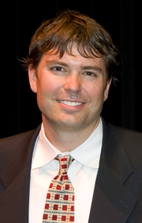

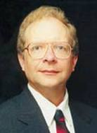
Authors
Scott Niederjohn
  Lakeland College
Mark Schug
  UW-Milwaukee
Bill Wood
  James Madison University

Slide 17
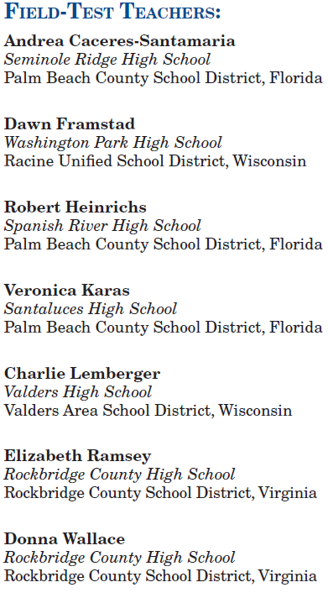

Slide 18
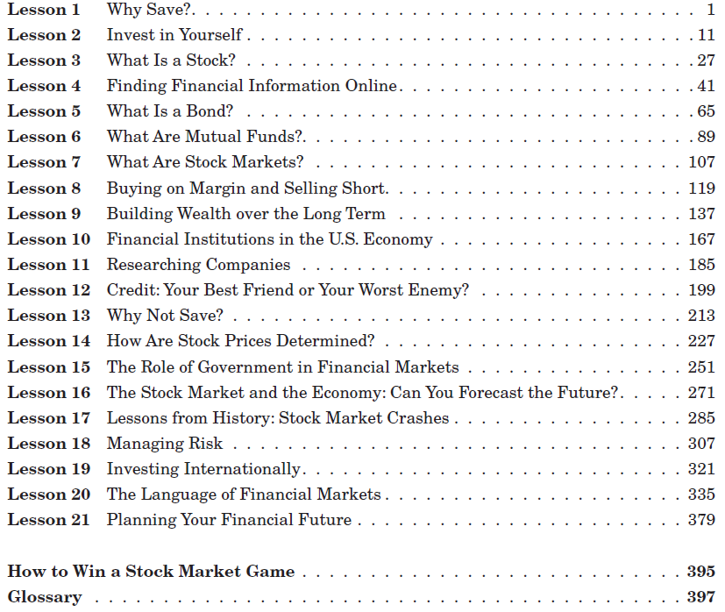

Slide 19
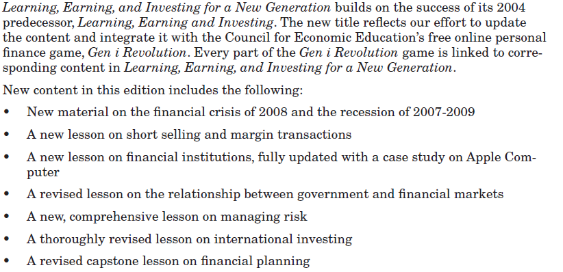
What’s New?

Slide 20
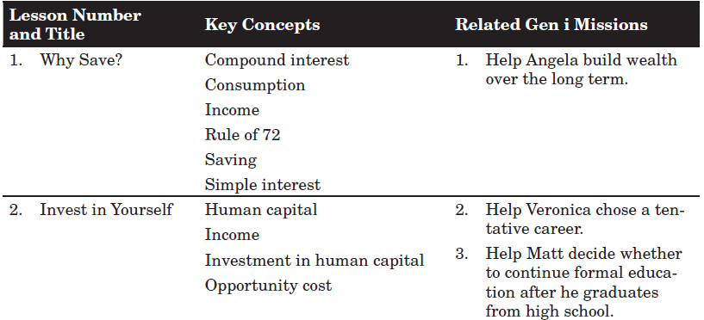

Slide 21
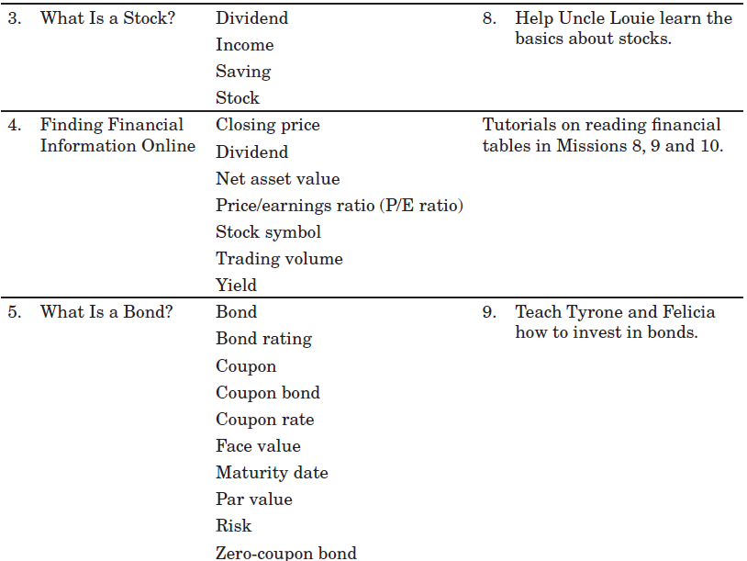

Slide 22
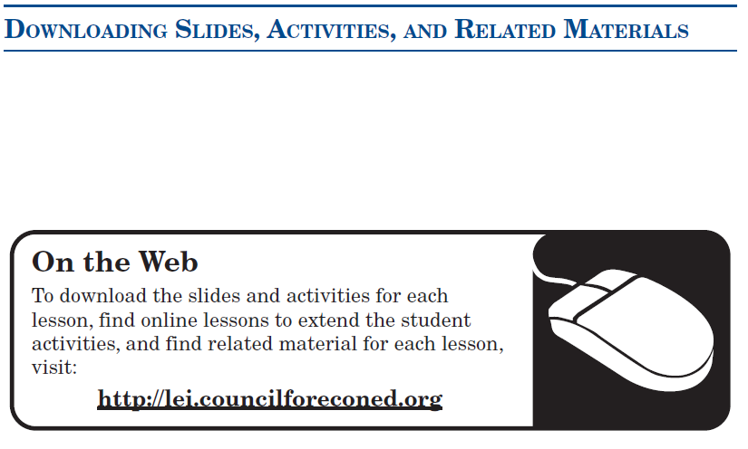

Slide 23

The Language of
Financial Markets
Lesson 20

Slide 24
The Language of Financial Markets: Terms
Slide 20.1
Lesson 20 – The Language of Financial Markets
Buying and Selling in the Market
Buying on Margin
Commission
Ponzi Scheme
Price
Short Selling
Exchanges and Indexes
Dow Jones Industrial Average (DJIA)
NASDAQ Stock Market
New York Stock Exchange (NYSE)
Over-the-Counter Market
S&P 500 Stock Index
People in Financial Markets
Broker
Dealer
Institutional Investor
Investment Bank
Stockholder
Stocks, Bonds, and Mutual Funds
Bond
Common Stock
Initial Public Offering (IPO)
Index Fund
Mutual Fund
Preferred Stock
Technical Terms
Capital Gain
Dividend
Growth Stock
Income Stock
Liquidity
Risk
Return
Stock Spill

Slide 25
The Language of Financial Markets:
Quiz Bowl Score Sheet
Slide 20.2
Lesson 20 – The Language of Financial Markets
Group | Score
1
2
3
4
5

Slide 26
What are Mutual Funds?
Lesson 6

Slide 27

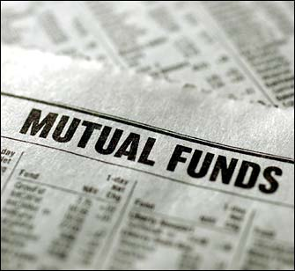
Lesson 6: What Are Mutual Funds?
More Americans invest in stocks and bonds through mutual funds than in any other way.
Mutual funds are like an investment club - - but with thousands of members.

Slide 28

Activity 6.1
Each club has $3,000 to invest.
The club sold $300 shares at $10 each to start the club.
You may buy any of six stocks.
Invest the entire $3,000.
Complete the chart in Activity 6.1.

Slide 29
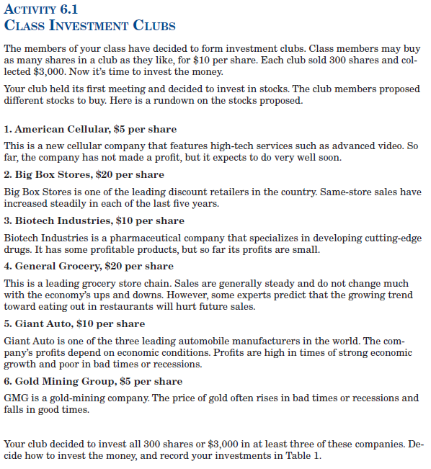

Slide 30
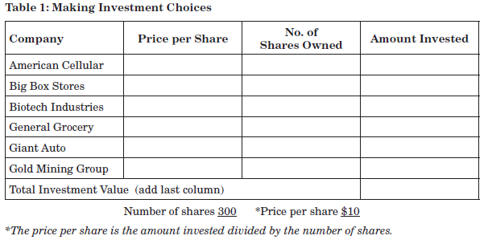
Complete Table 1

Slide 31
Activity 6.1
Complete Table 1
Company | Price per Share | No. of Shares Owned | Amount Invested
American Cellular | $ 5.00
Big Box Stores | $20.00
Biotech Industries | $10.00
General Grocery | $20.00
Giant Auto | $10.00
Gold Mining Group | $ 5.00
Total Investment Value

Slide 32
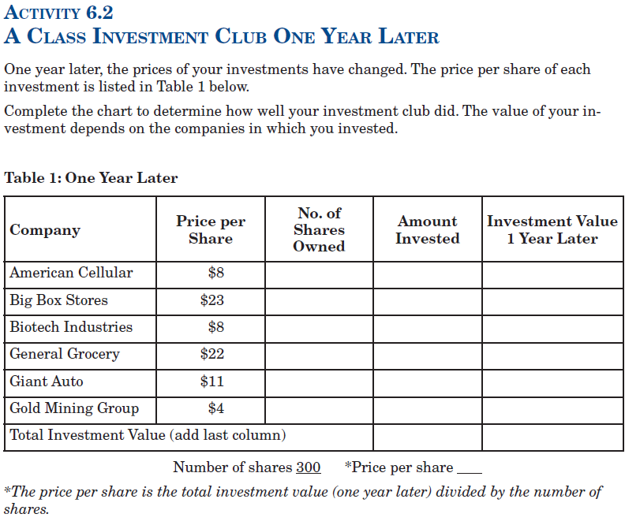

Slide 33
One Year Later: An example
Slide 6.1
Lesson 6 – What are Mutual Funds?
This is an example of what might have happened to a class investment club’s share of stock.
Company | Price per Share | Number of Shares Owned | Amount Invested | Investment Value One Year Later
American Cellular | $8 | 100 | $500 | $800
Big Box Retail | $23 | 50 | $1,000 | $1,150
Biotech Industries | $8 | 0 | $0 | $0
General Grocery | $22 | 0 | $0 | $0
Giant Auto | $11 | 100 | $1,000 | $1,100
Gold Mining Group | $4 | 100 | $500 | $400
Total Investment Value (add last column) |  |  | $3,000 | $3,450
Number of shares 300 *Price per share $11.50
*The price per share is the total investment value (one year later) divided by the number of shares.

Slide 34
How Mutual Funds Work
Slide 6.2
Lesson 6 – What are Mutual Funds?
The price per share changes every day and depends on the value of the investments.
The value of the investments depends on the performance of the assets chosen by the fund manager. Unlike members of an investment club, mutual fund investors do not decide which stocks or bonds the fund will buy or sell. The fund manager does that.
A mutual fund charges investors for the financial management it provides. The investor may also pay brokers’ fees and other costs. The lower these costs, the higher the investor’s returns from a set of holdings.
Some mutual funds charge a sales commission called a load. The higher the load, the less the actual investment made on behalf of the investor. Lower loads are better for investors, other things being equal.

Slide 35
Types of Mutual Funds
Slide 6.3
Lesson 6 – What are Mutual Funds?
Low Risk and High Risk and
Low Potential Reward High Potential Reward
Money market funds (short-term securities) | Bond funds (corporate or longer-term government bonds) | Income funds (high-yield stocks and bond funds) | Growth funds (larger company stocks; long-term capital gains) | Aggressive growth funds (smaller company stocks; short- and long-term capital gains)

Slide 36
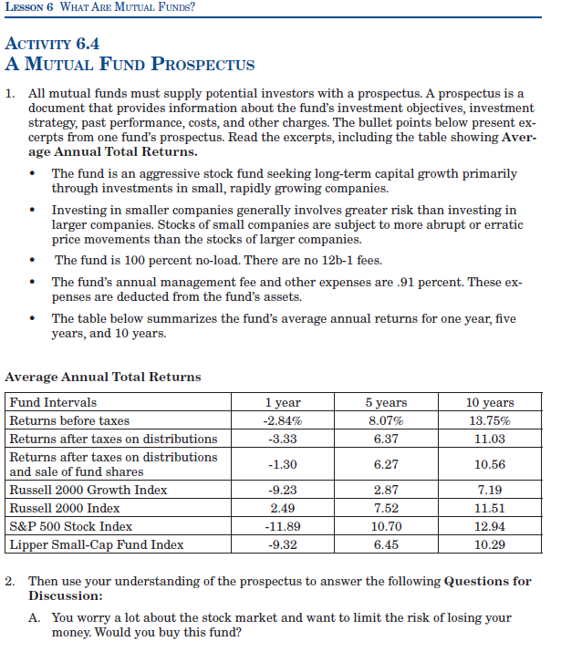

Slide 37
JOIN THE

Slide 38
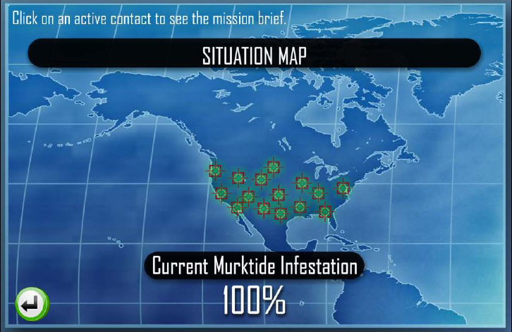
What Is the Gen i Revolution?
An interactive, web-based computer game.
Designed to teach students the basics of personal finance and investments.
15 missions designed to be playable as stand-alone missions.
Also effective as a supplement to classroom instruction.

Slide 39
The Story Line
People are losing confidence in their ability to save and invest.
This confusion is called “the Murktide”.

Slide 40
The Story Line
The mysterious Monique founded her movement, the Gen i Revolution, to fight the Murktide.
Students take on the role of operatives in Monique’s movement.
In each of the 15 missions, players are briefed and trained by Monique to help their contacts battle the Murktide.

Slide 41
The Object of the Game
Accumulate as many points as possible by correctly answering questions and giving good financial advice to contacts.

Slide 42

Missions
1. Help Angela build wealth for the long run.
2. Help Verona choose a tentative career.
3. Help Matt to consider whether to continue formal education after he graduates from high school.
4. Help the O'Neil's save $300 a month for a down payment on a new home.
5. Teach Justin about credit.

Slide 43
Missions
6. Advise Kai on how to invest his grandmothers $10,000.
7. Convince Paul, Fred and Diana to reconsider their choice of financial institution.
8. Help Uncle Louie learn the basics about stocks.
9. Teach Tyrone and Felicia how to invest in bonds.
10. Teach a group of students how to invest in mutual funds.

Slide 44
Missions
11. Advise a Gen I $10 million donor on her investment.
12. Show Jasmine what determines stock prices.
13. Advise Markos on how to weather a crash in the scholarship fund.
14. Advise political leaders on their economic forecasts.
15 Conduct the Red Roosters annual financial planning workshop.

Slide 45
How to Play
http://www.genirevolution.org/demonstration.php
Notes:
Play the Player’s Guide video

Slide 46
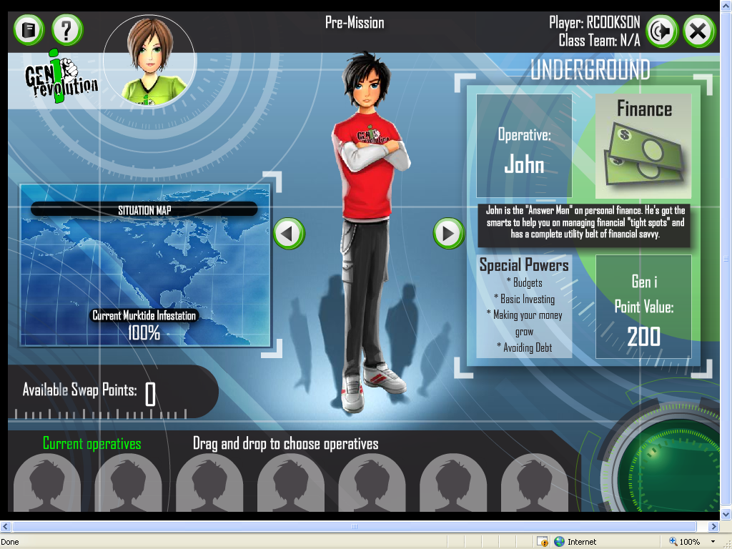

Slide 47
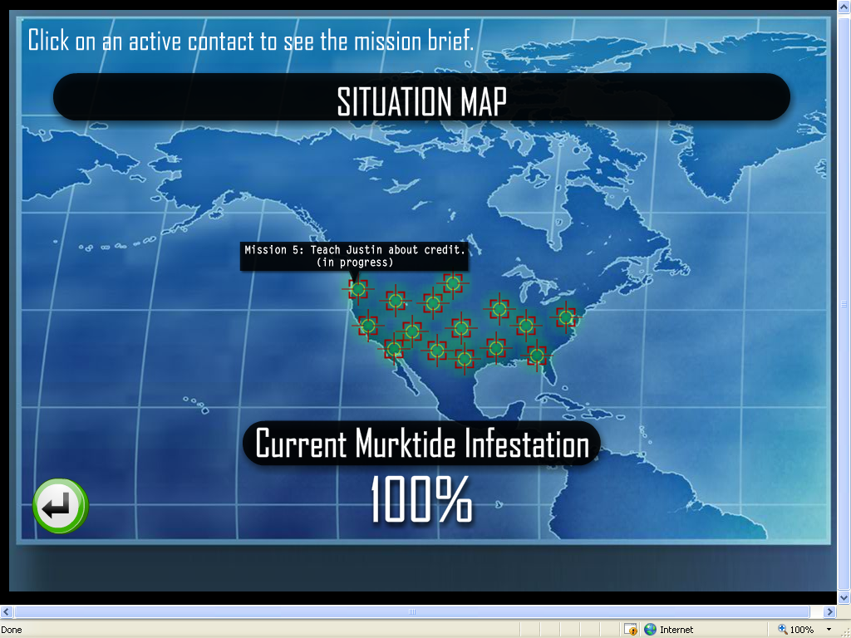
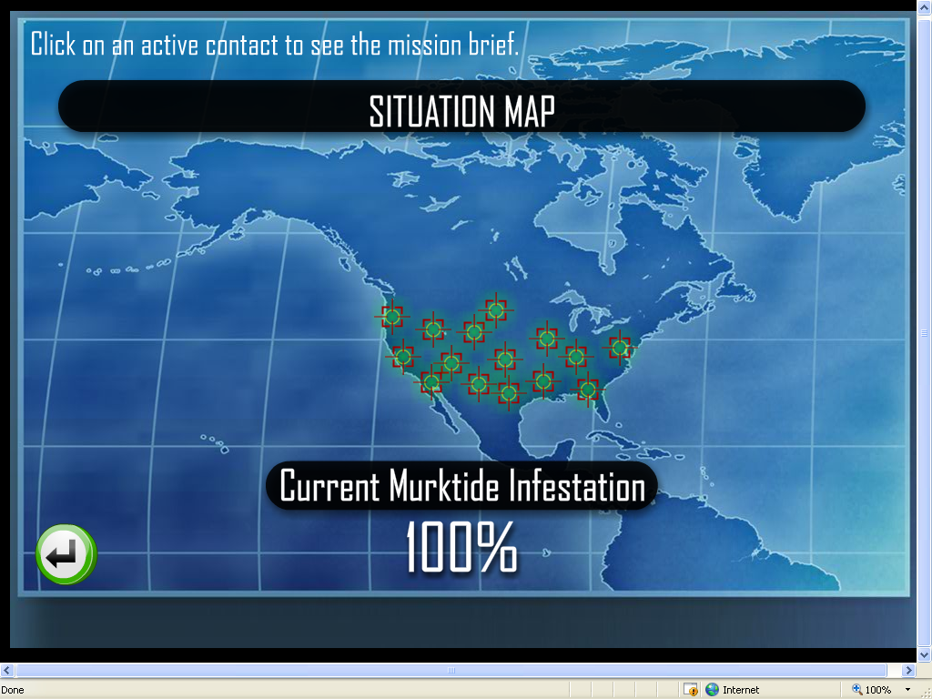

Slide 48
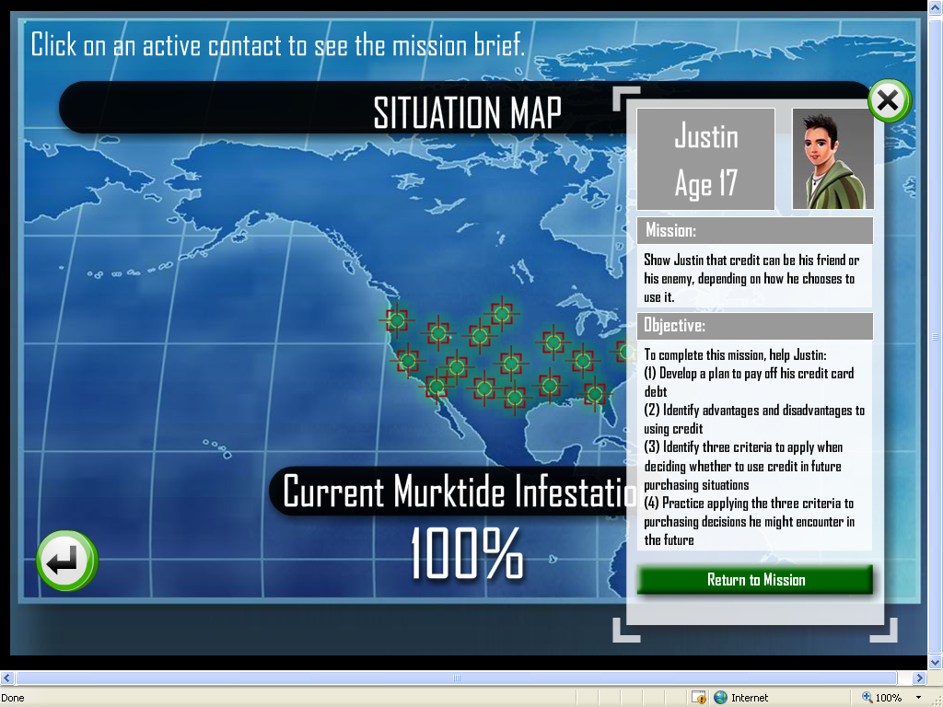

Slide 50
Thank You for Participating
Questions?

