Slide 1
Cybersecurity and Personal Finance
Appily Ever After
By
Deborah Kozdras, Ph.D.

Slide 2
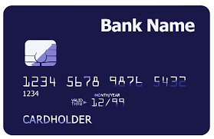
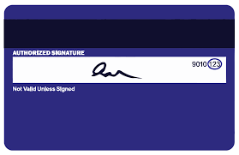
Visual 1: Credit Card

Slide 3
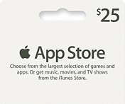
Visual 2: Pre-paid Gift Card
App Card
Choose from our large selection of games and apps.
$25
A C

Slide 4
Handout 1: Ana’s Spending
Ana wanted to download some apps
Her mom said she could download free apps
The app said she could have it ad-free for $5.00
Her mom entered her credit card
She paid $10.00 for the second app to be ad-free
Ana downloaded a free Princess Ninja app
It said she could buy 5 new dresses for $1.00 each
Then it said “get a new world for $10.00”
Paid $10.00 for tokens to buy new outfits and equipment
Paid $5.00 for faster time
New worlds cost $5.00 each – she bought 2
New characters cost $2.00 each – she bought 5
Total = ____
She downloaded 5 songs from the game at $2.00 each
New cars cost $5.00 – she bought 4
She downloaded a princess race car game

Slide 5
Handout 2: Problem/Solution
Problem: What was Ana’s problem?
Solution: What advice did Jamal give Ana?
Draw what happened:
Write about it:
_________________________________________________________________________________
Draw what happened:
Write about it:
_________________________________________________________________________________

Slide 6
Handout 3: In-app Purchases
Ana received a $25.00 gift card for app purchases. These are the apps she likes. Make some recommendations to Ana that you think are responsible.
Pop Star Singing | Build a Roller Coaster | Superhero Fashion Show
$5.00 to make ad-free | $5.00 to make ad-free | $10.00 to make ad-free
$1.00 per song for kid’s songs | $5.00 for each new roller coaster kit | $1.00 for each new outfit
$2.00 per song for current popular songs | $10.00 for a new theme park | $1.00 for each new background
$1.00 per each new background image | $10.00 for faster time | $2.00 for each new superhero

