Slide 1
Election Economics

Slide 2
THE ECONOMICS OF PRESIDENTIAL ELECTIONS
WHERE DOES THE $$ COME FROM?
WHAT IS THE $$ SPENT ON?
WHERE IS THE $$ SPENT?

Slide 3
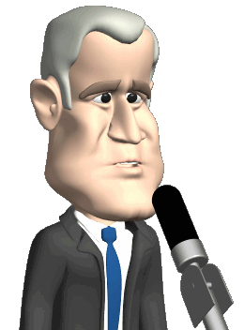
FREEDOM OF SPEECH
DO AMERICANS HAVE THE RIGHT TO EXPRESS THEIR POLITICAL OPINIONS?
SHOULD PEOPLE BE LIMITED TO HOW OFTEN THEY EXPRESS THEIR POLITICAL OPINIONS?
IS THE SPOKEN WORD THE ONLY WAY TO EXPRESS POLITICAL OPINIONS?

Slide 4
POLITICAL SPEECH
WHEN AN INDIVIDUAL CONTRIBUTES MONEY TO A POLITICIAN’S CAMPAIGN, HAS AN OPINION BEEN EXPRESSED?
IS MONEY GIVEN TO SUPPORT A POLITICIAN’S CAMPAIGN A FORM OF SPEECH?
SHOULD PEOPLE BE LIMITED IN THE QUANTITY OF MONEY CONTRIBUTED?

Slide 5
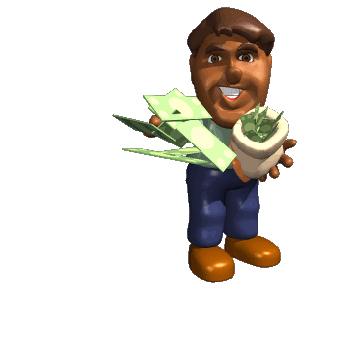
CITIZENS UNITED V. FEC (2010)
The justices ruled that political spending is protected under the First Amendment.
Corporations and unions can spend unlimited amounts of money on political activities, as long as it is done independently of a party or candidate.
Corporations enjoy the same political rights as individuals.

Slide 6
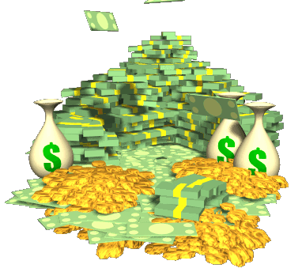
McCUTCHEON V. FEC (2014)
Individuals were prohibited from giving more than $48,600 combined to all federal candidates and $74,600 combined to all parties and political action committees.
The justices struck down longstanding caps on what an individual may contribute to all federal candidates, collectively, in any two-year election cycle.

Slide 7
WHERE DOES THE MONEY COME FROM?
PAC (Political Action Committee)- committee representing business, labor or ideological interests, organized for the purpose of raising and spending money to elect and defeat candidates.
Super PAC- raises unlimited sums of money to advocate for or against political candidates. Unlike traditional PACs, super PACs are prohibited from donating money directly to political candidates.
501(c)(4) groups- “social welfare” organizations that may engage in political activities. Not required to disclose donors.

Slide 8
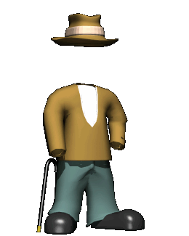
WHERE DOES THE MONEY COME FROM?
Dark Money- money from entities that do not have to make the sources of their funding public, such as 501(c)(4) groups.
Hard Money- refers to tightly regulated contributions to candidates.
Soft Money- refers to unregulated, unlimited contributions to political parties for so-called "party-building" activities.

Slide 9
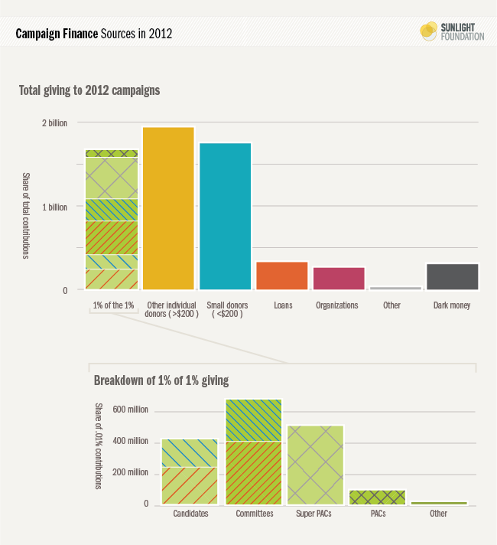
WHERE DOES THE MONEY COME FROM?
In the 2012 election, 28 percent of all disclosed political contributions came from just 31,385 people. In a nation of 313.85 million, these donors represent 1% of 1% of the United States population.
Source: Sunlight Foundation, 2013. http://sunlightfoundation.com/blog/2013/06/24/1pct_of_the_1pct/ .

Slide 10
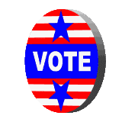
WHAT IS THE MONEY SPENT ON?
The Obama campaign spent $750 million in 2012.
65% of that was on media spending.
$75 million was spent on digital ads (4x increase).
$67 million on fundraising and $61 million on salaries.
$128,000 to Katy Perry
$9500 to Dominos

Slide 11
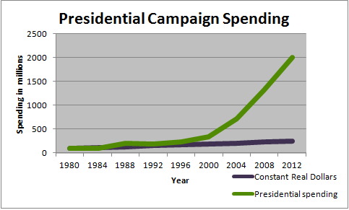
ASTRONOMICAL SPENDING
$30.33 was spent during every second of the 2012 election cycle on votes (that includes everything from rallies to banners and TV ads), according to Federal Election Commission data.
22% of all votes came out of California, New York, and Texas. But they’re non-competitive states. Most of the money spent went to a handful of swing states.
Campaign spending data courtesy of Center for Responsive Politics: Opensecrets.org.

Slide 12
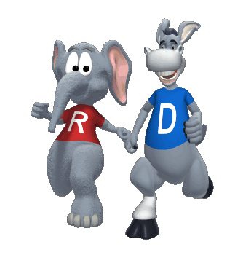
WHERE IS THE MONEY SPENT?
Red States- Chose the Republican candidate in the last four elections.
Blue States- Chose the Democratic candidate in the last four elections.
Purple States- Swing or Battleground states.

Slide 13
PARTY POSITIONS
DEMOCRATS
REPUBLICANS
PRO-CHOICE
GUN CONTROL
SUPPORT SAME-SEX MARRIAGE
MINIMUM WAGES AND PROGRESSIVE TAXATION
SUPPORT UNIVERSAL HEALTHCARE
PATHWAY TO CITIZENSHIP FOR THE UNDOCUMENTED
PRO-LIFE
2ND AMENDMENT RIGHTS
OPPOSE SAME-SEX MARRIAGE
WAGES SHOULD BE SET BY THE MARKET AND TAXES REDUCED
OPPOSE UNIVERSAL HEALTHCARE
STRONGER BORDER PATROLS AND NO AMNESTY

Slide 14
PARTY AFFILIATION
DEMOCRATS
REPUBLICANS
UNDER 35 YEARS OF AGE
NON-CHRISTIAN FAITHS
SECULAR (NON-RELIGIOUS)
WOMEN
ASIAN AND NATIVE AMERICAN
AFRICAN-AMERICAN
HISPANIC/LATINO
COLLEGE-EDUCATED PEOPLE
URBAN
UNION MEMBERS
50 PLUS WHITE VOTERS
WHITE CHRISTIANS
MORMONS
MARRIED MEN
CUBAN-AMERICANS
NON-COLLEGE-EDUCATED WHITES
RURAL
Republican affiliation in cities with populations over 500,000 is only 39 percent, compared with 52 percent in suburban areas and 59 percent in rural areas.

Slide 15
WHO VOTES? (% 2012 PRESIDENTIAL ELECTIONS)
Black 66 – White 64.1 – Hispanic 48 – Asian 46.9
Income > $75K 77 – Income < $75K 62
65 and older: 69.7 – 45-64: 63.4 – 25-44: 49.5 –
18-24: 38
Bachelor’s Degree 75 – H.S. Degree 52.6
Women 63.7 – Men 59.7
Purple States 66 – All others 57
States with early voting laws have experienced falling turnout rates in the last three elections.
States with same day registration and vote have witnessed higher turnout rates.

Slide 16
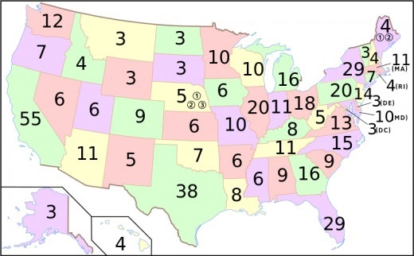
270 IS THE MAGIC NUMBER
*Nebraska and Maine allow for the splitting of votes while all others are winner take all.
Notes:
*Nebraska and Maine allow for the splitting of votes while all others are winner take all.

Slide 17
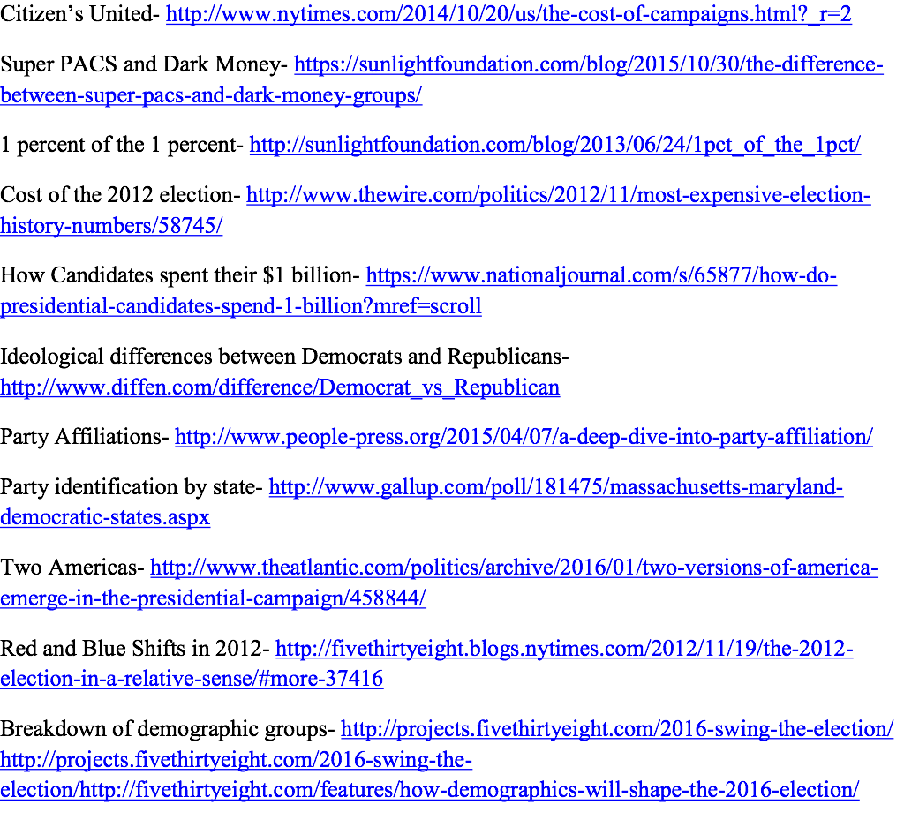
LINKS TO DATA SOURCES

Slide 18
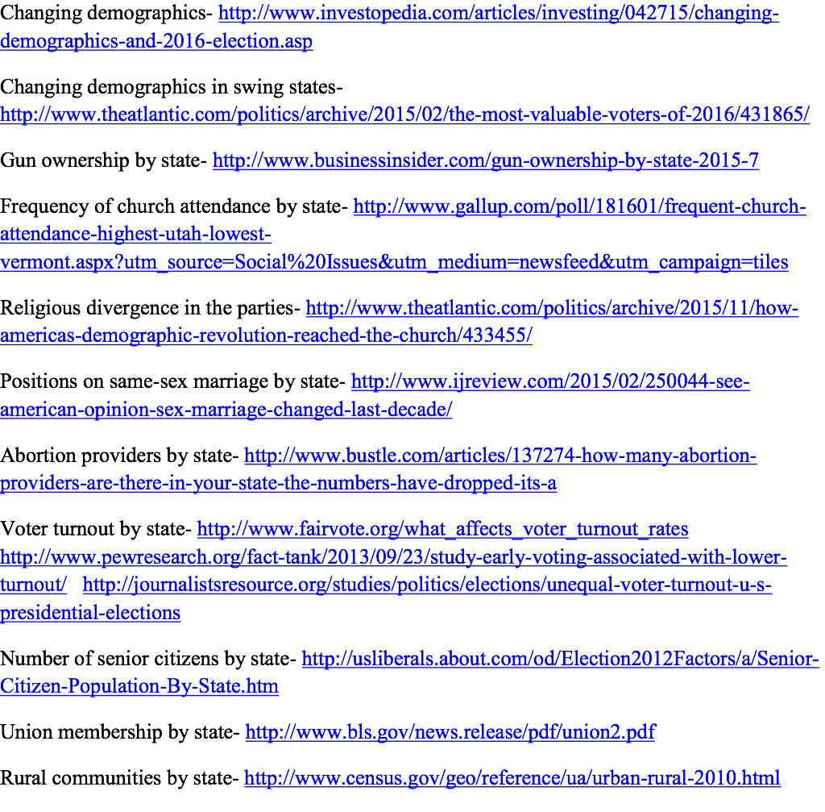
LINKS TO DATA SOURCES

