Slide 1
What is a Stock?
Lesson 3

Slide 2
Stock Questions: True or False?
Slide 3.1
Lesson 3 – What is a Stock?
Stocks represent ownership in a corporation.
People who invest in stocks cannot loser their money.
Mark bought 100 shares of Intel stock. Each share sold for $35.50. If no fees were involved, Mark paid $3,550 for the shares.
The price people pay for a stock is called a dividend.
The closing price for a share of Wal-Mart stock was $37.25. This means that the price of the share was $37 and one-quarter of a dollar. One quarter of a dollar is $0.20.
People who own stocks are guaranteed a return on the money they have invested in stocks.
The only way stockholders make money is through dividend payments while they own the stock.
One way stockholders make money is by selling their stock for more money than they paid for it.
Stockholders can reduce the risk on their stock investment by diversifying their portfolios.
The New York Stock Exchange is the only place where people can buy and sell stocks.

Slide 3
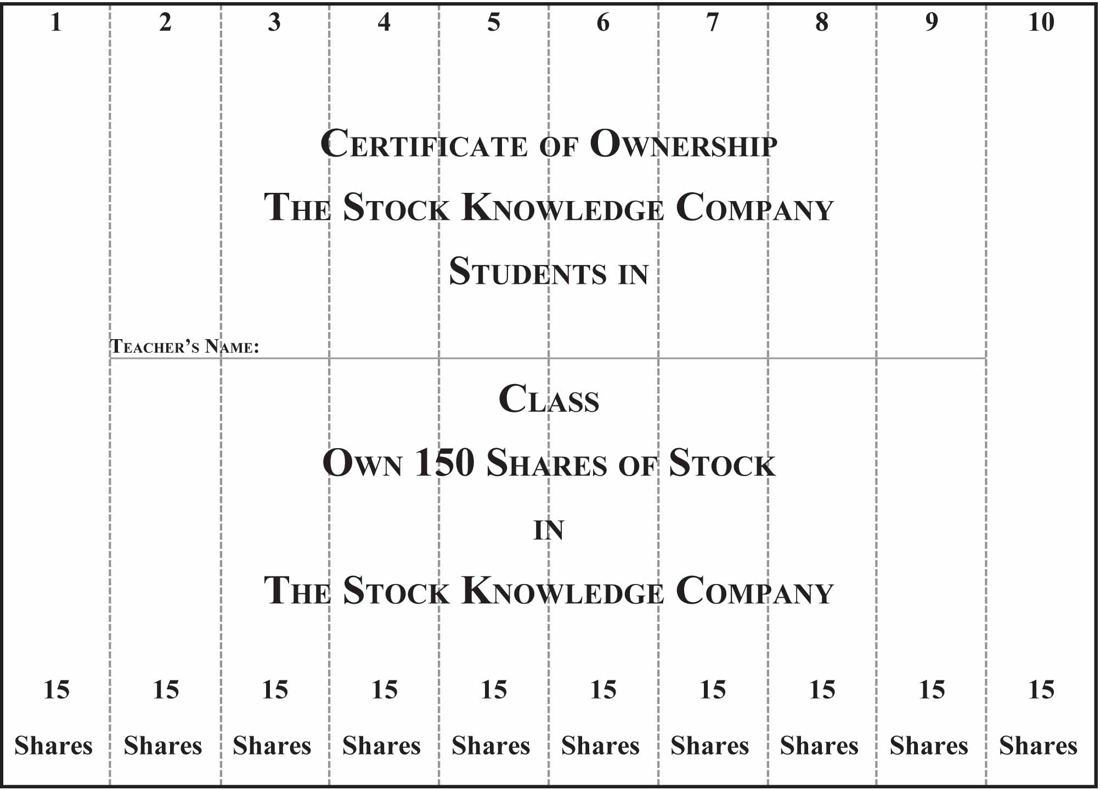
Activity 3.1: Certificate of Ownership
Slide 3.2
Lesson 3 – What is a Stock?

