Slide 1
Presented by: Amber Peters (Mizz P.) Email: Apeters@mizzp.nyc Date: 10/24/2023
GET READY TO TACKLE
THE “BETTER” FAFSA

Slide 2
EconEdLink Membership
You can now access CEE’s professional development webinars directly on EconEdLink.org! To receive these new professional development benefits, become an EconEdLink member. As a member, you will now be able to:
Automatically receive a professional development certificate via e-mail within 24 hours after viewing any webinar for a minimum of 45 minutes
Register for upcoming webinars with a simple one-click process
Easily download presentations, lesson plan materials and activities for each webinar
Search and view all webinars at your convenience
Save webinars to your EconEdLink dashboard for easy access to the event
Access our new Professional Development page here

Slide 3
Professional Development Opportunities
To earn professional development credit for CEE webinars found on EconEdLink, you must:
Watch a minimum of 45-minutes and you will automatically receive a professional development certificate via e-mail within 24 hours.
Attendees can learn how much credit they will earn per workshop.
Accessing resources:
You can now easily download presentations, lesson plan materials, and activities for each webinar from EconEdLink.org/professional-development/
Local resources:
Insert your local professional development opportunities (if applicable)

Slide 4
About The Presenter
Amber Peters(Mizz P.)
Founder, On Track With Mizz P. Lead College and Career Access Consultant
Mizz P. partners with schools and educational organization leaders to
provide students, parents, and staff with informative yet fun ways to explore
college and career options
www.mizzp.nyc

Slide 5
Agenda
Introduction
FAFSA Basics
FAFSA Changes
Best Practices
Resources
Q&A

Slide 6
Objectives
To provide information and best practices for FAFSA completion
To answer questions to support your understanding

Slide 7
Here’s The Tea:
According to the National College Attainment Network (NCAN):
The high school class of 2022 left about $3.6 billion in Pell Grants on the table by not completing the Free Application for Federal Student Aid (FAFSA).

Slide 8
FAFSA BASICS
What is the FAFSA?
The FAFSA or FREE APPLICATION FOR FEDERAL STUDENT AID is an application that determines a students eligibility for need based aid, namely the PELL and FSEOG grants which is determined by income and other factors. The FAFSA is also the gateway to all other forms of aid such as federal loans, state funding, and institutional scholarships.

Slide 9
FAFSA BASICS
Students & families (regardless of their income) should be encouraged to apply so they don't miss out on additional money for college!!!

Slide 10
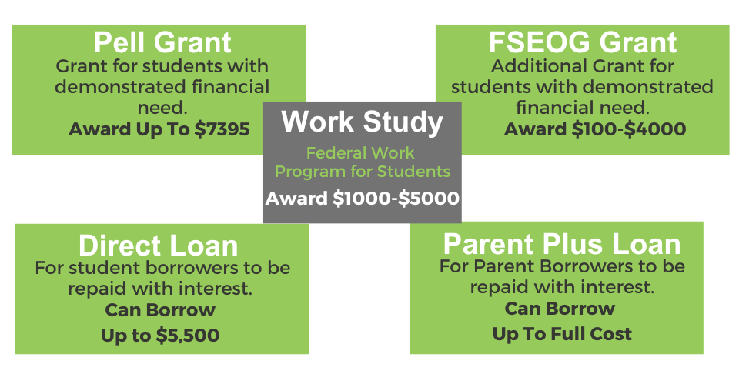
FAFSA BASICS
Here is a break down of the funding sources that can be accessed from the federal government as a result of filing the FAFSA:

Slide 11
FAFSA BASICS
When does it open?
Typically the application opens in October but this year only it will open in December (No date specifically yet)
FAFSA will open October 1st every year after as normal.
Follow @FederalStudentAid on Instagram and @FAFSA on X
for information on official launch date.

Slide 12
FAFSA CHANGES
Why is FAFSA changing?
The FAFSA has changed because of the CONSOLIDATED APPROPRIATIONS ACT, 2022 which had clauses for FAFSA Simplification and Privacy.
Future ACT
Made it possible to get data directly from the IRS
FAFSA Simplification Act
Changed the form, process, and eligibility calculation

Slide 13
FAFSA CHANGES
What parts of the application changed?
FAFSA will transfer data from the IRS automatically
Application is split into two parts. Parents will have to be invited to their child’s FAFSA form. The new form will be role based and you will only be able to see questions related to your role.If a student begins the FAFSA, they will be asked to identify the parent(s) or spouse who will be contributing financial information on the form.
Parents are now called contributors on the new FAFSA.

Slide 14
FAFSA CHANGES
FAFSA Changes Continued
The new formula no longer accounts for multiple siblings in college.
Families need to give consent for the FAFSA to retrieve their income from the IRS. Not giving consent invalidates your form.
Families making over $60000 will be asked questions about assets, families making under $60000 these questions will be skipped
You have 45 days to complete the form or you’ll have to start over.
No save keys needed.
Students can now add up to 20 schools.

Slide 15
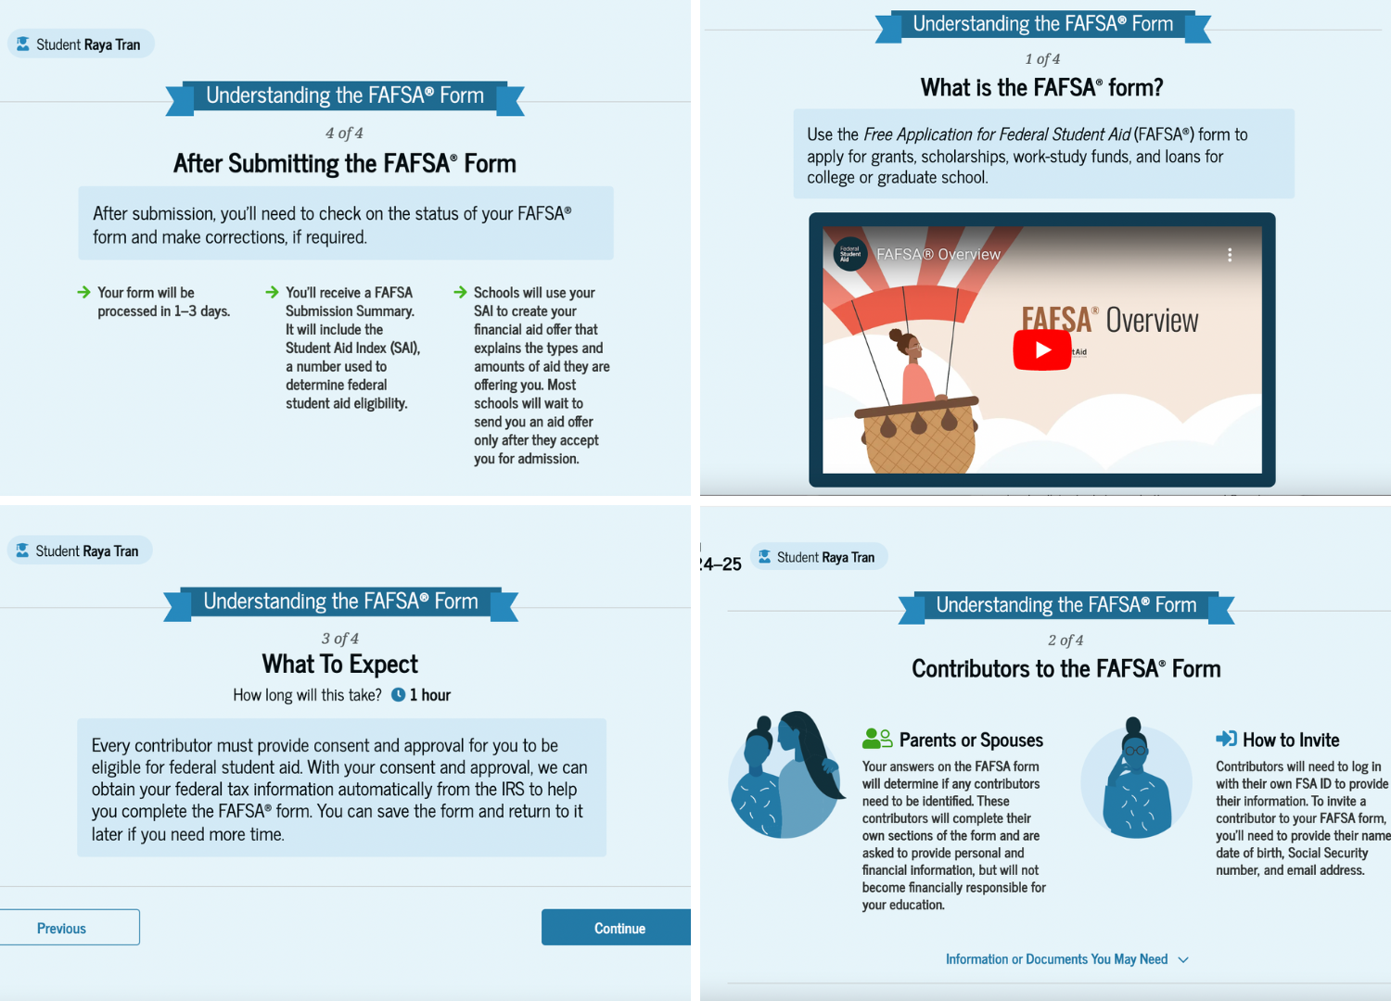
FAFSA CHANGES
The new application has much more details and help for families built into the form. There will now be explainer videos and surveys added throughout the form for support.

Slide 16
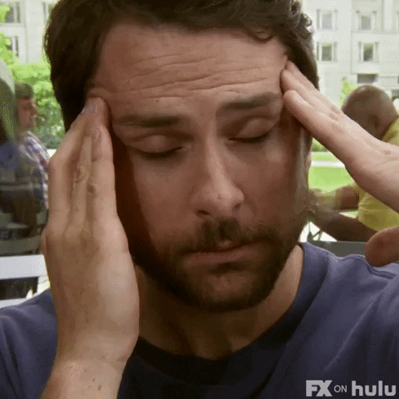
What can we expect this fall?
A lot of confusion
A lot of frustration
A lot more students needing support
A lot of glitching and technical issues

Slide 17
FAFSA Essentials
What do students and parents need to apply?
2022 Taxes
FSA ID
List of up to 20 schools they
want to apply to
Patience…lots of it

Slide 18
BEST PRACTICES
Best practices for getting students ready
-Assist students in getting their FSA ID’s in November ahead of December’s official FAFSA launch
-Have an information session with families early
-Lookup FAFSA deadlines in your state: Check Here
-Work with your school’s team to determine a date to get FAFSA’s in and submitted
-Set goals around FAFSA completion and provide incentives for students to complete it
-Hold bootcamp like sessions to get as many students completed as possible
-Check-in with students about their FAFSA progress

Slide 19
RESOURCES
If students need help after the FAFSA Opens
FAFSA Hotline
1-800-4-FED-AID (1-800-433-3243)
Your new best friend….

Slide 20
RESOURCES
Resources for additional learning:
NCAN Better FAFSA Tool Kit Site (Counselor Facing)
https://www.ncan.org/page/better-FAFSA-training-toolkit
FSA YouTube (Counselor Facing)
https://www.youtube.com/@FSAOutreach
FAFSA YouTube Student Facing
https://www.youtube.com/user/FederalStudentAid
FAFSA Vocabulary
https://docs.google.com/document/d/1r4hMr73vmoDXjCEH8sW86o16cxq4c1dd0IW4epnBH1A/edit?usp=sharing

Slide 21
Q & A

Slide 22
Amber Peters
Apeters@mizzp.nyc
Thank You

