Slide 1
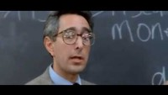
THIS IS WHAT ECONOMICS SHOULD NOT BE

Slide 2

THIS IS WHAT ECONOMICS SHOULD NOT BE

Slide 3
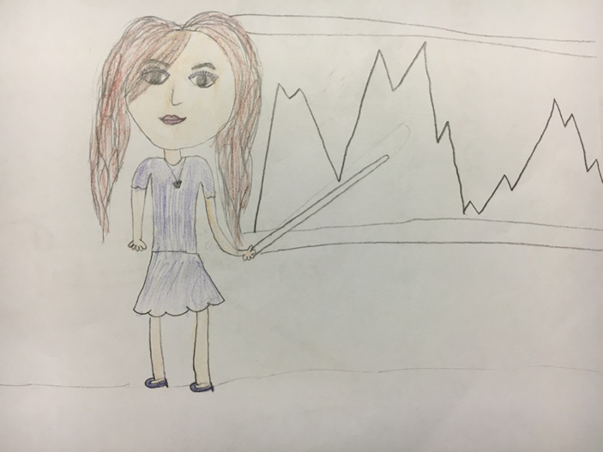
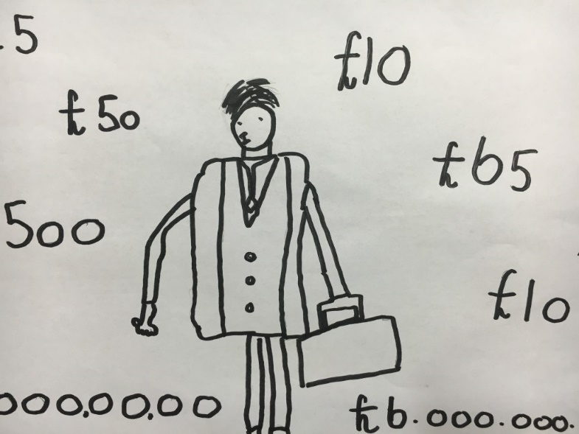
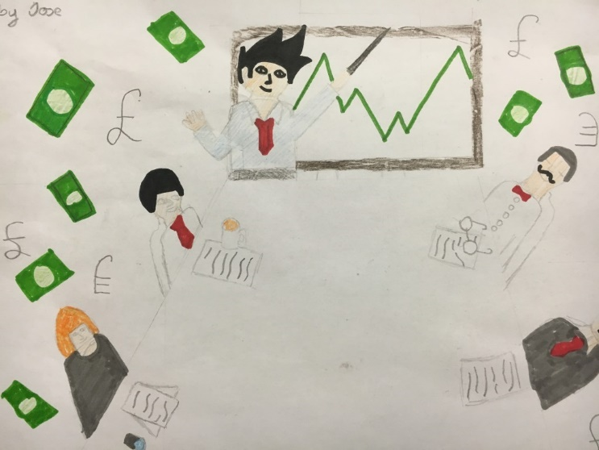
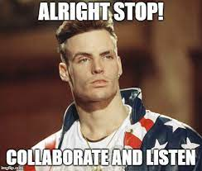
Draw what you think economics is about

Slide 4
Demystifying Economics: Engaging Students in the Fundamentals of Economics
Glossary
Economics
The study of how people, firms and societies choose to allocate scarce resources with alternative uses. In other words, it’s a field of study that exits to examine all the choices that people make.
Scarcity
The condition that exists (for rich countries, poor countries, individuals, and organizations) because human wants exceed the capacity of available resources to satisfy those wants. In other words, Blame Nature
Shortage
Shortages generally occur when a price is set below the equilibrium price In other words : Think Taylor Swift

Slide 5

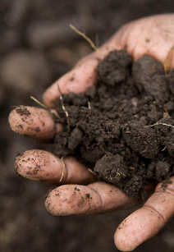
Scarcity Requires Choices
Scarcity: the condition that exists because there are not enough resources to produce everyone's wants- BLAME NATURE-UGHHH
Notes:
Individuals, firms, and societies cannot have everything they want, so they must choose which wants to pursue. The two characteristics that make something scarce are that it is desirable and, at any given time, there is a finite quantity. Something that is not scarce is garbage because it is not desirable. Note: Consider playing this video for your students to provide additional information about scarcity.
Connection to Lesson 1.2 (Packing for a River Trip): You and your partner had to make choices about what to pack because the space on your raft was scarce (there was not enough space on the raft to accommodate everything you wanted to pack).

Slide 6
Notes:
Lecture notes:
Start with the notion that we have unlimited wants and limited resources:
Unlimited wants exceed limited resources.
This is why scarcity exists and why choices have to be made.
Make students think of resources in a broad sense: not just physical resources but things such as time as well.
Phang Kim Shan/Dreamstime.com

Slide 7
Scarcity Video and QuizAmazing Econ Ed link resource

Slide 8
Quick quiz
What can be said about scarcity?
  A.Scarcity forces us to make choices.- clap
  B. Scarcity doesn’t affect the super wealthy.- stomp
  C. Scarcity only affects commodities such as oil.- whistle
  Scarcity generally doesn’t affect our day-to-day living. Raise
Notes:
Clicker Question
Correct answer: A, Scarcity forces us to make choices.
Each choice we make results in an opportunity cost.

Slide 9
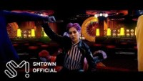
1. “Ka-Ching” is a song about money, but how does it also illustrate the problem of scarcity?
2. How do scarcity and prices influence the way people may decide to spend their money?

Slide 10
Demystifying Economics: Engaging Students in the Fundamentals of Economics
Glossary
Opportunity Cost
The next-best alternative a person gives up in making a choice. In other words it’s the value you could have received but passed up by pursuing another option
Marginal Analysis
A decision-making tool for comparing the additional or marginal benefits of a course of action to the additional or marginal costs. In other words means to let the past go and to think forward to the next hour, day, year, or dollar that you expend in time or money.

Slide 11
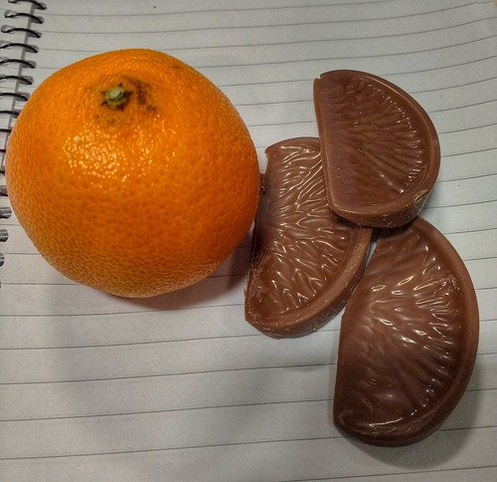
Opportunity Cost
Opportunity cost: the true cost of your choice is the next best alternative that you gave up
This Photo by Unknown Author is licensed under CC BY-SA-NC
Notes:
Alert students to the stumbling block. This is a common area of confusion. Let students know that so they can avoid it. The opportunity cost of a decision refers only to the next best alternative that is given up. Students often incorrectly equate opportunity cost with all other options that were not selected. If the person in the picture chooses to eat the orange, we can assume their opportunity cost was the chocolate—not all the other things they might have eaten.

Slide 12
Opportunity Cost Video and Quiz- Amazing Econ Ed link resource

Slide 13
If you made a 40 hour video, what else could you do with your time?

Slide 14
Mr. Beast
Is MrBeast’s opportunity cost is high or low?

Slide 15
Discussion Questions
Is the opportunity cost of studying on a Tuesday night the same as a Saturday night? Why or why not?
How does the concept of opportunity cost explain airlines offering increasing amounts of $$$ to bump customers off of overfilled flights?

Slide 16
Activity: Opportunity Cost Matching
Unpaid summer internship at a local newsroom |  | Spending 1 hr hanging out with friends
Building a set for the school play on Saturday |  | Working as a consultant earning $75,000-$200,000/yr. for 5 yrs
Taking AP Psychology |  | Buying a $15 burrito bowl
Attending medical school for 5 yrs |  | Taking AP Chemistry
Buying a $15 chicken sandwich |  | Earning $15/hr working for an ice cream shop that hires students for May-August
Studying for 1 hr for an Economics test |  | Going to an amusement park on Saturday with friends
Waiting thirty minutes in a long line for a free t-shirt |  | Spending 30 minutes watching funny videos

Slide 17
Activity: Opportunity Cost Matching
Unpaid summer internship at a local newsroom |  | Spending 1 hr hanging out with friends
Building a set for the school play on Saturday |  | Working as a consultant earning $75,000-$200,000/yr. for 5 yrs
Taking AP Psychology |  | Buying a $15 burrito bowl
Attending medical school for 5 yrs |  | Taking AP Chemistry
Buying a $15 chicken sandwich |  | Earning $15/hr working for an ice cream shop that hires students for May-August
Studying for 1 hr for an Economics test |  | Going to an amusement park on Saturday with friends
Waiting thirty minutes in a long line for a free t-shirt |  | Spending 30 minutes watching funny videos

Slide 18
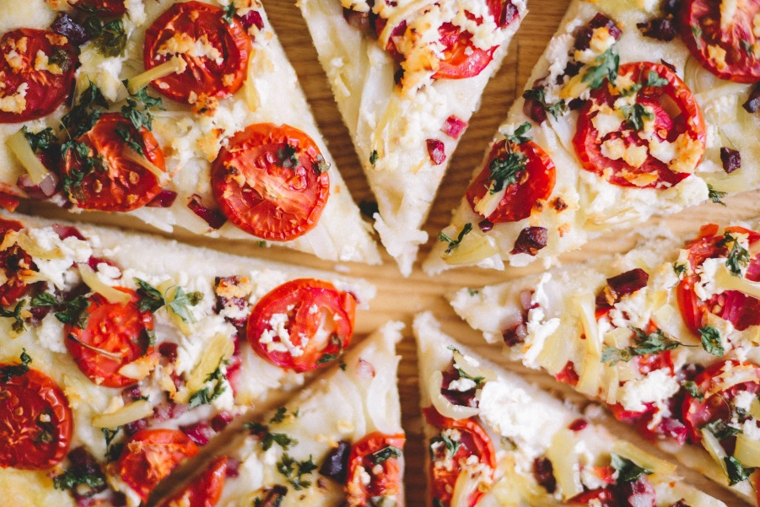
Marginal Thinking
Is the additional benefit greater than the additional cost?
What is the optimal amount of pizza consumption?

Slide 19
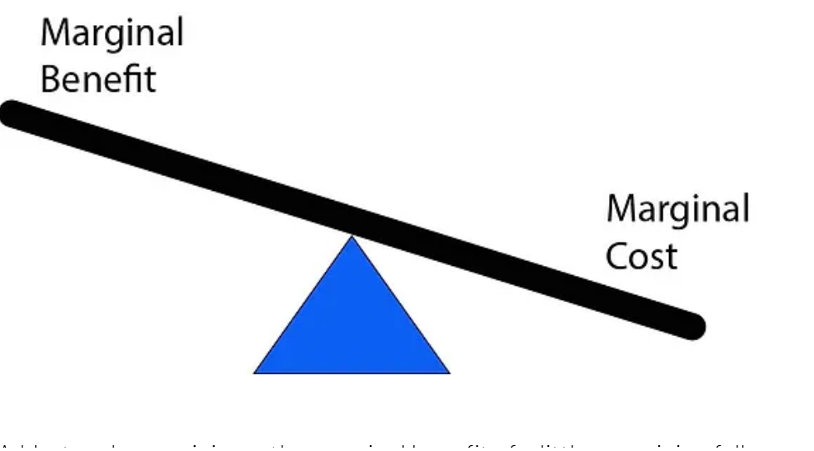

Slide 20
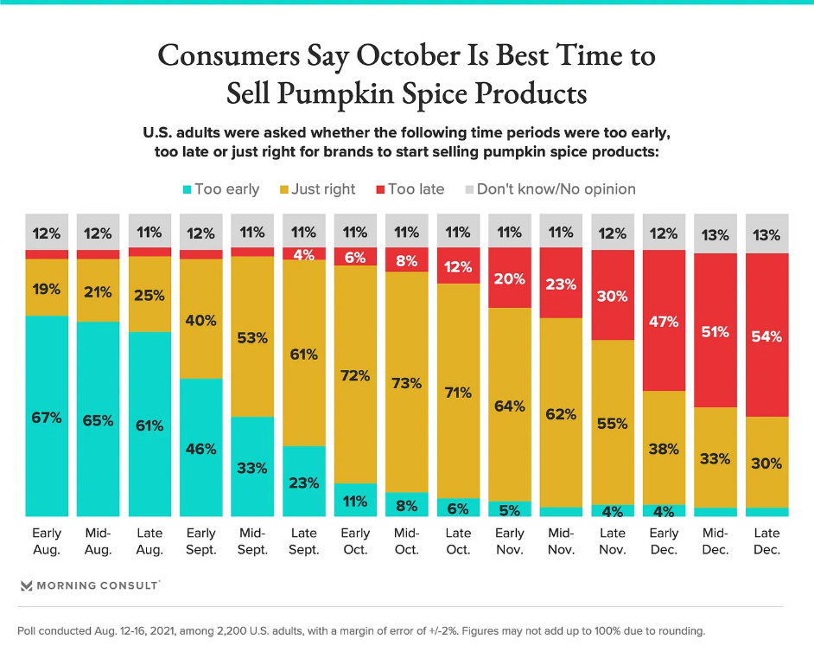
Why not drink pumpkin spice stuff all year around_ Companies understand marginal thinking

Slide 21
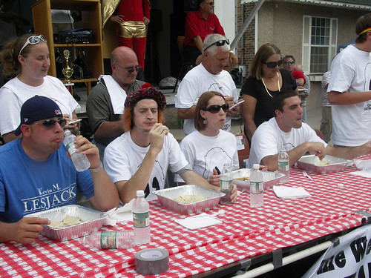
ERIC CHIANG
Bring in some donuts, or twinkies have an eating contest- and have students vote on who they think is going to win
CHAPTER 1
SLIDE 21

Slide 22
Quick quiz
When MrBeast counts from 99,990 to 100,000 which of these statements is true?
a. The marginal cost > than the marginal benefit
b. The marginal benefit > than the marginal cost
c. The marginal cost = the marginal benefit

Slide 23
Post-video questions: Discuss in small groups
How is marginal thinking different from comparing the total costs and benefits?
In July 2022, Delta Offered Passengers $10,000 Each to Get Bumped From a Flight. Imagine that you were a passenger with a ticket for that flight. Your later flight option is for a flight 24 hrs later.
  What’s the marginal benefit of accepting the voucher and the later flight?
  What’s the marginal cost? Hint: don’t forget about opportunity cost!
  Would you take the voucher and the later flight?

