Slide 1
Once Upon a Time
in Economics
Chandler Jordan
SC Economics

Slide 2
Why teachers should read aloud to older students?
Encourages diversity and inclusivity
Improves vocabulary and comprehension
Promotes a love for reading
Reduces stress levels
Teaches valuable life lessons
Source: https://tinyurl.com/2exk3v25

Slide 3
Setting the Stage for Children’s Literature in a Secondary Classroom
Create Buy-In
Be excited. Excitement is contagious.
Invite guest readers. Think outside your 4 walls.
Allow kids to be kids. Some will be all in, some won’t.
Set the Stage. Circle up, dim the lights, make it special.

Slide 4
Agenda
Book 1: Financial Literacy
Book 2: Scarcity
Book 3: Markets and Resources
Book 4: Economic Indicators
Book 5: Trade

Slide 5
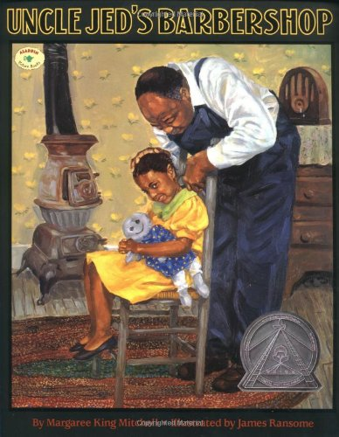
Book 1: Financial Literacy

Slide 6
Book 1: Uncle Jed’s Barbershop
Lesson:
Concepts
Synopsis:
St. Louis Federal Reserve
Lesson Plan
savings, savings goals, opportunity cost
The story of a Black American barber who, despite significant setbacks, saves enough money to buy his own barbershop.

Slide 7
Pre-Reading Discussion Questions
Has anyone ever gotten their hair cut by a family member?
Where do you go to get your haircut?
Who owns the shop/salon you go to? The person who cuts your hair or someone else?
What things do owners of a shop/salon have to spend money on to start a business?
How do they get the money to start a business?

Slide 8
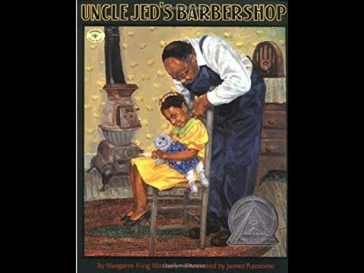
Uncle Jed’s Barbershop by Margaree Mitchell

Slide 9
Post-Reading Discussion Questions
Who is telling the story?
How do you know it is Sarah Jean who is telling the story?
Why did Uncle Jed come to the house?
Did Uncle Jed cut Sarah Jean’s hair? Why or why not?
What did Uncle Jed do for Sarah Jean?

Slide 10
Savings and Savings Goals
Savings means not spending money now but instead keeping the money to buy things in the future.
What was Uncle Jed saving for?
A savings goal is any good or service that you want to buy in the future.
What was Uncle Jed’s savings goal?

Slide 11
Opportunity Cost
Opportunity cost is the value of the next-best alternative when a decision is made; it’s what is given up.
If you go to the store and you have money for only an ice cream cone or a snow cone and you choose the snow cone, what is your opportunity cost?
Why can’t you have both the ice cream cone and the snow cone?
When you don’t have enough money for both an ice cream cone and a snow cone, what do you have to do?
What was the opportunity cost of Uncle Jed’s decision to pay for Sarah Jean’s operation?

Slide 12
Activity: Reaching a Savings Goal
Students will work in groups or 4-5 students to investigate further what it takes to reach a savings goal.
Their goal is to earn enough money to buy a video game that cost $50.
They will need:
Saving and Spending Register (virtual)
Saving and Spending Cards (virtual)
2 dice (virtual)
Saving and Spending Game Directions (virtual)

Slide 13
Activity Review
How many weeks did it take each group to reach the savings goal?
What made it difficult to reach the savings goal?
Did any groups ever have less than zero in their balance at any time?
What does less than zero money mean?
Is it harder to reach a savings goal in real life or in the saving and spending game?
What things do you have to do in order to successfully meet a savings goal?

Slide 14
Questions?
How would you modify this activity for your classroom?

Slide 15
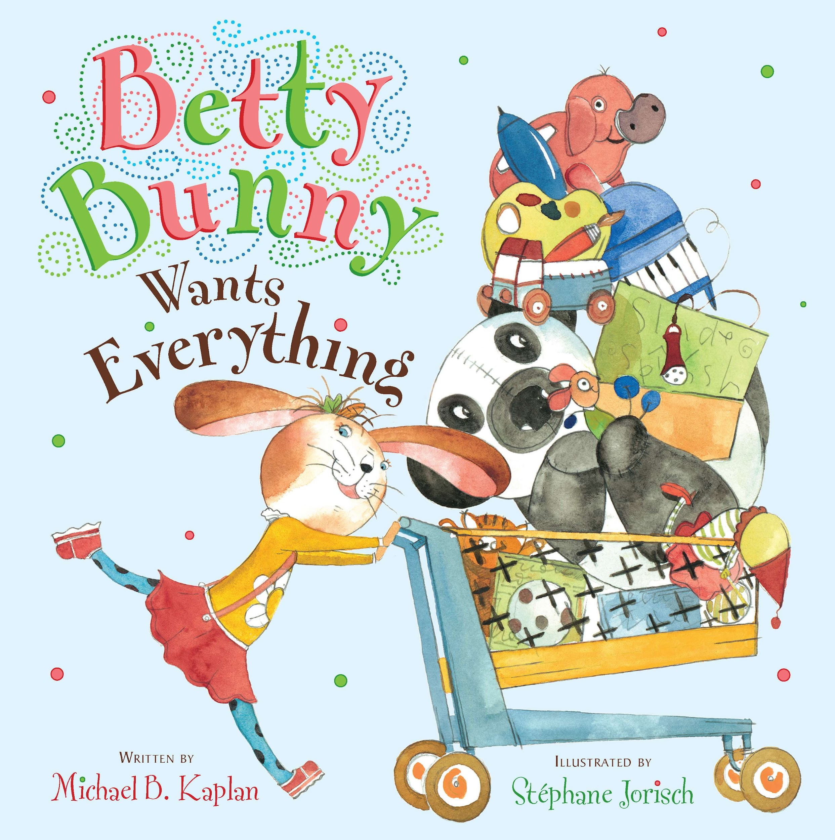
Book 2: Scarcity

Slide 16
Book 2: Betty Bunny Wants Everything
Lesson:
Concepts
Synopsis:
Kiddynomics
Lesson Plan
Betty Bunny Wants Everything identifies all the wants that Betty Bunny has in the toy store. However, Betty cannot have everything and must make a choice.
choice, wants, scarcity

Slide 17
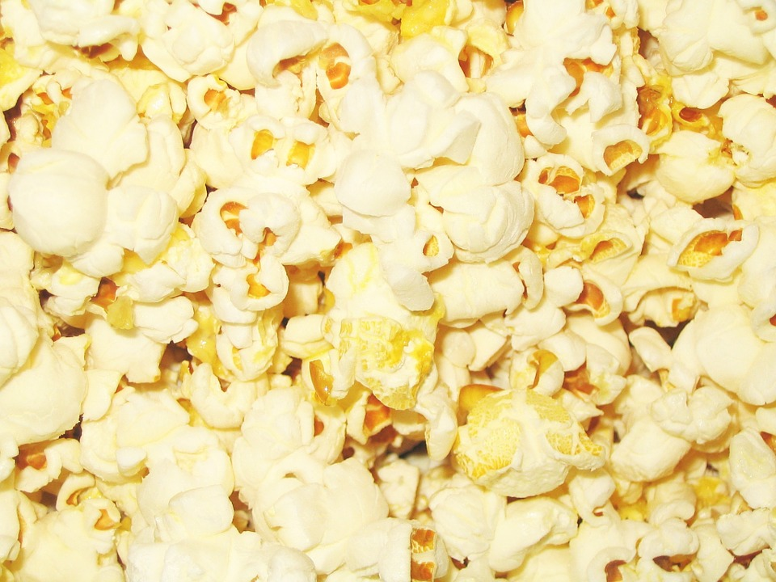
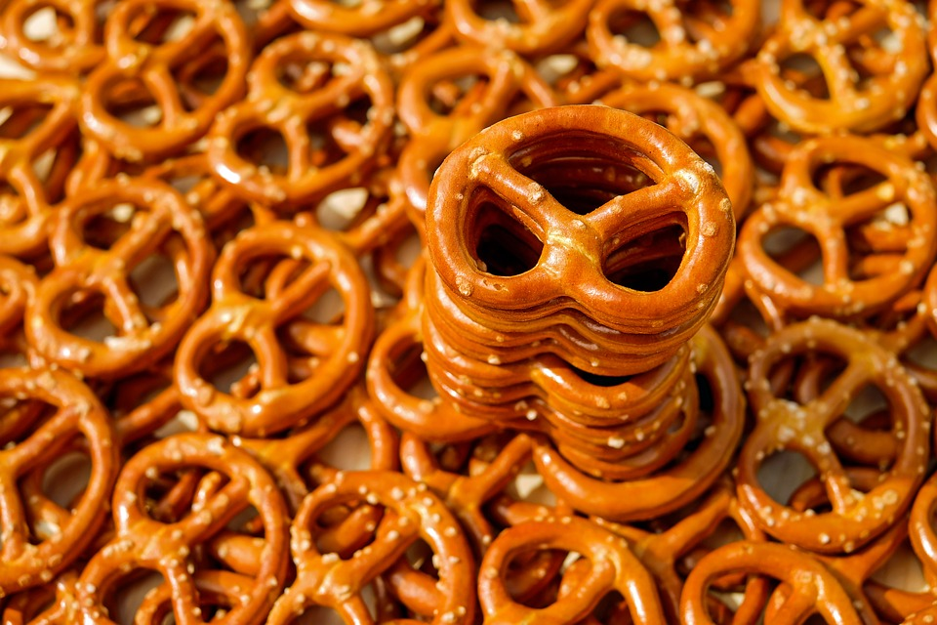
Who wants a snack?
Does anyone want a snack?
Raise your hand if you would like popcorn.
Raise your hand if you would like pretzels.
Raise your hand if you would like both.
A want is something that you would like to have.
A need is something you cannot live without.
There are not enough snacks for everyone to have BOTH, so you must select only one snack.

Slide 18
Make a Choice
When you selected between popcorn and pretzel you made a choice.
A choice is when you must pick among different options.
You had two options: popcorn or pretzel
Why couldn’t every student have popcorn and pretzel?

Slide 19
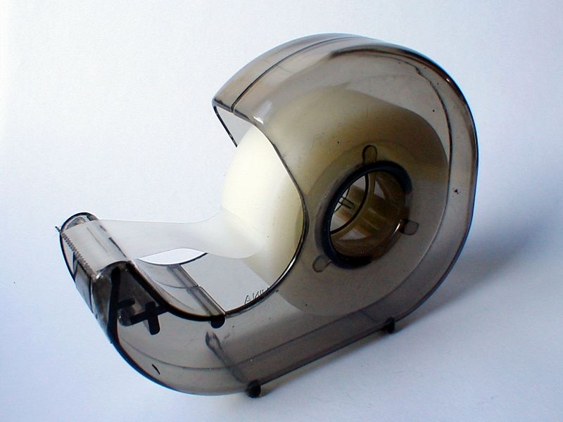
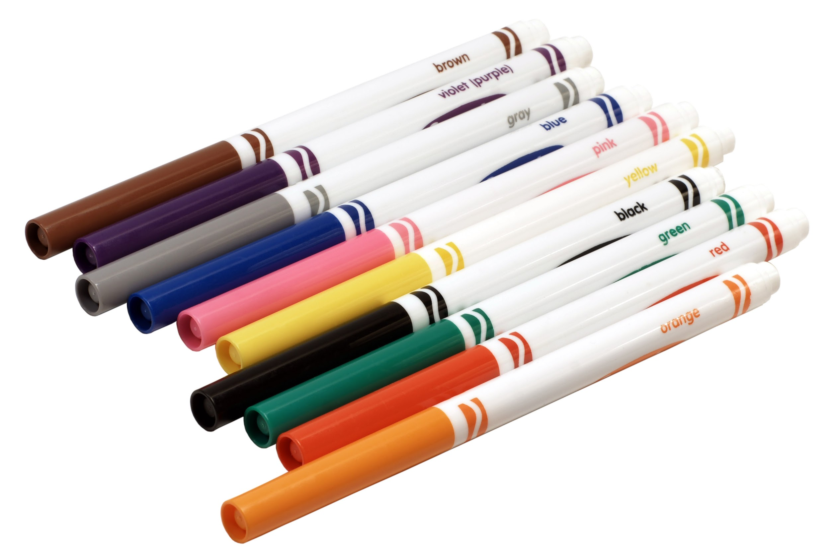
Scarcity
No having enough is called scarcity.
Scarcity mean that there isn’t enough for everyone to have everything they want.
What are some things in your classroom that are scare?

Slide 20
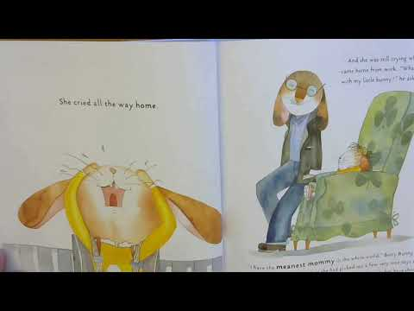
Betty Bunny Wants Everything
by Michael B. Kaplan

Slide 21
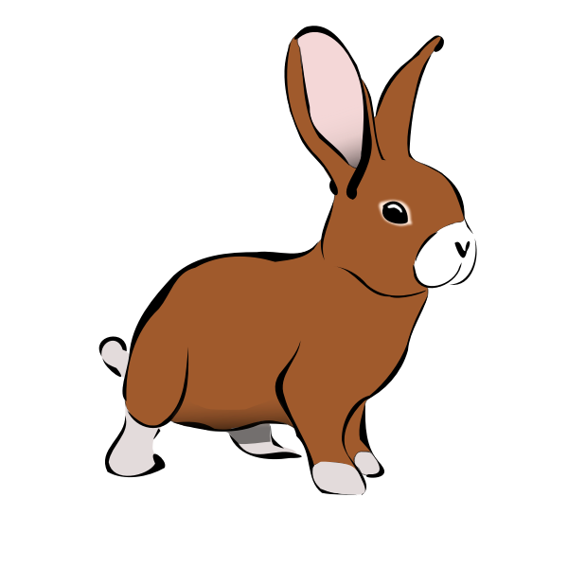
Post-Reading Questions
What toys did Betty Bunny want?
What problem did Betty Bunny have?
Why couldn’t Betty Bunny have all of the toys she put in her cart?
Could Betty Bunny buy all of the toys she wanted with the money her parents gave her?
What choices did Betty Bunny have to make?
What was scarce in this story?

Slide 22
Questions?
How would you modify this activity for your classroom?

Slide 23
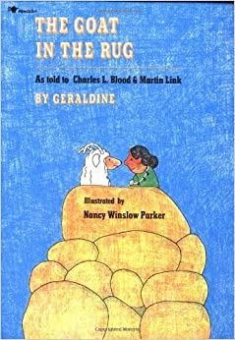
Book 3: Markets and Resources

Slide 24
Book 3: A Goat in the Rug
Lesson:
Concepts
Synopsis:
St. Louis and Philadelphia Federal Reserve Banks
Lesson Plan
Capital resources, human resources, natural resources, intermediate goods, productive resources
The Goat in the Rug about a Navajo weaver named Glenmae who uses mohair from her goat, Geraldine, and a number of resources and intermediate goods to make a traditional Navajo rug.

Slide 25
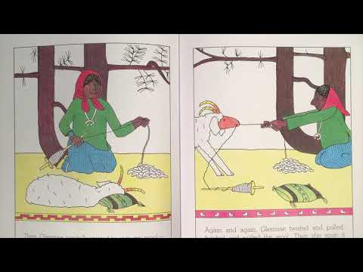
The Goat in the Rug by Geraldine

Slide 26
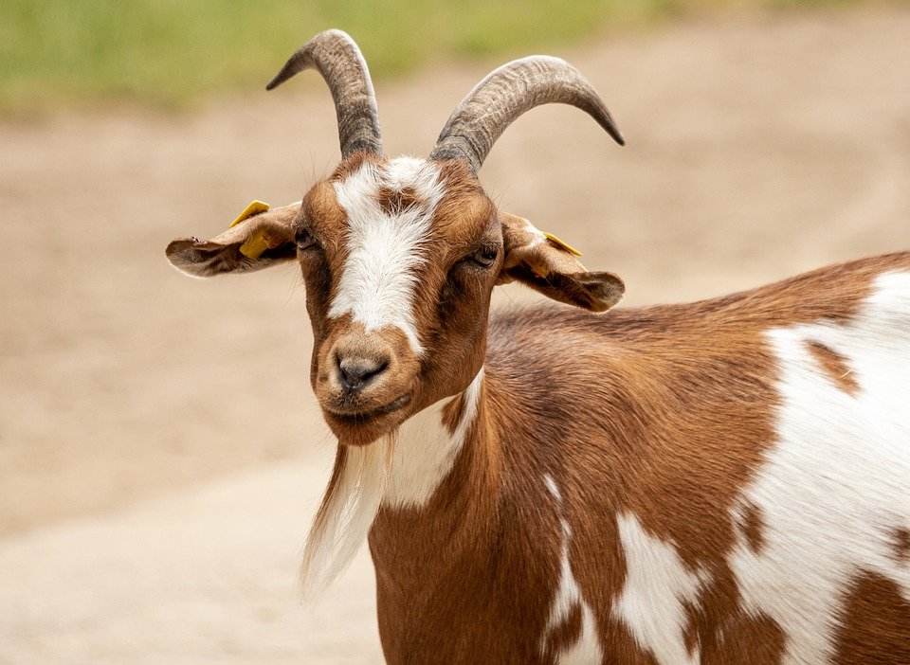
Post-Reading Discussion Questions
Who is telling the story?
How do we know that Geraldine is telling the story?
Who is Glenmae?
What are some of the things Glenmae uses to produce the rug?

Slide 27
Activity: Matching Game
Create groups of 3-4 students.
Give them a set of cards.
Object of the game is to categorize the things Glenmae used to make the rug into four groups: natural resources, human resources, capital resources, and intermediate goods.
Have one student in each group shuffle the cards and lay them face down in the four-by-six pattern.
Group members will take turns trying to find a match.
Once a match is found, set them aside and take another turn.
Keep going until all cards are matched.

Slide 28
Activity: Matching Game (cont.)
After all the groups have completed the matching game, have them take a piece of paper and fold it into fourths. Unfold the paper and label each of the quadrants created like the example below:
Have students list their matches under each of the 4 categories.
Natural Resources | Human Resources
Capital Resources | Intermediate Goods

Slide 29
Virtual Activity: Padlet
Productive Resources - The natural resources, human resources, and capital resources used to make goods and services.
Natural Resources - Things that occur naturally in and on the earth that are used to produce goods and services.
Human Resources - The quantity and quality of human effort directed towards producing goods and services.
Capital Resources - Goods that have been produced and are used to produce other goods and services. They are used over and over again in the production process.
Intermediate Goods - Man made goods that are used to produce another good or service, becoming part of that good or service.

Slide 30
Questions?
How would you modify this activity for your classroom?

Slide 31
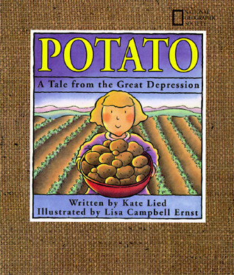
Book 4: Economics Indicators

Slide 32
Book 4: Potato: A Story About the Great Depression
Lesson:
Concepts
Synopsis:
consumer, goods, income, services, wants, needs, unemployment
St. Louis and Little Rock Federal Reserve Banks
Lesson Plan
Potato: A Story About the Great Depression tells the story of a family during the Great Depression and all the choices they had to make to meet their needs.

Slide 33
The Great Depression
The Great Depression it was difficult for people in the United States to get and keep jobs. Because people could not work at jobs, they weren’t able to earn income.
Do you know someone who has lost their job?
What kind of stress can be cause on a family due to job loss?

Slide 34
Unemployment
Unemployment: People who are jobless, actively seeking work, and available to take a job.
There are 5 types of unemployment:
Frictional
Structural
Cyclical
Technological
Seasonal

Slide 35
Activity: Fictional Figures
In groups of 3-4 students:
Choose an occupation for which a person might become unemployed in each of the 5 ways.
Draw a sketch of the person and create 5 different scenarios (one for each type of unemployment) that explain how they became unemployed.
Add the explanations around your person.

Slide 36
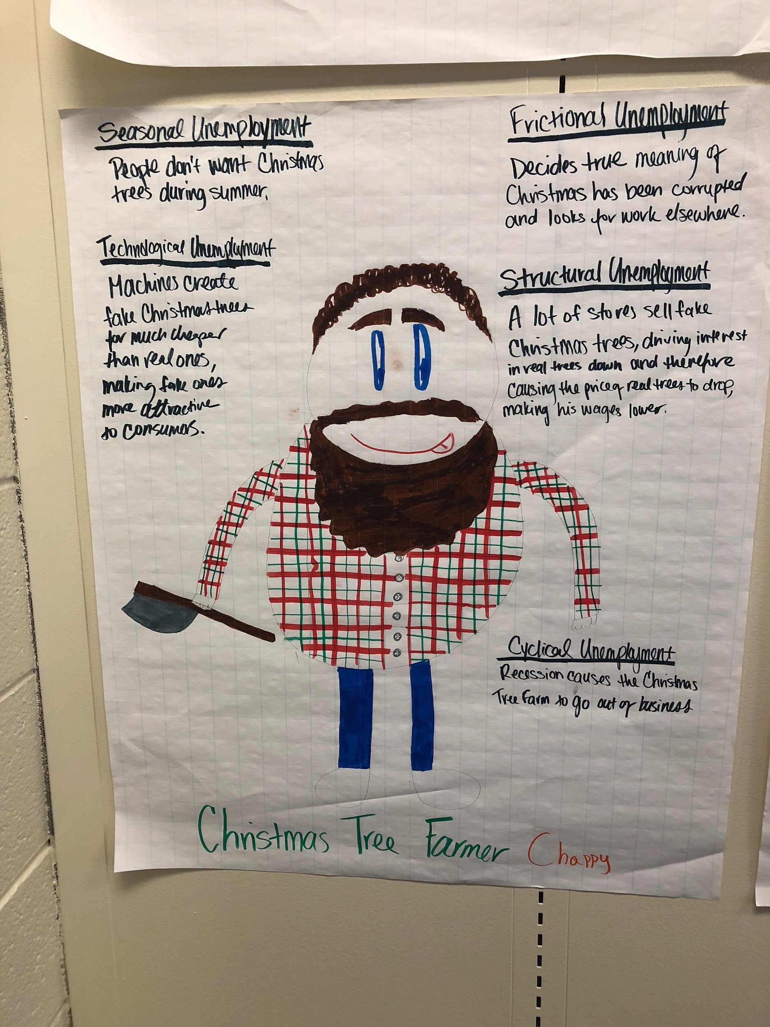
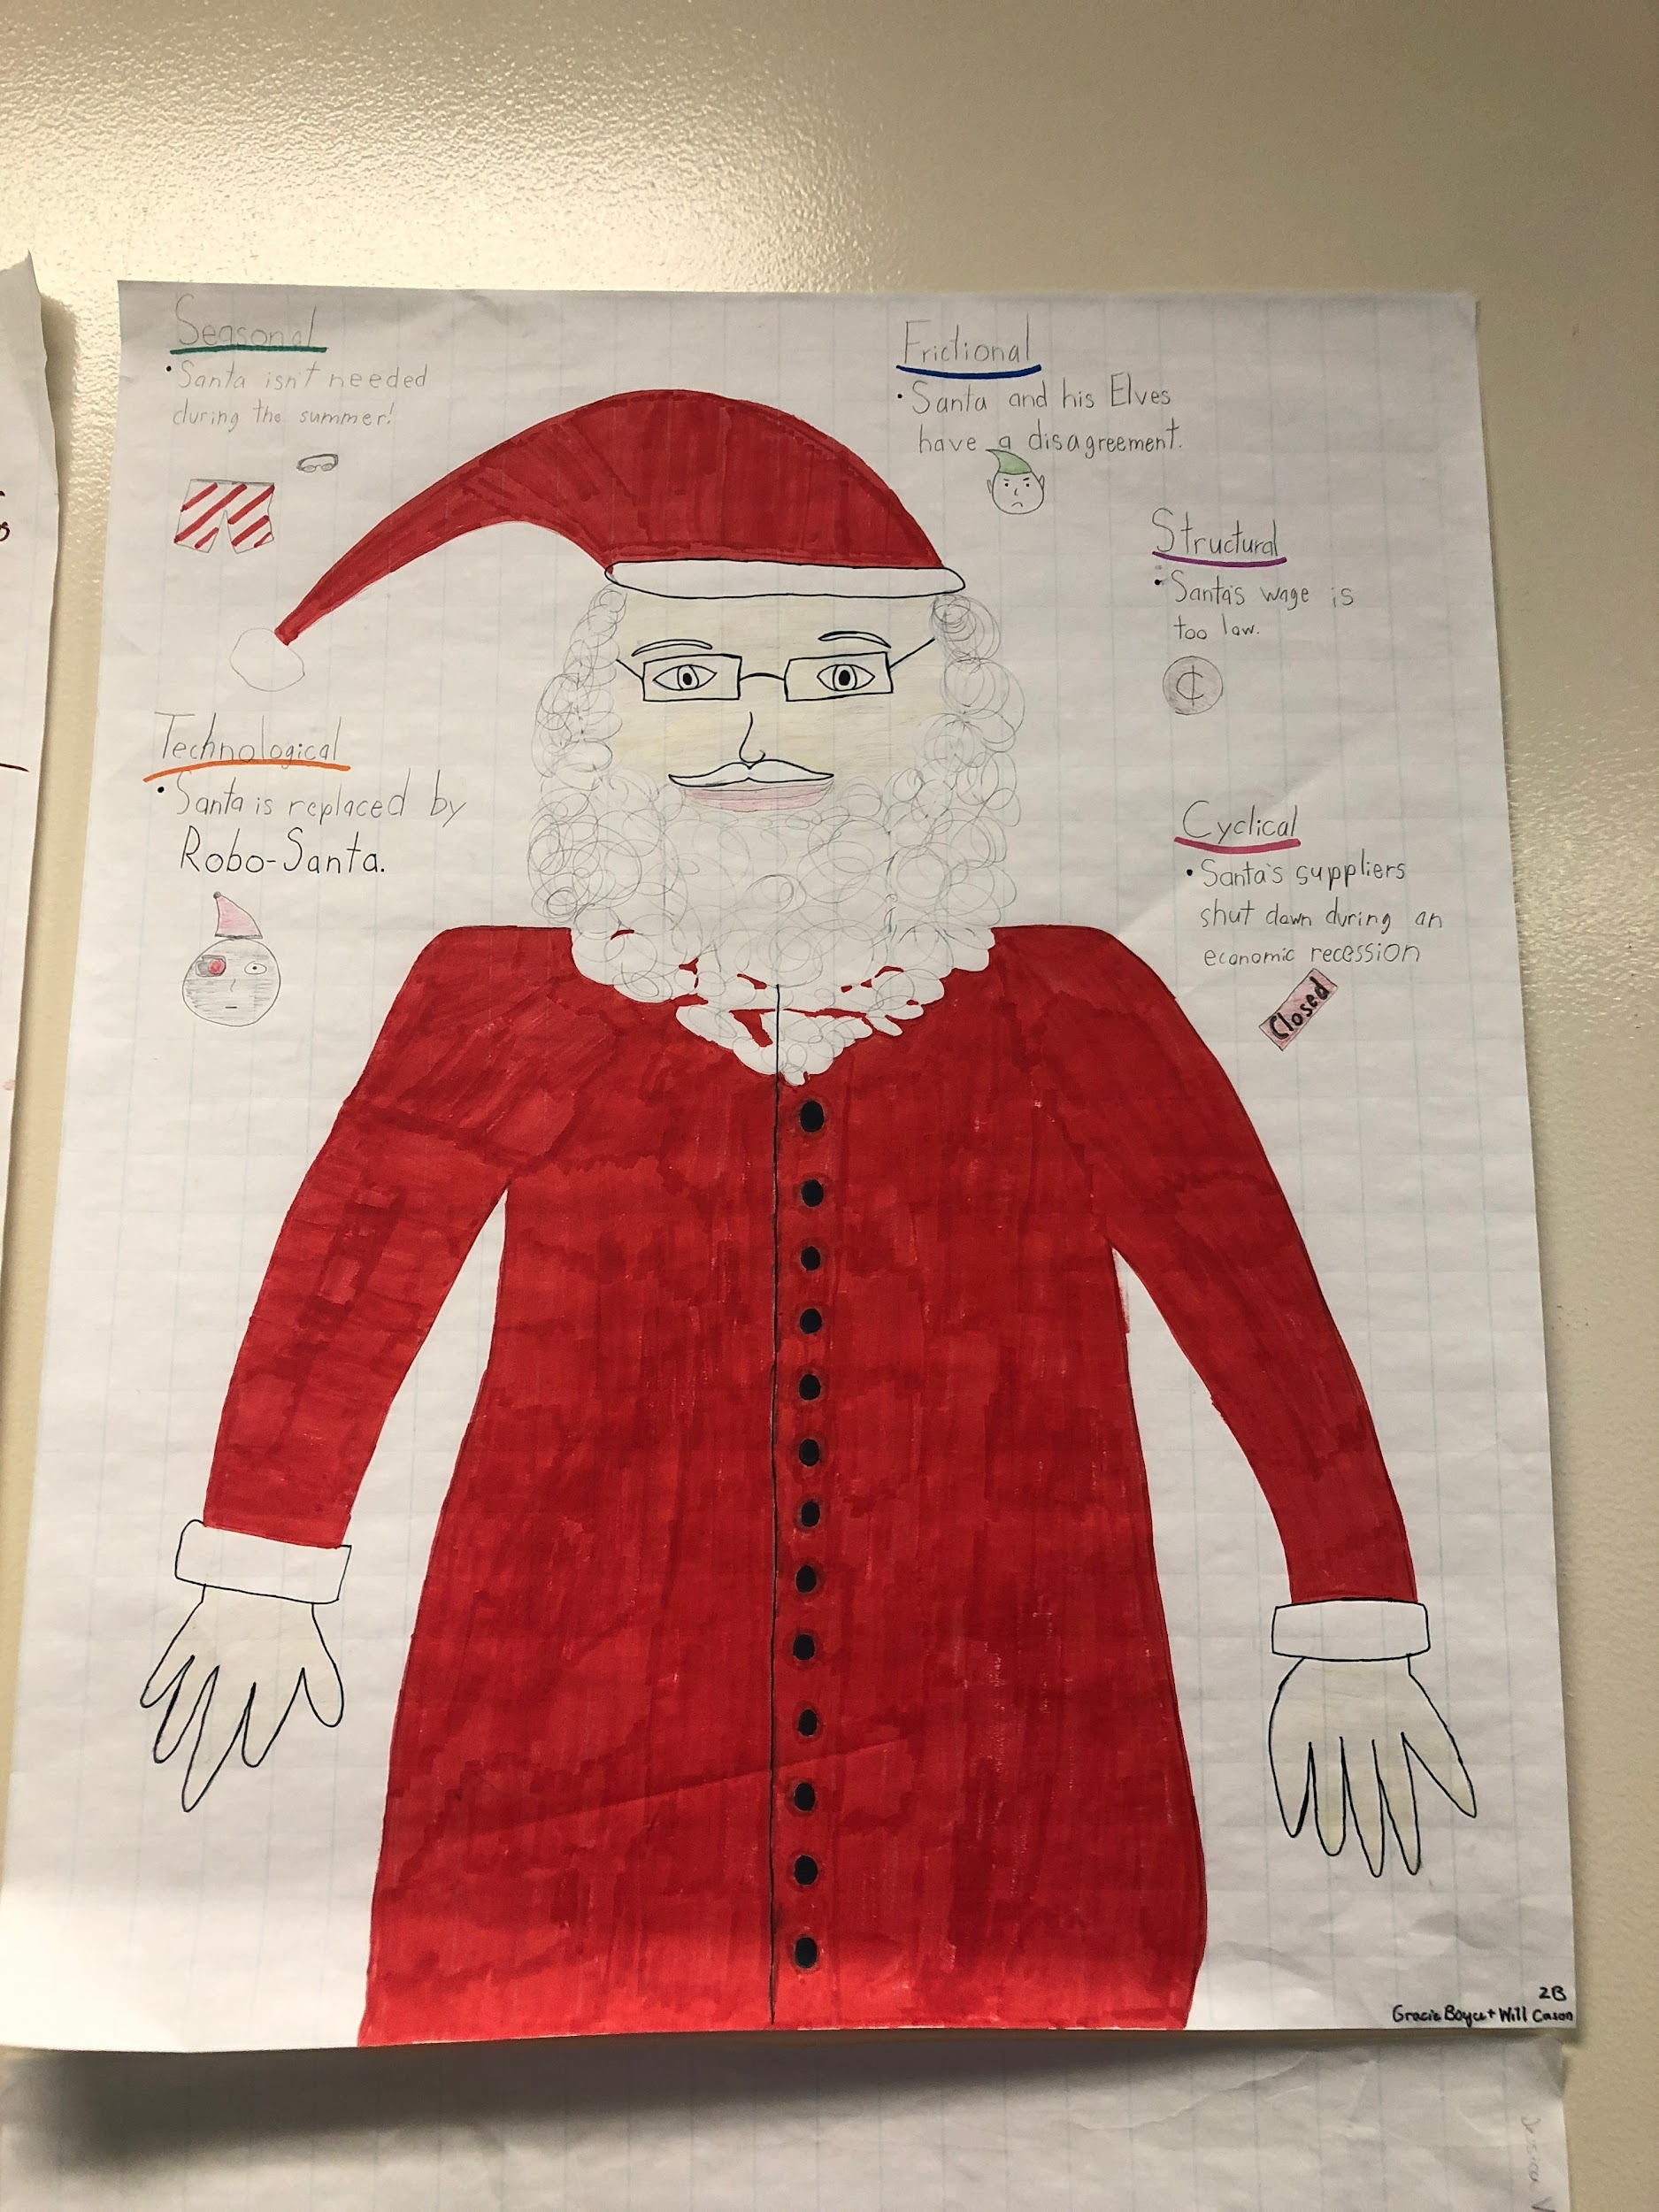
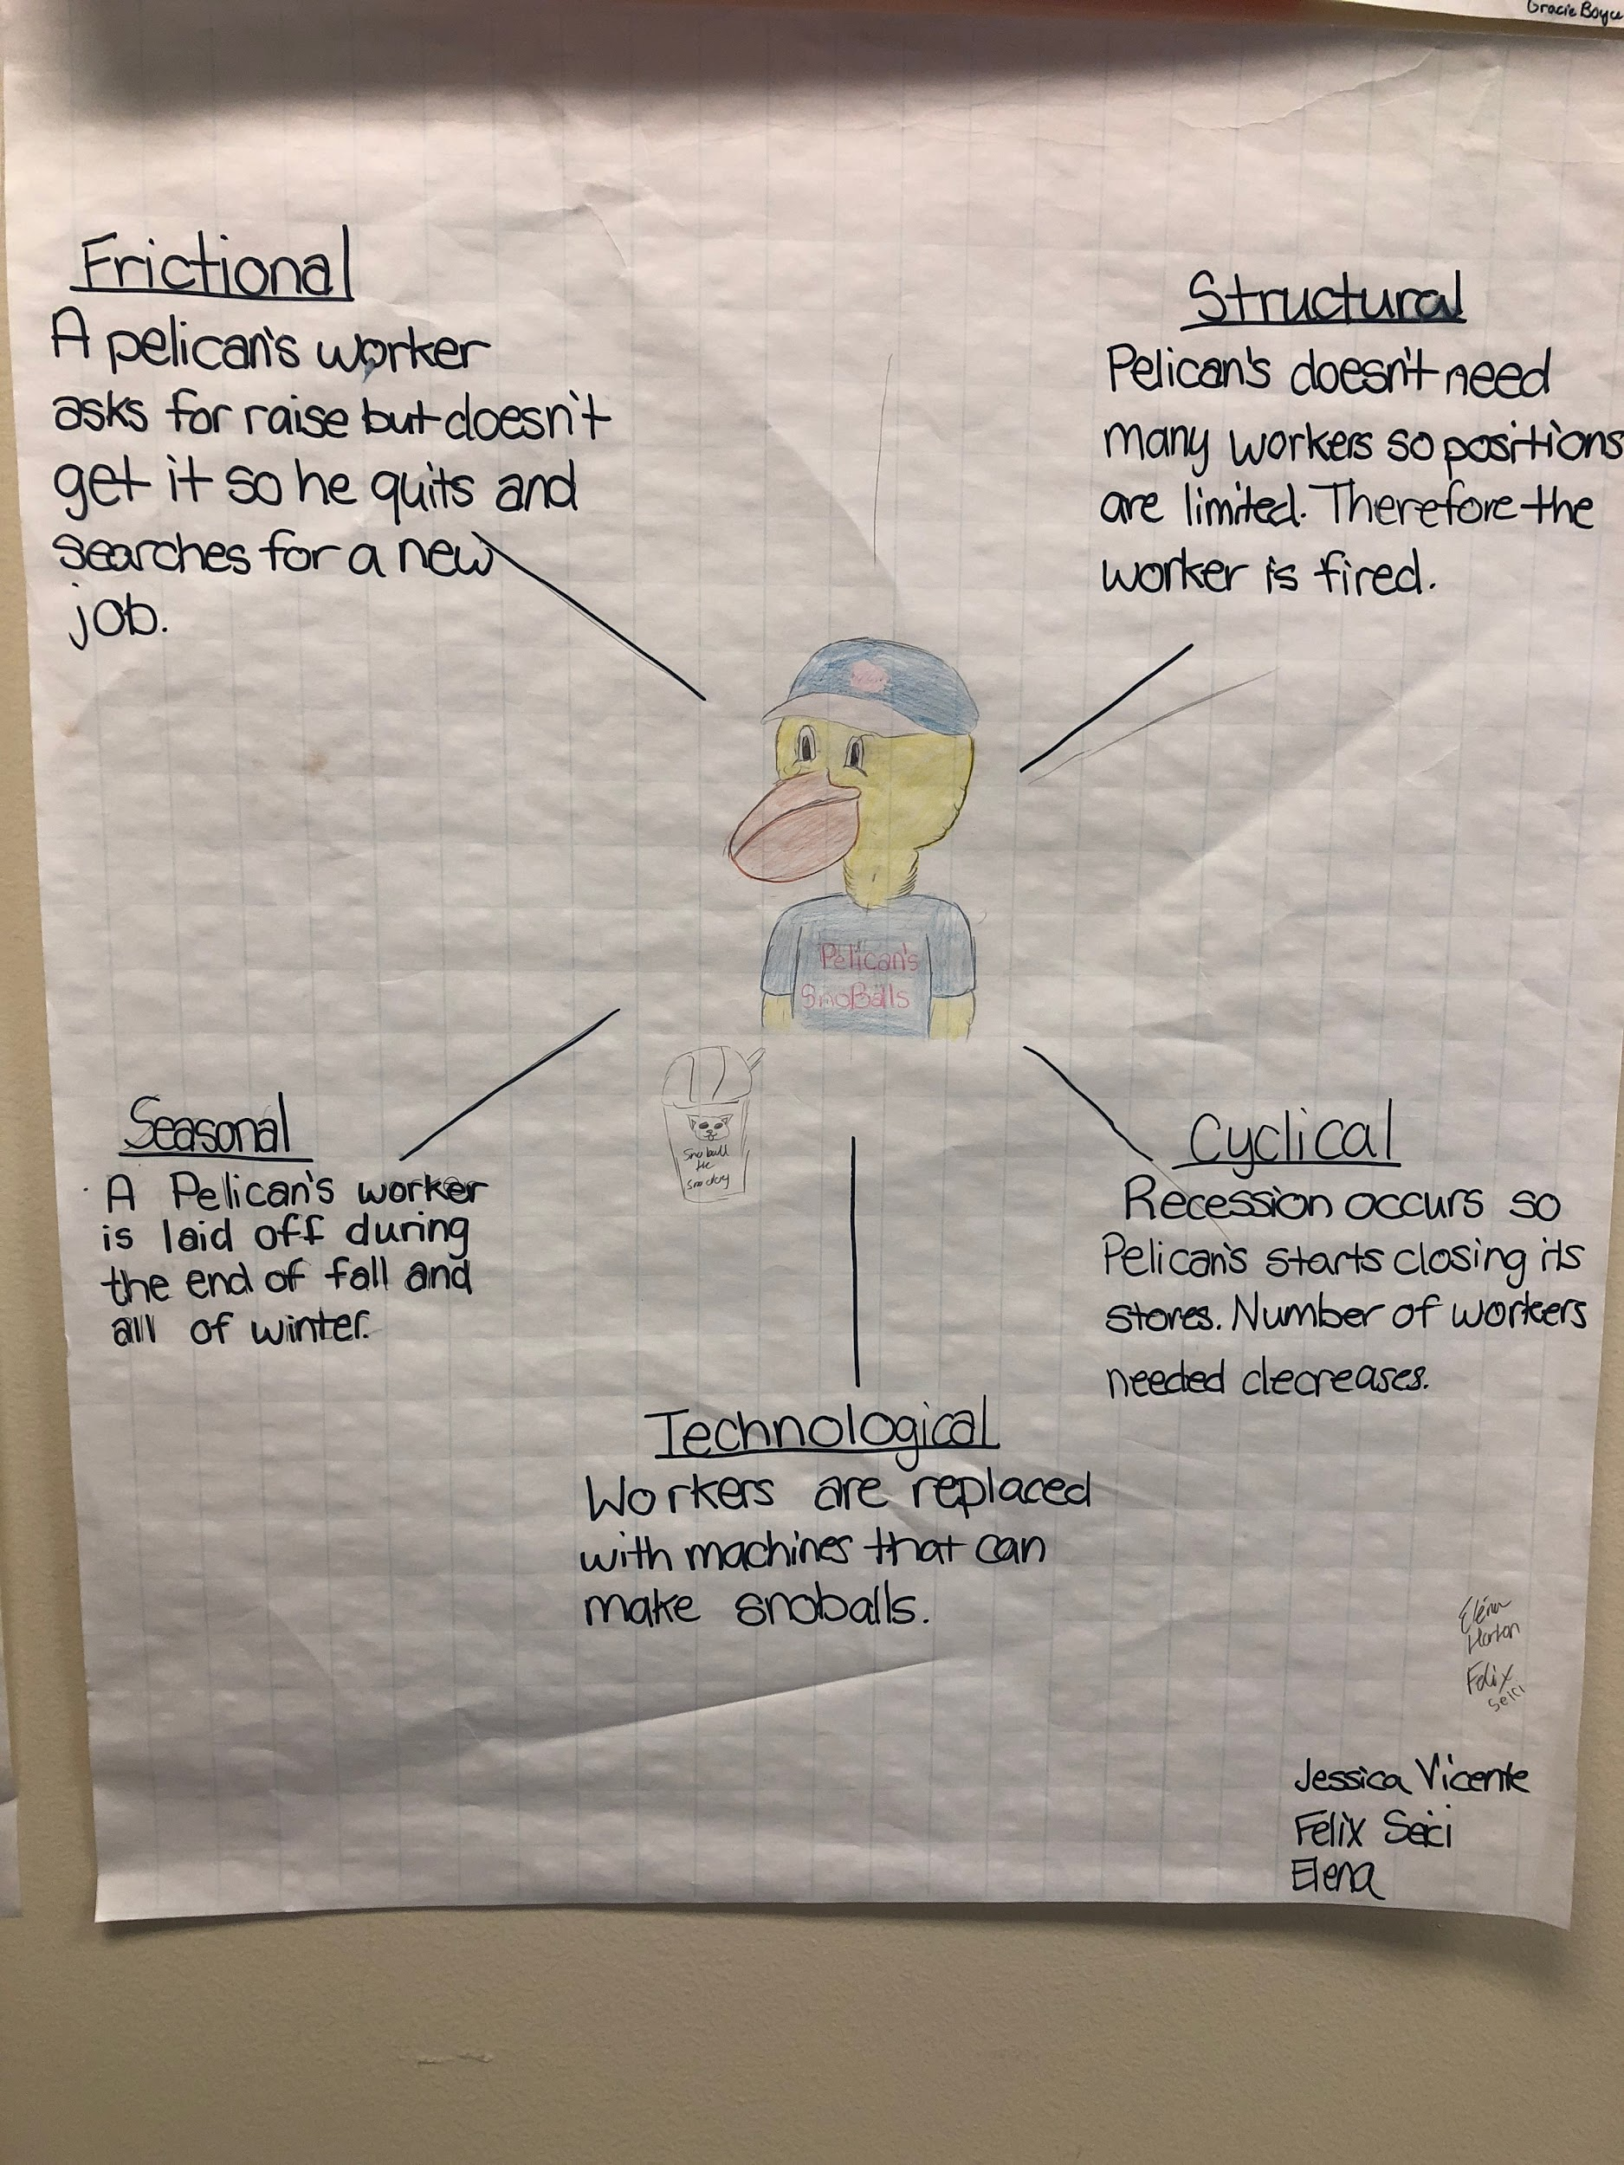
Examples

Slide 37
Questions?
How would you modify this activity for your classroom?

Slide 38
Book 5: Trade

Slide 39
Lesson 5: A New Coat for Anna
Lesson:
Concepts
Synopsis:
Maryland Council on Economic Education
Lesson Plan
wants, scarcity, productive resources, production, trade, barter
Set during World War II, a mother overcomes the lack of money and finds a way to make her daughter, Anna, a badly needed coat.

Slide 40
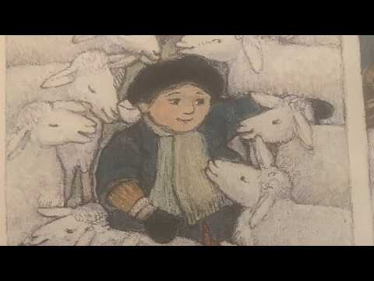
A New Coat for Ann by Harriet Ziefert

Slide 41
Comprehension Questions
How did Anna get a new coat for winter without any money?
Why did Anna and her mother not have money?
What is it called when people make trades without using money?
What trades did Anna’s mother have to make in order to get the new coat?
Why do people trade?
What resources (human, capital, and natural) where used to make the coat?

Slide 42
Productive Resources
Natural Resources (Land) | Capital Resources (Tools) | Human Resources (Labor)
Worksheet Link: https://docs.google.com/document/d/1aIgKS74rK-76T1dhmyldUNAB8w7VHejR6gMXN1tQgMY/edit?usp=sharing

Slide 43
Trade/Barter Game
International Trade Game: https://www.economicsnetwork.ac.uk/showcase/sloman_game
The Trading Game: https://www.nationalgeographic.org/activity/the-trading-game/
Tic-Tac-Toe Tariff: https://www.fte.org/wp-content/uploads/Tic-Tac-Toe-Tariff-.pdf
Trade and Specialization: https://www.stlouisfed.org/-/media/project/frbstl/stlouisfed/education/lessons/pdf/potato.pdf
Win-Win - A Trading Game: https://www.izzit.org/products/detail.php?video=win_win

Slide 44
Questions?
How would you modify this activity for your classroom?

Slide 45
Thank You!
Chandler Jordan
SC Economics
Chandler.Jordan@moore.sc.edu

