Slide 1
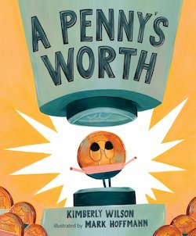

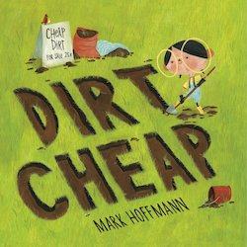

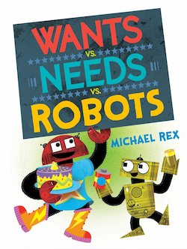
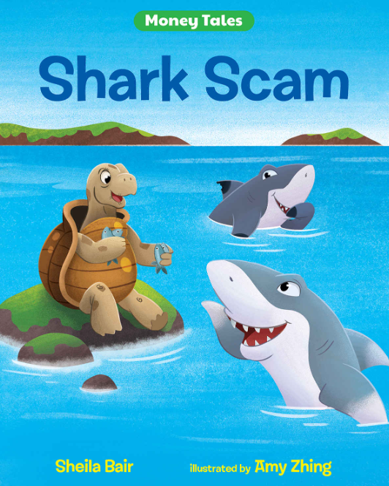
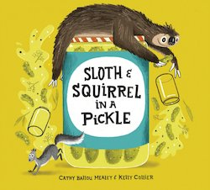
Lauren H Shifflett shiffllh@jmu.edu
Lynne F Stover stoverlf@jmu.edu
May 4, 2023
Using Children’s Literature to Teach Economics Series
Session I
What’s New: Featuring Funny Characters Learning Life Lessons

Slide 2
EconEdLink Membership
You can now access CEE’s professional development webinars directly on EconEdLink.org! To receive these new professional development benefits, become an EconEdLink member. As a member, you will now be able to:
Automatically receive a professional development certificate via e-mail within 24 hours after viewing any webinar for a minimum of 45 minutes
Register for upcoming webinars with a simple one-click process
Easily download presentations, lesson plan materials and activities for each webinar
Search and view all webinars at your convenience
Save webinars to your EconEdLink dashboard for easy access to the event
Access our new Professional Development page here

Slide 3
Professional Development Opportunities
To earn professional development credit for CEE webinars found on EconEdLink, you must:
Watch a minimum of 45-minutes and you will automatically receive a professional development certificate via e-mail within 24 hours.
Attendees can learn how much credit they will earn per workshop.
Accessing resources:
You can now easily download presentations, lesson plan materials, and activities for each webinar from EconEdLink.org/professional-development/
Local resources:
Insert your local professional development opportunities (if applicable)

Slide 4
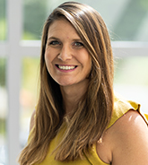
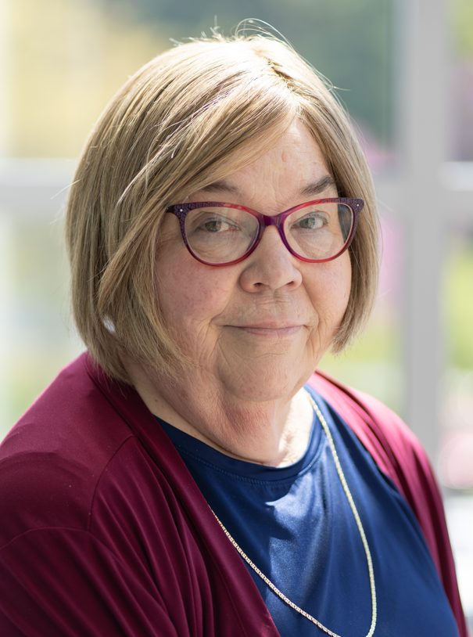
Presenters
Lauren Hensley Shifflett is the new Associate Director at the James Madison University Center for Economic Education. Prior to joining the Center, she spent twelve years in early elementary education where she enjoyed prospering young minds as a classroom teacher. Lauren became nationally known as an elementary economic educator when she received the John Morton Award of the national Council for Economic Education in 2021. Her love for economics guides her lessons to prepare students for life.
shiffllh@jmu.edu
Lynne Farrell Stover is currently a Teacher Consultant at the James Madison University Center for Economic Education. Prior to this, she spent thirty-three years in public education where she enjoyed various teaching assignments including classroom teacher, gifted education specialist, and librarian. She is the author of over fifty educational articles and eight teacher resource books. She is the recipient of the 2022 NAEE Platinum Curriculum Award for her lessons developed for Virginia’s Reading Makes Cents Program.
stoverlf@jmu.edu

Slide 5

Agenda
Introduction [5 mins.]
Review information concerning value of using children’s literature to teach in the content area. [5 mins.]
Examine related children’s books and review lessons and activities based on the featured titles. [45 mins.]
Conclude with discussion questions, book list review, and webinar survey [5 mins.]

Slide 6
Objectives
In this webinar teachers will:
Explore the concept of the value of using children’s literature to teach in the content areas.
Relate the concepts of scarcity, goods, services, opportunity cost, and decision-making as they pertain to the featured titles.
Consider the cross curricular possibilities of the topic as related to the social sciences, math, and language arts.
Review an annotated bibliography listing new children’s picture books that contain economic and personal finance content.

Slide 7
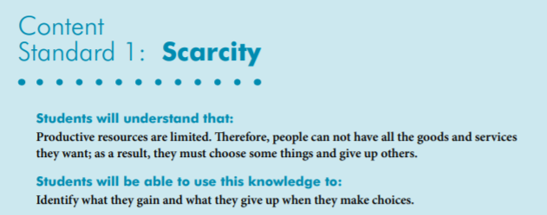
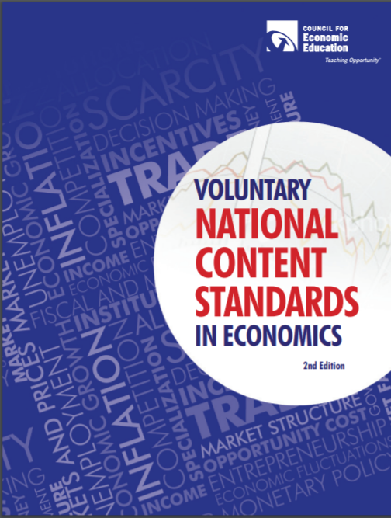
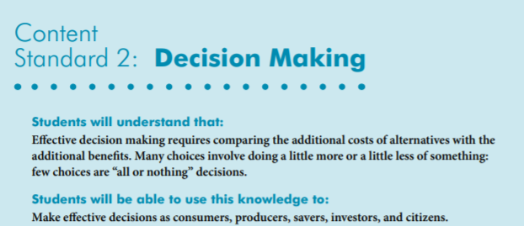
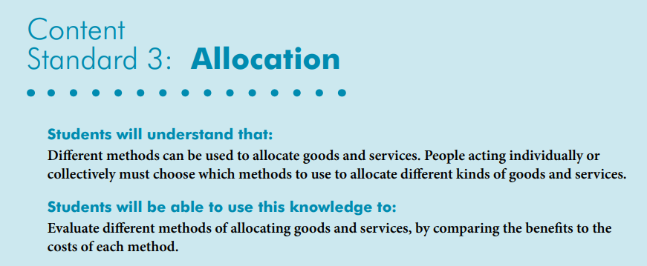
National Content Standards
https://www.councilforeconed.org/wp-content/uploads/2012/03/voluntary-national-content-standards-2010.pdf

Slide 8

Using Children’s Literature to Teach Content
It is to be noted that by using children’s picture books to teach in the content areas, we are providing students with engaging background information that encourages them to relate to concepts, improve vocabulary, and promote reading and writing skills. Children’s literature offers many interdisciplinary possibilities including those of economics and personal finance.

Slide 9
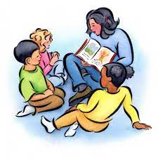
Using Children’s Literature to Teach Economics
Economics has become a component of the social studies curriculum. Research has show that children enter school with an experienced-based knowledge of economics. Educators, faced with a crowded instructional schedule, are combining reading strategies with economic education. They find that integrating a class-read aloud that features economic concepts is a time saving teaching strategy.

Slide 10
Dirt Cheap
by Mark Hoffmann
Story Synopsis: Birdie, a young entrepreneur, doesn't know much about money. She is motivated to learn so that she can purchase a new soccer ball for $24.95. When she observes her neighbors all working in their yards, she realizes that she has something that they all could use…dirt!
After digging and bagging her product she has accumulated a bag full of quarters, dimes, nickels, pennies, and even dollar bills!
However, she may not have thought through her enterprise as well as she could have.
Publisher: Alfred A. Knopf, Inc.
Copyright Date: 2020
Reading Level: 1.0
Interest Level: P-2
https://www.youtube.com/watch?v=0axD7bRxHXs
6 minutes

Slide 11
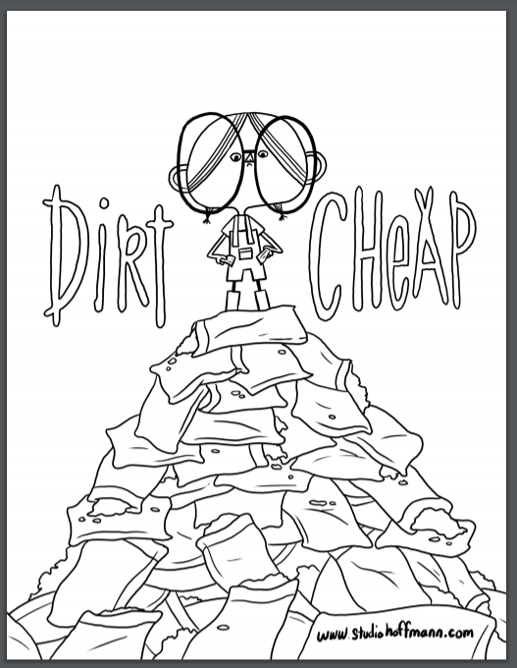
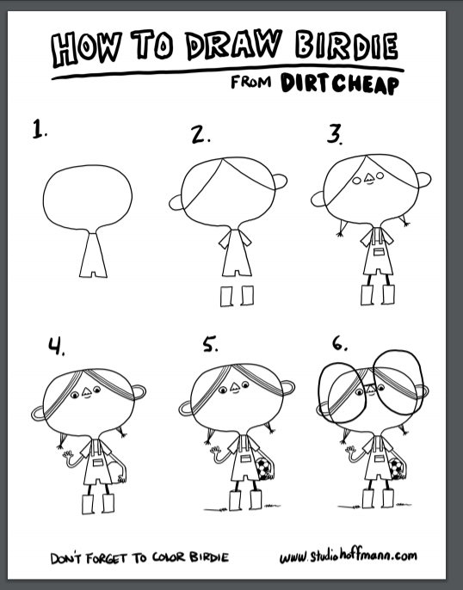

Activity Pages
https://static1.squarespace.com/static/596301cc3a0411d39d8b2f47/t/5ebf5e72e5e653713b79f82e/1589599926254/Dirt_Cheap_2.pdf
https://static1.squarespace.com/static/596301cc3a0411d39d8b2f47/t/5ebf5e72e5e653713b79f82e/1589599926254/Dirt_Cheap_2.pdf

Slide 12
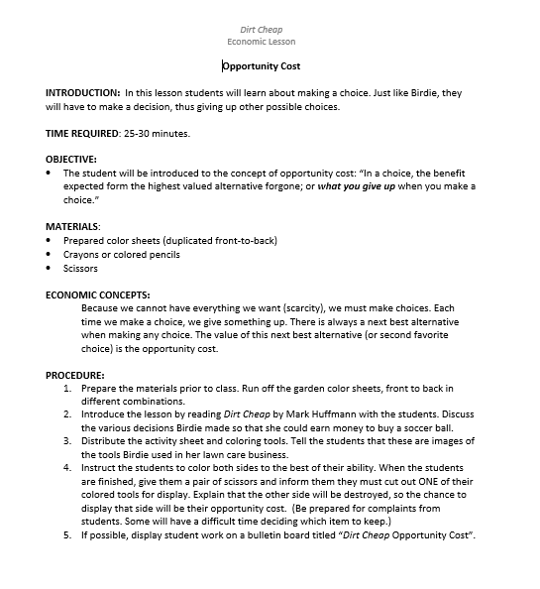



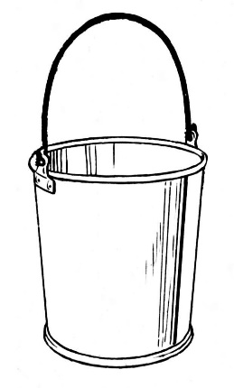


Dirt Cheap Opportunity Cost Lesson

Slide 13
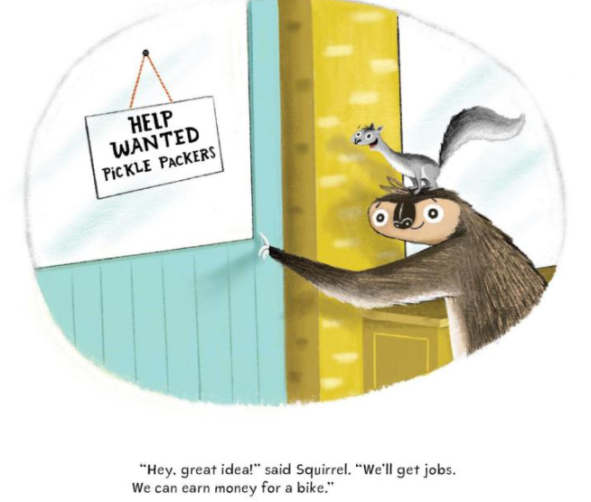
SLOTH & SQUIRREL IN A PICKLE
Publisher: Kids Can Press
Copyright Date: 2021
Reading Level: 2.0
Interest Level: PK-2
https://www.youtube.com/watch?v=lpwVwa8GaxI
5 minutes

Slide 14

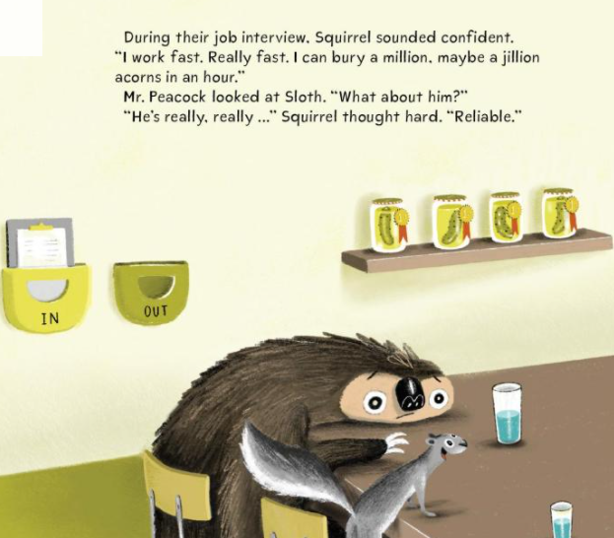
SLOTH & SQUIRREL IN A PICKLE
Story Synopsis: A quick squirrel and a slow sloth try to earn some money by applying for and getting a job in a pickle factory.
Funny and heartwarming this tale of two unlikely friends includes positive themes that feature perseverance, resourcefulness and teamwork.

Slide 15
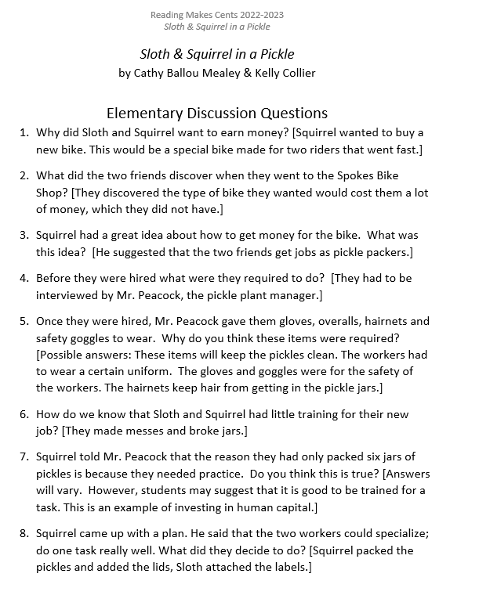

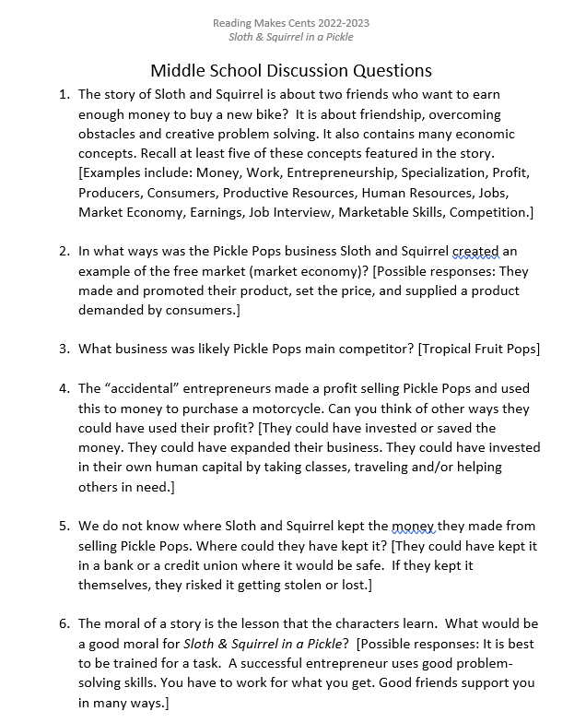
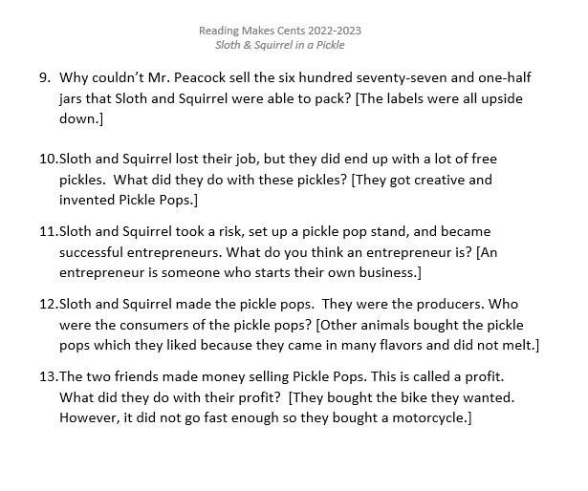
Discussion Questions

Slide 16
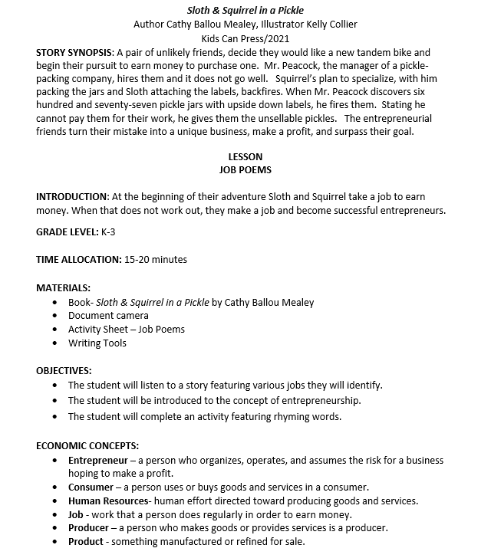
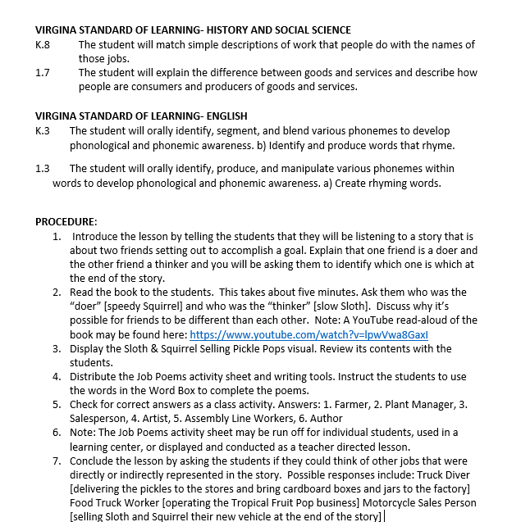
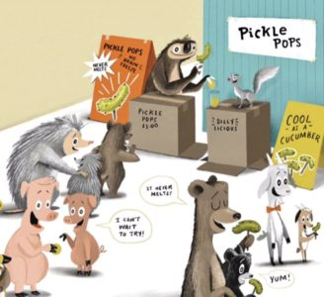
Lesson Plan

Slide 17
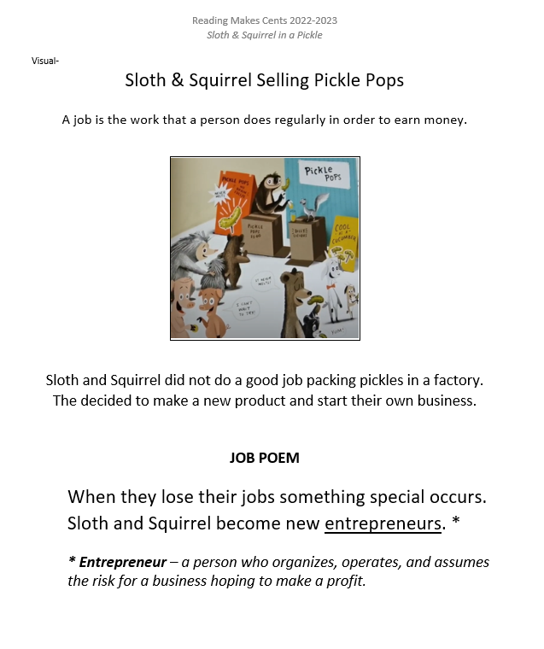
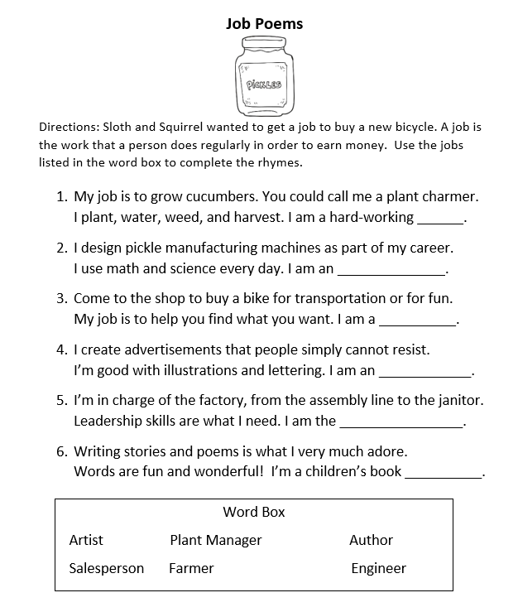
Lesson Plan

Slide 18
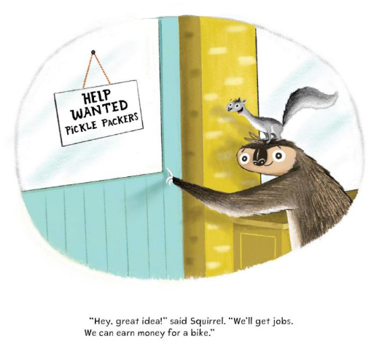
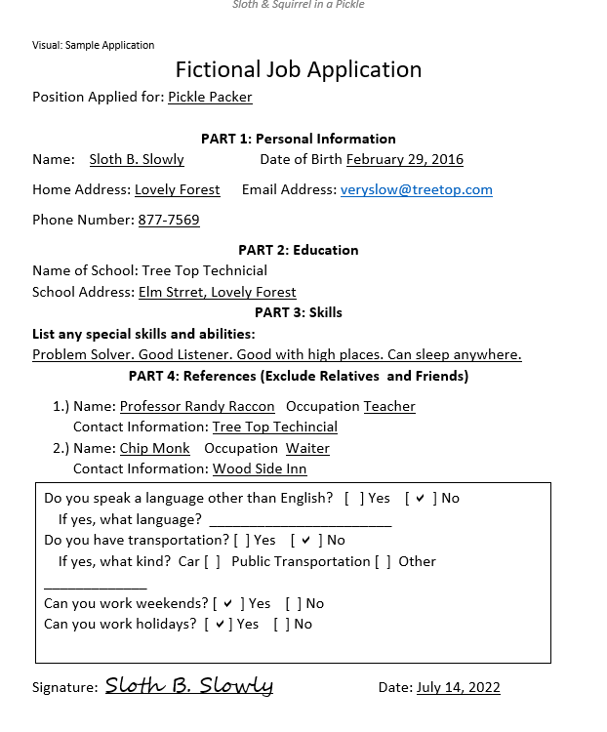
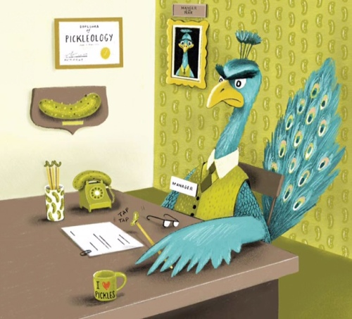
Job Application

Slide 19
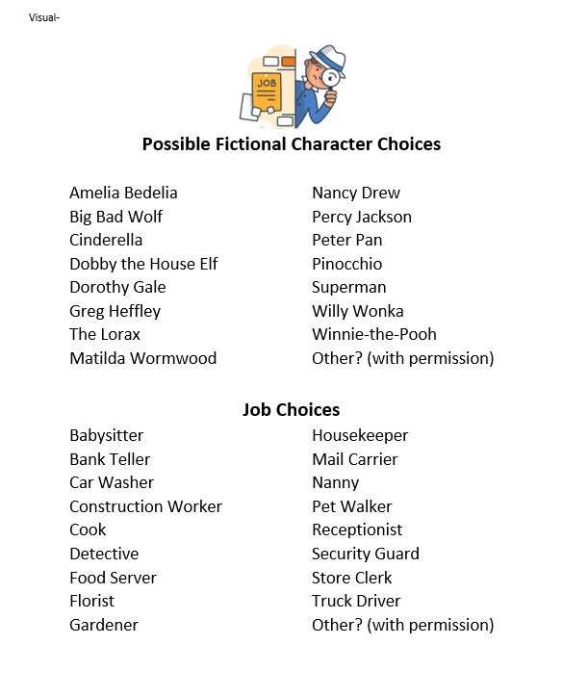
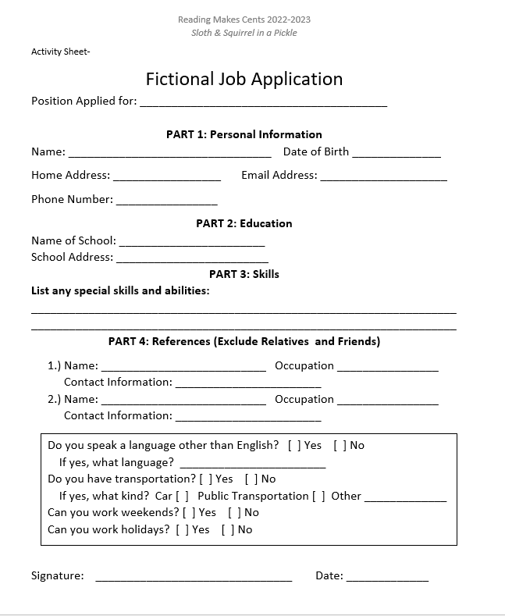
Job Application

Slide 20
A Penny’s Worth
Story Synopsis: Hot off the minting press, Penny feels like a million bucks. But as other coins and bills are spent while she sits forgotten, she begins to doubt her value. Refusing to be short-changed, she sets out to find her purpose at any cost. Readers will learn a basic lesson on US currency.
Publisher: St Martin’s Press
Copyright Date: 2022
Reading Level: 2.0
Interest Level: K-3
https://www.youtube.com/watch?v=8zUpdDf3Zbo

Slide 21
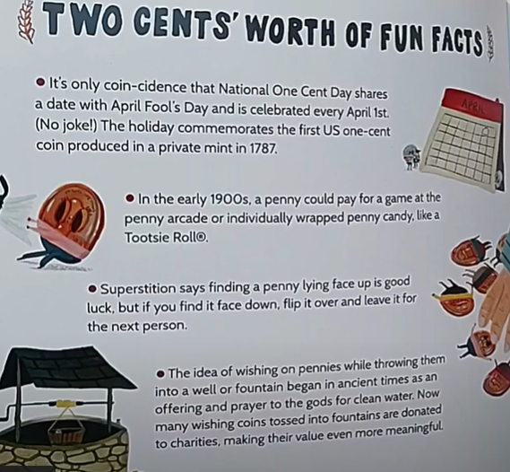
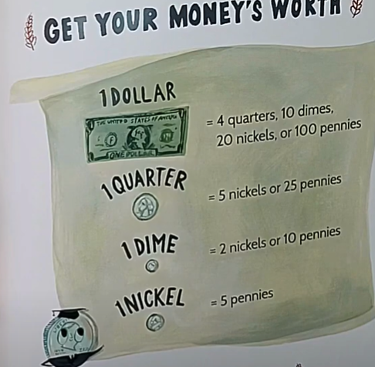
Back Matter

Slide 22
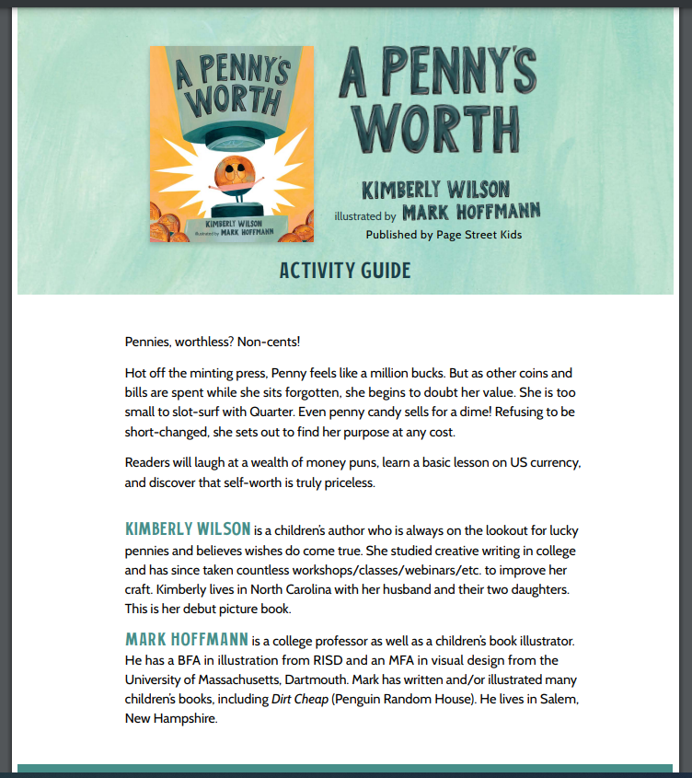
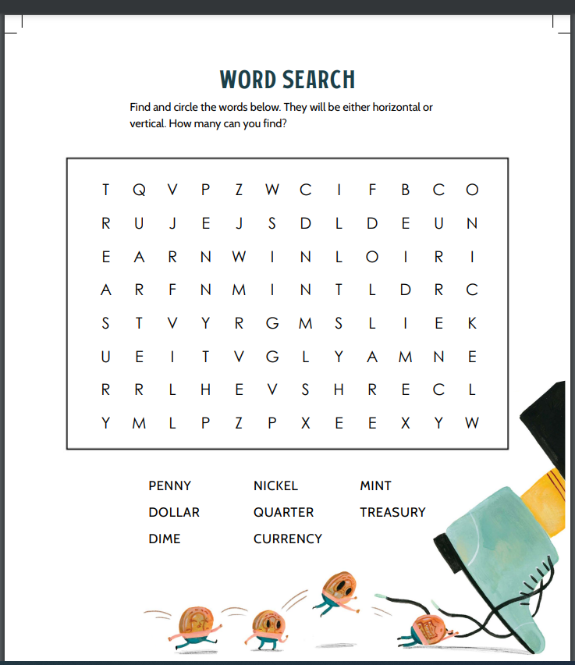
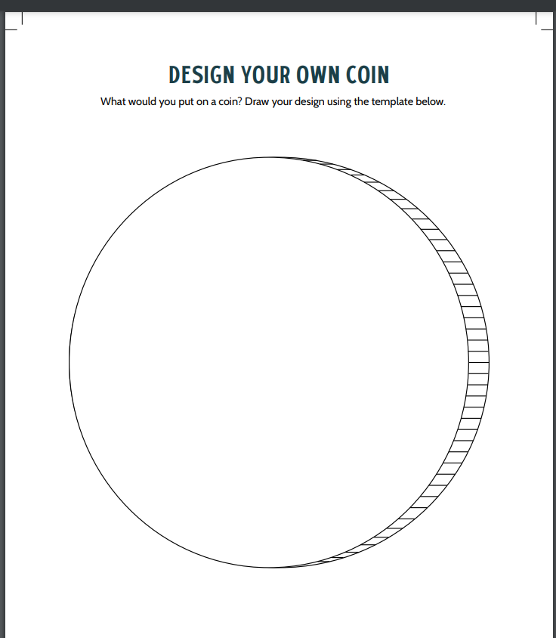
A Penny’s Worth
7-page Activity Guide
https://static1.squarespace.com/static/596301cc3a0411d39d8b2f47/t/6279be9205c7696c693dac42/1652145811803/PennysWorth_ActivityGuide3.pdf

Slide 23
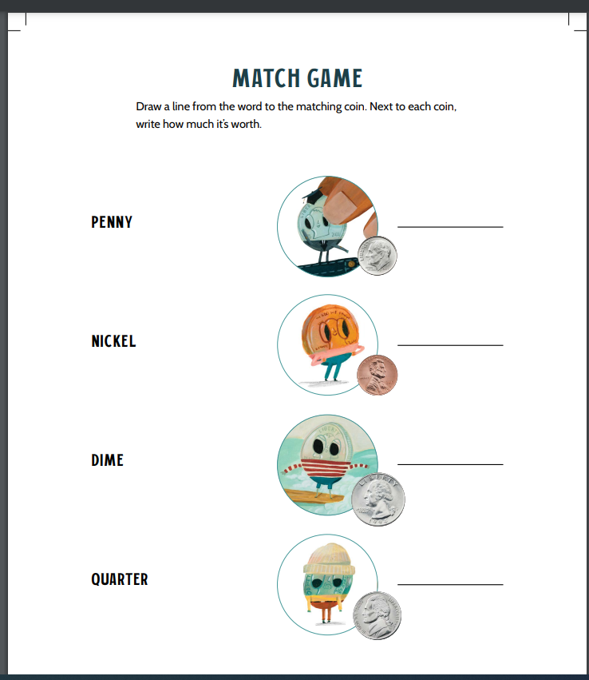
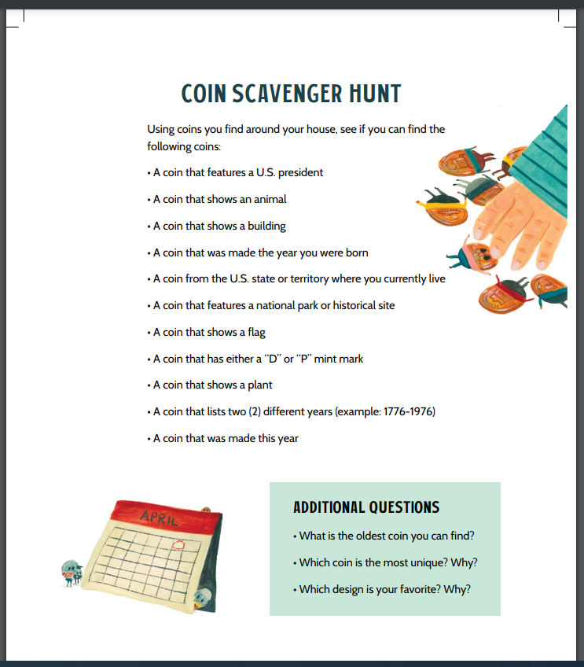
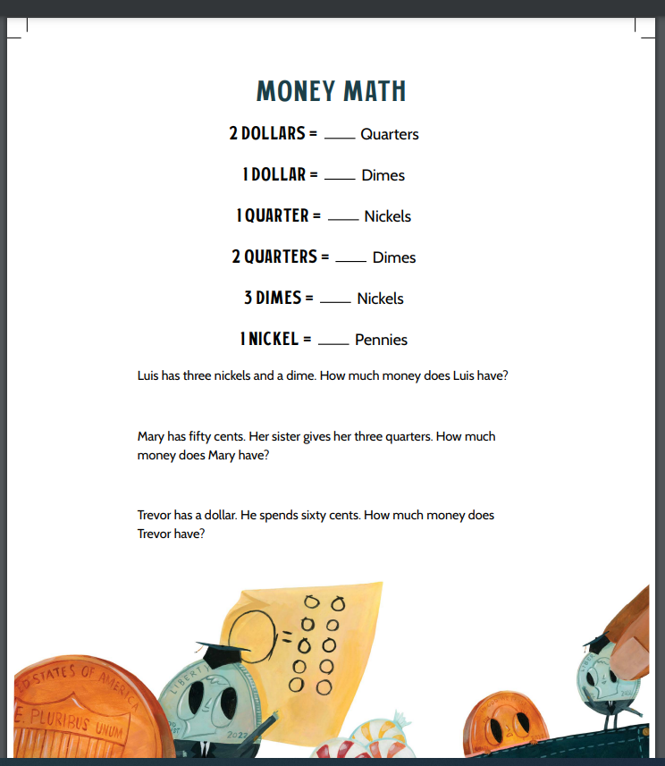

Slide 24

GOLD!
Story Synopsis: Instead of making friends, seven-year-old Max Midas decides to make millions and spend it on what he loves best, gold, but one day things get lonely inside his shiny castle and Max finally learns that gold is not worth anything without friends and family by your side.
Publisher: Penguin
Copyright Date: 2022
Reading Level: 2.0
Interest Level: PK-2
https://www.youtube.com/watch?v=qkZk1AzGYvM

Slide 25

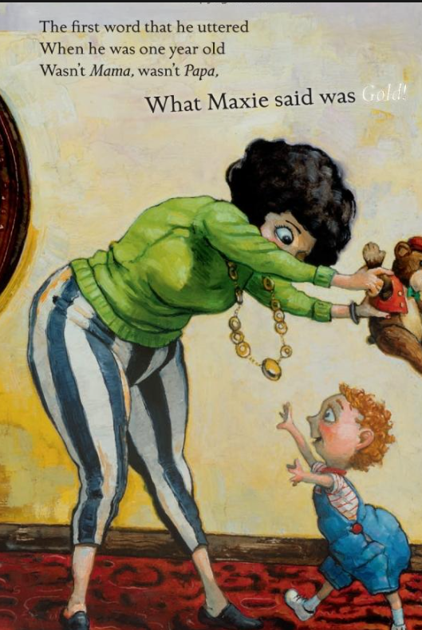
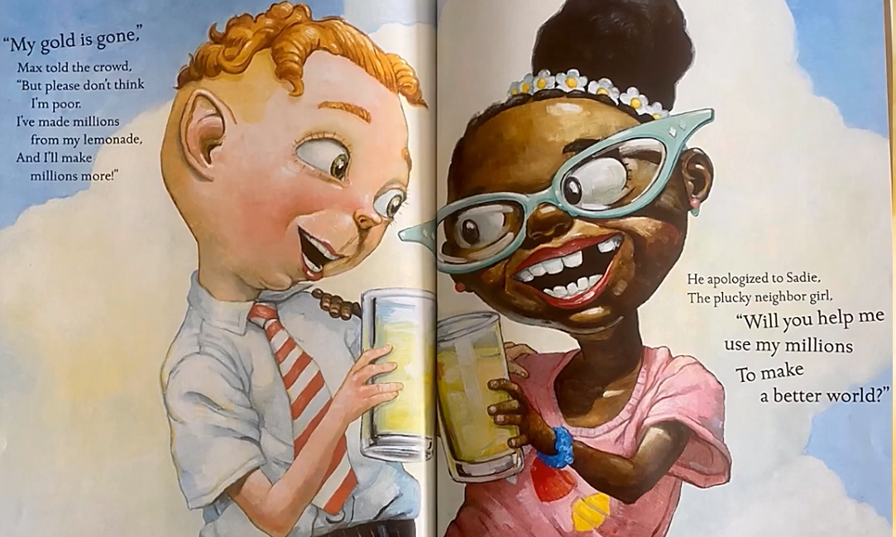
GOLD!
Starts with greed.
Concludes with giving.

Slide 26
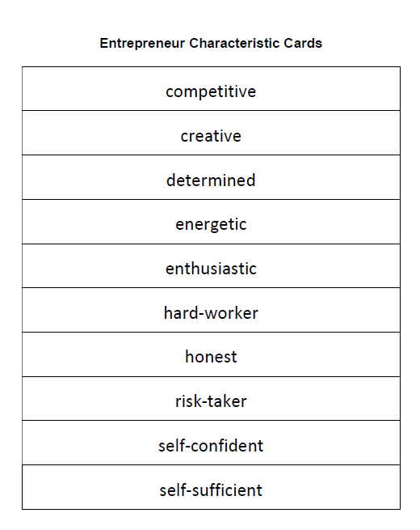
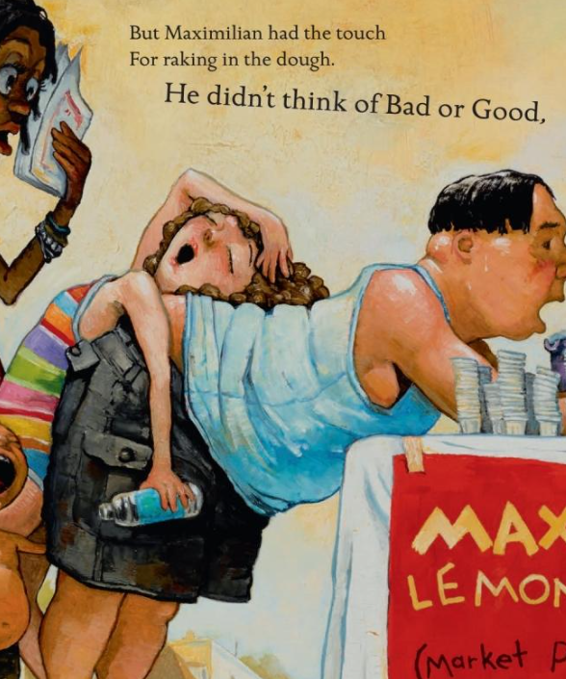
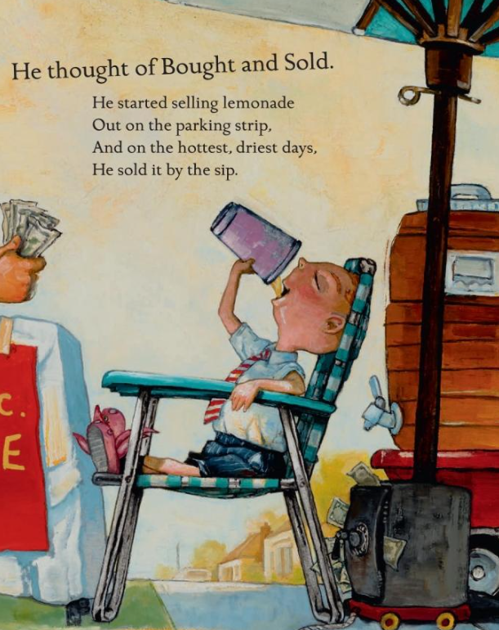
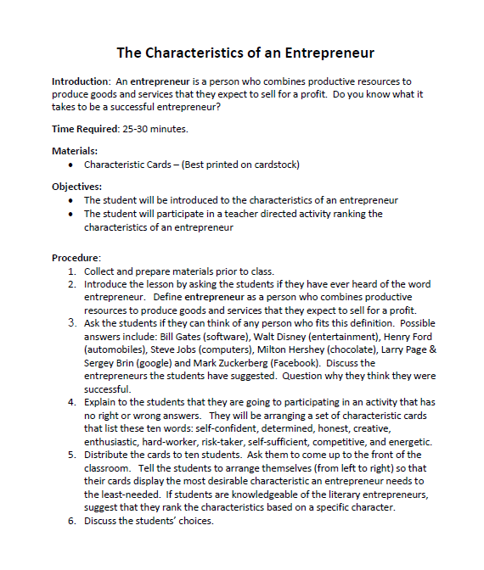

Slide 27
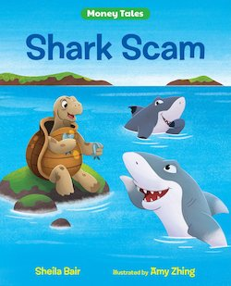
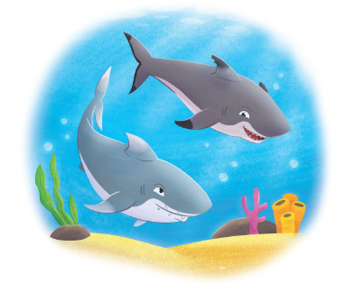
Shark Scam
Story Synopsis: Two sharks convince giant tortoise Arlene to invest in their business, and Arlene takes the bait but soon finds out it was a Ponzi scheme. Includes information on Ponzi schemes.
Publisher: Albert Whitman
Copyright Date: 2022
Reading Level: 3.0
Interest Level: 5-9

Slide 28
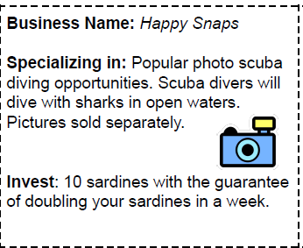
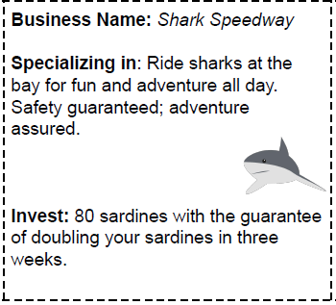
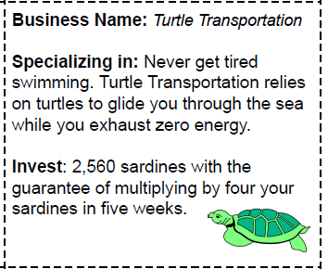




Slide 29




Slide 30
I LOVE STRAWBERRIES!
Story Synopsis: Through Jolie's comical scrapbook-style journal entries, readers will learn how she convinces "old people" (her parents) to let her grow her own strawberries. Growing strawberries is a lot of work and responsibility, but Jolie is ready with the help of her faithful rabbit Munchy! Together they find out just how delicious, rewarding, and sometimes complicated it can be to grow your own food.
Publisher: Feeding Minds Press
Copyright Date: 2022
Interest Level: 1-4
https://www.youtube.com/watch?v=OYgGou9bKns

Slide 31




https://www.ncfb.org/wp-content/uploads/2023/04/April-2023_I-Love-Strawberries.pdf

Slide 32





A Basket of Berries Challenge

Slide 33






Slide 34

WANTS vs. NEEDS vs. ROBOTS
Do you know the difference between a want and a need? It can be a hard thing to understand, especially when you want something so much that you feel like you have to have it. But some things aren’t essential—like jellybean tacos and groovy boots. Other things are essential—like fuel and feet to put the boots on. The robots in this book are here to show you the difference as they make trades to get some things they really want (hooray!) but give away some things they need (oops!).
Publisher: Penguin Copyright Date: 2023
Reading Level: 1.0
Interest Level: K-3
https://www.youtube.com/watch?v=EpCUSQB874E
13 mins.

Slide 35

WANTS vs. NEEDS vs. ROBOTS
Robots Need:
Batteries
Arms
Legs
Oil

Slide 36


WANTS vs. NEEDS vs. ROBOTS
https://maistorybook.com/2023/03/14/maistorybook-wants-vs-needs-vs-robots-wants-vs-needs-robot-activity/

Slide 37




Slide 38

Assessment Questions
Do you think there is merit in using picture books to teach economics and personal finance in the elementary classroom?
What other subjects could the featured titles be used to teach?
Which one of these titles do you think would work best in either a “one book-one school” program or as a multi-curricular component for a grade level teaching unit?

Slide 39

Invest In Girls

Slide 40

NEC

Slide 41

NPFC

Slide 42

Advocacy

Slide 43

Suggested Presentation Deck
CEE Affiliates
https://www.councilforeconed.org/resources/local-affiliates/
Include your local affiliate page

Slide 44










Thank You to Our Sponsors!

Slide 45
Contact information
Thank You
Lauren H Shifflett shiffllh@jmu.edu
Lynne F Stover stoverlf@jmu.edu

