Slide 1
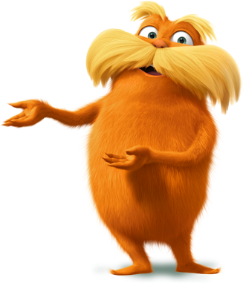
Lauren H Shifflett shiffllh@jmu.edu
Lynne F Stover stoverlf@jmu.edu
May 18 , 2023
Using Children’s Literature to Teach Economics Series
Session III
The Power of Storytelling:
From Book to Movie

Slide 2
EconEdLink Membership
You can now access CEE’s professional development webinars directly on EconEdLink.org! To receive these new professional development benefits, become an EconEdLink member. As a member, you will now be able to:
Automatically receive a professional development certificate via e-mail within 24 hours after viewing any webinar for a minimum of 45 minutes
Register for upcoming webinars with a simple one-click process
Easily download presentations, lesson plan materials and activities for each webinar
Search and view all webinars at your convenience
Save webinars to your EconEdLink dashboard for easy access to the event
Access our new Professional Development page here

Slide 3
Professional Development Opportunities
To earn professional development credit for CEE webinars found on EconEdLink, you must:
Watch a minimum of 45-minutes and you will automatically receive a professional development certificate via e-mail within 24 hours.
Attendees can learn how much credit they will earn per workshop.
Accessing resources:
You can now easily download presentations, lesson plan materials, and activities for each webinar from EconEdLink.org/professional-development/
Local resources:
Insert your local professional development opportunities (if applicable)

Slide 4


Presenters
Lauren Hensley Shifflett is the new Associate Director at the James Madison University Center for Economic Education. Prior to joining the Center, she spent twelve years in early elementary education where she enjoyed prospering young minds as a classroom teacher. Lauren became nationally known as an elementary economic educator when she received the John Morton Award of the national Council for Economic Education in 2021. Her love for economics guides her lessons to prepare students for life.
shiffllh@jmu.edu
Lynne Farrell Stover is currently a Teacher Consultant at the James Madison University Center for Economic Education. Prior to this, she spent thirty-three years in public education where she enjoyed various teaching assignments including classroom teacher, gifted education specialist, and librarian. She is the author of over fifty educational articles and eight teacher resource books. She is the recipient of the 2022 NAEE Platinum Curriculum Award for her lessons developed for Virginia’s Reading Makes Cents Program.
stoverlf@jmu.edu

Slide 5
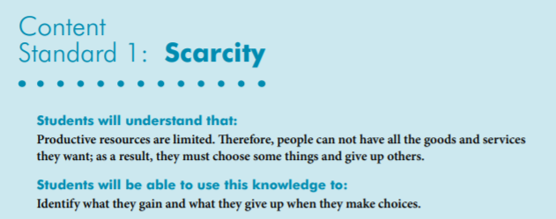

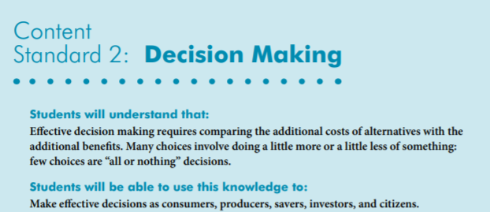
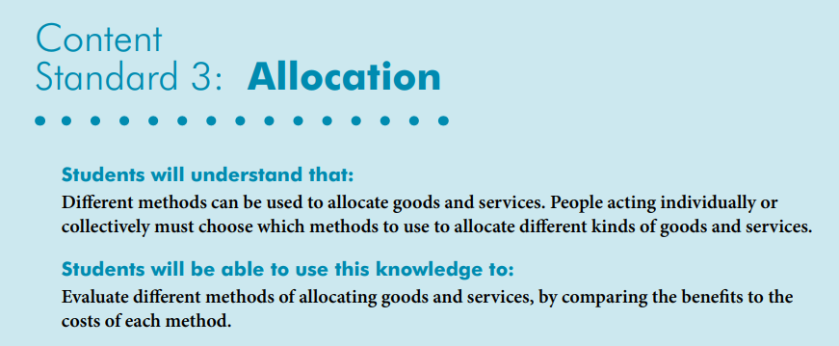
National Content Standards
https://www.councilforeconed.org/wp-content/uploads/2012/03/voluntary-national-content-standards-2010.pdf

Slide 6

Agenda
Introduction [5 mins.]
Review information concerning available materials and the featured economic concept. [5 mins.]
Examine related children’s books and related movies and review the lessons and activities based on them. [45 mins.]
Conclude with discussion questions, book list review, and webinar survey [5 mins.]

Slide 7
Objectives
In this webinar teachers will:
Explore the concept of the value of using children’s literature that have been made into movies to teach in the content areas.
Relate the concepts of scarcity, goods, services, money, entrepreurship, economic markets, and decision-making as they pertain to the featured titles.
Consider the cross curricular possibilities of the topic as related to the social sciences and creative problem solving.
Recognize the value of taking advantage of trends in popular culture.
Review an annotated bibliography listing new children’s books that contain economic and personal finance content.
It is to be noted that the students do not need to have read the books
or seen the movies to successfully complete the lessons.

Slide 8

"Never judge a book by its movie.”
- J. W. Eagan
But be an opportunist –
A popular movie will generate interest in a book. It’s not a coincidence that The Hunger Games Trilogy was on the USA Today Bestseller List six straight weeks before the movie release date.

Slide 9
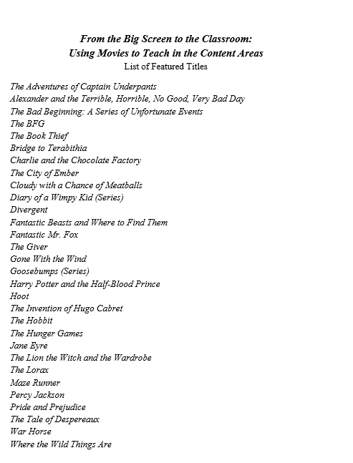
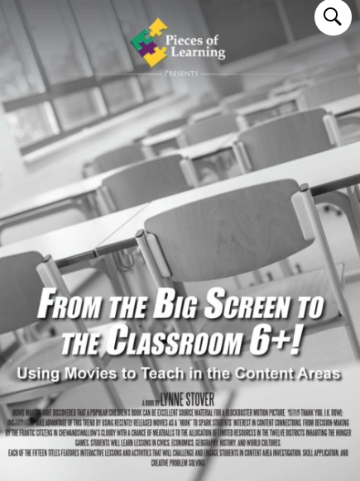
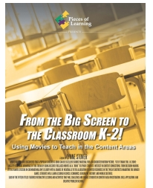
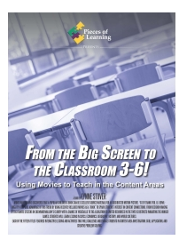
CHOICES!

Slide 10
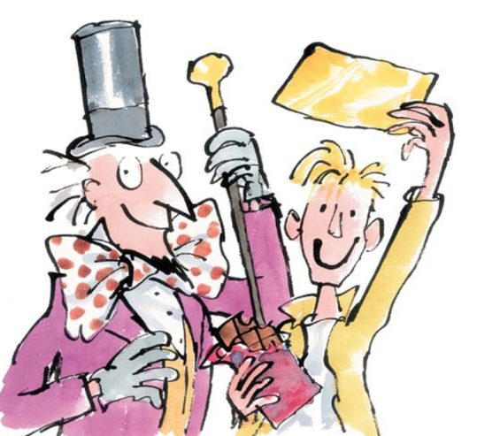
Session Titles and Featured Concepts
The Lorax – Productive Resources
Cloudy with a Chance of Meatballs – Goods and Services
Charlie and the Chocolate Factory – Scarcity
Diary of a Wimpy Kid – Entrepreneurship
Harry Potter and the Sorcerer's Stone – Money
The Hunger Games – Economic Systems
.

Slide 11
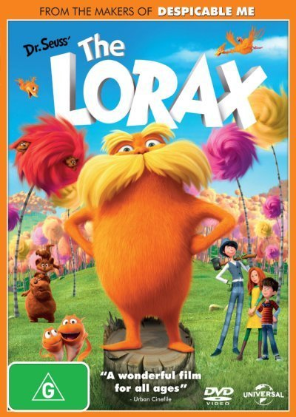

The Lorax
An irresponsible entrepreneur, the Once-ler, leads to the destruction of the environment. The Lorax, who represents the interests of the creatures being affected by this disaster, tries to convince the Once-ler to stop. The environment is completely devastated before the Once-ler realizes the harm he has caused. The story ends with hope for the future
Publisher: Random House
Copyright Date: 1971
Reading Level: 3.1
Interest Level: K-3
https://www.youtube.com/watch?v=i6a0b3jnn3Y

Slide 12
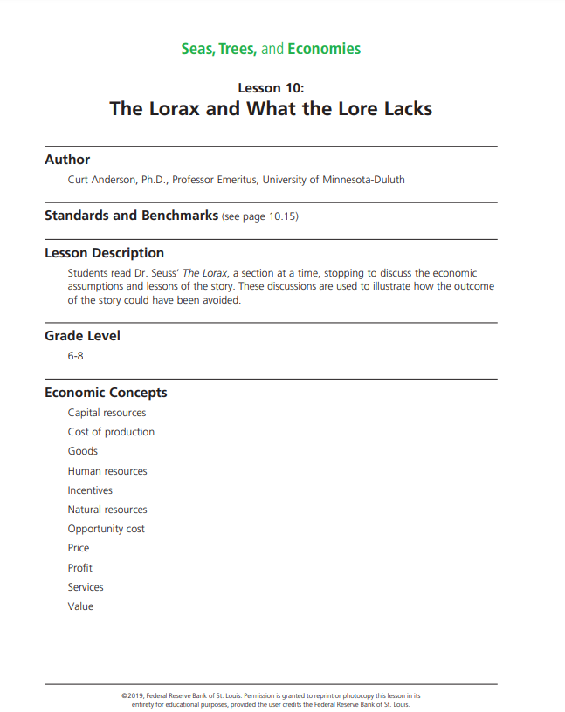
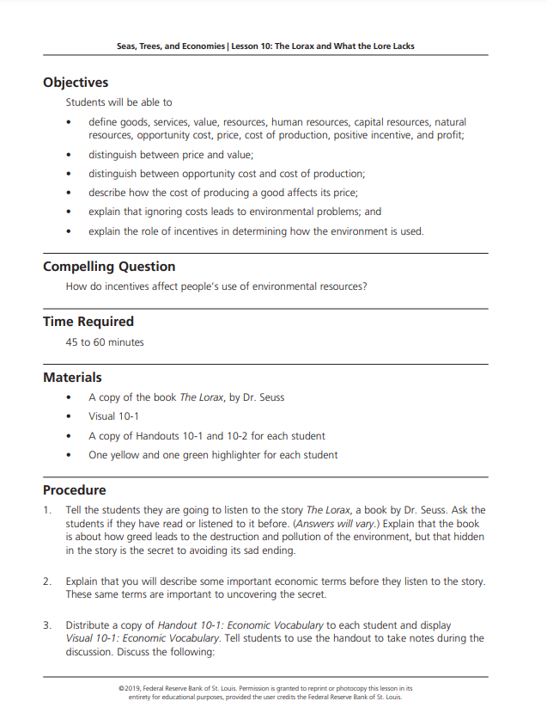

https://www.stlouisfed.org/-/media/project/frbstl/stlouisfed/education/curriculum/pdf/seas_trees_econ_lesson10.pdf

Slide 13
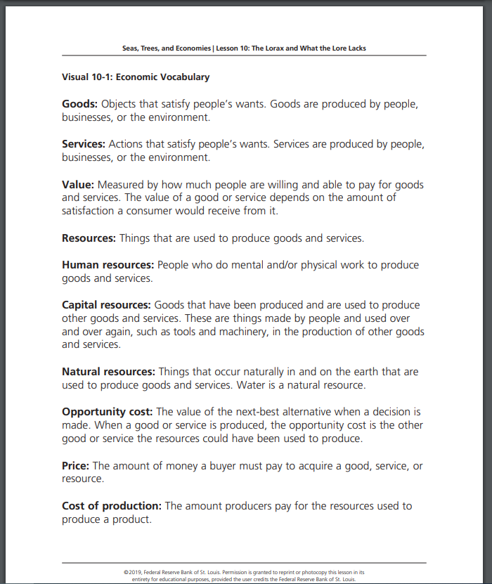
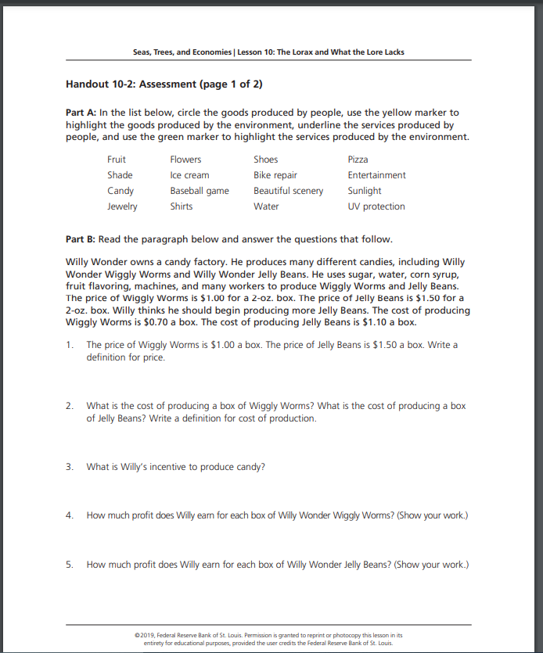

Slide 14

The Lorax
What do you think?
The Once-ler discovered that in the creation of a product required the use of natural resources.
What happened once the Truffula trees were all gone?
How could this environmental disaster have been prevented?
Be prepared to share your ideas with the class.

Slide 15
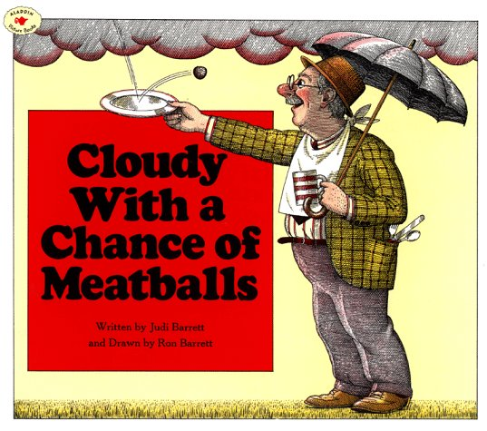
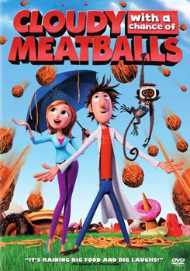
Cloudy With a
Chance of Meatballs
In the imaginary town of Chewandswallow the availability of food is dependent on climatic conditions. Soon the town’s citizens learn that there can be “too much of a good thing”.
First published in 1978 this wonderfully illustrated picture book is as applicable today as it was forty years ago…maybe more so!
Publisher: Aladdin Copyright Date: 1978
Reading Level: 4.3
Interest Level: K-3
https://www.youtube.com/watch?v=q5uXp4694sE

Slide 16
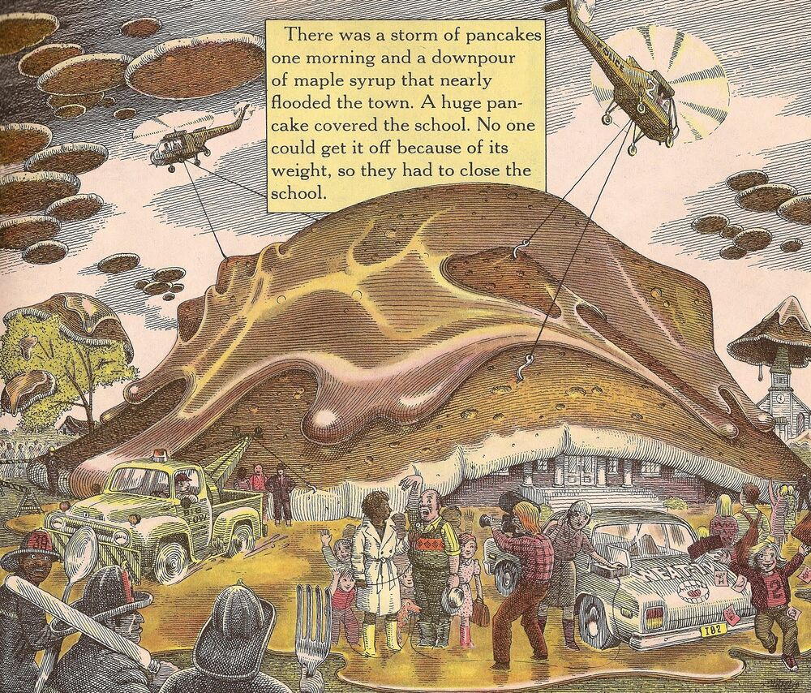
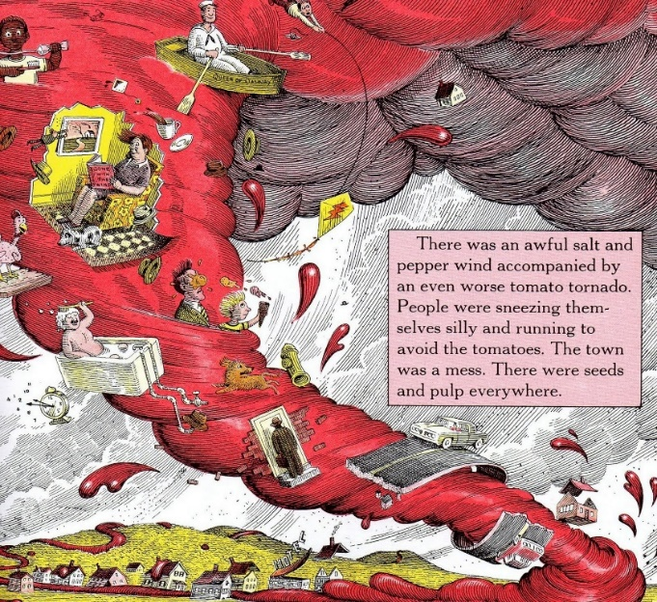
Possible Cross-Curricular Ideas
Climate Change
Weather Patterns
Creative Problem Solving
Unintended Consequences
Point of View
Word Play (synonyms, alliteration, hyperbole)

Slide 17
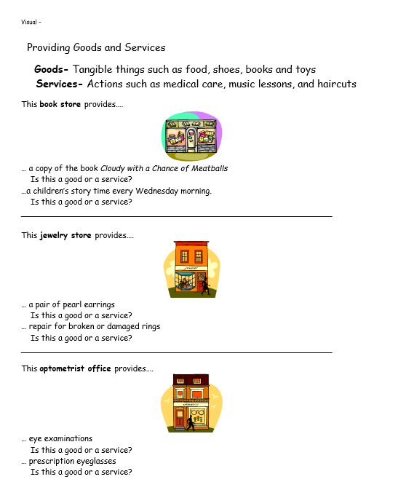
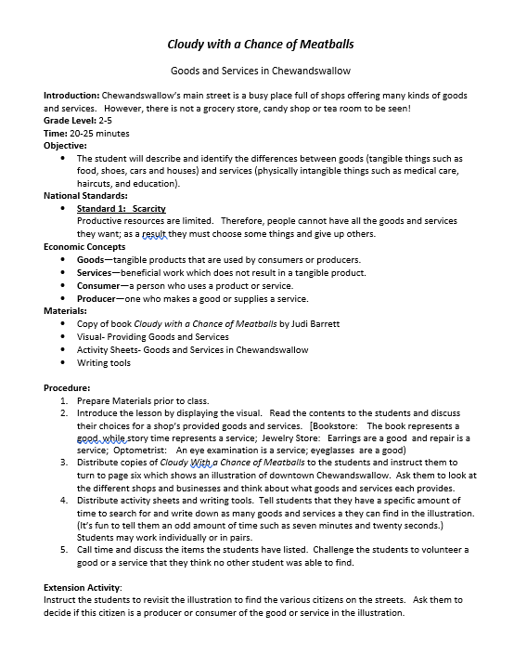

Slide 18
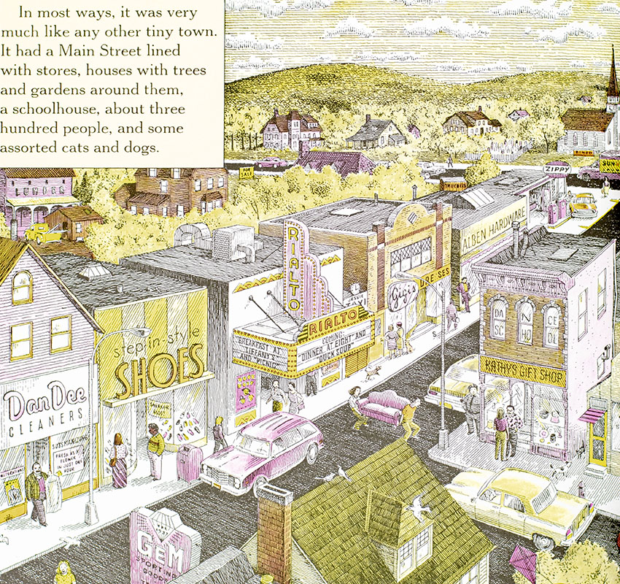
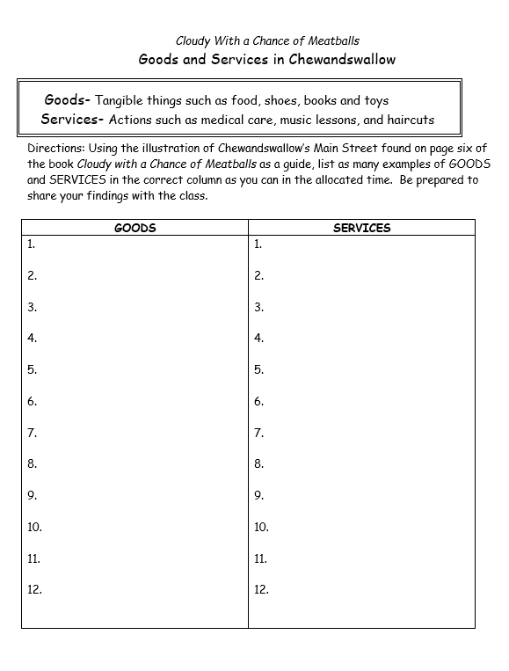

Slide 19
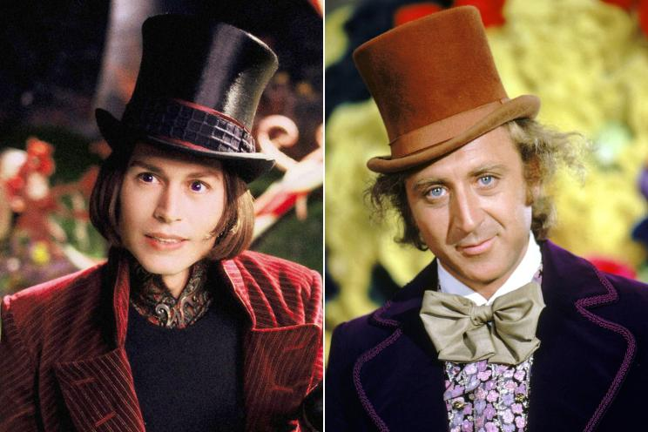

Charlie and the Chocolate Factory
A cautionary rags-to-riches story, where impoverished, Charlie Bucket outlasts the selfish other four candidates to win the grand prize: Willy Wonka's chocolate factory.
Publisher: Penguin
Copyright Date: 1964
Reading Level: 4.8
Interest Level: 4-7
https://www.youtube.com/watch?v=qCuNSZjCKg8
Reading Time: 3 hours 7 minutes!

Slide 20
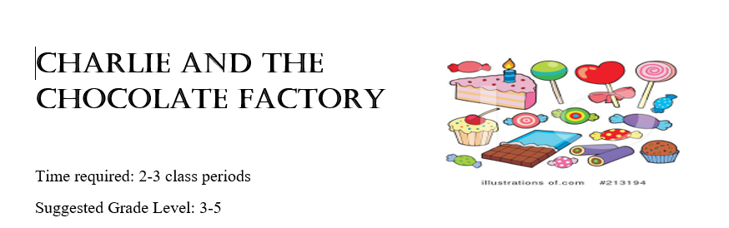
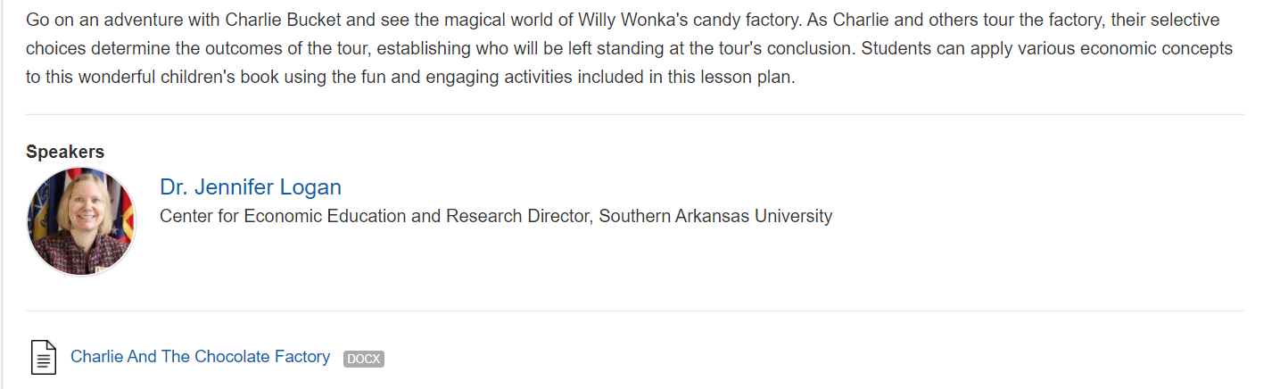
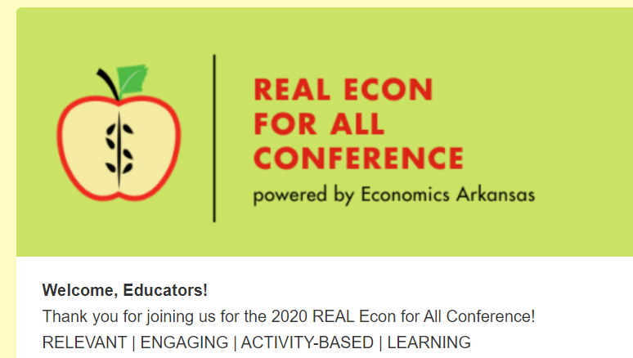
https://realconference2020.sched.com/event/cSH4/economics-in-literature-charlie-and-the-chocolate-factory

Slide 21
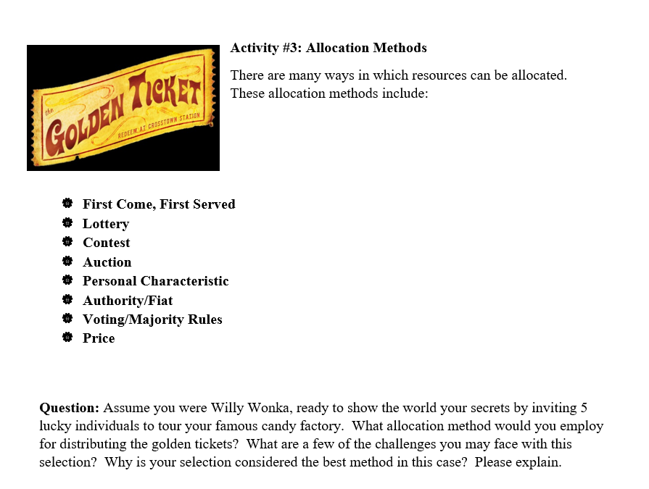
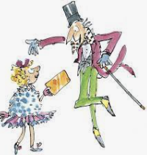
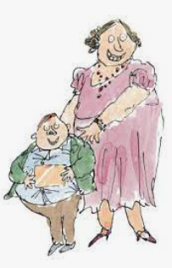

Slide 22
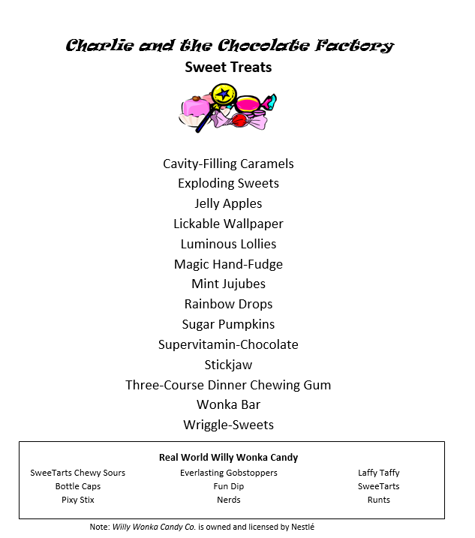
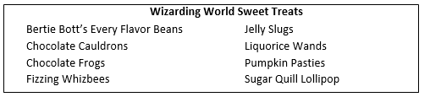

Charlie and the Chocolate Factory
Extension Activities
Compare and Contrast –Match three sweet treats from J.K. Rowling’s Wizarding World to three of Willy Wonka’s candy creations.
Then list three similarities and three differences of each pair.

Slide 23
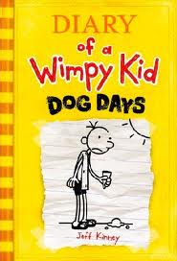
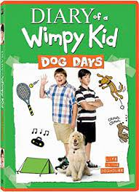
Diary of a Wimpy Kid
Dog Days
Greg Heffley records his attempts to spend his summer vacation sensibly indoors playing video games and watching television, despite his mother's other ideas. In an effort to pay the debts he incurred at his friend’s father’s county club, he endeavors to become an entrepreneur.
Publisher: Harry N Abrams, Inc.
Copyright Date: 2009
Reading Level: 5.2
Interest Level: 4-7

Slide 24
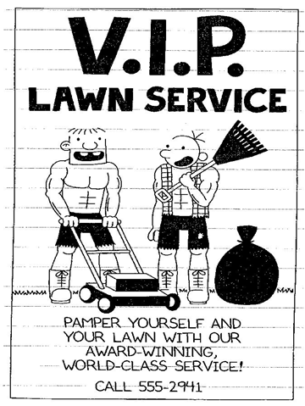
Productive Resources Poster
Capital Resources are man-made resources such tools, buildings, and vehicles used in production. The lawn mower is a capital resource.
Natural Resources are gifts of nature. The bag of grass clippings that can be turned into compost is an example of a natural resource.
Human Resources are people who work. Greg and Rawley would be examples of human resources if they had any skills.
Goods are tangible things such as food, clothes, and cars. The boys’ boots are examples of goods.
Services are physically intangible things such as medical care, haircuts, and education. Mowing lawns is an example of a service.
Entrepreneurs are people who organize, operate, and assume the risk for a business venture. Greg and Rawley would like to be entrepreneurs, but are not sure how to do this.

Slide 25
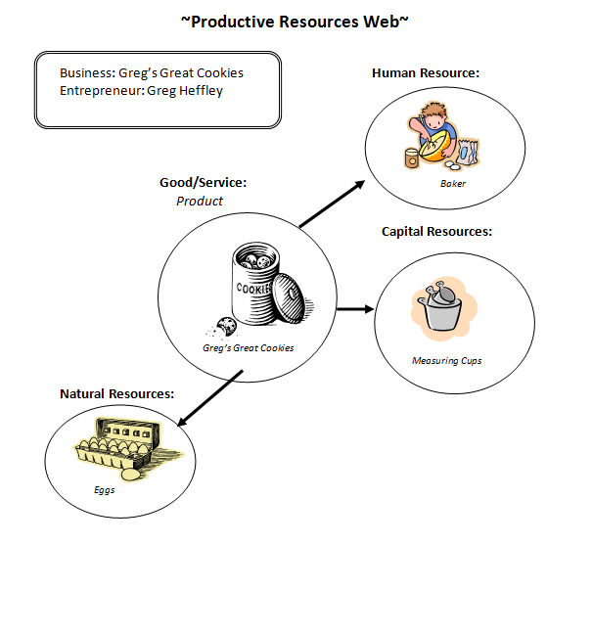
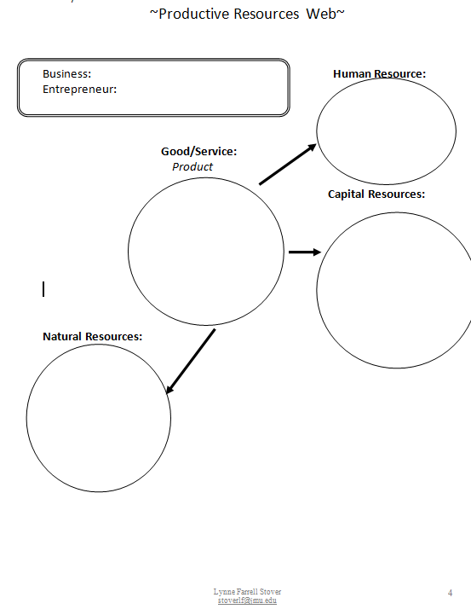

Slide 26


The Giver
by Lois Lowry
Given his lifetime assignment at the Ceremony of Twelve, Jonas becomes the receiver of memories shared by only one other in his community and discovers the terrible truth about the society in which he lives.
Copyright:1993
Publisher: Houghton Mifflin Reading Level: 5.7
Interest Level: 5-9

Slide 27

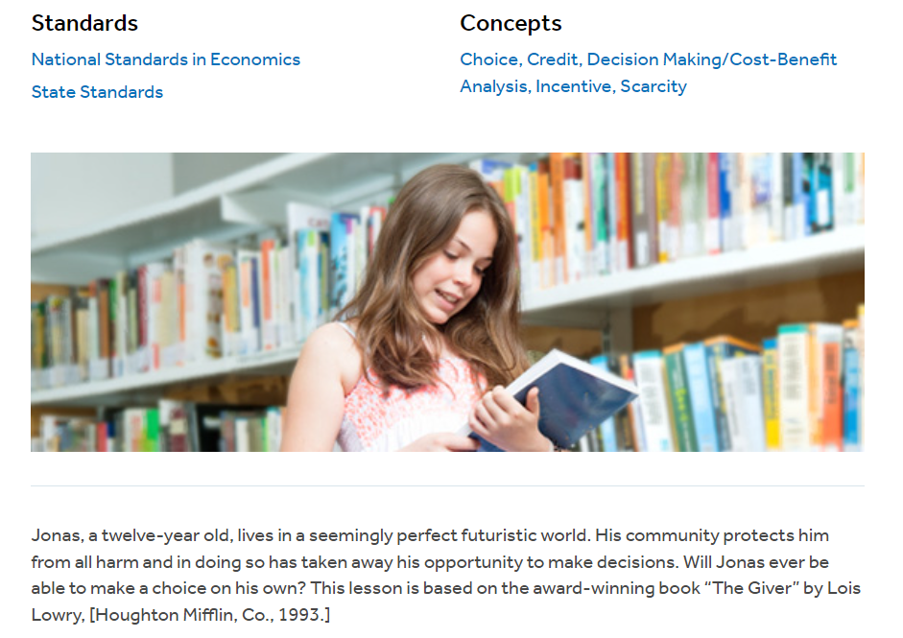
https://www.econedlink.org/resources/the-giver-jonas-makes-a-choice/

Slide 28
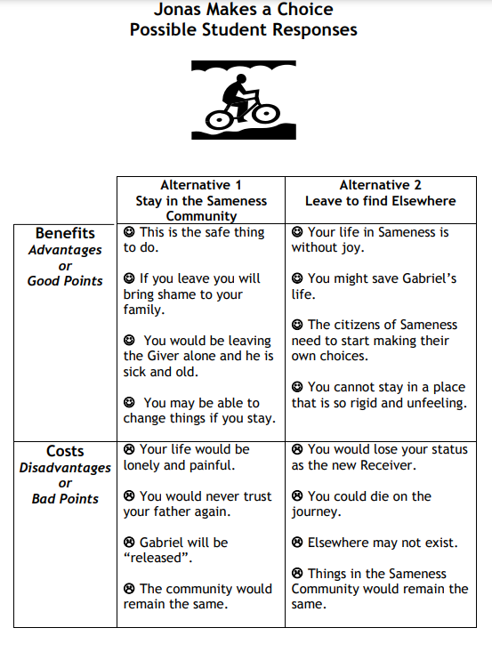
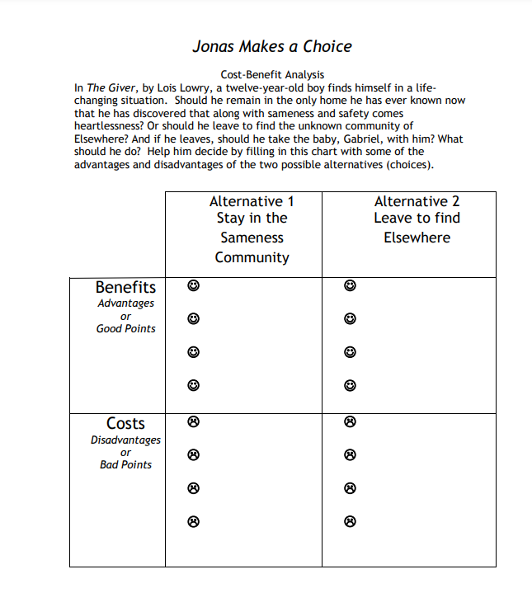
Cost/Benefit Analysis
A process of examining the advantages (benefits) and disadvantages (costs)
of each available alternative
in arriving at a decision.

Slide 29
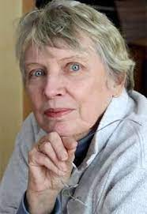
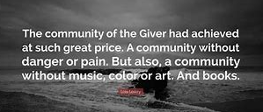
The Giver
For Discussion:
Jonas was living in a community that valued safety above everything else.
Can comparisons be made from the book to aspects of today’s society?

Slide 30
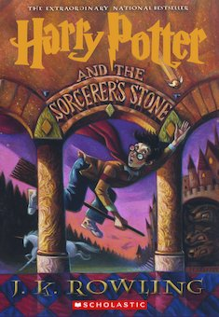
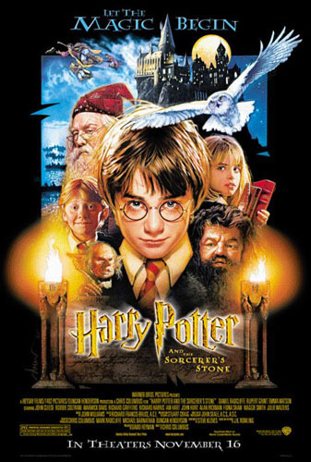

Harry Potter and the Sorcerer's Stone
Rescued from the outrageous neglect of his aunt and uncle, a young boy with a great destiny proves his worth while attending Hogwarts School for Wizards and Witches.
Publisher: Scholastic
Copyright Date: 1999
Reading Level: 5.5
Interest Level: 5-9

Slide 31
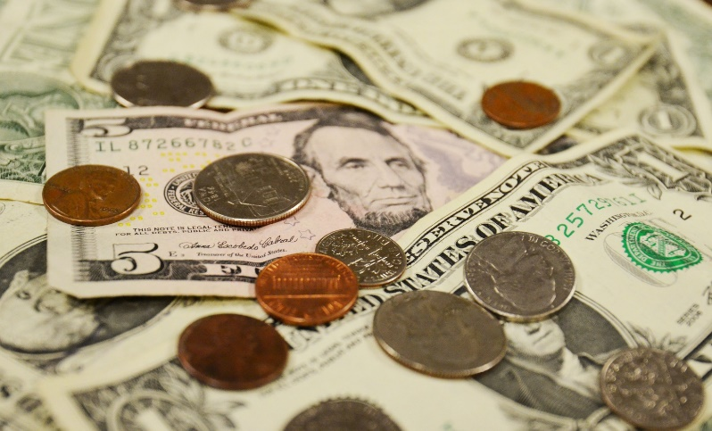


What is money?
Money: Anything that serves as a medium of exchange, a standard of value, and a store of value.

Slide 32
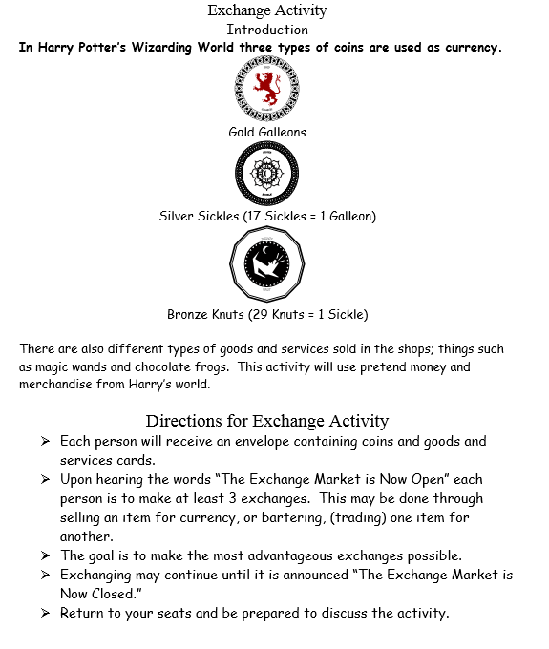
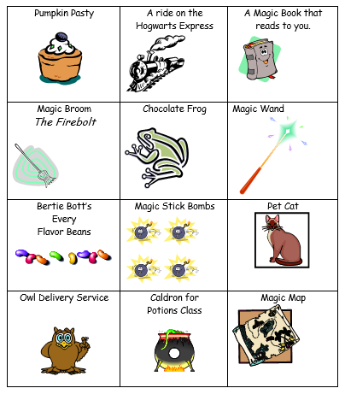


Slide 33


Ask the students these questions at the end of the Exchange Activity.
There are no predictable answers. However, students tend to enjoy the activity and should come away with the concept that money is “anything generally accepted in exchange for goods and services.”
Was everyone able to make three exchanges, either by bartering or purchasing the desired item?
What was the most popular item, the one in greatest demand? Why do you think this was?
What was the least favorite item, the one the most difficult to exchange? Why do you think this was?
How many people are happy with the contents in your envelopes?
If so, would you consider yourself wealthy?

Slide 34
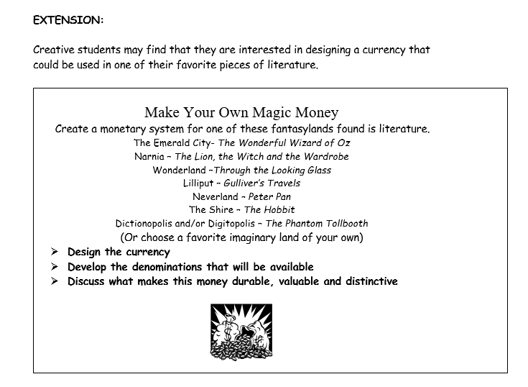

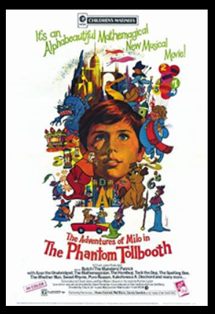
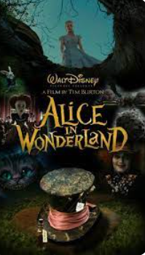

Slide 35


The Hunger Games
In a future North America, where the rulers of Panem maintain control through an annual televised survival competition pitting young people from each of the twelve districts against one another, sixteen-year-old Katniss's skills are put to the test when she voluntarily takes her younger sister's place.
Publisher: Scholastic
Copyright Date: 2010
Reading Level: 5.3
Interest Level: 7-12

Slide 36
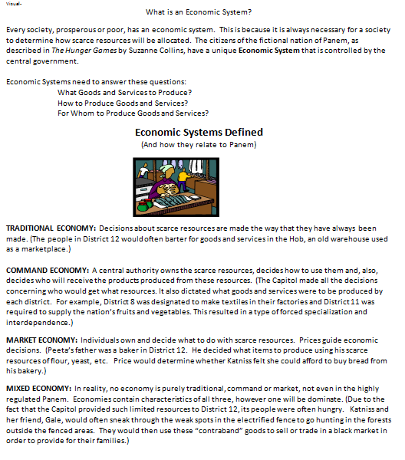



Slide 37



Coming this Fall

Slide 38








Possible Books to Movies Lesson Plans For Consideration

Slide 39







Slide 40

Lynne’s LibrarySparks Library Lessons
Online Movie Connections
A Series of Unfortunate Events-December 2004
http://www.highsmith.com/pdf/LibrarySparks/2004/lsp_dec_lesson.pdf
Harry Potter a Half-Blood Prince -July 2005
http://www.highsmith.com/pdf/LibrarySparks/2005/lsp_aug05_lessons.pdf
Hoot April 2006
http://www.highsmith.com/pdf/LibrarySparks/2006/lsp_apr06_lesson.pdf
Bridge to Terabithia -January 2007
http://www.highsmith.com/pdf/librarysparks/2007/lsp_jan07_lessons.pdf
The Invention of Hugo Cabret –November 2008
http://www.highsmith.com/pdf/librarysparks/2008/lsp_nov08_LL_hugo_cabret.pdf
The Tale of Despereaux -December 2008
http://www.highsmith.com/pdf/librarysparks/2008/lsp_dec08_LL.pdf
Where the Wild Things Are -October 2009
http://www.highsmith.com/pdf/librarysparks/2009/lsp_oct09_ll.pdf
Cloudy with a Chance of Meatballs -April 2010
http://www.highsmith.com/pdf/librarysparks/2010/lsp_apr10_ll_cloudy_meat.pdf

Slide 41

Invest In Girls

Slide 42

NEC

Slide 43

NPFC

Slide 44

Advocacy

Slide 45

Suggested Presentation Deck
CEE Affiliates
https://www.councilforeconed.org/resources/local-affiliates/
Include your local affiliate page

Slide 46










Thank You to Our Sponsors!

Slide 47
Contact information
Thank You
Lauren H Shifflett shiffllh@jmu.edu
Lynne F Stover stoverlf@jmu.edu

