Slide 1
Teaching Elasticity in AP Microeconomics
CEE Webinar
4/24/2023
Mr. Tim Reeder

Slide 2
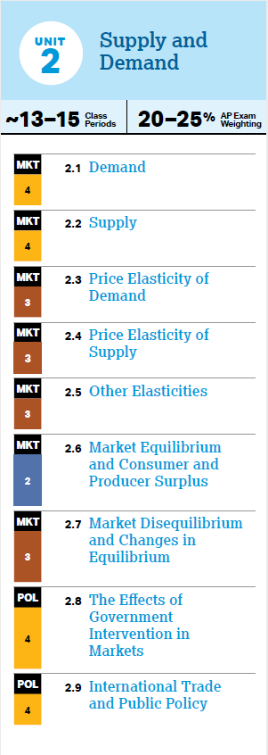
AP Micro College Board’s CED
Unit 2: Supply & Demand
Topics
  **2.3 Price Elasticity of Demand**
  2.4 Price Elasticity of Supply
  2.5 Other Elasticities
    Income Elasticity
    Cross-Price Elasticity
  2.8 The Effects of Government Intervention in Markets
Skill
  Determine the effect(s) of a change in an economic situation using quantitative data or calculations.

Slide 3
What do we already know?
Demand is the willingness to buy items.
The Law of Demand says that there is an inverse relationship between price and quantity demanded.
  As prices increase, the quantity demanded decreases.
  As prices decrease, the quantity demanded increases.
  Graphically, this means demand curves have a negative slope, causing the curve to slope downwards.
While changes of price cause changes in the quantity demanded, non-price factors change the amount demanded at all prices.
  Some factors increase demand, while others decrease demand.
  Change in Income is a demand determinant, as is change in price of a related good.
  Graphically, increases in demand shift the entire curve right, while decreases in demand shift the entire curve left.

Slide 4

What we’re going to learn
We will learn…
- what price elasticity of demand means.
- how to describe and graph price elasticities of demand.
- how to determine elasticities by using the Total Revenue Test.
- determinants of price elasticity of demand.
- what price elasticity of supply means.
- how to use Income Elasticity to determine whether goods are normal or inferior.
- how to use Cross-Price Elasticity to determine whether goods are substitutes or complements.
- how elasticity relates to tax revenue.

Slide 5
Price Elasticity of Demand
College Board Topic 2.3

Slide 6
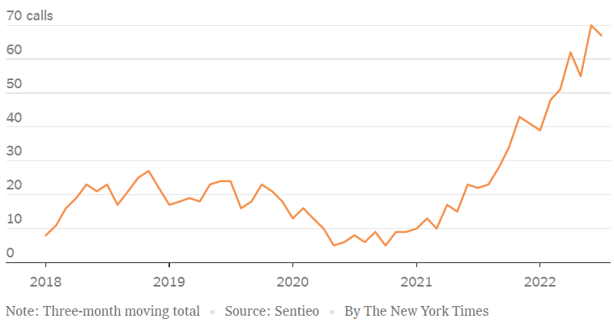
In the News
In 2021 and 2022, when inflation quickly increased,the term “elasticity” jumped in popularity among corporate executives. Click the link to read the short article and think about what “elasticity” means and why it increased in usage so much in 2021 and 2022.
Why Are C.E.O.s Suddenly Obsessed With ‘Elasticity’?
“Increase use of the Word “elasticity” by Corporate Executives.”
Notes:
https://www.nytimes.com/2022/08/19/business/elasticity-prices-inflation.html

Slide 7
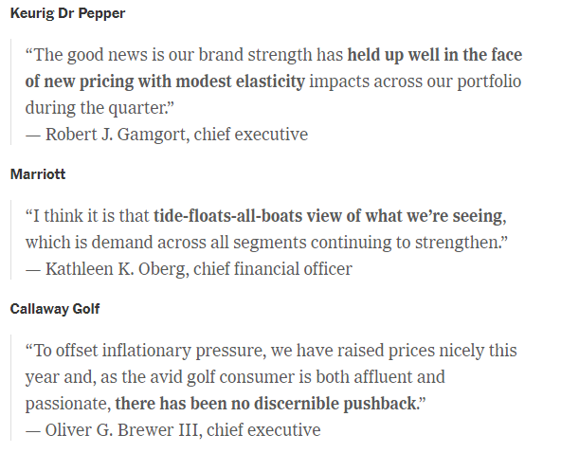

Slide 8
Price Elasticity of Demand
Price elasticity of demand tells us how strong or weak the response is to a change in price. In other words, elasticity tells how much quantity demanded changes when price changes.
When price decreases, we know quantity demanded increases, but elasticity tells us how much quantity demanded increases.
P cause Quantity OR
When price increases, we know quantity demanded decreases, but elasticity tells us how much quantity demanded decreases.
P cause Quantity OR

Slide 9


Describing Elasticities
A strong response to a change in price is called elastic. In this case, the % change in quantity demanded is greater than the % change in price.
A weak response to a change in price is called inelastic. In this case, the % change in quantity demanded is less than the % change in price.
A proportional response to a change in price is called unit elastic. In this case, the % change in quantity demanded is equal to the % change in price.

Slide 10
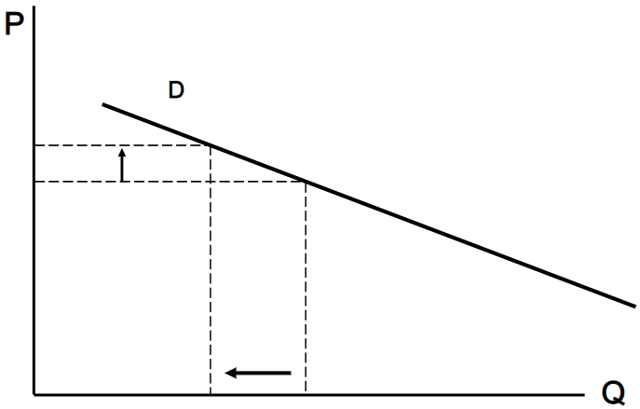
Elastic: a strong response
When price increases, the quantity demanded not only decreases, but it decreases by a greater percent than price increased by.
When price decreases, the quantity demanded not only increases, but it increases by a greater percent than price decreased by.
This product is more sensitive to changes in price. Price changes cause greater changes in quantity.

Slide 11
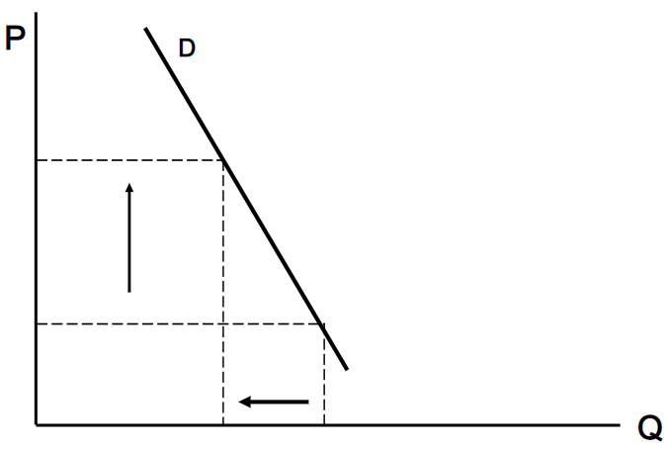
Inelastic: a weak response
When price increases, the quantity demanded decreases, but it decreases by a lesser percent than price increased by.
When price decreases, the quantity demanded increases by a lesser percent than price decreased by.
This product is not very sensitive to changes in price. Price changes, but quantity does not change as much.

Slide 12
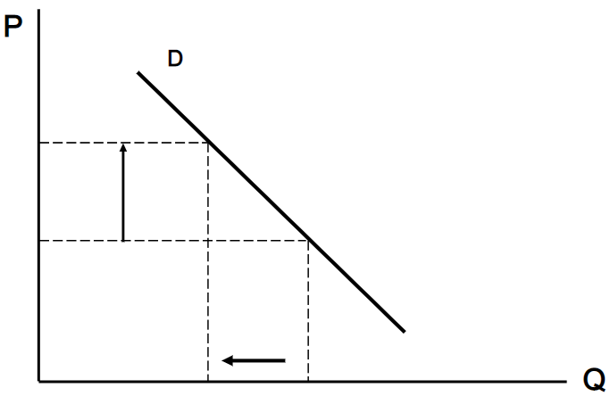
Unit Elastic: a proportional response
When price increases, the quantity demanded not only decreases, but it decreases by the same percent as price increased by.
When price decreases, the quantity demanded not only increases, but it increases by the same percent as price increased by.
This product has neither a strong or a weak response to changes in price. The response is proportional.

Slide 13
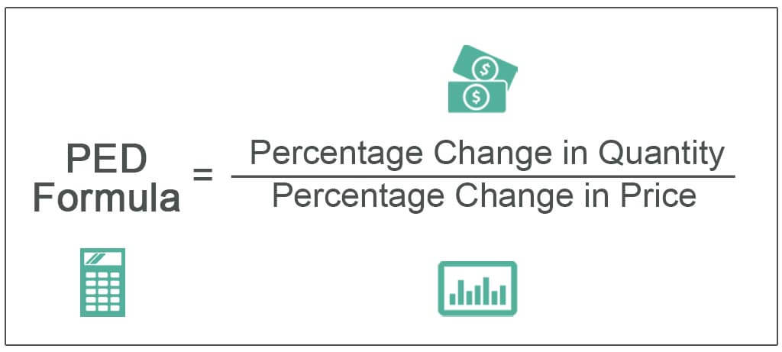
Price Elasticity of Demand Formula
[(Qf – Qi) / Qi] / [(Pf – Pi) / Pi]
Qf = final quantity demanded, Qi = initial quantity demanded, Pf = final price, Pi = initial price

Slide 14
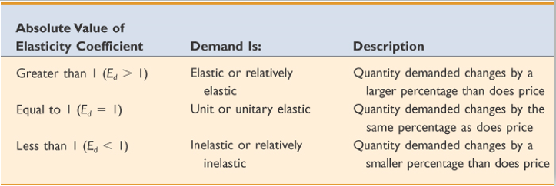
PED Coefficients

Slide 15
Price Elasticity of Demand Formula
A closer look (especially for math folks!):
College Board expects this formula to be used, not the arc or midpoint formula.
Students will calculate different elasticity values between the same two points, whether they are going up the curve or down the curve – this is okay.
                For example, consider a quantity change of 1 and a price change that goes from $150 to $100. If going down the demand curve (from $150 to $100), we calculate the % change in price as 33%, but if we go up the demand curve (from $100 to $150), we calculate the % change in price as 50%.
Elasticity is NOT the same as slope.
A straight line will have a portion that is elastic and a portion that is inelastic.

Slide 16
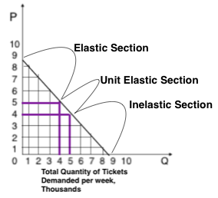
Same slope, different elasticities

Slide 17

AP Microeconomics
Student Resource Manual, 4th ed
Activity 2-3
Elasticity: An Introduction
(Parts A – F)

Slide 18


Slide 19

Total Revenue Test
One way to calculate elasticity is by using the total revenue test.
We can find a firm’s revenue by multiplying the price of its product by the quantity of products it sells.
Total Revenue = P x Q

Slide 20
Total Revenue Test: elastic
If a firm lowers its price and total revenue increases, then the product is elastic. This is because the strong response to price for an elastic product causes the increased quantity to more than makeup for the decreased price. The firm receives less money for each product with the lower price, but sells much more products.
P causes Total Revenue
or
P causes Total Revenue
If Price and Total Revenue go in opposite directions, it’s elastic

Slide 21
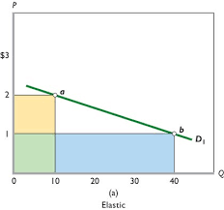
Elastic
At point ‘a’ the total revenue is:
$2 x 10 = $20
At point ‘b’ the total revenue is:
$1 x 40 = $40
We see that the price decreased ($2 to $1), but total revenue increased ($20 to $40).
This is a strong response to price.

Slide 22
Total Revenue Test: inelastic
If a firm lowers its price and total revenue decreases, then the product is inelastic. This is because the weak response to price for an inelastic product causes the increased quantity to not makeup for the decreased price. The firm receives less money for each product with the lower price, but does not sell many more products.
P causes Total Revenue
or
P causes Total Revenue
If Price and Total Revenue go in the same direction, it’s inelastic

Slide 23
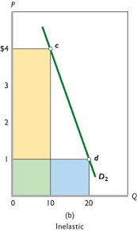
Inelastic
At point ‘c’ the total revenue is:
$4 x 10 = $40
At point ‘d’ the total revenue is:
$1 x 20 = $20
We see that the price decreased ($4 to $1) and total revenue decreased ($40 to $20).
This is a weak response to price.

Slide 24
Total Revenue Test: unit elastic
If a firm lowers its price and total revenue stays the same, then the product is unit elastic. This is because the decreased price is exactly made up by the increased quantity.
P causes Total Revenue to stay the same
or
P causes Total Revenue to stay the same
If Price changes, but Total Revenue stays the same, it’s unit elastic

Slide 25
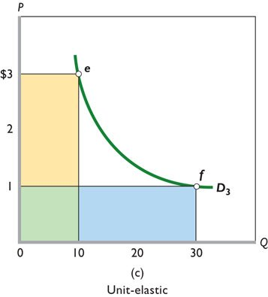
Unit elastic
At point ‘e’ the total revenue is:
$3 x 10 = $30
At point ‘f’ the total revenue is:
$1 x 30 = $30
We see that the price decreased ($3 to $1), but total revenue remained the same ($30).
This is a proportional response to price.

Slide 26
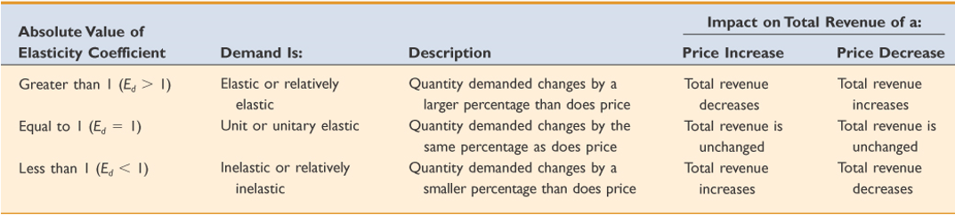
PED Coefficients and Impact on Total Revenue

Slide 27

Total Revenue Test: application
If a company owner knows that the product she sells has an inelastic demand, should she lower or raise the price? Why?
If you graphed the demand curve for this product, would it be flatter or steeper?
Why would it be important for a company owner to know whether the item they sell has elastic or inelastic demand?
All else equal, would a company owner prefer to sell products that have elastic or inelastic demand? Why?

Slide 28
AP Microeconomics
Student Resource Manual, 4th ed
Activity 2-5
Elasticity and Total Revenue

Slide 29

In the News
The USA’s inflation rate increased throughout 2021 and 2022. This means, the general price level of all products increased. We know from the Law of Demand that with higher prices, quantity decreases. So, with inflation increasing, we know demand decreases. Elasticity, we now know, tells us how much demand decreases.
Click on the link and watch the video about the real world consequences of elasticity and what causes some products to have elastic demand while others to have inelastic demand.

Slide 31

Determinants of Elasticity
There are 4 determinants of elasticity. They tell us whether a product is elastic or inelastic.
Necessity or a luxury
Few substitutes or lots of substitutes
Small portion of income or large portion of income
Time to buy the item is long or short

Slide 32
Necessity or Luxury
If the product is something the buyer needs to have, the buyer is not very sensitive to a change in price. A change in price would have a weak effect on the buyer’s decision to buy the product or not. So, a necessity has inelastic demand.
P cause Quantity OR P cause Quantity
On the other hand, if the product is a luxury that the buyer doesn’t have to have, the buyer is more sensitive to a change in price. A change in price would have a strong effect on the buyer’s decision to buy the product or not. So, a luxury has elastic
demand.
P cause Quantity OR P cause Quantity

Slide 33

Necessity or Luxury
For example, heart medicine has inelastic demand. If the price of heart medicine increases, most buyers will still purchase it. If someone needs heart medicine to survive, they will still purchase it at a high price. Likewise, if the price drops, the same people who need it will purchase it, but not many new people will decide to suddenly buy heart medicine just because it’s cheaper. So, despite changes in price, quantity does not change very much. The price change has a weak response, so necessities like heart medicine have inelastic demand.
Necessities are inelastic.

Slide 34

Necessity or Luxury
On the other, many consider a winter pedicure a luxury purchase that is not needed. This causes buyers to be more sensitive to changes in price. This stronger response to changes in price cause luxury products like winter pedicures to have an elastic demand.
Luxury items are elastic.

Slide 35

Amount of Substitutes
If the product is one-of-a-kind or has few substitutes, then the buyer does not have other options for that particular item, so the buyer is not very sensitive to a change in price. A change in price would have a weak effect on the buyer’s decision to buy the product or not. So, a product with few substitutes has inelastic demand.
The opposite is true for a product that has a lot of close substitutes. In this case, the buyers will not buy the product if the price increases because they will choose to buy one of the less expensive substitutes instead. This greater sensitivity to price causes a strong effect, so it’s elastic.
“Just give me any pen.”

Slide 36

Amount of Substitutes
For example, consider tickets to a Beyoncé concert. If your friend loves Beyoncé and believes there is no substitute for a Beyoncé concert, than your friend’s demand for Beyoncé tickets is inelastic. The price can go up, but your friend will still buy those tickets anyways.
“There’s no substitute for Queen Bey.”

Slide 37

Amount of Substitutes
However, if your other friend just enjoys going to concerts and does not particularly care who is performing, this friend’s demand for the Beyoncé tickets is elastic. In this case, if the price of Beyoncé tickets increases, this friend will not buy tickets to the Beyoncé concert, but will buy tickets to see a different performer instead.
“Any live music will do”

Slide 38

Portion of Income
If a product costs a small portion of income, like a $1 candy bar, its price could increase by a large percentage, like 50% so it now costs $1.50, but many people would still buy it. $1.50 is still a small portion of people’s income (few care about an extra 50 cents), so the increase in price has a weak effect, making this inelastic.
Small portion of your income means it’s inelastic.

Slide 39

Portion of Income
However, if a product that costs a large portion of income like a new car increases in price by 50%, such as from $36,000 to $54,000, most people would not buy that car anymore (most care about an extra $18,000). The price increase is a large portion of income so people are more sensitive to it. The stronger effect makes it elastic.
Large portion of your income means it’s elastic.

Slide 40

Urgency of Purchase
If the buyer has a lot of time to purchase a product, he can shop around and wait for a lower price. In this case, if the price of the product increases, he will not purchase it because she can keeping shopping around and wait. The price change has a strong effect, so the product has elastic demand.
.
More time to buy means it’s elastic.

Slide 41

Urgency of Purchase
If, instead, the buyer has to have the product right away, there is no time to shop around or wait for a lower price.
In this case, if the price of the product increases, she will purchase it anyways because she can’t wait any longer. This change of price has a weak effect, so the product has inelastic demand.
Less time to buy means it’s inelastic.

Slide 42

Urgency of Purchase
For example, let’s say you need a tri-fold board for your entry in the Science Fair. If you go to the store 2 months before the Science Fair and you see the store is selling them for $30, you probably wouldn’t buy it. That is expensive for tri-fold boards and you have a lot of time to shop around and wait for a lower price. You have a strong response to the price.
However, if you didn’t go to the store until the night before the Science Fair and the store is selling them for $30, you would probably buy it anyways even though you know you’re getting ripped off. You can’t wait and shop around so you pay the money. You have a weak response to the price.

Slide 43
AP Microeconomics
Student Resource Manual, 4th ed
Activity 2-4
The Determinants of Price Elasticity of Demand

Slide 45
Price Elasticity of Supply
College Board Topic 2.4

Slide 46
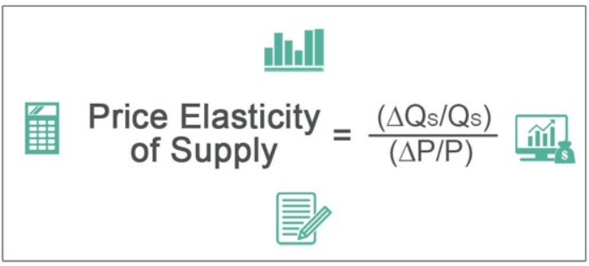
Price elasticity of supply
Measures the responsiveness of the quantity of a good supplied to changes in the price of that good.
Compares the % change in Qs to the % change in P
[(Qf – Qi) / Qi] / [(Pf – Pi) / Pi]
Qf = final quantity supplied, Qi = initial quantity supplied, Pf = final price, Pi = initial price

Slide 47
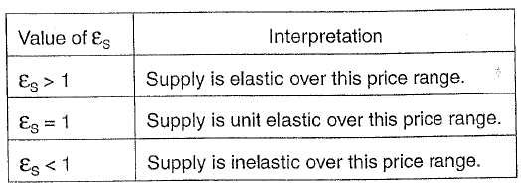
Price elasticity of supply

Slide 48
Price elasticity of supply
Determinants:
Availability of inputs (easy to shift inputs)
Substitutability of inputs (alternative inputs for those unavailable)
Time (producers are more responsive when they have more time)
Existing inventories (firms can respond without inputs or production)
Excess capacity (the ability for a firm to increase output with current facilities)

Slide 49
Other Elasticities
Income Elasticity of Demand
Cross-Price Elasticity of Demand
College Board Topic 2.5

Slide 50
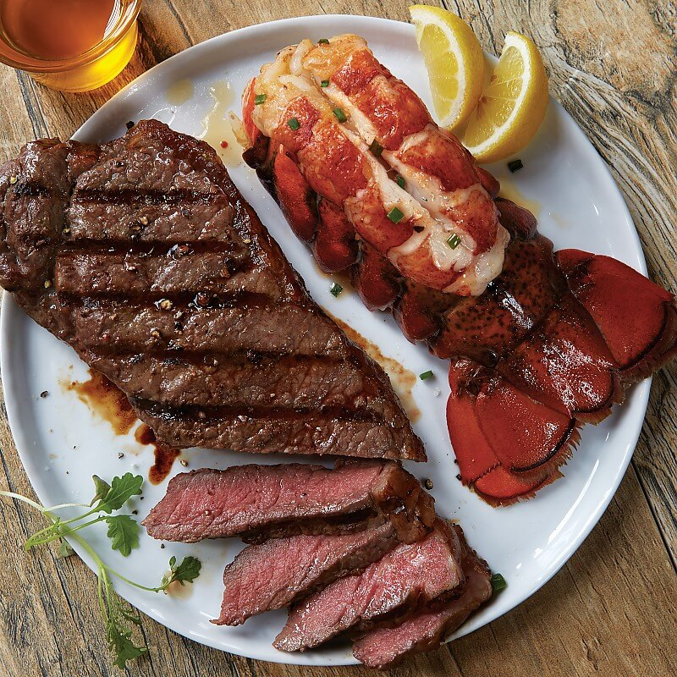



Income Elasticity of Demand
When we learned about determinants of demand earlier, we learned that changes in income effect demand. Income Elasticity tells us how responsive demand is with changes in income as well as the direction of that change.
Normal goods
Income , Demand
Income , Demand

Slide 51

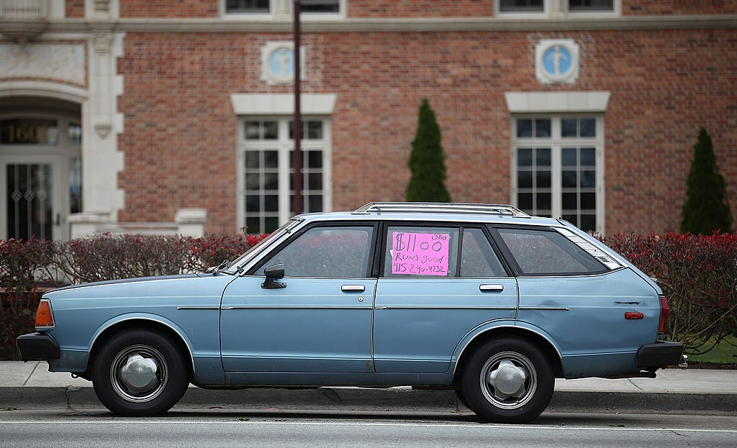


Income Elasticity of Demand
When we learned about determinants of demand earlier, we learned that changes in income effect demand. Income Elasticity tells us how responsive demand is with changes in income as well as the direction of that change.
Inferior goods
Income , Demand
Income , Demand

Slide 52
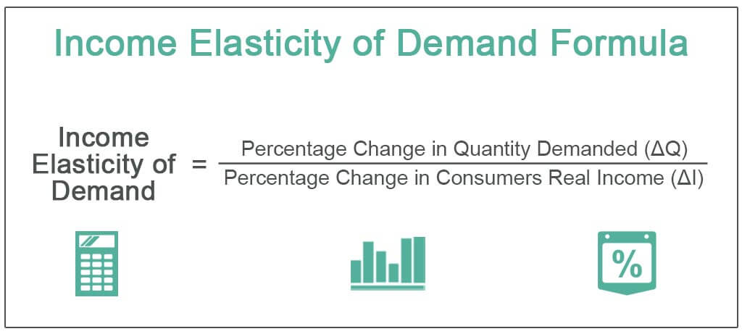
Income Elasticity of Demand
[(Qf – Qi) / Qi] / [(If – Ii) / Ii]
Qf = final quantity demanded, Qi = initial quantity demanded, If = final income, Ii = initial income

Slide 53
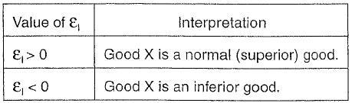
Income Elasticity of Demand

Slide 55
Cross-price Elasticity of Demand
Tells us how responsive consumers of Good X are to a change in the price of Good Y.
This tells us whether consumers tend to buy Good X and Y together (complementary goods) or whether they tend buy one in the place of the other (substitute goods).

Slide 56
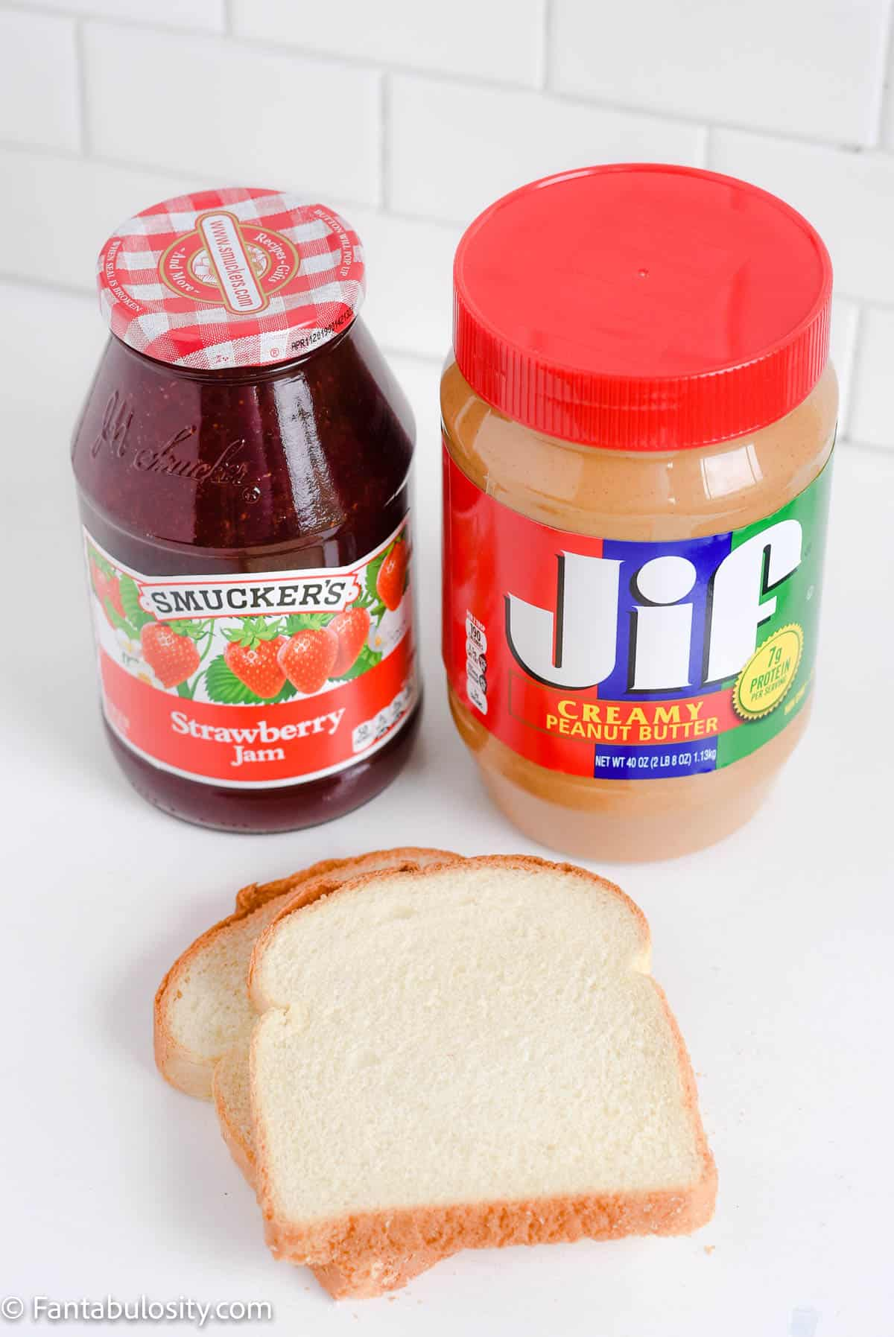

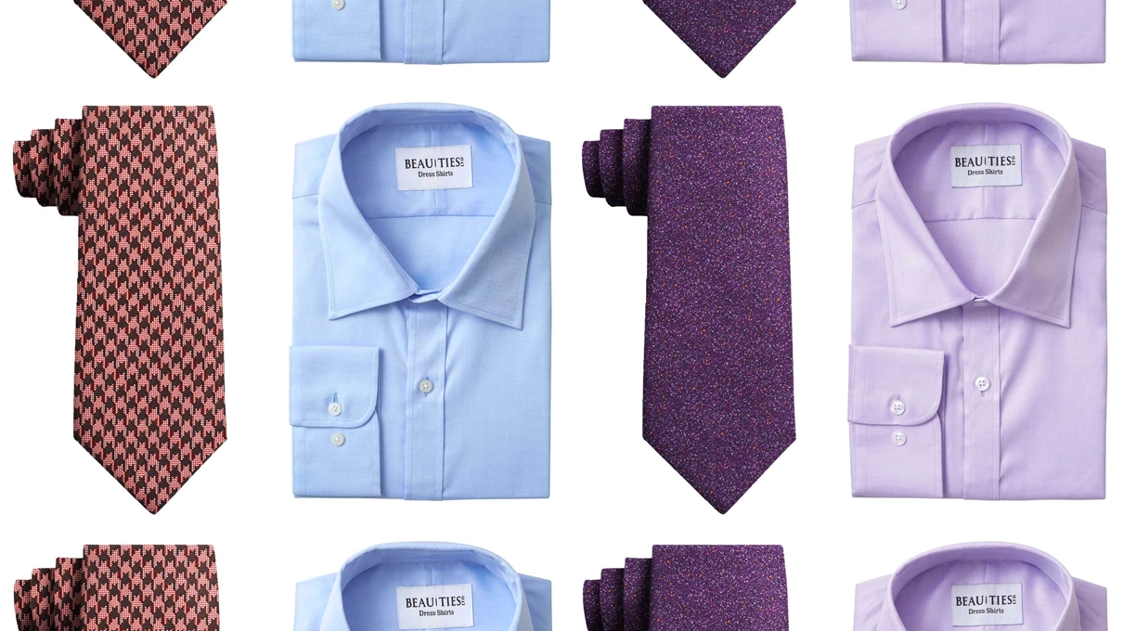

Complements

Slide 57

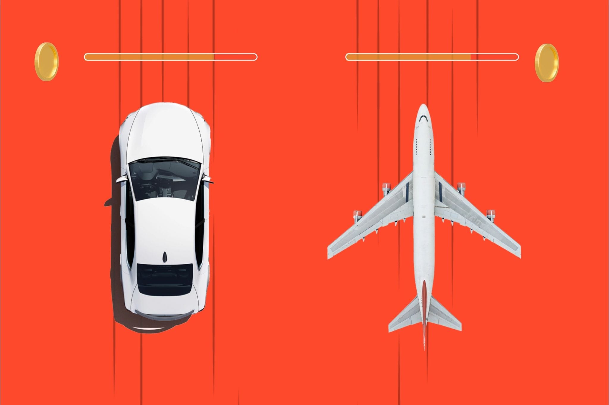
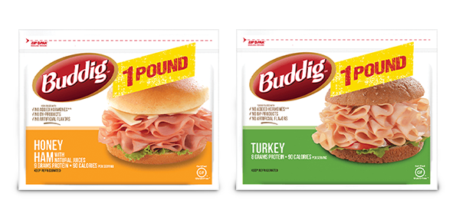
Substitutes

Slide 58
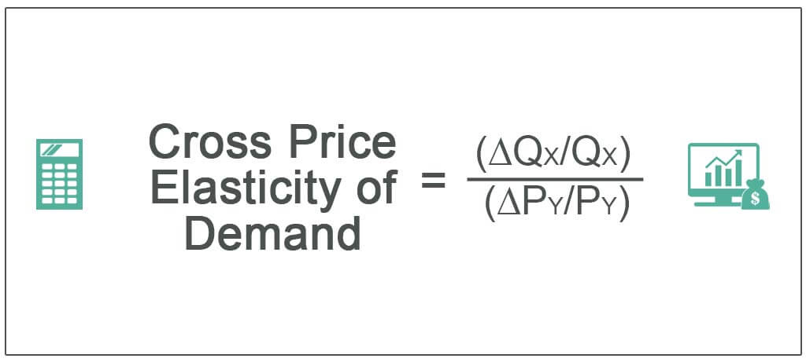
Cross-price Elasticity of Demand
[(Qxf – Qxi) / Qi] / [(Pyf – Pyi) / Pyi]
Qxf = final quantity Good X, Qxi = initial quantity Good X,
Pyf = final price Good Y, Pyi = initial price Good Y

Slide 59
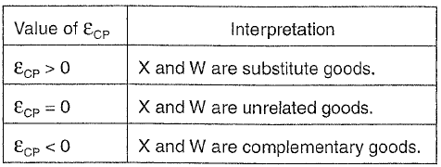
Cross-price Elasticity of Demand

Slide 60
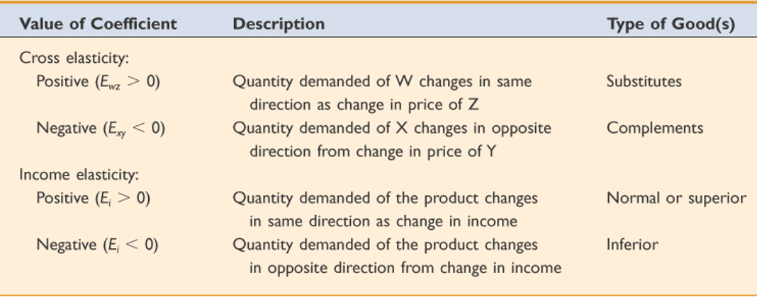
Cross-price and Income Elasticity

Slide 61
AP Microeconomics
Student Resource Manual, 4th ed
Activity 2-3
Elasticity: An Introduction
(Part G)

Slide 63
The Effects of Government Intervention in Markets
College Board Topic 2.8

Slide 64
Elasticity and Taxes
The elasticity of Demand and Supply effect Taxes.
Efficiency
Burden
Deadweight
Tax revenue

Slide 65
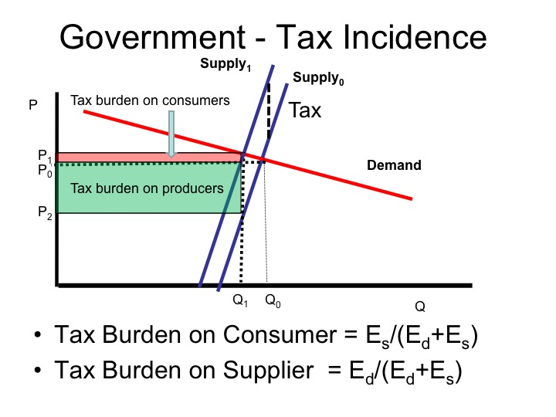

Slide 66
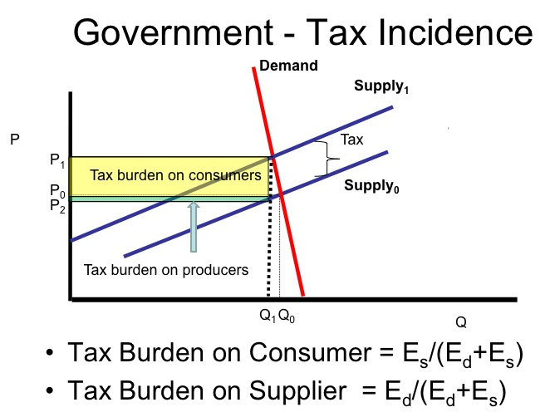

Slide 67
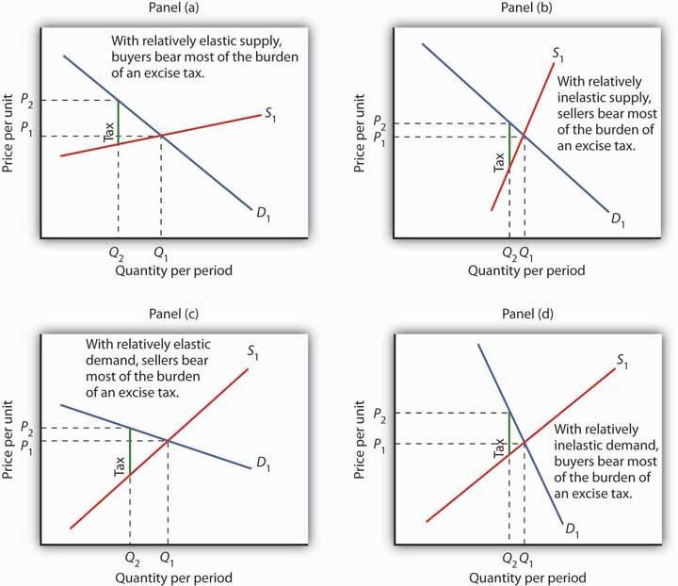

Slide 69
Additional Resources
ACDC Economics Mr. Clifford - Elasticity Overview and Tips- Micro Topics 2.3, 2.4, and 2.5
ReviewEcon.com
Marginal Revolution University
College Board AP review video
College Board Elasticity Questions on Econowaugh

Slide 70
Thank You! reedert@fultonschools.org

