Slide 1

Is Efficiency
Ethical?
Stephen Day
Virginia Council on Economic Education
shday@vcu.edu

Slide 2
In this session, we will:
Introduce the new Ethics, Economics, and Social Issues curriculum on EconEdLink.
Demonstrate the lesson “Is Efficiency Ethical?”
  Doctor example
  Lecture on efficiency and ethics
  Casino example: “should our town permit a casino?”
  Application of these concepts to your personal decisions
  We decide: is efficiency ethical?

Slide 3
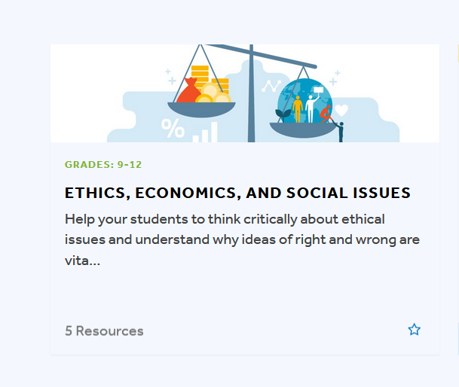
Ethics, Economics, and Social Issues
Available now via EconEdLink

Slide 4
Table of Contents
Do Businesses Have a Social Responsibility?-Chris Cannon
Can you Conduct Research Ethically?-Matt Pierson
How does Information and Ethics Impact Decision Making?-Chandler Jordan
Is Efficiency Ethical?-Stephen Day
Should I Join the Sweatshop Boycott?-Stephen Day
Does Self-Interest Prevent Economic Justice?-John Kruggel
Can You Allocate Ethically?-Chandler Jordan
Should We Allow a Market for Transplant Organs?-Jamie Wagner
HIGHLIGHTED lessons available NOW!

Slide 5
Table of Contents
Should We do Something About Income Inequality?-Chris Cannon
What is the Most Ethical Way to Fund Public Schools?-Matt Pierson
Should We House the Homeless?-John Kruggel
What Can We do About Pollution?-Stephen Day
Can You be Fashionable and Ethical?-Jamie Wagner
Should Private Companies Operate Prisons?-Chris Cannon
How Can I Apply Ethics to Any Issue?-Jamie Wagner

Slide 6



Thank You Sponsors!

Slide 7
Is Efficiency
Ethical?

Slide 8
What is efficiency?
What does efficiency mean to you?
  What is the most efficient way to study for a test?
  What is the most efficient way to get from your home to school?
Efficiency in economics is getting the most of some goal for the least (opportunity) cost

Slide 9
What is efficiency?
More broadly, efficiency is getting more good without getting any more bad
  In this sense, efficiency must be an ethical concept
  But in real life, things are more complicated
Allocation is the decision about what should be produced, how it should be produced, and who will consume it. It is the process of distributing something.

Slide 10
Life or Death?
A doctor in a hospital has to make life-and-death decisions.
How can we can measure the doctor’s efficiency?

Slide 11
Activity 5.1: Solving a Public Health Problem
You are a doctor who runs a hospital in an isolated rural area.
You have 20 sick patients: 10 patients have Disease A and 10 patients have Disease B. Both diseases are painful and make the people unable to do daily tasks.
Each patient with Disease A needs one dose of medicine to be cured.
Each patient with Disease B needs two doses of medicine to be cured.
Problem: You have only 10 doses of medicine for the rest of the year. Whom will you pick to get the medicine?
Your job: Answer the questions in the Activity 5.1: Solving a Public Health Problem handout about how you would solve this problem

Slide 12
Activity 5.1: Discussion Questions
How many people could you cure if you gave all the medicine to patients with Disease A?
How many people could you cure if you gave all the medicine to patients with Disease B?
Which option is the most efficient at healing people?
What if you learn that patients with Disease A are all more than 80 years old, and patients with Disease B are all children. Would this change how you choose to allocate your medicine, and if so, why?
If you had to personally decide how to allocate this medicine, what other factors (besides number of people helped and age) would you consider?

Slide 13
Positive and Normative Statements
Economists must analyze public policy proposals and even provide recommendations.
Part of that is collecting facts (positive statements) and weighing the importance of different goals (normative statements).
For example, in the activity you could save 10 Disease A patients with the doses you had–that is a fact and a positive statement. But whether you should save the 10 patients with Disease A (a normative statement) depends upon the goal of society.

Slide 14
What is efficiency?
Defining the goal: What is most important?
Society has many possible goals. These include preserving freedom, maintaining national security, improving standards of living, equality, and providing opportunities for all citizens.
In addition, economists often focus specifically on the goal of enhancing “welfare.”
Welfare means the satisfaction of individual preferences – gaining happiness, good fortune, or well-being.

Slide 15
What is Allocative Efficiency?
Measuring success: How do we know we have achieved the goal of enhancing welfare?
Allocative efficiency means that people are able to obtain what best satisfies their individual preferences, while not making anyone else worse off.
If a dictator were to require everyone to buy only classical music, would this satisfy individual preferences?

Slide 16
An efficient choice is ethical if:
Your goal is ethical
Making this choice does not require one to give up a more important ethical goal.
  (That is, the opportunity cost of the choice is not more ethically important than your choice.)
When making a choice, we define our goal, and then consider the alternatives.
We must consider both the ends (outcome-based ethics) and the means (duty-based ethics) of our choices to determine if the action is right or wrong

Slide 17
Making an Efficient, Ethical Choice
Outcomes-based ethics: a moral philosophy that discerns right or wrong action based on the consequences produced by the action.
  For example: A doctor would consider saving the most amount of people
Duty-based ethics: a moral philosophy that discerns right or wrong based on the analysis of one’s obligations.
  For example: A doctor would consider what is being given up when saving the most people. They would consider the lives saved – child vs. adult, quality of life, etc.

Slide 18

Activity 5.2: Should the City Allow a Casino?
Scenario: You are an economist who works for your city government. The city is thinking about allowing a casino to be built in order to create jobs.
Your task: List all the possible ways a casino could create jobs (be appropriate).
Based only on your analysis of jobs created, is a casino efficient for the goal of creating jobs?
What else besides jobs created would determine if this is allocatively efficient?

Slide 19
Activity 5.3: The Town Hall Meeting
Scenario #2: You are the same economist as in the previous scenario.
You gave your report on casino jobs to the city government, but you feel that something is missing.
You think that the city’s goal of making jobs fails to consider other important goals.
You decide to hold a town hall meeting to learn about the ethical views of the citizens as they think about the casino.

Slide 20
Activity 5.3: The Town Hall Meeting
Opinions of citizens:
Citizen 1: “A casino would be jobs to the people and tax money for the city! It’s what we need to bring life back to our town!”
Citizen 2: “A casino would cause gambling addiction for many of our citizens. It would also bring more crime. Gambling is no way to build a virtuous citizenry!
Citizen 3: “Gambling is fun. Why are we even voting on this? No one can tell me what I should do with my money! The casino and the people should have the freedom to do what they want!”
Citizen 4: “Casinos make money on poor and lower-middle-class people. Our city should support projects that lead to wealth equality, not the casino’s false promises of getting rich.”

Slide 21
Marginal Decision Making
Marginal benefit is the added value from each additional unit of something that one chooses, while marginal cost is the decreased value from each additional unit of something one chooses.
Marginal analysis is studying the production or consumption of each additional unit of something that brings value (or “utility”).
Market equilibrium is where quantity supplied and quantity demanded are equal; there is no shortage or surplus.
As you evaluate the other comments made during the Town Hall, consider the costs and benefits.

Slide 22
Marginal Cost or Marginal Benefit?
Let's evaluate each statement based on Marginal Analysis:
Citizen 1: “A casino would be jobs to the people and tax money for the city! It’s what we need to bring life back to our town!”
Marginal Cost or Marginal Benefit?
Citizen 2: “A casino would cause gambling addiction for many of our citizens. It would also bring more crime. Gambling is no way to build a virtuous citizenry!
Marginal Cost or Marginal Benefit?
Evaluate the rest of the Citizen's statements on your handout.

Slide 23
Activity 5.3: The Town Hall Meeting
What did you decide–should we allow the casino?
How did you use both facts and ethical beliefs to make your decision?
Will all the citizens agree that your choice is the “efficient” choice? Why or why not?

Slide 24
Closure
Efficiency is when we achieve a goal for the least cost.
Efficiency is ethical when:
  we pursue an ethical goal, and
  we do not sacrifice more important ethical considerations
Therefore, when there are competing ethical claims, it is unclear if a choice can be truly efficient.
However, if we allow that a person’s personal preferences can be ethical, than our choices can be both efficient and ethical.
  But that requires YOU to make choices you believe are right!
  Your ethics become part of your marginal benefit curve.

Slide 25
Assessment 5: How Do Ethics Affect Your Personal Decisions?
When you are making a personal choice, your ethical beliefs can affect your decisions.
Make a list of at least five ethical beliefs that you may consider when shopping. You can list more than five if you wish!
Then use this list to complete the assessment worksheet.

Slide 26

Follow the Project On Social Media
Stephen Day
Twitter: @VCUEconEd
E-mail: shday@vcu.edu
Google Scholar: Stephen H Day

