Slide 1

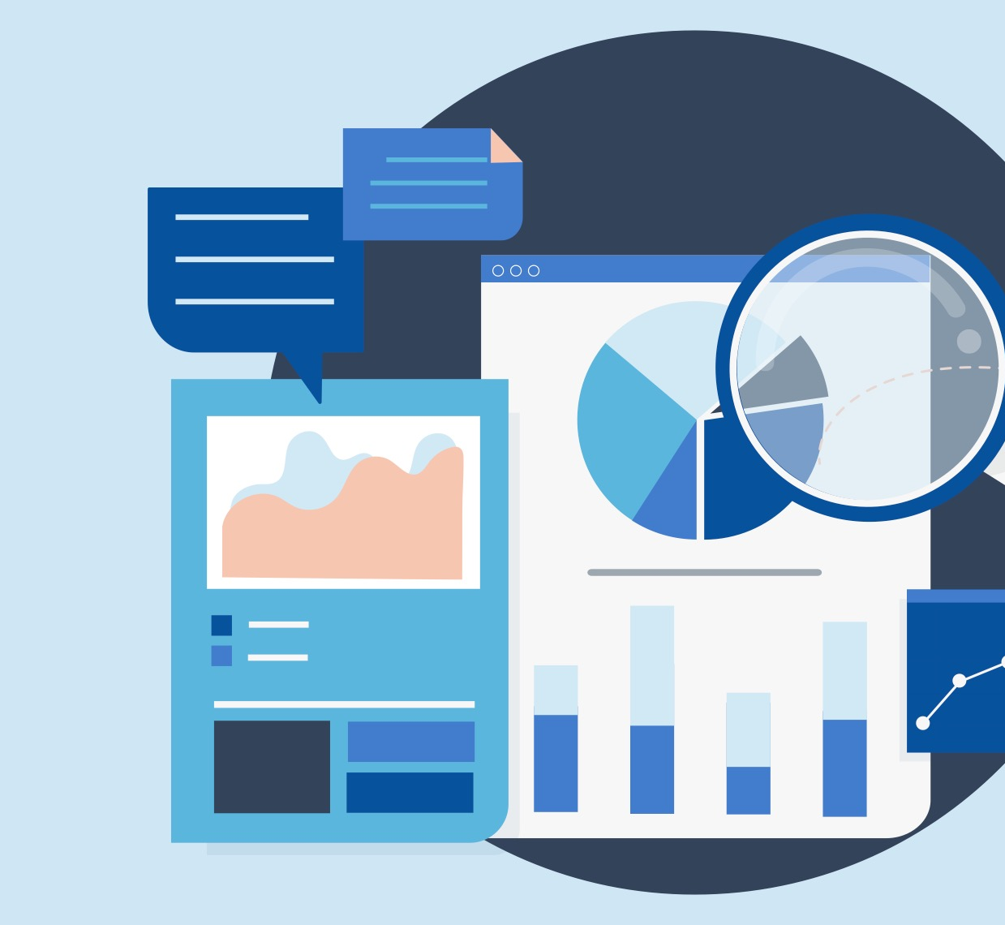
Can you conduct
research ethically?

Slide 2
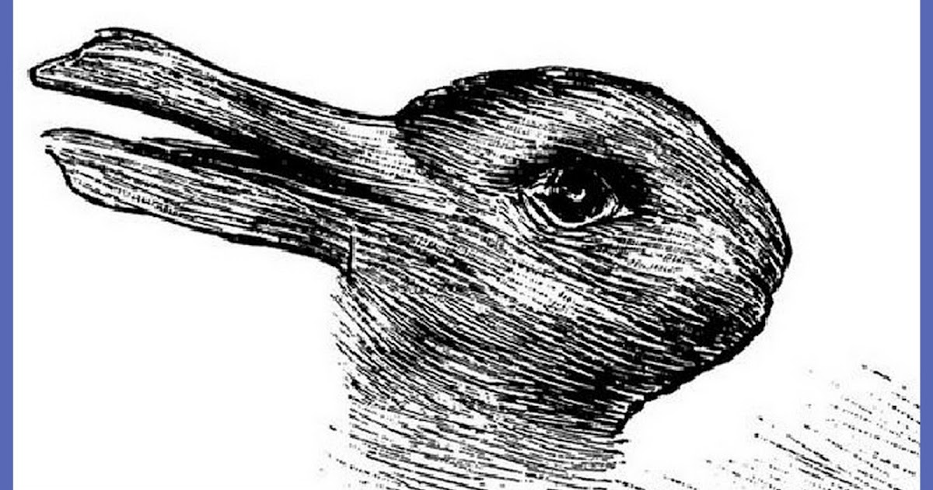
What do you see here?

Slide 3
Debrief
Have you seen this photo before?
  Did this impact your answer to the question?
Can you think of any other pictures like this?

Slide 4
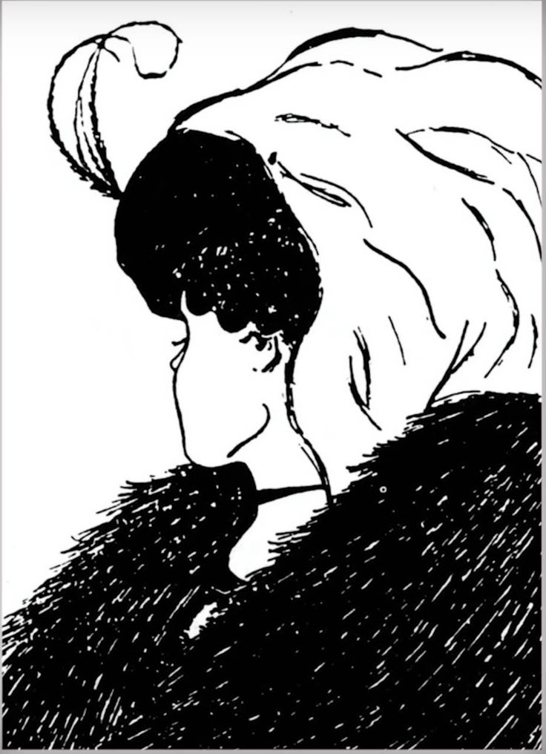
What do you see here?

Slide 5
Is the United States Powerful?
You are going to be working with groups of 4.
You are going to get a HyperDoc with 4 different maps/data sets.
You will ONLY use these 4 pieces of data to answer the topic question.
Discuss as a group and come to a consensus answer that cites ALL of your data sets.
Choose one student to share out.
You have 5 minutes.

Slide 6
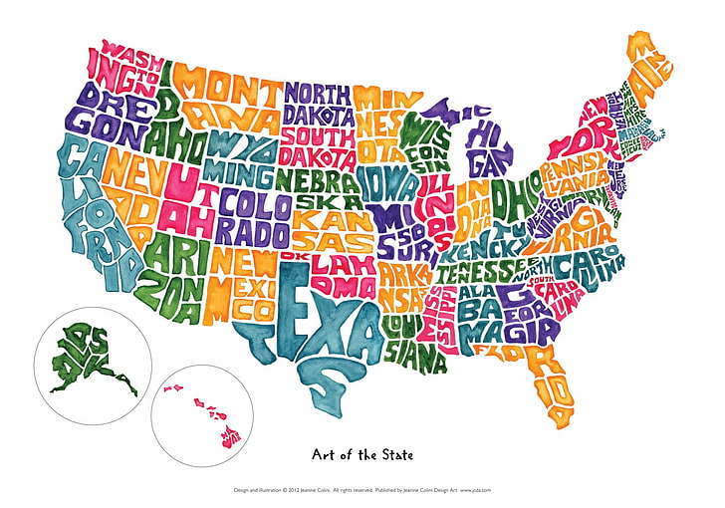
Share Out
Share your groups findings and answer our topic question.
  Is the United States Powerful?

Slide 7
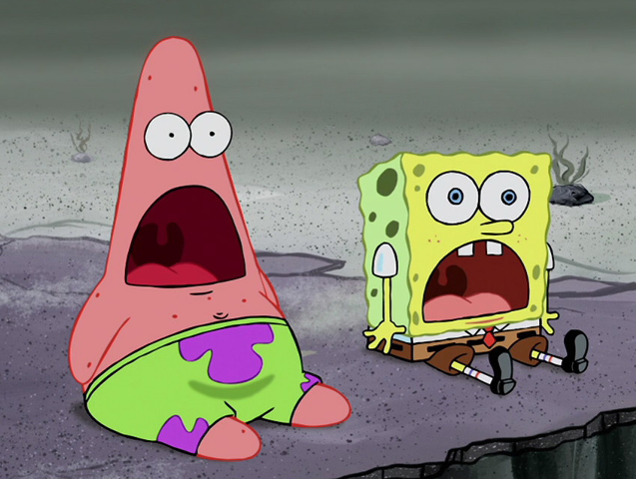
WHOA
Why were our answers different?
What data did you receive?

Slide 8
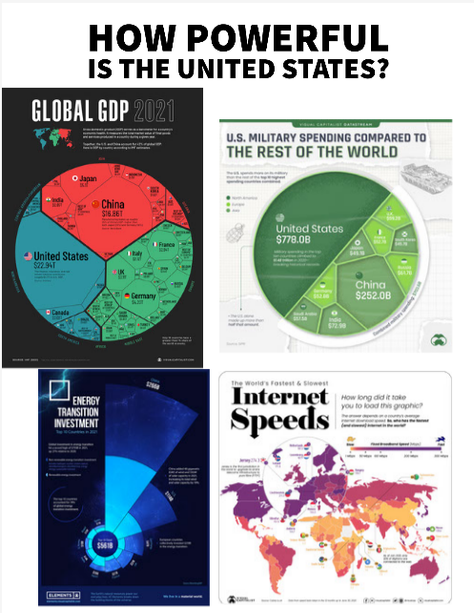
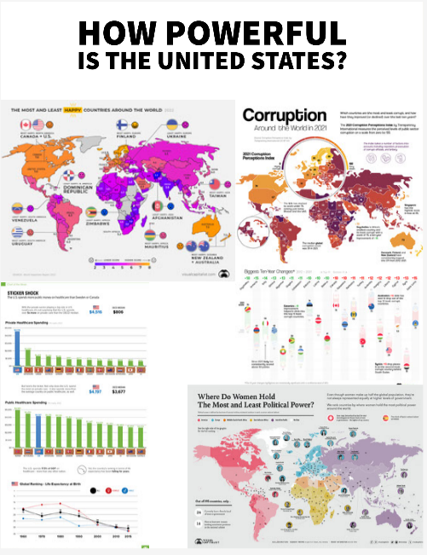

Slide 9
Data Sets
Now that you have seen both data sets, how would you answer the question, "Is the United States Powerful?"
Does seeing the other data set change your answer?
If all of this data is credible, how can your answers have been so different?
Scientists and other researchers have an ethical obligation to answer questions using all the data provided.
  In the case of our main topic question, you did not have all the data, and it changed your answer to the question.

Slide 10
Vocabulary
Find a shoulder partner and split these 6 words between you.
Explain why these terms are important to research.
Economic model: a simplified picture of reality which hypothesizes causality between variables in order to predict or understand outcomes
Facts: knowledge about the world
Fiduciary duty: the obligation of one party to another party; a situation in which trust is expected
Ideology: a framework of beliefs or theories about the world
Moral hazard: a situation in which one party to a transaction has both an incentive and the ability to extract unearned rewards from another party or behave unethically
Values: principles or beliefs that guide behavior and choice

Slide 11

Economic Models are a Road Map
An economic model is like a road map focusing on the larger roads/interstates, ignoring the smaller roads
it guides how a researcher would look at a subject they are studying and
shows the big ideas the economist is interested in researching.
Researchers gather facts from sources
including data, surveys, etc.

Slide 12
The Responsibility of Researchers
How we perceive an outside reality is partly a function of our inside mental activity and values.
Ideology and our acquaintance with prior random information can bias the identification and collection of what we call “facts.”
Investigators often “see” what their prescientific vision leads them to expect to see and ignore information that contradicts their preconceptions.
Researchers hold a lot of responsibility. What would happen if researchers behaved unethically, or lied about their work or results?

Slide 13
Fiduciary Duty
Researchers are charged with maintaining high ethical and honesty standards and must fulfill their Fiduciary duty - the obligation of one party to another party; a situation in which trust is expected.
Doctors must fulfill their fiduciary responsibility by taking care of their patients and not talking about their private information.
What sort of fiduciary duties might an economist or researcher have?
What are the obligations of someone doing research to make sure that all sides/ideas are represented?

Slide 14
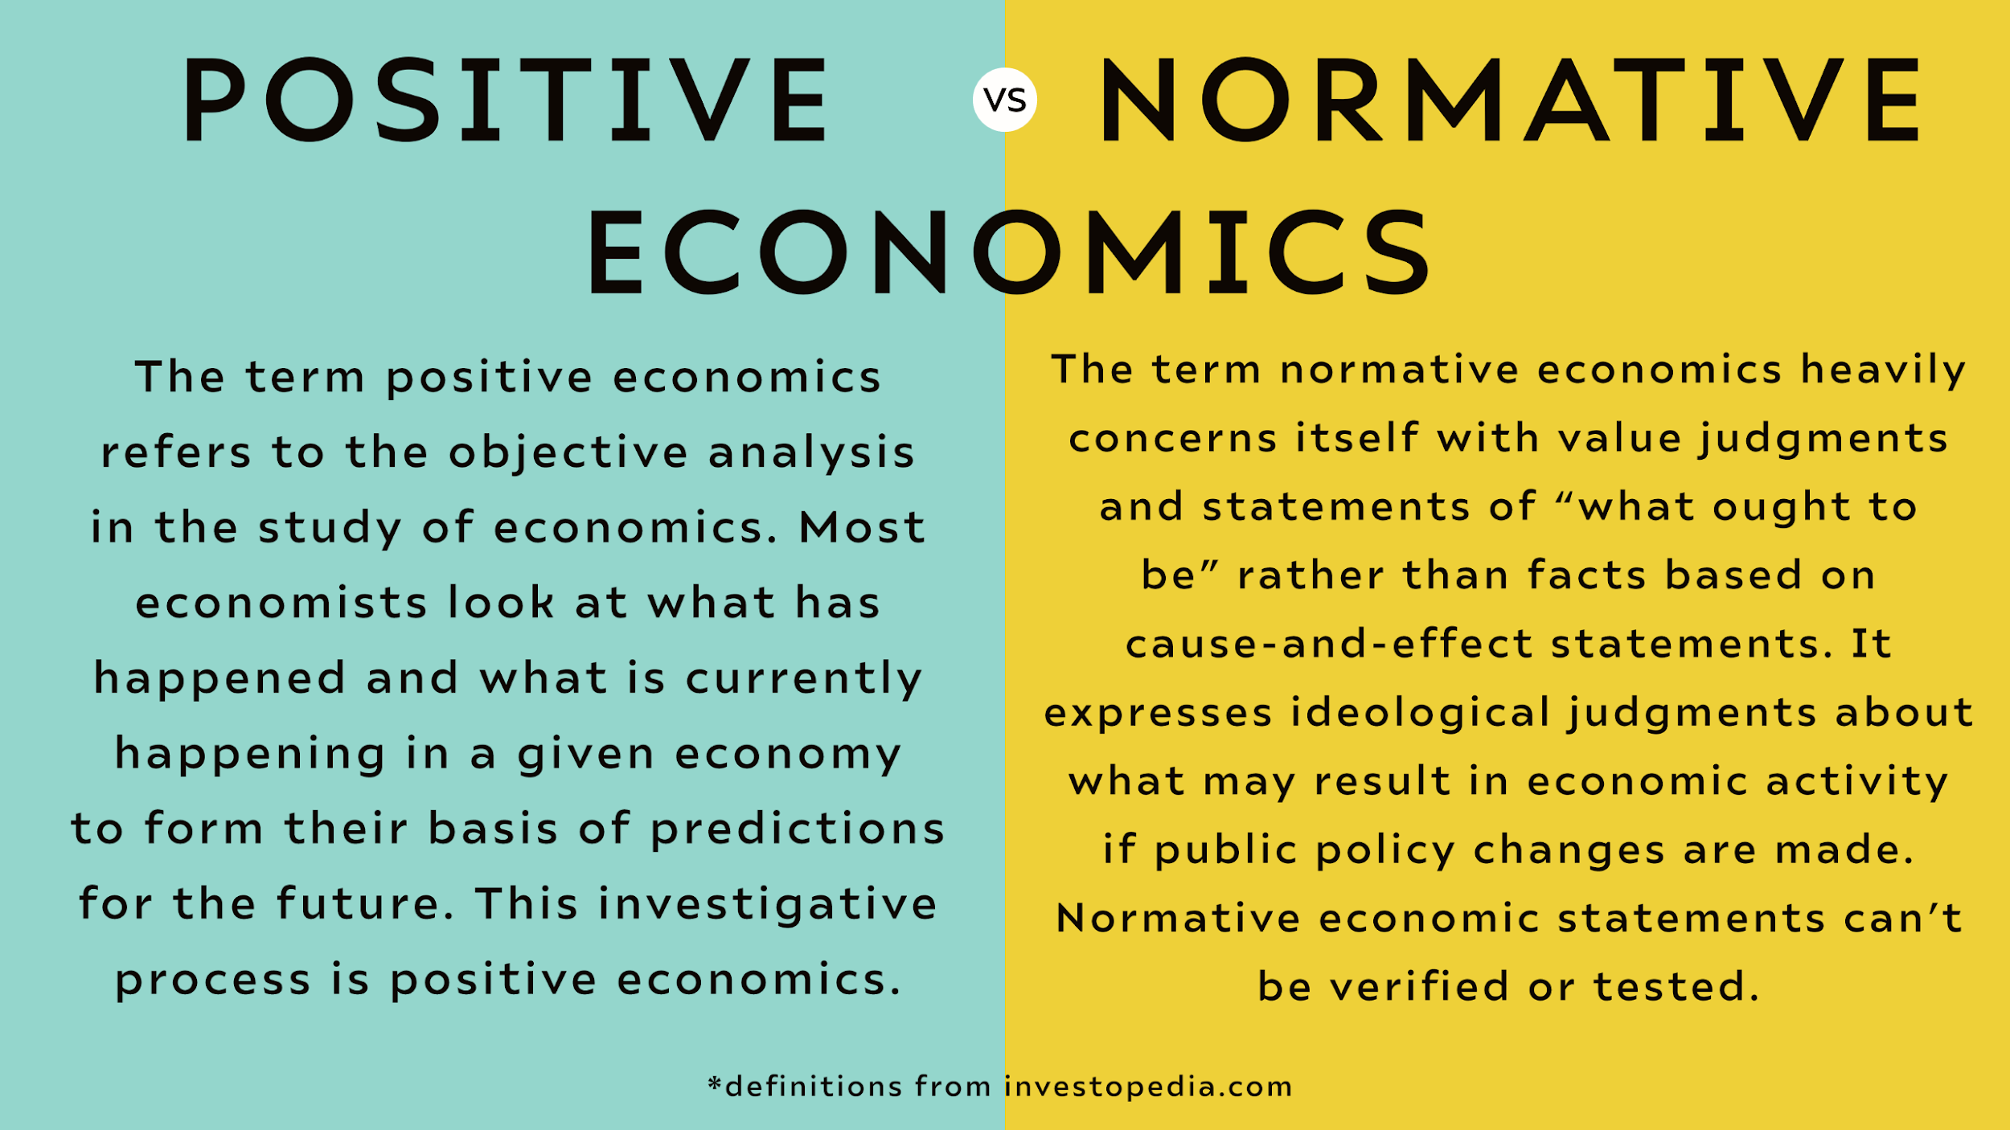
Activity 1.1
We are going to look at some statements individually and decide whether they are positive or normative statements.
Please use these definitions to assist you.

Slide 15
Positive or Normative?
The unemployment rate for the United States is 4.8%.
The United States should offer paid parental leave.
The President of the United States should increase spending in the economy to help with the crisis.
The United States has a GDP of $20.48 trillion dollars
Businesses should pay a living wage to their employees.
The United States runs a trade deficit.
People in the United States should buy American made products.

Slide 16

Why are Ethical Standards Important?
What ethical behaviors are required of researchers for scientific research to be effective?
Economists and researchers must behave ethically.
There are serious consequences if people could not or would not trust the information from research.
Economists face a fiduciary duty. They must maintain ethical standards and protect the people that are part of their study.

