Slide 1


Should I Join
the Sweatshop
Boycott?

Slide 2
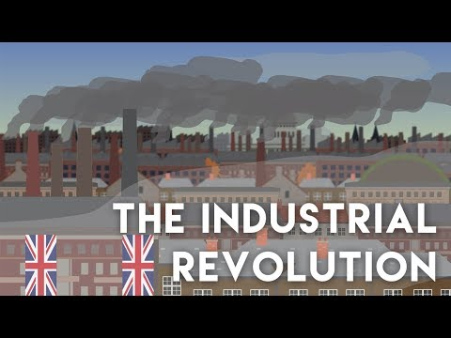

Slide 4
Vocabulary
Sweatshop: a pejorative (negative) term for factory work in developing countries, where the job is presumably low-paid, dangerous, unhealthy, or otherwise has bad working conditions.
Boycott: Refusing to buy something for a moral or other non-market reason, usually to get the boycotted company to change policy.
Working conditions: How well workers are treated at a job.
Labor activist: Someone who works to get companies to improve working conditions, sometimes in a confrontational way (such as a boycott).

Slide 5

Vocabulary
Economic growth: an increase in the output of goods and services. It’s what causes nations to become wealthier.
Income: money received from work or investments.
Industrialization: the widespread development of industries in a region due to improvements in technology.
GDP per capita: how much money the average person makes in a year.

Slide 6
Supporting questions
Answer these supporting questions as you interpret primary sources and watch the following videos.
“What is one thing that factory owners and labor activists agree on?”
“What reasons do young women give for working in factories?”
“At what stage of economic development are the factory workers that were interviewed in the Planet Money video?”

Slide 7
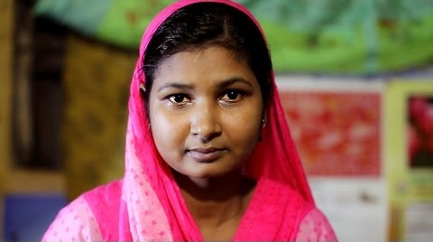
Planet Money Makes a T-Shirt, Part III, “People”

Slide 8
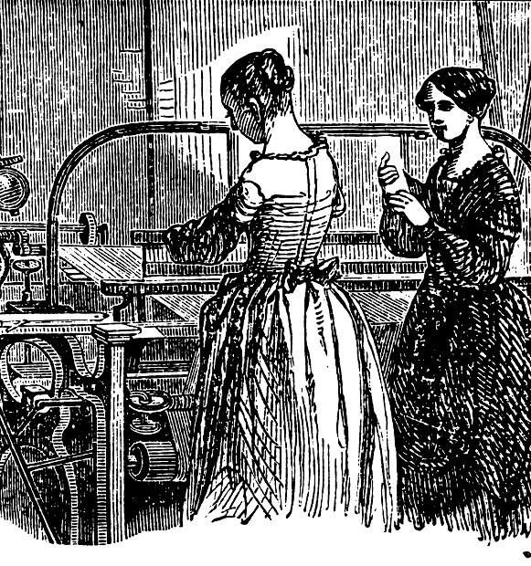
Letters home
Anonymous New England mill worker, 1840s.
“I will speak to you of my acquaintances in the family here. One, who sits at my right side at table, is in the factory because she hates her mother-in-law. The one next to her has a wealthy father but like many of our country farmers, he is very penurious [cheap]…The next has a “well-off” mother, but she is a very pious [holy] woman, and will not buy her daughter as many pretty gowns and collars and ribbons…as she likes…The next is here because her parents and family are wicked infidels, and she cannot be allowed to enjoy the privileges of religion at home.”
(Continued)
Notes:
Source: “The Travels of a T-Shirt in the Global Economy” by Pietra Rivoli.

Slide 9
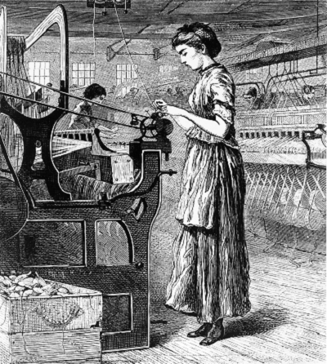
Letters home
Anonymous New England mill worker, 1840s.
(Continued from previous slide)
“The next is here because she must labor somewhere, and she has been ill-treated in so many families that she has a horror of domestic service. The next has left home because her lover, who has gone on a whaling voyage, wishes to be married when he returns, and she would like more money than her father will give her. The next is here because her home is in a lonely country village and she cannot bear to remain where it is so dull. The next is here because her parents are poor, and she wishes to acquire the means to educate herself. The next is here because her ‘beau’ came, and she did not trust him among so many pretty girls.”
Notes:
Source: “The Travels of a T-Shirt in the Global Economy” by Pietra Rivoli.

Slide 10
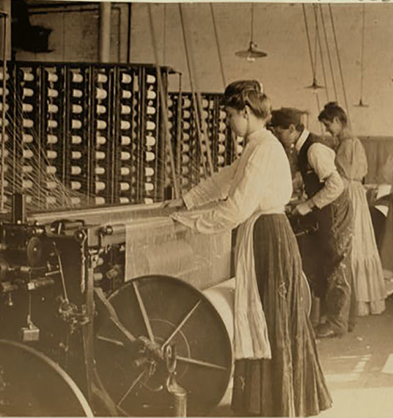
Letters home
Bertha Black, North Carolina mill worker, 1899
“We all went to work in the Amazon Cotton Mill and we all worked there all our lives. We were all anxious to go to work because, I don’t know, we didn’t like the farming. It was so hot from sunup to sundown. No, that was not for me. Mill work was better. It had to be. Once we went to work in the mill after we moved here from the farm, we had more clothes and more kinds of food than we did when we was a-farmin’. And we had a better house. So yes, when we came to the mill life was easier.”

Slide 11
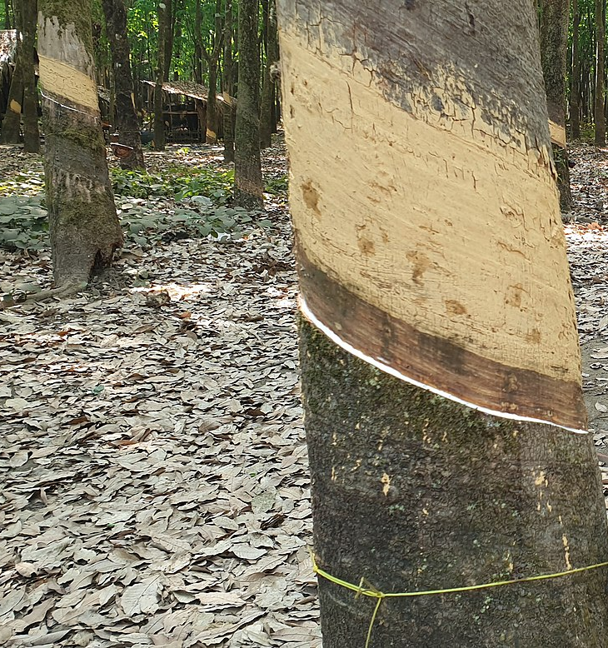
Letters home
Liang Ying, China mill worker, late 20th century
“[Life on the farm] was really hard work. Every morning, from 4am to 7am you have to cut through the bark of 400 rubber trees in total darkness. It has to be done before daybreak, otherwise the sunshine will evaporate the rubber juice. If you were me, what would you prefer, the factory or the farm?”

Slide 12
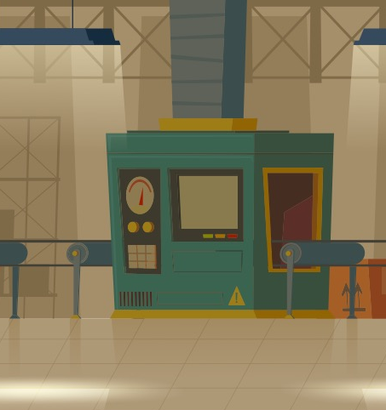
Letters home
Economists studying mill workers in Ethiopia, 2017
“To our surprise, most people who got an industrial job soon changed their minds. A majority quit within the first months. They ended up doing what those who had not gotten the job offers did – going back to the family farm, taking a construction job or selling goods at the market.
Contrary to expert opinion (and ours), quitting was a wise decision for most. The alternatives were not so bad after all: People who worked in agriculture or market selling earned about as much money as they could have at the factory, often with fewer hours and better conditions. We were amazed. By the end of the year only a third of the people who had landed an industrial job were still employed in the industrial sector at all…”
Notes:
New York Times, “Everything We Knew About Sweatshops Was Wrong, April 27, 2017. https://www.nytimes.com/2017/04/27/opinion/do-sweatshops-lift-workers-out-of-poverty.html?smid=nytcore-ipad-share&smprod=nytcore-ipad&_r=1

Slide 13
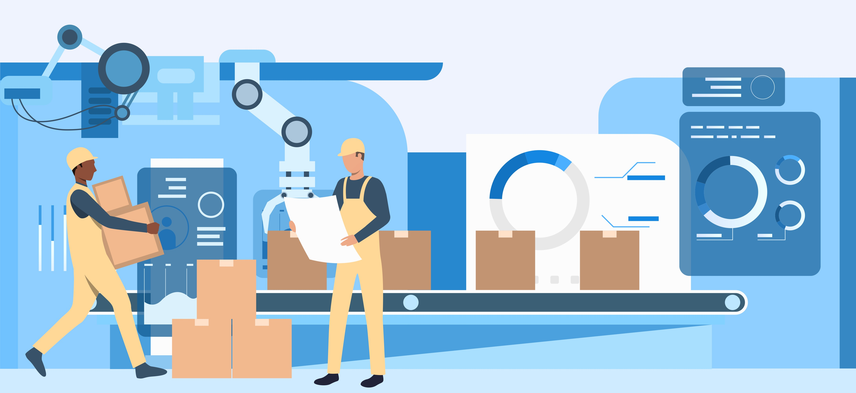
Letters home
Economists studying mill workers in Ethiopia, 2017
“Serious injuries and disabilities were nearly double among those who took the factory jobs, rising to 7 percent from about 4 percent. This risk rose with every month they stayed. The people we interviewed told us about exposure to chemical fumes and repetitive stress injuries.”
Notes:
New York Times, “Everything We Knew About Sweatshops Was Wrong, April 27, 2017. https://www.nytimes.com/2017/04/27/opinion/do-sweatshops-lift-workers-out-of-poverty.html?smid=nytcore-ipad-share&smprod=nytcore-ipad&_r=1

Slide 14
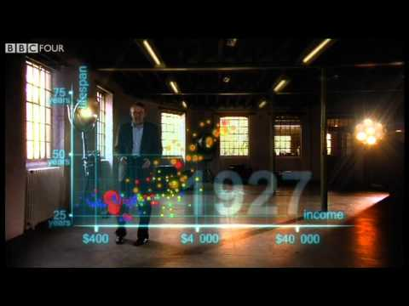

Slide 15
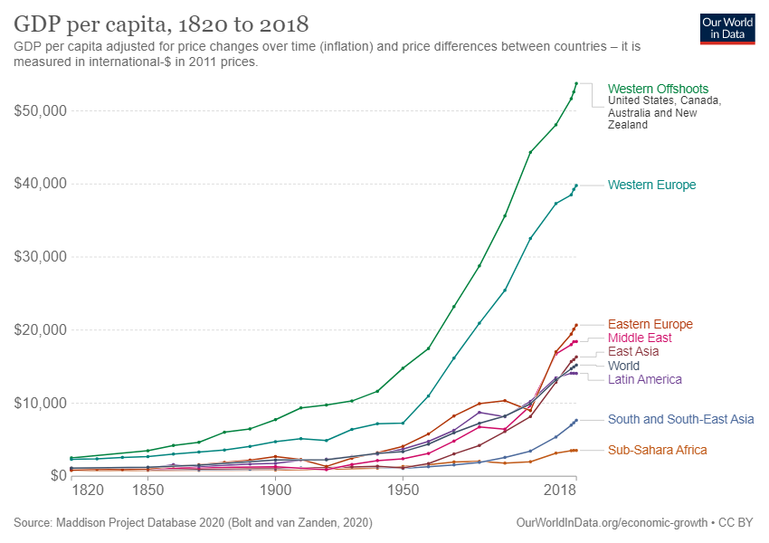
GDP per capita
GDP per capita: how much the average person makes in a year

Slide 17
Should I Join the Student Boycott?
What are the benefits of factory work?
What are the costs of factory work?
Notes:
Ask students what the benefits of factory work are. Answers may vary but include: benefits include an increase in standards of living, from living on just a few dollars a day to pay that is several times higher (as seen in the income graph). This increase in standard of living can include better education, housing, clothing, and food, as well as newfound freedom to make life choices (as seen in the letters home). Next, ask students what the costs of factory work are. Answers may vary but may include: costs include change in family relations and society (as seen in the letters home), and the work being dangerous and not what workers expected (as seen in the Ethiopian study). Say that you hope that studying how a T-shirt is made has helped them learn about the world, the people in it, how the things that we consume are made, and made them think more deeply about how these things are connected.

