Slide 1



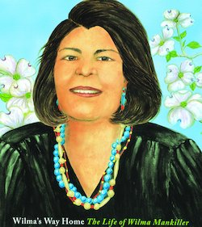

Women Overcoming Adversity:
Using Picture Books to Teach Economics
Lauren H Shifflett shiffllh@jmu.edu
Lynne F Stover stoverlf@jmu.edu
March 1, 2023

Slide 2
EconEdLink Membership
You can now access CEE’s professional development webinars directly on EconEdLink.org! To receive these new professional development benefits, become an EconEdLink member. As a member, you will now be able to:
Automatically receive a professional development certificate via e-mail within 24 hours after viewing any webinar for a minimum of 45 minutes
Register for upcoming webinars with a simple one-click process
Easily download presentations, lesson plan materials and activities for each webinar
Search and view all webinars at your convenience
Save webinars to your EconEdLink dashboard for easy access to the event
Access our new Professional Development page here

Slide 3
Professional Development Opportunities
To earn professional development credit for CEE webinars found on EconEdLink, you must:
Watch a minimum of 45-minutes and you will automatically receive a professional development certificate via e-mail within 24 hours.
Attendees can learn how much credit they will earn per workshop.
Accessing resources:
You can now easily download presentations, lesson plan materials, and activities for each webinar from EconEdLink.org/professional-development/
Local resources:
Insert your local professional development opportunities (if applicable)

Slide 4
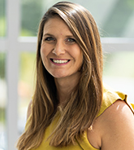
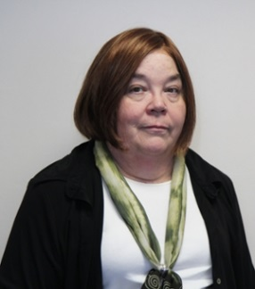
Presenters
Lauren Hensley Shifflett is the new Associate Director at the James Madison University Center for Economic Education. Prior to joining the Center, she spent twelve years in early elementary education where she enjoyed prospering young minds as a classroom teacher. Lauren became nationally known as an elementary economic educator when she received the John Morton Award of the national Council for Economic Education in 2021. Her love for economics guides her lessons to prepare students for life.
shiffllh@jmu.edu
Lynne Farrell Stover is currently a Teacher Consultant at the James Madison University Center for Economic Education. Prior to this, she spent thirty-three years in public education where she enjoyed various teaching assignments including classroom teacher, gifted education specialist, and librarian. She is the author of over fifty educational articles and eight teacher resource books. She is the recipient of the 2022 NAEE Platinum Curriculum Award for her lessons developed for Virginia’s Reading Makes Cents Program.
stoverlf@jmu.edu

Slide 5
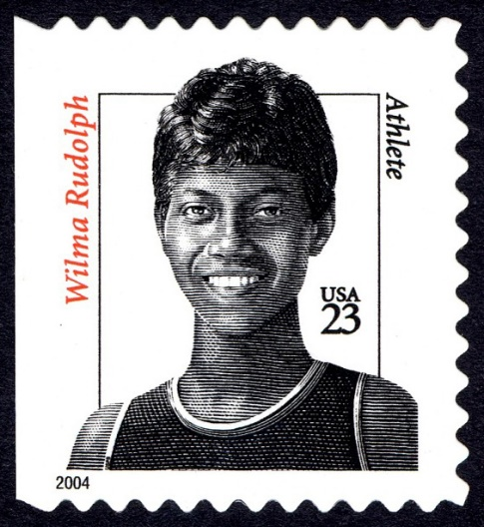
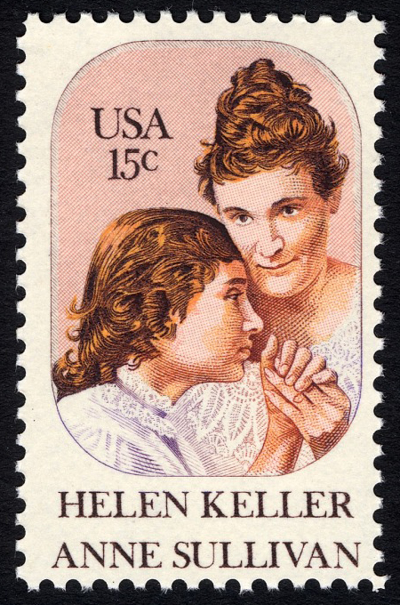
Agenda
This session features:
Information about how to teach economic concepts using picture book biographies
Related lesson plans
Extension and enrichment activities
Links to support materials
Q & A session

Slide 6
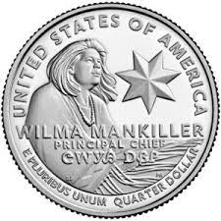
Objectives
Teachers will be able to:
Learn about the challenges four strong women faced and overcame by investing in their human capital
Discover methods for teaching the featured concepts using lessons and activities created for the elementary classroom.
Consider the benefits of using children’s literature to teach in the content area.
Review the economic concepts of decision-making, opportunity cost, human capital, good & services, and productive resources and learn how they apply these concepts to the featured books.

Slide 7
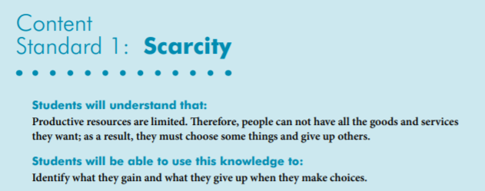
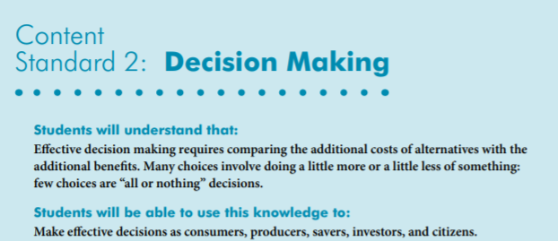

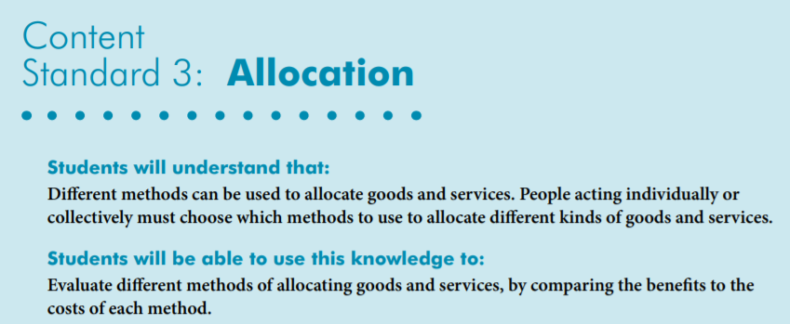
National Standards
https://www.councilforeconed.org/wp-content/uploads/2012/03/voluntary-national-content-standards-2010.pdf

Slide 8
National Standards
Benchmarks: Grade 4

Slide 9
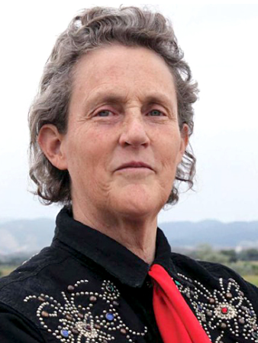
Temple Grandin
August 26, 1947
Temple Grandin has a BA from Franklin Pierce University, a MS from Arizona State University
and a PhD from the University of Illinois.
Mary Temple Grandin is an American academic and animal behaviorist. She is an important spokesperson for autism spectrum disorders. By using her abilities to think visually, she has pursued a career as an industry consultant, is a professor of animal science at Colorado State University, and is the author of ten books and hundreds of articles.

Slide 10
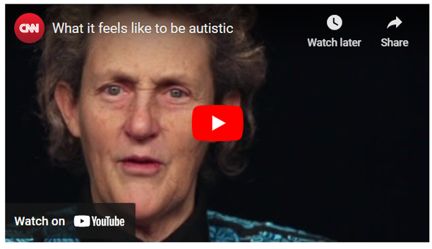
https://www.cnn.com/videos/living/2014/01/27/temple-grandin-red-chair-orig.cnn

Slide 11

The Girl Who Thought in Pictures:
The Story of Dr. Temple Grandin
by Julia Finley Mosca
Story Synopsis: This picture book in verse describes the life and accomplishments of the animal scientist and designer of cruelty-free livestock facilities. It covers her early life and autism diagnosis through her journey to become a livestock expert, author, and public speaker.
Publisher: Innovation Press
Copyright Date: 2019
Reading Level: 3.5
Interest Level: 1-4
https://www.youtube.com/watch?v=6wgBarZ5ytE15 10 minutes
August 29, 1947

Slide 12
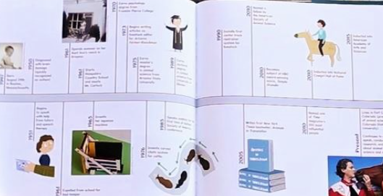
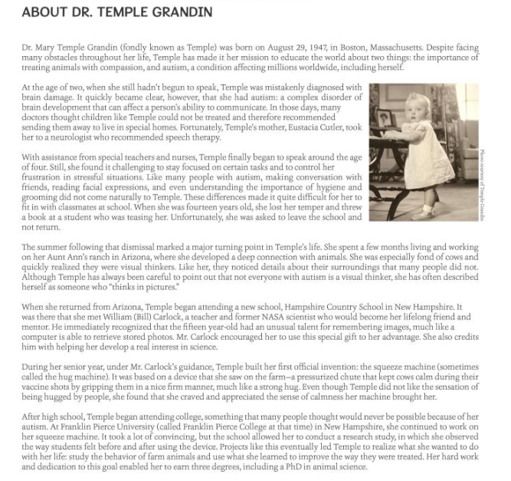
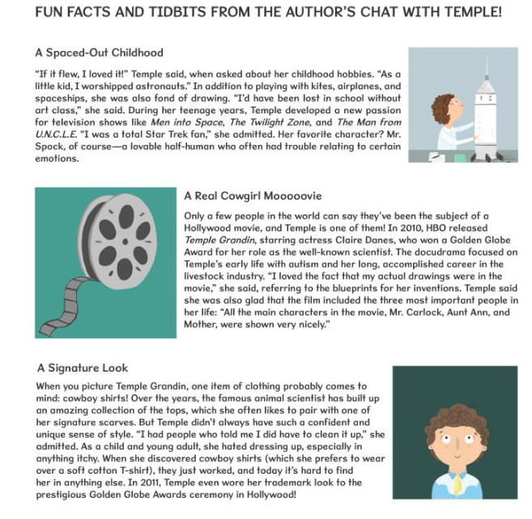
The Girl Who Thought in Pictures: The Story of Dr. Temple Grandin
Backmatter
Timeline
Detailed Biography
Author’s Interview

Slide 13
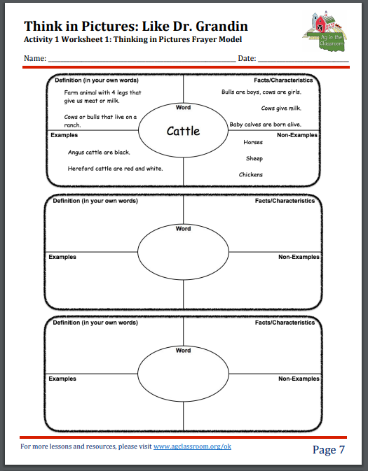
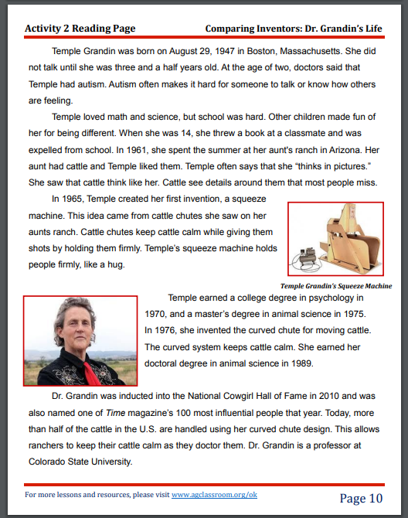
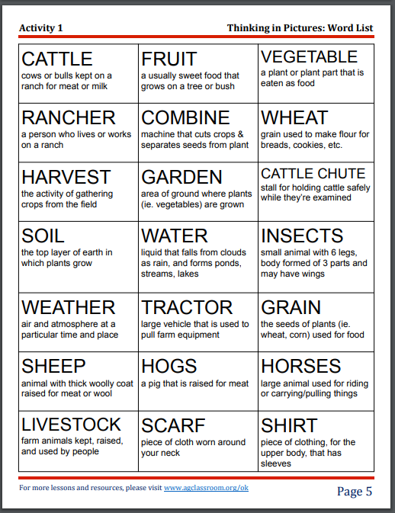
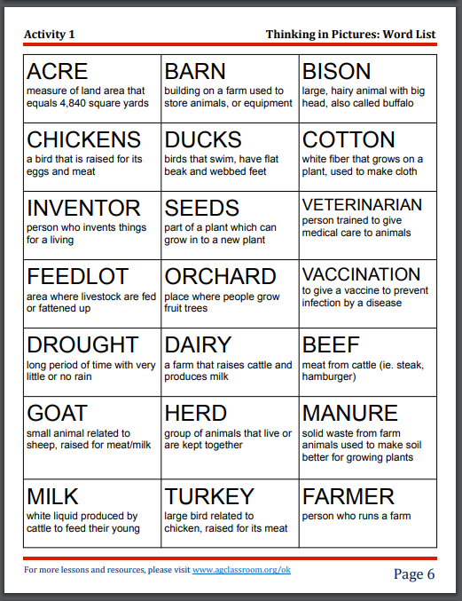
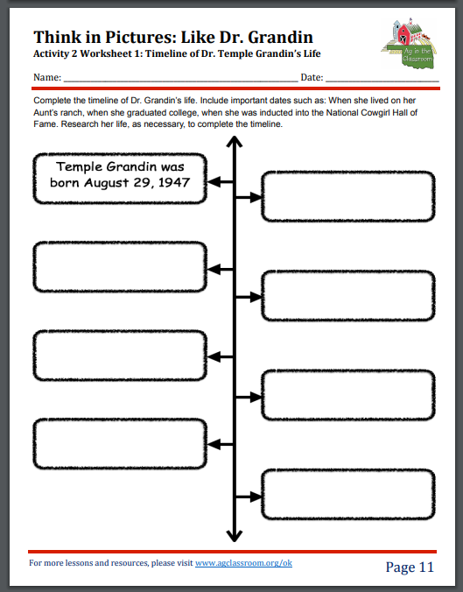

https://cdn.agclassroom.org/ok/lessons/intermed/thinkpictures_35.pdf

Slide 14

How to Build a Hug:
Temple Grandin and Her Amazing Squeeze Machine
By Amy Guglielmo
Story Synopsis: The story of how Temple Grandin
came to build her squeeze machine.
Publisher: Atheneum
Copyright Date: 2018
Reading Level: 4.4
Interest Level: k-3
https://www.youtube.com/watch?v=a7x44PJXV8M
5 minutes

Slide 15
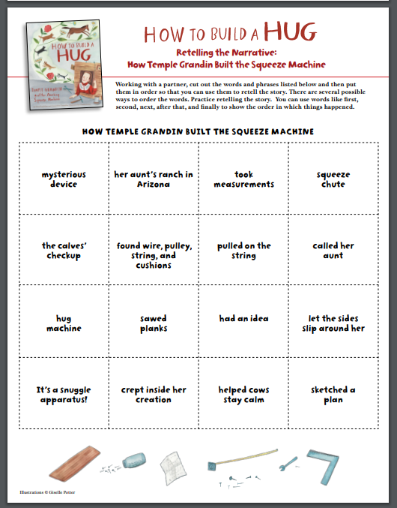
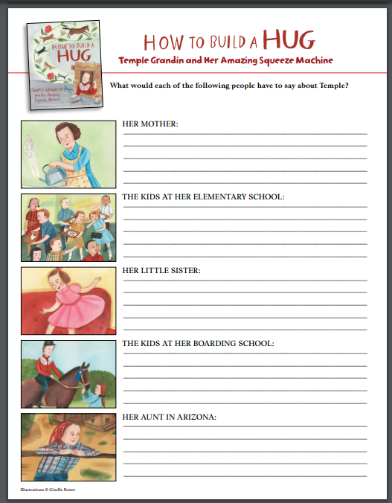
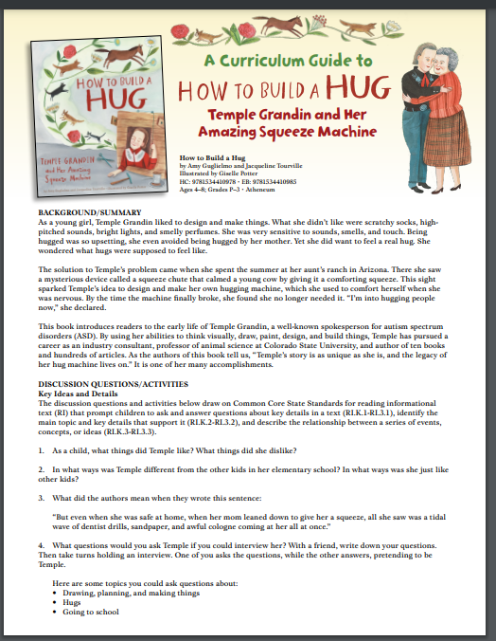
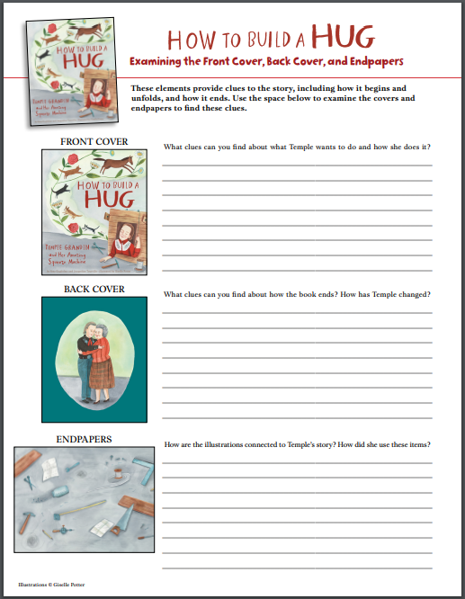
Publisher’s Curriculum Guide
https://d28hgpri8am2if.cloudfront.net/tagged_assets/4301212/9781534410978_cg_how%20to%20build%20a%20hug.pdf

Slide 16
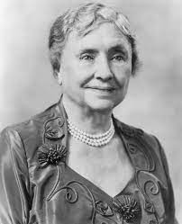
Helen Keller
June 27, 1880-June 1 1968
Helen Keller (1880-1968) was born in Alabama. When she was nineteen months old, an illness left her deaf and blind. With the help of Annie Sullivan, her teacher for 49 years, she was able to learn how to communicate. Helen graduated with honors from Radcliffe College in 1904, where she learned how to read German, Greek, Latin, and French in Braille. An advocate for women rights and the disabled, she campaigned against war, child labor, and capital punishment.

Slide 17
Helen's Big World:
The Life of Helen Keller
by Doreen Rappaport
Story Synopsis: A childhood illness caused Helen Keller to be blind and deaf. With the support of her parents, an excellent teacher, and determination she learned to read, speak and write. She became a prominent speaker, writer, and activist for progressive causes, including labor rights and the rights of the disabled.
Publisher: Hyperion
Copyright Date: 2017
Reading Level: 4.9
Interest Level: 2-4
https://www.youtube.com/watch?v=etKIEgdmifY
14 minutes
June 27, 1880 – June1, 1968

Slide 18
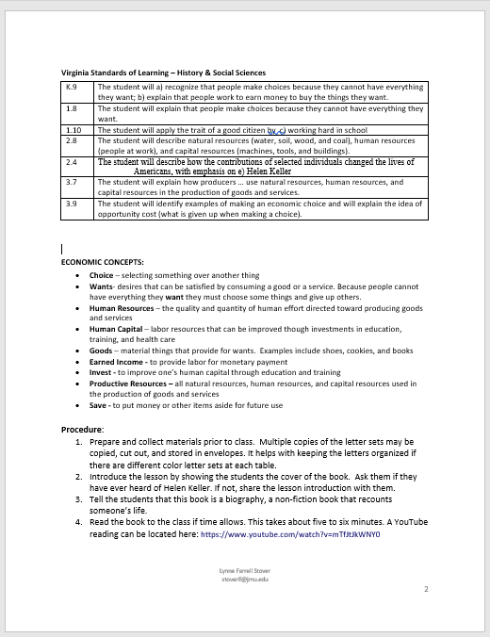
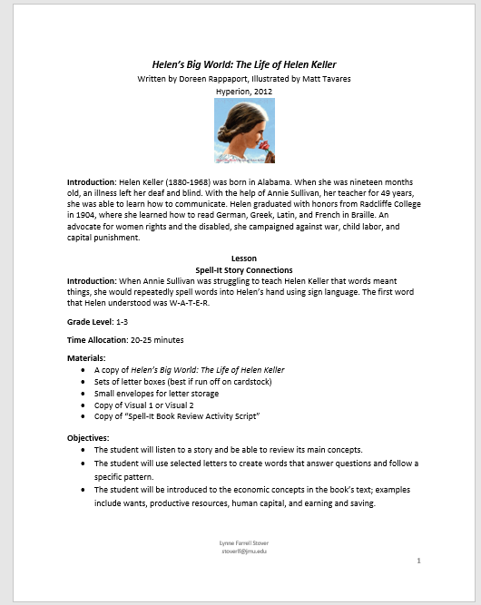
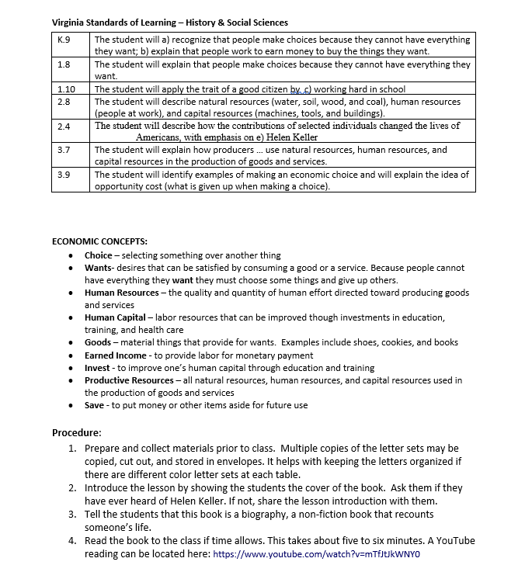
Lesson Plan

Slide 19
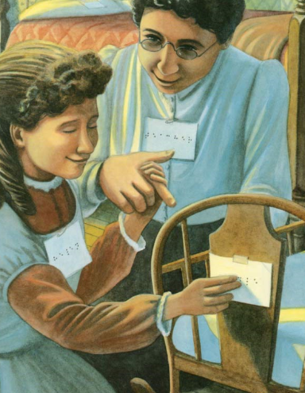
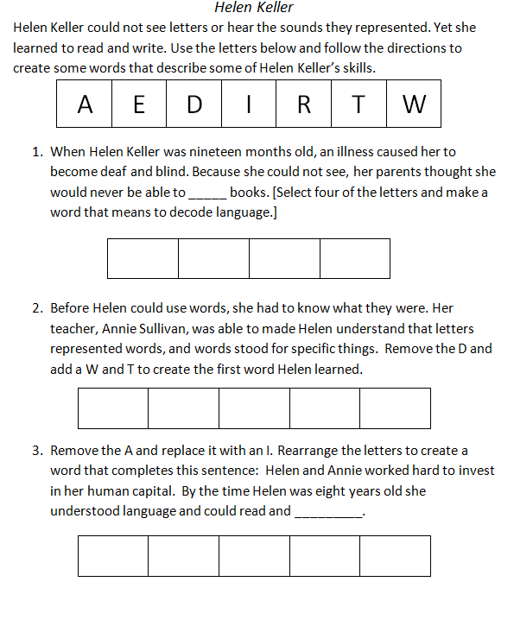
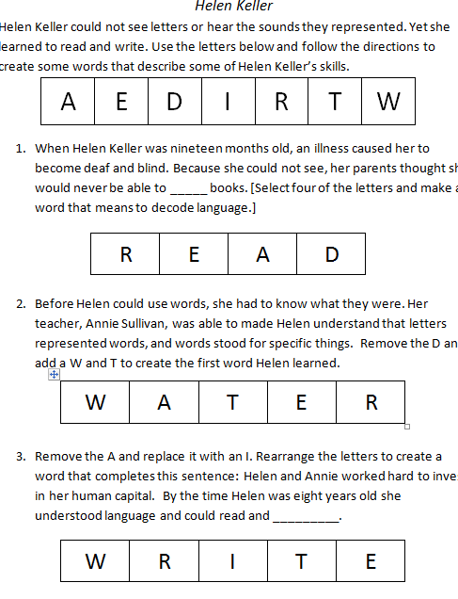

Slide 20
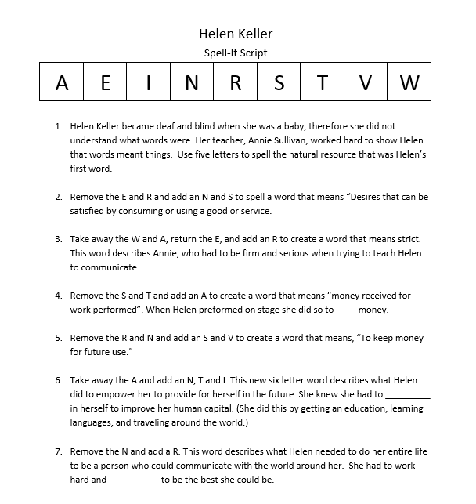
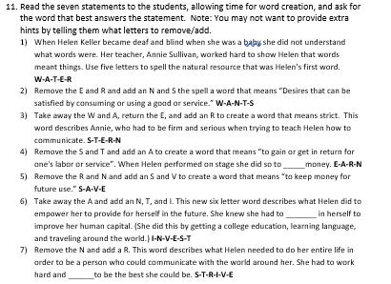
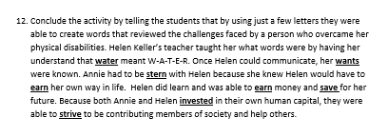
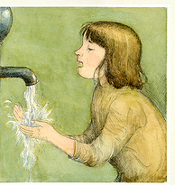

Slide 21
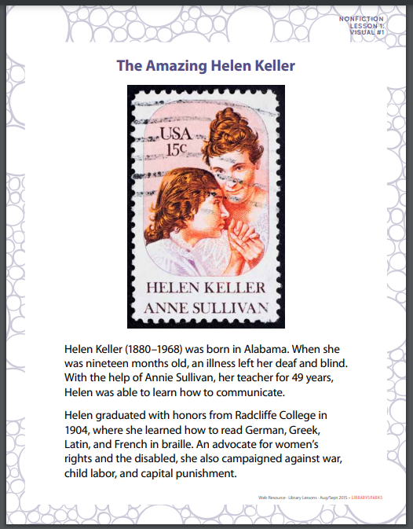
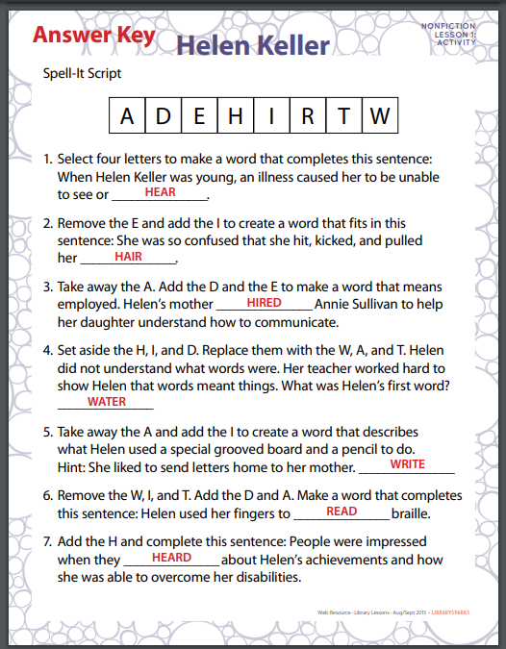

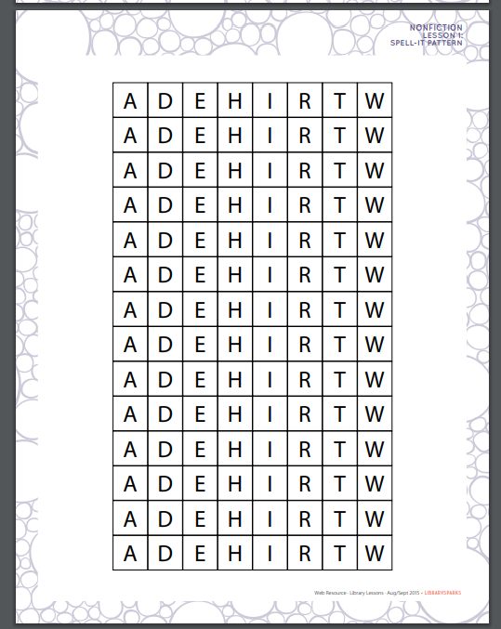
https://www.librarysparks.com/wp-content/uploads/2016/06/lsp_ll_helenkeller_augsept15.pdf
Lynne’s Library Lessons

Slide 22
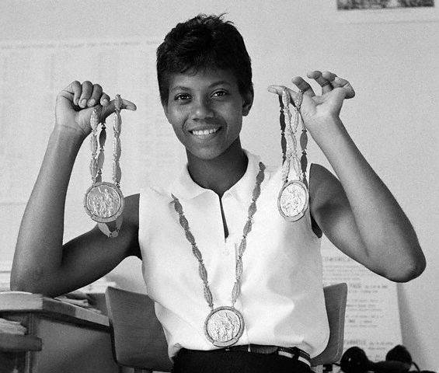
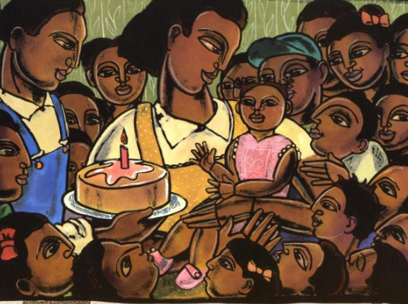
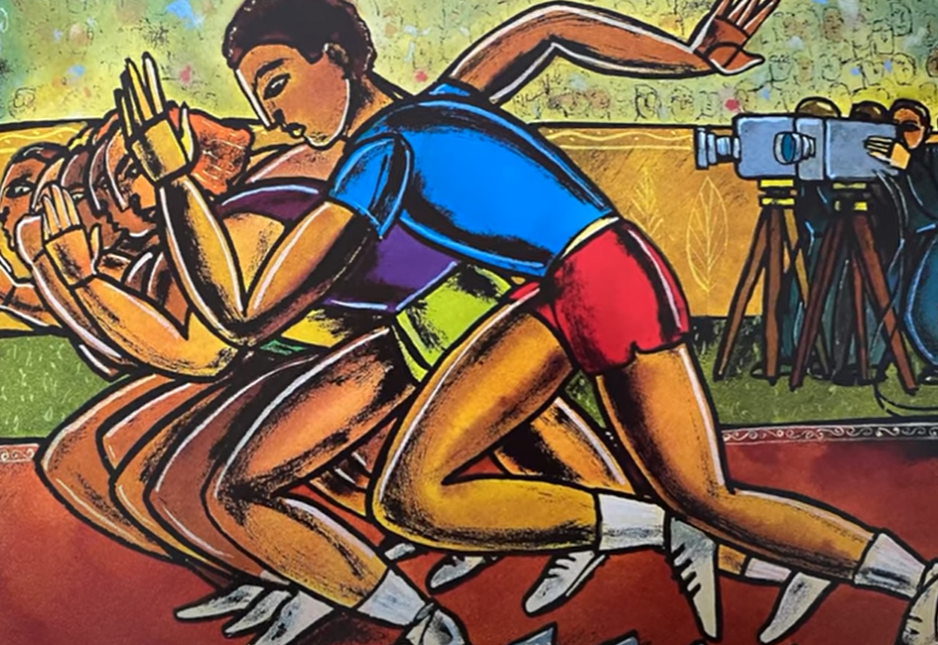
Wilma Rudolph
June 23, 1940-November 12, 1994
Rudolph graduated from Tennessee State with a bachelor's degree in education.
Wilma Rudolph(1940-1994) was the twentieth of 22 children. She was small and sickly. She contracted Polio at the age of five and it was thought she would never walk again. In school, Wilma was teased by her peers because she walked with a metal brace. As an African-American person in Tennessee, she had limited access to opportunities. Despite these challenges, in the 1960 Summer Olympics in Rome, Wilma Rudolph was the first American woman to win three gold medals in a single game.

Slide 23

Wilma Unlimited:
How Wilma Rudolph Became the World' S Fastest Woman
by Kathleen Krull
Story Synopsis Rudolph overcame polio and the inability to walk and became the first American woman to win three gold medals at a single Olympics.
Publisher: Harcourt
Copyright Date: 1996
Reading Level: 5.1
Interest Level: 2-5
June 23 1940 – November 12, 1994
https://www.youtube.com/watch?v=ruVKikbV0YM
11 minutes

Slide 24
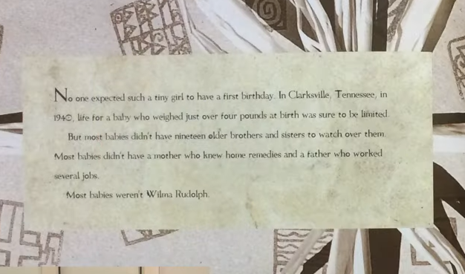
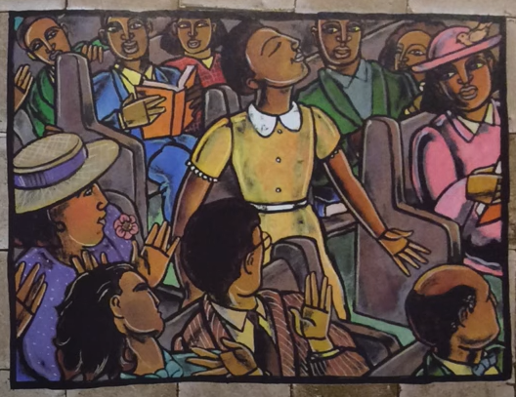
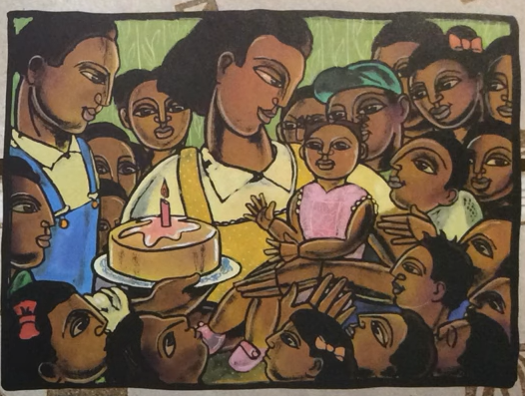

Slide 25
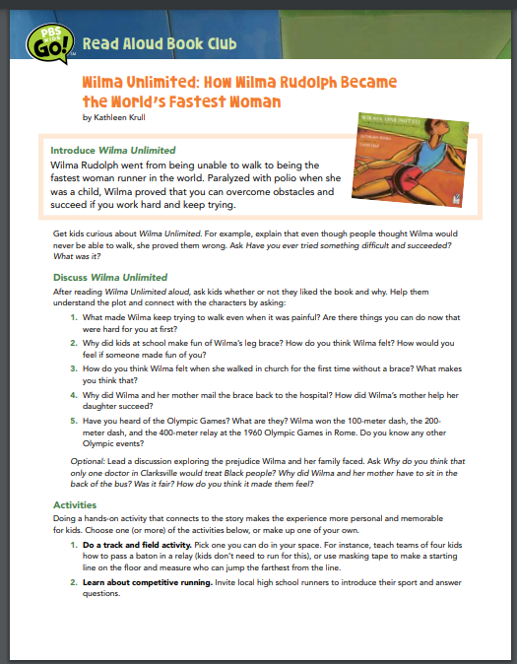
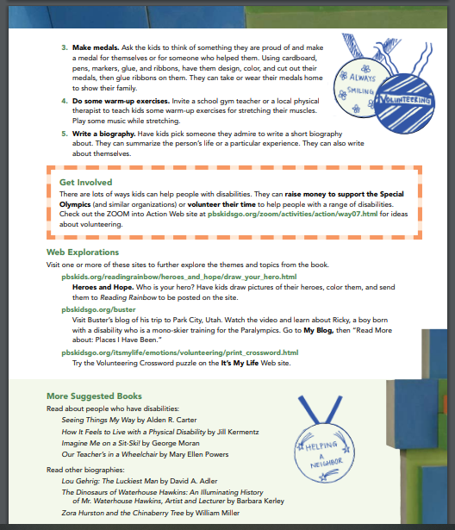
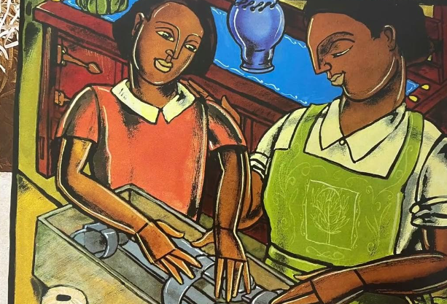
http://www-tc.pbs.org/parents/bookfinder/bookclub/PKGO_bc04_wilma.pdf

Slide 26


Would today’s students be interested in learning about polio?
https://www.pbs.org/wgbh/americanexperience/features/polio-teacher-resource/

Slide 27
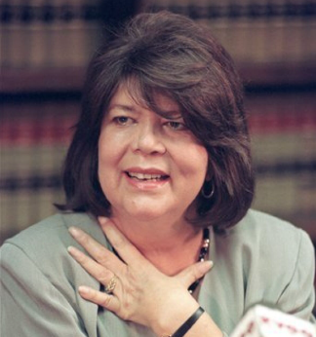
Wilma Mankiller
November 18, 1945-April 6 2010
Wilma graduated from San Francisco State University (BA) and was awarded an Honorary doctorate from the University of New England and recurved a citation for leadership from Harvard University .
Wilma Mankiller was a Native American activist, social worker, community developer and the first woman elected to serve as Principal Chief of the Cherokee Nation. Throughout her life, she had serious health problems, and needed two kidney transplants. In 1979 she was involved in a car accident crushing her face and an leg. The doctors thought she would never walk again.

Slide 28
Wilma's Way Home:
The Life of Wilma Mankiller
by Doreen Rappaport
Story Synopsis: A picture-book biography of Wilma Mankiller, the first female chief of the Cherokee Nation.
Publisher: Hyperion
Copyright Date: 2019
Reading Level: 5.1
Interest Level: 2-5
https://www.youtube.com/watch?v=--seTLltE44
15 minutes
November 18, 1945 - April 6, 2010

Slide 29
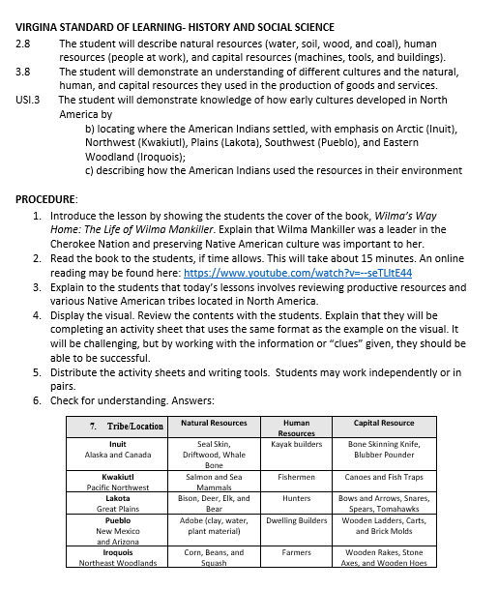

Native American Productive Resources

Slide 30
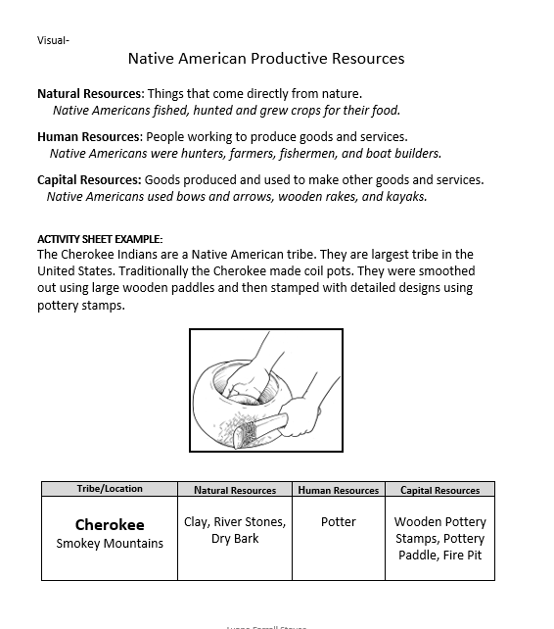
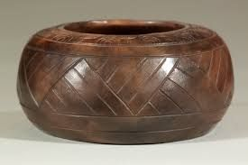

Native American Productive Resources

Slide 31



Slide 32



Elementary Discussion Questions

Slide 33




Slide 34

Quick Quote Activity Ideas
Directions: Rewrite the displayed quotes on index cards. Select one of the tasks and when complete, share it with the class.
Compare and Contrast
Rank
Re-write as text message
Illustrate

Slide 35

Something to Think About
Each of these women invested in their success with hard work and education. Do you think their challenges made them over-achievers?
Helen Keller and Temple Grandin had families who were able to finance the unique educations they required. Wilma Rudolph and Wilma Mankiller both came from large families who struggled financially. Yet all four women earned college degrees. What do you think of this situation?
How do you think young students will react to learning about the lives of these four women?

Slide 36
Lauren Shifflett shifflllh@jmu.edu
Lynne Stover stoverlf@jmu.edu
Thank You

Slide 37

Invest In Girls

Slide 38

NEC

Slide 39

NPFC

Slide 40

Advocacy

Slide 41

Suggested Presentation Deck
CEE Affiliates
https://www.councilforeconed.org/resources/local-affiliates/
Include your local affiliate page

Slide 42











Thank You to Our Sponsors!
42

