Slide 1
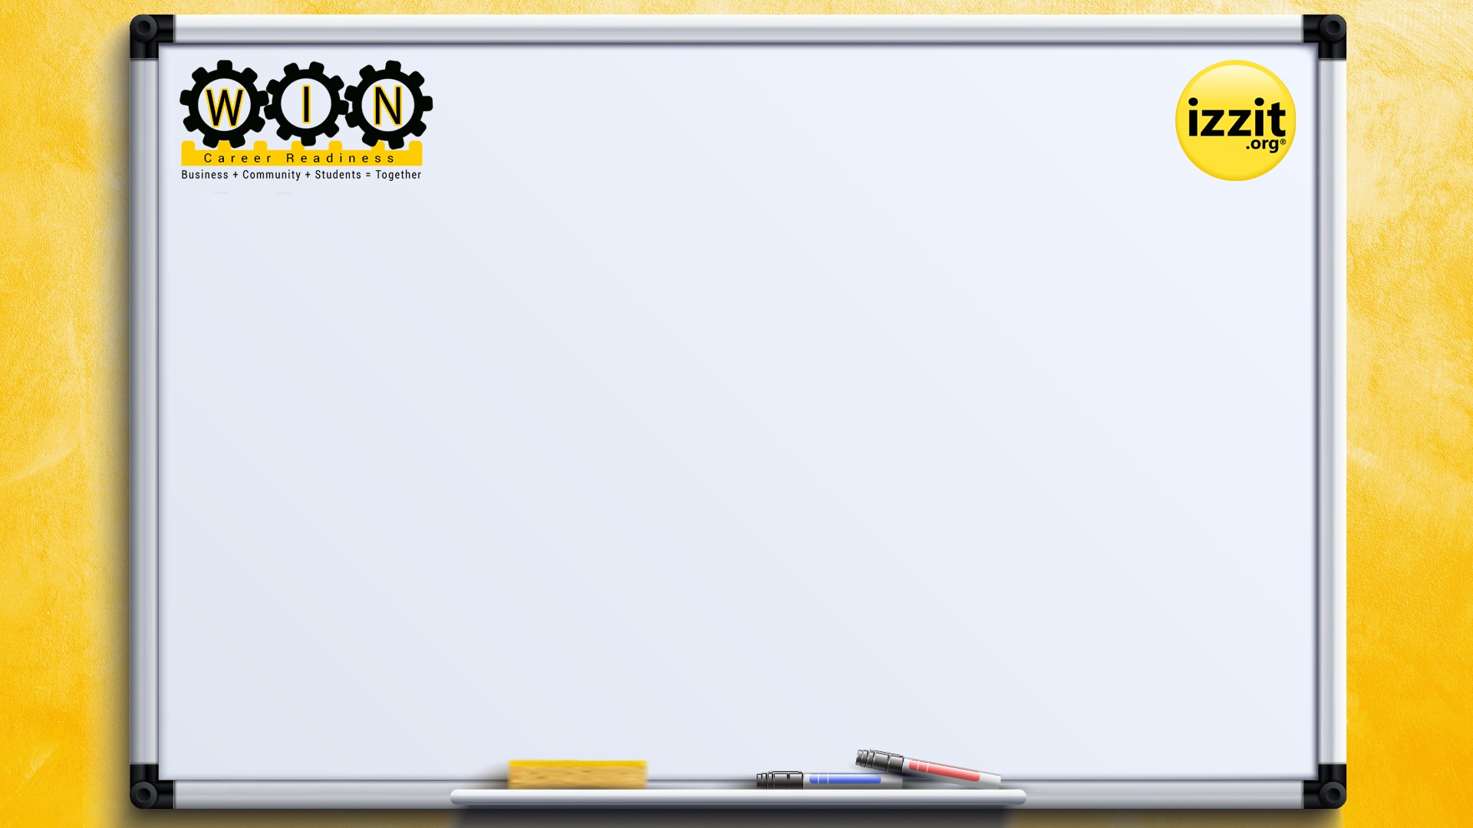

Work-force Innovation Now (W.I.N.)
A first-in-the-nation
Career Readiness
Competency-based Course!

Slide 2
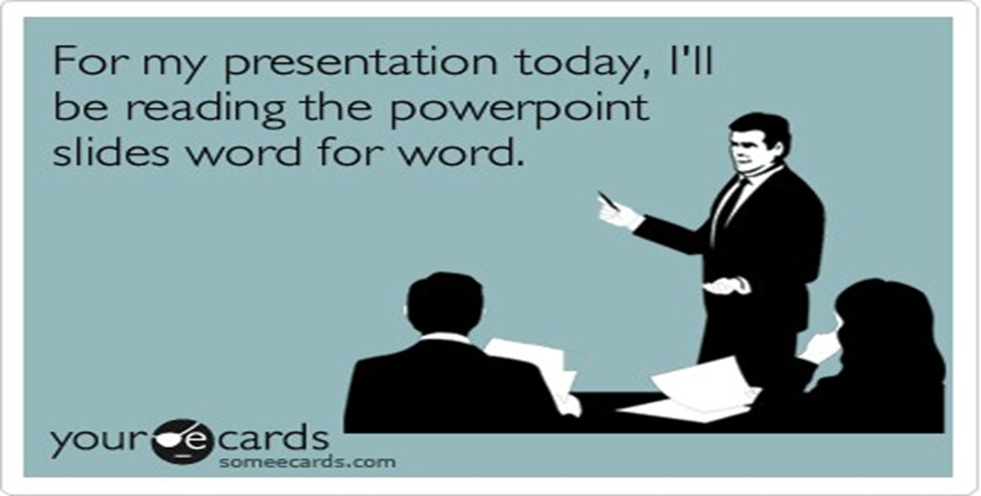

Slide 3
Background for development
The Common Career Technical Core (CCTC), which includes an overarching set of Career Ready Practices that apply to all programs of study. The Career Ready Practices include 12 statements that address the knowledge, skills, and dispositions that are important to becoming career ready.
I applied these 12 statements to develop competencies applicable to the ACTE Career Ready Practices to include these key elements. These are classified as FL/HL (Financial and Health Literacy), ES/EIW (Employability Skills and Ethics in the Workplace), CL/DL (Civic and Digital Literacy), and CP (Career Pathways, or Work-Based Learning).
W.I.N. breaks down career readiness into three areas:
Financial/Health Literacy
Employability Skills-including digital literacy and civic literacy
Work-Based Learning

Slide 4
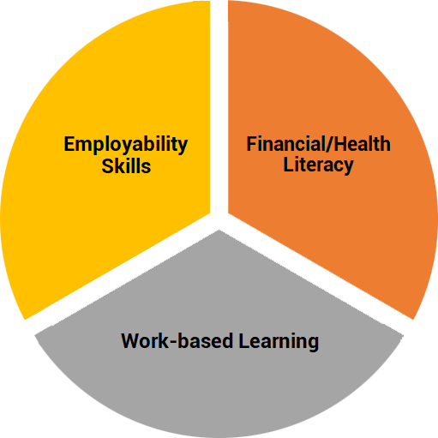
A well-rounded course that infuses the key tenets from ACTE and NOW is Competency-based!
I placed a great emphasis on employability skills built on a strong foundation of financial literacy. izzit.org’s W.I.N. course also provides opportunities to integrate community partners for mentoring on resume writing, cover letters, and mock interviews.

Slide 5
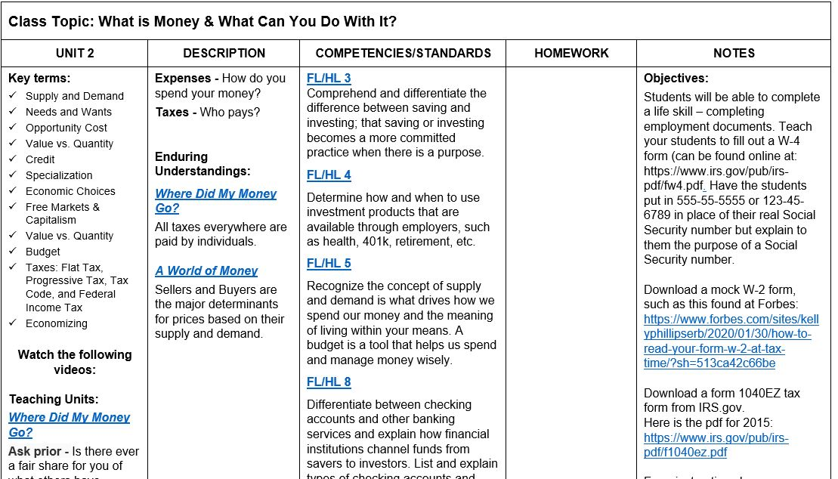
Sample W.I.N. classroom unit with topics
Sample of course syllabus.
Note this is a teacher’s page as it includes competencies and objectives for students.
Combines real-world experiences (filling out W-4, 1099, etc.)

Slide 6
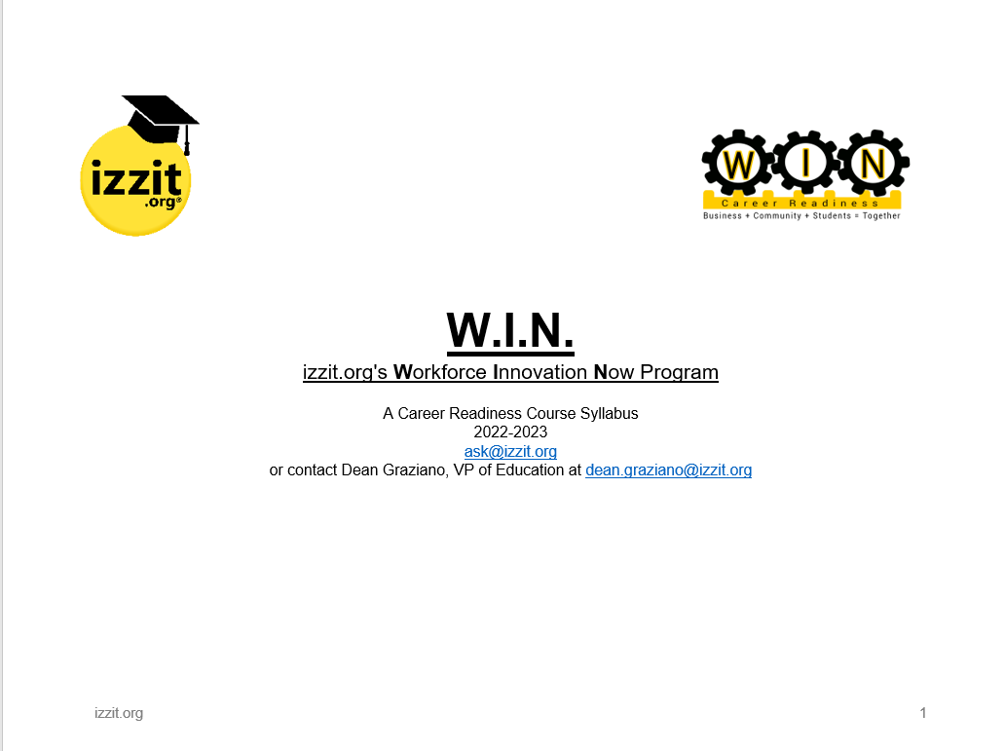

Our W.I.N. Course allows teachers to either utilize in their classroom or assign on the student page @ izzit.org (Our materials are free!)

Slide 7
The Appendix has a myriad of materials to assist teachers as well as students.
The Common Career Technical Core (CCTC) Career Ready Practices *
Financial Literacy Pre-Assessment
Compound Interest Worksheet
Finding Adventure in the CTE Classroom PowerPoint
Apprenticeship PowerPoint
Including Soft Skills in CTE Curriculum
Employability Basics – Resume and Cover Letter
Student Inventory of Work-Based Experiences
Soft Skills Vowels
IRS Work Forms - PowerPoint
Financial Literacy Post-Assessment
Twenty Commonly Asked Interview Questions *
Mock job description for in-person/zoom exercise *
Work-Based Learning Inventory
Scholarship Application Matrix *

Slide 8

A main focus of the course is Financial Literacy & solid information for students.

Slide 9

An additional resource for students that explains that first paycheck.

Slide 10
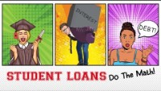
This course covers all post-secondary pathways: college, career, or career-tech.

Slide 11

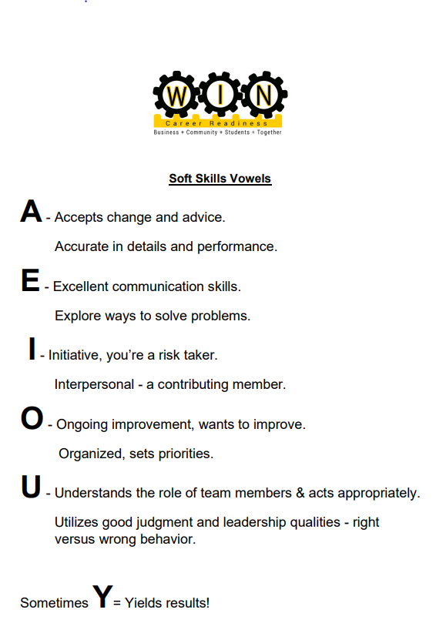
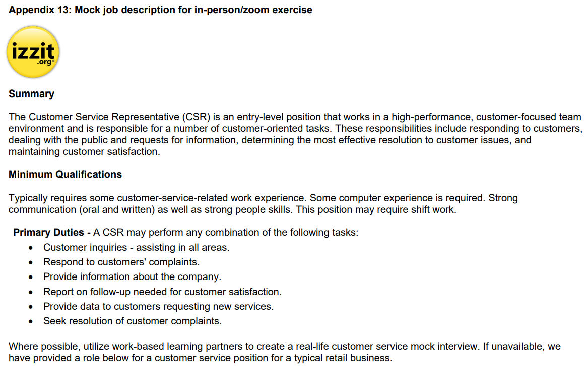
Employability Skills are one leg of the tripod.
(All resources can be found in the appendix.)

Slide 12
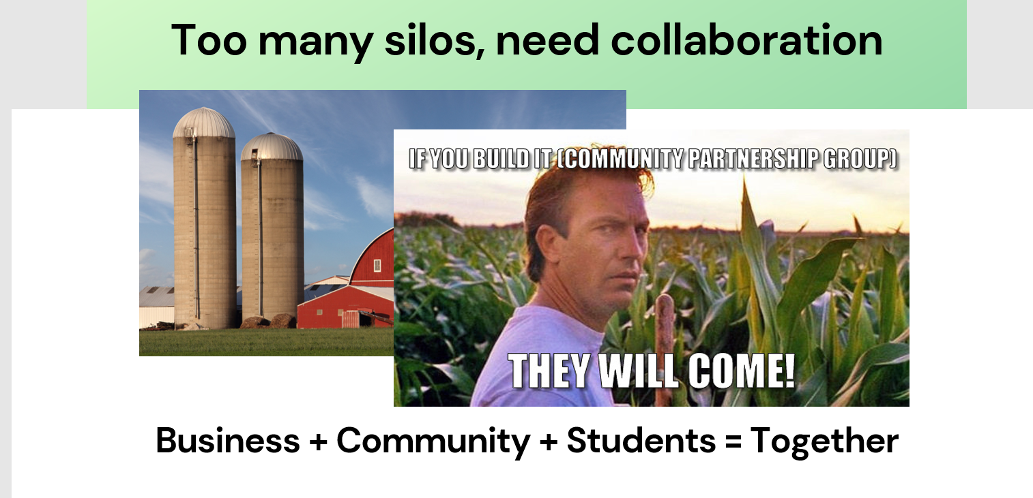
Building Community Support via WBL Groups
Inside course provides tools to assist your efforts!

Slide 13
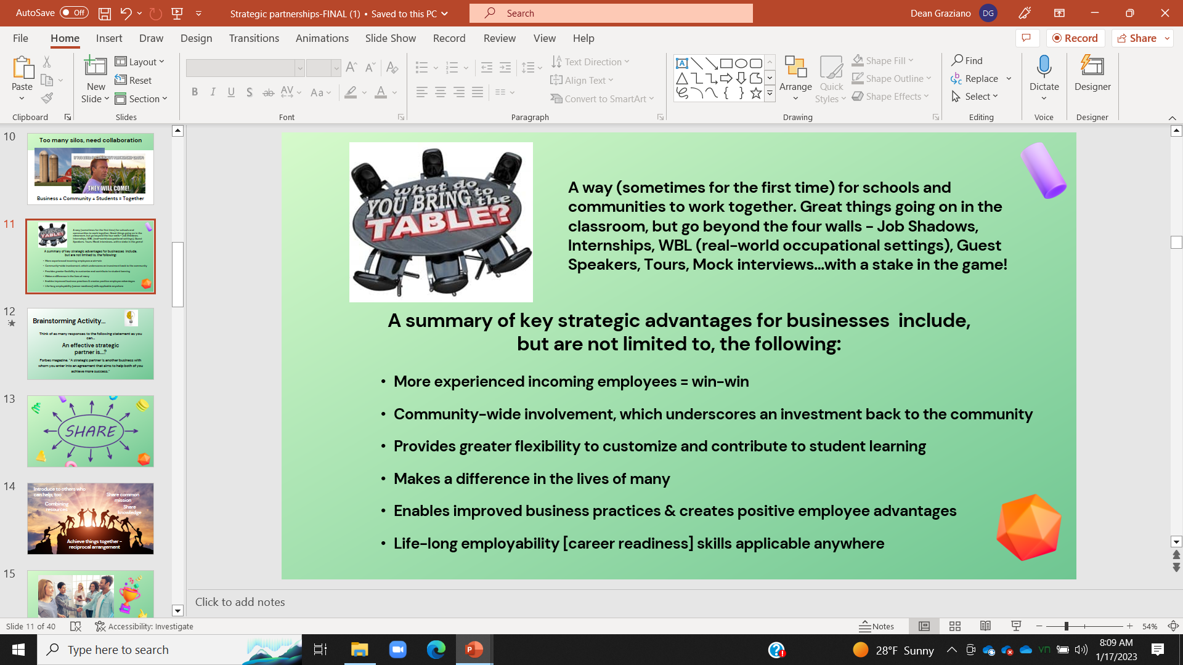
Building Community Support via WBL Groups
Inside course provides tools to assist your efforts!

Slide 14

I would like to discuss three connected areas today:
  Your goals for student learning are similar to those of employers.
  EVERYONE in the community has a stake.
  Breaking the four walls of the “school-only mindset” for 21st-century learning!
v

Slide 15

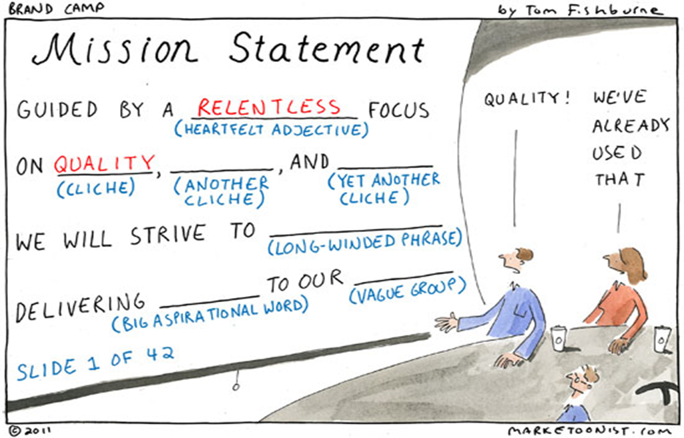
Your goals for student learning are similar to those of employers.

Slide 16
Mission Statements - a few examples of
PA schools and businesses
Schools
“Building on Derry Township School District’s tradition of excellence, Hershey High School—a dynamic educational environment—advances the academic, physical and social abilities of students to meet their individual potential. Engaging students in a supportive community will facilitate their transition into productive, global citizens.”
“The mission of the Susquehanna County Career & Technology Center (SCCTC), in cooperation with parents, families, local agencies, and community members, is to provide educational opportunities for all students to reach their full potential by striving towards excellence through academic knowledge, basic skills, and technology taught by a competent and committed staff within a safe environment. The opportunities will enable students to become lifelong learners, productive citizens, and responsible members of society.”
Businesses
“Together, we provide our communities with life's essentials, so our neighbors have the opportunity to thrive”.
“…it’s our mission to empower our customers and neighbors with the knowledge and tools they need to improve their financial well-being and peace of mind. The greatest gift we can provide people is to coach them along their journey, helping them achieve their own vision of wealth and happiness.”

Slide 17
Brainstorming Activity…
Think of as many responses to the following statement as you can…
An effective strategic
partner is...?
HINT-
Forbes magazine, “A strategic partner is another business with whom you enter into an agreement that aims to help both of you achieve more success.”

Slide 18


Slide 19
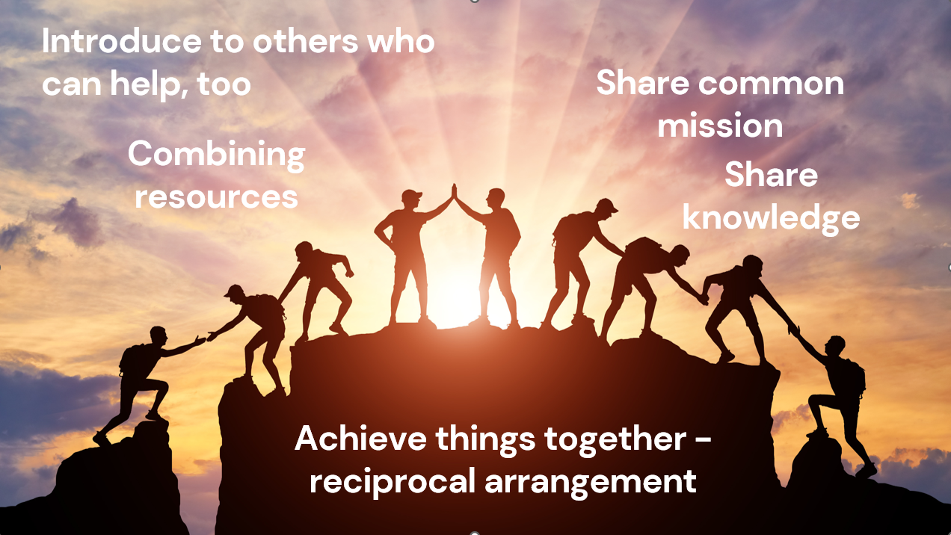

Slide 20
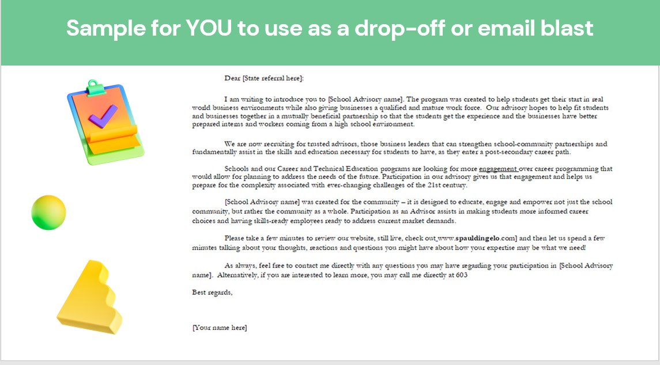

Slide 21
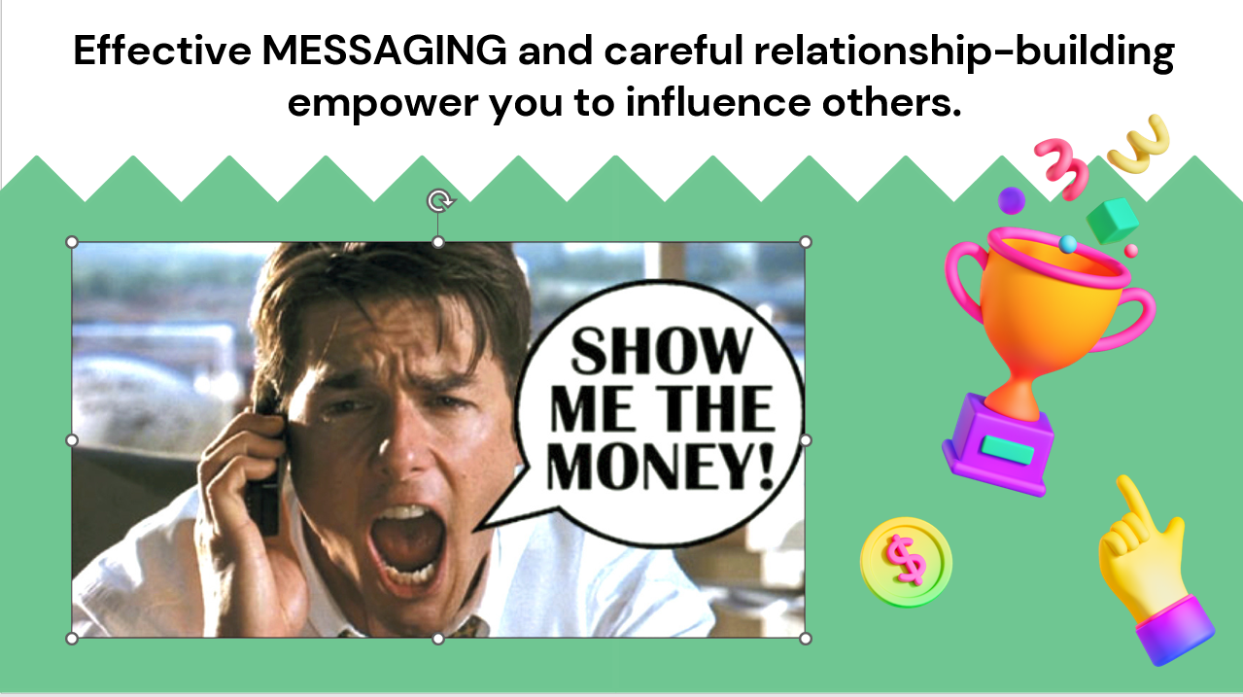

Slide 22
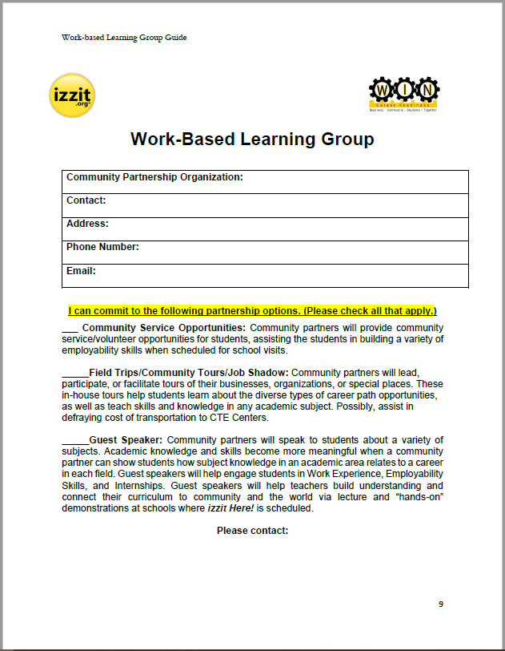
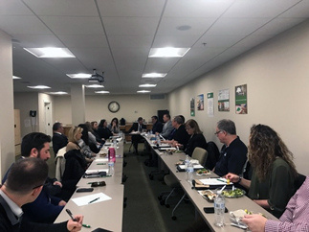
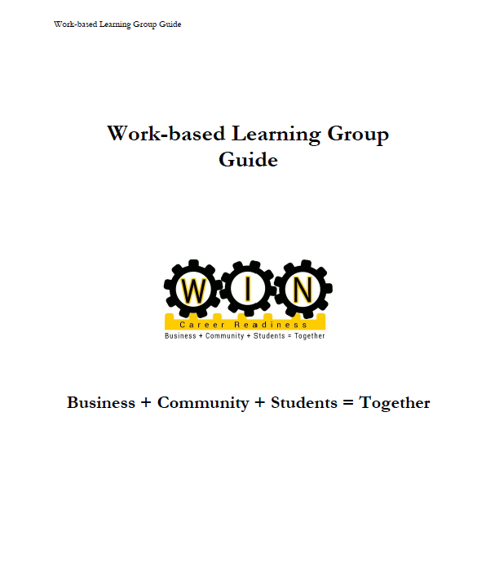
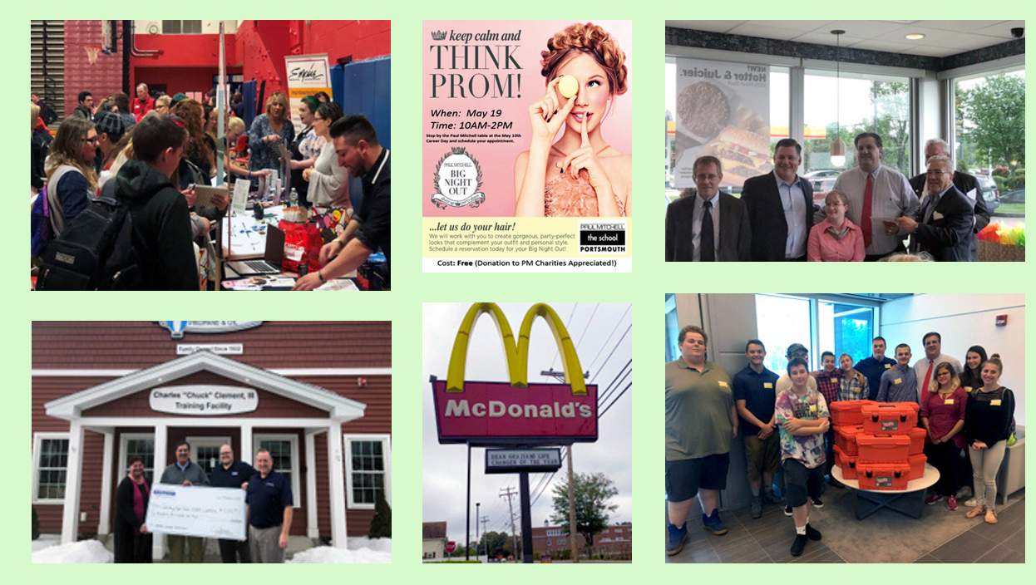
Building Community Support via WBL Groups
Inside course provides tools to assist your efforts!

Slide 23
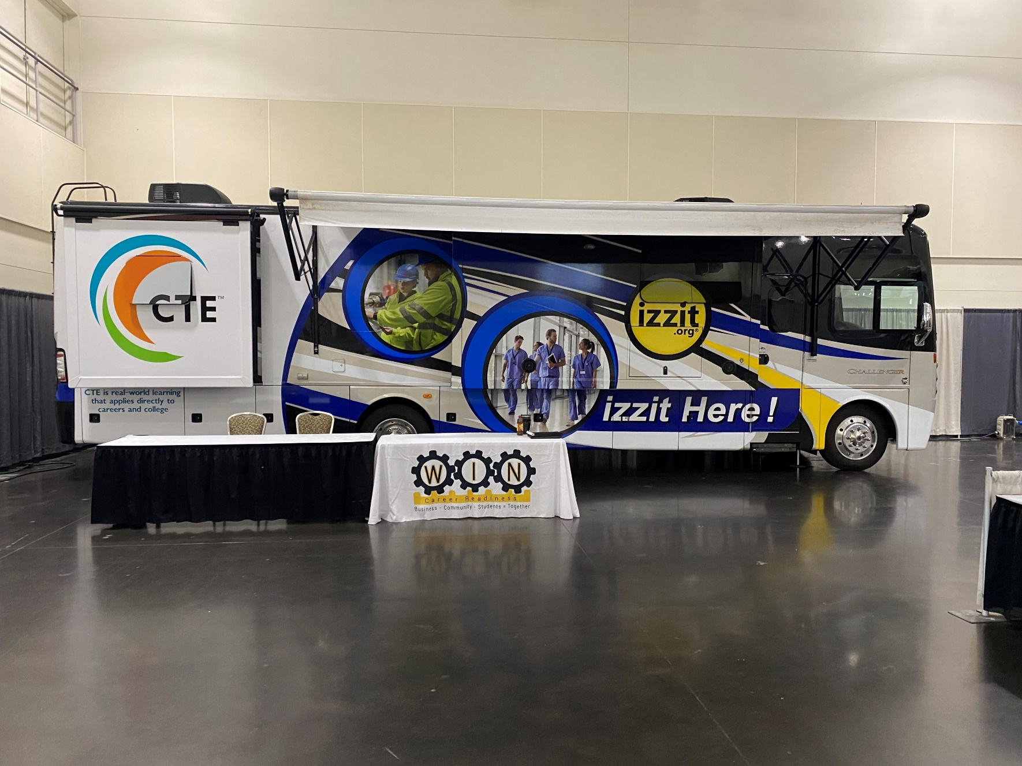
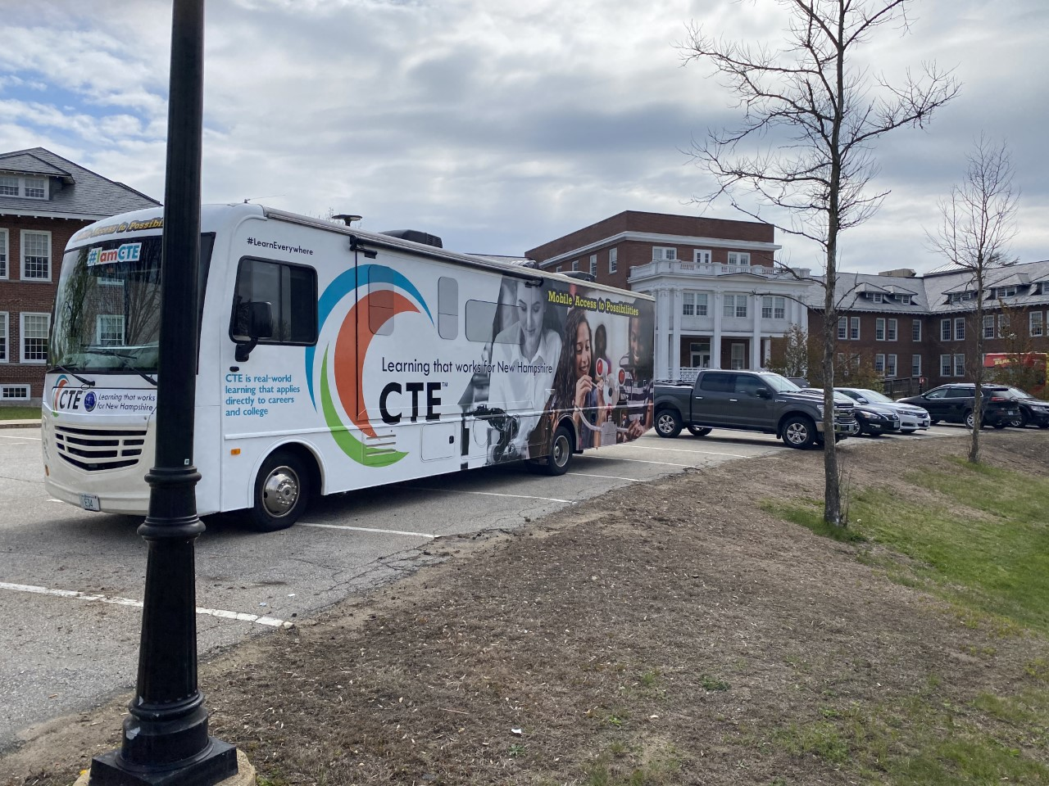
A “vehicle” to spread CTE
Innovative thinking from izzit.org Team!
When I was at the NH DOE, I came up with the idea and utilized Perkins V funds and called it the mobile classroom - M.A.P.s - Mobile Access to Possibilities.
izzit.org has izzit Here!, serving 27 western PA schools through a grant.

Slide 24
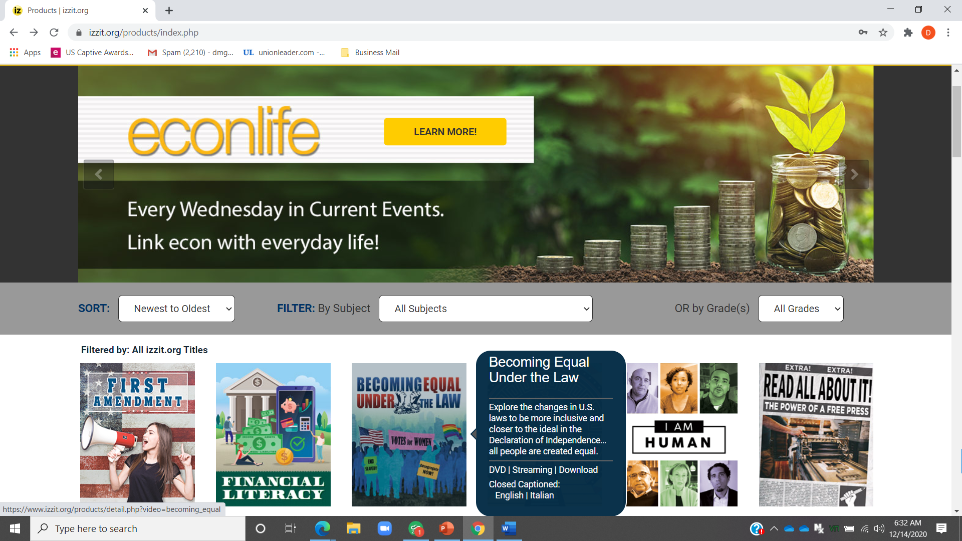
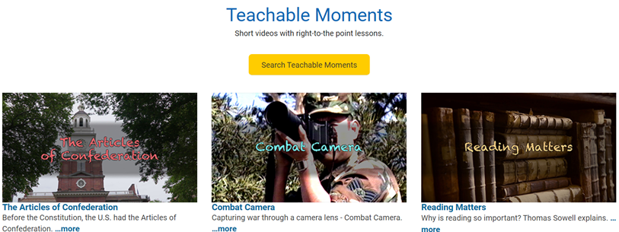



izzit.org provides
(AT NO COST!)
Educational Videos
Over 70 Educational Videos, with teacher guides, quizzes and sub lesson plans. Our 10-15 minute videos encourage critical thinking.
Check out our new catalog located in the footer of the izzit.org home page!
Teachable Moments Videos
Current Events Lessons
Over 60 Teachable Moments – Short, single-topic videos that are an ideal, in-class supplement or homework assignment.
2 lessons each school day with vocabulary and discussion questions.
Learning Modules
U.S.-based Customer Service
8:00am – 6:00pm ET
888-242-0563
Standards-aligned, curated subjects that take a deep dive into today’s hottest topics. May be used as a weeklong (3 hours) activity.

Slide 25

Thank you!
Questions?
Call izzit.org 888-242-0563 8 am – 6 pm Eastern Time
Dean.Graziano@izzit.org
413-306-2598 (Dean’s direct #)
Brian.Dean@izzit.org

