Slide 1
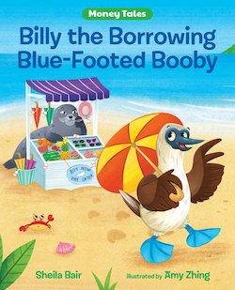
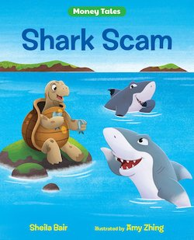

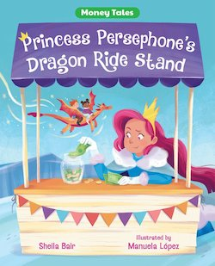
Money Tales Series
Sheila Bair’s New Books
Lauren H Shifflett shiffllh@jmu.edu
Lynne F Stover stoverlf@jmu.edu
March 14, 2023
Notes:
Lauren

Slide 2
EconEdLink Membership
You can now access CEE’s professional development webinars directly on EconEdLink.org! To receive these new professional development benefits, become an EconEdLink member. As a member, you will now be able to:
Automatically receive a professional development certificate via e-mail within 24 hours after viewing any webinar for a minimum of 45 minutes
Register for upcoming webinars with a simple one-click process
Easily download presentations, lesson plan materials and activities for each webinar
Search and view all webinars at your convenience
Save webinars to your EconEdLink dashboard for easy access to the event
Access our new Professional Development page here

Slide 3
Professional Development Opportunities
To earn professional development credit for CEE webinars found on EconEdLink, you must:
Watch a minimum of 45-minutes and you will automatically receive a professional development certificate via e-mail within 24 hours.
Attendees can learn how much credit they will earn per workshop.
Accessing resources:
You can now easily download presentations, lesson plan materials, and activities for each webinar from EconEdLink.org/professional-development/
Local resources:
Insert your local professional development opportunities (if applicable)

Slide 4
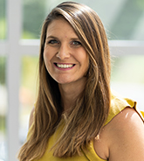
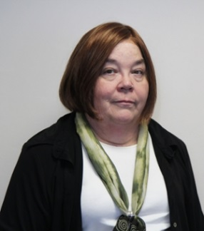
Presenters
Lauren Hensley Shifflett is the new Associate Director at the James Madison University Center for Economic Education. Prior to joining the Center, she spent twelve years in early elementary education where she enjoyed prospering young minds as a classroom teacher. Lauren became nationally known as an elementary economic educator when she received the John Morton Award of the national Council for Economic Education in 2021. Her love for economics guides her lessons to prepare students for life.
shiffllh@jmu.edu
Lynne Farrell Stover is currently a Teacher Consultant at the James Madison University Center for Economic Education. Prior to this, she spent thirty-three years in public education where she enjoyed various teaching assignments including classroom teacher, gifted education specialist, and librarian. She is the author of over fifty educational articles and eight teacher resource books. She is the recipient of the 2022 NAEE Platinum Curriculum Award for her lessons developed for Virginia’s Reading Makes Cents Program.
stoverlf@jmu.edu

Slide 5
Session Agenda
In this session we will:
Introduce the webinar [4 mins.]
Review related standards [1 min.]
Discuss using children’s literature to teach economics and personal finance. [5 mins.]
Explore featured titles and the lessons and activities based on their content. [35 mins.]
Discover online links to websites and resources. [5 mins.]
Share related bibliographies & additional resources. [5 mins.]
Discuss the merits of cautionary tales. [5 mins.]
Notes:
Lauren

Slide 6
Objectives
In this webinar teachers will:
Consider the benefits of using children’s literature to teach in the content areas.
Review the concepts such as compound interest, decision-making, choices, investments, contacts, debt, and Ponzi Schemes.
Consider choices made when making an investment.
Discover methods for teaching the featured concepts using lessons created for the upper elementary and middle school classrooms.
Share related bibliography.
Notes:
lynne

Slide 7
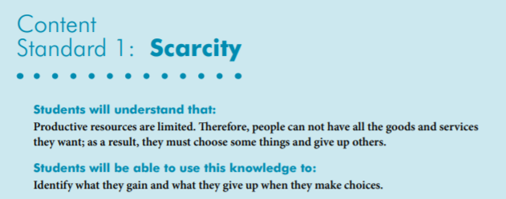
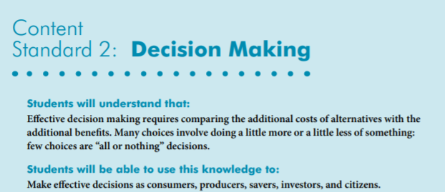

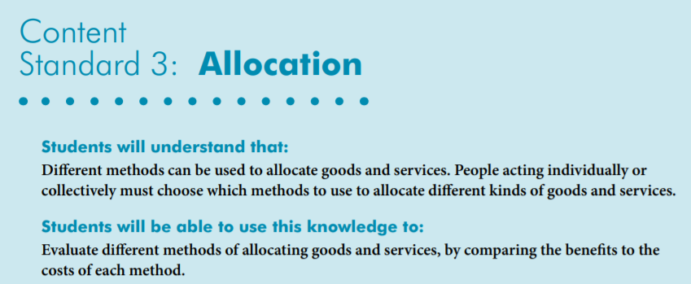
National Standards
https://www.councilforeconed.org/wp-content/uploads/2012/03/voluntary-national-content-standards-2010.pdf

Slide 8
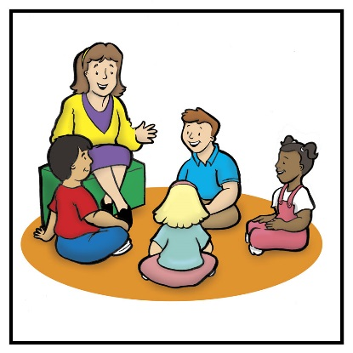
Using Children’s Literature to Teach Content
It is to be noted that by using children’s picture books to teach in the content areas, we are providing students with engaging background information that encourages them to relate to concepts, improve vocabulary, and promote reading and writing skills.
Children’s literature offers many interdisciplinary possibilities including those of economics and personal finance.
Notes:
Lynne

Slide 9
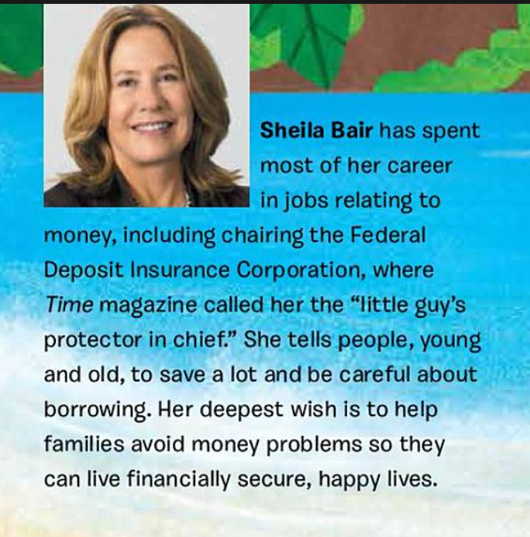
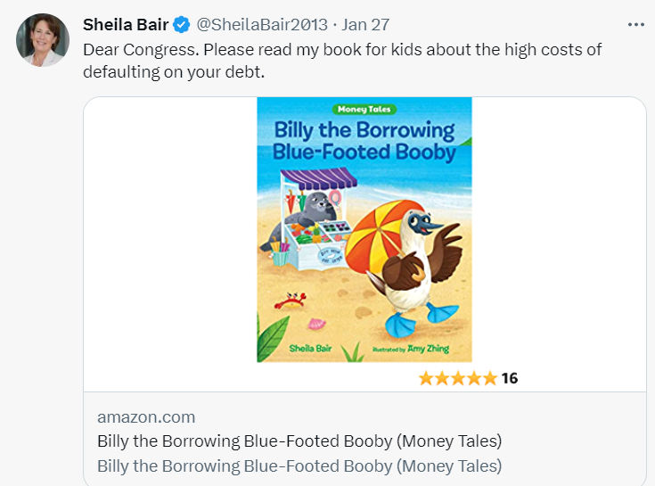


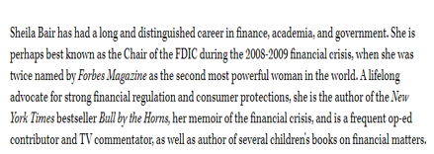
Introducing Sheila Bair
Notes:
Lynne

Slide 10
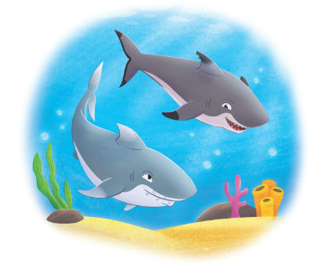
Shark Scam
Two sharks convince giant tortoise Arlene to invest in their business, and Arlene takes the bait but soon finds out it was a Ponzi scheme. Includes information on Ponzi schemes.
Publisher: Albert Whitman
Copyright Date: 2022
Reading Level: 3.0
Interest Level: 5-9
Notes:
Lauren

Slide 11
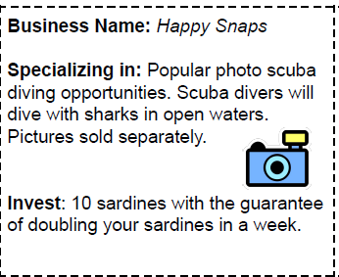
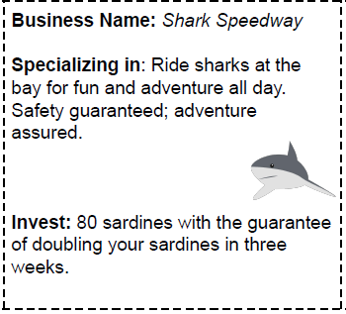
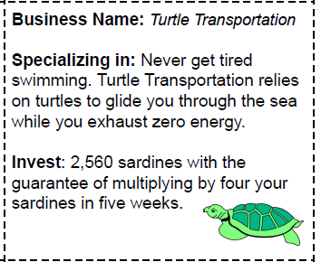
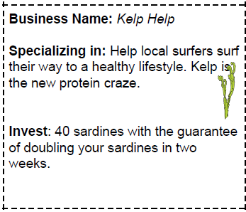
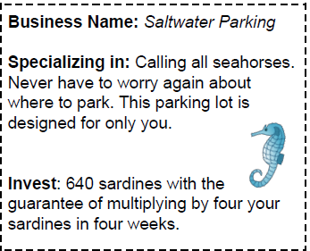
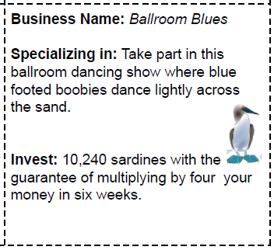

Slide 12
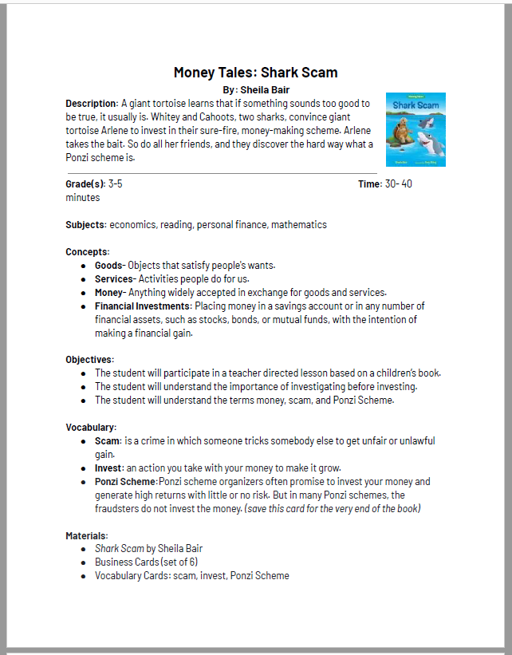
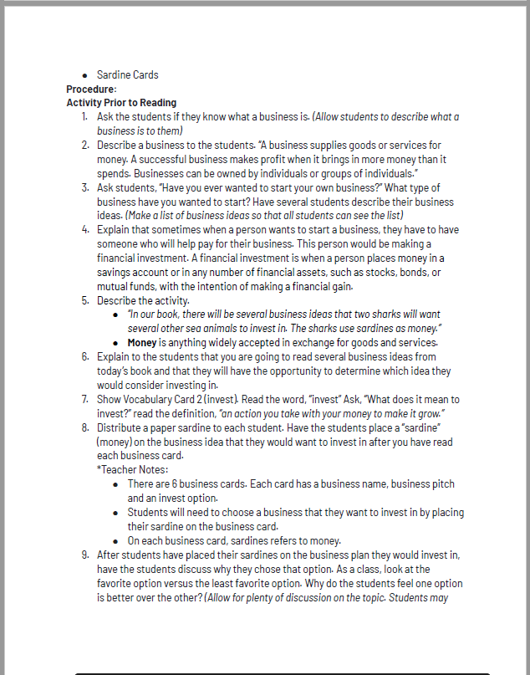
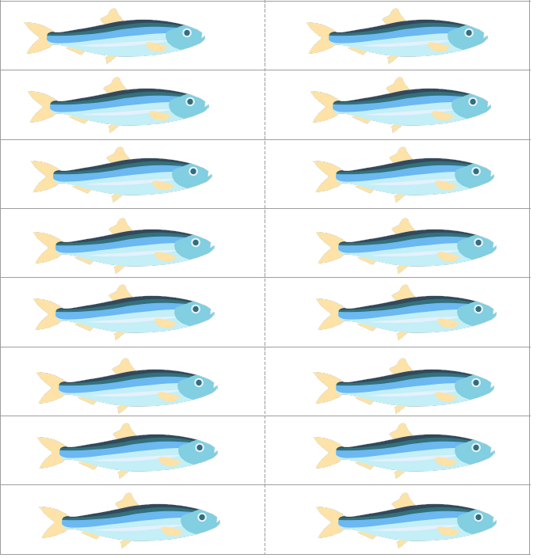

Slide 13
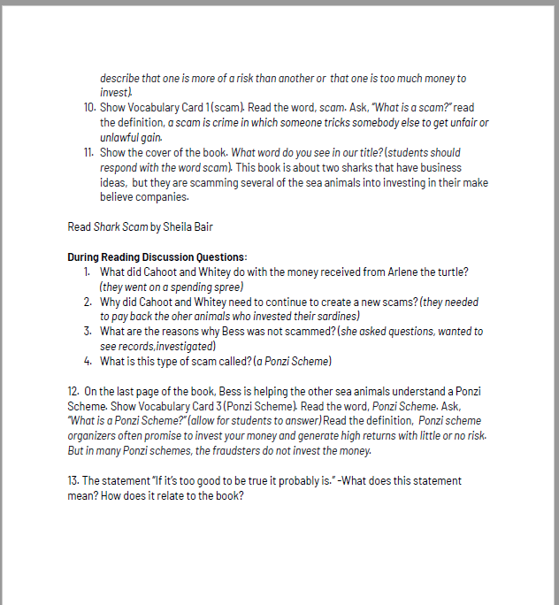
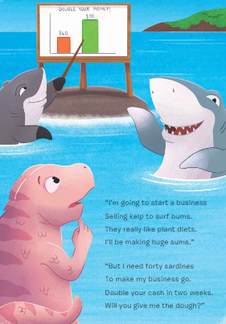
P. S. Bess the Blue-footed Booby is one smart chick!

Slide 14
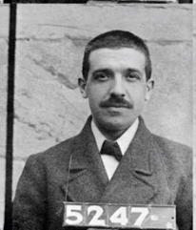
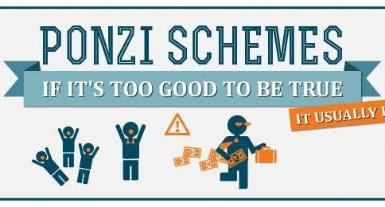
Who Was Charles Ponzi?
https://www.google.com/search?q=ponzi+video+for+kids&source=lnms&tbm=vid&sa=X&ved=2ahUKEwj01Zil3KT9AhUUMlkFHYWiAagQ0pQJegQIBBAC&biw=1440&bih=722&dpr=2#fpstate=ive&vld=cid:b1187106,vid:PyEMlmJZHro
Notes:
Lauren

Slide 15
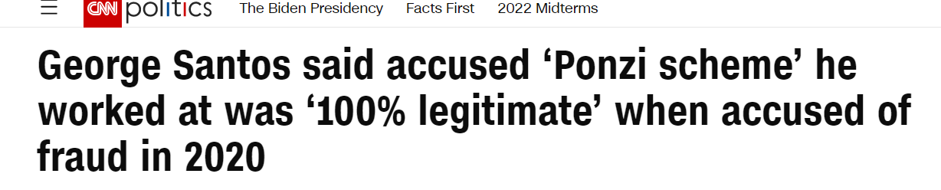
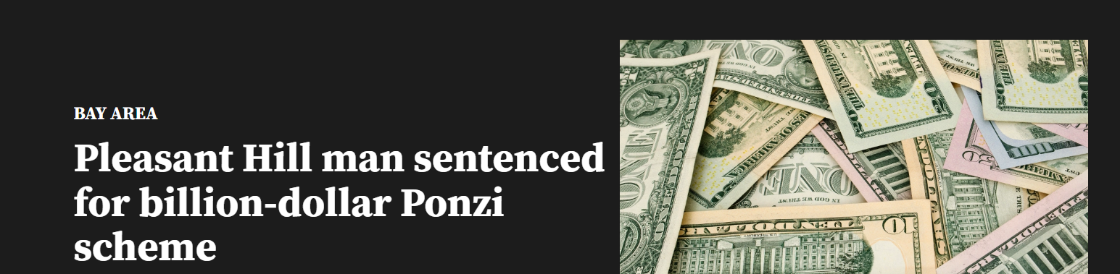
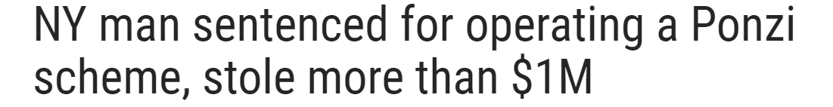
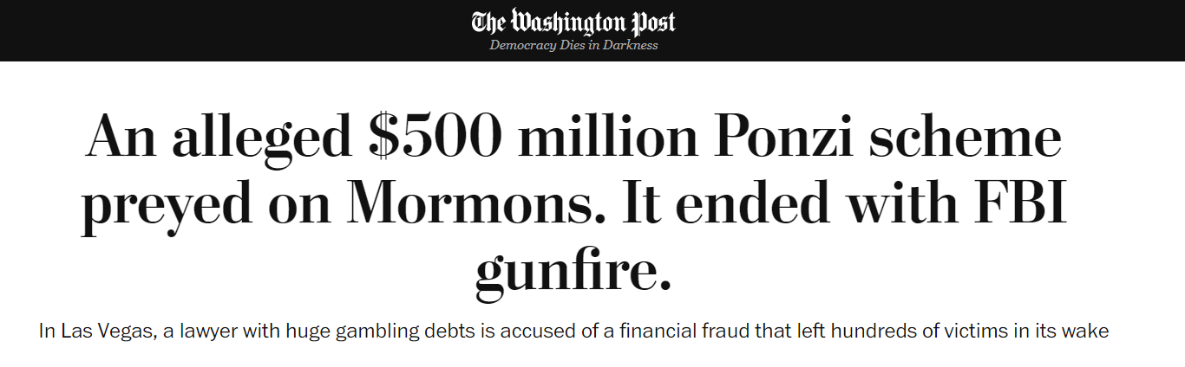
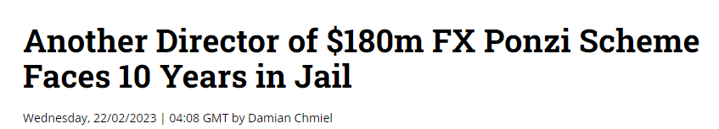
Ponzi Scheme “In the News”

Slide 16
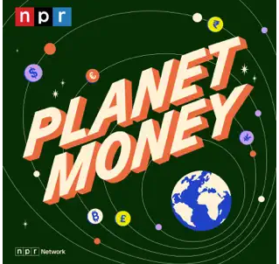
https://podcasts.apple.com/us/podcast/planetmoney/id290783428?i=1000595828012
Some of history's biggest financial scams owe their name to Charles Ponzi. Listen to the story of the man behind the scheme.

Slide 17
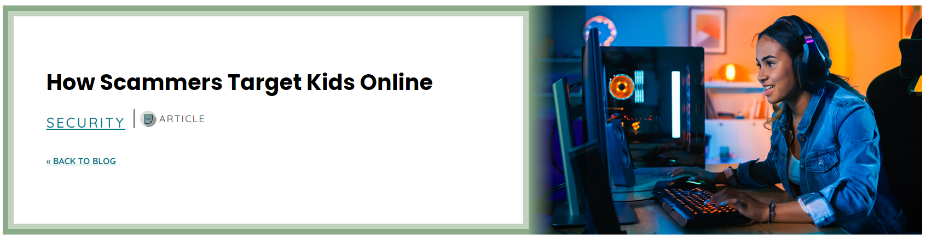
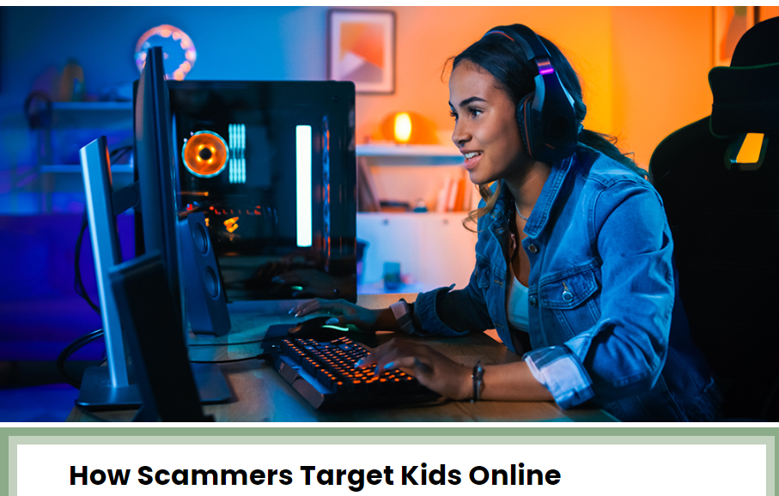
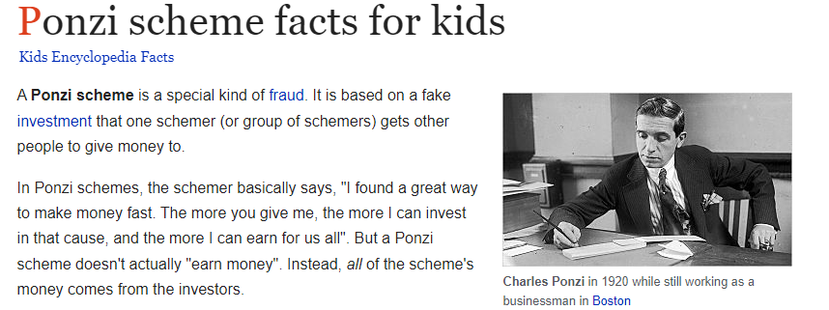
https://www.onpointcu.com/blog/how-scammers-target-kids-online/
https://kids.kiddle.co/Ponzi_scheme

Slide 18
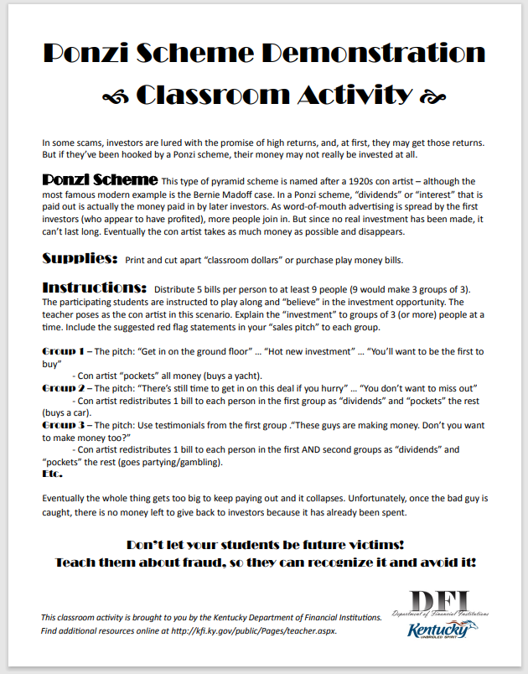
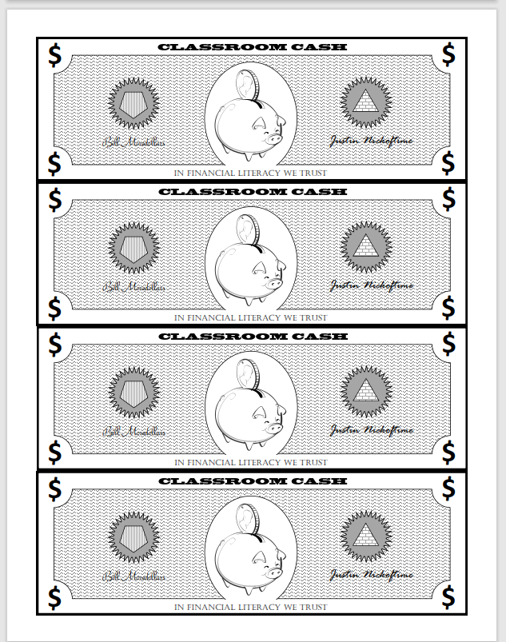
https://kfi.ky.gov/Documents/Ponzi%20Scheme%20Demonstration%20-%20Classroom%20Activity.pdf

Slide 19
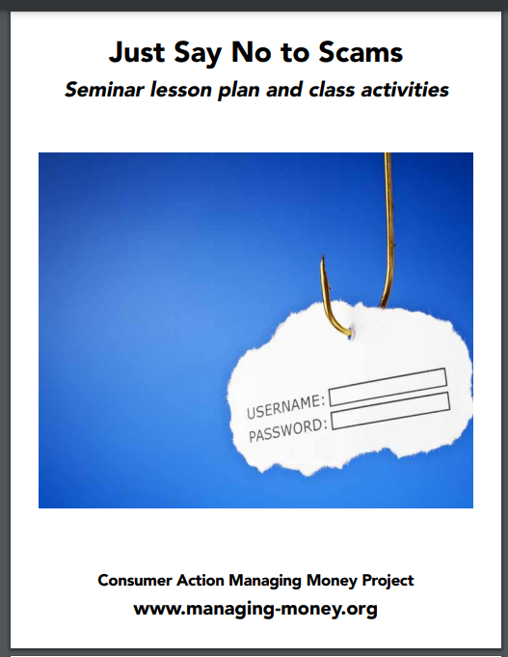
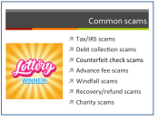
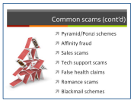
~Secondary Slide Trip~
Twenty-six page booklet
https://www.consumer-action.org/downloads/english/Scams_Lesson_2018.pdf
Notes:
Lynne concept lessons available at the secondary level (30 seconds)

Slide 20

Billy the Blue-Footed Booby
Billy the Blue-Footed Booby, who lived on the Galapagos, wanted to buy an umbrella, so he went to Selling Seal. But Billy didn't listen to Seal's explanation of what that umbrella would end up costing him. And then Billy wanted a fan like Arlene the tortoise's, a purple-striped wig like Ig the iguana's, neon-green shoes like Niels the lizard's, and Seal's anchovy grill. All his friends and his twin sister Bess tried to help, but Billy lost everything.
Publisher: Albert Whitman
Copyright Date: 2021
Reading Level: 3.0
Interest Level: 5-9
Notes:
Lauren introduces book (no lesson needed for this session – Ponzi scheme clip and info shared

Slide 21
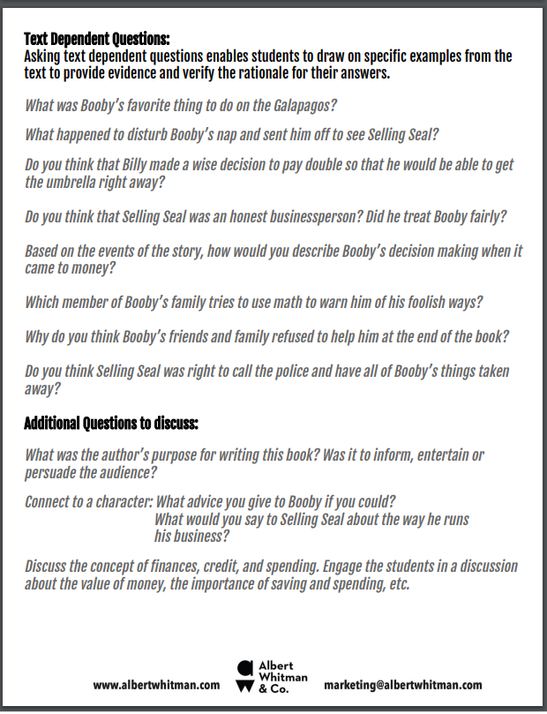
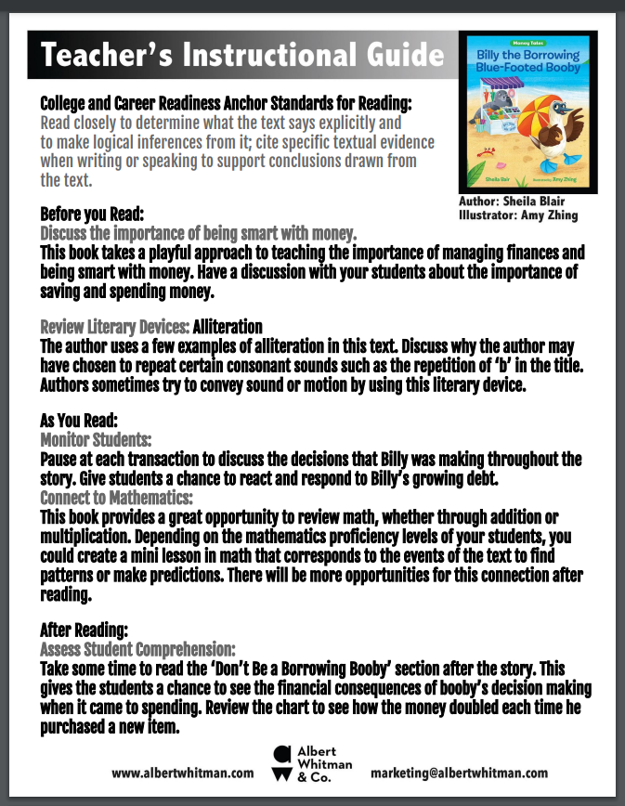
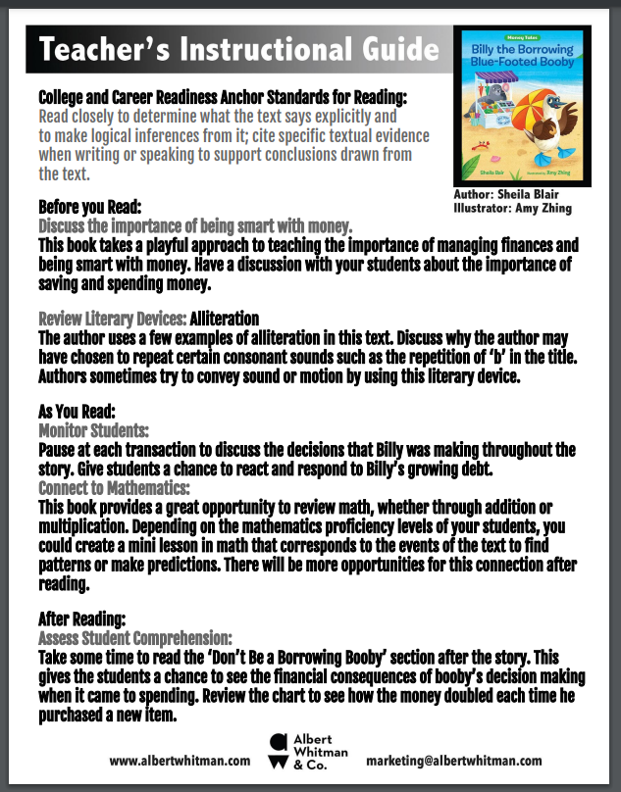
file:///C:/Users/stoverlf/Downloads/Billy-the-Borrowing-Blue-Footed-Booby-TG.pdf

Slide 22
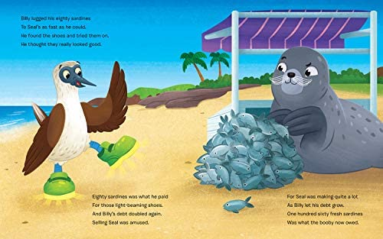
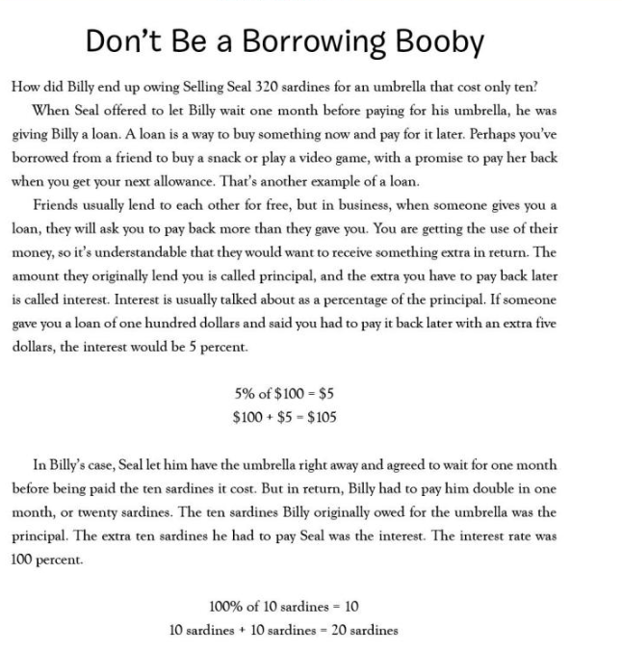
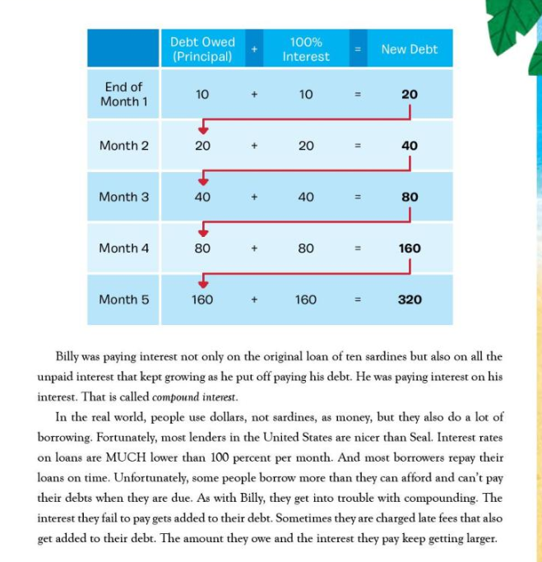
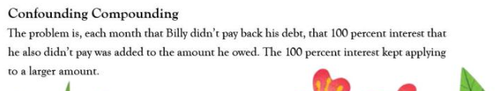
Book Illustrations and Backmatter
Notes:
Lynne – Share that all the books contain helpful backmatter.

Slide 23

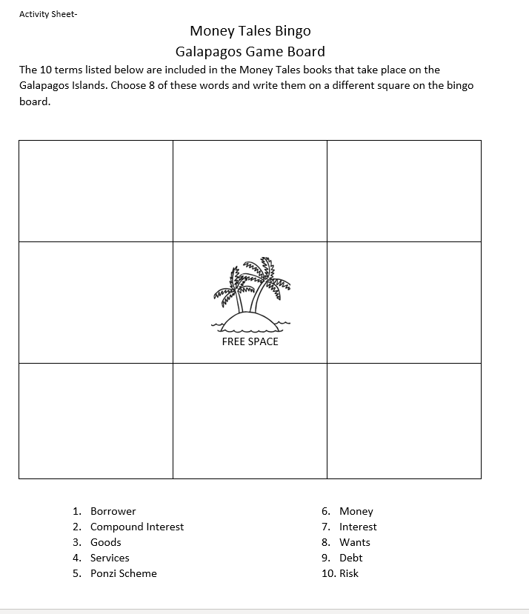
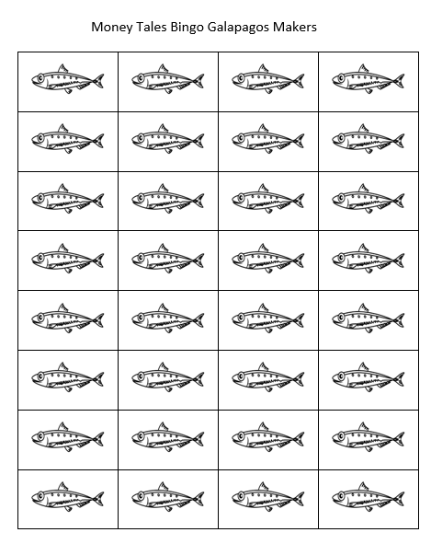

Slide 24
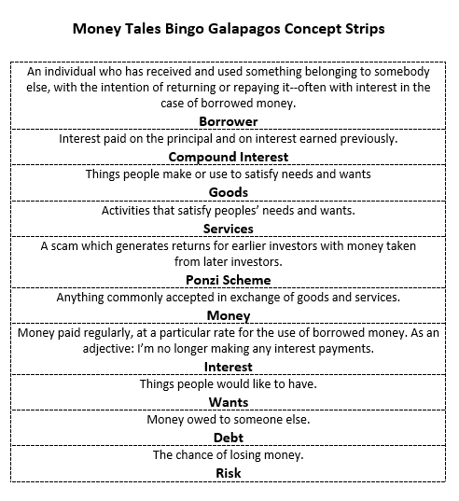



Slide 25



~Secondary Slide Trip~
https://www.econedlink.org/resources/how-expensive-are-payday-loans/
https://www.stlouisfed.org/-/media/project/frbstl/stlouisfed/Education/Curriculum/pdf/Its-Your-Paycheck-Lesson-8.pdf
Notes:
Lynne concept lessons available at the secondary level (30 seconds)

Slide 26

Princess Persephone’s Dragon Ride Stand
A princess and her pet dragon discover that while making money can be difficult, keeping it can be even harder. Princess Persephone wants to travel somewhere warm and sunny in a shiny new spaceship. But her father won't give her the money she needs for her dream vacation. Persephone comes up with a great idea to earn cash: dragon rides! Learn the ups and downs of entrepreneurship in this amusing story about working hard and spending wisely
Publisher: Albert Whitman
Copyright Date: 2022
Reading Level: 3.0
Interest Level: 5-9
Notes:
Lynne-

Slide 27



Notes:
Lynne-

Slide 28




Princess Persephone’s Dragon Ride Stand
Writing an Imaginary Business Plan
INTRODUCTION: Princess Persephone, who lives on the moon Ganymede, is eager to earn money to purchase a spaceship so she can take a vacation to Earth. She will need to become a successful entrepreneur. Spaceships are expensive.

Slide 29


Slide 30



~Secondary Slide Trip~
https://www.econedlink.org/resources/is-it-worth-it/
https://www.kansascityfed.org/Education/documents/7897/NCEE_EntrepreneurshipGuide_2021_FINAL.pdf
Notes:
Lauren

Slide 31


Princess Persephone Loses the Castle
Princess Persephone was cold in her castle on freezing Ganymede. So, when Aluminum Jim came calling to sell her tin sheets to nail onto the exterior walls to keep out the cold, Persephone was only too happy to agree and signs the contract without reading it. She then learns a valuable lesson about reading the small print.
Publisher: Albert Whitman
Copyright Date: 2021
Reading Level: 3.0
Interest Level: 5-9

Slide 32


file:///C:/Users/stoverlf/Downloads/Princess-Persephone-Loses-the-Castle-TG%20(1).pdf

Slide 33


Money Tales Bingo

Slide 34



Slide 35
Human Capital: Intangible assets possessed by individuals,
including knowledge, talent, skills, health, and values.
Princess Persephone invests in herself!
She became a lawyer many years later
An expert at reading contract paper.
Renowned throughout the Milky Way
For Keeping cheats and scoundrels at bay.
Protecting the meek and law abiding
From crooks like Jim and his cheap, tin siding.

Slide 36


~Secondary Slide Trip~
https://www.econedlink.org/resources/show-me-the-money/
https://www.stlouisfed.org/-/media/project/frbstl/stlouisfed/education/curriculum/pdf/its-your-paycheck-lesson-1.pdf
Notes:
Note- Show Me the Money Lesson contains a worksheet (Mortgage from Hell) that shows that the loan will never be paid off.

Slide 37

Assessment Questions
Thinking about Money Tales Common Themes
These books all serve as cautionary tales; stories that are told to alert the listeners of a specific danger.
They teach a lesson, often to children.
They follow a specific pattern:
  A situation or individual is said be menacing, or dishonest.
  The main character disregards the warning.
  The character who ignored the warning suffers negative consequences.
  Do you think young children will benefit by interacting with these stories?

Slide 38


Book Series Favorites

Slide 39

Invest In Girls

Slide 40

NEC

Slide 41

NPFC

Slide 42

Advocacy

Slide 43

Suggested Presentation Deck
CEE Affiliates
https://www.councilforeconed.org/resources/local-affiliates/
Include your local affiliate page

Slide 44











Thank You to Our Sponsors!
44

Slide 45
Contact information
Thank You
Lauren H Shifflett shiffllh@jmu.edu
Lynne F Stover stoverlf@jmu.edu

