Slide 1
Presented by: Kathleen Brennan Email: kmbrennan108@gmail.com Date: February 21, 2023
2023 Winter Economics Bootcamp

Slide 2
EconEdLink Membership
You can now access CEE’s professional development webinars directly on EconEdLink.org! To receive these new professional development benefits, become an EconEdLink member. As a member, you will now be able to:
Automatically receive a professional development certificate via e-mail within 24 hours after viewing any webinar for a minimum of 45 minutes
Register for upcoming webinars with a simple one-click process
Easily download presentations, lesson plan materials and activities for each webinar
Search and view all webinars at your convenience
Save webinars to your EconEdLink dashboard for easy access to the event
Access our new Professional Development page here

Slide 3
Professional Development Opportunities
To earn professional development credit for CEE webinars found on EconEdLink, you must:
Watch a minimum of 45-minutes and you will automatically receive a professional development certificate via e-mail within 24 hours.
Attendees can learn how much credit they will earn per workshop.
Accessing resources:
You can now easily download presentations, lesson plan materials, and activities for each webinar from EconEdLink.org/professional-development/
Local resources:
Insert your local professional development opportunities (if applicable)

Slide 4
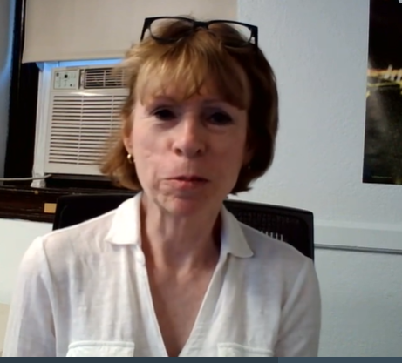
Kathleen Brennan
Mathematics Department Chair
Mount Saint Mary Academy
Watchung, NJ
AP Economics
Intro To Economics
Personal Finance
Business Analytics
Social Entrepreneurship
Euro/Fed Challenge Teams
Investment Club
Quality Of Life Innovations Competition

Slide 5
Agenda
9:00- 9:55 - Part 1: Scarcity and Opportunity Cost
9:55- 10:00 - Break
10:00- 10:55 - Part 2: Economic Goals and Systems
10:55-11:00- Break
11:00- 11:55- Part 3: Supply and Demand
11:55- 12:00- Survey and Closing Remarks ​

Slide 6
National Standards
Standard 2
Students will understand that: Effective decision making requires comparing the additional costs of alternatives with the additional benefits. Many choices involve doing a little more or a little less of something: few choices are “all or nothing” decisions.
Students will be able to use this knowledge to make effective decisions as consumers, producers, investors, and citizens.

Slide 7
New York State Standards
Standard 4- Economics
Students define and apply basic economic concepts such as scarcity, supply/demand, opportunity costs, production, resources, money and banking, economic growth, markets, costs, competition, and world economic systems.
The study of economics requires an understanding of major economic concepts and systems, the principles of economic decision making, and the interdependence of economies and economic systems throughout the world.

Slide 8
Objectives
Introduce the fundamental economic concepts of scarcity, opportunity costs, economic systems, and market behavior.
Share lessons and activities that can be used to engage students.

Slide 9
Scarcity

Slide 10
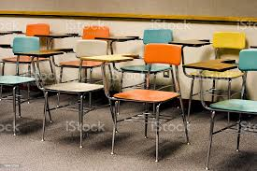
OPENING DAY ACTIVITY: SCARCE CHAIRS
(With many thanks to Jason Welker)
Scarce Chairs Lesson Plan

Slide 11
How Are Seats Allocated in Our Society?
Movie Theaters
Universities
Private Hospitals
Airlines
Restaurants

Slide 12
ALLOCATION METHODS
Lottery
First-come, first-served
Physical attributes
Merit
Rationing
Payment
Brute force- teacher or “ruler” decides

Slide 13
Economist’s Favorite Solution
Sealed- Bid Auction
Write your full name
Write the maximum amount you would be willing and able to pay each day to have a chair to sit in for the next month.
There is no limit; you can pay me each week. I will donate the money to a charity of my choice.
Once you make a bid to rent a chair, fold your bid, and hand it to me.

Slide 14
Time to Talk
Did everyone make a bid greater than zero?
Why/why not?
Why did some people bid more than others?
Was our system fair?
Did you feel bad for those who didn’t get a chair?

Slide 15
EQUITY vs. EFFICIENCY
Equity means fairness. (But what does fair mean?)
Efficiency means resources go toward their most socially optimal use.
The tradeoff between equity and efficiency is a major theme for societies!

Slide 16
SCARCITY
Everyone wants to sit– there aren’t enough chairs.
The greater the demand relative to the supply, the more scarce an item is.
Choices must therefore be made on how to allocate scarce resources.

Slide 17
Fundamental Economic Questions
What is scarcity and why does it exist?
What are some of the scarce resources in the world outside of school?
How should scarce resources be allocated between competing needs and wants?
Who should get the stuff that scarce resources go toward producing?
What is fair? What is efficient?
What kind of system for allocating scarce resources is both fair and efficient? Scarce Chairs Assignment

Slide 18
The Price System
Markets Typically Allocate Resources Based on Price and the Ability to Pay

Slide 19
Should There Be a Price For Everything?

Slide 20
The Current “Market” for Kidneys
Over 3,000 new patients are added to the kidney waiting list each month. Thirteen people die each day while waiting for a life-saving kidney transplant
The United States discards about 3,500 donated kidneys a year, many of which could be used to save lives.
For 25 years, the waiting list for donor kidneys, currently 106,000, has remained stubbornly high due to regulations rooted in a federal policy that amounts largely to first come, first served.
Source: National Kidney Foundation

Slide 21
SVU: Black Market Kidneys (6:18)

Slide 22
Should There Be a Market for Kidneys?
After watching the video clip, answer the following questions:
Would the transplant process be more efficient if people could buy and sell organs?
Is it ethical to trade in organs, and what would be the negative consequences of this market?

Slide 23
STUDENf HANDOUT A
Kidney Transplant Case Study
Using the criteria listed, you are to select one patient for a kidney transplant. You are to assume that all suffer from equally urgent cases of kidney failure and that those who do not receive a transplant will die within the year.
CRITERIA: 1) the person's merit 2) their contribution to society (past or potential) 3) their ability to pay 4) their need 5) their age
Patient #1: Dr. M.
Forty-five year old physician with large inner-city practice. Had mild he.art attack three years­ ago, but made good recovery and he.art seems sound. No wife or children. Present yearly income: $70,000. Potential lifetime earnings: $994,095. Health insurance? Yes.
Patient #2: Bonnie T.
Twenty-four year old mother of two children. Active in community work. Red Cross, church. Plans to resume nursing career when children reach school age (4 years). Yearly income now: (Husband's $32,000). Her potential lifetime earnings: $327,003. Health insurance? Yes.
Patient #3: Fred S.
Third year medical student, doing well and considered "of great promise" by his advisors. Plans to specialize in neurology. Father of one child, another on the way. Yearly income now:
$10,000. Potential life earnings: $1,149,812. Health insurance? Yes.
Patient #4: Agnes M.
Twenty-six year old mother of two children, abandoned by husband. Unable to work because of lack of day-care facilities in area: presently on welfare. Activities: church, Tenant's Organization in her building, welfare rights organization. Present yearly income: (public aid
+ food stamps) $6,996. Potential lifetime earnings: $121,425. Health insurance'] Medicare.
Patient #5: Ellen R.
College junior, 20, suffering from hereditacy condition. Doing excellent work in school, has been accepted already for law school. Family fears her twin sister has the same disease. Yearly income now: (Parent's) $47,000. Potential lifetime earnings: $928,753. Health insurance? Yes.
7.4

Slide 24
An Economist’s Solution (9:58)

Slide 25
Scarcity (2:57)

Slide 26
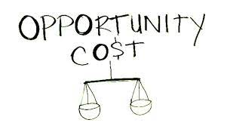

Slide 27
Opportunity Costs with Paul Solman and Economists (9:09)

Slide 28
Important Concepts
Explicit Costs- monetary payment made to an outsider to acquire an item, service, or activity
Implicit Costs- the imputed costs of the next best alternative
Opportunity Cost = Explicit Costs + Implicit Costs
The opportunity cost of an action is the next best alternative you must give up to get it. Your decision should reflect all your opportunity costs, rather than just your out-of-pocket expenses. Both explicit and implicit costs are considered opportunity costs.

Slide 29
YOUR MORNING DILEMMA
What choices did you have this morning as your alarm went off or someone told you it was time for school?
ALTERNATIVES | GET UP NOW | DON’T GET UP NOW-GET UP LATER
PERCEIVED BENEFITS
CHECK THE BOX OF THE ALTERNATIVE TAKEN.
CHECK THE BOX OF THE ALTERNATIVE NOT TAKEN. THIS IS YOUR OPPORTUNITY COST.
BENEFITS REFUSED
DISCUSSION
What benefits did you give up if you decided to get up now?
What benefits did you give up if you decided to get more sleep?
Your opportunity cost can be characterized as the benefits you refused when you made your choice.
Adapted from: Krueger and Anderson. Explorations in Economics (2014).

Slide 30
The Opportunity Cost of Pursuing a College Education
(per year)
If you go to College | If you decide to work full-time | Cost of College relative to working full-time
Tuition- $50,000 | You won’t pay tuition | $50,000 tuition
You don’t get a job | You earn $30,000 | $30,000 foregone income
Room and board- $20,000 | Rent and meals- $20,000 | No opportunity cost (You have to pay for housing and food regardless)
8 hours per day studying | 8 hours per day working | Assume no opportunity cost- indifferent between studying and working
 |  | Total= $80,000 opportunity cost

Slide 31
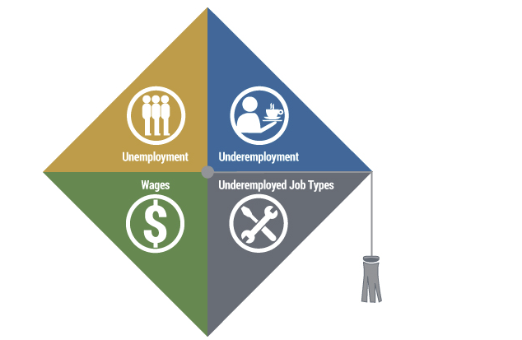
Federal Reserve Bank of New York- Economic Research
The Labor Market for Recent College Graduates
Compare the unemployment rates of recent college graduates
Monitor the underemployment rate of recent college graduates
Track trends in the types of jobs held by those who are underemployed
Gauge the earnings of recent college grads against those of workers holding only a college diploma

Slide 32
Opportunity Cost- MJM Foodie
Episode 7- Individual PPC- 6:20
Episode 8- Opportunity Cost- 3:39
Episode 9- Society’s PPC- 7:39
Episode 10- PPC/Resource Changes- 3:05

Slide 33
Links to Scarcity/Opportunity Cost Resources
CEE Opportunity Cost Resources
Scarce Chairs Lesson Plan
Scarce Chairs Assignment
SVU: Black Market Kidneys
Kidney Transplant Case Study
Your Morning Dilemma
Resource Scarcity Game

Slide 34
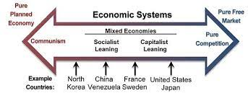
PART 2
ECONOMIC SYSTEMS
Commons/Wikimedia.org

Slide 35
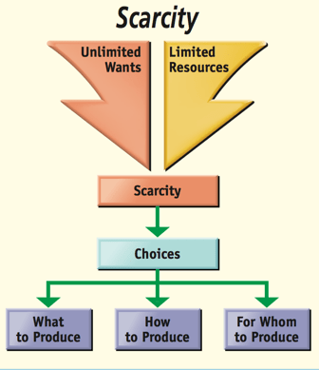
Foundations of Economics

Slide 36
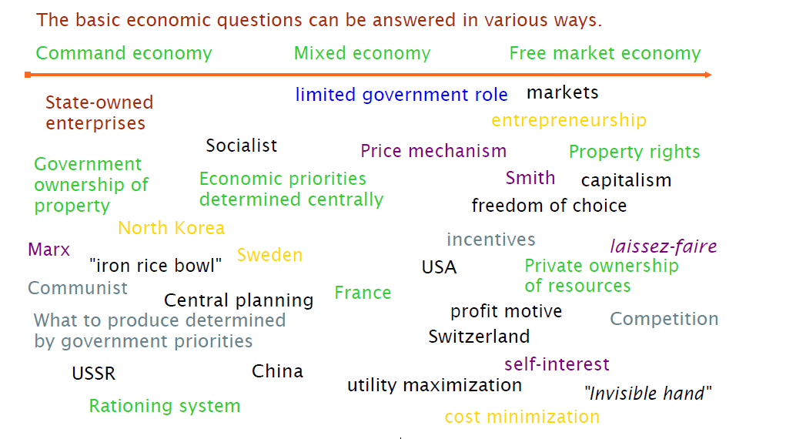
Types of Economic Systems
Source: Jason Welker

Slide 37
Economic Systems (9:43)

Slide 38
Traditional Economy
Economic activity is based on ritual, habit and custom.
Everyone knows their role.
Source: David Mayer

Slide 39
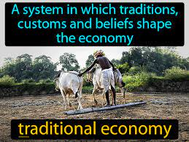
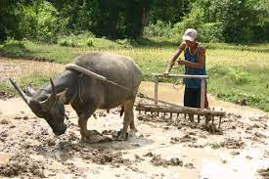
TRADITIONAL ECONOMY
ADVANTAGES | DISADVANTAGES
Everyone knows their role | Tends to discourage new ideas
Little uncertainty over what to produce or how to produce | Lack of progress leads to lower standard of living
The question of For Whom to produce is answered by custom
Life is generally stable, predictable
Strong social safety net

Slide 40
Command Economy
Central authority makes most economic decisions.
Economic decisions are made by central planning.
People are expected to go along with the choices their leaders make.

Slide 41
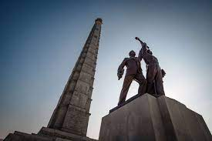
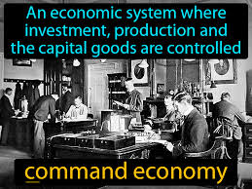
Command Economy
ADVANTAGES | DISADVANTAGES
Can change direction in a relatively short period of time | Little economic freedom
Everyone has a “job” | Businesses don’t have freedom to decide what and how much to produce
Can develop specific industries | Not responsive to market demand
Everyone is provided for | Few incentives to work hard
 | Individuals with new or unique ideas are stifled

Slide 42
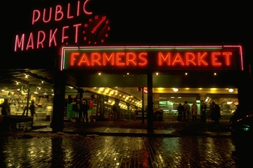
Market Economy
People and firms act in their own best interest to answer what to produce, how to produce, and for whom to produce
Markets allow buyers and sellers to come together in order to exchange goods and services

Slide 43
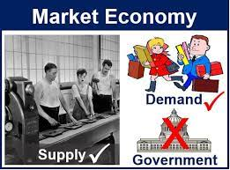
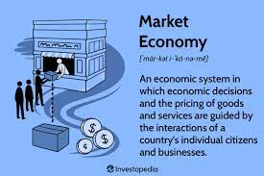
Pure Market Economy
Advantages | Disadvantages
Competition incentivizes the production of high-quality items at low cost. | Limited central authority to enforce property rights, enforce contracts, etc.
Individuals own the factors of production | Externalities such as pollution are often not considered
Laissez Faire- relatively small degree of government interference | Existence of asymmetric information
Decision making is decentralized | Monopolies may eliminate competition
Variety of goods and services are produced | Survival of the fittest- young, sick, old may have difficulty in a pure market economy
High degree of consumer satisfaction | Public goods, such as national defense, will not be provided

Slide 44
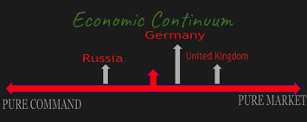
Mixed Economies
A system with free markets, but also with some government intervention.

Slide 45
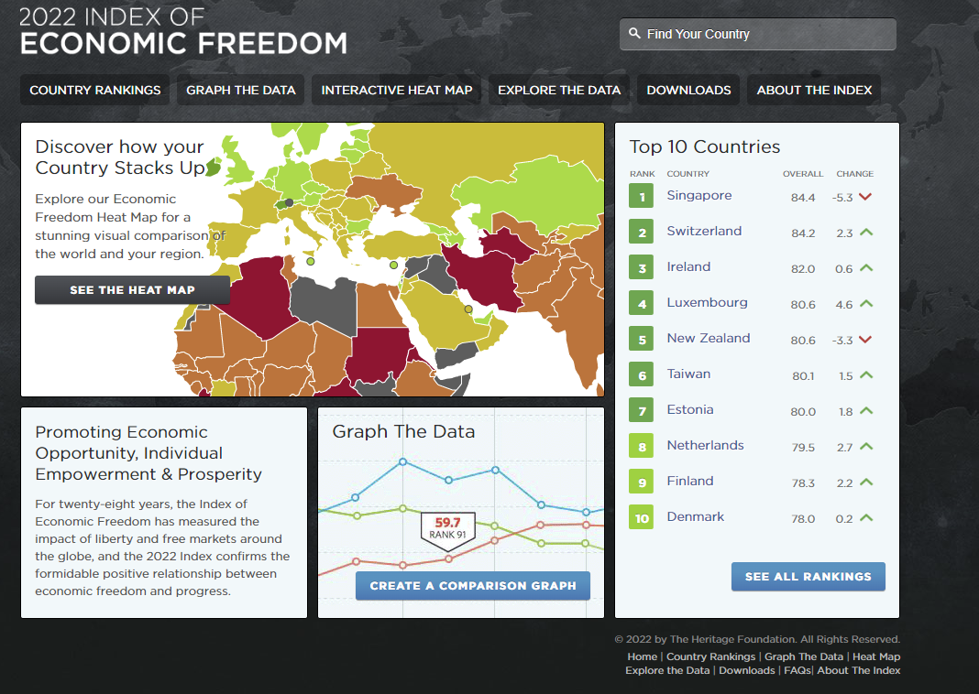
Index of Economic Freedom- Heritage Foundation

Slide 46
The Worst Economy- Jacob Clifford (6:38)

Slide 47
The Hunger Games- Jacob Clifford (7:04)

Slide 48
Links to Economic Systems Resources
Comparing Economic Systems
Index of Economic Freedom- Heritage Foundation
Economic Systems Assessment
Comparative Economic Systems Project

Slide 49
PART 3
DEMAND AND SUPPLY
MRU UNIVERSITY
CEE Standards Alignment

Slide 50
The Demand Curve (3:31)
MRU- Law of Demand Lesson Plan

Slide 51
The Demand Curve Shifts (9:54)
MRU- The Demand Curve Shifts Lesson Plan

Slide 52
Change in Demand vs. Change in Quantity Demanded (3:19)

Slide 53
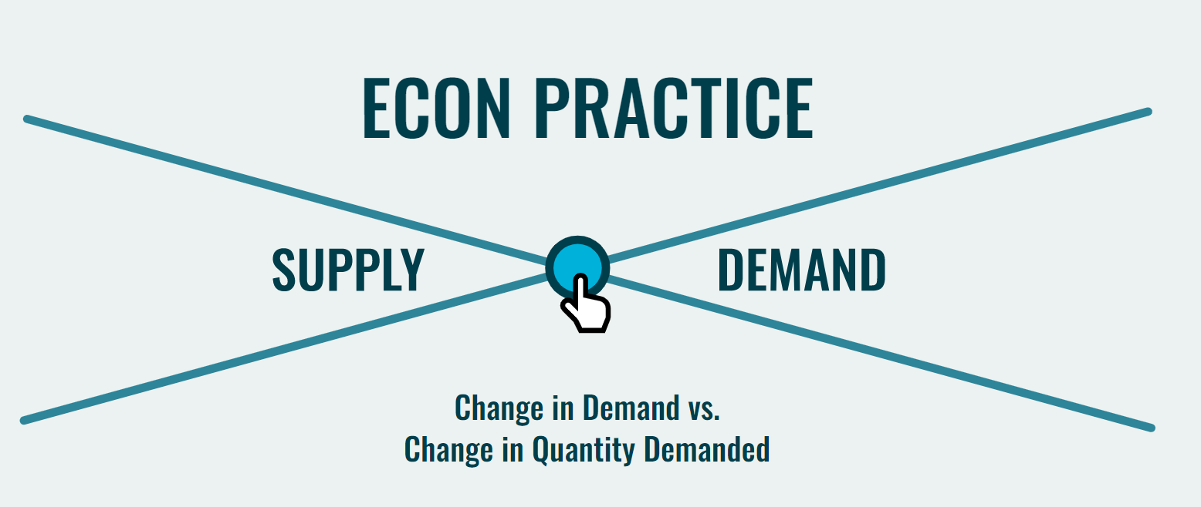
Interactive Practice
Interactive Practice- Demand

Slide 54
The Supply Curve (2:54)
MRU- Law of Supply Lesson Plan

Slide 55
The Supply Curve Shifts (12:15)
MRU: The Supply Curve Shifts Lesson Plan

Slide 56
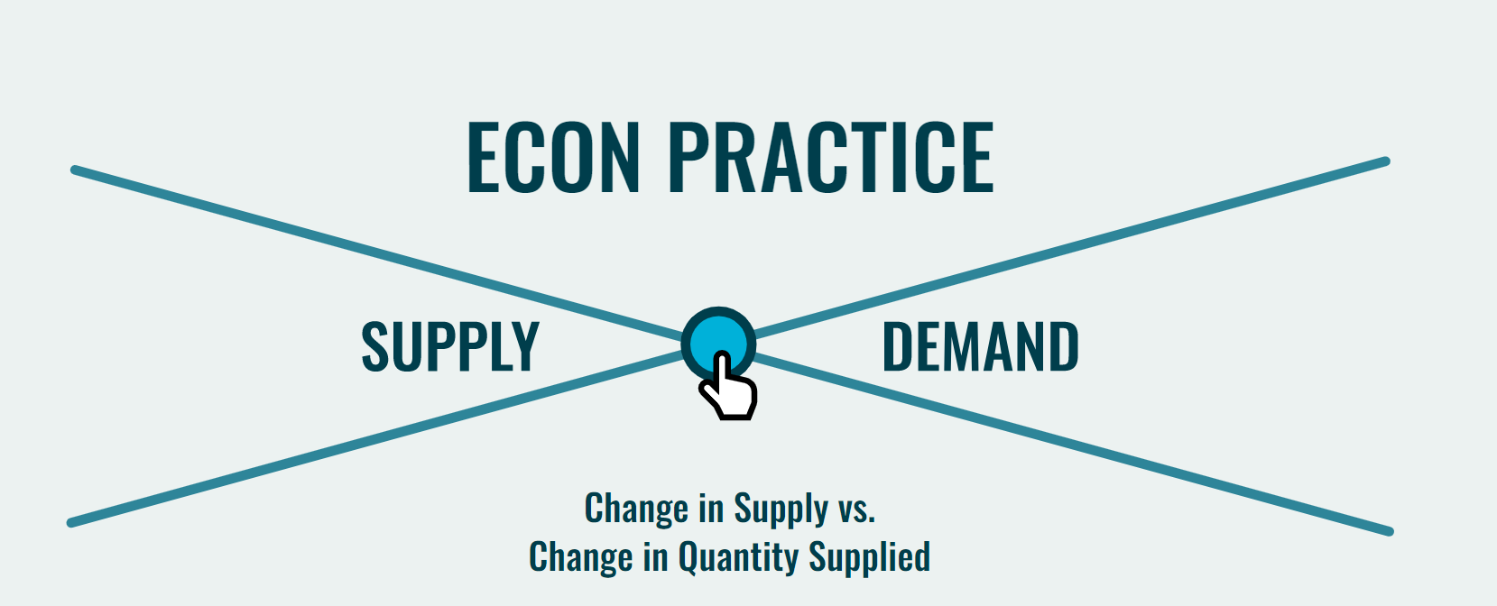
Interactive Practice
Interactive Practice- Supply

Slide 57
The Equilibrium Price and Quantity (4:50)
MRU- Finding Equilibrium Lesson Plan

Slide 58
Supply and Demand
Demand Schedule
P
S
Supply Schedule
$5
4
3
2
1
P | Qd
$5 | 10
$4 | 20
$3 | 30
$2 | 50
$1 | 80
P | Qs
$5 | 50
$4 | 40
$3 | 30
$2 | 20
$1 | 10
Equilibrium Price = $3 (Qd=Qs)
D
10 20 30 40 50 60 70 80
Q
Equilibrium Quantity is 30
Copyright
ACDC Leadership 2020

Slide 59
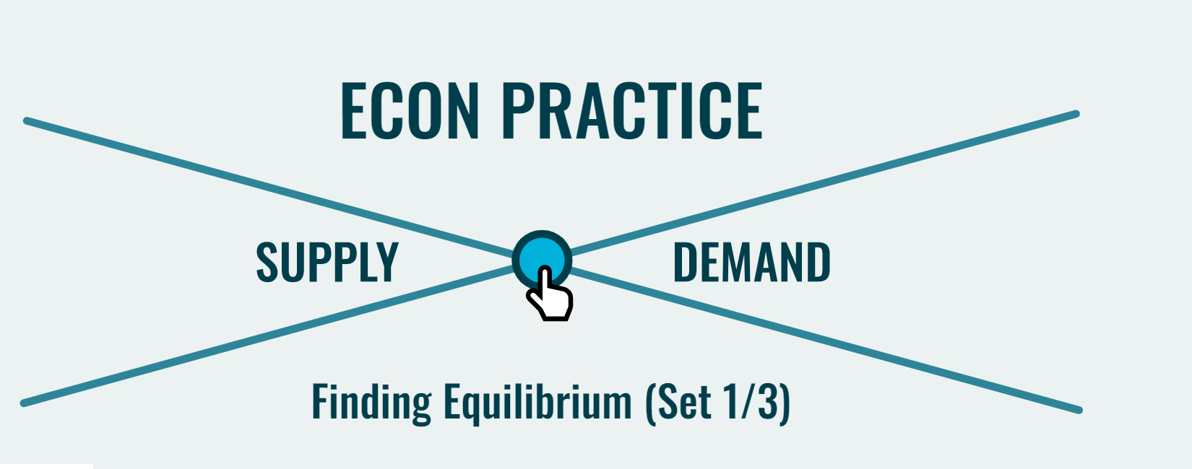
Interactive Practice
Interactive Practice- Equilibrium
Additional Practice

Slide 60
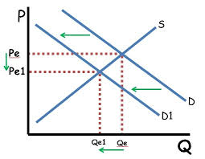
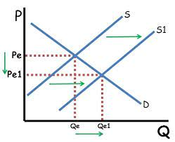
Summary of Demand and Supply Shifters
DEMAND SHIFTERS | SUPPLY SHIFTERS
T- TASTES AND PREFERENCES OF CONSUMERS | R-RESOURCE (INPUT) PRICES
R- RELATED GOOD PRICES- SUBSTITUTES AND COMPLEMENTS | O- OTHER GOODS’ PRICES
I- INCOMES OF CONSUMERS- NORMAL AND INFERIOR GOODS | T-TECHNOLOGY
B- NUMBER OF BUYERS | T- TAXES AND SUBSIDIES
E- EXPECTATIONS OF FUTURE PRICES | E-EXPECTATIONS OF FUTURE PRICES
 | N- NATURAL AND MAN-MADE PHENOMENOM
ReviewEcon.com
ReviewEcon.com

Slide 61
Price Ceilings: Shortages and Quantity Reduction (6:26)

Slide 62
Price Floors: Minimum Wage (9:45)

Slide 63
Price Ceilings
Legal maximum price
Examples
Resource prices during WWII
Oil Prices in1970s
California electricity
New York City apartments
Krugman’s Economics for AP
Notes:
A price ceiling is a maximum price sellers are allowed to charge for a good.
Who would want such a thing? Consumers.
Note: Ask the students what goods/services they consider to be unfairly expensive.
You will often get responses like “gasoline” or “college tuition”.
You might use one of these examples to show students the impacts of a price ceiling on the market for this good.
If Pe is considered “too high”, then a price ceiling must be set below the equilibrium price. A price ceiling set above the equilibrium price has no effect.
Or you could go through an example of a common good that is very unlikely to be the target of a price control.

Slide 64
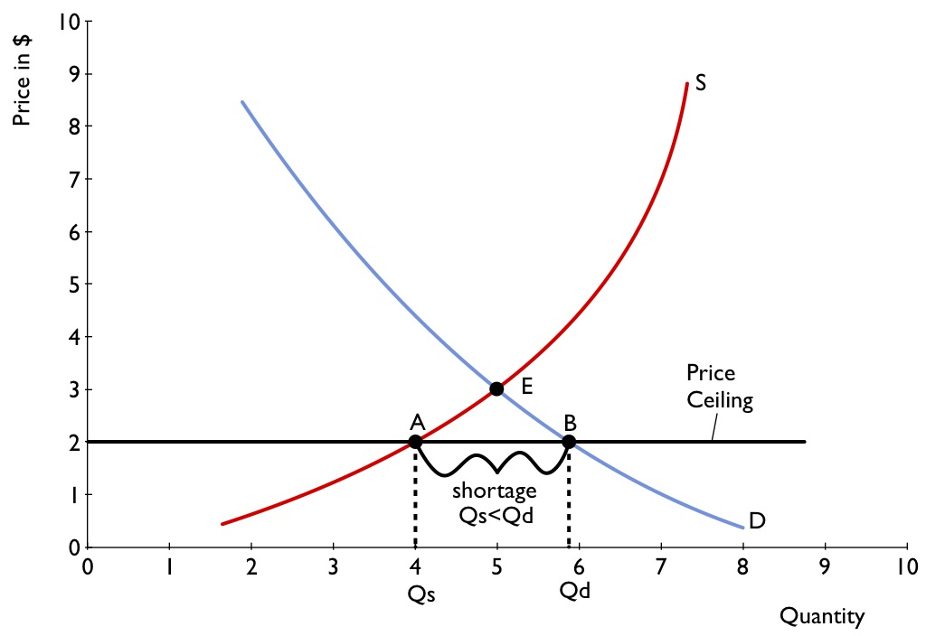
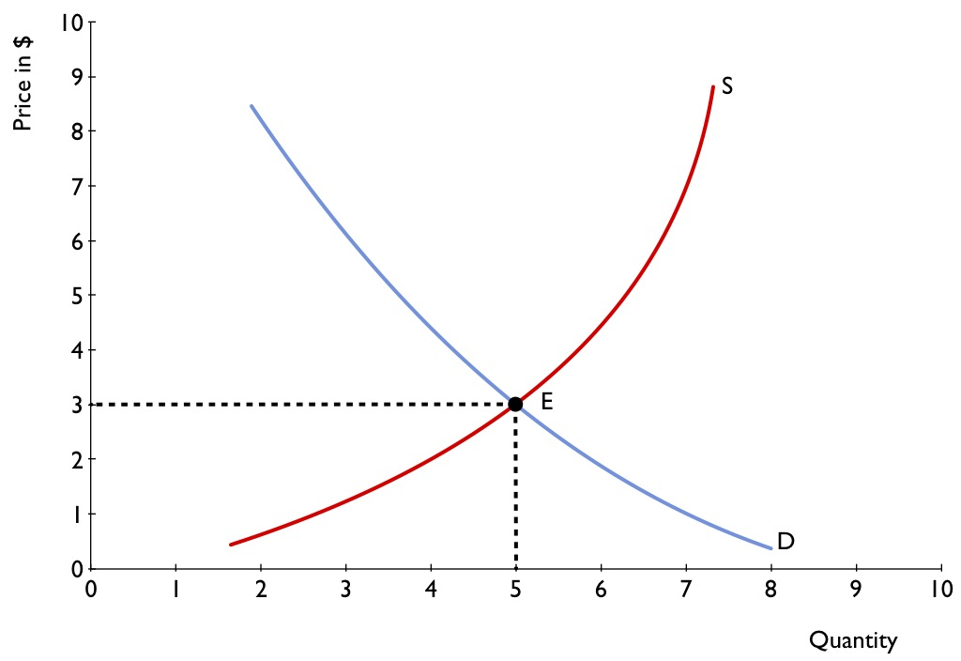
Modeling a Price Ceiling
Source: Krugman’s Economics for AP
Notes:
Shortage at Pc = Qd - Qs
If the Pc=$2, Qd =5.75 and Qs = 4 so there is a shortage of almost 2 tacos.
Is this so bad? Aren’t consumers helped by this lower price? Yes, if you are among the lucky 4 who get tacos!

Slide 65
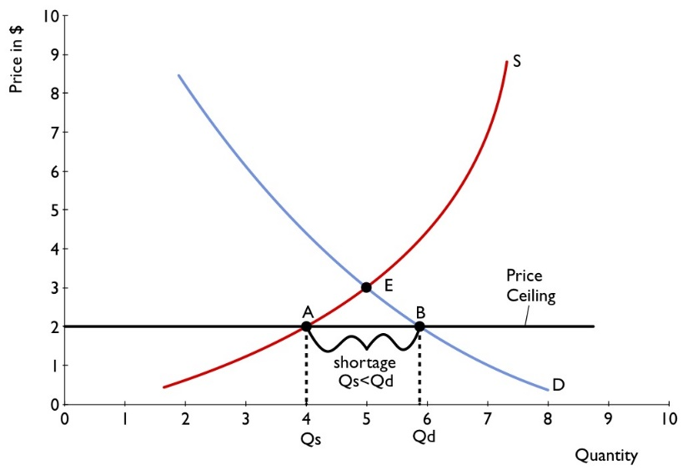
How a Price Ceiling Causes Inefficiency
Inefficient Allocation to Consumers
Wasted Resources
Inefficiently Low Quality
Black Markets
Krugman’s Economics for AP
Notes:
People who want the good badly and are willing to pay a high price don’t get it, and those who care relatively little about the good and are only willing to pay a low price do get it.
Suppose Stan was our sixth potential consumer. He would not have paid $5 for a taco before the price control, but maybe now he is one of the lucky ones that gets a taco at $3.
Julia was our second potential customer who would have paid $8 for a taco, but can’t find one now.
One way to define inefficiency: A market or an economy is inefficient if there are missed opportunities: Some people could be made better off without making other people worse off.
This is inefficient, because Stan can sell a taco to Julia for $7 and both win.
This is exactly the reallocation that improves someone without harming another.
People spend money and expend effort in order to deal with the shortages caused by the price ceiling.
Time spent looking for scarce tacos has an opportunity cost. You could be working, having some leisure, etc. These missed opportunities create more inefficiency to the price control.
Sellers offer low-quality goods at Pc, even though buyers would prefer a higher quality at a higher price.
Taco suppliers may cut corners on food safety because that costs money. Maybe we get more tacos that make us sick
A black market is a market in which goods or services are bought and sold illegally—either because it is illegal to sell them at all or because the prices charged are legally prohibited by a price ceiling.

Slide 66
So Why Are There Price Ceilings?
Benefit some
Uncertainty
Lack of understanding
Notes:
Price ceilings are enacted because
1. They do benefit some consumers. Consumers may have the political clout to persuade government that the equilibrium price is taking advantage of them. This is a normative argument.
2. When they have been in effect for a long time, buyers may not have a realistic idea of what would happen without them.
3. Government officials often do not understand supply and demand analysis.

Slide 67
Price Floors
Legal minimum price
Examples
Agricultural products
Minimum wage
Trucking
Air travel
Notes:
A price floor is a legal minimum price buyers are required to pay for a good.
The minimum wage is a legal floor on the wage rate, which is the market price of labor.
If Pe is considered “too low”, a price floor is set above the equilibrium price. A price floor set below the equilibrium price has no effect.

Slide 68
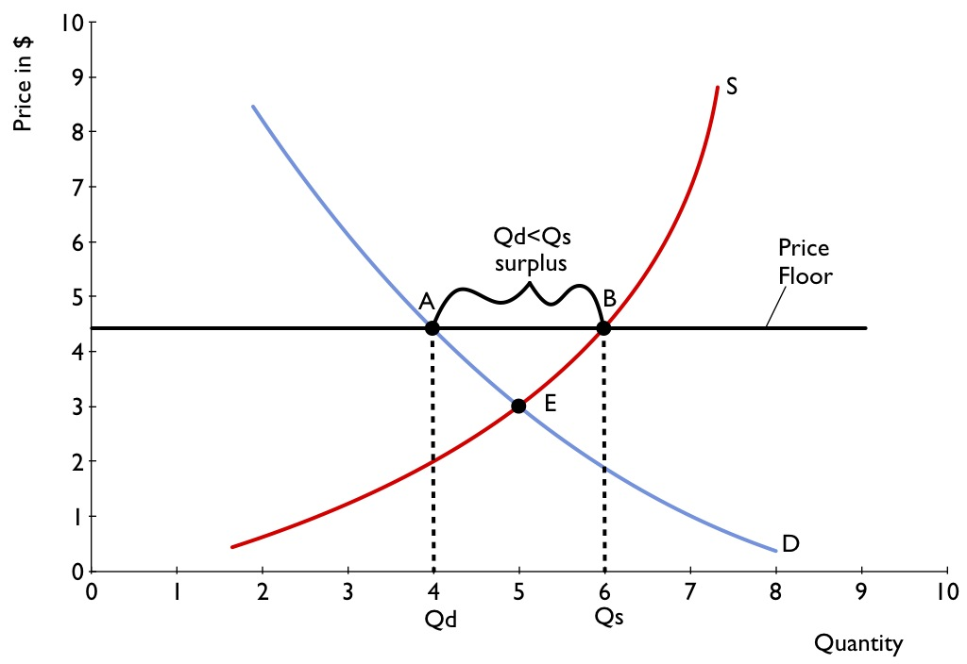
Modeling a Price Floor
Notes:
. Surplus at Pf
Price floors lead to excess supply; the quantity supplied is greater than quantity demanded.

Slide 69
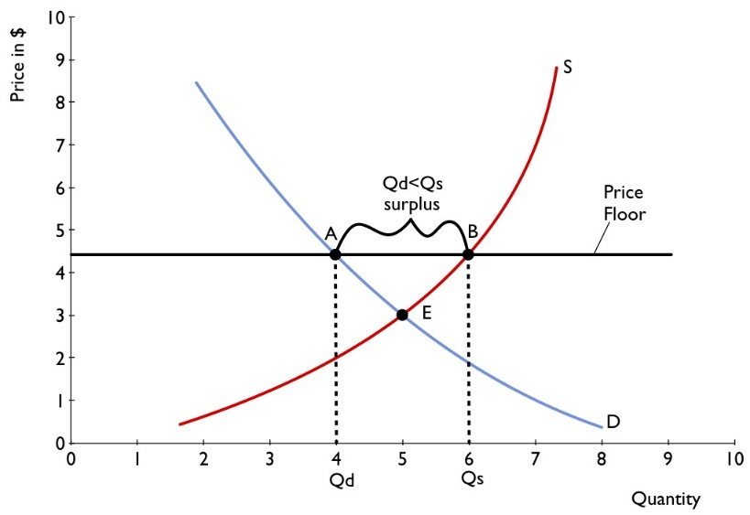
How a Price Floor Causes Inefficiency
Inefficiently Low Quantity
Inefficient Allocation of Sales Among Sellers
Wasted Resources
Inefficiently High Quality
Illegal Activity
Notes:
1. Surplus at Pf
Price floors lead to excess supply; the quantity supplied is greater than quantity demanded.
2. Inefficiently low quantity:
Since a price floor raises the price of a good to consumers, quantity demanded falls, so the quantity bought and sold falls, creating a loss to society.
3. Inefficient allocation of sales among sellers:
Those who would be willing to sell the good at the lowest price are not always those who actually manage to sell it.
Suppose Susan isn’t a very efficient taco vendor and couldn’t sell tacos at a price of $5, but can at $7. She is lucky enough to get one of the few buyers.
Juan is very efficient and could sell at $4, but is unlucky and doesn’t get a buyer at $7.
The price floor has just enabled a less efficient seller to make a sale, and might force an efficient seller out of the market.
4. Wasted resources.
Government price floors set about the equilibrium price cause surpluses which the government may be required to buy and destroy.
Minimum wages result in fewer jobs available and so would-be workers waste time searching for a job.
What do we do with the surplus tacos?
Maybe they go to waste, even if the government purchases them.
5. Goods of inefficiently high quality:
Sellers offer high-quality goods at a high price, even though buyers would prefer a lower quality at a lower price.
The high price may induce taco suppliers to provide extravagantly expensive ingredients that would be unprofitable at the lower market price.
Taco consumers would probably just rather have a low-priced taco without the fancy bells and whistles.
If they were really wanting expensive ingredients, their preferences would have been reflected in a stronger demand curve to begin with and the market price would have been $6 or higher.
6. Illegal activity.
Bribery of sellers or government officials.
Examples of working for less than minimum wage (off the books) because there is a surplus of labor willing to work.
Minimum wage laws are an example of price floors. Relatively high minimum wages in Europe lead to higher levels of unemployment and black markets in labor. In contrast, the minimum wage in the United States is set closer to the equilibrium wage, and labor is relatively more productive in the United States.

Slide 70
So Why Are There Price Floors?
Benefit some
Disregard
Lack of understanding
Notes:
Price floors are enacted because:
They do benefit some producers. Producers may have the political clout to persuade government that the equilibrium price is unfairly low. This is a normative argument.
Price floors create a persistent surplus of the good.
Inefficiencies arising from the persistent surplus come in the form of inefficiently low quantity, inefficient allocation of sales among sellers, wasted resources, and an inefficiently high level of quality offered by suppliers.
There is also the temptation to engage in illegal activity, particularly bribery and corruption of government officials.

Slide 71
Links to Demand/Supply Resources
MRU- Finding Equilibrium Unit Plan
Demand and Supply Practice
CEE Demand/Supply Resources
Price Control Practice
Economics Media Library
Econiful

Slide 72
Demand and Supply Lessons
Lesson 4- A Classroom Market in Cocoa
Lesson 5- What Happens When Prices Are Not in Equilibrium?
Lesson 6- The Market Never Stands Still
Lesson 7- How Markets Interact

Slide 73
QUESTIONS??
Inc. Magazine

Slide 74
Summary of Resources
CEE Opportunity Cost Resources
Scarce Chairs Lesson Plan
Scarce Chairs Assignment
SVU: Black Market Kidneys
Kidney Transplant Case Study
Your Morning Dilemma
Resource Scarcity Game
Comparing Economic Systems
Index of Economic Freedom- Heritage Foundation
Economic Systems Assessment
Comparative Economic Systems Project
MRU- Finding Equilibrium Unit Plan
Demand and Supply Practice
CEE Demand/Supply Resources
Price Control Practice
Economics Media Library
Econiful

Slide 75
Invest In Girls

Slide 76
NEC

Slide 77
NPFC

Slide 78
Advocacy

Slide 79
Suggested Presentation Deck
CEE Affiliates
https://www.councilforeconed.org/resources/local-affiliates/
Include your local affiliate page

Slide 80
Thank You to Our Sponsors!

Slide 81
Contact information
Thank You

