Slide 1
William Anderson Ed. D William.anderson72@du.edu Twitter: @Mizter_A 2/16/23
“Black” Education as a Form of Resistance

Slide 2
EconEdLink Membership
You can now access CEE’s professional development webinars directly on EconEdLink.org! To receive these new professional development benefits, become an EconEdLink member. As a member, you will now be able to:
Automatically receive a professional development certificate via e-mail within 24 hours after viewing any webinar for a minimum of 45 minutes
Register for upcoming webinars with a simple one-click process
Easily download presentations, lesson plan materials and activities for each webinar
Search and view all webinars at your convenience
Save webinars to your EconEdLink dashboard for easy access to the event
Access our new Professional Development page here

Slide 3
Professional Development Opportunities
To earn professional development credit for CEE webinars found on EconEdLink, you must:
Watch a minimum of 45-minutes and you will automatically receive a professional development certificate via e-mail within 24 hours.
Attendees can learn how much credit they will earn per workshop.
Accessing resources:
You can now easily download presentations, lesson plan materials, and activities for each webinar from EconEdLink.org/professional-development/
Local resources:
Insert your local professional development opportunities (if applicable)

Slide 4
Agenda
A brief history on Black education in the USA
A reframing of the Black education experience/ The Black teacher
Why ”they” are working so hard to keep repress Black education
Looking for forward

Slide 5
Objectives
EWBAT: Discuss and reflect on the ways Black teachers and students have used a variety of educational practices to push directly back against the forces of oppression in the US historically
EWBAT: Critically think about potential ways to develop instructional practices or policies that center emancipatory practices, and push back against oppressive and marginalize structures to Black education
EWBAT: Analyze the impacts of the current repression of Black education and critique the WHYs behind the repression.

Slide 6
Dr. William Anderson
Director of the Teacher Education Program/ Clinical Assistant Professor
University of Denver
Founder of: Love 1st Education Consultation LLC

Slide 7
National Standards
CCSS.ELA-LITERACY.RH.11-12.3
Evaluate various explanations for actions or events and determine which explanation best accords with textual evidence, acknowledging where the text leaves matters uncertain.
CCSS.ELA-LITERACY.RH.11-12.7
Integrate and evaluate multiple sources of information presented in diverse formats and media (e.g., visually, quantitatively, as well as in words) in order to address a question or solve a problem.
CCSS.ELA-LITERACY.RH.11-12.9
Integrate information from diverse sources, both primary and secondary, into a coherent understanding of an idea or event, noting discrepancies among sources.

Slide 8
Assessment Questions
In what ways have Black folks historically educated themselves, and other Black people regardless of laws and societal norms prohibiting it?
In what was was education seen as a tool in the experience of Black American?
Why would power not be interested and fight against in Black education happening in the US?

Slide 9
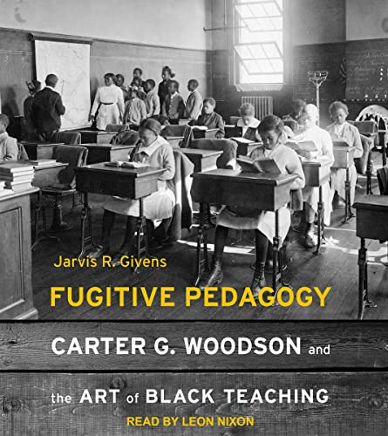
Reference Material
Dr. Jarvis Givens
Assistant Professor at the Harvard Graduate School of Education
&
Suzanne Young Murray Assistant Professor at the Radcliffe Institute for Advance Studies at Harvard University

Slide 10
A brief history
“Before Emancipation, the enslaved had to gain their education by ‘snatching a learning in forbidden fields’”.
“…to steal a little from the book. And put words together, and learn by hook or crook”
“Antiliteracy laws targeting Black people were older than the United States itself. The first law of its kind was a slave code enacted in 1740 in reaction to the Stono Slave rebellion of 1739 in South Carolina”.
P.27

Slide 11
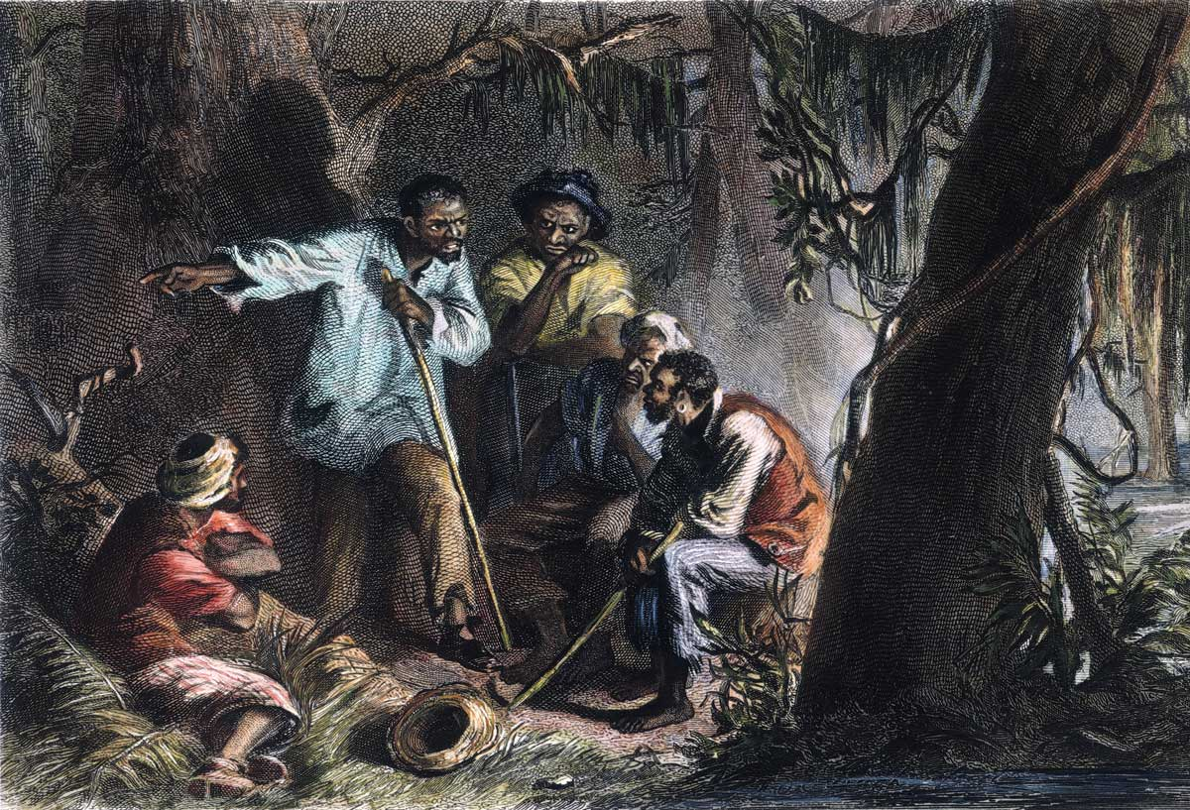
A brief history
“…10 Percent learned to read and/or write; suggesting that literate slaves were not so unusual as to be unknown to other Blacks. These literate slaves were recognized as leaders with a practical skill set that benefitted the community”.
Pg. 28

Slide 12
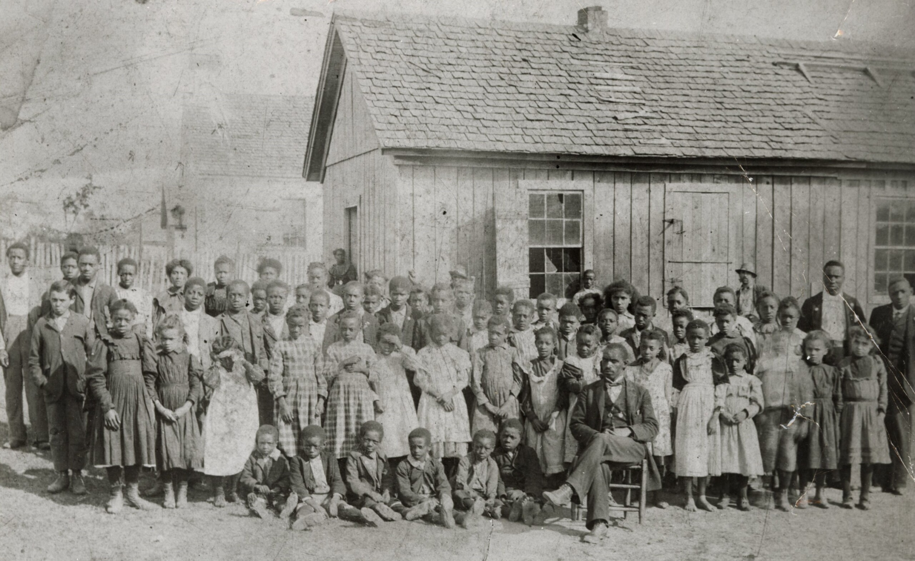
A brief history
“Few were too young, and none were too old, to make the attempt to learn. As fast as any kind of teacher could be secured, not only were day-schools filled, but night schools as well”.
Pg. 29

Slide 13
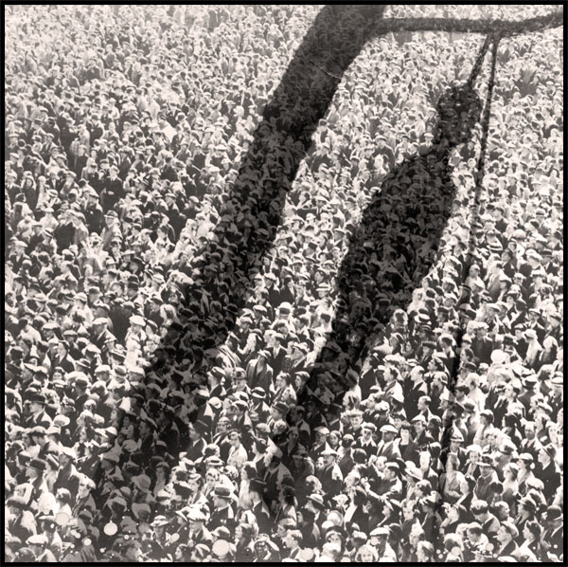
“There would be no. lynching if it did not start in the schoolroom”.
Pg. 95

Slide 14
Reframing Black Education:
“… ‘miseducation’, became a lasting fixture in Black vernacular culture as a shorthand critique of white supremacist ideas propagated by western imperialist indoctrination, especially in the context of schools”.
Pg. 94

Slide 15
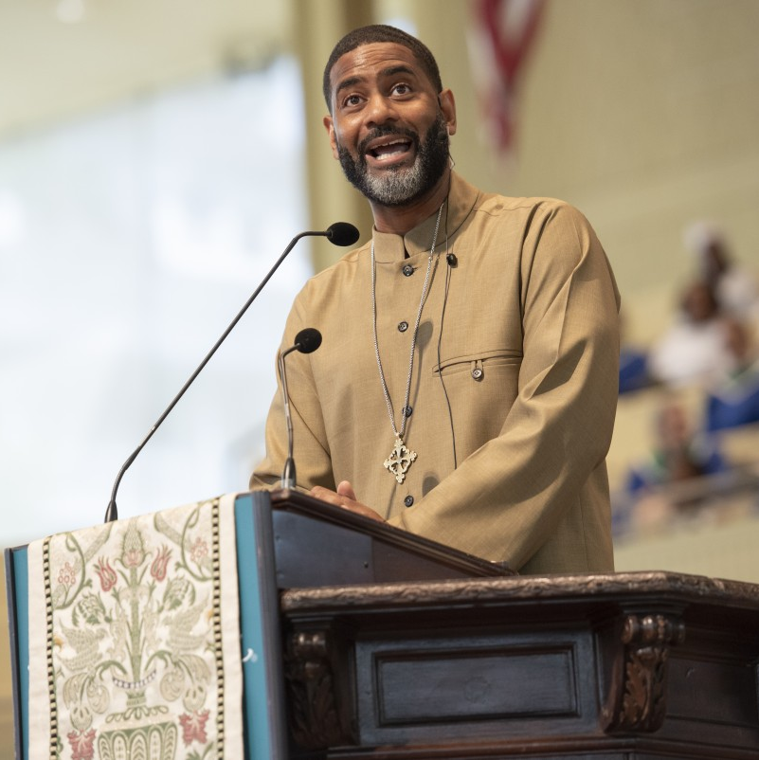
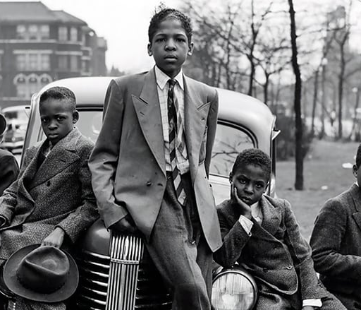
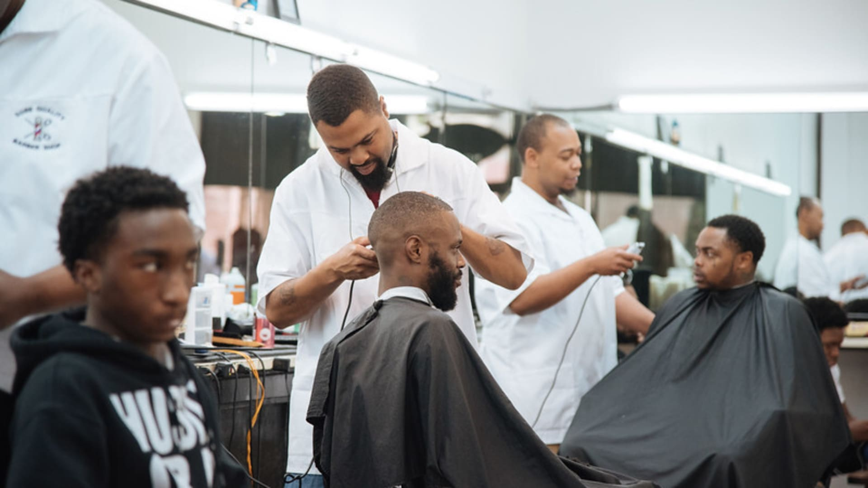
Reframing Black Education
The responsibility of Black education was removed from the school and placed in the hands of other…
-Parents/Guardian
-Churches
-Barber and Beauty Shops
-Peers
-The Streets
-Entertainment

Slide 16
Reframing Black Education
In regard to teacher preparation… “this teacher was ‘well informed on all the educational theories developed from the time of Socrates down to the day of Dewey’, yet he had no clear understanding about what was needed for Black students”
Pg. 123

Slide 17
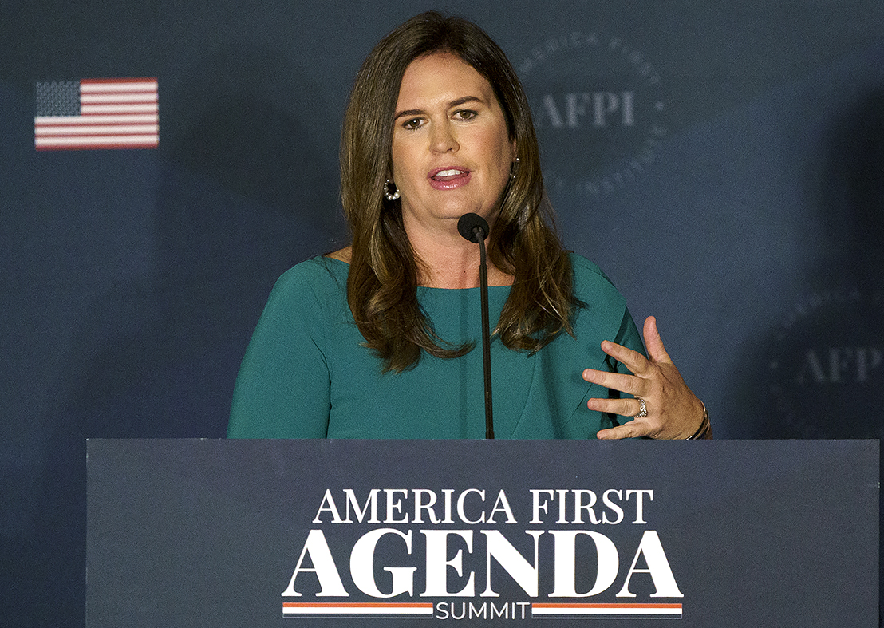
Looking Forward
The teaching of Black histories, the elevation of Black educational practices, and the elevation of contemporary collective Black experiences, is not only good for Black people, but also for all people…in particular WHITE people.
The “mis-education” of white people is just as, if not more damaging than the “mis-education” of Black people.

Slide 18
Questions

Slide 19
Thank you
Dr. William Anderson
University of Denver
William.anderson72@du.edu
Twitter: Mizter_A
720-937-0576

Slide 20
CEE Affiliates
https://www.councilforeconed.org/resources/local-affiliates/
Include your local affiliate page

Slide 21
Thank You to Our Sponsors!

Slide 22
Contact information
Thank You

