Slide 1
Women’s History Month featuring STEM Picture Books:
Science, Technology, Economics, and Math
Lauren H Shifflett shiffllh@jmu.edu Lynne F Stover stoverlf@jmu.edu March 8, 2023

Slide 2
EconEdLink Membership
You can now access CEE’s professional development webinars directly on EconEdLink.org! To receive these new professional development benefits, become an EconEdLink member. As a member, you will now be able to:
Automatically receive a professional development certificate via e-mail within 24 hours after viewing any webinar for a minimum of 45 minutes
Register for upcoming webinars with a simple one-click process
Easily download presentations, lesson plan materials and activities for each webinar
Search and view all webinars at your convenience
Save webinars to your EconEdLink dashboard for easy access to the event
Access our new Professional Development page here

Slide 3
Professional Development Opportunities
To earn professional development credit for CEE webinars found on EconEdLink, you must:
Watch a minimum of 45-minutes and you will automatically receive a professional development certificate via e-mail within 24 hours.
Attendees can learn how much credit they will earn per workshop.
Accessing resources:
You can now easily download presentations, lesson plan materials, and activities for each webinar from EconEdLink.org/professional-development/
Local resources:
Insert your local professional development opportunities (if applicable)

Slide 4
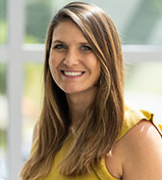
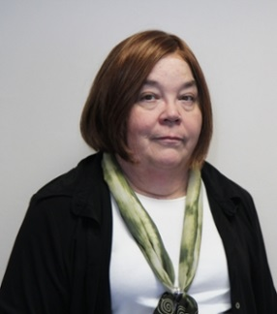
Presenters
Lauren Hensley Shifflett is the new Associate Director at the James Madison University Center for Economic Education. Prior to joining the Center, she spent twelve years in early elementary education where she enjoyed prospering young minds as a classroom teacher. Lauren became nationally known as an elementary economic educator when she received the John Morton Award of the national Council for Economic Education in 2021. Her love for economics guides her lessons to prepare students for life.
shiffllh@jmu.edu
Lynne Farrell Stover is currently a Teacher Consultant at the James Madison University Center for Economic Education. Prior to this, she spent thirty-three years in public education where she enjoyed various teaching assignments including classroom teacher, gifted education specialist, and librarian. She is the author of over fifty educational articles and eight teacher resource books. She is the recipient of the 2022 NAEE Platinum Curriculum Award for her lessons developed for Virginia’s Reading Makes Cents Program.
stoverlf@jmu.edu

Slide 5
Objectives:
In this webinar teachers will:
Celebrate Woman’s History Month by learning about five women who excelled in math and science.
Learn how the featured women all invested in their human capital and had to make life-defining choices.
Discover methods for teaching the featured concepts using lessons created for the elementary classroom.
Discuss the possibilities of enriching each book’s content to extended science, math, and technology activities.

Slide 6
Agenda
In this webinar we will:
Welcome attendees and introduce the session. [5 mins.]
Discuss the importance of teaching STEM. [5 mins.]
Explore featured titles. [30 mins.]
Discover online links to websites and resources. [5 mins.]
Review content using Assessment Questions. [5 mins.]
Share related bibliography. [5 mins.]
Conclude and complete evaluation [5 mins.]

Slide 7
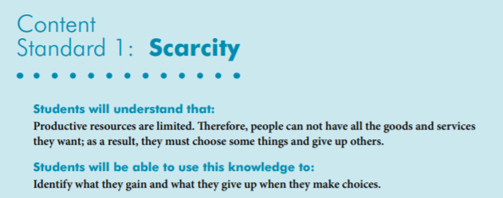
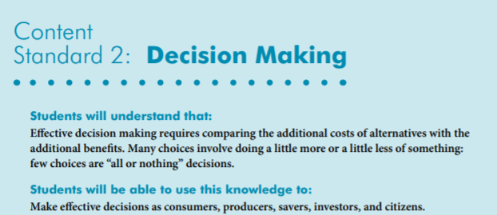
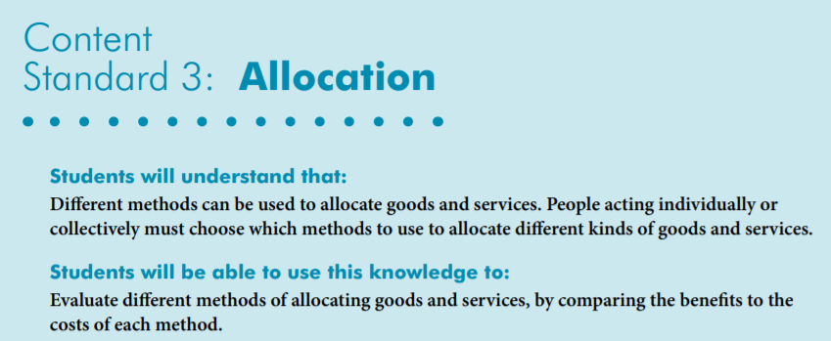
National Standards
https://www.councilforeconed.org/wp-content/uploads/2012/03/voluntary-national-content-standards-2010.pdf

Slide 8
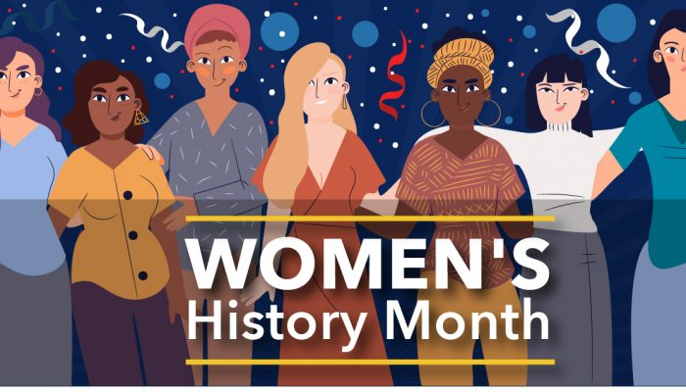
National Women's History Month was established by presidential proclamation in order to draw attention to and improve the focus on women in historical studies. It began in New York City on March 8th 1857, when female textile workers marched in protest of unfair working conditions and unequal rights for women. Beginning in 1910, March 8th became annually observed as International Women's Day.

Slide 9
Introduction
Real Quick!
Create a picture of a scientist in your mind.
What is this scientist’s name?
What are three things this scientist does?
Was your scientist a male?

Slide 10
Classroom STEM Gender Bias Experiment
INTRODUCTION: Today’s students are aware that girls can do and be whatever they chose to. However, bias still exists, especially in the fields of science, technology, engineering and math. This quick activity is designed to create awareness of this situation and will likely lead to student awareness and a likely classroom discussion.
Note: The first line for the Google search “Scientist Clipart” displayed six male scientist and one female.

Slide 11
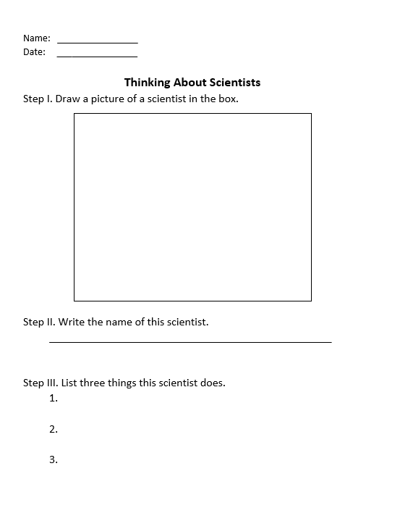
Tell the students that you would like them to do a quick activity with the following rules:
There will be limited directions.
No questions will be answered and no discussion between students will be allowed.
The task must be completed in 5 minutes or less.
The task can not begin until the word “START” is announced.
There are no right or wrong answers.

Slide 12
Secret Engineer: Emily Roebling
Book Synopsis: A picture book portrait of the uncredited woman behind the construction of the Brooklyn Bridge traces the life of 19th-century engineer Emily Roebling and her significant contributions to math, science, engineering and feminism.
Publisher: Roaring Book Press
Copyright Date: 2019
Reading Level: 5.5
Interest Level: 1-4
9/23/1843-2/28/1903
Book Reading
https://www.youtube.com/watch?v=vmGROuIGx20
9 minutes

Slide 13
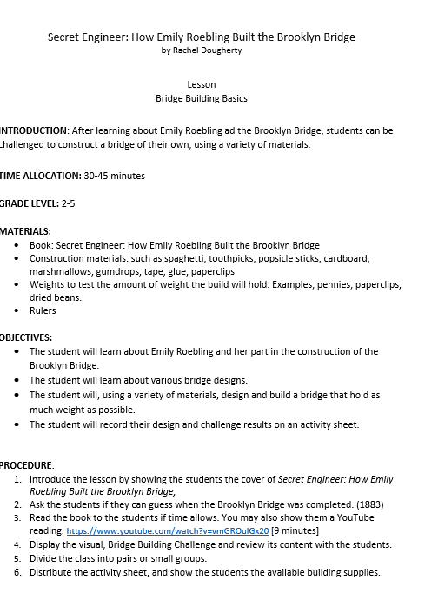
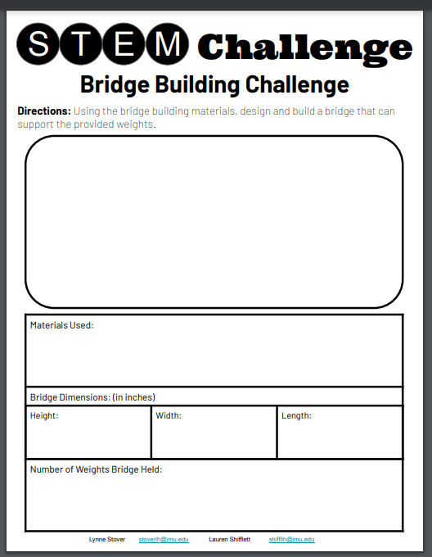
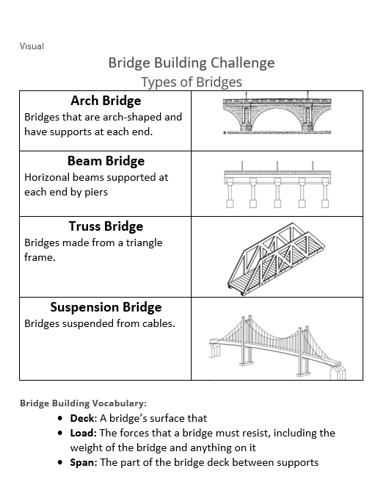
Lesson- Bridge Building Challenge

Slide 14
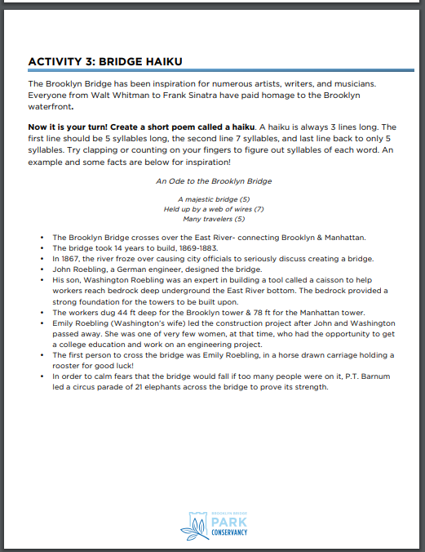
https://www.brooklynbridgepark.org/wp-content/uploads/2020/10/Brooklyn-Bridge-Anniversary-Activity-Packet.pdf

Slide 15
GRACE HOPPER
Who was Grace Hopper?
A software tester
Workplace jester
Cherished mentor
Ace inventor
Avid reader
Naval leader
Rule breaker
Chance taker
And Troublemaker
12/9/1906-1/1/1992
Publisher: Sterling
Copyright Date: 2017
Reading Level: 4.7
Interest Level: 1-4
Book Reading
https://www.youtube.com/watch?v=uS4Jm5aJ-bo
11 minutes

Slide 16
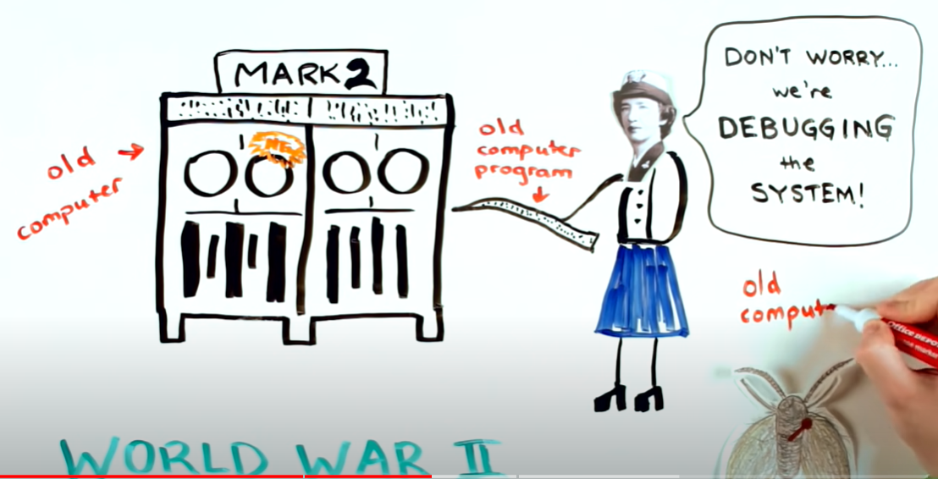
https://www.youtube.com/watch?v=Fg82iV-L8ZY

Slide 17
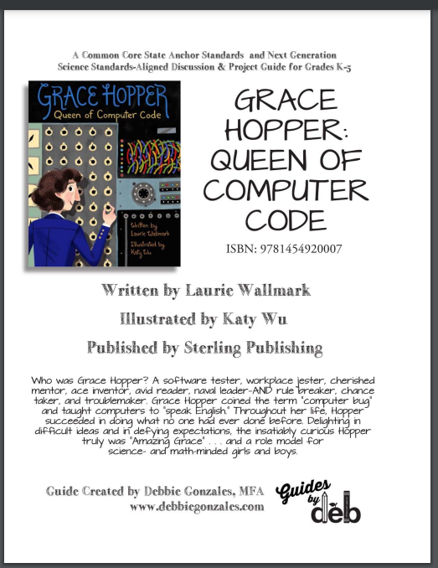
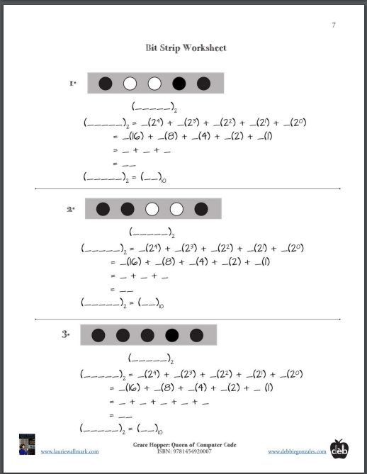
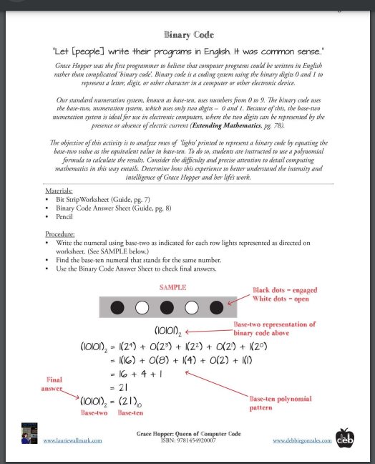
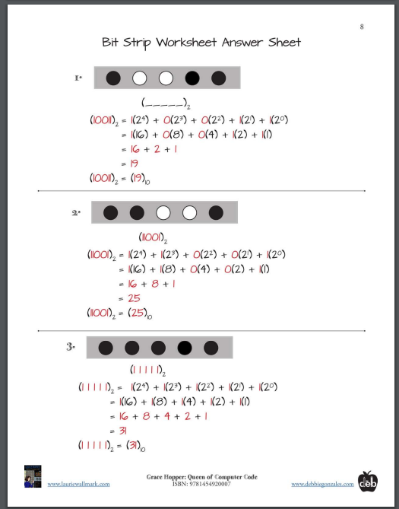
Eighteen-Page Educator’s Guide
Author’s Website
https://www.lauriewallmark.com/books.php
https://www.lauriewallmark.com/resources/Grace%20Hopper%20guide.pdf

Slide 18
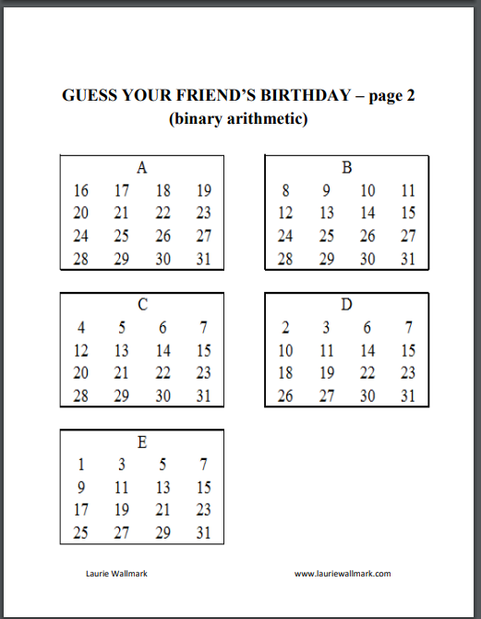
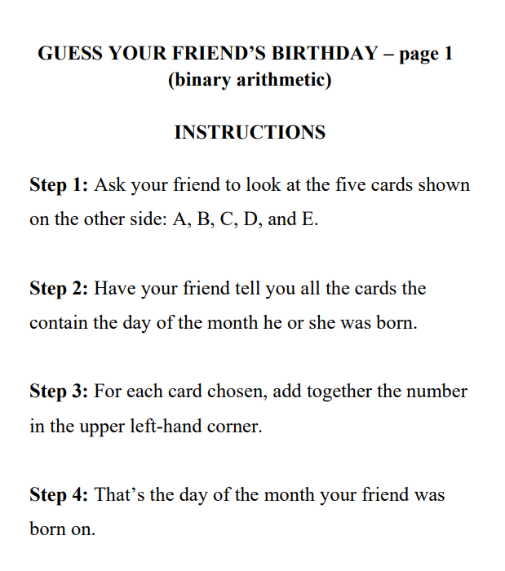
Binary Arithmetic

Slide 19
Hedy Lamarr’s Double Life
Story Synopsis: Hedy Lamarr, was a beautiful Hollywood star in the 1930s-1950s. She was also a noted inventor, who, during World War II, developed a groundbreaking communications system that still remains essential to the security of today's technology.
11/9/1914-1/19/2000
Publisher: Sterling
Copyright Date: 2019
Reading Level: 5.6
Interest Level: 1-4
Book Reading
https://www.youtube.com/watch?v=XhcQB7VcgFQ
14 minutes

Slide 20
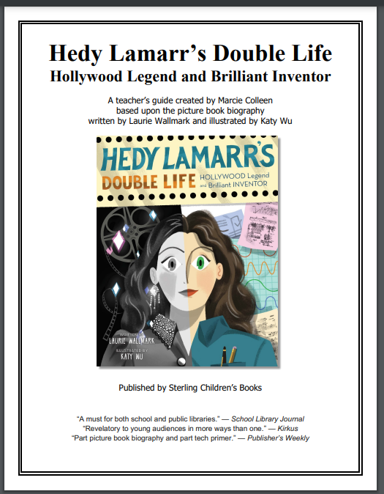
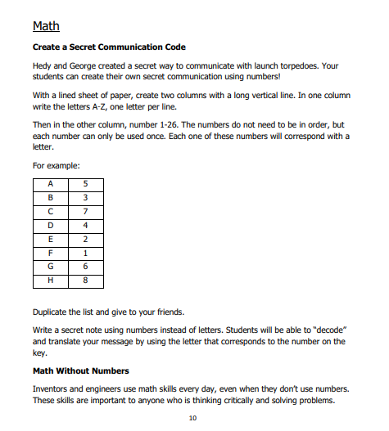
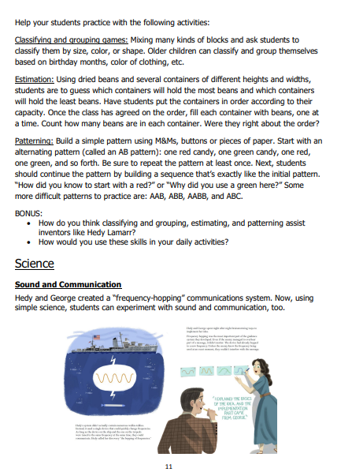
Seventeen-Page Educator’s Guide
Author’s Website
https://www.lauriewallmark.com/books.php
https://www.lauriewallmark.com/resources/Hedy%20Lamarr%20guide.pdf

Slide 21
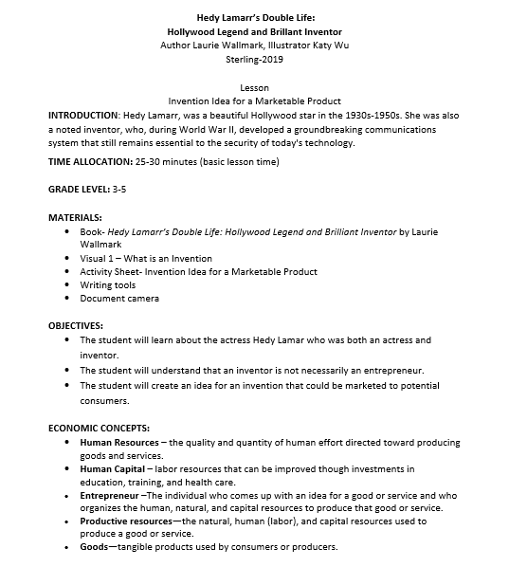
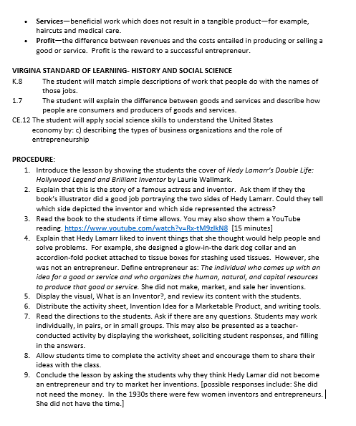
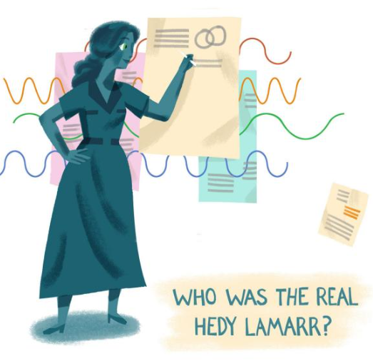
Lesson
Invention Idea for a Marketable Product

Slide 22
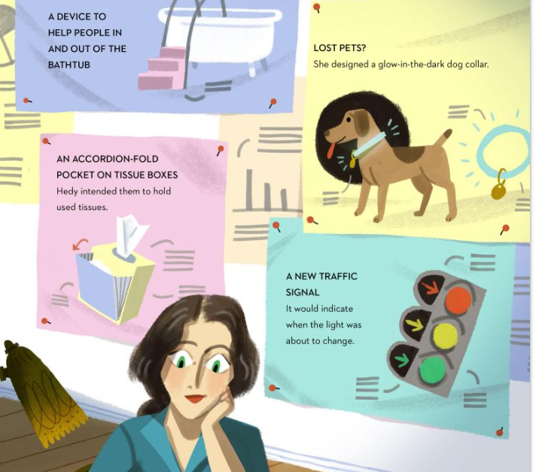

Slide 24
THE GIRL WITH A MIND FOR MATH
Book Synopsis: Young Raye Montague sets her sights on becoming an engineer after she tours a German submarine in the early 1940s.
Publisher: Innovation Press
Copyright Date: 2018
Reading Level: 3.1
Interest Level: K-3
1/21/1935-10/10/2018
Book Reading
https://www.youtube.com/watch?v=maBiBjirKwk
6.34 minutes

Slide 25
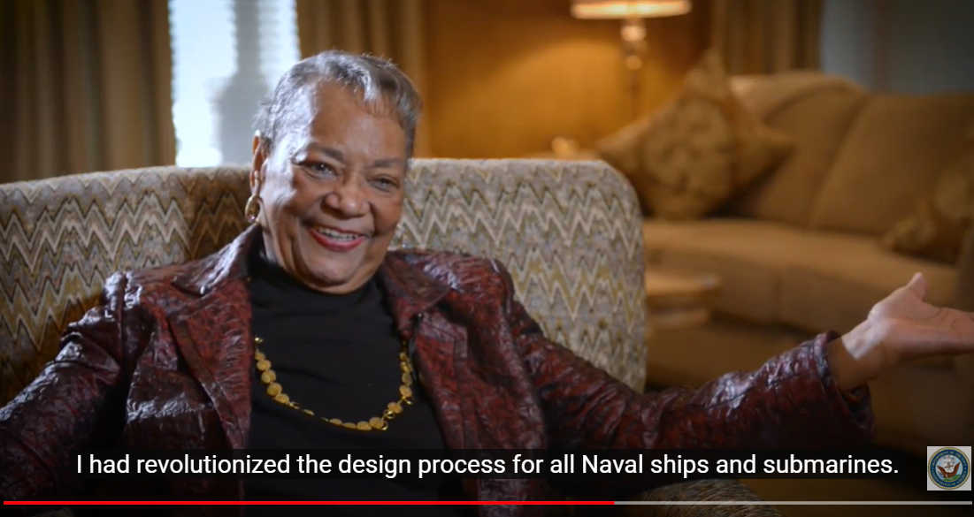
https://www.youtube.com/watch?v=1ejoOFulfmQ

Slide 26
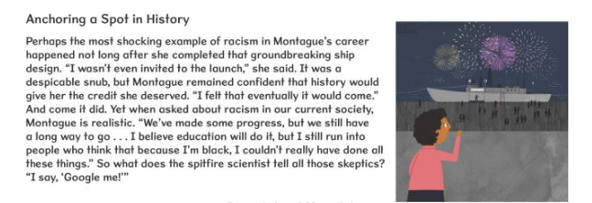
Backmatter

Slide 27
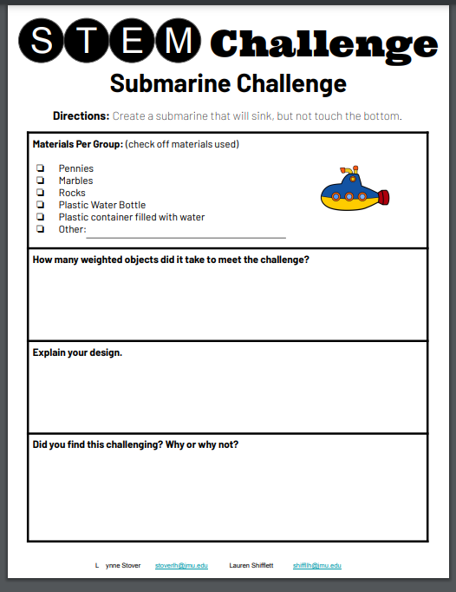

Slide 28
Margaret and the Moon
Book Synopsis: Margaret Hamilton’s love of mathematics led to her prestigious education and contributions at NASA. Reader’s learn how her handwritten codes proved essential throughout numerous space missions.
Publisher: Alfred A. Knopf, Inc.
Copyright Date: 2017
Reading Level: 3.7
Interest Level: K-2
August 17, 1936
Book Reading
https://www.youtube.com/watch?v=ywps6R6B4vY
6 minutes

Slide 29
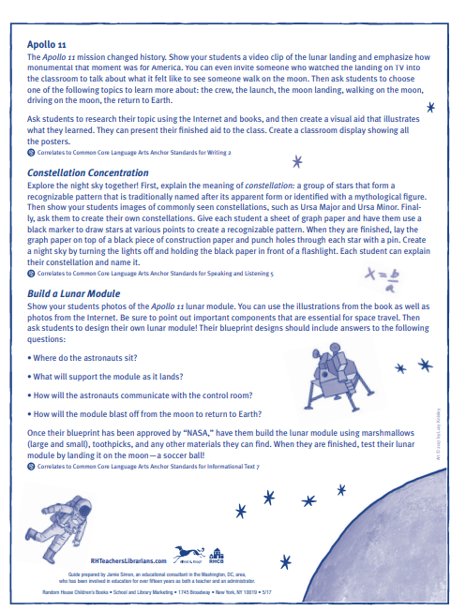
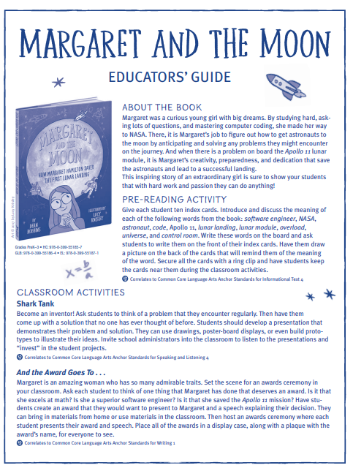
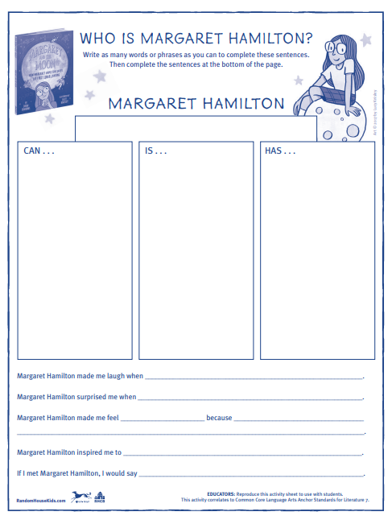
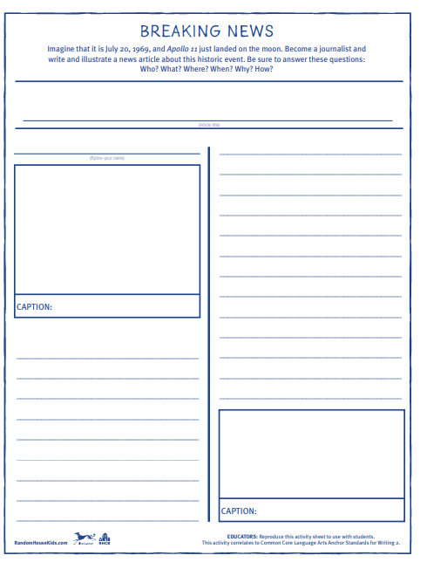
Publisher’s Educator’s Guide
https://images.randomhouse.com/promo_image/9780399551857_3518.pdf

Slide 30
Something to Think About
Assessment Questions
How have the STEM professions changed for females over the since the featured women applied their skills and passions?
How have they stayed the same?
Is it possible to change gender bias in the STEM field?
What can we do to help this change take place?

Slide 31
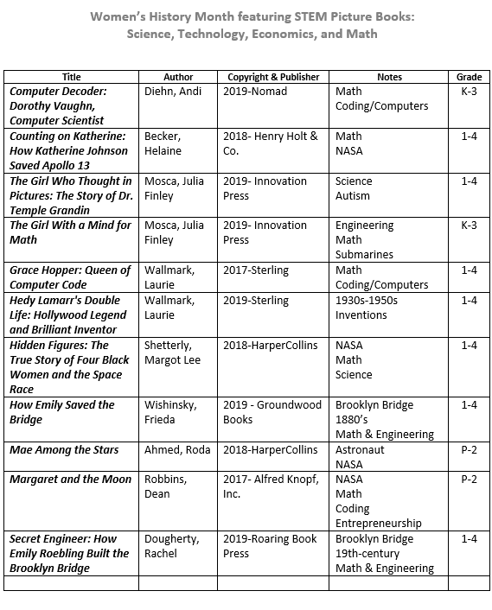

Slide 32
Invest In Girls

Slide 33
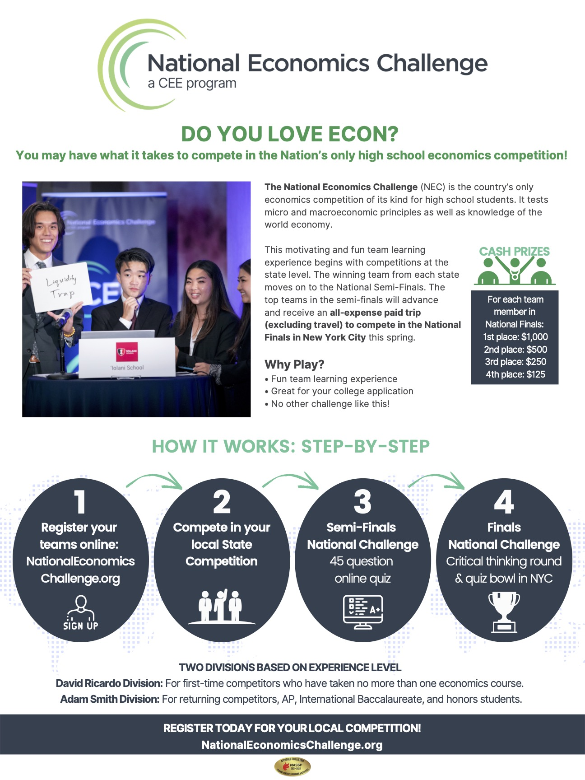
NEC

Slide 34
NPFC

Slide 35
Advocacy

Slide 36
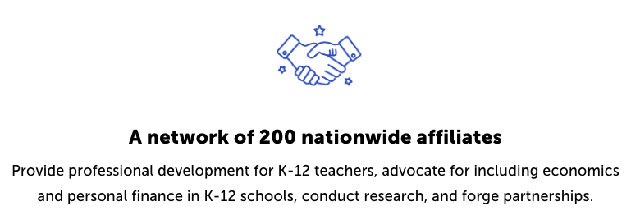
Suggested Presentation Deck
CEE Affiliates
https://www.councilforeconed.org/resources/local-affiliates/
Include your local affiliate page

Slide 37
Thank You to Our Sponsors!

Slide 38
Contact information
Thank You
Lauren H Shifflett shiffllh@jmu.edu Lynne F Stover stoverlf@jmu.edu

