Slide 1
Presented by: Theodore Opderbeck
Email: opderbeckt@waldwickschools.org
Date: February 22, 2023
2023 Economics Winter Bootcamp:
Macroeconomics Part One

Slide 2
EconEdLink Membership
You can now access CEE’s professional development webinars directly on EconEdLink.org! To receive these new professional development benefits, become an EconEdLink member. As a member, you will now be able to:
Automatically receive a professional development certificate via e-mail within 24 hours after viewing any webinar for a minimum of 45 minutes
Register for upcoming webinars with a simple one-click process
Easily download presentations, lesson plan materials and activities for each webinar
Search and view all webinars at your convenience
Save webinars to your EconEdLink dashboard for easy access to the event
Access our new Professional Development page here

Slide 3
Professional Development Opportunities
To earn professional development credit for CEE webinars found on EconEdLink, you must:
Watch a minimum of two and half hours and you will automatically receive a professional development certificate via e-mail within 24 hours.
Attendees can learn how much credit they will earn per workshop.
Accessing resources:
You can now easily download presentations, lesson plan materials, and activities for each webinar from EconEdLink.org/professional-development/
Local resources:
Insert your local professional development opportunities (if applicable)

Slide 4
Presenter - Ted Opderbeck
Teacher at Waldwick High School 1996 - Present
Social Studies/Economics:
  AP Economics
  Honors Economics I and II
  Introduction to Economics and Personal Finance
  U.S. History I and II
  Introduction to Law
  Criminal Procedure
Coach varsity tennis and volleyball
Graduated from Gordon College in Wenham MA
Masters’ Degree in Teaching Montclair State University
Attended Seton Hall Law School
Enjoy photography, hiking, travelling, spending time with wife and two teenage and grown children.

Slide 5
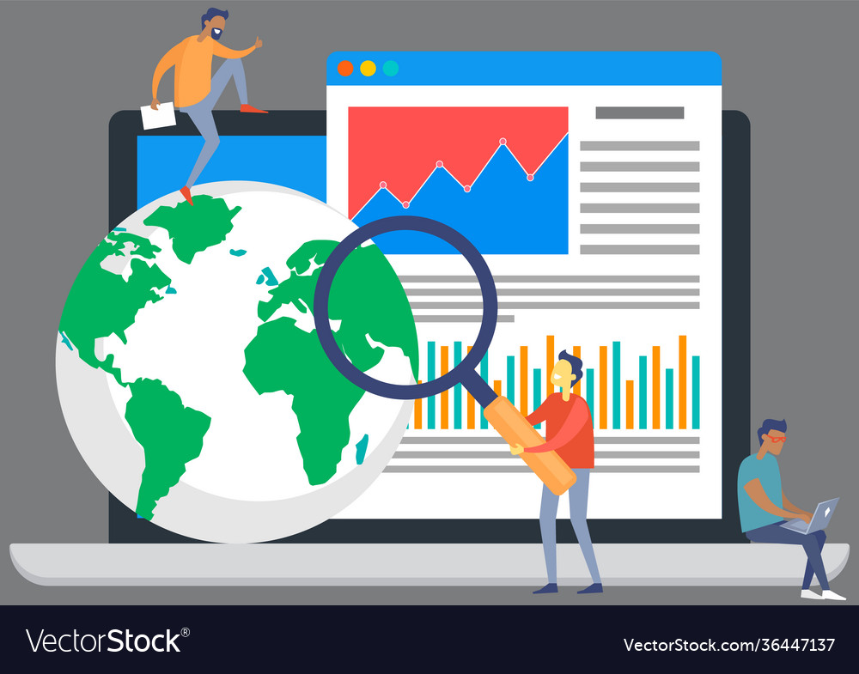
Agenda
Discuss key macroeconomic measurement tools - GDP, Unemployment, Inflation
Analyze the aggregate supply and demand model as a means to assess various states of macroeconomic performance
Explore fiscal policy tools used by the federal government and discuss fiscal challenges faced by the government.
Utilize current economic data to evaluate the state of the U.S. and global economy and discuss possible future trends
Participate in online games that can be modeled to students
Examine lesson plan ideas and engaging activities to use in your classroom
Discuss learning extensions and further application

Slide 6

Objectives
To explore and discuss macroeconomic measurement indicators
To analyze the aggregate supply and demand model and apply to current macroeconomic performance
To discuss fiscal policy implementation and challenges
To model online games that can be used to enhance instruction
To introduce lesson plans and learning activities to create a dynamic classroom
To analyze the topics in the context of current events and developments.

Slide 7
CEE National Standards
Content Standard 18: Economic Fluctuations. Fluctuations in a nation’s overall levels of income, employment, and prices are determined by the interaction of spending and production decisions made by all households, firms, government agencies, and others in the economy. Recessions occur when overall levels of income and employment decline.
Content Standard 19: Unemployment and Inflation. Unemployment imposes costs on individuals and the overall economy. Inflation, both expected and unexpected, also imposes costs on individuals and the overall economy. Unemployment increases during recessions and decreases during recoveries.
Content Standard 20: Fiscal and Monetary Policy. Federal government budgetary policy and the Federal Reserve System’s monetary policy influence the overall levels of employment, output, and prices.

Slide 8
N.Y. State Standards
12.E4 THE TOOLS OF ECONOMIC POLICY IN A GLOBAL ECONOMY: Globalization and increased economic interdependence affect the United States economy significantly. The tools that the policy makers have available to address these issues are fiscal policy, monetary policy, and trade policy.
12.E4a Policy makers establish economic goals related to economic indicators, including the Gross National Product (GNP), Gross Domestic Product (GDP), Consumer Price Index (CPI), employment and interest rates, and aggregate supply and demand.
12.E4b The president and Congress determine fiscal policy by establishing the level of spending and taxing in the annual budget. Some tax programs are designed to provide incentives to individuals and businesses that influence private sector spending, saving, and investment.

Slide 9
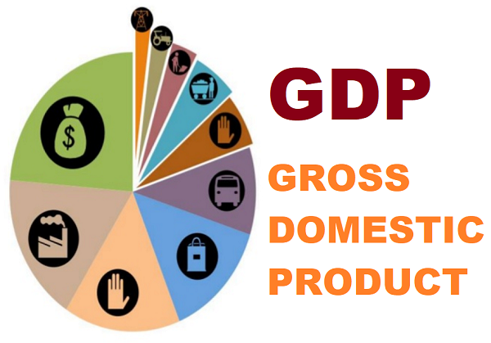
Question of the Day Activity
The U.S. currently has the highest GDP in the world, with China second. Which nation is third?
Germany
Brazil
Japan
India
https://forms.gle/WTQ9YUei29vtziax6

Slide 10
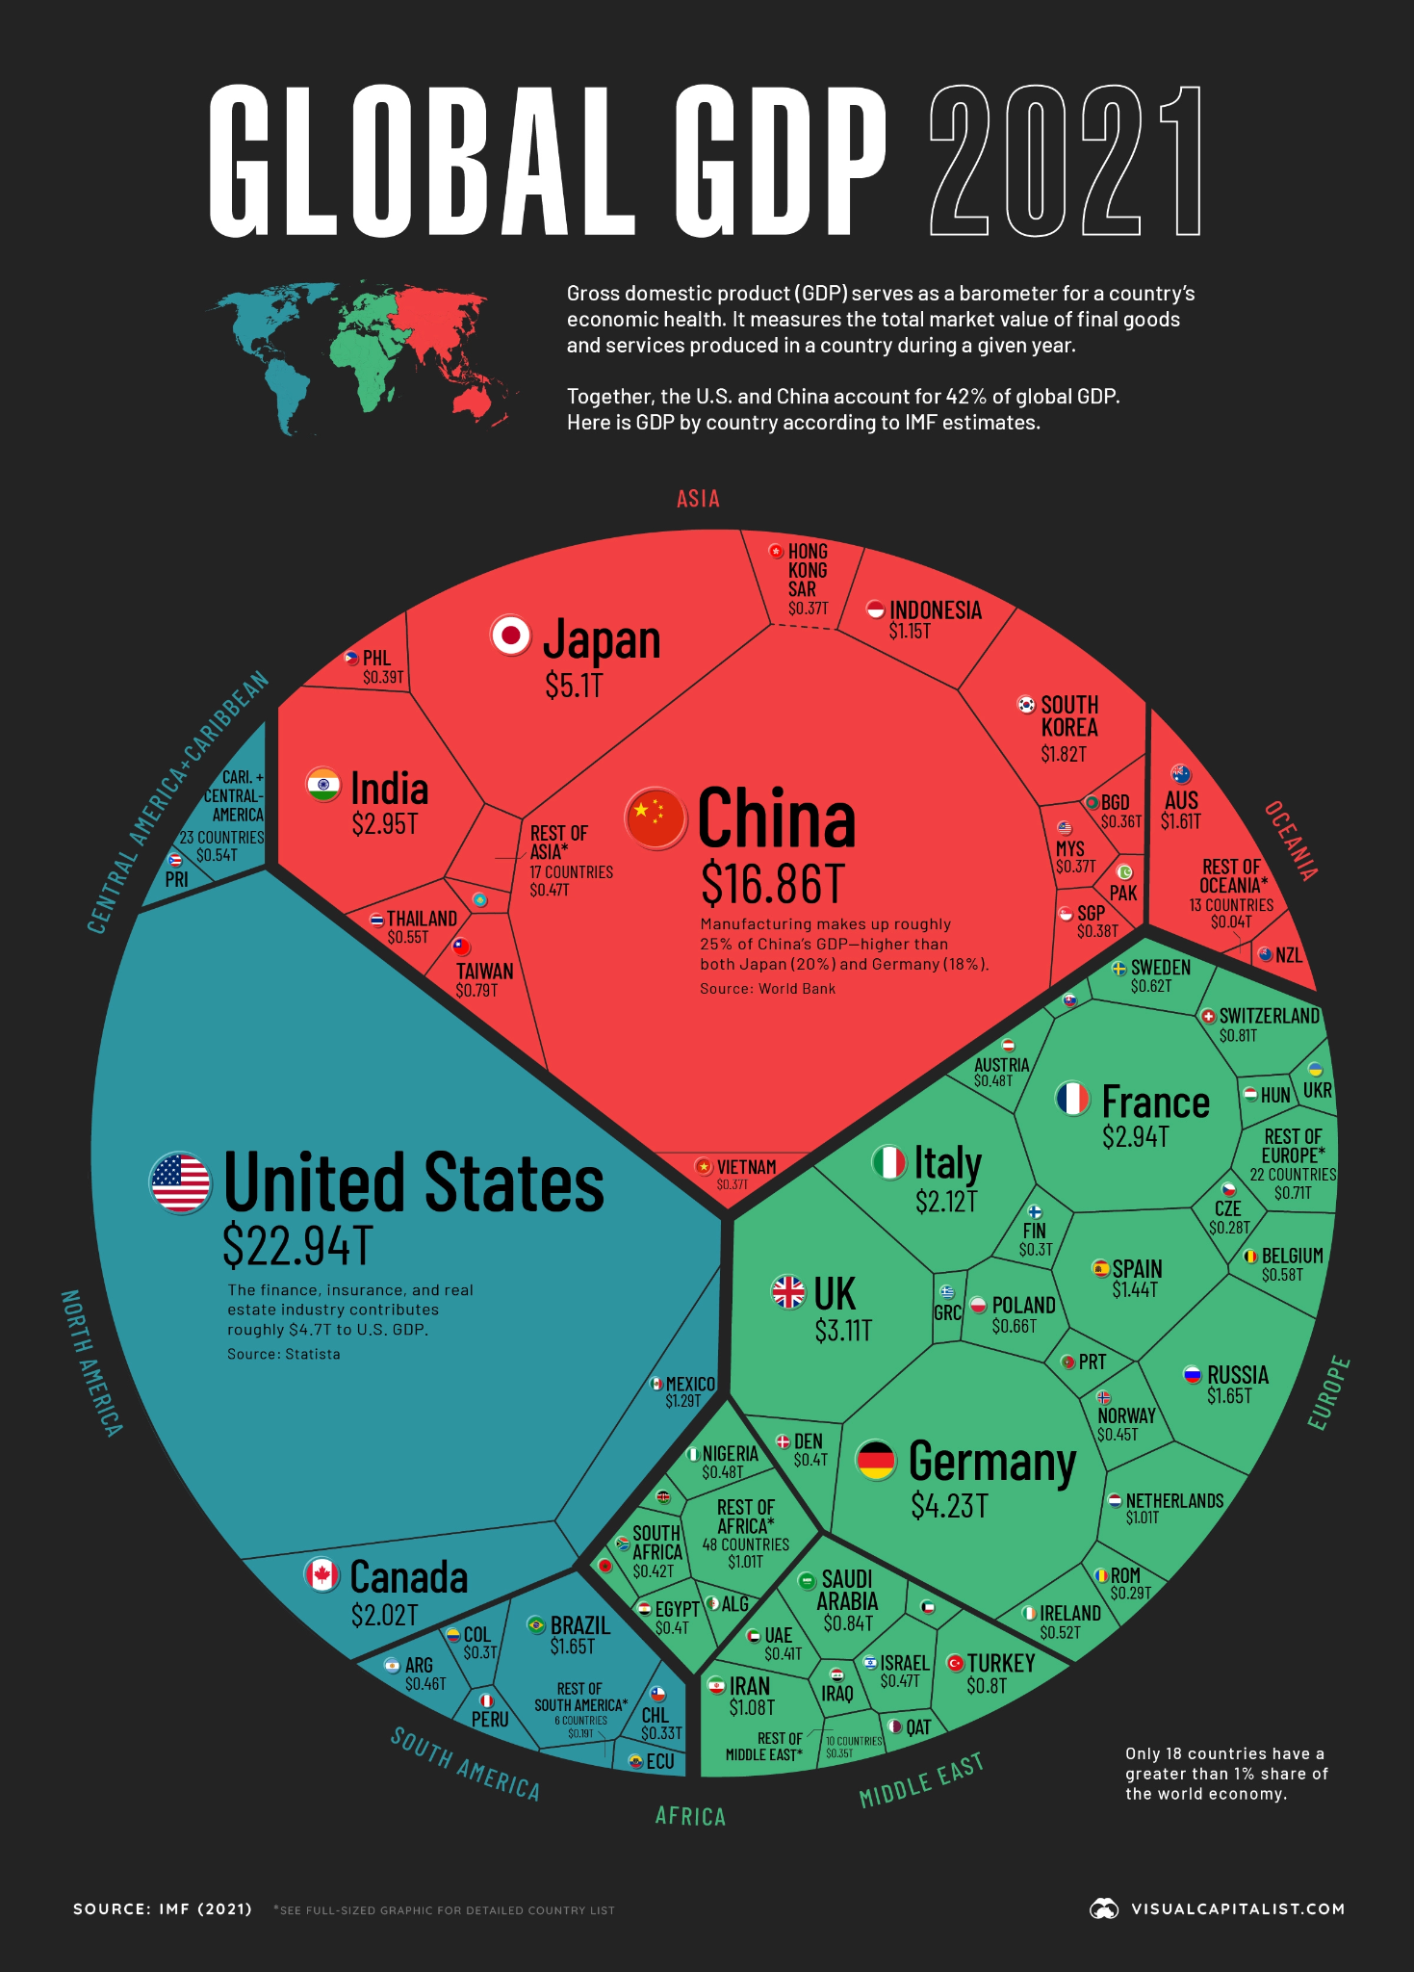

Slide 11
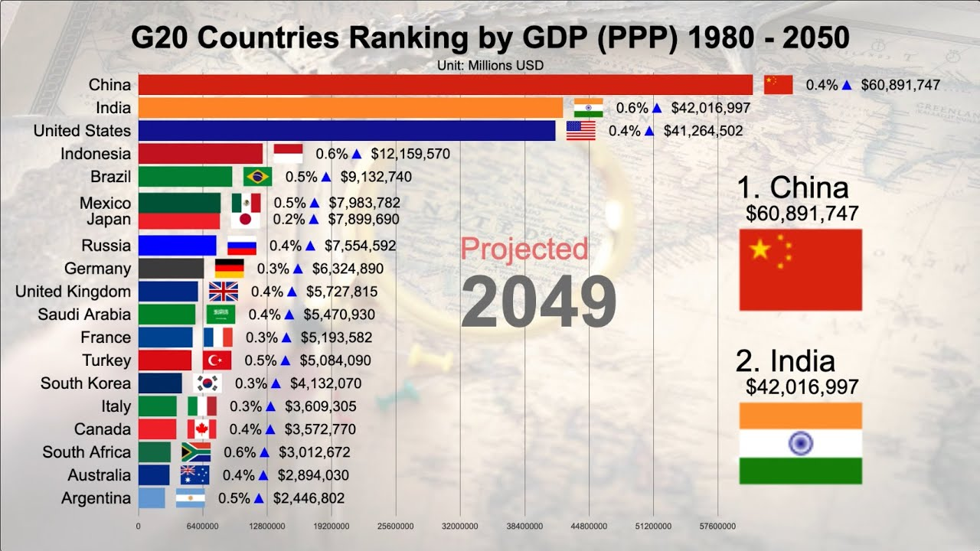
Question of the Day Activity

Slide 12
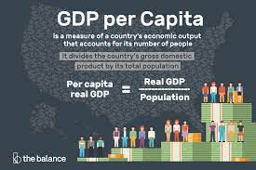
Question of the Day Activity
What country/sovereign nation currently has the highest per capita GDP?
Luxembourg
Monaco
Switzerland
Liechtenstein
https://forms.gle/ZsqFPspkRocWYwDc7

Slide 13
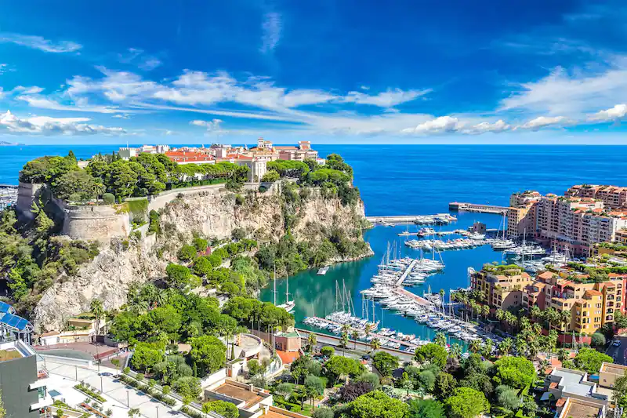
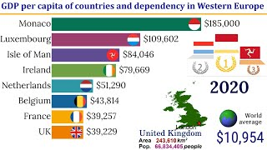
Question of the Day Activity

Slide 14


Slide 15
Sources for Questions of Day
Economics History Questions:
  https://www.history.com/this-day-in-history
  https://www.historynet.com/today-in-history/february-22/
  https://jasonzweig.com/this-day-in-financial-history/
  https://archive.nytimes.com/learning.blogs.nytimes.com/on-this-day/
Current Events Questions:
  https://www.cnbc.com/economy/
  https://www.npr.org/sections/economy/
  https://www.msn.com/en-us/money
Bizarre, Wacky Holidays:
  https://www.holidayinsights.com/moreholidays/index.htm

Slide 16

Current Issues Questions
Idea: start class with a current article (possibly relevant to the topic at hand) and have the students answer a simple question or two.
Example: https://classroom.google.com/c/NTMyNjk1NjcxMTEz/sa/NTc0NzA1MjE5ODc2/submissions/by-status/and-sort-name/all
Format:
Think-Pair-Share
Google Classroom
Poll Everywhere
Collaborative Google Doc
Various Learning Platforms
Sources: https://www.wsj.com/newsletters?sub=197
https://www.nytimes.com/series/us-morning-briefing
https://newsela.com/

Slide 17
Micro vs. Macroeconomics
Microeconomics: the study of individual segments of the economy.
Ex : supply/demand in specific markets, costs of production for firms.
Macroeconomics: the study of the economy as a whole.
Ex: measuring the unemployment rate, GDP, inflation

Slide 18


Macroeconomics

Slide 19

Part One: Economic Indicators
Measuring the Macroeconomy
Gross Domestic Product (GDP), Unemployment, Inflation

Slide 20

Gross Domestic Product

Slide 21
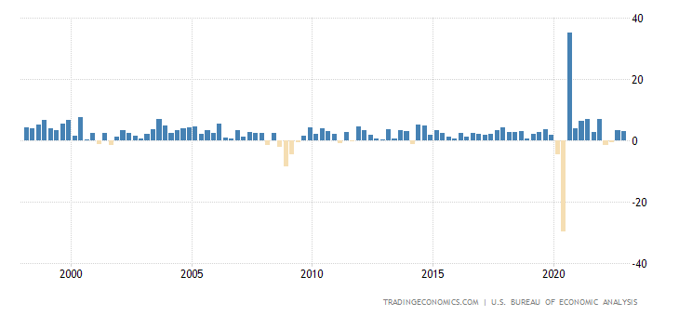
Gross Domestic Product
https://forms.gle/5xzbUhb6NhKC25kj6
What has been the overall trend regarding GDP growth in the U.S. for the past twenty years?
The “Great Recession” happened in 2008-09? Using GDP growth as a tool, compare that time period to the economic impact of COVID in 2020.

Slide 22
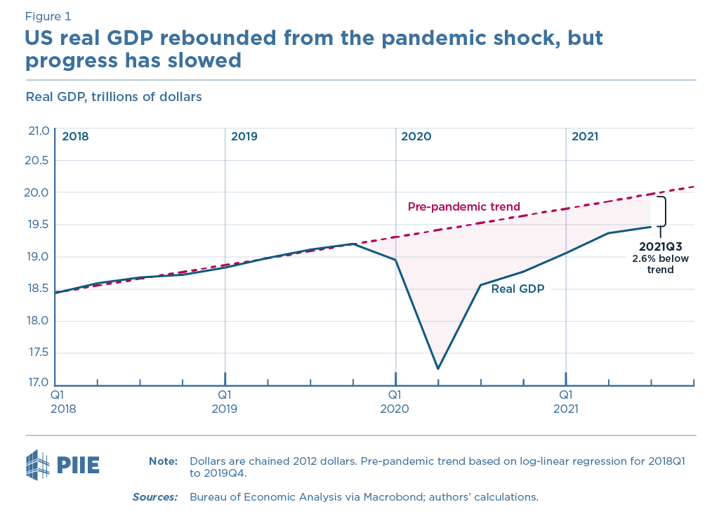

Slide 23
Sources for Economic Data/Graphs
Trading Economics: https://tradingeconomics.com/
FRED (Federal Reserve Economic Data): https://fred.stlouisfed.org/
Bureau of Economic Analysis: https://www.bea.gov/
Bureau of Labor Statistics: https://www.bls.gov/
U.S. Census: https://www.census.gov/economic-indicators/
Moody’s Analytics: https://www.economy.com/indicators
Economic Policy Institute: https://www.epi.org/indicators/

Slide 24
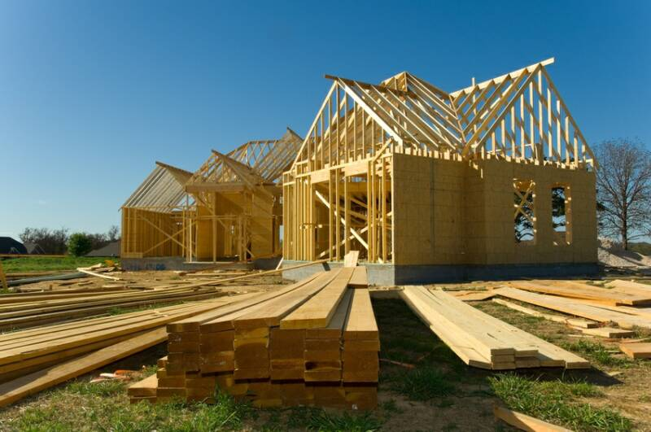

Gross Domestic Product
Gross Domestic Product: the value of all final goods produced within the borders of a nation in a given time period.
  Final goods - not intermediate
  Newly sold - not used
  Within the borders - even if foreign nations own the business that produces the goods/services

Slide 25
Gross Domestic Product
Activity:
Hand out slips of paper with examples (here)
Divide the room in half - “GDP” and “Not GDP”
Give students time to decide if their example is included as GDP or not included as GDP.
Students stand on the side of the room that corresponds with “GDP” or “Not GDP”
Each student reads his/her example and explains why he/she chose to stand on either side.
Gently give students a chance to change sides if they are not correct.

Slide 26
Gross Domestic Product
Four Components of GDP:
Consumer Spending (C)
Business Investment and New Home Sales (I)
Government Spending (G)
Net Exports (Exports minus Imports) (NX)
C + I + G + NX

Slide 27
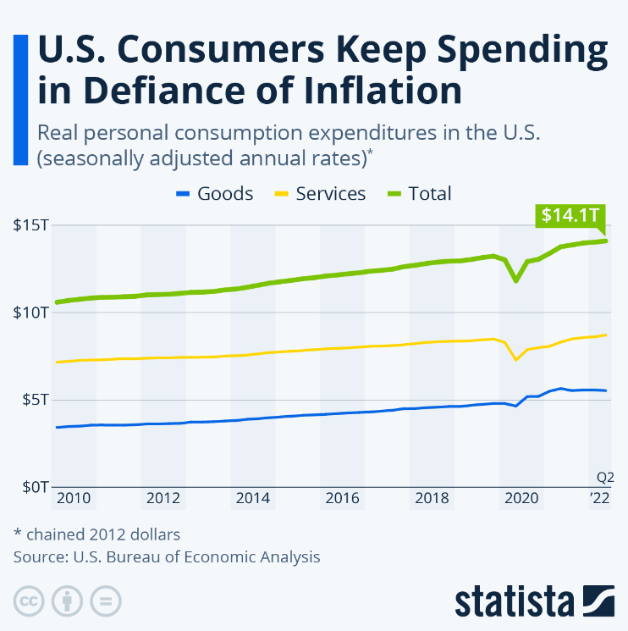
Gross Domestic Product
Consumer Spending: roughly 70% of GDP - ($15 trillion out of total GDP of
$23.32 trillion)

Slide 28
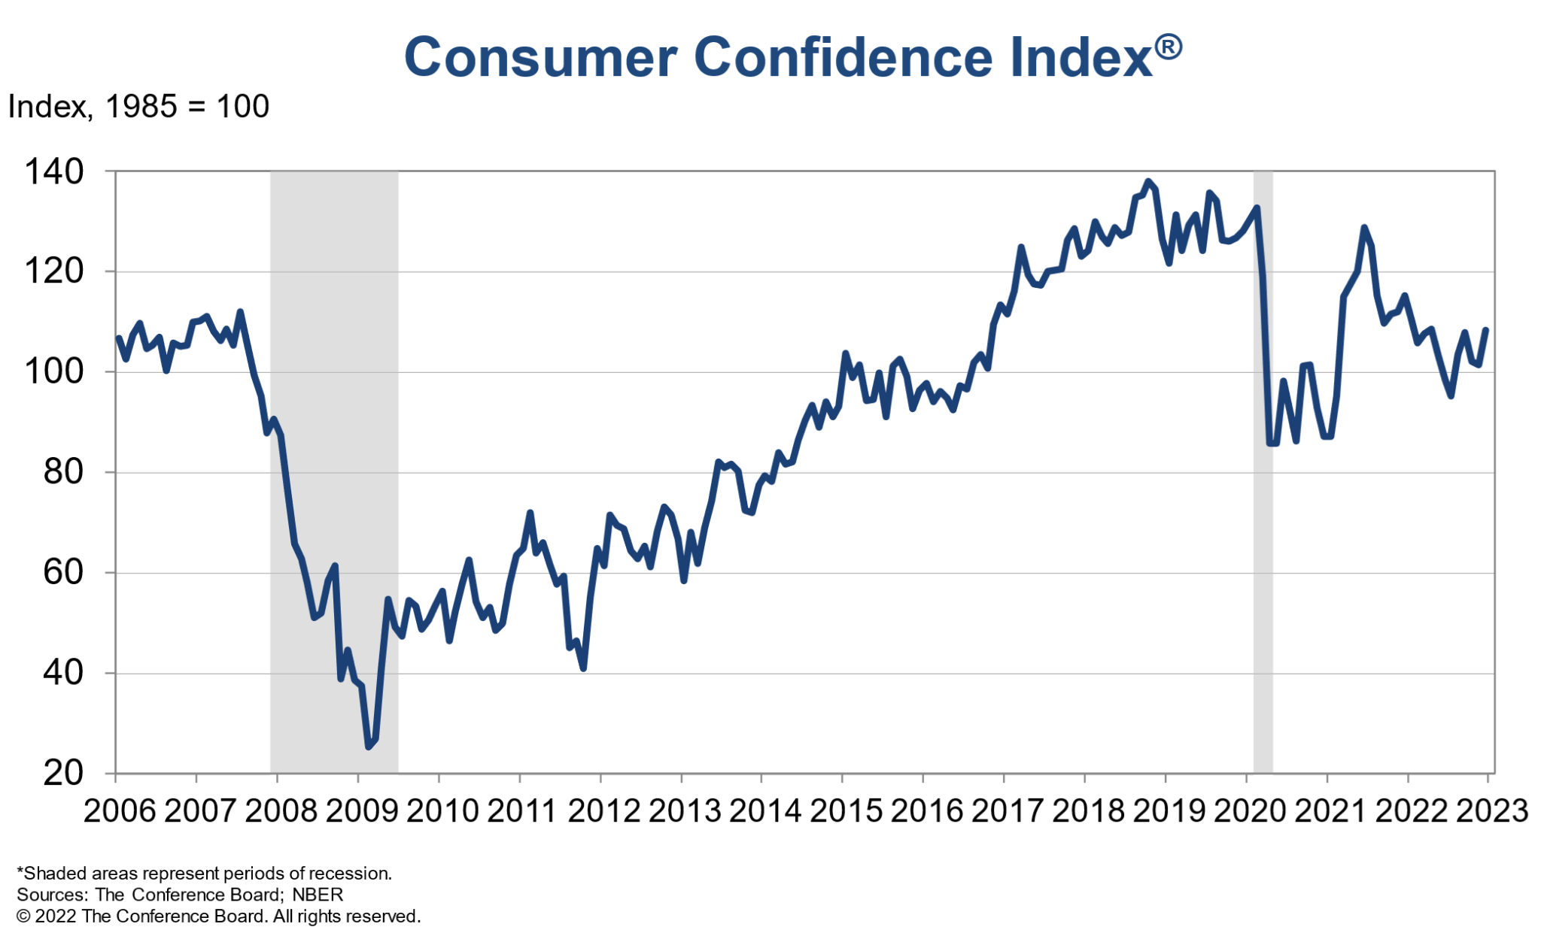

Slide 29
Gross Domestic Product
Consumer Spending: Think-Pair-Share Discussion Questions
Why do most recessions begin with a decline in consumer spending and a decrease in consumer confidence?
What are some factors that might lead consumers to decrease spending?
Why does a decrease in consumer spending often lead to a decline in business spending and eventual increases in unemployment?

Slide 30

Gross Domestic Product
Business Investment (I)
Consumer Spending + BUSINESS INVESTMENT + Government Spending + Net Exports
Business Investment = Purchase of new capital goods and additions to business inventories plus purchases of new homes.
(not financial investment)

Slide 31
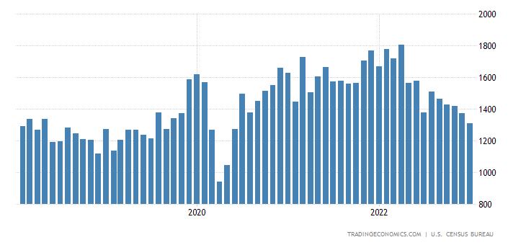
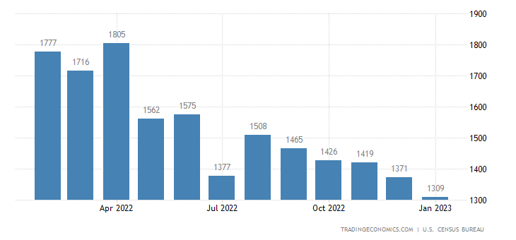
Gross Domestic Product
Business Investment (I)
Housing Starts

Slide 32
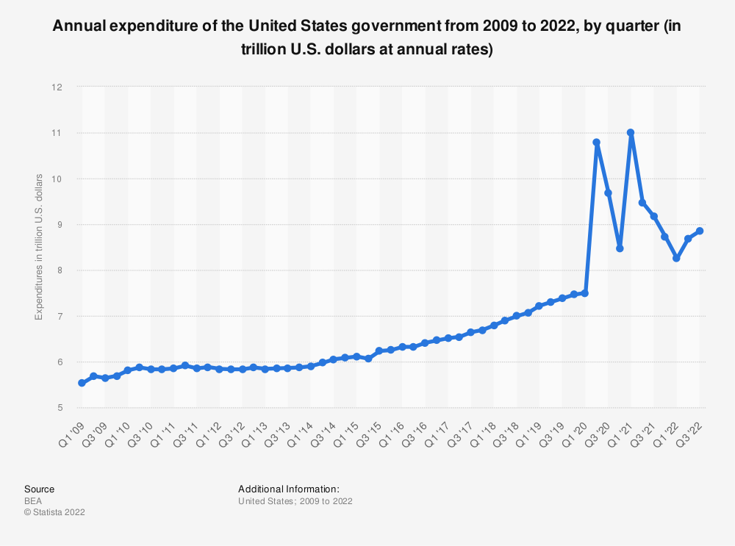
Gross Domestic Product
Government Spending (G)
Consumer Spending + Business Investment + GOVERNMENT SPENDING + Net Exports
Government Spending on goods and services

Slide 33
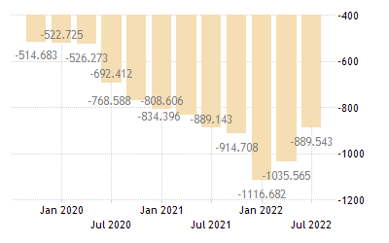
Gross Domestic Product
Net Exports
Consumer Spending + Business Investment + Government Spending + NET EXPORTS
Net Exports =
Exports minus Imports

Slide 34
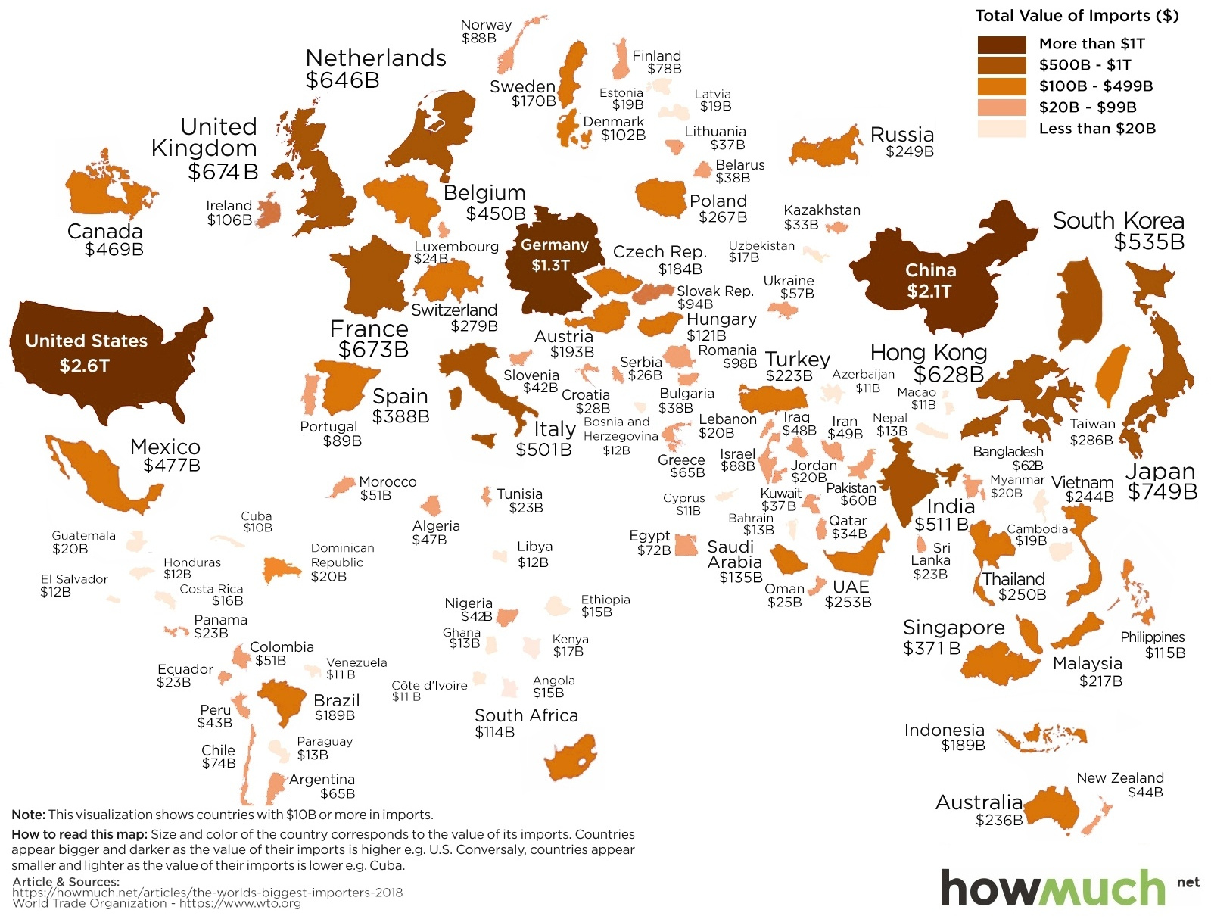

Slide 35
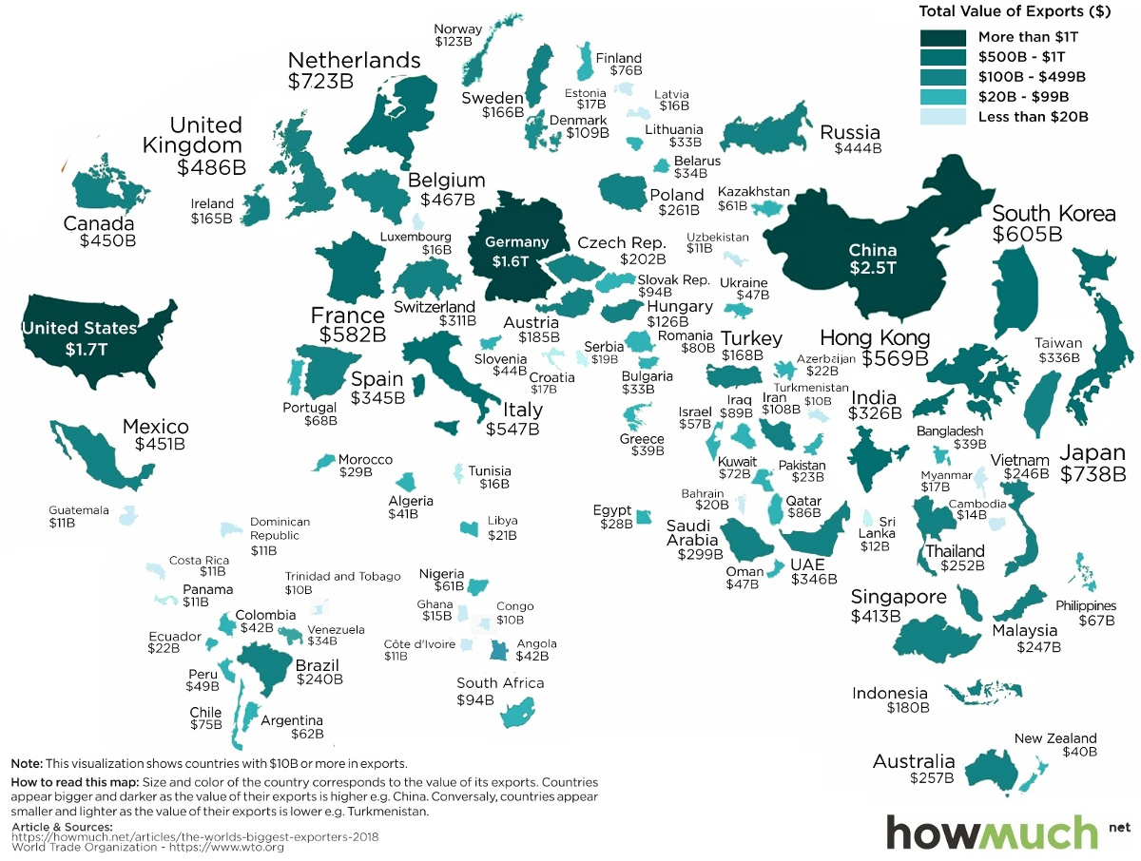

Slide 36
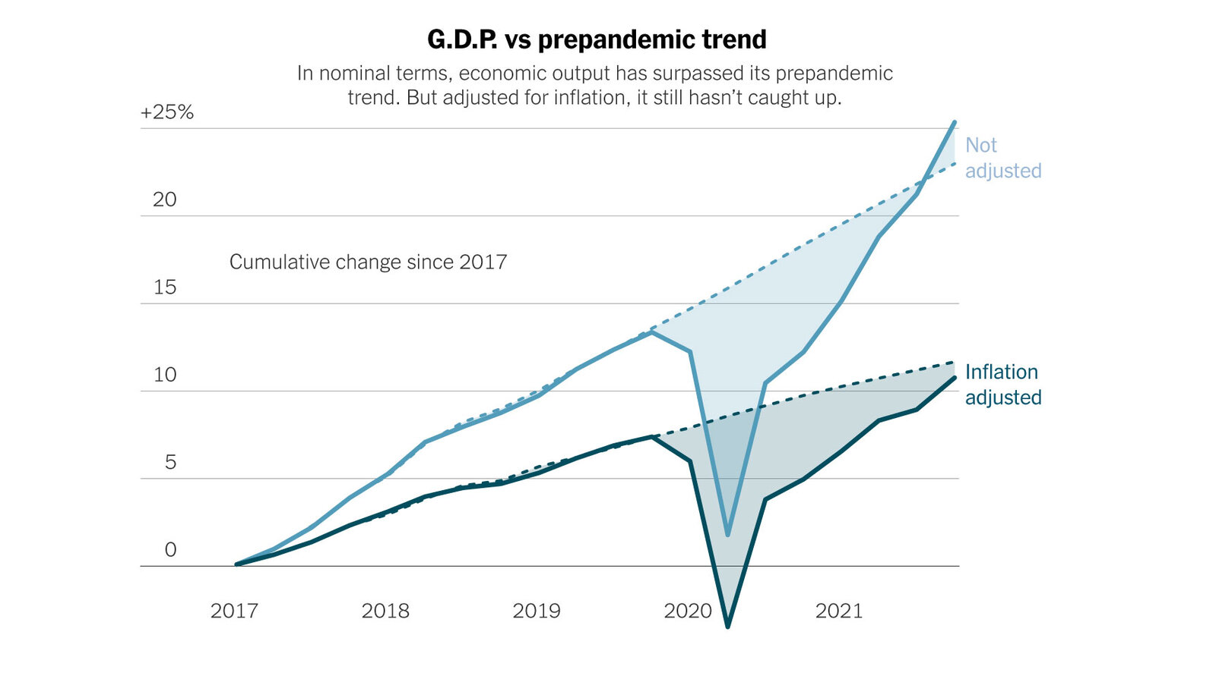
Gross Domestic Product
“Real” vs. “Nominal” GDP:
Nominal GDP: current dollar amount of production, not adjusted for inflation
Real GDP: adjusted for inflation

Slide 37
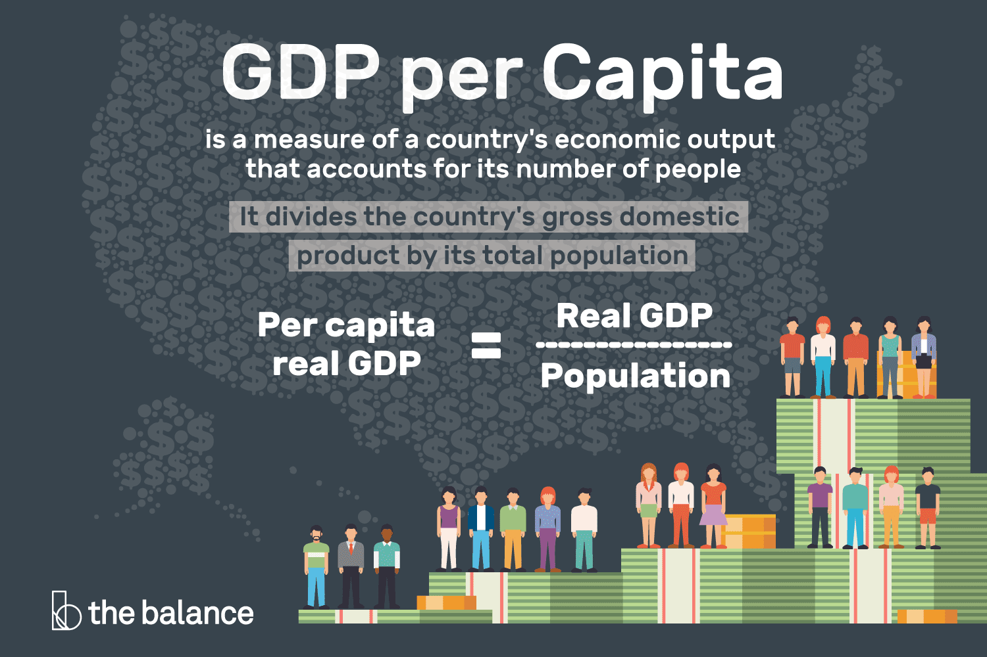
Gross Domestic Product
Real Per Capita GDP: Real GDP divided by the population level.
Ex: In the U.S. Real GDP is $21 Trillion. The population is 331 million.
Real GDP per capita = 21 trillion / 331 million =
$63,444
Discussion Question: Why is Per Capita GDP perhaps a better measure of overall standard of living than total GDP?

Slide 38
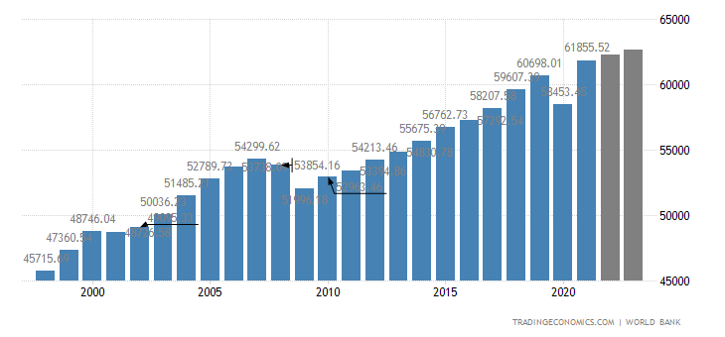

Slide 39
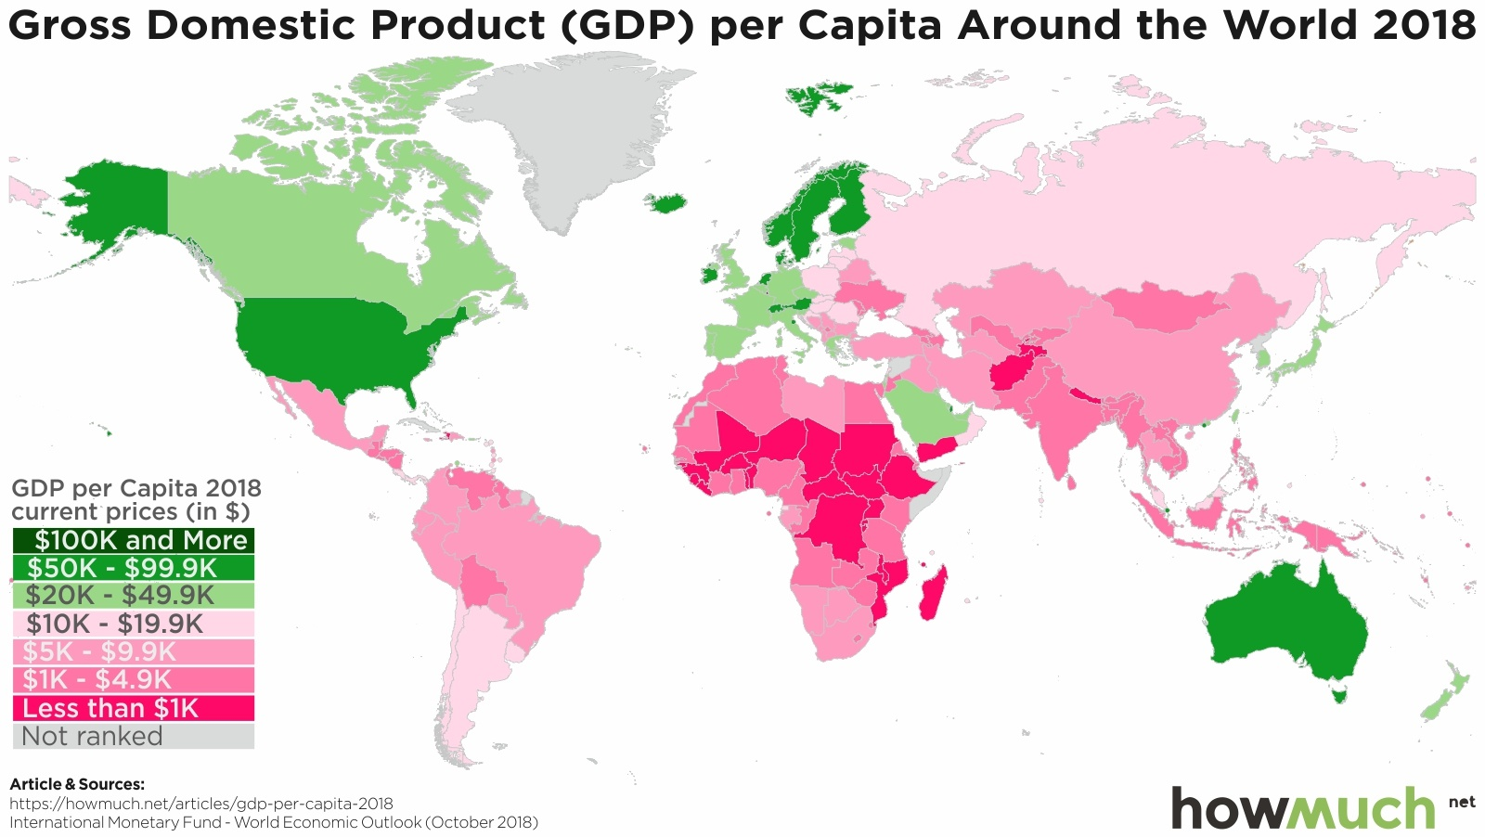

Slide 40
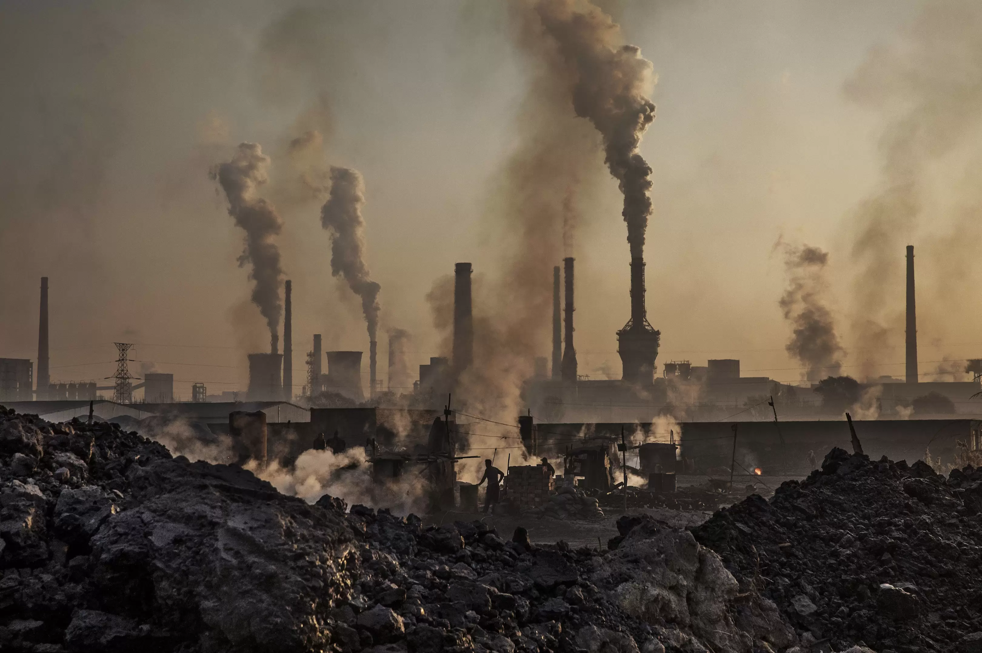

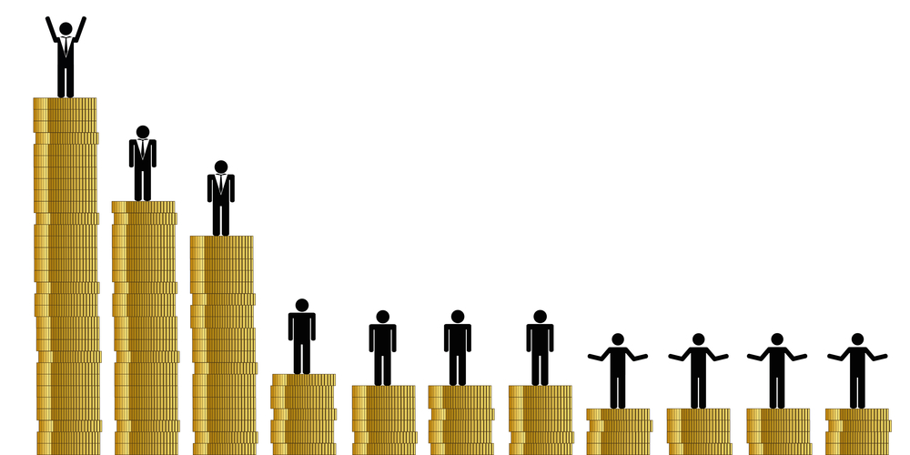
Gross Domestic Product (GDP): Limitations
Goods and Services Excluded from GDP:
Income Inequality
Household Production
Underground Economy
Quality of Life
Health and Life Expectancy
Environmental Quality
Leisure Time
Political, Social, Economic Freedom

Slide 41
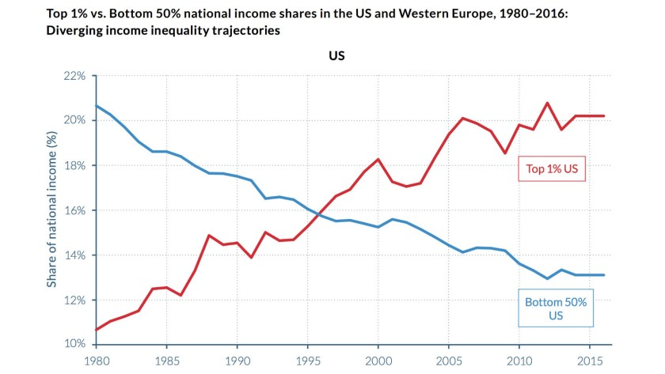

Slide 42
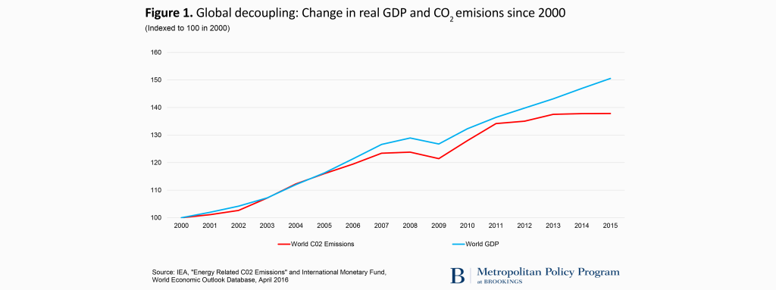

Slide 43
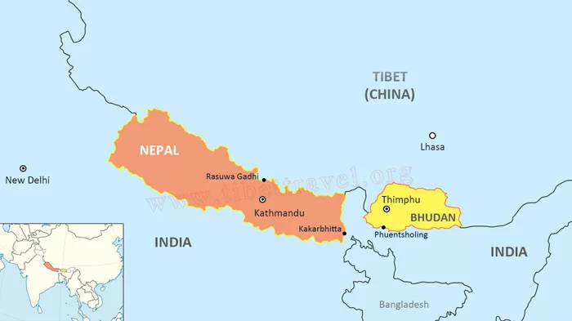
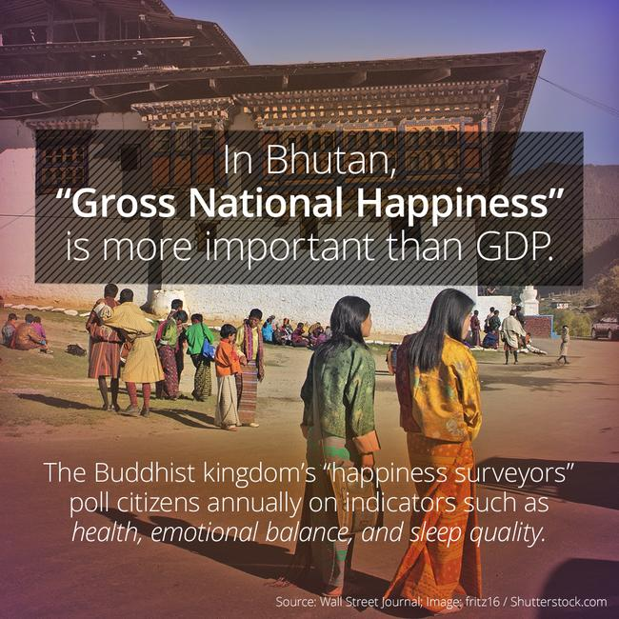



Slide 44
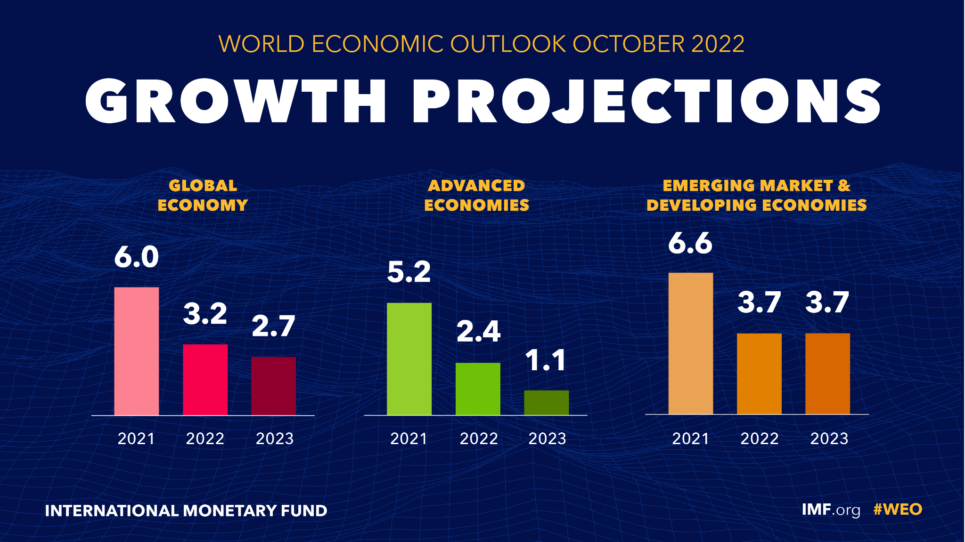
Is GDP a Reliable Indicator for Standard of Living?
https://docs.google.com/document/d/11S9W8OhXc1Kq4s8-c0FvA4YB5nSEtK-8VP2GO2D2A8Y/edit

Slide 45

Quality of Life Index by Country
https://hdr.undp.org/data-center/country-insights#/ranks
https://www.numbeo.com/quality-of-life/rankings_by_country.jsp
https://www.oecdbetterlifeindex.org/countries/united-states/
https://hdr.undp.org/data-center/human-development-index#/indicies/HDI

Slide 46

GDP and the BEA
The Bureau of Economic Analysis (BEA) gathers data and calculates GDP by quarter
The BEA releases three reports (one per month): first estimate, second estimate, third estimate, and final numbers
GDP data are seasonally adjusted to account for any weather related issues and holidays. There is also a non-seasonally adjusted GDP release

Slide 47
Gross Domestic Product (GDP)
Research Assignment Option: Do Higher GDP levels lead to a Better Quality of Life?
Student groups choose individual countries
Conduct research on that nation’s GDP statistics and quality of life indicators.
Create a multimedia presentation using slides with data analysis, visuals, video links, etc. showing the connections to and disparities between GDP and quality of life.
Conclude by conducting a Socratic Seminar style discussion with each group having time in the middle of the seminar discussing their research and conclusions. Students in the outside ring can introduce questions or observations at any time.

Slide 48

Gross Domestic Product (GDP)
Break Out Groups:
Is GDP a reliable indicator for evaluating standard of living and quality of life?
If GDP isn’t a good indicator to measure overall quality of life, what factors should be considered that GDP doesn’t account for?
https://www.usnews.com/news/best-countries/quality-of-life-rankings

Slide 49

Gross Domestic Product (GDP)
Econ EdLink Lessons:
https://www.econedlink.org/?s=Gross+Domestic+Product&post_type=post

Slide 50
Gross Domestic Product
Discussion Questions
Is GDP a reliable indicator for standard of living and quality of life?
If GDP isn’t a good indicator to measure overall quality of life, what factors should be considered that GDP doesn’t account for?
How do changes in any one of the four categories of GDP spending (C, I, G, NX) impact other categories?

Slide 51

Gross Domestic Product
Online Game: BLOOKET

Slide 52
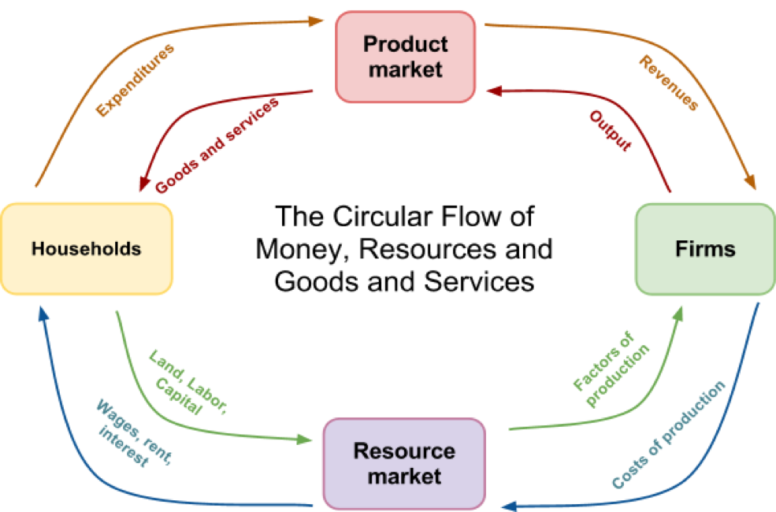
Circular Flow

Slide 53
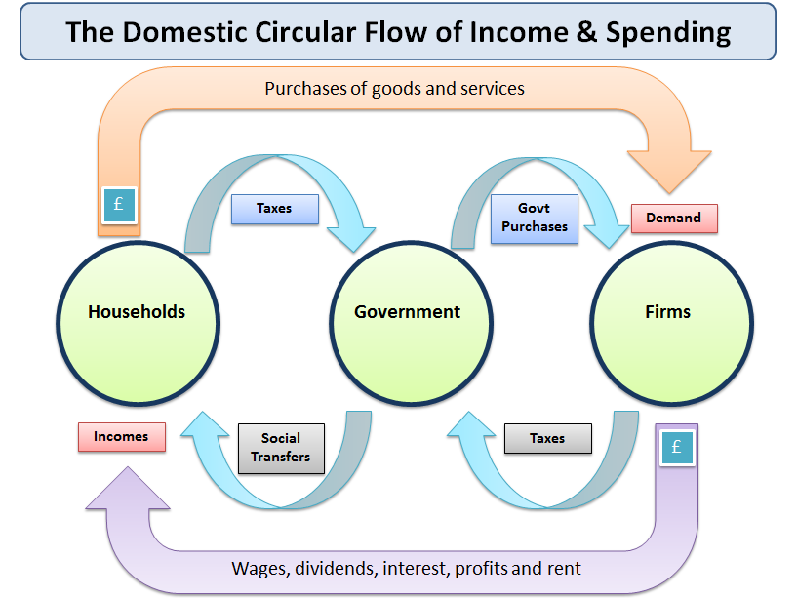
Circular Flow

Slide 54
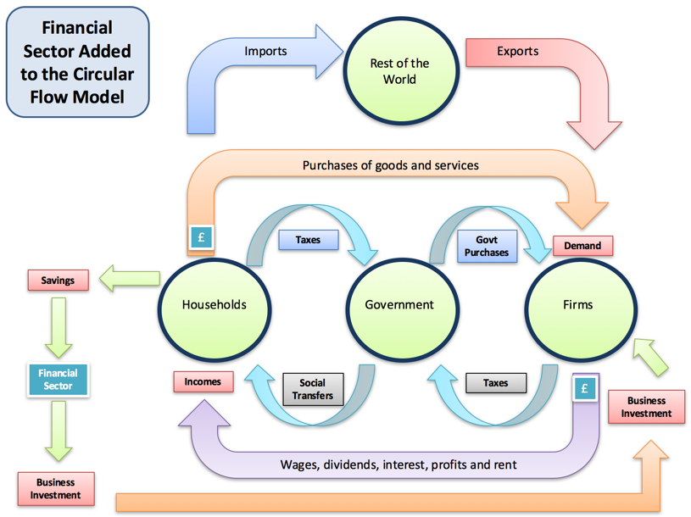
Circular Flow

Slide 55
Circular Flow Activity
Randomly choose two or three students to represent a “firm”
The rest of the class represents “households”
The firms produce and sell a product such as pretzels and purchase labor
The households produce and sell labor and purchase pretzels.
Give the firm and the students who represent households some fake money. The households purchase pretzels but in order to sell them the firm must purchase labor to deliver them to the households. The price of the pretzels and the price of the labor are determined by free market forces of supply and demand.
As long as households are purchasing, money flows to firms which is used to purchase labor.
Take note of any factors that could lead to a slowdown (recession) of spending or inflation on either end and debrief.

Slide 56
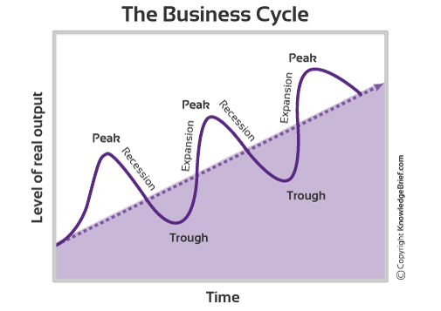
Gross Domestic Product (GDP) and Business Cycles

Slide 57
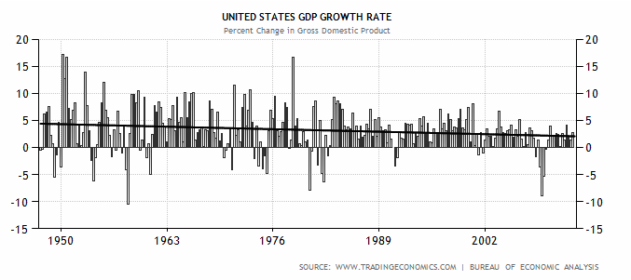
Gross Domestic Product (GDP) and Business Cycles

Slide 58
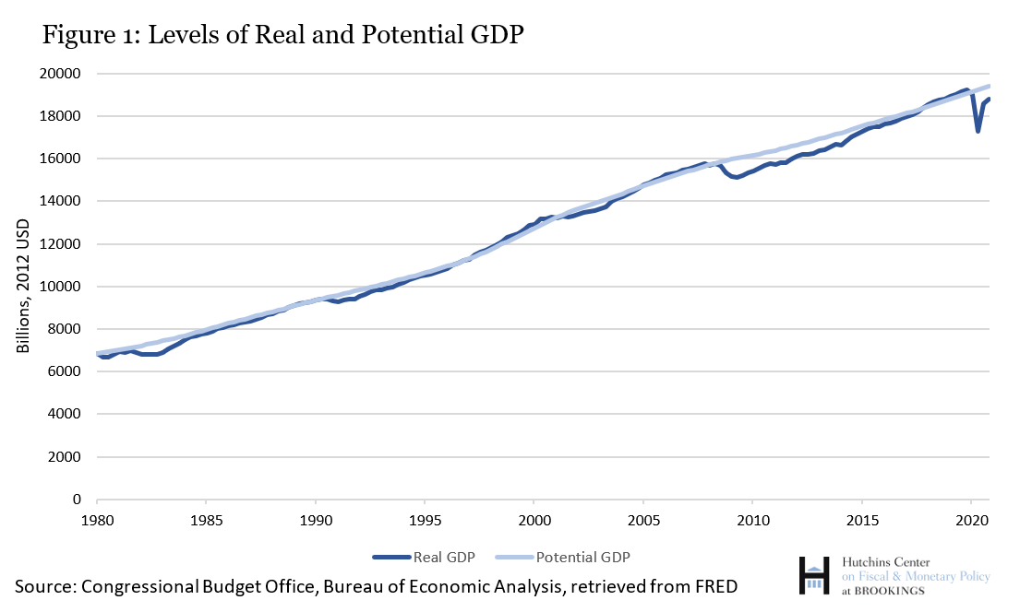
Gross Domestic Product (GDP) and Business Cycles

Slide 59


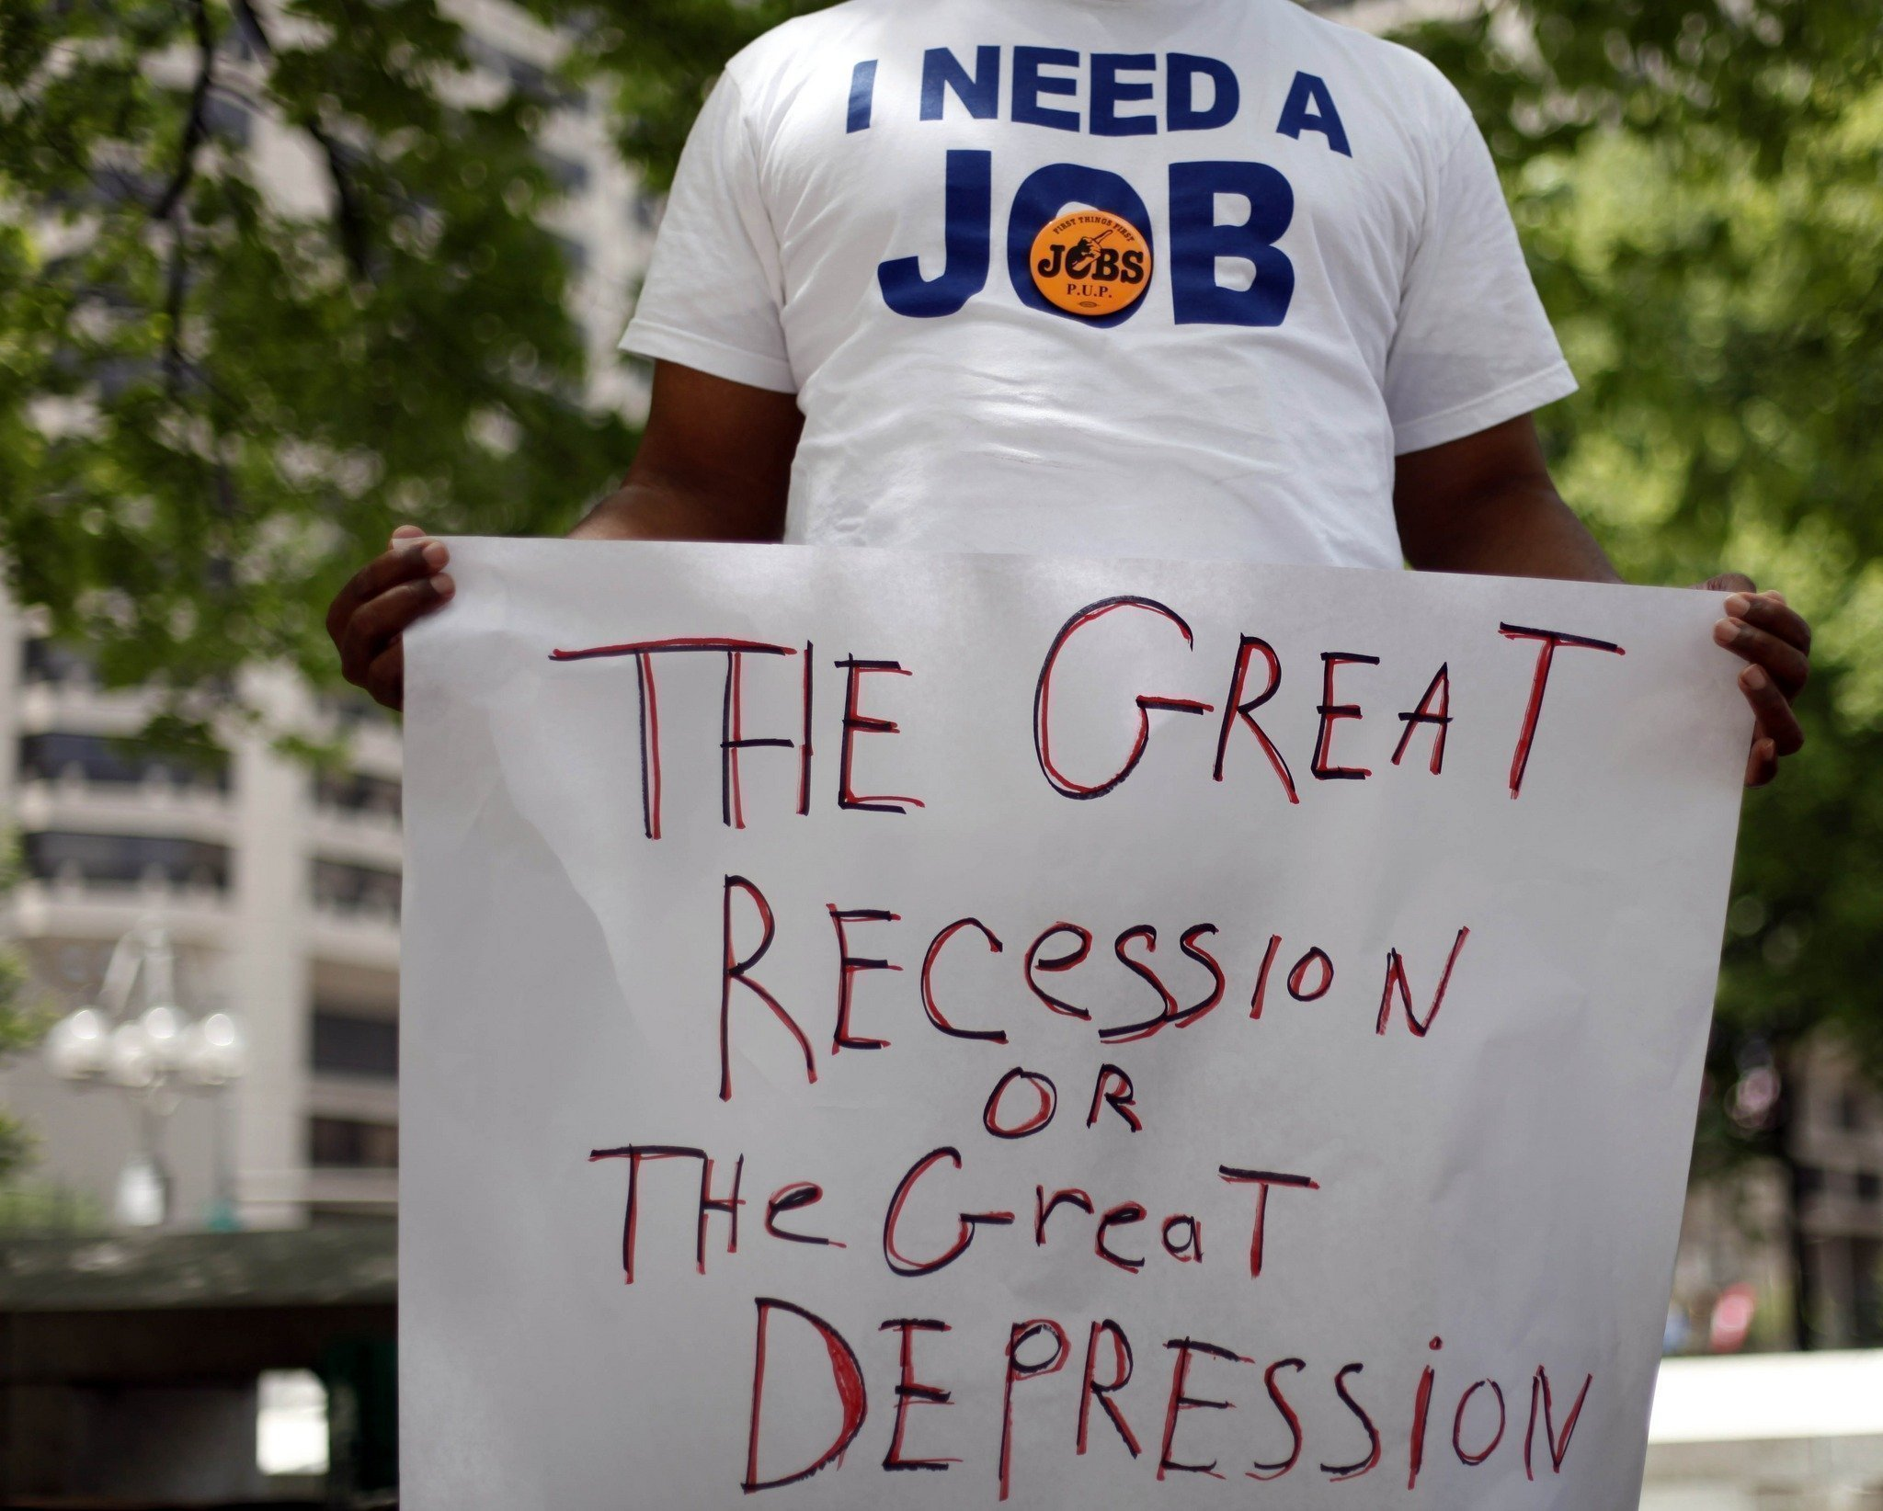
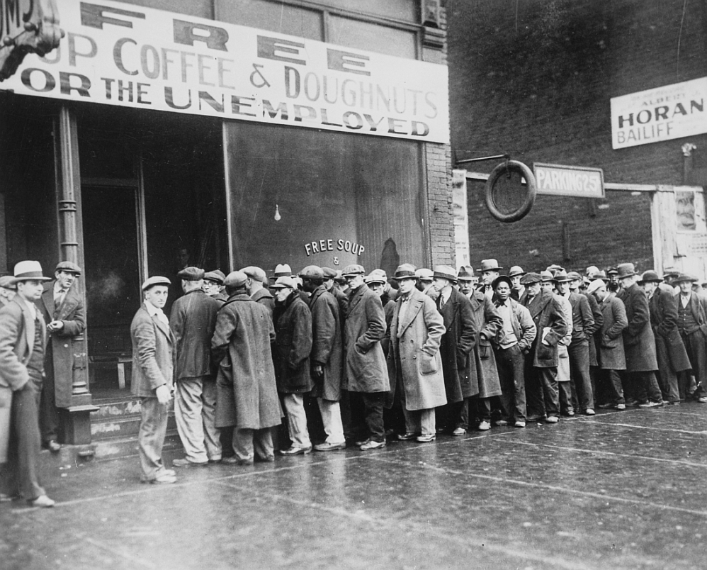
Unemployment

Slide 60

Unemployment
Unemployment Indicators:
Unemployment Rate
Youth Unemployment Rate
Labor Force Participation Rate
Nonfarm Payroll Employment

Slide 61
Unemployment Rate
The percentage of the labor force that is unemployed.
Labor Force: all people within the working age population that are either working or actively seeking work.
Working Age Population: all citizens within a certain age range (typically 16-64) who are non-institutionalized, non-military, and able to work.
** To be “unemployed” one must be actively seeking employment
**”Discouraged Worker” - one who is unemployed and has given up seeking a job.
**Part time work counts as “employed”

Slide 62
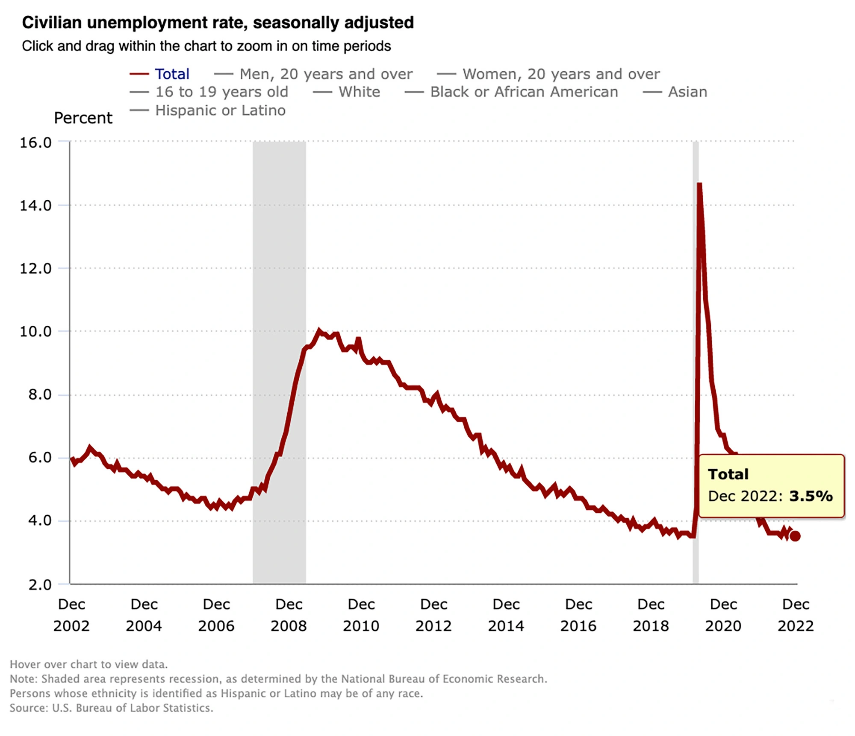
Unemployment Rate

Slide 63
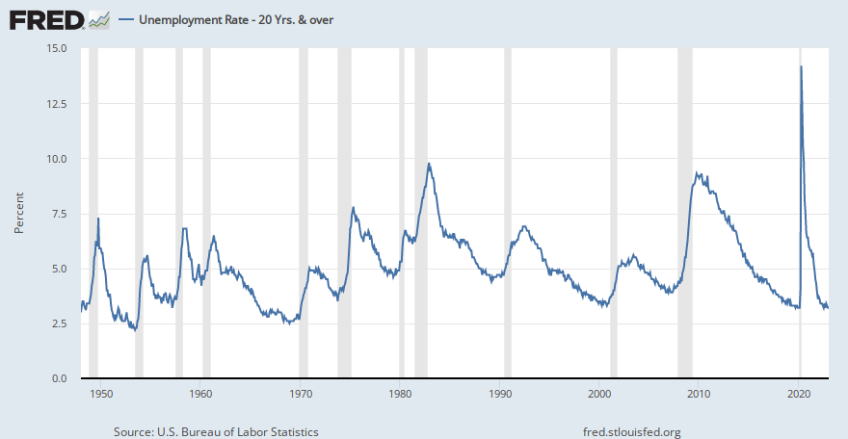
Unemployment Rate

Slide 64
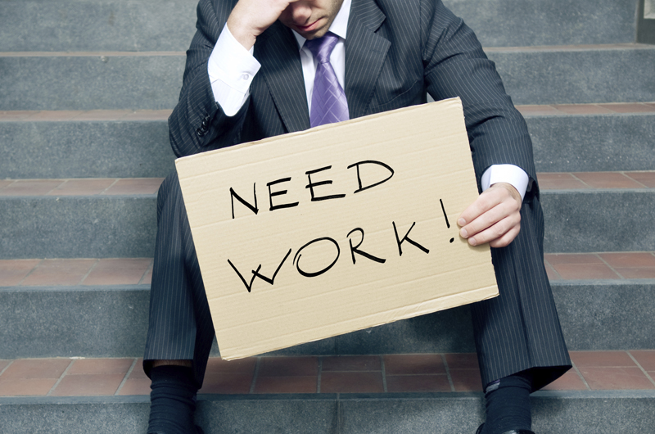
Unemployment Rate: Limitations
It does not account for “discouraged” workers
It does not account for “underemployed” workers
It does not factor in the “labor force participation rate”
It counts part time work as employment.

Slide 65
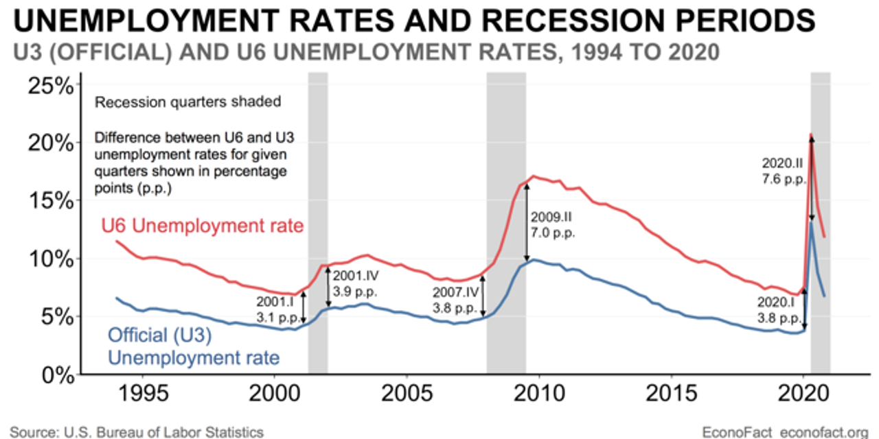

Slide 66
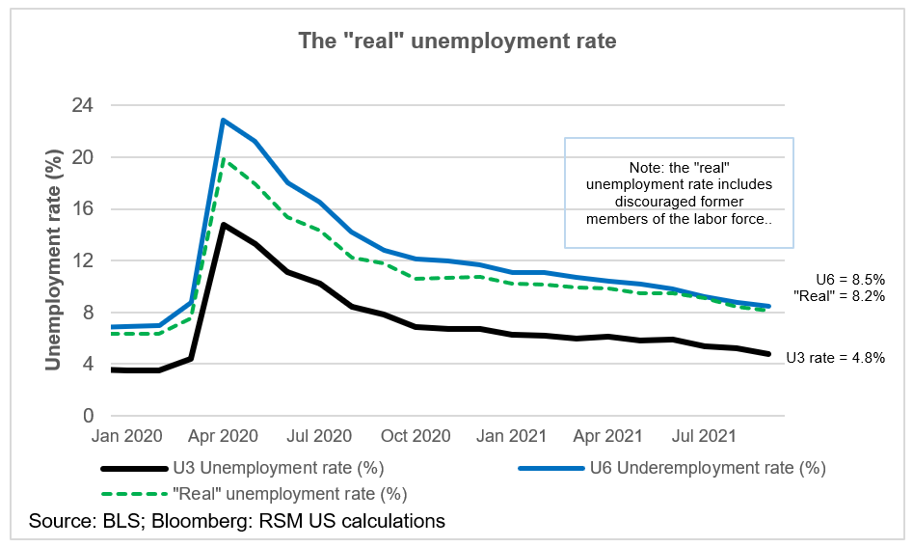

Slide 67
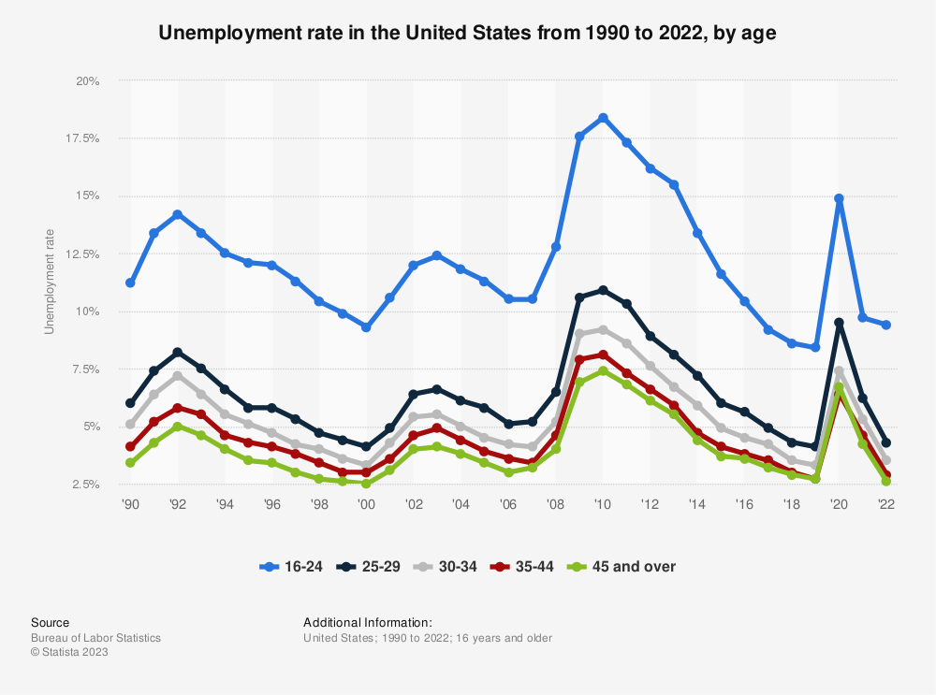
Youth Unemployment Rate
Youth unemployment - the percentage of young workers aged 18-24 that are looking for work and can’t get a job.

Slide 68
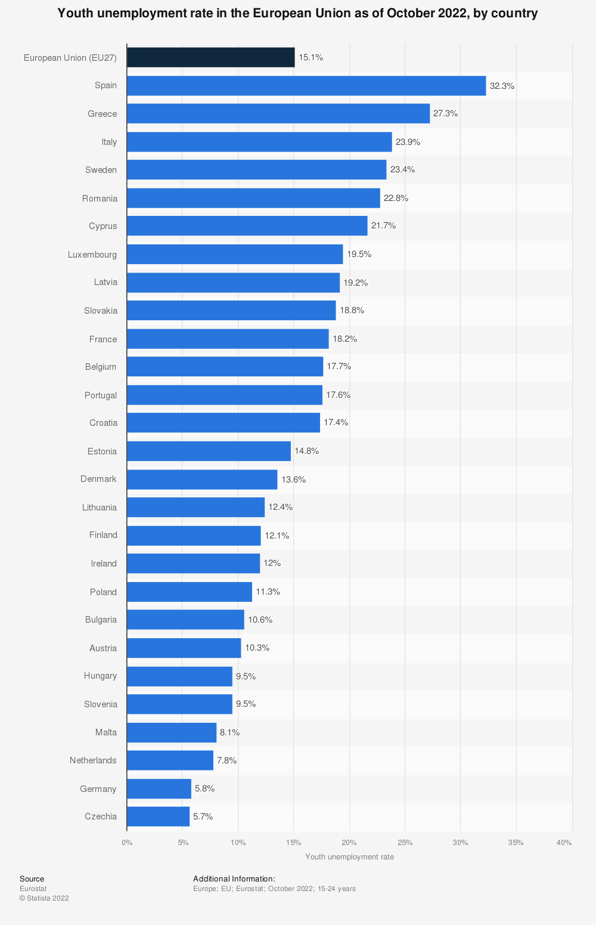
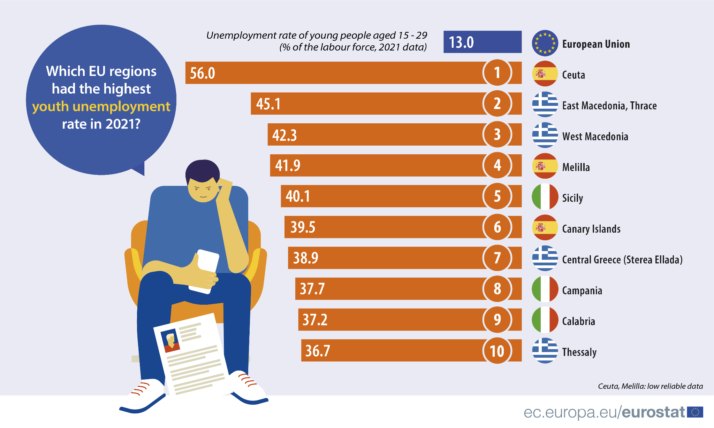
Youth Unemployment Rate in Europe

Slide 69
Labor Force Participation Rate
Labor Force Participation Rate: the percentage of people who are in the working age population that are either working or looking for a job (labor force)
  Labor Force / Working Age Population
  Ex: There are 100,000 citizens in the working age population (aged 16-64). Out of the 100,000 there are 70,000 people in the labor force.
    The labor force participation rate is 70%
Discussion Question: Why would some people in the working age population decide to not be actively in the labor force?

Slide 70
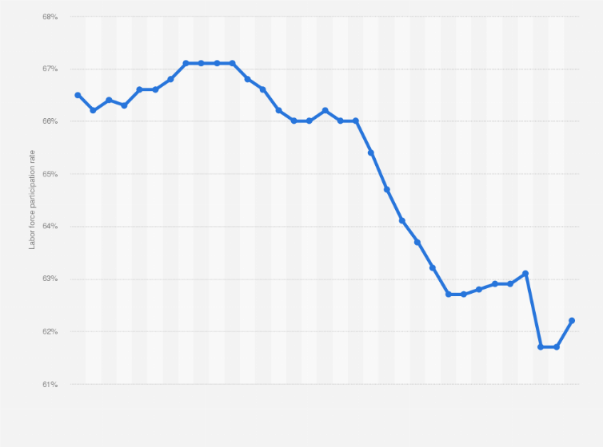
Labor Force Participation Rate

Slide 71
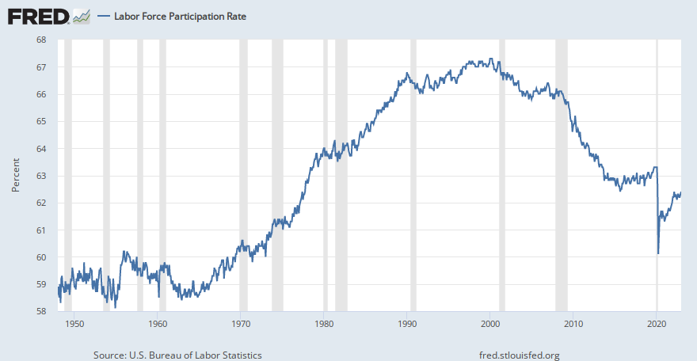
Labor Force Participation Rate

Slide 72
Employment Indicators: Activity
Distribute unemployment scenarios to students (each student gets one hypothetical scenario, here)
Give students a few minutes to determine if they are in the working age population, if they are in the labor force, and if they are technically “unemployed”
Create a chart on the board with the following categories: Working Age Population, Labor Force, Employed, Unemployed, Youth Unemployed
Each student comes up to the front and reads his/her scenario. He/she puts a tally mark into the respective categories on the board. If he/she is struggling, the class can help out.
After each student goes, calculate the unemployment rate, the youth unemployment rate, and the labor force participation rate

Slide 73
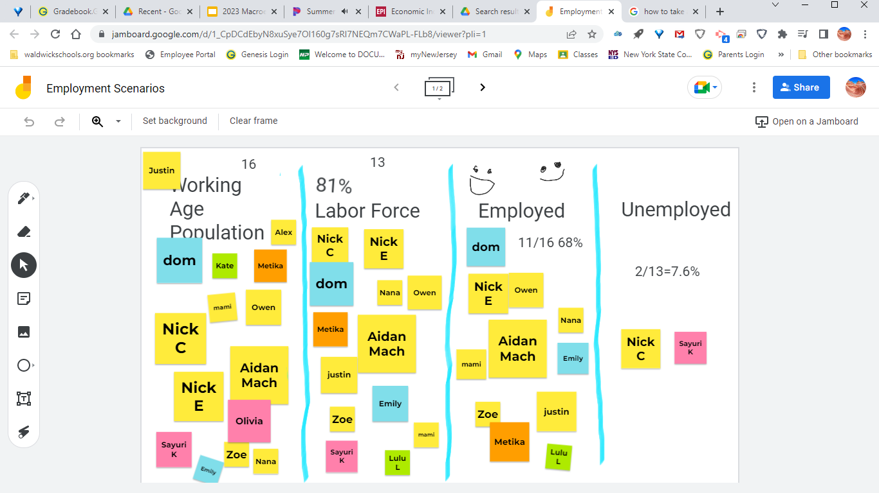
Jamboard

Slide 74
Jamboard
https://jamboard.google.com/d/1swkHOaqBIwZkQMPjvzqIKktyhtN0P8NPMn-Zw9Un6tU/edit?usp=sharing

Slide 75
Construct Your Own Research: Teenage Unemployment Rate Activity
Have student act as the BLS and conduct their own research
Students ask fellow students around the school if they are currently working, if they have tried to get a job but have not been able to, or if they are choosing not to work.
The teacher can predetermine the required sample size
Students gather data and create a Google or Excel spreadsheet
Students generate an unemployment rate and a labor force participation rate and a U6 “unofficial” unemployment rate.
Students present their data to the class and debrief.

Slide 76
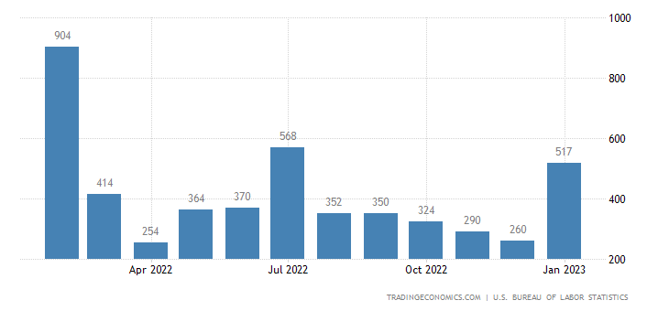
Nonfarm Payroll Employment
The total number of paid jobs (excluding farming) available each month.

Slide 77
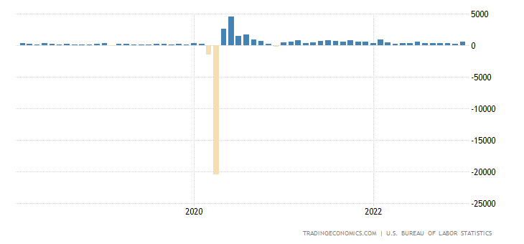
Nonfarm Payroll Employment

Slide 78
Employment Indicators
How is the U.S. doing in terms of employment indicators?
Unemployment rate = 3.4% (lowest since 1969)
Youth unemployment rate = 8%
Labor force participation rate = 62.4%
Nonfarm Payroll Employment = +517,000 per month
What grade would you give the U.S. employment scenario?

Slide 79
Types of Unemployment
Seasonal: workers are laid off during certain seasons
  Examples?
Structural: the nature of the economy changes and there is a mismatch between workers’ skills and available jobs
  Examples?
Frictional: people change jobs and are temporarily unemployed while conducting a job search.
  Examples?
Cyclical: people are laid off due to a recession and weak business cycle
  Examples?
Discussion Question: Which of the four types is the most difficult to face and overcome?

Slide 80
Unemployment: Full employment
“Full Employment”/ “Natural Rate of Unemployment”:
the level of unemployment with no cyclical unemployment
there will always be some frictional, seasonal, structural
Is our goal to have as close to a 0% unemployment rate as possible?
What are the dangers if the unemployment rate goes too low?

Slide 81

Unemployment: Full Employment/ Natural Rate of Unemployment

Slide 82

Employment Indicators and the BLS
The Bureau of Labor Statistics (BLS) conducts a monthly survey
The BLS surveys 60,0000 households each month and inquires about employment. This is called the Current Population Survey (CPS)
The U.S. Census Bureau conducts the survey for the BLS
Each month data is gathered: employed, unemployed, or not in labor force

Slide 83

Unemployment Lessons
Econ EdLink:
https://www.econedlink.org/?s=unemployment&post_type=post

Slide 84
Unemployment Rate/ Employment
Discussion Questions:
Does the “official” unemployment rate (U3) accurately reflect joblessness in the economy or should the U.S. include discouraged workers and underemployed? (U6) Which is a more accurate measurement?
For what reasons has the labor force participation rate decreased in the U.S. in recent decades?
We have a current labor shortage with the prospects of a declining population rate in coming decades. What do you think needs to be done to deal with this situation?
Have you ever faced unemployment or underemployment?

Slide 85

Unemployment
Online Game: GIMKIT

Slide 86




Inflation
‹#›

Slide 87
Inflation
Types of Inflation:
Creeping Inflation: low, steady inflation that represents healthy growth.
Chronic Inflation: higher, persistent inflation that plagues an economy and causes problematic cost of living increases.
Hyperinflation: inflation that spirals out of control. This type of inflation can reach the hundreds, millions, billions percent per year increases.
Ex: Zimbabwe: 25,000,000,000,000,000,000,000,000% in one year!

Slide 88


Slide 89

Inflation Rates in the U.S.

Slide 90

Inflation Rates in the U.S.

Slide 91
Inflation
Causes of Inflation:
Cost push inflation - the cost of resources increases and pushes up the price of final products.
  Ex: there’s a severe drought that causes increases in the price of crops. Food prices increase dramatically
Demand pull inflation - there is an overall increase in demand that pulls the price of goods and services up.
  Ex: a dramatic increase in the population level increases demand for most goods and services
Monetary causes - the government puts too much money in circulation. The money rapidly loses value.
  Ex: Germany in the 1920’s; Zimbabwe in 2008

Slide 92

Inflation
What are the major causes of our recent inflation in the U.S.?
Demand: Pent demand, COVID relief stimulus
Supply: Supply chain issues
Supply Shock: Russia invasion of Ukraine

Slide 93
Causes of Inflation Simulation
Appoint two sellers. The sellers are pretzel producers
Give students a determined amount of currency (different amounts for each students randomly)
Round 1: students purchase pretzels for arranged market prices
Round 2: explain to the class that a drought has reduced the production of pretzels. Take away half of the pretzels for sale. Sellers offer the pretzels and likely a higher price (cost push inflation)
Round 3: explain that due to a financial crisis the Central Bank of your nation is creating a huge amount of money to stimulate the economy. Give some students a ton of extra money but explain that some students are on “fixed” incomes so they only get a small bit more. Due to all the money chasing not enough goods, the price should rise steeply (monetary inflation)
Debrief and discuss the various factors that caused inflation and who benefited and who was hurt.

Slide 94
Inflation
Inflation “Winners”
Inflation “Losers”
People who are paying fixed rate loans at a lower guaranteed interest rate.
People with wages indexed to inflation (COLA)
People with investments that appreciate with inflation (ex: rising home prices)
People on fixed incomes not indexed to inflation
Banks that issued lower fixed rate loans in the past
Consumers or businesses who have variable rate loans
Lower wage jobs that are “sticky”

Slide 95

Effects of Inflation
Decline in purchasing power
Decline in the value of currency
Decline in the real value of income
Increase in interest rates
Which of the above will impact consumers the most?
Which of the above will impact businesses the most?
Which of the above will impact the government the most?

Slide 96
Inflation
Deflation: a decrease in the prices of goods and services
Ex: In 2019 inflation is 1%, in 2020 inflation is -1%.
Is deflation a bad thing?
What could be some of the positive and negative aspects of deflation?
Disinflation: the rate of inflation slows from one time period to the next. There still is inflation but the rate decreases.
Ex: In 2017 inflation was 2.5% and in 2018 inflation was 1.5%

Slide 97

Inflation

Slide 98
Inflation
How is inflation measured?
Consumer Price Index (CPI): a “market basket” of 200 goods and services purchased by a typical “urban” consumer (93% of U.S. consumers are considered urban consumers)
  Prices of the 200 goods and services are tracked monthly
  The “base year” period of the CPI is 1982-84
  In order to calculate the CPI, the price of the current market basket is determined.
  CPI = Price of current market basket / price of base year market basket x 100
EX: In 2019 it cost $150,000 for the market basket. In 1982 it cost $50,000. Therefore the CPI is 150,000/ 50,000 = 3 x 100 = 300

Slide 99

Inflation

Slide 100
Inflation
Inflation Rate =
Value of Current CPI - Value of Previous CPI
______________________________________
Value of Previous CPI
EX: In 2018 the CPI was 295. In 2019 the CPI was 300. What is the inflation rate?
300 - 295 / 295 = 0.0169 = 1,7%

Slide 101
Inflation
Producer Price Index : same idea as the CPI but a market basket of goods and services producers would buy
The PPI is often a “leading indicator” that moves ahead of CPI. Why?
Core Consumer Price Index: a CPI that excludes food and energy prices.
Why might we factor out food and energy prices?
“Supercore Inflation”

Slide 102
Nominal vs. Real Prices
Nominal - the current market price
Real - prices adjusted for inflation
Real prices = CPI current year / CPI previous year x price of good
Ex:
The CPI in 1982 was 100. The nominal price of gasoline in 1982 was $1.50. The CPI in 2020 is 250. What is the real price of gasoline in 1982 expressed in 2020 dollars?
250 / 100 x $1.50
2.5 x $1.50 = $3.75

Slide 103
Nominal vs. Real Prices
Nominal - the current market price
Real - prices adjusted for inflation
Real prices = CPI current year / CPI previous year x price of good
Ex:
The CPI in 1982 was 100. The nominal price of gasoline in 1982 was $1.50. The CPI in 2020 is 250. What is the real price of gasoline in 1982 expressed in 2020 dollars?
250 / 100 x $1.50
2.5 x $1.50 = $3.75

Slide 104
Inflation Learning Activities
Students research times of hyperinflation in various nations throughout history. Students create a illustrated timeline (possibly digital) of the events leading up to and throughout the period. Alternatively use online timeline generators (https://elearningindustry.com/top-10-free-timeline-creation-tools-for-teachers)
Assume that the Bureau of Labor Statistics wishes to create a new “Teenage CPI”. Have students choose 20 items to include with a rationale. If possible track previous prices and compare to current prices while determining inflation rates.
Students create a digital collage that shows the impact of inflation for various sectors of the economy.

Slide 105
Inflation and the BLS
The Bureau of Labor Statistics (BLS) gathers data on prices of goods and services in the CPI market basket
Approximately 24,000 consumers are surveyed each month called the Consumer Expenditures Survey. This determines the weight of CPI categories
BLS representatives conduct research on prices of items in those categories
The BLS calculates the CPI and the Core CPI (excluding food and energy) each month.
The BLS compares the cost of the CPI with previous months to determine inflation rates which are annualized.

Slide 106
Inflation Discussion Questions
How has recent inflation affected you?
What do you think is more dangerous: inflation or deflation?
When present, why is inflation such a persistent problem?
What are the major causes of our current inflation? What are some solutions?

Slide 107

Unemployment
Online Game: Quizlet Live

Slide 108
Putting It All Together . . .
How do GDP, Unemployment, and Inflation relate to each other?
High GDP can lead to low unemployment which can lead to high levels of inflation
Low GDP can lead to higher unemployment which can lead to low levels of inflation
There is an enormous “trade-off” when it comes to monetary policy (the Federal Reserve) and fiscal policy (the U.S. government)
  Promoting growth (GDP) and low unemployment can lead to undesired inflation
  Fighting inflation can lead to lower growth and higher unemployment

Slide 109

Putting It All Together . . .

Slide 110

Aggregate Supply and Demand
Aggregate: total of all sectors of the economy (C + I + G + NX)
Similar to microeconomic supply and demand model
Measures total supply and demand in the entire macroeconomy
Used to illustrate various macroeconomic conditions (ex: recession, inflation) and the impact of monetary and fiscal policy

Slide 111



Slide 112

“Recessionary Gap” - Below full employment

Slide 113

“Inflationary Gap” - Above Full Employment

Slide 114

Effects of Monetary (Federal Reserve) or Fiscal Policy

Slide 115

Effects of Monetary (Federal Reserve) or Fiscal Policy

Slide 116

Fiscal Policy
Fiscal policy: the use of federal government taxes and spending to influence the economy
Expansionary fiscal policy: increase spending; decrease taxes
Contractionary fiscal policy: decrease spending; increase taxes

Slide 117

Fiscal Policy
Balanced Budget: Tax revenue is equal to government spending
Budget Deficit: within a fiscal year, government spending is greater than tax revenue
Budget Surplus: within a fiscal year, tax revenue is greater than government spending
National Debt: the accumulation of budget deficits over time.

Slide 118

Fiscal Policy: Debt Clock
https://www.usdebtclock.org/

Slide 119

Fiscal Policy: The Debt Ceiling Debate
https://www.investopedia.com/terms/d/debt-ceiling.asp
https://www.forbes.com/sites/anthonytellez/2023/01/19/the-debt-ceiling-explained-what-happens-if-the-us-doesnt-raise-it/?sh=2d6c70ce3488
https://www.cnbc.com/2023/01/18/what-the-debt-ceiling-is-and-how-a-standoff-may-affect-consumers.html

Slide 120
Fiscal Policy/Debt Ceiling Discussion Questions
Do you believe that the debt ceiling should be raised again?
What should the government focus on more: raising taxes or cutting spending? Or both?

Slide 121

Tech Based Online Games
Kahoot: https://kahoot.com/
Quizlet Live: https://quizlet.com/228188053/live
GimKit: https://www.gimkit.com/
Quizizz: https://quizizz.com/
Quizalize: https://www.quizalize.com/
Socrative: https://www.socrative.com/
Blooket: https://www.blooket.com/
Notes:
GimKit: Username: topderbeck@gmail.com Password: amelia21 or amelia 2121

Slide 122




Old School Games
Jeopardy
Password
Pictionary
Scattergories
Four Corners
The Lottery Game
Bingo

Slide 123

Final Questions?

Slide 124

Invest In Girls

Slide 125

NEC

Slide 126

NPFC

Slide 127

Advocacy

Slide 128

Suggested Presentation Deck
CEE Affiliates
https://www.councilforeconed.org/resources/local-affiliates/
Include your local affiliate page

Slide 129










Thank You to Our Sponsors!

Slide 130
Contact information
Thank You

