Slide 1
Presented by: Clarissa Delgado Email: Optionsinstitute@goddard.org Date: January 31, 2023
Making Applications Stronger:
Essays/Letters of Recommendation

Slide 2
EconEdLink Membership
You can now access CEE’s professional development webinars directly on EconEdLink.org! To receive these new professional development benefits, become an EconEdLink member. As a member, you will now be able to:
Automatically receive a professional development certificate via e-mail within 24 hours after viewing any webinar for a minimum of 45 minutes
Register for upcoming webinars with a simple one-click process
Easily download presentations, lesson plan materials and activities for each webinar
Search and view all webinars at your convenience
Save webinars to your EconEdLink dashboard for easy access to the event
Access our new Professional Development page here

Slide 3
Professional Development Opportunities
To earn professional development credit for CEE webinars found on EconEdLink, you must:
Watch a minimum of 45-minutes and you will automatically receive a professional development certificate via e-mail within 24 hours.
Attendees can learn how much credit they will earn per workshop.
Accessing resources:
You can now easily download presentations, lesson plan materials, and activities for each webinar from EconEdLink.org/professional-development/
Local resources:
Insert your local professional development opportunities (if applicable)

Slide 4
About Options
A program of Goddard Riverside​ (based in NYC)
Founded 1986 as direct service access center ​
Today​
Access Program​
Success Program​
Professional Development Program
Notes:
A program at Goddard Riverside​
​
Options has been around for 36 years. We support New Yorkers with getting into, paying for, and graduating from college or skill-specific certificate programs. We specialize in working with low-income and first-generation students, who often face the largest barriers to accessing and completing college.​
​
Started as, and continues to be, a one-on –one access counseling program – helping students to match good fit matches and apply for financial aid. The access program also offers services such as college trips, workshops for students; and student get-togethers​
​
In 2012 we added our Success program where counselors work with students in college to support them through graduation​
​
Lastly, through the Options Institute we offer workshops for Access professionals. The Institute started in 2005 and since than more than 9000 professionals have attended workshops​
​
We believe college access is a social justice issue that helps levels the playing field for underrepresented students and that college access is most importantly about choosing a good fit college that is affordable. ​

Slide 5
Housekeeping
Evaluation
One Mic
Cameras on is Highly Encouraged
Participation Highly Encouraged
Step Up, Step Back

Slide 6
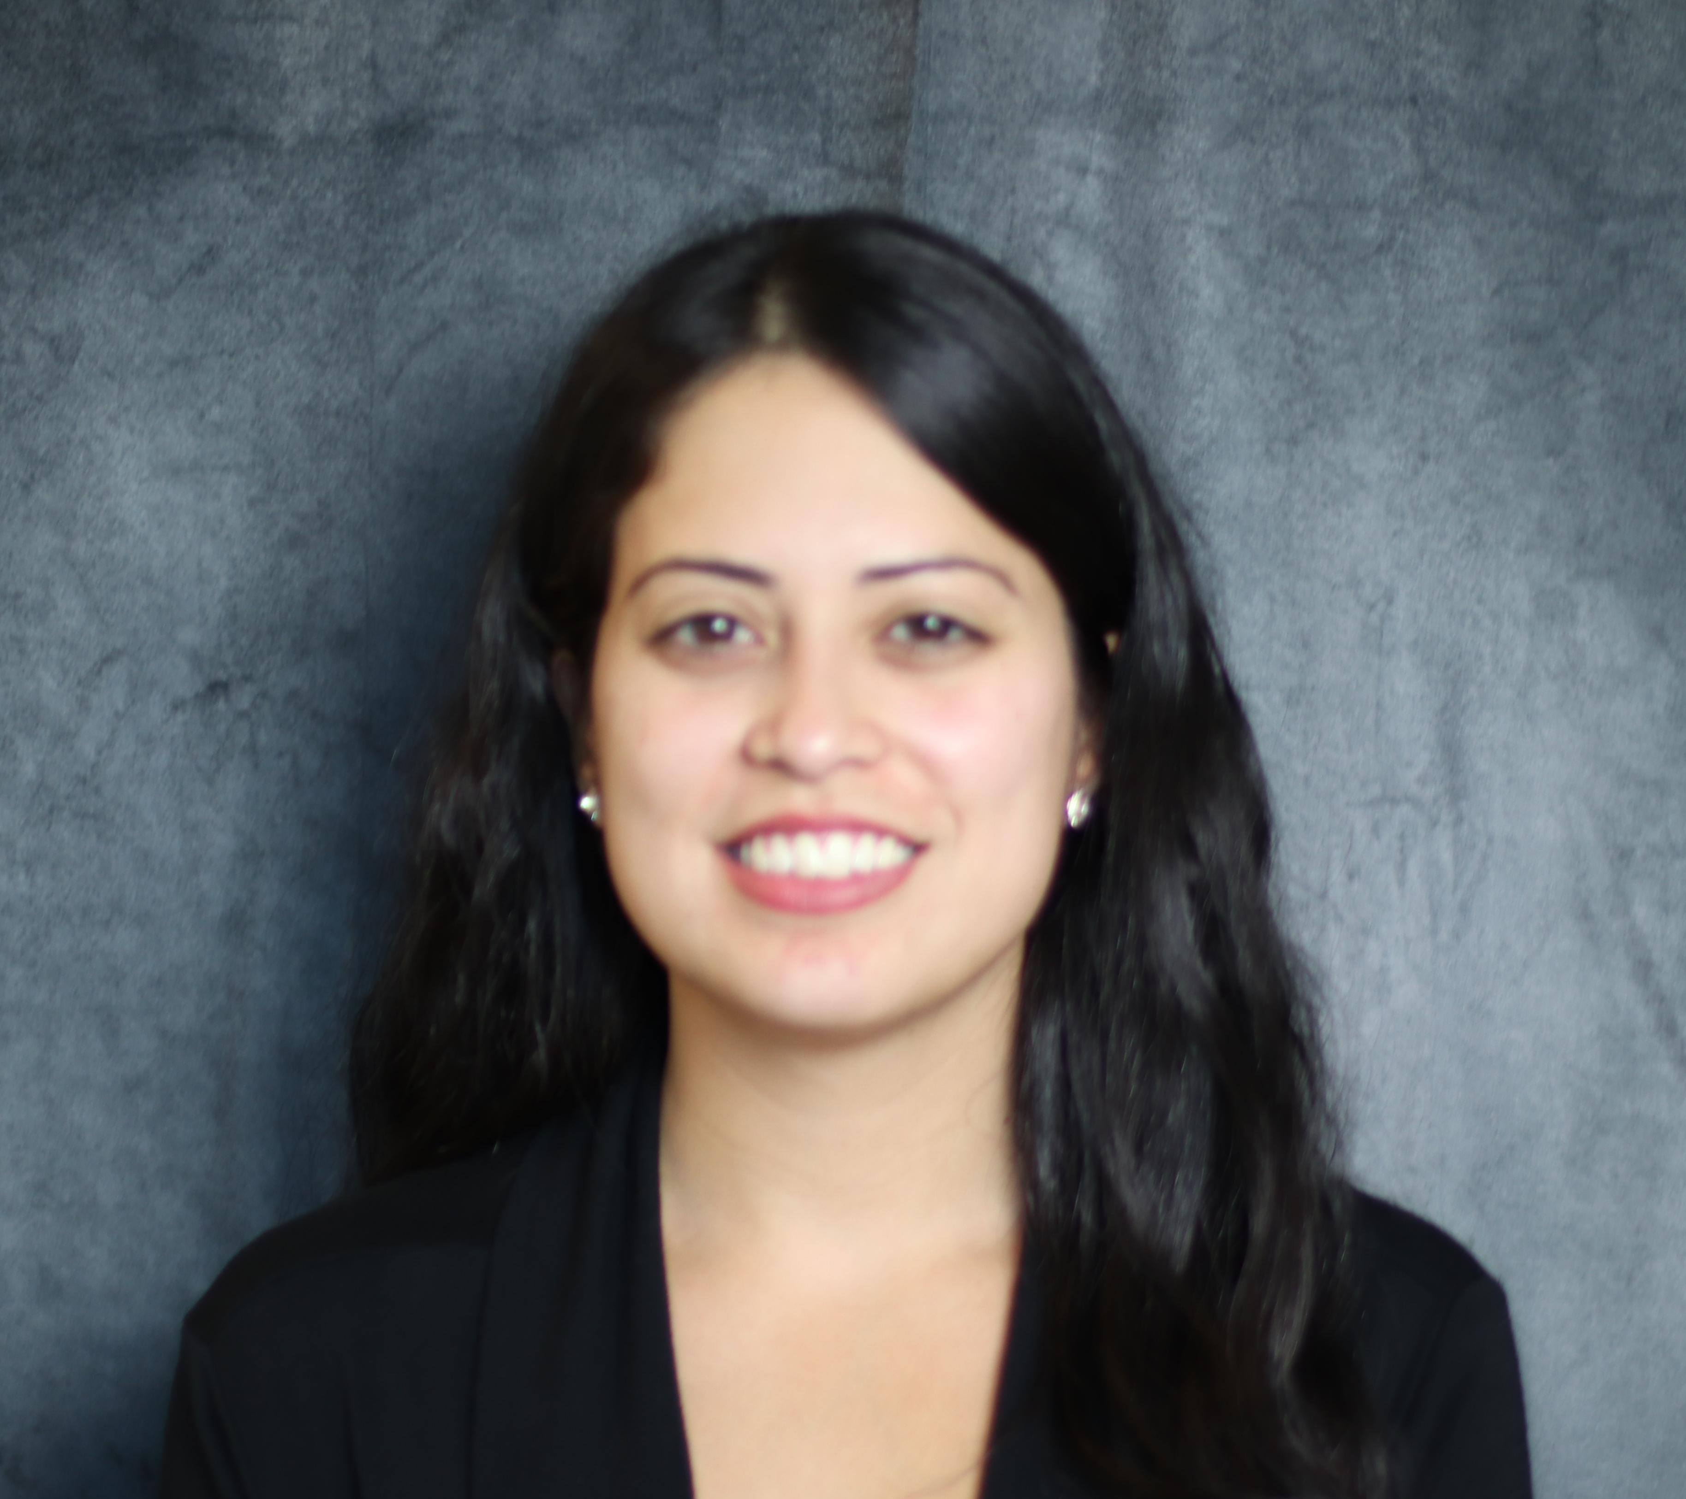
Presenter
Clarissa Delgado
Trainer/College Access Counselor, Options Institute
Born and raised in Queens, New York.
Worked for the NYC Department of Education for 8 years as an English teacher, college advisor, and mentor.
Passionate about college and career readiness and is a firm believer that lack of access to information is one of the biggest barriers underrepresented communities face when it comes to postsecondary planning.
Pastime activities include singing, writing, & listening to podcasts

Slide 7
Objectives
Understand the criteria that go into crafting strong essays and letters of recommendation.
Provide specific feedback to students, parents, and recommenders about essay and recommendation drafts to ensure high quality submissions.

Slide 8
Agenda
Introduction
Why are college essays important?
Features of a strong college essay
Providing essay feedback
Recommendation Letters: Context, Dos and Donts
Brag Sheet
Q&A
Notes:
We will start by discussing the importance of college essays in the application process. Then we will discuss the qualities of a well crafted essay, noting what can enhance one's essay, as well as some 'traps' to avoid. We will then review how we can support students with crafting their essays using the ARROW feedback method, following a sort of glow and grow approach when providing feedback. Then we will shift our focus to recommendation letters, and explore some of the dos and donts behind rec letter writing, and how brag sheets can help you craft rich, detailed letters of rec. As always we will leave time at the end for q&a.

Slide 9
Making Applications Stronger: Essays
Notes:
You know it’s important to have a high GPA, strong standardized tests scores, and extracurricular activities for your college application. But what about the essay? Just how much does it really matter to your overall academic profile?
While the weight of the college essay varies across programs/instituitions, At the top 250 schools, your essays generally account for 25% of your overall application. This is only slightly behind the 30% for extracurriculars. Essays are actually ahead of the 20% for grades and coursework, 15% for test scores, and 10% for recommendations and interviews.
Now that many schools are going test-optional or test-blind, however, this breakdown changes slightly. In these situations, test scores no longer account for 15%, meaning that other portions of your application, including essays, are given more weight and consideration.
https://blog.collegevine.com/how-important-is-the-college-essay/#:~:text=To%20truly%20assess%20an%20applicant's,unique%20experiences%2C%20and%20your%20perspective.

Slide 10
Why essays are important
Essays are:
A students' personal introduction to the admissions committee
An opportunity to share their voice & unique perspectives
Space to demonstrate the qualities they will bring to a college campus
Notes:
while no essay will make an unqualified student acceptable, a good essay can help a qualified applicant stand out from the competition. A good essay just might be what turns a “maybe” into a “yes.”
..Another reason to focus your energy on crafting a quality essay: at this point in the admission process, it is one of the few things you can still control. This is your chance to show us what you are capable of and set yourself apart from the applicant pool – this is a chance to stand out and leave an impression!
How will you further enrich/enhance the school community?

Slide 11
College Essays
What makes an essay strong?
Notes:
Have participants brainstorm the qualities of a good essay – drop in chat/unmute
Debrief & summarize what was said
Clear theme/purpose
Good use of details
Being specific
Not ‘fluff’
Organized
Grammatically correct/proper use of conventions
7 qualities of a good essay:
Introspective and reflective (demonstrate growth)
Full of a student’s voice
Descriptive & engaging
Honest
Unconventional & distinct
Well written
Meaningful
https://prepmaven.com/blog/applying/qualities-successful-college-essay/

Slide 12
Factors of a strong college essay
Highlight values/qualities you bring to the table
Show growth
Get personal/vulnerable
Demonstrate craft
Notes:
Highlight - So how can I, in the span of a few minutes, give you a sense of who I am?
One way is to show you who I am through what I value, to show you the values that drive my actions, thoughts, relationships.
Why in the span of a few minutes? Because that’s how long someone will tend to spend reading your college application.
One of the clearest ways I know how to communicate that is through communicating values. And linking those values to specific thoughts, moments, actions.
Growth - This can come in many different forms. To show growth, we generally have to talk about how we were wrong, or didn’t know something, or had to develop X quality. It is impactful to see how a student has grown & developed through their experiences. In short, we have to get a little vulnerable. Which leads to our next factor, get personal.
Personal - Vulnerability can be a scary thing for some people. Especially since we can be culturally trained to think of vulnerability as weakness (which it isn’t… I’d actually argue vulnerability takes a ton of strength).
But, again, we’re looking for a way to help a total stranger get to know us in the span of 5 minutes. And vulnerability is a great way to do so. When a student opens up some about their worries, fears, or difficulties, they’re bravely offering up a part of themselves. It helps the reader feel like I know the real them, beyond their grades and test scores.
Craft – grammar/spelling, - Do remember that the people reading your college essay are also thinking about your readiness for college-level writing and work. That’s why things like grammar are important—a bunch of grammar and spelling errors may make them think you didn’t spend much time on this, and may not care too much
Fludity with languae, - One is to write similarly to how you speak. You should be able to read your essay out loud and have it feel fluid and easy. Meaning it shouldn’t feel forced or overly formal or stilted. don’t try to demonstrate facility with language by using “big words” just for the sake of using big words. Write the way you speak so it does not read as forced.
verb usage - as go your verbs, so goes the rest of your writing. The more specific, precise, and evocative your verbs are, the stronger the rest of your writing around those verbs becomes.
https://www.collegeessayguy.com/blog/what-do-colleges-look-for-essay
http://clipart-library.com/essay-cliparts.html

Slide 13
College Essay: Dos and Don'ts
DO:
Find a hook
Show
Use your challenges or difficulties to demonstrate your success and growth
Brainstorm
DON’T:
Rehash your resume
Tell
Use the sympathy card
Think you have nothing to share
Notes:
Colleges have your transcript, SAT/ACT scores, recs & extra currics to understand the academic side of you. The essay is a studnets opportunity to show what they're really like – their personality, passions & what they will bring to the campus. It's a place to demonstrate how they will fit with/contribute to the school/program.
Hook/don’t rehash resume
Don’t just reword what can be learned from reading your resume. To really capture the readers' attention, use a hook – a compelling anecdote, an example, a question – at the begiining of your essay to draw the reader in! This is a chance to demonstrate what your personality is like and give them an idea of your voice.
Remember, admissions reps are reading hundreds, if not thousands of essays – capture their attention early with an engaging hook that leaves them 'wanting more!' (what makes you click on an article to read – an attn grabbing headline)
Show not tell
A personalized metaphor4 can be a great way to capture your experiences and views throug the lens of a single experience. However, be wary of using common or cliché experiences as metaphors for something more global.
How you say it is more important than what you say. Do not simply state facts or qualities about yourself to get an idea across.
Include specific details, examples, & reasons to develop your ideas.
That's why you should use rhetorical devices – symbols, imagery, anecdotes, etc – to describe your experience
You don't have to have started your own business or been part of something 'groundbreaking' to tell a compelling story. Remember, how you say it is more important than what you say.
Use challenges to demonstrate growth – okay to use a 'difficult' story, but have the 'so what' behind it- what do you want the reader to remember about you? What impression are you trying to leave?
Brainstorm
Getting started on the college essay is often the hardest part. Many students feel overwhelmed by choosing a topic that would be suitable for their admissions application. Others feel they have nothing to say. These and other issues lead many students to procrastinate writing the first draft. A great way to help students overcome the initial blocks to writing this essay is by brainstorming!
For instance, free write! -Make a list of beliefs, flaws, personal anecdotes or whatever else pops in your head. Then review what you've written to identify common themes/strong details that demonstrate your character/values/beliefs. However, some students may need a more structured approach to brainstorming to help develop their ideas.
Edit this slide with this info instead?
https://crf.georgetown.edu/dos-and-donts-of-writing-recommendation-letters/
https://blog.collegevine.com/what-makes-a-good-recommendation-letter/
DO:
Tell me a story. Kati says, “It's the character stuff that I really need to hear from you … I need to know what kind of community member I'm getting—you're my best (sometimes only) source.”
Pick specific descriptors and back them up with evidence; avoid cliches like “hard-working,” “passionate,” and “team-player.”
Show me good student work. Copy and paste an especially well-writ paragraph from your student’s best essay, or a screenshot of clean coding they did in class. Here’s Kati: “Be brief in how you set it up, but it's cool to let the student speak for themselves.”
Ask permission if you're going to reveal something private about the student (they have a learning disability, their mother has cancer, they struggle with depression).
DON’T:
Write your autobio. The letter’s about the student, not you.
Repeat a student’s resume. Admissions counselors get a copy of that, too. Kati says, “I know this comes from a desire to portray the student as well-rounded and also to pad out what you're worried will be a short letter, but trust me: Two paragraphs actually specific to the student are so much better than a page of puff.”
Address letters to a specific school. It’s awkward if Stanford reps are reading your letter and it talks about how much the student loves USC.
Recycle letters—even those you wrote in previous years. Here’s Kati: “I read high schools in groups—so, if I get five applications from Montgomery High, I read all five of them right in a row. It does your students zero favors if I see you are not writing them individual letters. And next year, I will also be the person who reads letters from Montgomery High.”
Avoid common generalzations that fail to distinguish a student from their peers
AVOID – regurgitating resume, placing emphasis on quantitative data that can be found elsewhere in application
AVOID – hyperbolic or ambiguous language
Tip: structure –see if your students colleges have a 'mandated' LOR structure, most don't. In place of a standard 'letter' format, bullet point structure is fine too!
Use section headings
Support each point with evidence
Each bullet should convey something about a students academic character, personal qualities, impact, etc
https://www.collegeessayguy.com/blog/how-to-write-a-recommendation-letter#B

Slide 14
Structured Brainstorming
Broad Topic
Experience
Take Away
Notes:
However, some students may need a more structured approach to brainstorming to help develop their ideas.
Instead of free writing, think about a broad topic (the overarching theme that immediately pops into your mind when you think about the writing prompt). This will be the jumping point for more specific points you want to make
Ex broad topic: Family
Once you have your topic, reflect on the experience that makes the broad topic stand out to you as influential, be specific
Ex situation: living in a single parent household
Now reflect further on the situation to find a take away and identify the aspects that make your story uniquely your own. While you may choose to write about a situation that many students also identify with, your unique point should set your story apart from others.'
Ex unique point: Learning how to make meals for siblings with only $20 because mom had to work long hours.

Slide 15
Identify Common Thread
Family
Living in a single parent household
Learning how to make meals for siblings with only $20.
Take Away
Resourcefulness
Notes:
Step 2: Outline
Once you have hashed out your broad topic, relevant experience and take away, now it is time to find that common thread that ties everything together. The Common Thread is an idea, topic, or theme that is carried throughout your essay. It doesn’t have to be explicit — you don’t have to explain how every paragraph relates to the common thread. However, it should be prevalent enough to ensure your essay is united.
> Example of common thread: Resourcefulness
o 1st Paragraph:
Eldest of 4 siblings, single parent, struggling family (don’t share every last detail; provided just enough to give context to the situation (equate to movie trailer)
o 2nd Paragraph:
Juggled multiple responsibilties, the one most tricky to navigate was being responsible to buy food for siblings with only $20. Needed to get creative.
o 3rd Paragraph:
Perfected the art of budgeting. Looked up videos/budgeting tips online, collected coupons, became familiar with 'staple pantry items' that could be used in numerous ways. Became very resourceful, and was soon able to make entire meals with only $20.
Taking the time to brainstorm & outline will allow your students to flesh out ideas & organize their thoughts, and build confidence around their essay, thus providing them with a solid foundation to then tackle drafting the essay.
Once your students have drafted their essay, it's every teacher/counselors' favorite request: Miss, can you please look over my essay and give me feedback?
But what exactly does quality feedback look like?
TRANSITION to the Arrow Method
“Let’s look at a method, we call the ARROW method that we can use to help give students feedback on their essays to make them better “

Slide 16
Essay Feedback
Be Timely
Be Specific
Have positive intent
Encourage student to rewrite
Needs to:
Notes:
To help students make the most of the opportunity the essay allows, Quality Essay feedback should be:
Timely – students should not be waiting over a month to get feedback. Be sure to provide feedback in a timely manner that allows them ample time to review, make necessary edits and polish before their chosen deadline.
Specific – feedback should be specific and clearly indicate what is working well and what needs to be worked on. Avoid general statements that do not give context. Students need to be clear on what needs to be worked on.
Have positive intent – this is one of many stressful factors of the application process for students. We want to be sure our feedback has positivity that encourages their attempts and builds up confidence in their ability. This also plays a role in...
Encouraging students to rewrite. Essays are not accomplished in one sitting alone. It needs to go through multiple revisions before getting that finsihed quality piece. (equate to athletes – do they practice once before a championship?)
Okay great, but I am no English teacher/writing is not my strong suit - *how does one go about providing this quality feedback?
“Let’s look at a method, we call the ARROW method that we can use to help give students feedback on their essays to make them better “

Slide 17
Essay Feedback – ARROW Method
Accentuate the positive | Start by identifying strengths of the essay
Reflect back | Reflect back what you took from the essay – main points, important messages etc.
Restate aims for essay | Restate what the goals of a college application essay are
Observe what needs revision | Identify areas to work on by observing what the essay includes and contrasting it to the aim
Work on strategies | Work together to identify strategies the student will use to revise the essay
Notes:
A – Accenuate the positive. Always start with strengths. Every essay has strengths, whether in the writing, messages, examples, or effort.
No matter how a student writes, it is important to communicate respect for the student’s effort and experience.
Avoid solely giving your opinion about what you liked.
For example, “I really liked your opening paragraph,” is not as helpful as specifying what was strong about the opening paragraph, as in: “I really like your opening paragraph because it clearly stated the main idea of your essay and made me want to know more about your experience.”
R - Reflect back what you took from the essay:
It is helpful for the writer to hear whether you understood the essay as it was intended. Sometimes with a first draft, the writer is not fully clear on his or her main ideas, so it helps to hear what you concluded. This is why we suggest you reflect back to the student the main ideas you took from the essay.
SAY: “Let me share what I got from your essay. I understand that you overcame many obstacles to attending school and concentrating on your school work. It is clear that over time you have come to see education as critical to your future goals.”
Open the door for the student to either confirm your impression or help you better understand his or her intention.
R-Restate aims for the essay. Restate the goals of a college application essay, particularly around the areas in which you are going to recommend work. Overall, a college application essay must inspire confidence in the student’s readiness for college and reveal a personal side.
O – Observe what needs revision. In identifying what you would like the student to work on, first observe what is happening in the essay as it is and contrast it to what it needs to accomplish. The more specific and concrete the feedback, the more helpful it is.
SAY: “Are you open to some suggestions on how you might revise? I have a couple of thoughts about how you can strengthen your essay in the next draft. As opposed to saying a stand alone comment of you need to further expand your details, say something like – One improvement could be to include some specific examples to bring your main points to life. For example, you mention in your essay that you are very dedicated to getting your school work done; you need to give the reader some concrete examples that demonstrate your dedication. You could think about occasions when it has been really hard to get your school work done, but you did it anyway. What was going on? What made it difficult? What did you do to overcome the challenge?”
W- Work on strategies. It is important for each student to do the work of revising his or her essay. Different strategies are effective for different types of revisions and different types of students. Work with your student to identify what strategies might work for him or her:
SAY: “Now that we’ve talked about a couple of areas to work on, let’s talk about next steps. Let’s identify the points in the essay where examples would be helpful. Once we’ve identified the places, you can brainstorm two or three examples of each point. Then choose the ones you think fit best and work them into the essay. When you’re done, bring it back and I’ll have another look. Would that work for you?”

Slide 18
Making Applications Stronger: Recommendation Letters
Notes:
In addition to essays, letters of recommendation play a significant role in helping reps get to know the "whole person" behind the IB or AP courses, grades, and test scores. They give the admissions board more information about how students view themselves and how others see them.
A compelling recommendation:
provides colleges with an assessment of a student that goes beyond the numbers. Teachers can describe your scholastic ability in a way that’s more detailed than what letter grades provide, and they can also speak to qualities like personal integrity, which are prized by colleges, but may not be fully reflected on your transcript.
For schools with exceptionally competitive admissions processes, letters of recommendation can also become more important. At a very competitive school with a large applicant pool made up of highly qualified high-school students, many applicants will have achieved high grades and major accomplishments, so it’s more difficult for a student to stand out based on academic work alone.
In these cases, recommendations can have a palpable impact on how the college assesses an applicant. Highly competitive schools don’t just want to know that you have succeeded in high school; they want to know whether you have the personal qualities, like intellectual curiosity and dedication, that you’ll need to take advantage of all the opportunities that school has to offer.
A strong letter can be the deciding factor between receiving an acceptance or a rejection letter when the school is faced with two equally qualified applicants.
It is also important to consider the different letter types (from counselor or teacher) and what context they should be providing admissions counselors
https://blog.collegevine.com/how-important-are-letters-of-recommendation/

Slide 19
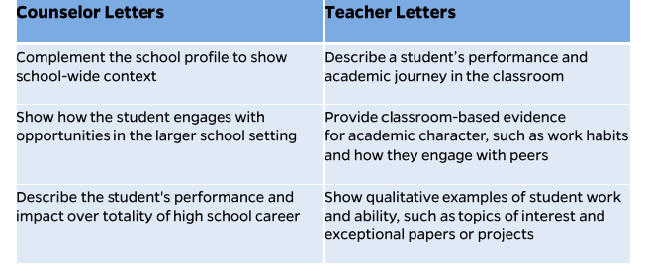
Counselor vs Teacher Letters of Recommendation
Notes:
Here is a great chart from Johns Hopkins University that highlights what key information should be included in a counselor letter of recommendation vs a teacher letter of recommendation.
Counselor
Discuss students impact in their activities & larger school community (describe the *impact of their involvement, not just list of activities)
Highlight if they are involved in any special academic/extracurricular programs in or out of school (like my student who studied tae kwon doe since 5)
Provide Context for student within entire graduating class, while also highlighting major strengths and impressive/distinctive qualities (always first to follow up with me after a presentation, first to offer a helping hand to a struggling peer, first to volunteer to be on committees to have a voice in our school community etc)
If applicable provide context for special circumstances (Long term absence, scheduling conflicts etc)
Speak to students future success using anecdotes from HS career in order to envision that student’s success moving forward (student not getting into program but says she views all ‘disappointments’ as learning opportunities – ‘at least I have essays I can recycle for other programs)
Teacher
Provide context for student within that specific academic course – interest, why in class, etc
Focus on student & Their abilities, not the teachers background – spending more than 1-2 lines on teachers qualifications detracts from space that could be used describing the student
Give insight to the students personal qualities & potential contribution to the college classroom
Expand upon current and past successes & challenges
Address distinguishing features of the student including exceptional work/how they work with others
Include a personal example regarding an event or experience that sticks out as memorable/notable from that student’s tiem in the course
Basically, if it comes down to your student and another candidate—all else being equal—your recommendation letter can get your student in or keep them out.
*taken from johns hopkins LOR workshop
https://apply.jhu.edu/wp-content/uploads/2017/04/2020-Tips-and-Takeaways.pdf

Slide 20
Letters of Recommendation: Dos and Donts
DO:
Demonstrate academic ability
Be specific
Speak on student's individuality
Highlight unique circumstances (if applicable)
DON’T:
Write your autobiography
Repeat a student’s resume
Use generic language
Recycle letters
Notes:
DO:
Demonstrates Academic Ability
The primary consideration upon which colleges will make their admission decision is a students academic ability. Therefore, you want your recommendation letters to showcase your unique talents and skills that make you an important contributor in any classroom.
A letter is even stronger if it can communicate both aptitude and passion. Not only can this teacher speak to your competence in the classroom, but also your intellectual vitality and love of learning.
However, you don’t have to have earned A’s in a teacher’s class in order for them to write you a strong recommendation letter. Just as effective as letters detailing natural ability in a subject are those that describe hard work, determination, and effort to succeed in a class, even if the course material doesn’t come naturally. While colleges undoubtedly value academic skill, they also value students who work hard, struggle, and go the extra mile in a class, even if that doesn’t always result in perfect grades.
Demonstrates Personal Characteristics
A good letter of recommendation not only communicates a students strongest characteristics, but supports them with evidence as well. \
Pick specific descriptors and back them up with evidence; avoid cliches like “hard-working,” “passionate,” and “team-player.”
Whatever traits or skillsets you mention in your letter, be sure to support it with specific examples to. Much like what we tell students when writing essays, show, don’t tell.
Discusses Applicant as Both a Student and an Individual
We’ve discussed how a letter of recommendation should address both your academic and personal strengths. One of the trickiest things to get right in a recommendation letter, but one that will ultimately make for the most effective letter, is to weave these characteristics together in a way that allows adcoms to understand how you would perform not only as a student in class, but also as a member of the greater campus community.
Many characteristics are conducive to success both in academics and in one’s personal life. For example, a student who is hard-working and dedicated can bring those qualities to their performance in the classroom, but also to the relationships they form with other students and their participation in extracurricular groups on campus. An effective letter highlights a students best characteristics and demonstrates how they apply them across all spheres of their life.
Discusses Any Unique Personal Circumstances
Some students have exceptional personal circumstances that affected their high school performance in some way – prolonged mental or physical illness, a death in the family, or a myriad of other reasons can all have adverse effects on grades, class participation, extracurricular participation, etc.
While you can use the Additional Information section of the Common App to discuss such circumstances, corroboration of these statements by a trusted official like a teacher or counselor can reassure adcoms that a dip in performance is not a reflection of a lack of ability or dedication.
DON’T:
Write your autobio. The letter’s about the student, not you.
Repeat a student’s resume. Admissions counselors get a copy of that, too. Kati says, “I know this comes from a desire to portray the student as well-rounded and also to pad out what you're worried will be a short letter, but trust me: Two paragraphs actually specific to the student are so much better than a page of puff.”
AVOID – hyperbolic or ambiguous language (same way it reads when students use the thesarus feature, it reads the same when recommenders are using 'fluff'
Recycle letters—even those you wrote in previous years. Here’s Kati: “I read high schools in groups—so, if I get five applications from Montgomery High, I read all five of them right in a row. It does your students zero favors if I see you are not writing them individual letters. And next year, I will also be the person who reads letters from Montgomery High.”
Avoid common generalzations that fail to distinguish a student from their peers
AVOID – regurgitating resume, placing emphasis on quantitative data that can be found elsewhere in application
https://www.collegeessayguy.com/blog/how-to-write-a-recommendation-letter#B
https://blog.collegevine.com/what-makes-a-good-recommendation-letter/

Slide 21
Recommendation Letter Analysis
Notes:
Now that we have reviewed the dos and donts behind writing LORs, let's take a look at some recommendation letter examples and determine whether or not we feel these are quality letters.
***Change use of letters? https://blog.prepscholar.com/4-amazing-recommendation-letter-samples
https://blog.prepscholar.com/what-makes-for-a-bad-college-recommendation
https://blog.prepscholar.com/examples-of-bad-letters-of-recommendation-from-teachers

Slide 22
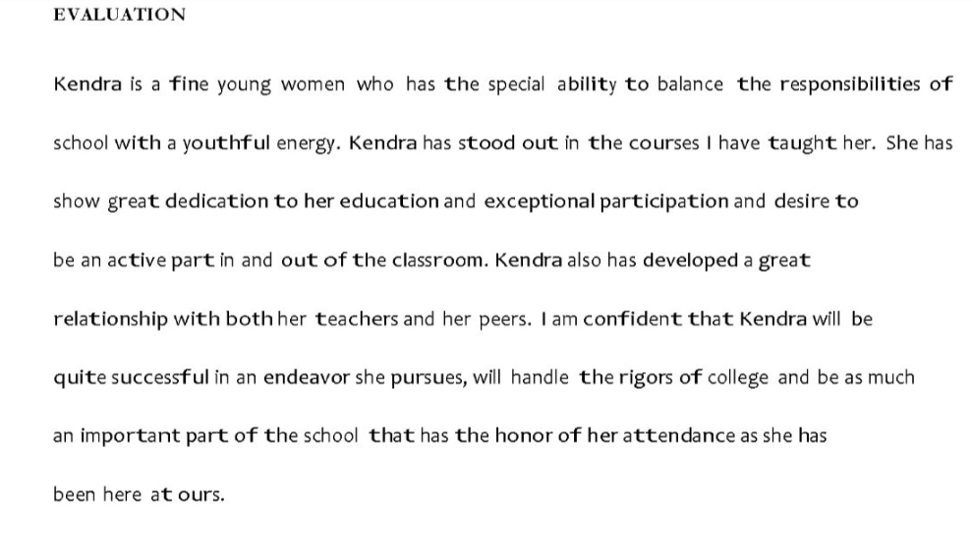
Example 1
Is this a quality recommendation letter?
Notes:
Reads generic
No details – ability to balance responsibilities, youthful energy, great relationship with peers/teachers – but not backing up with details to support
Reads like you could take out kendras name and plug in another name –
Leaves me with more questions about the applicant – not providing a clear picture of their qualities/values
What did you teach her?
What stood out to you about her – academic ability? How she interacted with peers? How she carried herself when it came to assignments and expectations?
Not bad but not great

Slide 23
Example 2
Is this a quality recommendation letter?
Notes:
1st para – great context. Provides just enough detail to paint a nice picture of this student from the get go – she is a diligent student who demonstrates great potential being nominated for this character building program.
Contxt on Kendra’s home life shows her struggles and how she chose to overcome them as opposed to letting it hold her back – made it a point to seek ‘new directions for herself’ demonstrates drive, self awareness/motivation, open to new things, not afraid of hard work. Then supports this statement with concrete details:
Highlights a memorable moment of leadership – Kendra took charge to help form a community within her group – ‘with everyoner being shy, she realized if she did not step up and do something to change the situation, she couldn’t expect others to do it either’ – speaks to her character and how she approaches obstacles. Not afraid to put herself out there for the greater good
Highlgihts specific values and qualities Kendra brings to the table and backs it up with specific examples. This letter leaves me with a great lasting impression of the student, instead of leaving me with more questions

Slide 24
So many students, so little time
Notes:
Now you might be saying to yourself okay great, if I had a caseload of 10 students I could easily write about each individuals unique qualities and accomplishments. But let’s be real – the average educator has quite a robust student caseload – when I was a college advisor I had about 300+ students I was responsible for, and you bet I got an endless sea of counselor recommendation requests (which tended to increase the closer application deadlines got!)
There was no way I could write these letters based solely on my daily interactions/memories –some students came by my office weekly, while others it was almost impossible to get to hold an appointment. So how do you get the information you need for each student to write a quality recommendation letter?
Image: https://www.uft.org/news/opinion/editorial-cartoons/why-class-size-important

Slide 25
Brag Sheet
A tool that is used to support college applications and should include a students’:
Accomplishments, skills, and abilities
Insight into who they are in and outside of school
Notes:
A brag sheet is similar to a student resume – it highlights their accomplishments, key experiences, leadership skills and employment throughout their secondary education. Essentially, it’s a quick reference guide with all the details and achievements for someone trying to get to know the student better.
By providing recommenders with a brag sheet, they can speak more clearly and accurately to the students skills, talents, and accomplishments - important information that potential colleges want to hear!
https://getschooled.com/article/5622-brag-sheets/

Slide 26
What does a brag sheet look like?
Notes:
Questionnaire brag sheets asks studnents to answer a series of short answer questions, generally on their activities in and out of school, their academic interests, and plans for the future.
Narrative brag sheets tell a story and are usually around a page in length. Recommend discussing one of your extracurricular accomplishments, as most teachers likely know little to nothing about what you do outside of class (unless they happen to be the faculty advisor for one of your clubs).
There is not a universal brag sheet format, and while you are welcome to create your own brag sheet template from scratch, there is no need to reinvent the wheel as there are many templates you can utilize as is/adapt to meet your needs.

Slide 27
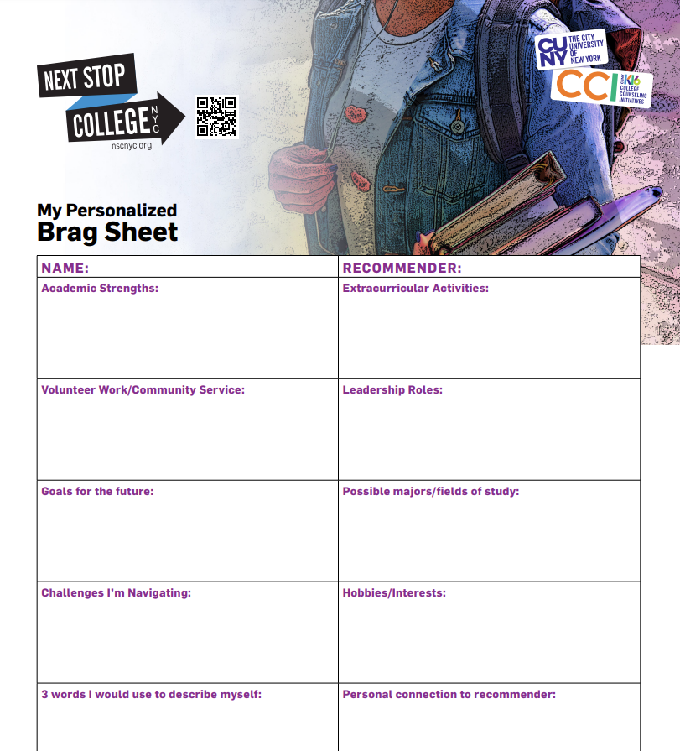
Brag Sheet Template
Notes:
This is from nextstopcollegenyc.org
https://nextstopcollegenyc.org/wp-content/uploads/2020/05/NSC-bragsheet-F.pdf
What I especially liked about this template is (not seen here) it also provides an example of this template filled out, for those students who might struggle with knowing what details to highlight about themselves.
Some may feel that this template is a little too restrictive and does not allow the student to expand on these details. Another great template that encourages deeper reflection is:

Slide 28
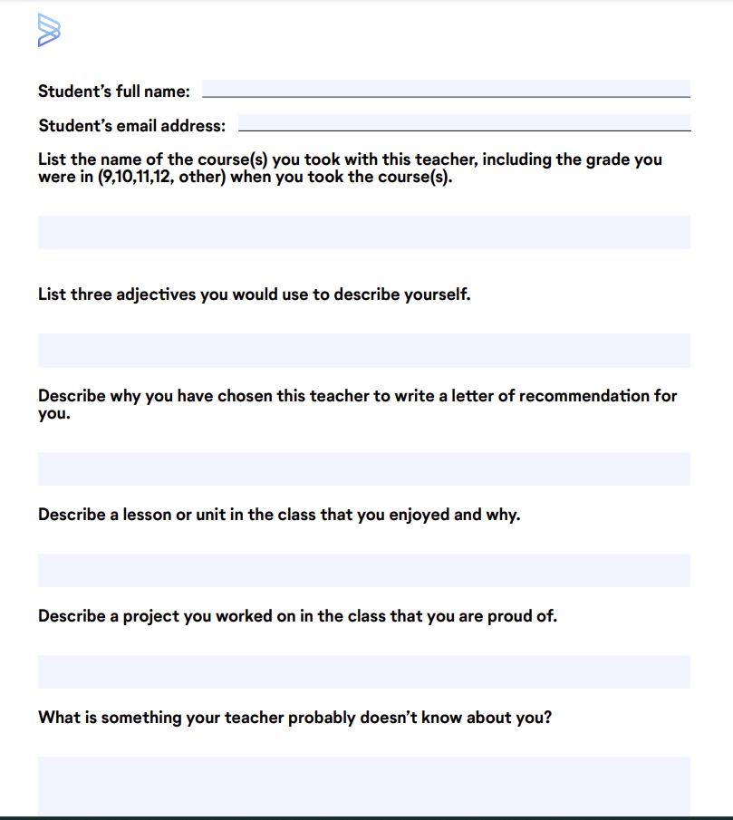
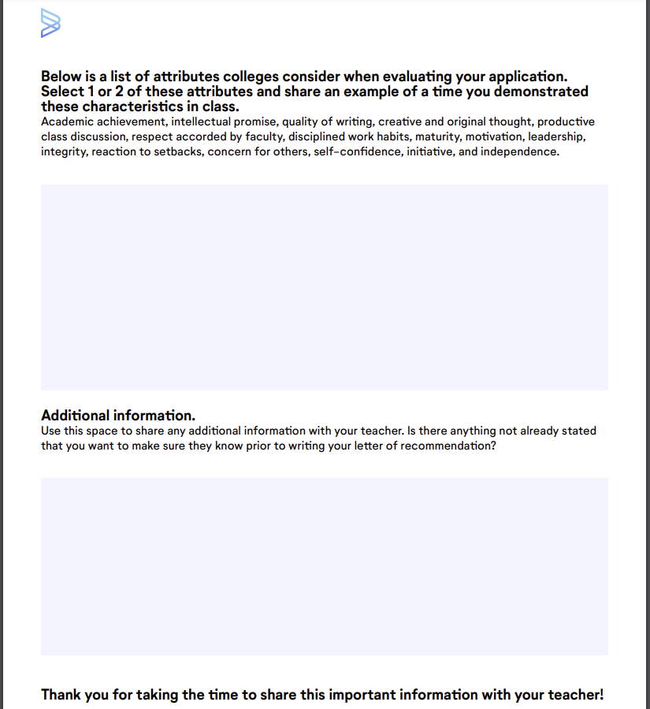
Brag Sheet Template
Notes:
This template is from common app – an undergraduate college admission application that applicants may use to apply to over 1,000 member colleges and universities in all 50 states and various countries.
They have a brag sheet template for teacher recommendation letters (seen here) as well as a separate template for counselor recommendation letters.
These templates go a step beyond just plugging in details, by asking students to provide additional insight into what they are sharing – why are you sharing this accomplishment? Why are you asking this specific teacher for a rec?
Also encourages self reflection – use 3 adjectives to describle self. What is something your teacher doesn’t know about you?
Feel free to use these as is, or adapt to your needs (or make your own!)

Slide 29
Action Plan: Create a Workshop
Choose a Target Audience:
Students, Staff, or Parents
Design a 30” to 60” workshop including:
Goals
Intro/Icebreaker
Content/Activities
Close/Next Steps
Notes:
Using the Action Planning sheet in the workbook, have participants reflect on the day’s content and decide who most needs the information back at their sites – students or advisors.
Have participants grop together by their seleclted target frop and esign a 45-60 minute workshop they can present to their students or peers. The outline should include:
Goal/Objective
Intro/Icebreaker
Content
Activities
Close/Next Steps
Have participant groups outline their workshop on chart paper. Have each grp choose a volunteer to report out.
DEBRIEF: Summarize highlights of the workshops presented. Tell participants you would love to hear how their workshop goes

Slide 30
Action Plan
Please reflect on today’s material and write the following:
2 things that you are aware of that you did not know this morning
1 actions that you will take with you when you return to your workplace

Slide 31
College Essay Resources
Collegeboard: Essay Tips
College Essay Guy: tips & examples of quality essays
Collegevine: Essay Resources
Resources for getting free essay feedback:
Collegevine
Get schooled
Fair opportunity project
Notes:
Collegeboard: https://bigfuture.collegeboard.org/plan-for-college/your-college-application/write-your-essay
College Essay Guy: College essay guy (tips, examples) - https://www.collegeessayguy.com/college-essay-resources\
Collegevine: https://blog.collegevine.com/how-to-write-your-college-essay-the-ultimate-step-by-step-guide/
College essay basics, types of college essays, brainstorming/composition & more
Resources for getting free essay feedback:
Collegevine - https://www.collegevine.com/apply/essay-editing/
Get schooled - https://getschooled.com/college-review/
Fair opportunity project - https://www.fairopportunityproject.org/essay-review-form

Slide 32
Recommendation Resources
Recommendation Letter Writing:
College Essay Guy - For teachers
College Essay Guy - For counselors
Collegeboard – Tips and resources
Johns Hopkins – Tips and Takeaways
Brag Sheet Templates:
Nextstopcollegenyc
Common App – For teachers
Common App – For counselors
Notes:
College Essay Guy:
For teachers: https://www.collegeessayguy.com/blog/how-to-write-a-recommendation-letter
For counselors: https://www.collegeessayguy.com/blog/how-to-write-a-letter-of-recommendation
Collegeboard:
https://bigfuture.collegeboard.org/plan-for-college/college-prep/stand-out/how-to-get-a-great-letter-of-recommendation
Tips for writing letters (with add'l resources): https://counselors.collegeboard.org/college-application/writing-recommendations-teachers
https://apply.jhu.edu/wp-content/uploads/2022/12/2020-Tips-and-Takeaways.pdf
Brag sheet templates
https://nextstopcollegenyc.org/wp-content/uploads/2020/05/NSC-bragsheet-F.pdf
Common App:
Teachers: https://www.commonapp.org/static/71f67faedd72b3cdaf1c28ed85d621cf/FYBragSheetStudentsTeachersCAReady.pdf
Counselors: https://www.commonapp.org/static/1333b2c3c4f93755d248c7721d4edb5f/FYBragSheetStudentsCounselorsCAReady.pdf

Slide 33
Q & A

Slide 34
Invest In Girls

Slide 35
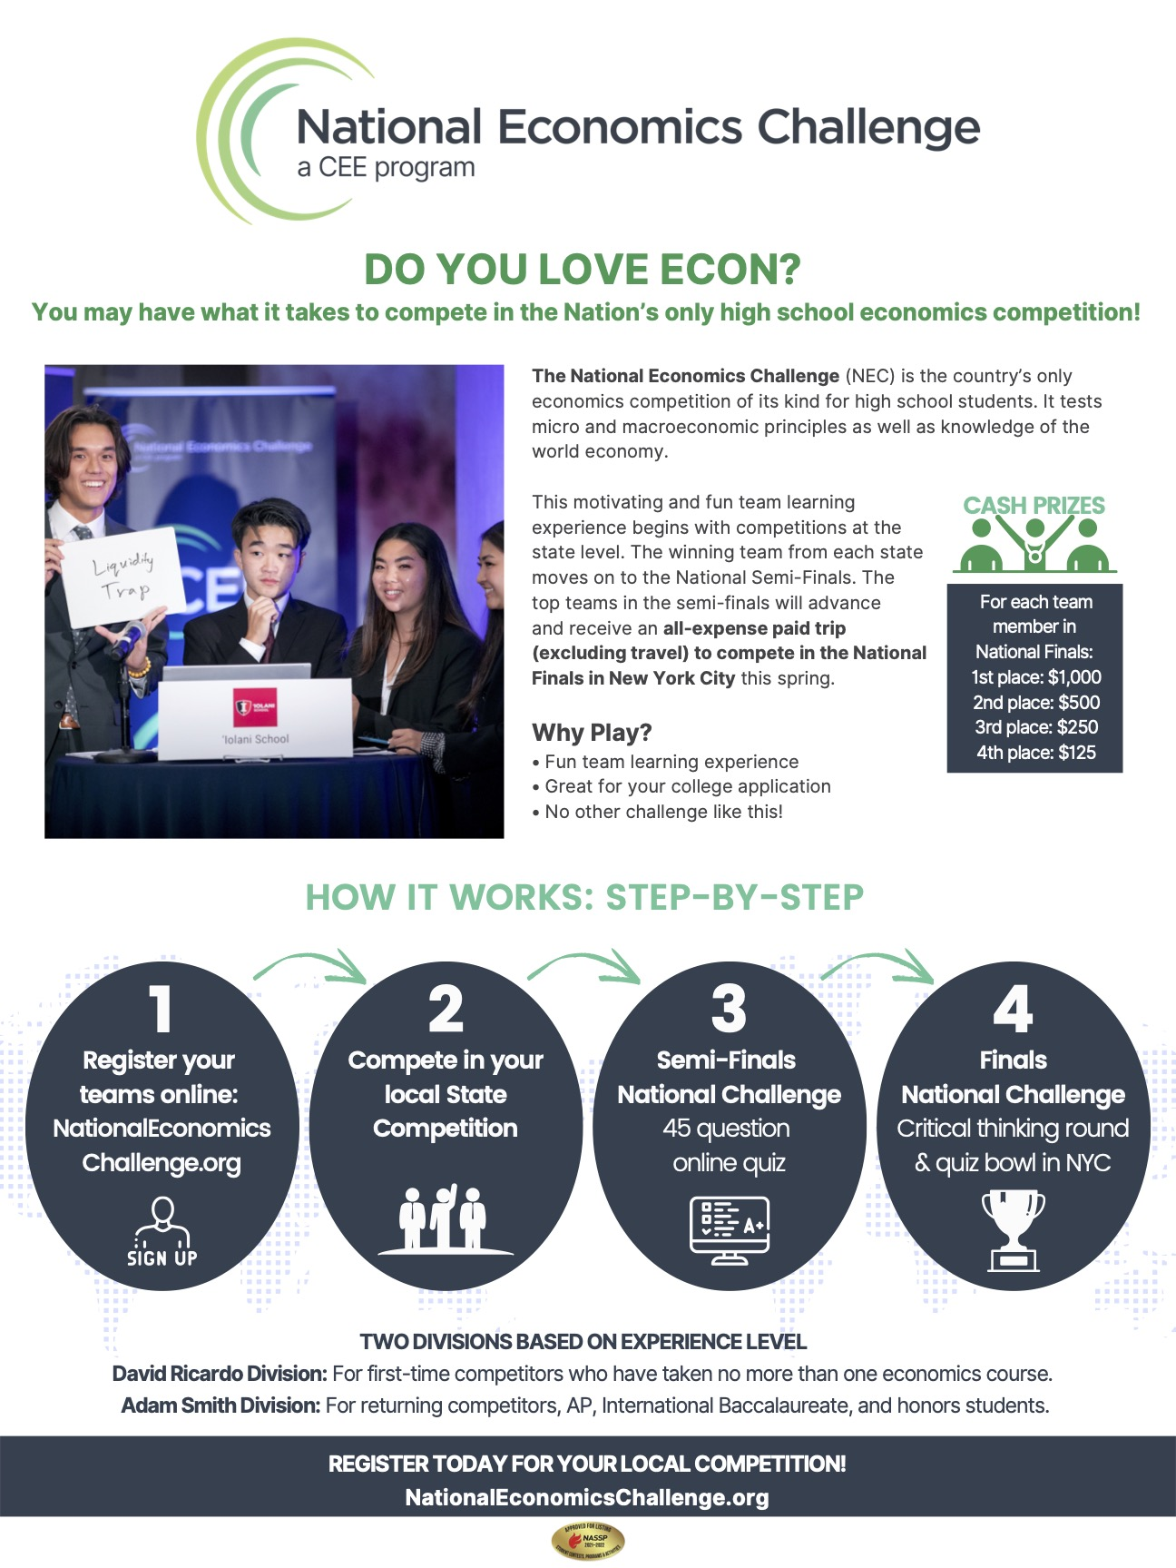
NEC

Slide 36
NPFC

Slide 37
Advocacy

Slide 38
Optionsinstitute@goddard.org
Thank You

Slide 39
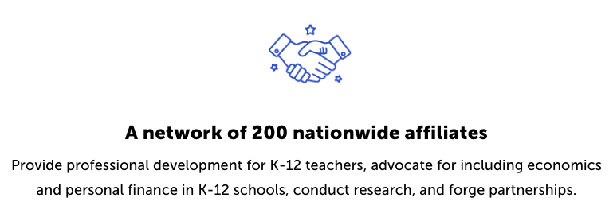
Suggested Presentation Deck
CEE Affiliates
https://www.councilforeconed.org/resources/local-affiliates/
Include your local affiliate page

Slide 40
Thank You to Our Sponsors!

