Slide 1
Presented by: Tawni Hunt Ferrarini, PhD Email: tawni.Ferrarini@gmail.com; tawni.org Date: 2023 Feb 06
Professional Development

Slide 2
EconEdLink Membership
You can now access CEE’s professional development webinars directly on EconEdLink.org! To receive these new professional development benefits, become an EconEdLink member.
As a member, you will now be able to:
Receive a professional development certificate via email within 24 hours after viewing any EconEdLink webinar for 45 minutes
Register for upcoming webinars with a simple one-click process
Easily download presentations, lesson plan materials and activities for each webinar
Search and view all webinars at your convenience
Save webinars to your EconEdLink dashboard for easy access to the event
Access our new Professional Development page here.

Slide 3
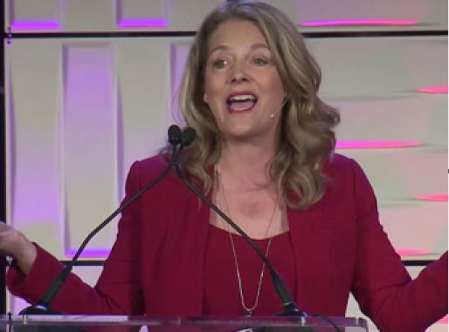
Presented by: Tawni Hunt Ferrarini, PhD Email: tawni.Ferrarini@gmail.com; tawni.org Date: 2023 Feb 06
Presenter

Slide 4
Agenda
Compelling question
Objectives and Standards
6 Core Principles of Economics
Spotlight “Entrepreneurs in the Marketplace”
Once Over Lightly
References
Thanks

Slide 5
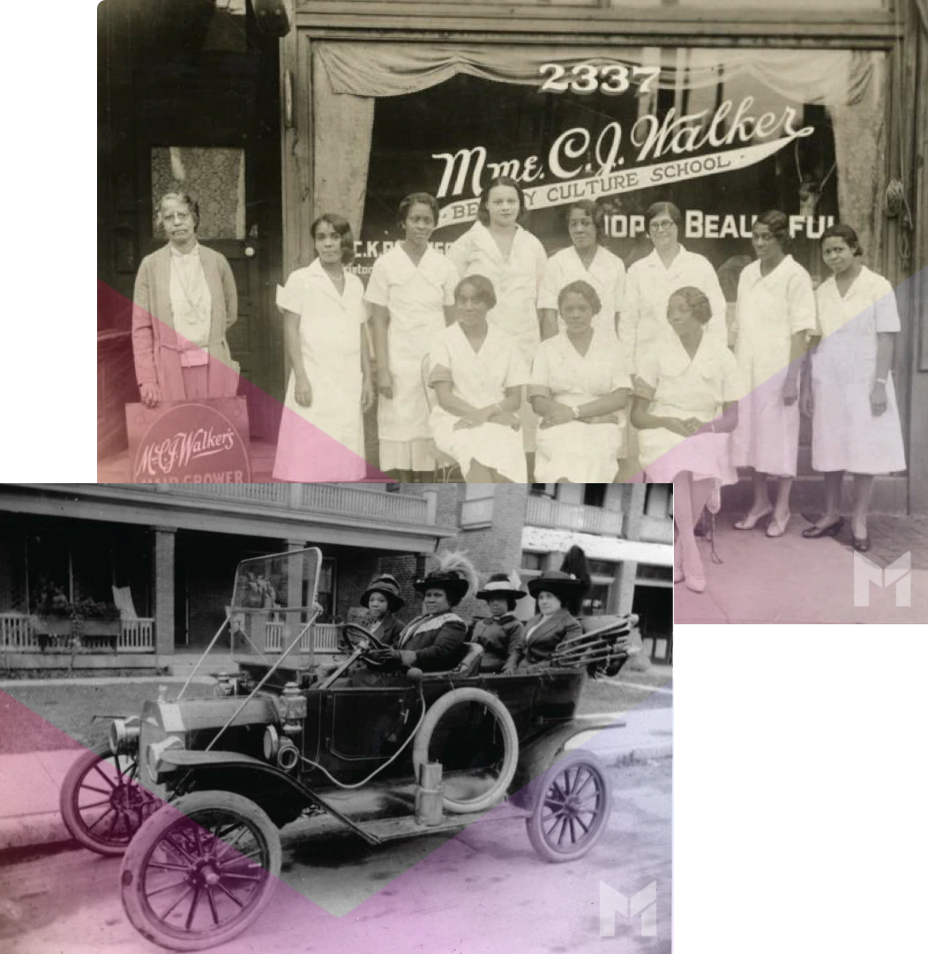
Question:
Who is Madam C.J. Walker? How did she leverage market opportunities in the early 1900s that influence us today?
Notes:
🍐 This is a Pear Deck Text Slide
🍐 To edit the type of question, go back to the "Ask Students a Question" in the Pear Deck sidebar.

Slide 6
Objectives
Objectives
In this webinar teachers will be able to:
Utilize economic concepts to integrate within various grades 9-12 disciplines and undergraduate survey courses
Provide students with an economic tool bag of 6 basic economic principles to explain their and others’ behaviors

Slide 7
National Standards
Link

Slide 8
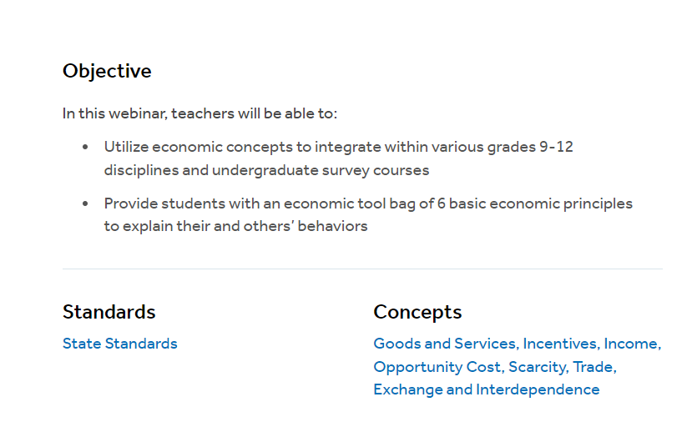
State Standards
LINK

Slide 9
Assessment Question
How does a person like Madam C.J. Walker become one of the wealthiest women in the early 1900s?
She marries into it.
Government gives it to her.
She opens a heavily subsidized business.
The marketplace provides opportunity.
Notes:
🍐 This is a Pear Deck Multiple Choice Slide. Your current options are: A: Madam C.J. Walker marries into it., B: Someone gives it to her., C: She opens a heavily subsidized business supported by government., D: The marketplace provides opportunity.,
🍐 To edit the type of question or choices, go back to the "Ask Students a Question" in the Pear Deck sidebar.

Slide 10
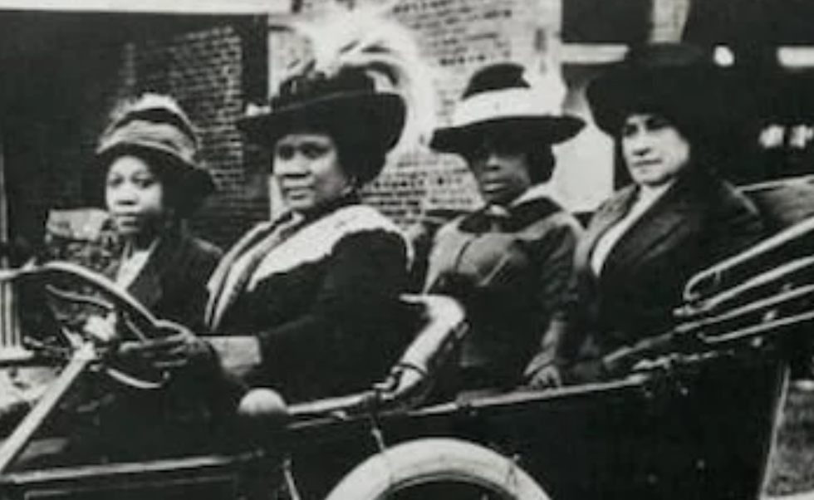
The Marketplace
Notes:
🍐 This is a Pear Deck Web Slide.
🍐 To edit the type of question, go back to the "Ask Students a Question" in the Pear Deck sidebar.

Slide 11
The Marketplace
Notes:
🍐 This is a Pear Deck Web Slide.
🍐 To edit the type of question, go back to the "Ask Students a Question" in the Pear Deck sidebar.

Slide 12
6 Core Principles
People choose.
People’s choices always have costs.
People respond to incentives in predictable ways.
People create economic systems that influence choices and incentives.
People gain when they engage in voluntary trade.
People’s choices have future consequences.
Notes:
🍐 This is a Pear Deck Text Slide
🍐 To edit the type of question, go back to the "Ask Students a Question" in the Pear Deck sidebar.

Slide 13
How to Measure Wealth?
People choose.
Madam C.J. Walker was born Sarah Breedlove.
She was one of six children born into freedom.
Orphaned by 7.
Married at 14. Widowed twice.
In 1906, she married Charles Walker.
Notes:
🍐 This is a Pear Deck Text Slide
🍐 To edit the type of question, go back to the "Ask Students a Question" in the Pear Deck sidebar.

Slide 14
6 Core Principles: Grab and Watch
People choose.
People’s choices always have costs.
People respond to incentives in predictable ways.
People create economic systems that influence choices and incentives.
People gain when they engage in voluntary trade.
People’s choices have future consequences.

Slide 15
MADAM CJ WALKER (Haircare Inventor) Black History Month
Notes:
🍐 This is a Pear Deck Web Slide.
🍐 To edit the type of question, go back to the "Ask Students a Question" in the Pear Deck sidebar.

Slide 16
6 Core Principles
People choose.
People’s choices always have costs.
People respond to incentives in predictable ways.
People create economic systems that influence choices and incentives.
People gain when they engage in voluntary trade.
People’s choices have future consequences.

Slide 17
A story of an inspiring entrepreneur
Every choice has a cost.
In the cotton industry of the Mississippi South, Madam Walker traded a day of labor for $1.50 in wages per day.
That is about $45 a day in today’s dollars.
Long days and stress caused her hair to fall out.

Slide 18
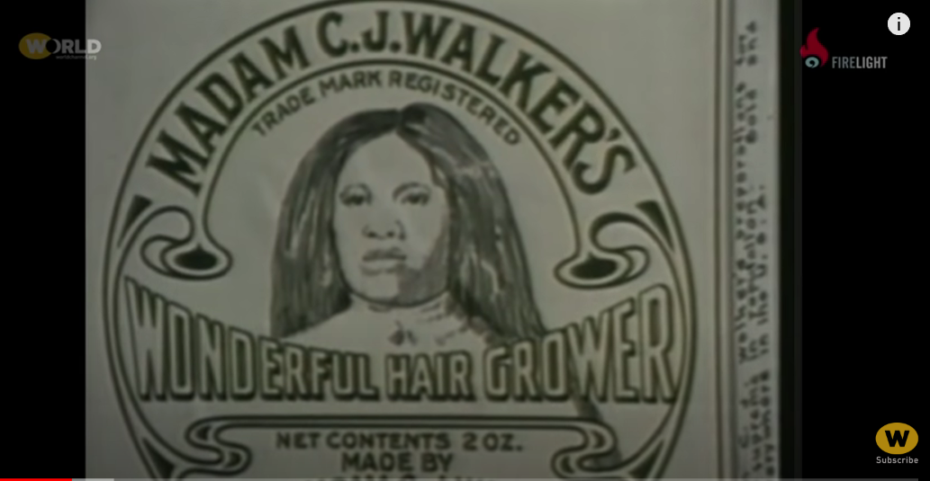
A story of an inspiring entrepreneur
Madam Walker sought solutions for black women and monetized them
Started selling hair products.
Set up a factory in Indiana.

Slide 19
People choose.
People’s choices always have costs.
Work picking cotton for dollars a day.
Sell her products on the road each day.

Slide 20
People choose.
People’s choices always have costs.
Work picking cotton for dollars a day. The cost is not selling hair products on the road.
Sell her products on the road each day. The cost is not picking cotton for dollars a day.

Slide 21
A story of an inspiring entrepreneur
Madam Walker earned profits, traded with others, and paid wages to her employees in the U.S. and around the world
A variety of services popped up
Used profits and expertise to start a school
It is reported that eventually earned $1000 a day (assume around 1916)
Wage labor
ENTR/sales
Profits
Employ/ invest

Slide 22
3. People respond to incentives in predictable ways.
Madam Walker earned profits, traded with others, and paid wages to her employees in the U.S. and around the world
A variety of services popped up
Small businesses started
Used profits and expertise to start a school
It is reported that she eventually earned $1000 a day (assume around 1916)
Wage labor
ENTR/sales
Profits
Employ/ invest

Slide 23
A story of an inspiring entrepreneur
Madam Walker earned profits, traded with others, and paid wages to her employees in the U.S. and around the world
A variety of services popped up
Used profits and expertise to start a school
It is reported that eventually earned $1000 a day (assume around 1916)
$45,000 a day

Slide 24
4. People create economic systems that influence choices and incentives.
5. People gain when they engage in voluntary trade.
6. People’s choices have future consequences.

Slide 25
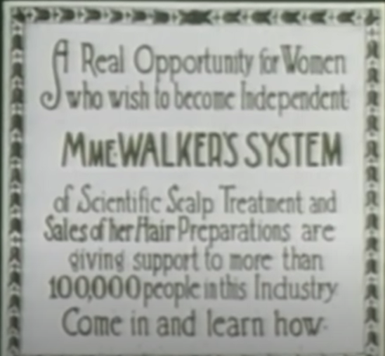
A story of an inspiring entrepreneur
Madam Walker grew her system of factories and earned profits.
She traded with others, and paid wages to her employees in the U.S. and around the world.

Slide 26
A story of an inspiring entrepreneur
A variety of services popped up and new businesses started.
Profits and expertise to start a school system.
Trained others how to run businesses.

Slide 27
Free-To-Choose System Matter
The rule of law, safety and security,
Identity and relationships (i.e. the freedom to choose your relationship partner),
Freedom of movement, speech, assembly and religion—alongside economic freedom,
The ability of individuals to make their own economic decisions, including where to work, for how much to work, export, import, and more.

Slide 28
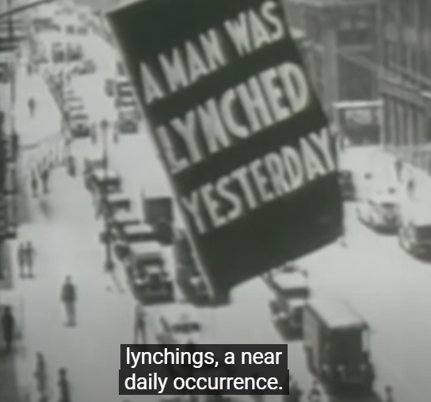
A story of an inspiring individual
Though the 13th Amendment abolished slavery,
Philanthropist
Used profits and expertise to start a school
Donated money to social causes and support youth groups
Philanthropist, leaving ⅔ of her money to others on her death

Slide 29
A story of an inspiring entrepreneur
The decisions of today have future consequences…
Notes:
🍐 This is a Pear Deck Web Slide.
🍐 To edit the type of question, go back to the "Ask Students a Question" in the Pear Deck sidebar.

Slide 30
6 Core Principles: Once Over Lightly
People choose.
People’s choices always have costs.
People respond to incentives in predictable ways.
People create economic systems that influence choices and incentives.
People gain when they engage in voluntary trade.
People’s choices have future consequences.
Notes:
🍐 This is a Pear Deck Text Slide
🍐 To edit the type of question, go back to the "Ask Students a Question" in the Pear Deck sidebar.

Slide 31
Once Over Lightly:
A story of an inspiring entrepreneur
Labor and wages in her industry - the cotton industry of the Mississippi South
Long days and stress caused her hair to fall out
Madam Walker sought solutions for black women and monetized them
Started selling hair products
Profits, trade, and wages employed others in the U.S. and around the world
Used profits and expertise to start a school
Philanthropist, leaving ⅔ of her money to others on her death

Slide 32
Economic Fundamentals: 6 Common Sense Principles, EconEdLink at: https://www.econedlink.org/webinar/economic-fundamentals-6-common-sense-principles/
“Facts about Madam C.J. Walker,” HistoryHit at: https://www.historyhit.com/facts-about-madam-c-j-walker/
Gwartney, J. D., Stroup, R., Lee, D., Ferrarini, T., & Calhoun, J. (2016). Common sense economics: What everyone should know about wealth and prosperity. St. Martin's Press.
MADAM by Madam C.J. Walker https://www.madambymcjw.com/us/en
The True Story of Madam C.J. Walker | TWO DOLLARS AND A DREAM, World Channel at: https://www.youtube.com/watch?v=WrpVozNIHds
MADAM CJ WALKER (Haircare Inventor) - Black History Month, The Wise Channel at: https://www.youtube.com/watch?v=yDYObStkiCQ
The Madam CJ Walker Museum at: https://www.madamecjwalkermuseum.com/

Slide 33
Questions?

Slide 34
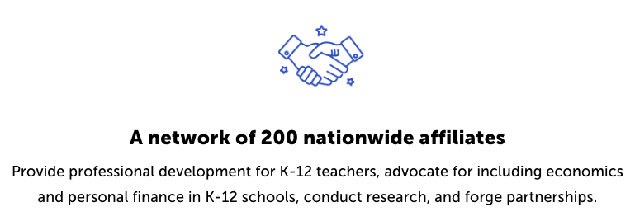
Council for Economic Education Affiliates
https://www.councilforeconed.org/resources/local-affiliates/

Slide 35
Thank You to Our Sponsors!

Slide 36
Contact information
Thank You

