Slide 1
Professional Development:
Future of Work
Presented by: Christina Ramos Email: Optionsinstitute@goddard.org Date: March 7, 2023

Slide 2
EconEdLink Membership
You can now access CEE’s professional development webinars directly on EconEdLink.org! To receive these new professional development benefits, become an EconEdLink member. As a member, you will now be able to:
Automatically receive a professional development certificate via e-mail within 24 hours after viewing any webinar for a minimum of 45 minutes
Register for upcoming webinars with a simple one-click process
Easily download presentations, lesson plan materials and activities for each webinar
Search and view all webinars at your convenience
Save webinars to your EconEdLink dashboard for easy access to the event
Access our new Professional Development page here

Slide 3
Professional Development Opportunities
To earn professional development credit for CEE webinars found on EconEdLink, you must:
Watch a minimum of 45-minutes and you will automatically receive a professional development certificate via e-mail within 24 hours.
Attendees can learn how much credit they will earn per workshop.
Accessing resources:
You can now easily download presentations, lesson plan materials, and activities for each webinar from EconEdLink.org/professional-development/
Local resources:
Insert your local professional development opportunities (if applicable)

Slide 4
About Options
A program of Goddard Riverside (based in NYC)​
Founded 1986 as direct service access center ​
Today​
Access Program​
Success Program​
Professional Development Program

Slide 5
Housekeeping
Evaluation
One Mic
Cameras on is Highly Encouraged
Participation Highly Encouraged
Step Up, Step Back

Slide 6
Presenter
Christina Ramos
Trainer/College Access Counselor, Options Institute
Born and raised in the Bronx, New York.
Worked with the Department of Education for about 7 years, as a math teacher, mentor, and coach.
Passionate about bridging the academic achievement gap and supporting students with college and career readiness.
Enjoys traveling, trying new restaurants, drawing and binge-watching Netflix series.

Slide 7
Objectives
After this workshop, attendees will be able to…
Understand the changes coming in the work field
Expand knowledge of declining fields
Have conversations with students about their dreams and pursuits

Slide 8
Agenda
Blast from the Past
Future of Work
Impact on Students
Final Thoughts
Questions & Answers

Slide 9
Blast from the Past
Notes:
Before we can explore the future of technology we are going to take a moment and look at some examples of how far we have already come with technology.

Slide 10
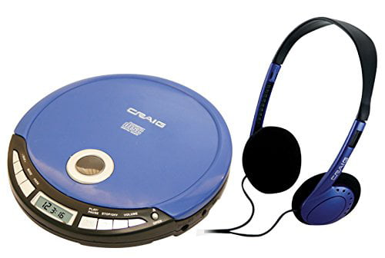
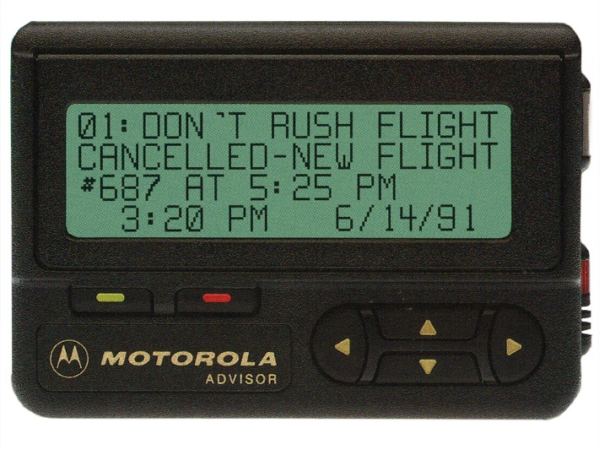
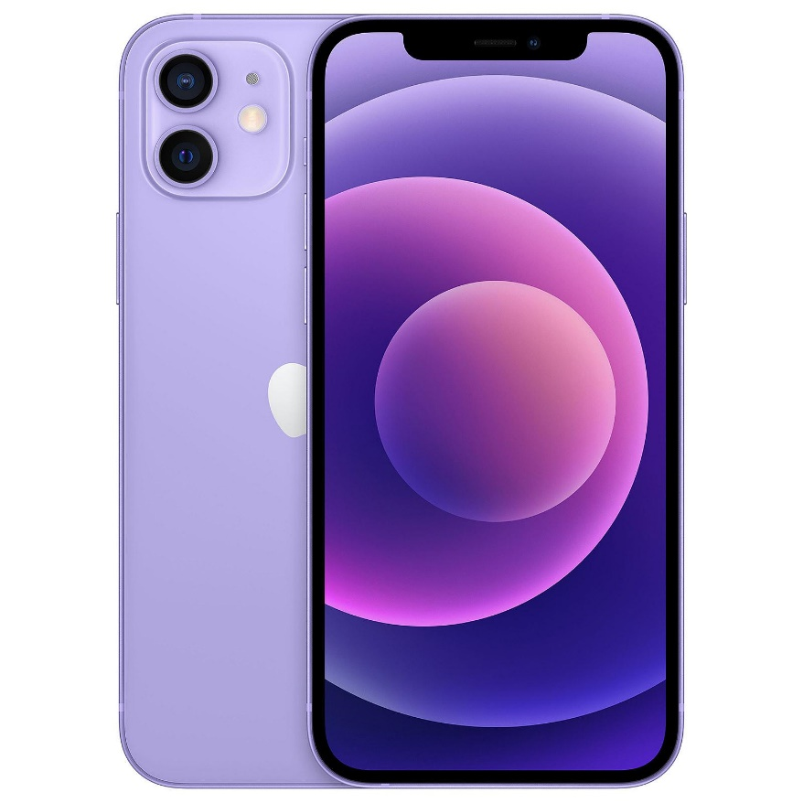
Blast from the Past
Notes:
Do these devices look familiar? Some of you may remember these devices, and others may have no idea what some of those are. Before we used to need one device to play audio, another device to receive messages and also be able to read an ACTUAL map for navigation (or print out directions on MapQuest). Now, today we have a single device that does all of this and more, for us. Our everyday cellphone is capable of all the functionalities, and more.

Slide 11
Blast from the Past
Notes:
Next lets explore the progression of communication. More popular in the 1800s Carrier Pigeons were used to send letters from one person to the other. Over time this has evolved from pigeons to written letters mailed to now instant messaging via email or even text messages for that matter. What used to take days and weeks to send messages, can now be received in a matter of seconds.

Slide 12
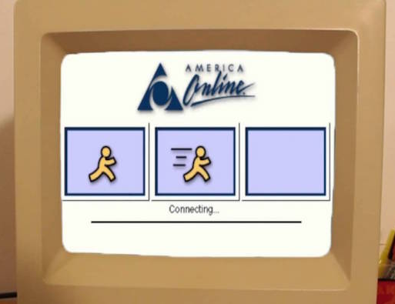
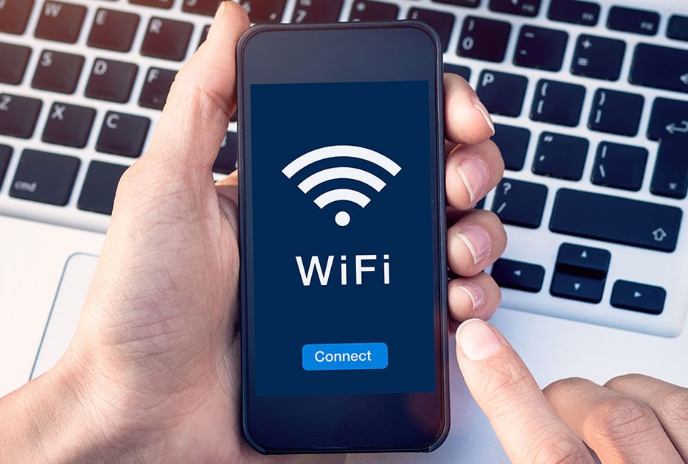
Blast from the Past
Notes:
How many of you remember that sound? In the early 1990s Dial-up took over the world. It was internet linked to a SINGLE device- it can only be for the computer and if someone called your phone or if someone needed to make a call- goodbye internet until the phone call ended.
Now today with wi-fi we can have multiple devices linked to the internet- your phone, laptop, even your tv now!

Slide 13
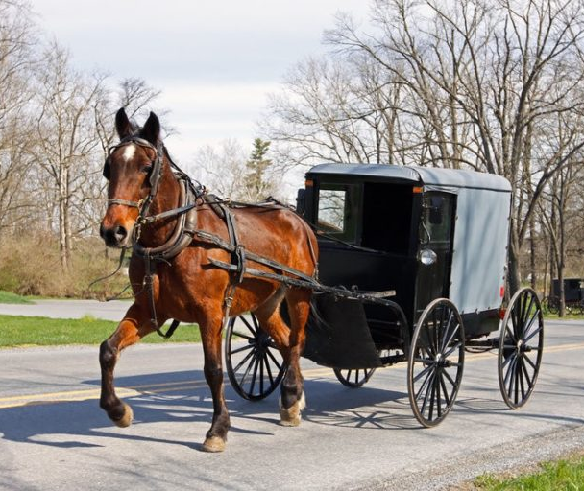
Blast from the Past
Notes:
The most common mode of transportation was the horse carriage until about the 1920s with the industrial revolution. Only a little more than 100 years ago! Now we have evolved our cars so much that they can run on gas and or electricity! In the 1920s there were only rough 7 million cars built to 20 million built today in the US alone! The idea of self driving cars is a reality now.

Slide 14
The Future of Work
Notes:
Now that we have taken a moment to remember how technology has progressed and evolved over time, lets explore and discuss how the changes of technology affect the future of work.

Slide 15
The Future of Work
Notes:
I want us to watch this video depicting the future of work. I love showing participants this video during our workshops, because it highlights which jobs can possibly be obsolete in several years, it also enlightens us with the direction that the future of work is moving toward.

Slide 16
Thoughts?
Notes:
Lets us this time to share any thoughts we may have had from watching this video. … PAUSE …. from this video we can see there is a continued significant shift toward automation. Moreover, shows us how the use of technology will impacts our day to day lives. What impact has this had on our students?

Slide 17
How Does This Impact our Students
Negative Impact
Communication
Easily Distracted
Minimizes social interaction
Loss of knowledge
Notes:
Let’s begin with how the advancing in technology has had a negative impact on our students over time:
I am sure we all have had experience with communicating with students. With that, we can say our students are lacking the common skills to communicate with adults- whether it’s writing an email or verbal communication. Moreover, often times students are struggling separating their "text lingo" from proper use of grammar when communicating with professionals.
Students have become more easily distracted. There has been an incredible decrease in the attention span of youths. Many studies have shown that students are having a hard time staying focus on tasks at hand for more than a few minutes or sometimes hours at a time. As a former teacher, I experienced this first hand, and through the use of different forms of technology I would increase student engagement.
Moreover, technology has minimized social interaction immensely. Studies have suggested that more individuals throughout society are becoming disconnected and isolated because of the links that technology provides through social networks. Young children who spend more time engaging with devices may not spend as much time interacting with their peers—which can affect those children’s social and emotional growth. Even as adults, how often do we go out to an event and almost everyone is on their phone?
Lastly there is a Loss of knowledge: There are some things that students no longer know because of technology. For example, how to tell time because of digital clocks, lacking basic math skills due to access of a calculator on cell phones, and inability to sometimes think critically because students lean on the internet.

Slide 18
How Does This Impact our Students
Negative Impact
Positive Impact
Communication
Easily Distracted
Minimizes social interaction
Loss of knowledge
Knowledge of how to use advanced tech
Engagement of learning
Encourage Spontaneous Learning
Accommodates Multiple Learning Styles
Notes:
Now lets accentuate some of the positive impacts technology has had on our students.
How often do we give a younger person- whether being a nephew/niece or child- your phone and they automatically know how to use it? They can get to YouTube or whatever game they want instantly! Our world is only becoming more reliant on technology, and having a good understanding of common technological devices and their uses is critical to prepare children for success
Engagement: The increase of technology has allowed there to be more room for hands-on learning. Technology in the classroom not only helps to harness attention and excitement while in the classroom but invigorates traditional learning experiences.
Spontaneous Learning: Children (and us) have a world of information right at their fingertips. How many times have you googled a random question or learned how to do something new straight from the internet in a matter of minutes/hours?
accommodating multiple learning styles allows education to be delivered in a more personalized way. That makes it a definite win for the students. Whether the student is a visual, auditory or tactile learner- tech has allowed education to longer be a “one size fits all” approach.

Slide 19
Labar Market Information

Slide 20
Students are Entering a Different World
YESTERDAY
TODAY
Work for a large company
One job for life
Stay in hometown
Secure retirement
Well-paying jobs in low-skill professions
No real international competition for good jobs
Work for a small company
Multiple jobs
Move for work or career
Uncertain retirement
Low paying jobs in low-skill professions
Cutthroat international competition for good jobs
Notes:
Important to understand our students are entering a different workforce world than what it was back when we remember it. (note things on slide)
Back in the day people had a tendency to work for a large company, and typically for many years. I am sure many of us know someone who has only ever had maybe 1 or 2 jobs in their entire life. Back in the day, people typically stood in their hometown for work. Also, because people would work for large companies for many years, which resulted in a secure retirement. Often times, people would find well paying jobs in low skill professions. Remember back in the day, people could get great jobs right out of highschool until postsecondary education was introduced on a larger scale. Lastly, in the past there was no real international competition for good jobs, a lot of Americans were being hired.
But today our students are entering a different world. Nowadays people tend to work for a small company, and work multiple jobs. Todays generation has no issue putting in their notice and finding a new job, should they not be happy. Nowadays people are more open to relocate for work, and companies are even willing to assist with the costs of moving. Next, working for small companys and sometimes even moving from job to job can result in uncertainty for retirement. Small companies do not tend to have the greatest retirement options and usually moving from job to job does not allow for the best retirement matches etc. In todays labor market, we find low paying jobs in low skill professions, which is why post secondary education to some capacity is necessary. Lastly, we have seen an influx of international competition for good jobs. We have a lot of international competition because many people are coming to the US to work and study.

Slide 21
The Impact of Technology in the Labor Market
Notes:
Lets take a moment to watch this video that displays the impact of technology in the labor market.

Slide 22
The Future of Work: The Changes We See
Notes:
A lot of companies are embracing the growth of technology and implementing it in new ways. Lets explore how these companies have taken on unique ways to utilize technology.
BMW is bringing the metaverse to a traditionally physical environment: the factory. The future factory was designed entirely in the digital realm and simulated from beginning to end to train and remotely connect workers in a virtual 3D environment.
AdventHealth is a non-profit health care system headquartered in Florida. The company has added virtual nurses to its care teams, which enhanced its workforce experience for nurses across the digital and physical workplace and enabled better teamwork and patient outcomes. Units can now have a virtual nurse team member on the screen, working with a team that’s in person. As a result, virtual nurses not only offload work from the in-person nurse, but provide care virtually with good outcomes and a good patient experience.
FamilyMart is a convenience store chain in Japan, experimenting with remote-controlled robots to stock shelves, enabling employees to work from anywhere using virtual reality (VR) goggles and controllers. FamilyMart shows us not all changes are bad however because A key fringe benefit of this solution is the ability to employ disabled people who lack the physical mobility to stock shelves without the assistance of robots.
Even here in NYC, we have amazon go stores, where you shop and go. Amazon uses technology ..

Slide 23
LMI: The Losers…and The Winners
Office and Admin Functions
Drivers
Manufacturing Functions
Retail
Dishwashers
Telemarketers
Notes:
With the advancement of technology, there has been a shift in the labor market index. What does that shift look like?
With the increase of technology, we can see why many of these jobs are decreasing and possibly becoming obsolete – when you consider retail, chances of seeing someone at a register, depending on the store are slim to none. Walk into walmart, may see 2 ppl at register but have 9-10 different options for self-checkout. Tesla is exploring and solidifying the idea of self-driving cars. Moreover, how often do we call companies hoping to speak to a customer respresentative and was quickly greeted with an automated voice system that prompts you with different options to better support your needs.
Healthcare, social work, etc- these are ppl/hands on oriented – high need for these careers because of what we experienced through the pandemic

Slide 24
LMI: The Losers…and The Winners
Office and Admin Functions
Manufacturing Functions
Retail
Dishwashers
Telemarketers
Recreational and Occupational Therapists
Emergency Mgmt
Health Care and Social Work Professionals
Technical Engineering
Notes:
Let's talk about the jobs that are on the up and up. These are some of the careers and industrys we've seen an increase in demand. The pandemic did play a role in the increase of need in some of these careers/industry, especially in the health care and social work professions. The advancement of technology has lead to a need of more opportunities in technical engineering.

Slide 25
Labor Market Index - Top Opportunities
HS/Equivalent Education
Customer Service Representatives
Medical Secretaries
Retail Salespersons
First-line Supervisor of Retail Workers
Office Clerks
Security Guards
Home Health & Personal Care Aides
Notes:
It's important to be able to support our students and meet them where they are in their journey. We gathered some research from the NYC labor market information service to gain insight into top career opportunities based on level of education. For populations that have a HS or equavilent education these are the top opportunities.

Slide 26
Labor Market Index - Top Opportunities
Entry Level Work Associates Degree
General Secretaries & Administration Assistants
Medical Assistants
Bookkeeping, Accounting & Auditing Clerks
Customer Service Reps
Human Resource Specialist
Notes:
For populations that have an associates degree here are the top opportunities.

Slide 27
Labor Market Index - Top Opportunities
Entry Level Work Bachelor's Degree
Registered Nurse
Sales Representatives – Wholesale & Manufacturing
Market Research Analyst & Marketing Specialist
Financial & Investment Analyst
Human Resource Specialist
Management Analyst
Software Developers
Notes:
For populations that have a bachelors degree here are the top opportunities

Slide 28
Labor Market Index - Top Opportunities
Entry Level Work 0-2 years' work experience
Registered Nurses
Sales Reps – Wholesale & Manufacturing
Market Research Analysis & Marketing Specialist
Administration Assistants
Human Resource Specialist
Software Developers

Slide 29
Final Thoughts

Slide 30
Final Thoughts
What conversations should you be having with your students?
How does knowing this information assist your students?
Notes:
What conversations should you be having with your students?
How does knowing this information assist your students?

Slide 31
Q & A

Slide 32
Invest In Girls

Slide 33
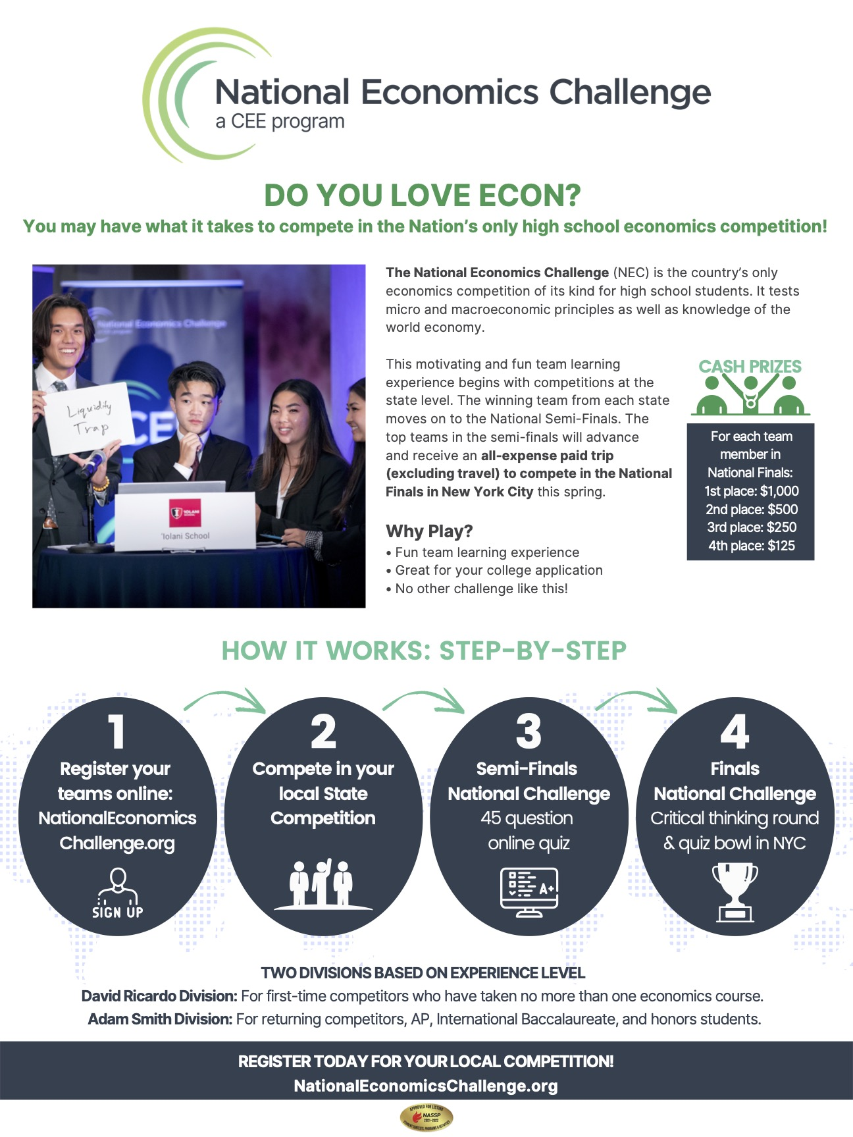
NEC

Slide 34
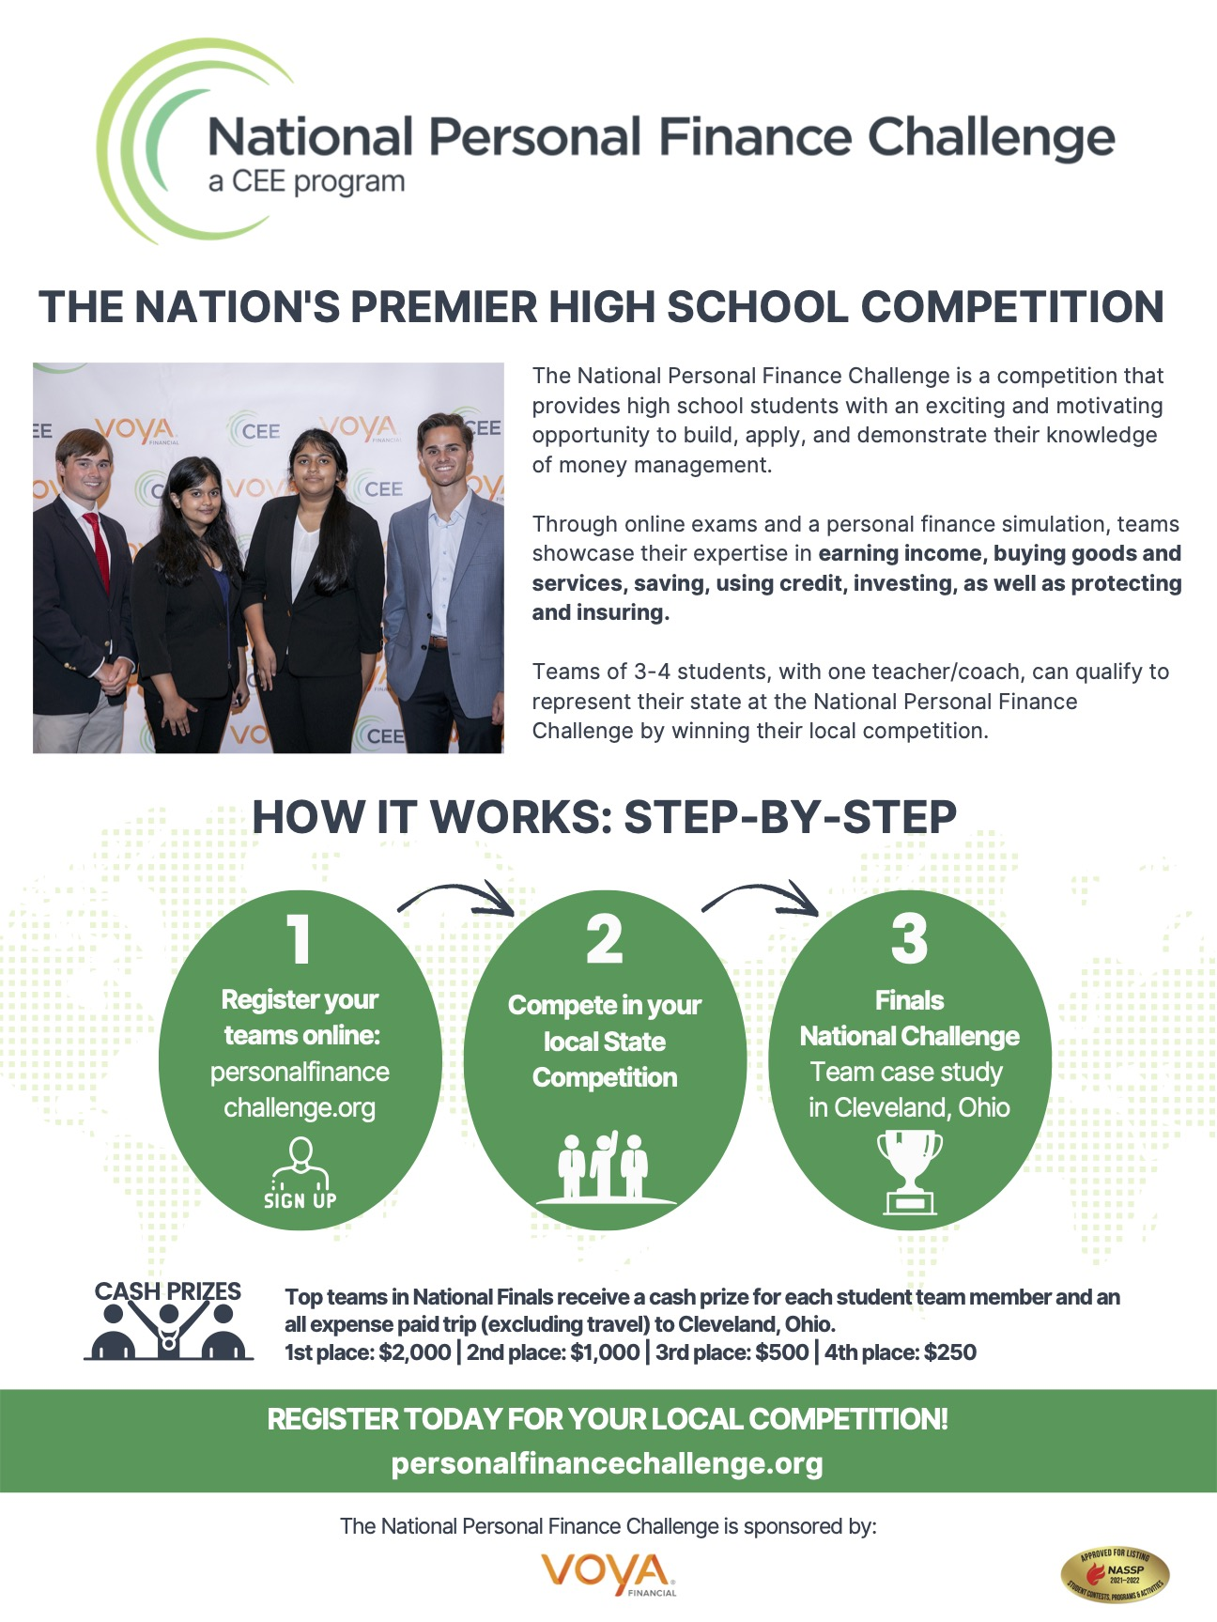
NPFC

Slide 35
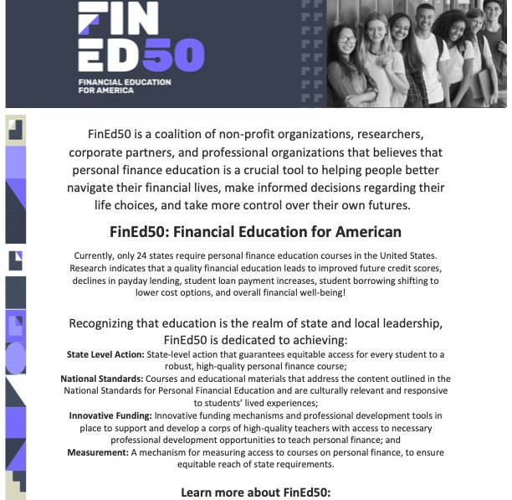
Advocacy

Slide 36
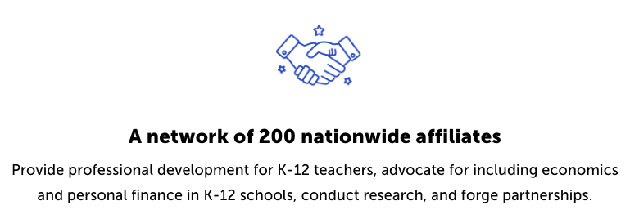
Suggested Presentation Deck
CEE Affiliates
https://www.councilforeconed.org/resources/local-affiliates/
Include your local affiliate page

Slide 37
Thank You to Our Sponsors!

Slide 38
Contact information
Thank You

