Slide 1
December 1st, 2022
Anmol Mital
Gamifying Personal Finance Education to Further Student Engagement

Slide 2
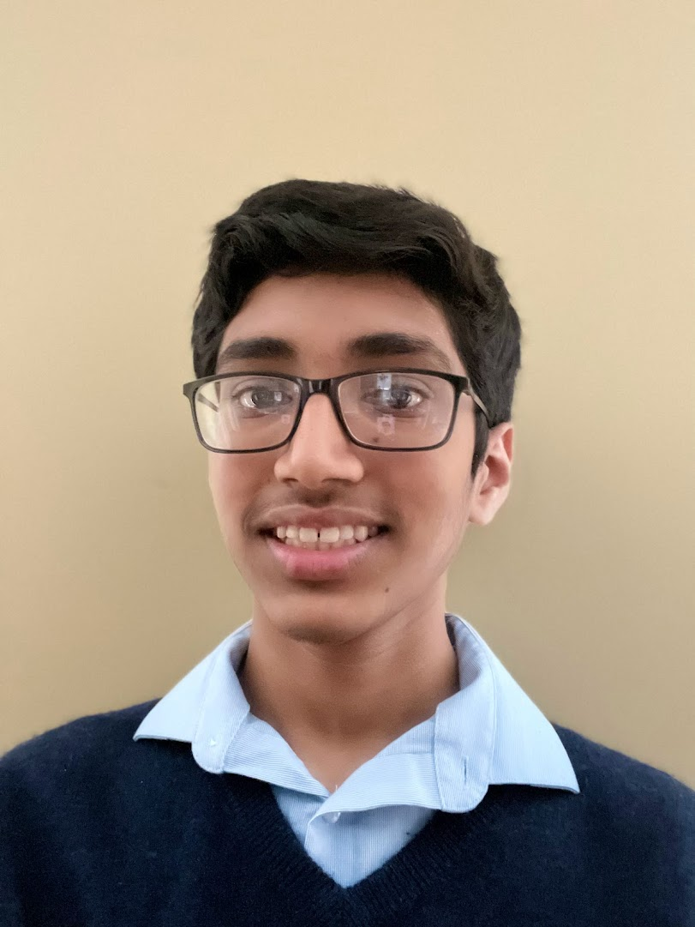
Presenters
Founder, Climate and Money (climateandmoney.org)
Student, Maggie L. Walker Governor’s School
23amital@gsgis.k12.va.us
Notes:
thank you ms anthony for the kind intro

Slide 3
Agenda
Issues with current personal finance curriculum
Innovative solution for boosting student interest and knowledge in personal finance
Hands-on experience of an innovative, grade-appropriate approach to classroom financial literacy
Simulate classroom discussions of decision-making and diversity
National Standards
Teacher Lesson Plan
Q&A and Wrap-up
Notes:
gaps
post-game reflection; solidifying VBP
standards
lesson plan
PD + Q&A
Today we will reach a couple of key objectives
First, we will unpack the gaps with the current personal finance curriculum and discuss how this game can help to fill those gaps
Then we will play the online game and discuss how a post-game classroom discussion can help students to reflect on the game and solidify the insights they gained while playing. There will be an emphasis on individual values and beliefs on the process of decision-making and how this diversity in opinion is perfectly okay.
Next, we will learn how the game fulfills the National Standards for personal finance education effectively.
Then, we will look at some materials, such as the teacher lesson plan, to help you better implement this game in your classroom.
Finally, you will have an opportunity to ask questions about the game and then give us feedback on the session through the CEE’s survey.

Slide 4
Why Are We Lagging in Financial Literacy?
“Because it is not introduced to children at a young age”
“Lack of exposure, financial literacy is not in students’ immediate environment”
“Not much awareness around financial literacy”
1. Current curriculum skips the 4th - 6th grade demographic
Recent games include too much content in one experience, which may be overwhelming for students new to personal finance
2. Skills being taught are too advanced and technical for young students
3. Traditional education is not fun or engaging
Notes:
open-ended question
skips 4th-4th grades
too heavy content in current games
trad. fin. ed. not engaging enough
Public financial education tends to focus on preparing high school students to go out into the world and manage their personal finance responsibly. However, we believe that the 4th to 6th grade demographic is just as important to cultivate a financially responsible population. Many have turned to games to teach this age group, but the content in these games is often repurposed from material geared towards high-school students. As a result, it is too advanced and heavy for a younger audience to understand.
On the flip side, traditional financial education has long failed to capture the attention of students and is simply not engaging enough.

Slide 5
The Solution: Worlde of Finance
A freely accessible, fun online board game that teaches students how to:
Budget
Save
Make forward-thinking decisions
Easy to understand board game format
Notes:
online, monopoly-style
digestible: students dont get lost in details
We believe that Worlde of Finance alleviates these issues. Worlde of Finance is an online, Monopoly-style board game which focuses on developing three simple skills
Budgeting
Saving
And making future-focused decisions
The digestible format ensures that students won’t be lost in the details.

Slide 6
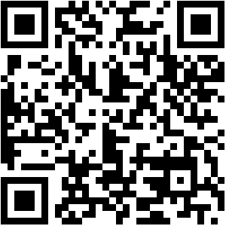
Time to Play!
https://tinyurl.com/wof-2-1
Materials Required:
double-sided coin
laptop, tablet, or mobile device
Notes:
So to help you better understand the experience from a student’s perspective, we will play through the game online. If you have a phone or tablet with you, I have included this QR code that you can scan to get the game link. For those with a laptop, there is also a link provided here.
The mobile or tablet view condenses the viewing screen so that it still fits into the space. On most laptops, you will see a view similar to what is presented on my screen.
To play the game, students are encouraged to keep a physical coin that they will flip for the unexpected events. Once they click the highlighted Profession square, students are given the option to choose from 10 professions. These professions each have different salaries, which reflect the salaries after paying tax and student loans. This was taken from the Federal Reserve Bank of Richmond in order to keep the game as realistic as possible. When playing the game with students, you should mention that they should choose jobs based on their interests, rather than blindly picking the highest salary. The game also includes a brief dialogue that explains what students need to do. On the side of the textbox, there’s a blue play audio button that activates a voice recording of the script, which may help students who struggle with reading or otherwise prefer listening over reading information. After receiving the crucial information to choose a career, students should click one of the options, which will then be recorded in the income column of the budget chart.
Next, students are prompted to choose a home. They are given four different choices for a home. Out of these, the close quarters, the small apartment, is the only renting option. Students learn that with a landlord, they are not responsible for the maintenance of the home, and only need to pay to live there. However, with the other options, students would need to buy a home. Although property ownership means that you will eventually own the home, you are also responsible for repairs and maintenance of the home. Students are also encouraged to pick a home based on their lifestyle. If they want to live with a big family, they may need a bigger house such as the Upscale High Life or Suburban Oasis. This explanation helps students understand the decision-making process and begin to form their own decisions based on the information they are given in the scenarios. After clicking on one of the home options, the home is logged as their first expense in the budget chart.
The next big purchase that students will decide on is their mode of transportation. Students have the option of riding the bus, or making monthly payments on a car. Again, the game describes the tradeoffs that they would have to make with each option. For example, if they took the bus, they would have to pay significantly less but also would lose autonomy through the bus routes.
After this, students will experience their first unexpected event. As we all know, sometimes things go better or worse than we expect. So the unexpected events teach students to plan for these random events. In this scenario, __________________. Now, the students would flip a coin. If they don’t have a physical coin, they can use a virtual coin flipper by just searching up “coin flip.” I opted not to use a digital coin built into the game or to have the game automatically decide their fate in order to keep a physical component in the game for kinesthetic learners. And students tend to be pretty honest with their results, so no worries there. If students lost money in the event, it is logged in the expenses column. If they earned money, it goes into the income column. This engaging role play simulates real-life experiences to help students learn better.
I also added in a retirement investing feature in order to teach students that they should start saving money early on in order to have sufficient money when they decide to retire. When they invest money, they receive a 20% interest rate on their capital. The reason the interest rate is so high is to incentivize students to actually invest their money and make the idea of putting away money for the future more exciting. The $1,500 saving cap is just to simulate real-life maximums on retirement savings.
Next, to inject even more fun into the game, I’ve included a Wheel of Fortune. There’s a relatively modest ticket price of $20 and a low chance to win the $1,500 prize. Although it’s not the primary goal of the wheel, it also subtly tells students not to gamble or depend on the lottery for their retirement savings. To operate the wheel, they simply click the spin button and wait for their result.
The importance of the communication part is to remind students of the small bits that make up a budget alongside larger expenses like a home and a car. This is also the purpose of the clothes shopping, entertainment, and grocery store squares. Again, students make choices depending on their needs and have to consider what types of technology are important for their individual lifestyles. They may choose as many technologies as they wish and click submit to finalize their choice.
The final square that we will cover together is the savings slide. This is different from the investing slide, as the purpose is to introduce the concept of saving as a percentage of your salary. Students can save 5%, 10%, or 20% of their income in plans labeled “Simple Saver,” “Savvy Saver,” and “Super Saver,” respectively. Students then get this amount back at the end of the game so they don’t feel discouraged to save.

Slide 7
Reflections
Clear and constructive feedback
Educator-facilitated classroom discussion
Thought-provoking questions
Where could you afford to spend more money?
What were the values, priorities, and beliefs that guided your decisions? How did you make these decisions?
If you could play again, what would you do differently?
How did your choices differ from others?
A Question for You: what is your biggest takeaway from experiencing the game?
Notes:
helps students built insights
simple feedback from the actual game
feedback is fuel for discussion
group/classroom discussion
my questions are good, but feel free to use your own questions with your students
no wrong answers
value culturally diverse perspectives and how these can really contribute to the game
extra time
share ur own VBPs
In order to help students form new insights from the game, there are thoughtful questions and discussions you can have with them
After playing, students receive a message from the game concerning their financial health.
If they had a positive balance, then they are on track to developing a good budget
If they had a negative balance, the student spent more than they earned and should reduce some of their expenses.
This clear and constructive feedback fuels discussions and lets students know how they could improve if they were to play again. After this, I would recommend that students, in either groups or as a class, answer some of these questions.
Where could you afford to spend more money?
What were the values, priorities, and beliefs that guided your decisions? How did you make these decisions?
If you could play again, what would you do differently?
How did your choices differ from others?
It’s important that students understand that there are no wrong answers and that all opinions on the questions are valid. Encourage students to share their priorities and values if they feel comfortable doing so, and if you have time, after the discussion students can go back and play again using what they learned in the reflection period.

Slide 8
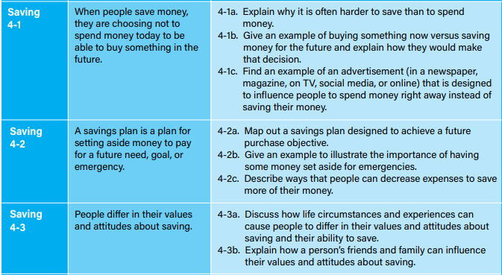
National Standards
Notes:
Go over National Standards very briefly. Simply call out the names of the standards because teachers will know that the presentation is required to align with the national standards.

Slide 9
Teacher Lesson Plan
Three Steps Outlined in the Plan:
1. Guiding students through the game
2. Reflection and asking students thought-provoking questions
3. Having students fill out our feedback form to help us improve!
Lesson Plan and Game provided at: climateandmoney.org
Notes:
play: walk students through investing; give time for exploration
reflection to empower students
In the session, everyone should have received a lesson plan with a guide to teaching students using the game. It outlines the three basic steps to the game
Guiding students through the first few tiles of the game, and then giving them free rein to explore the game by themselves. I would suggest walking students through the “Invest in a Retirement Fund!” square. While you are walking them through it, you may find it useful to make some decisions of your own and explain to the students why you made those decisions. Make sure that students understand that career choices should not be solely based on their respective salaries and that doing this may lead to an unfulfilling job.
Helping the students through meaningful and insightful reflection empowers them to deeply consider their choices and improve their decision-making ability.
Having students fill out the feedback form so that we can continue improving for more classrooms!
The teacher lesson plan, feedback form, and the game itself are free and conveniently located at climateandmoney.org.

Slide 10
Contact Anmol Mital: 23amital@gsgis.k12.va.us
LinkedIn: linkedin.com/in/anmol-mital/
Thank You

