Slide 1
Voters and Elections
Scott Wolla, Ph.D.
Economic Education Coordinator
scott.a.wolla@stls.frb.org
The views expressed in the presentation are mine and not the views of the Federal Reserve Bank of St. Louis or the Federal Reserve System.

Slide 2
Students Will Be Able To:
List the costs and benefits of voting in an election
Weigh costs and benefits to predict whether a person is likely to vote
Key Concepts:
Opportunity Costs
Benefit

Slide 3
Spark Some Discussion
Begin by noting that in a democracy, voting is an important civic right.
Did everyone who was eligible to vote in the last presidential election actually vote?
(The answer is no, not everyone voted.)
If the right to vote is so important, why do some people choose not to vote?
(Answers will vary. Some answers may involve costs associated with voting, even if the students do not use that term.)
After some discussion of the students’ answers, explain that the purpose of this lesson is to explore reasons why eligible voters do not always vote.

Slide 4
The Costs of Voting
Dollar Costs. No dollar costs may be imposed by fees or taxation. Amendment 24 to the U.S. Constitution rules out dollar costs:
Section 1. The right of citizens of the United States to vote in any primary or other election for President or Vice President, for electors for President or Vice President, or for Senator or Representative in Congress, shall not be denied or abridged by the United States or any State by reason of failure to pay any poll tax or other tax.
Other costs. While the Constitution prohibits monetary charges, this does not mean that voting is entirely without costs. Voters will incur opportunity costs. The opportunity costs of voting is what a voter gives up in choosing to vote. Here are some possible opportunity costs:
Time taken to register.
Time to find a voting location, or to vote via absentee ballot.
Time taken to vote, which may also mean lost wages for voters who miss work; or babysitting or transportation costs.
Time needed to investigate candidates and issues.
Fear of Covid (2020 election)

Slide 5
Top ten reasons registered voters gave for not voting in 2020
Reason All Voters 18-24 Year Old
10. Transportation problems 2.4 3.0
9. Inconvenient polling place 2.6 2.5
8. Forgot to vote 3.7 5.7
7. Covid concerns 4.3 2.3
6. Registration problems 4.9 4.9
5. Out of town 6.1 8.8
4. Illness or disability 13.0 4.5
3. Too busy, conflicting schedule 13.1 18.4
2. Did not like candidate/campaign issues 14.5 11.0
1. Not interested 17.6 19.2
In 2020, citizens aged 18-24 made up 11% of the population, but only 8% of the voters.
Notes:
Bad weather was 11th place .01 for all voters and 0% for 18-24 year olds
Other 14.5 for all voters and 15.7 for 18-24 year olds
Don’t know/refused 3.2 and 4.0

Slide 6
Notes:
https://www.census.gov/library/stories/2021/04/record-high-turnout-in-2020-general-election.html

Slide 7
Why Do People Vote
When the election is likely to be close and the person’s vote may change the election result:
People may vote to support a particular politician.
People may vote to remove incumbents (“Throw the rascals out.”)
When the election is not likely to be close and a person’s vote is not likely to change the election result:
People may believe it is their civic duty to vote.
People may vote to voice their opinions regardless of the likely outcome.
People may vote in order to feel they are part of the winning team.

Slide 8
Increase Student Interaction!
Notes:
To make this part of the lesson more interactive, you can use online survey tools like Kahoot, Slido, or Nearpod to have students guess for each category of “Who Voted More”
You can also cut out construction paper so that each student, or each pair of students has a red, blue and black square. On the next slide, the choices are in red, blue, or black font color. They will hold up the color that matches with their choice for each category of “Who Voted More”

Slide 9
Who Voted More in 2020? Of all voters, who voted most, percentage-wise, in the 2020 election?
Men or Women ……………………………………………………
White or Black or Asian ………………..……………………..
Naturalized Citizen or Native Born ……………………….
Married or Never Married or Divorced ..………………
Income Under $10k or Over $150k ………….……..
Employed or Unemployed ……………………………………
H.S. Degree or Bachelor’s Degree ………………………..
New Jerseyites and Arkansans…………..…………………
Veteran or Non-Veteran ………………………………………
Renter or Homeowner …………………………………………
Young (18-24) or Old (65-74) ……………………………….
Women 68.4 to 65.0
White 68.3 Black 62.4 Asian 60.1
Native 67.4 to 60.8
Married 69.4 Divorced 65.6 Never Married 56.6
High Income 84.8 to 47.1
Employed 68.5 to 57.8
Bachelor’s Degree 77.9 to 55.5
New Jersey – 78.3 Arkansas – 54.0
Veteran 74.1 to 66.1
Homeowner 71.4 to 55.0
Old 76.0 to 51.4
Notes:
https://www.census.gov/data/tables/time-series/demo/voting-and-registration/p20-585.html
Note: Federal surveys now give respondents the option of reporting more than one race. Therefore, two basic ways of defining a race group are possible. A group such as Asian may be defined as those who reported Asian and no other race (the race-alone or single-race concept) or as those who reported Asian regardless of whether they also reported another race (the race-alone-or-in-combination concept). These statistics are for race-alone-or-in-combination reporting.

Slide 10
Reported Voting
YEAR | VOTERS AS A PERCENTAGE OF THE U.S. CITIZEN VOTING-AGE POPULATION
1980 | 64.0
1984 | 64.9
1988 | 62.2
1992 | 67.7
1996 | 58.4
2000 | 59.5
2004 | 63.8
2008 | 63.6
2012 | 61.8
2016 | 61.4
2020 | 66.8

Slide 11
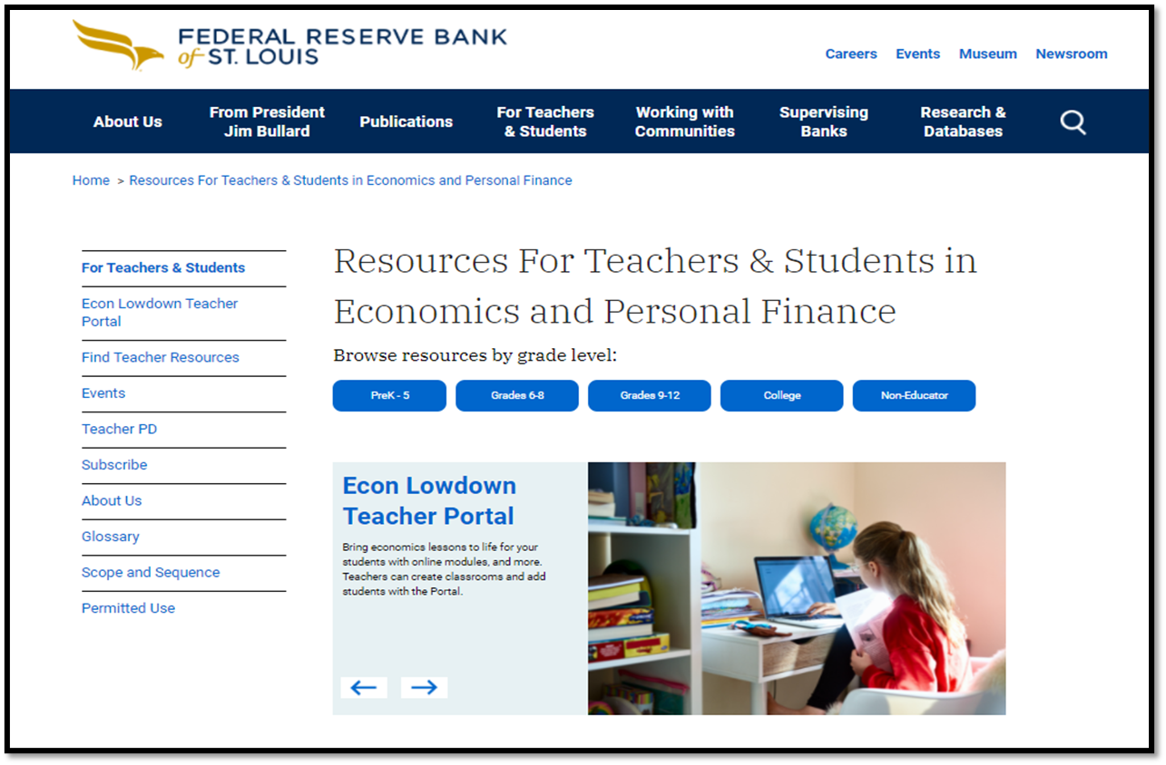
https://www.stlouisfed.org/education

Slide 12
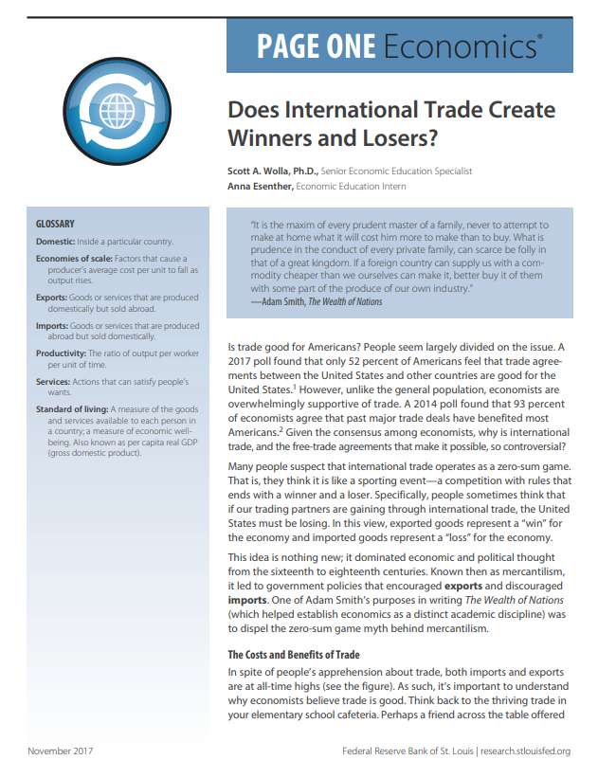
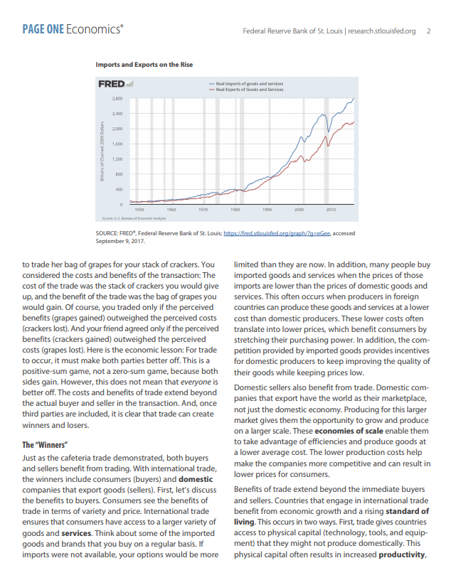
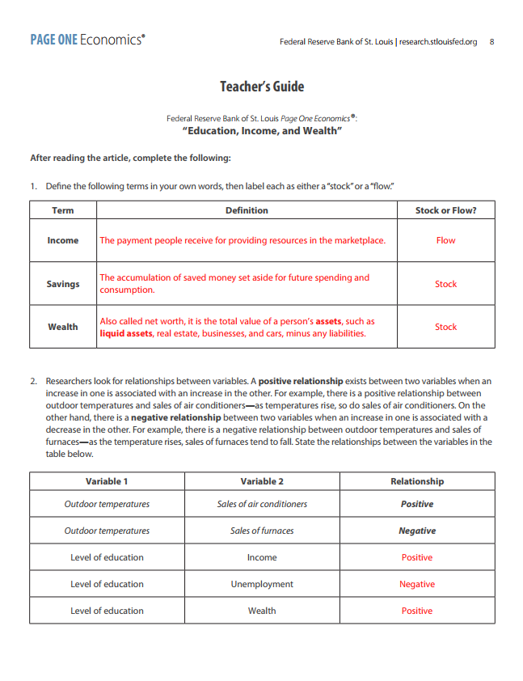
Page One value proposition:
Short current events articles that tie directly to the concepts addressed in an economics class.
A classroom-ready resource that instructors can plug into their semester syllabus to reinforce (by giving context to) the core content.

Slide 13
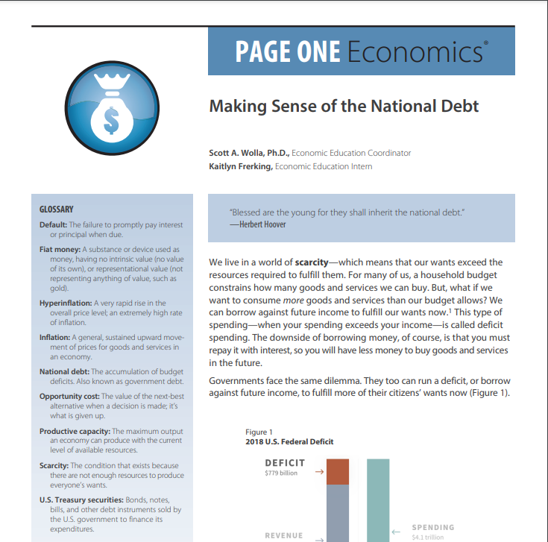
Page One Economics

Slide 14
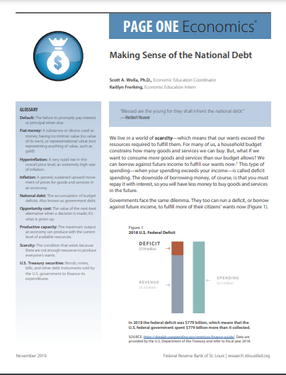
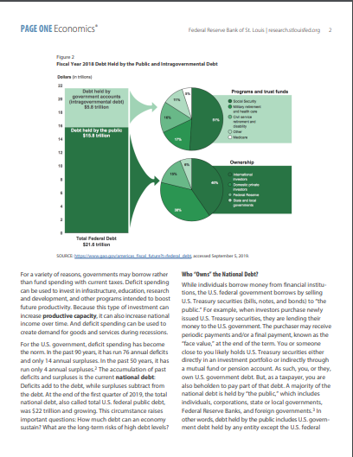
Page One Economics: Making Sense of the National Debt

Slide 15
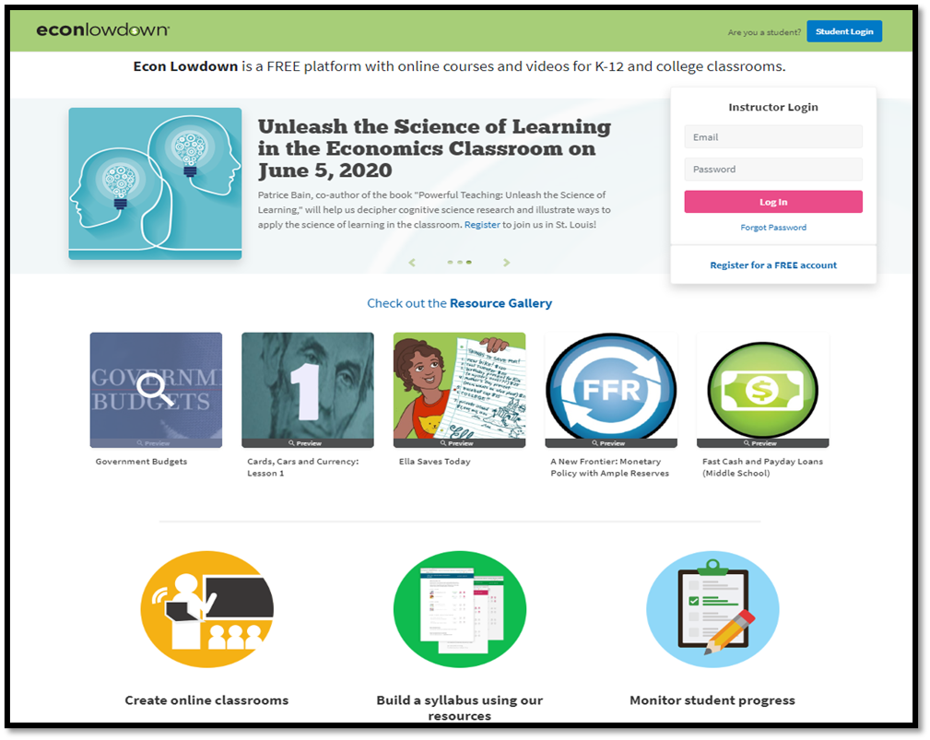
www.econlowdown.org

Slide 16
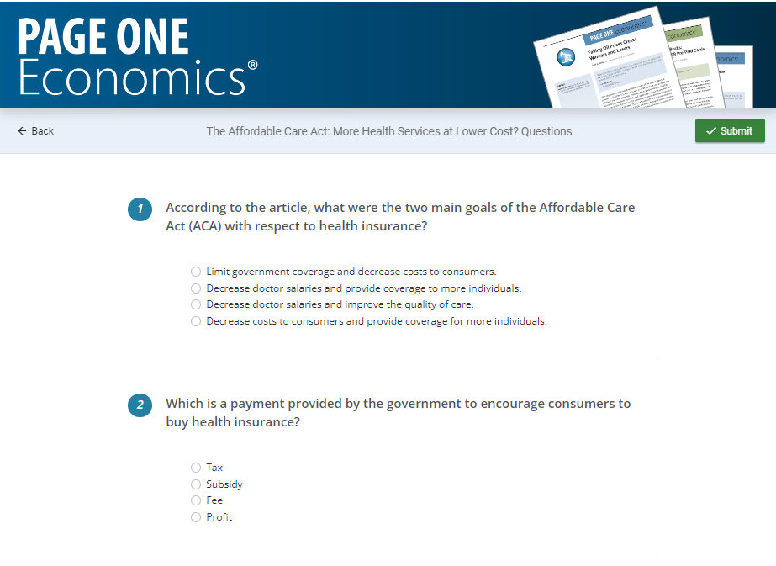
www.econlowdown.org

Slide 17
Place Holder for Information about Subscribing to Newsletters

Slide 18
Questions?
Scott Wolla, Ph.D.
Senior Economic Education Specialist
Federal Reserve Bank of St. Louis
scott.a.wolla@stls.frb.org

