Slide 1
Presented by: Andrea Mozo - Senior Director, Digital Products Email: amozo@councilforeconed.org Tuesday, November 22th 2022
ReadyAssessments for Beginners

Slide 2
Objective
To fall in love with ReadyAssessments.
To learn how to use the tool.
To add ReadyAssessments as another tool in your bag of tricks!

Slide 3
Agenda
Role Play
Bring ReadyAssessments to your Classroom
Roster classes/groups
Assign tests
View reports
Questions

Slide 4
Role Play
You are a student in the 9th grade. You're walking into your first day of Economics and Personal Finance 101 class.
Rules of Play:
Read the phrases on your index card or come up with your own
Feel free to interrupt the teacher
The more dramatic, the better

Slide 5
Role Play
Negative Nancy “This is the WORST day of my life.” “Economics is my worst subject.” “I’m never going to get a good grade.”
Teacher’s Pet “Oh, I love the idea of taking a test.” “You’re my favorite teacher.” “Can I help you hand out the tests?”
The Whiner “OMG, do we have to do this?” “I didn’t have enough time.” “Why do we have to take this testttt?”
The A+ Pessimist “I did SO terrible on this test. I just know it.” “On my last test I got 100 but I know this time around I won’t be so lucky.” “I know I’m going to fail.”
The Expert “I’m the best test taker ever.” “I love personal finance and economics.” “When are we taking a test on supply and demand?”

Slide 6
Hello Students
Welcome to Economics and
Personal Finance 101!

Slide 7
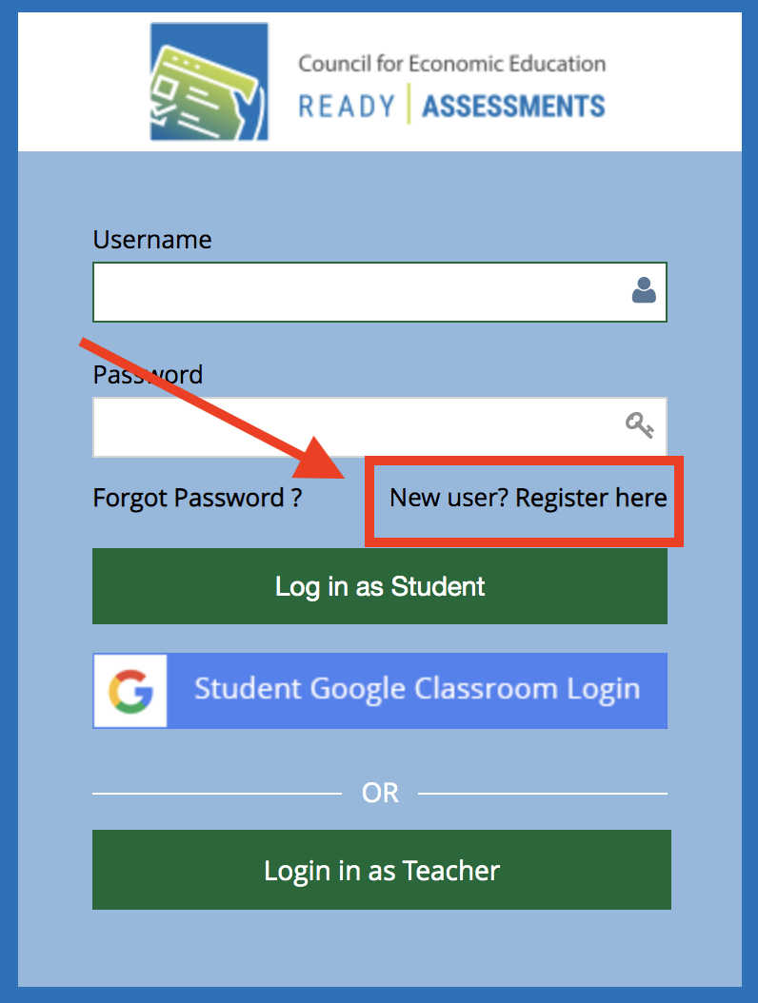
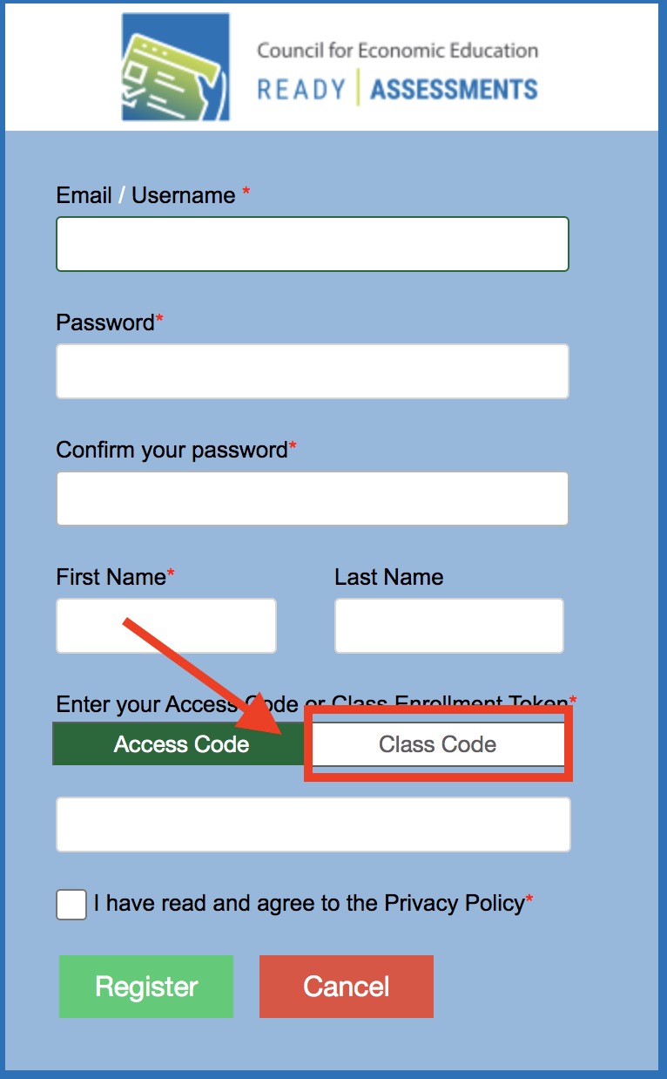
Log in to ReadyAssessments
STEP 1 Go to readyassessments.econedlink.org
STEP 2 Click on ‘New User? Register here'
STEP 3 Complete the form and add your class code
UHnFhKaa

Slide 8
Instructions
Take the test available on your dashboard. You will be timed. You have 5 minutes or less. Raise your hand when you are done.

Slide 9
Role Play

Slide 10
Why use ReadyAssessments?
It's a one-time set up
It saves you time
It has trusted standards-aligned content

Slide 11
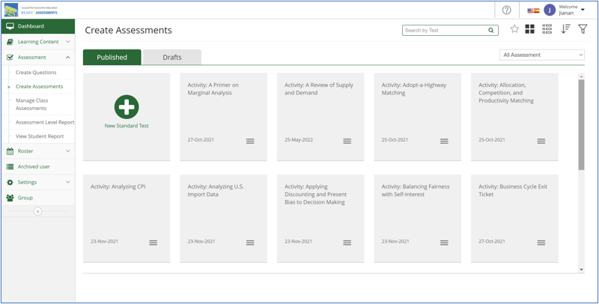
Overview
ReadyAssessments is a free assessment tool where you can easily access ready-made K-12 tests and quizzes on EconEdLink.org.

Slide 12
How can you use ReadyAssessments?
Use it as a formative or summative assessment tool for your classroom
Use it to test your student's personal finance and economics knowledge
Use it to analyze student comprehension on personal finance and economics standards
To practice for the Personal Finance Challenge, National Economics Challenge, or A.P. Macro/Micro Tests.

Slide 13
Check-in
Name one way you'd like to use
this tool in the classroom

Slide 14
Live Demo
Bring to your classroom!

Slide 15
To Start
Step 1: Create EconEdLink membership or log in to access ReadyAssessments
Log in to EconEdLink.org/membership
Type in your username and password or sign up as a new member. For a new member:
If you have Google, you can log-in using Google Single-Sign on OR
You must complete the form > Submit > Check your e-mail to verify your account > Go back to EconEdLink.org
Click “Log in”

Slide 16
Check-in
Type:
1 thing you loved about ReadyAssessments
1 thing you would improve about ReadyAssessments
What is your next step in implementing this tool in your classroom?

Slide 17
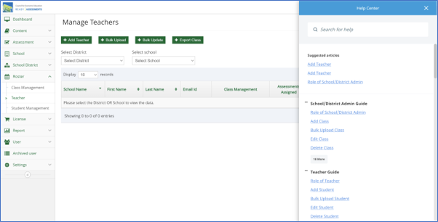
Resources/Materials
Visit https://www.econedlink.org/readyassessments/
Download the ReadyAssessments user guide
Watch the getting started, create tests, grades and reports videos
Use the Help Center in ReadyAssessments

Slide 18
Support/Issues
Report issues to help@councilforeconed.org
For additional support such as rostering, text or call 212-827-3640 (Andrea Mozo) or 212-827-3641 (John Jones)

Slide 19
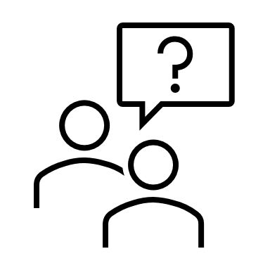
Questions
How can I help?

Slide 20
Andrea Mozo amozo@councilforeconed.org
Thank You

