Slide 1
CEE Back to School
Introduction to Intuit Financial Education tools
9/20/22
David Cook | Education Curriculum Manager

Slide 2


Slide 3
Intuit’s mission is to power prosperity around the world.
Notes:
Mission: power prosperity for all
Values:

Slide 4

We’ve seen firsthand the importance of developing personal finance and durable skills as individuals enter the job market.
We call this job readiness.
Intuit Confidential and Proprietary
‹#›
Notes:
As we’ve supported our customers, individuals, entrepreneurs and small business owners, as well as built up and supported thousands of Intuit employees, we’ve seen firsthand the role education plays in preparing people, or not preparing people, to enter the workforce and manage their financial futures.
Whether it’s understanding the in’s and out’s of tax, or building a functional budget, or learning accounting for a small business, or using critical thinking to address life’s challenges head-on, these are skills that have to be developed over time.
We call this job readiness. And, we believe this should start before an individual enters adulthood to develop the habits they’ll need well before they’ll have to make smart financial decisions in the future.
Intuit is uniquely positioned to address this inequity and education gap through its products, QuickBooks, TurboTax, Mint, Credit Karma, and Mailchimp, and its unique design thinking approach to problem solving, called Design for Delight.
Together, these real-world financial tools and skills empower students to enter adulthood with the toolkit they’ll need to manage their money well and approach challenges head-on, regardless of their starting place.

Slide 5

Learn the basics of financial literacy foundations
Build Confidence and knowledge with Mint
Test your tax acument with TurboTax
Preview additional Intuit resources coming your way
Goals of
this financial literacy session
Notes:
Spend roughly 2 minutes on this slide
this slide will change based on the days lecture
after each bullet state why each of these are important in a quick 1-2 sentences.

Slide 6
Teaching personal finance just got easier
Our new finance curriculum helps students get introduced to the foundations of personal finance. Before being able to successfully bring financial topics to life in their own lives, they need to be able to understand basic financial topics like credit scores and debt.
We know that personal finance is not a requirement for most schools, so trying to find time to integrate it into your curriculum can be difficult. We created a course that is meant to be either teacher or student-led, asynchronous in the classroom or at home, and is mobile-friendly first.
Financial Literacy Foundations
This course is a free, mobile-friendly tool for students looking to enhance their financial literacy skills. The learning playlists can be taught in class or at home at a students own pace, consisting of 7 playlists covering topics such as budgeting, credit cards, savings, and more. The course will help you support your students' knowledge gain and planned behavior for their futures.
Notes:
This is a blank slide layout to be used when other master layouts do not fit your content.

Slide 7
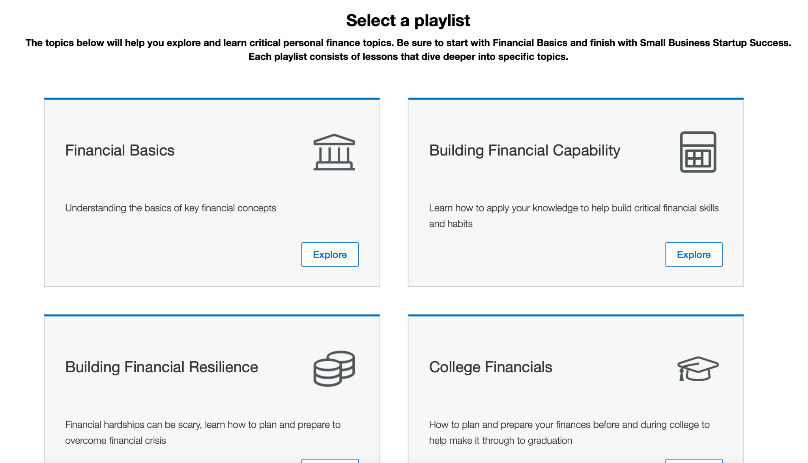
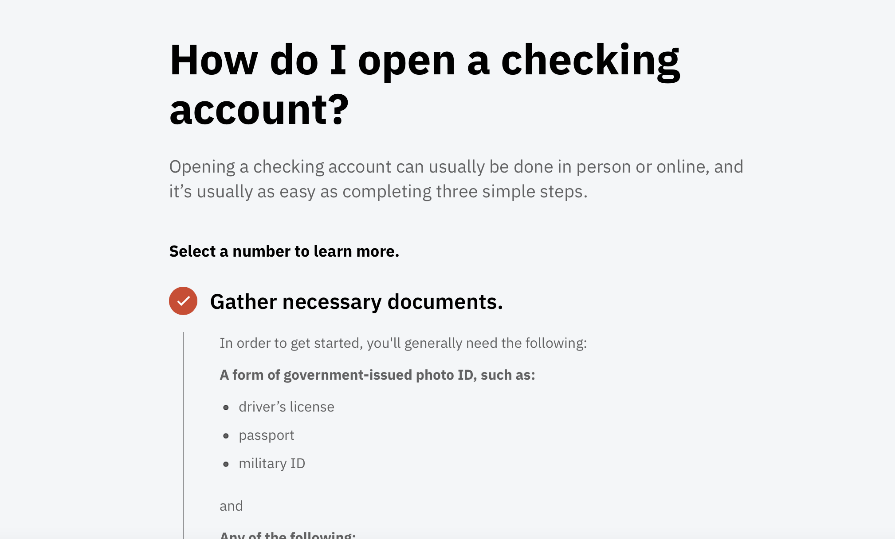
What is Intuit Financial Literacy Foundation?
Intuit Financial Literacy Foundations is a digital financial education program designed to help you better manage your money. Get started today and take the first step in preparing for your financial future.
PROGRAM HIGHLIGHTS INCLUDE:
A series of interactive modules on key
Financial topics
Mobile and tablet enabled so you can learn anytime, anywhere.
Courses available in both English and Spanish
PLAYLISTS INCLUDE: Healthy Financial Habits, Savings, Credit Scores & Reports, Building Emergency Savings, Checking Accounts, Mobile & Online Banking, Identity Protection, Considering Homeownership, Paying for College, Budgeting Tool
Notes:
Use this divider when using Title Option 2

Slide 8
Intuit Financial Literacy Foundation
Demo here
Notes:
https://intuit-financial-literacy-foundations.everfi-next.net/

Slide 9

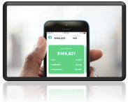
What is Mint?
Help students take control of their budgeting, credit scores and savings using Mint.
All your money in one app: See where all your money goes by easily adding your cash, credit cards, investments, and bills.
Spend smarter and save more: Personalized Mintsights™ make your money go further. Mint will automatically find savings you missed.
Stay focused on your financial goals: Improve your spending habits with custom goals that keep you going. Save for a home, crush debt, and prepare for the future.
Business Insiders #1 budgeting app 2018, 2019, 2020
Logging In: Students upon logging in will not need to connect to Isaiah’s Bank of Intuit Account or his Credit Score. This is all done manually on the backend.
Activities: Each question is validated and students cannot progress through the simulation without getting the questions correct.
Quiz/Assessments: At the end of each activity students are prompted to take a quiz.
Progress Bar: At the top of each activity and on the homepage students can track their progress.
Notes:
Logging In: Students upon logging in they will no longer need to connect to Isaiah’s Bank of Intuit Account or his Credit Score. This is all done manually on the backend.
Activities: Each question is now validated and students cannot progress through the simulation without getting the questions correct.
Quiz/Assessments: At the end of each activity students are prompted to take a quiz.
Progress Bar: At the top of each activity and on the homepage students can track their progress.

Slide 10
Mint for the Classroom
Demo here

Slide 11

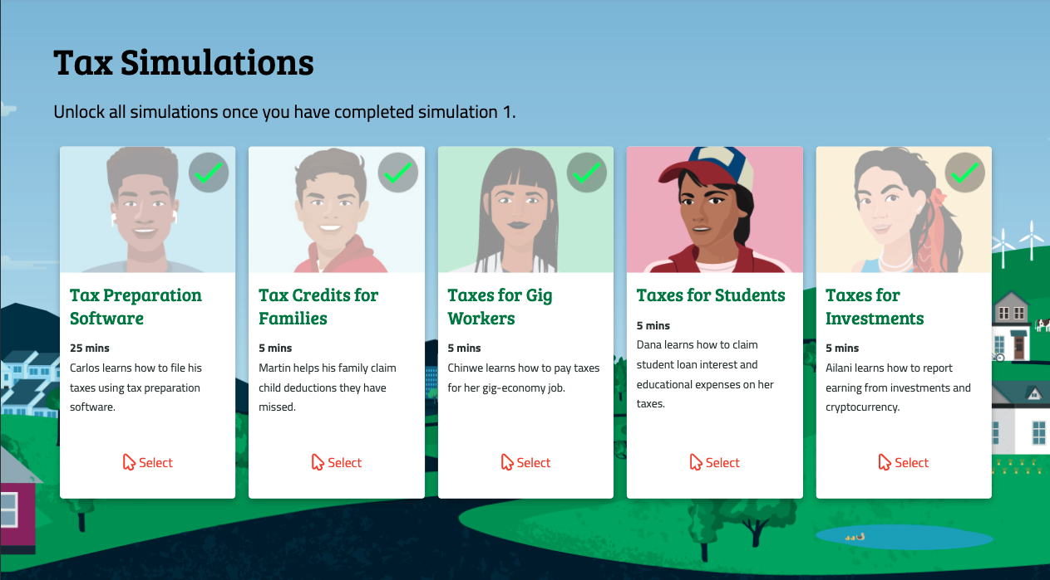
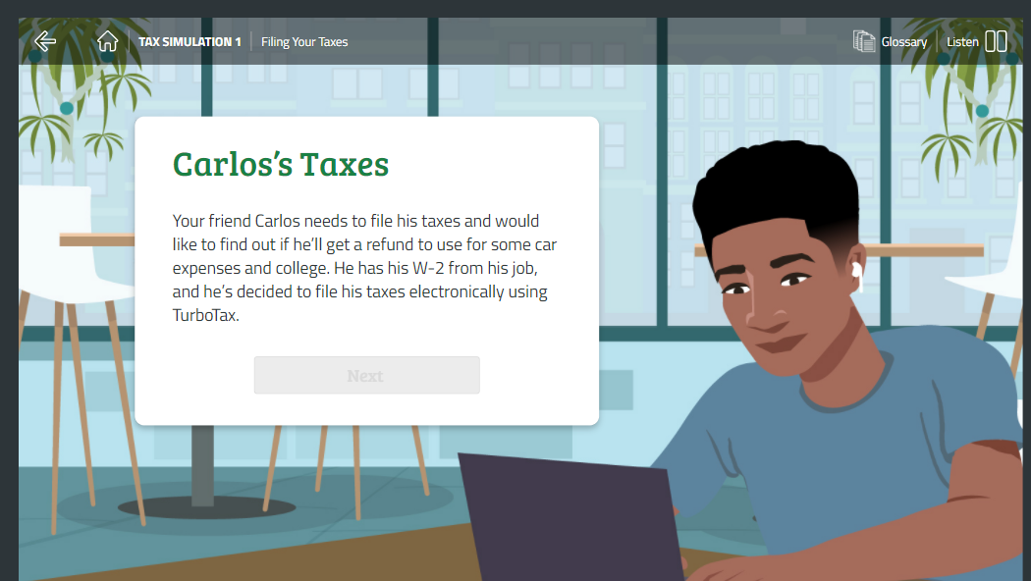
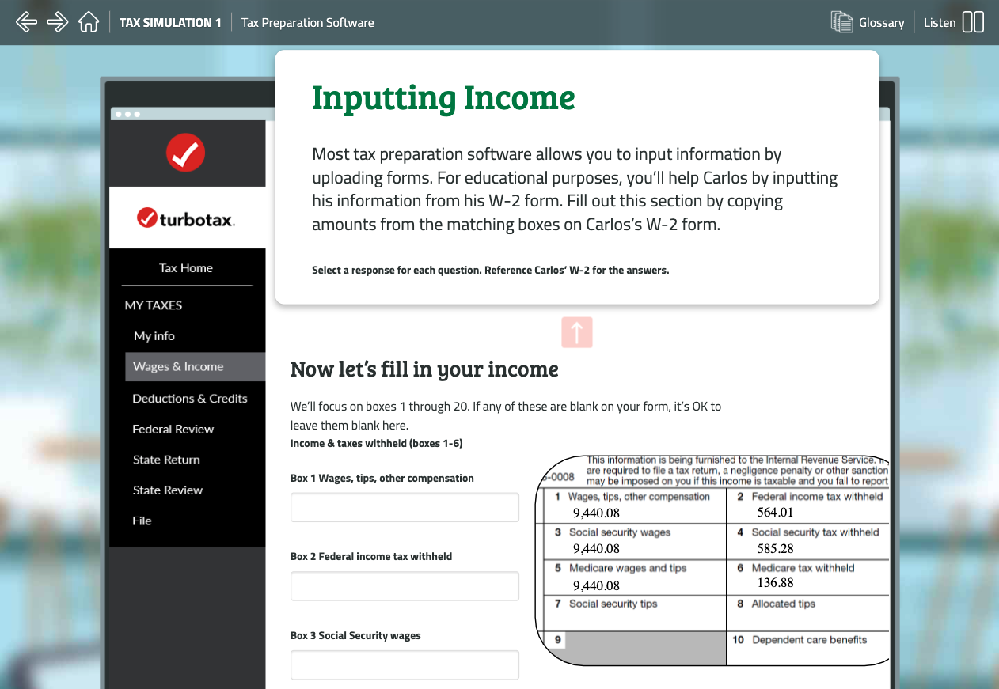
What is the TurboTax simulation?
Practice filing fictional taxes, in easy and relevant ways to Demystify Tax Day Anxiety, forever!
Tax Basics curriculum
Fictional W2 Scenario
  Carlos
Relevant Topics
  Gig-economy
  Education Credits
  Cryptocurrency & Investments
  Earned Income Tax Credit
Federal and State Returns
Notes:
Use this divider when using Title Option 2

Slide 12
Simulation features
60 minutes of interactive learning.
Easy for in-person or asynchronous learning
5 Scenarios
  Carlos is 25 minutes
  Others last 5-10 minutes each
Teacher Resources
  Curriculum Guide
  Discussion Guide
  Glossary
  Simulation Outline
Free for teachers and students
Notes:
Use this divider when using Title Option 2

Slide 13
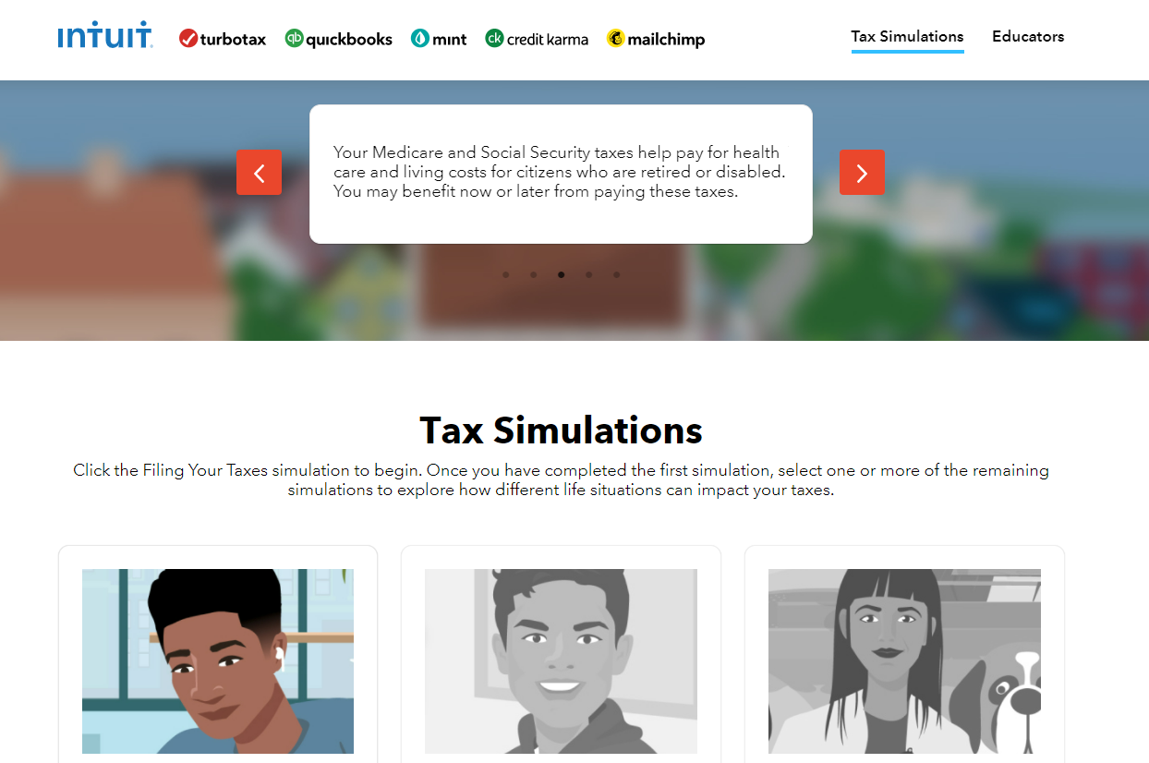

How to access the simulation
turbotax.everfi.com/
product demo
Notes:
After slide 7, show direct access change screen

Slide 14
TurboTax for the Classroom
Demo: http://turbotax.everfi.com/

Slide 15
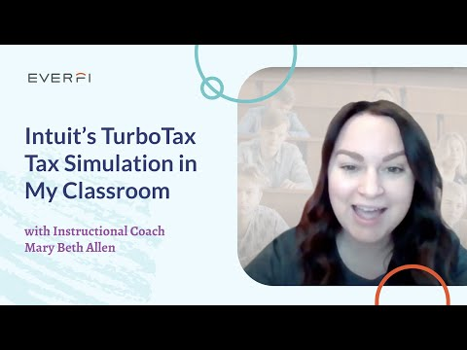
TurboTax Simulation: Experiences
Notes:
Use this divider when using Title Option 2
Spring
$2500
More info coming soon.

Slide 16
Resources
Mint | TurboTax
Download the teacher toolkit Part 1: Curriculum Overview 2022-2023 Part 2: Curriculum Orientation 2022-2023 | Microsite to receive the simulation - (Sign Up)

Slide 17
Bringing the
Intuit Social Innovation Challenge to Life
Intuit’s Social Innovation Challenge

Slide 18
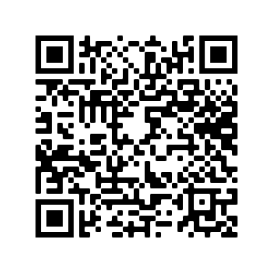
Timeline for the Intuit Social Innovation Challenge
All students sign up for the Challenge here or the QR code
Step 1: Register by September 30
Step 2: Form a team
Step 3: Build a solution
Step 4: Submit your team’s project by October 12
Step 5: Finalists paired with an Intuit mentor
Step 6: Finalists submissions due November 9
Step 7: Finalist winners announced on November 15

Slide 19
Funding
First place teams each received $5,000 to improve their project
Second place teams receive $3,000
Third place teams receive $2,000

Slide 20
Be on the lookout this year for:
Updated Mint & TurboTax Curriculum now!
  Intuit content is now updated to reflect student needs
Intuit Social Innovation Challenge
  Register your students now to potentially win $5,000 in grant funding for their impact proposals!
Library of Kahoot games coming in October!
  Intuit is partnering with Kahoot to provide relatable and fun financial literacy activities for your classrooms
Intuit TurboTax Scholarship coming this Spring
  $2500 for your students to pursue their higher education!
We will reach out to you with these opportunities. For more information or support reach out to Teymour_Ashkan@Intuit.com and David_Cook@intuit.com,
Q&A | THANK YOU!

Slide 21
Teacher resources (links below)
Product teaser
Product demo video
Educator resources (accessible at turbotax.everfi.com)
One page flyer
Notes:
https://turbotax.everfi.com/

Slide 22
Please fill out survey!

Slide 23
Breakout room discussion
Choose a topic within the Playlist you are assigned
Financial Basics | Breakout Room 1
Building Financial Capability | Breakout Room 2
Building Financial Resilience | Breakout Room 3
College Financials | Breakout Room 4
Adulting | Breakout Room 5
Small Business Startup Success | Breakout Room 6
Preparing for Retirement | Breakout Room 7
  What is the goal of this topic, as outlined on the first page of the topic?
  How is the information presented throughout the pages in this topic? Describe layout, readability, any interactive elements, etc.
  Is the site user-friendly for students? (navigation, etc.)
  Is the material age appropriate for high school students?
  How could you use this for in-person teaching?
Notes:
Use this divider when using Title Option 2

