Slide 1
WELCOME!
Housekeeping Items:
Please use the chat and/or Q & A function to ask questions or to notify moderator of issues
The session will be recorded and emailed to participants in the next few days
Thank you for joining us.
The webinar will begin shortly.

Slide 2
AP Macro Unit 5: Economic Growth
Live Webinar: November 14th, 2022

Slide 3
Instructor Bio
James Redelsheimer has been an AP and Regular Economics teacher at Robbinsdale Armstrong High School in Plymouth, Minnesota since 2003. James received his Bachelor’s degree from St. Olaf College and his Master's degree at the University of St. Thomas. He received the 3M Economics Educator Excellence Award from the Minnesota Council on Economic Education and was named Visa's Practical Money Skills Innovative Educator of the Month.
James enjoys traveling and has been a guest lecturer in the economics department at the Batumi State University in The Republic of Georgia and has received travel grants and fellowships for study travel to learn about the economies of Japan, China, Turkey, Germany, Korea, among others, and studied economics of the environment in Costa Rica. He currently serves as an AP Economics reader, grading AP Economics exams. He enjoys teaching Economics because it relates to students' everyday lives.

Slide 4
Webinar Objectives
In this webinar teachers will be able to:
Explain the factors that lead to economic growth.
Calculate economic growth using graphs and data.
Implement effective lessons to prepare students for AP exam questions on economic growth.

Slide 5
Measuring Economic Growth
What do economists use to measure economic growth and standard of living?
Not nominal GDP since in doesn’t account for inflation
Not real GDP because it doesn’t account for population.
Real GDP per Capita- The real GDP divided by the population.
Growth Rate- The change in real GDP per capita over time.
What are the characteristics of countries with high growth rates?
5

Slide 6
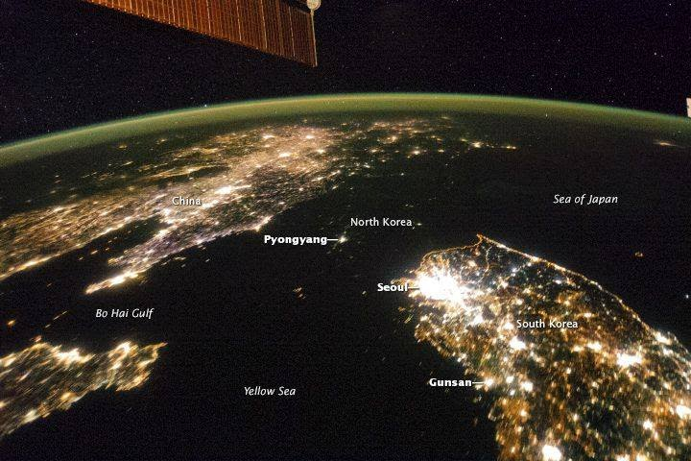
The difference between North and South Korea at night North Korea's GDP is $13 Billion
South Korea's GDP is $1.6 Trillion
6

Slide 7
Why do some countries have more growth?
1. Economic System- Capitalism promotes innovation and provides incentives to improve productivity.
2. Rule of Law- Countries with solid institutions and political stability have historically had more economic growth.
3. Capital Stock- Countries that have more machines and tools are more productive.
Example#1: India has a relatively low GDP because they have a lot of labor but not very much capital.
Example#2: Japan has few natural resources but a high GDP.
4. Human Capital- Countries that have better education and training are more productive.
5. Natural Resources- In general, countries that have access to more natural resources are more productive.
It all boils down to productivity!
Productivity- Output per unit of input

Slide 9
Aggregate Production Function
This graph shows that an increase in the amount of inputs causes an increase in the amount of output, but not at a constant rate.
Real GDP per worker
Productivity levels off because of diminishing returns
GDP₃
Productivity
GDP₂
GDP₁
Physical Capital Per Worker
PC₁
PC₂
PC₃

Slide 10
Aggregate Production Function
What happens on this graph when there is an improvement in technology?
Real GDP per worker
Productivity₂₀₂₉
GDP₂
Productivity₂₀₁₉
GDP₁
The same amount of inputs produce even more output
Physical Capital Per Worker
PC₁
10

Slide 11
If investment increases, what happens in the short-run and long-run?
Capital Stock- Machinery and tools purchased by businesses that increase their output.
Price
Level
LRAS
LRAS₁
The PPC shifts outward since producers can make more.
AS
AS₁
Capital Goods
PL₁
PL_{e}
AD
AD₁
Q_{Y}
Q₁
Q_{Y1}
GDP_{R}
Consumer Goods
11

Slide 12
Productivity Creates Wealth
Developing Countries
Developed Countries
12

Slide 13
Cuban Tractor

Slide 17
Showing Economic Growth with AD-AS and the PPC

Slide 18
An increase in consumption or net exports doesn’t cause economic growth.
Investment causes growth since firms increase their physical capital.
Price
Level
LRAS₁
AS₁
Capital Goods
PL_{e}
AD₁
Q_{Y1}
GDP_{R}
Consumer Goods
18

Slide 19
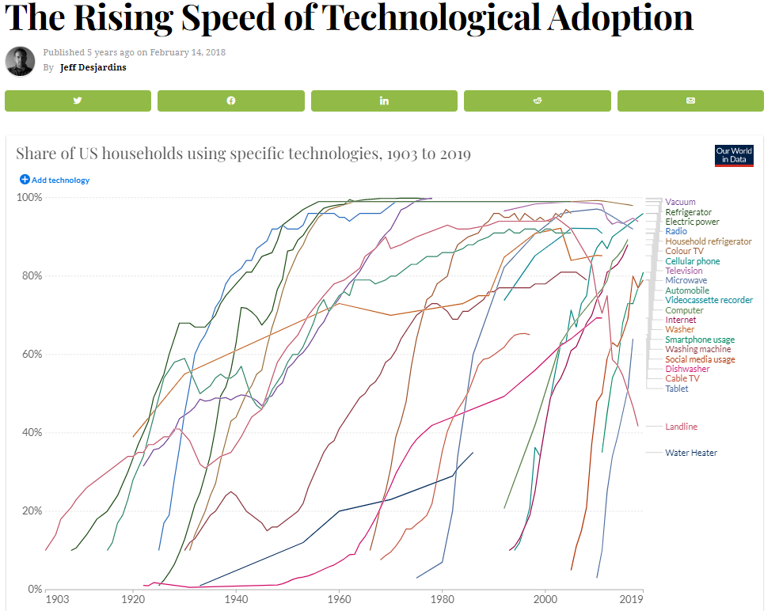

Slide 20
2008 Audit Exam
Notes:
E

Slide 21
2008 Audit Exam
Notes:
B

Slide 22
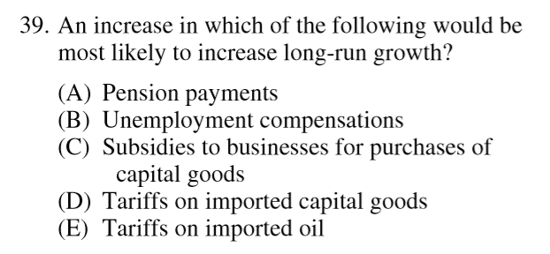
2012 Audit Exam
Notes:
C

Slide 23
2012 FRQ #3
23

Slide 24
2012 FRQ #3
Notes:
https://www.youtube.com/watch?v=uz-AotT82Xk

Slide 25
Aggregate Production Function
What happens on this graph when there is an improvement in education and human capital?
Real GDP per worker
Productivity₂₀₂₉
GDP₂
Productivity₂₀₁₉
GDP₁
The same amount of inputs produce even more output
Physical Capital Per Worker
PC₁
25

Slide 26
What government policies most likely result in long-run economic growth?
1. Education/training spending
-Increases human capital.
2. Infrastructure spending- public works like roads, bridges, and harbors
-Increases physical capital
3. Production/Investment incentive programs (e.g. investment tax credits)
-Increases physical capital
-These are called ‘supply-side policies’

Slide 27
Supply-side Fiscal Policy
Supply-side Fiscal Policies- government policies designed to increase production by reducing business taxes and/or regulations.
Why is this controversial?
Providing tax breaks to businesses might disproportionately benefit the wealthy.
It assumes that corporations will spend tax cuts on investment rather than payout shareholders.
27

Slide 28
Supply-side Fiscal Policy
What will happen in the long-run if the government decreases corporate taxes?
Price
Level
LRAS
LRAS₁
The PPC shifts outward since producers can make more.
AS
AS₁
Capital Goods
PL₁
PL_{e}
AD
AD₁
Q_{Y}
Q₁
Q_{Y1}
GDP_{R}
Consumer Goods
28
Notes:
Business have more money to spend on

Slide 29
What will likely happen in the long-run if there is an increase in social services?
In the long-run, wages and costs increase.
LRAS
AS₁
Government spending doesn’t necessarily results in economic growth.
Only spending that increases productivity or technology.
Price
Level
AS
PL₂
PL₁
PL_{e}
AD
AD₁
Q_{Y}
Q₁
GDP_{R}
29

Slide 30
2008 Audit Exam
Notes:
B

Slide 31
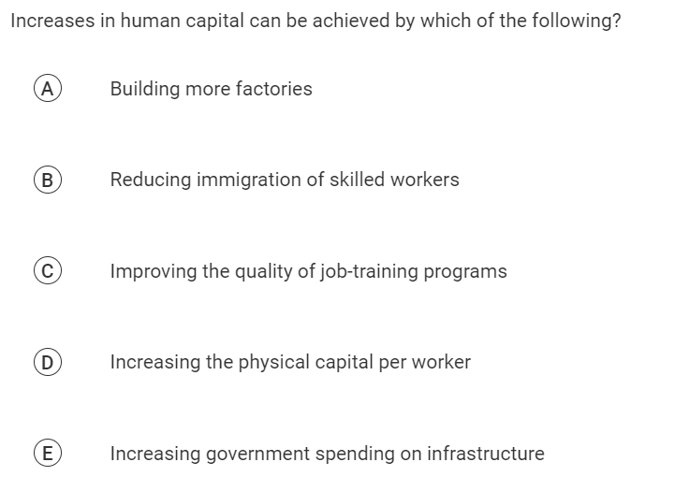

Slide 34
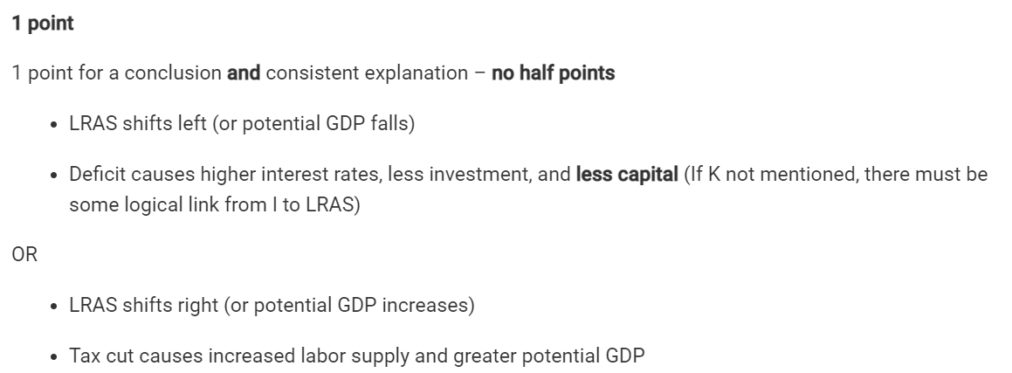

Slide 35
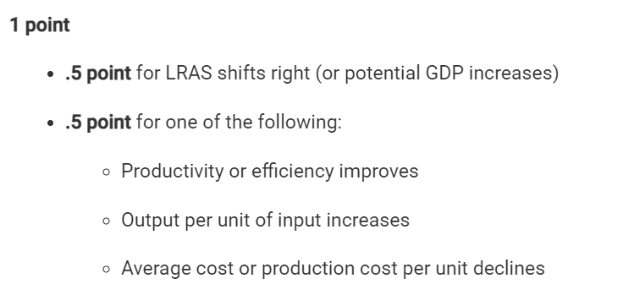

Slide 36
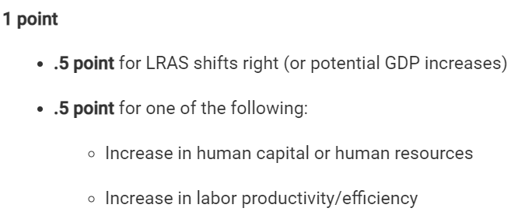

Slide 38
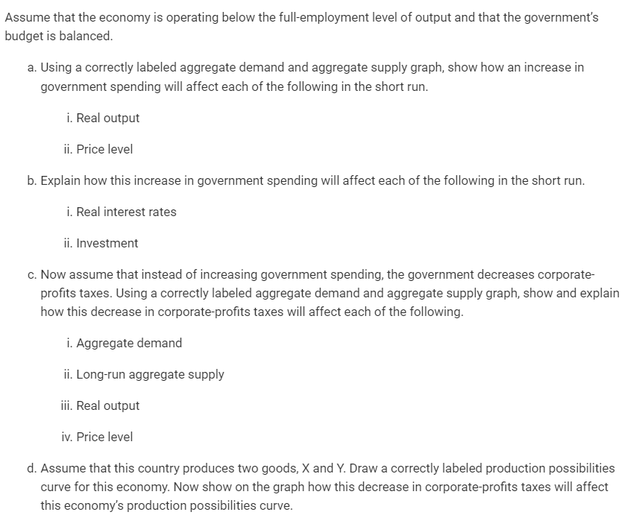

Slide 39
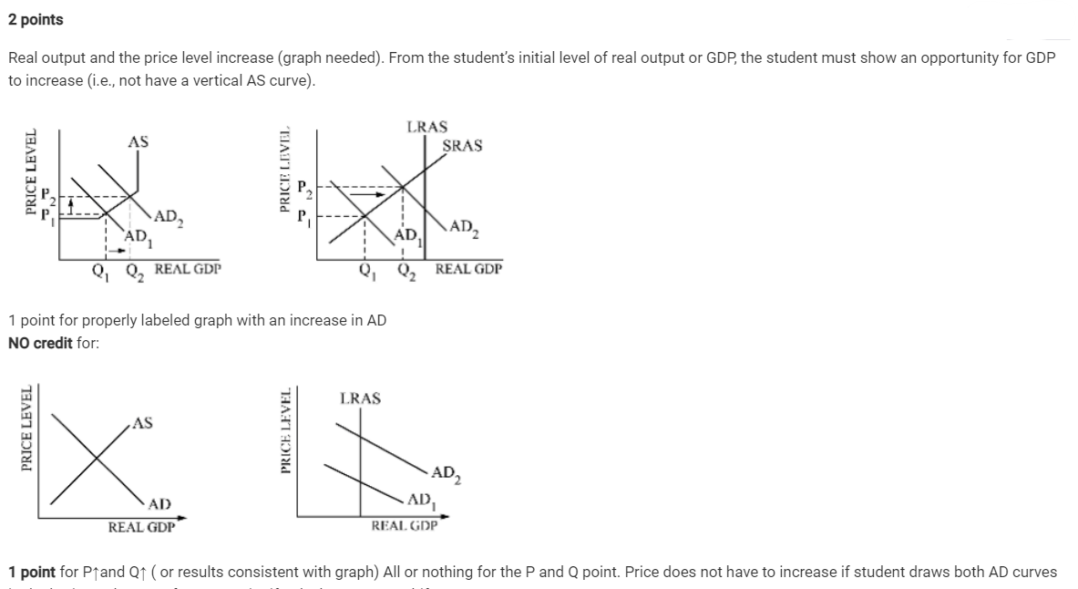

Slide 41
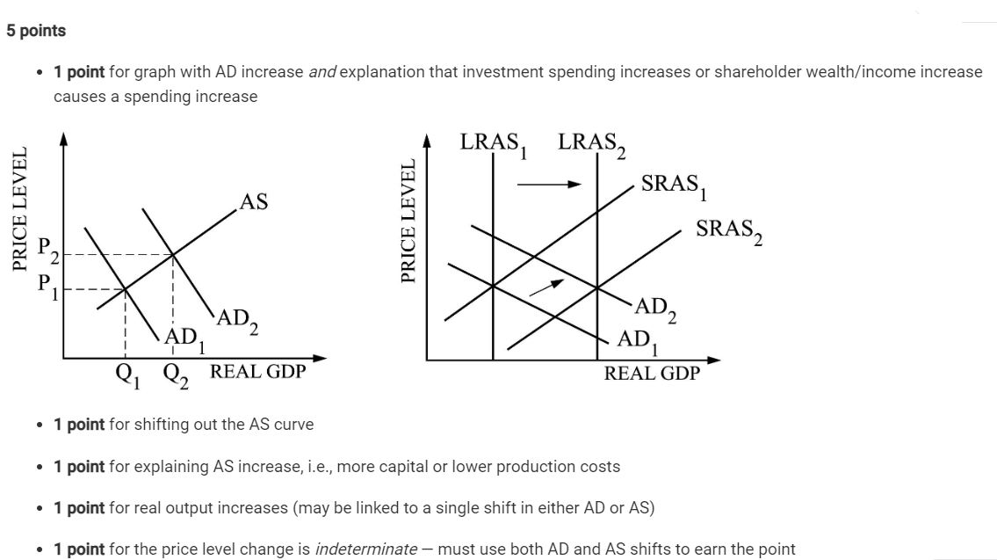

Slide 42
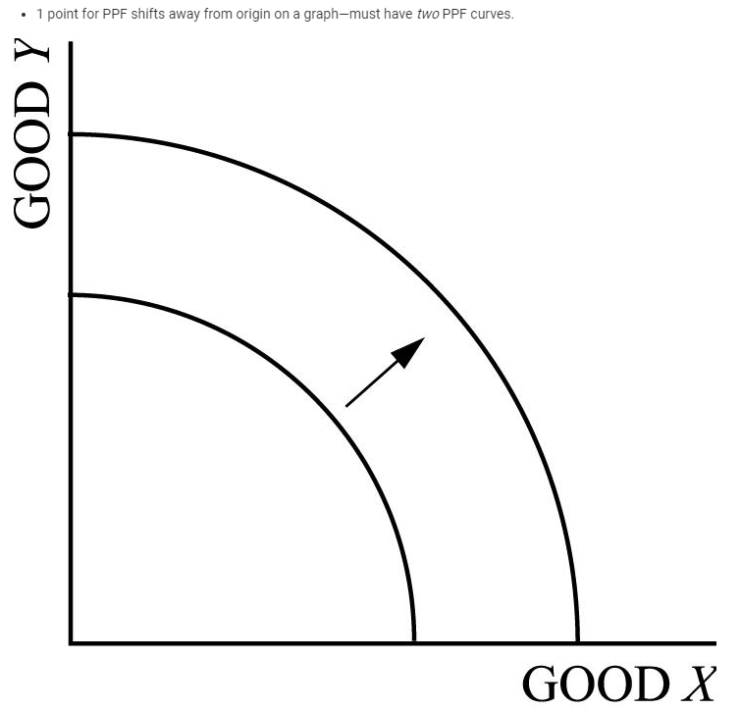

Slide 43
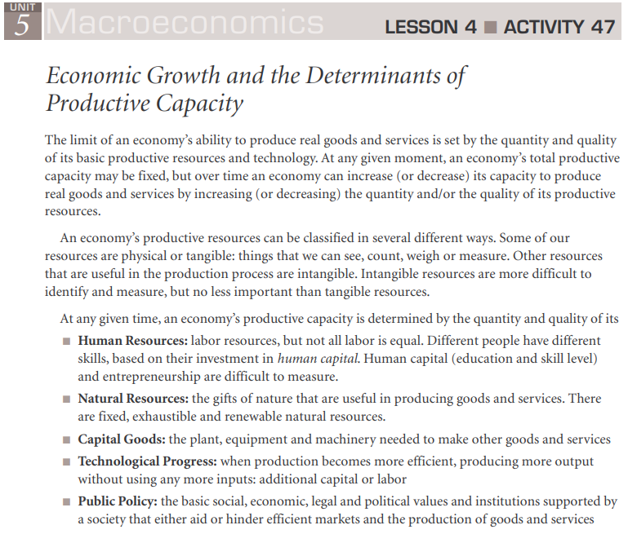

Slide 44
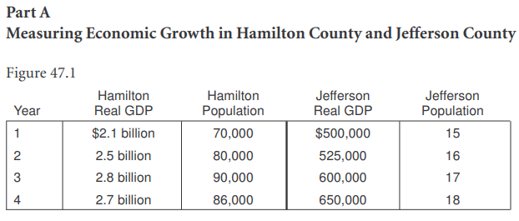

Slide 45
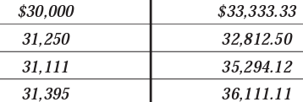

Slide 46
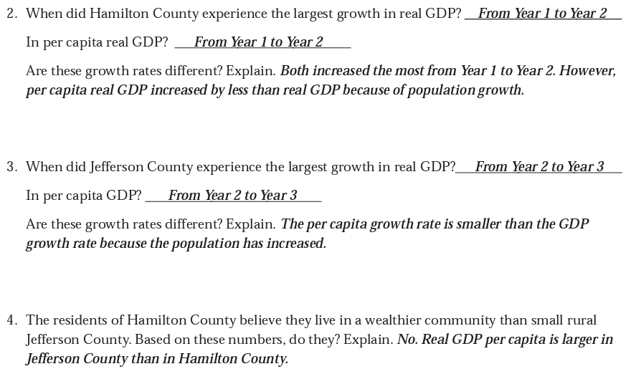

Slide 48
Any Questions?
James Redelsheimer | jred40@gmail.com
mcee.umn.edu | mcee@umn.edu | 612.625.3727

Slide 49
Thank You!
James Redelsheimer | jred40@gmail.com
mcee.umn.edu | mcee@umn.edu | 612.625.3727

