Slide 1
WELCOME!
Housekeeping Items:
Please use the chat and/or Q & A function to ask questions or to notify moderator of issues
The session will be recorded and emailed to participants in the next few days
Thank you for joining us.
The webinar will begin shortly.

Slide 2
AP Macro Unit 5:
Crowding Out
Live Webinar: November 7th, 2022

Slide 3

Instructor Bio
James Redelsheimer has been an AP and Regular Economics teacher at Robbinsdale Armstrong High School in Plymouth, Minnesota since 2003. James received his Bachelor’s degree from St. Olaf College and his Master's degree at the University of St. Thomas. He received the 3M Economics Educator Excellence Award from the Minnesota Council on Economic Education and was named Visa's Practical Money Skills Innovative Educator of the Month.
James enjoys traveling and has been a guest lecturer in the economics department at the Batumi State University in The Republic of Georgia and has received travel grants and fellowships for study travel to learn about the economies of Japan, China, Turkey, Germany, Korea, among others, and studied economics of the environment in Costa Rica. He currently serves as an AP Economics reader, grading AP Economics exams. He enjoys teaching Economics because it relates to students' everyday lives.

Slide 4
Webinar Objectives
In this webinar teachers will be able to:
  Understand and teach the loanable funds market with examples and activities.
  Explain the long-term effects of crowding-out, and effectively explain this to students.

Slide 5
Crowding Out and Loanable Funds
Assume the government increases deficit spending
What will happen to the demand for loanable funds, the real interest rate, and private domestic investment?
Real Interest Rate
-Demand increases
-Real interest rate increases
-Private investment decreases (Q_{PI})
S
r₁
r_{e}
D₁
D
Q_{PI}
Q_{Loans}
Q₂
Quantity of Loans
5

Slide 6
Crowding Out and Loanable Funds
Assume the government increases deficit spending
What will happen to the demand for loanable funds, the real interest rate, and private domestic investment?
Real Interest Rate
S
The total number of loans increased to Q₂ but that was due to public borrowing. Private borrowing decreased to Q_{PI}
r₁
r_{e}
D₁
D
Q_{PI}
Q_{Loans}
Q₂
Quantity of Loans
6

Slide 7
Crowding Out and Loanable Funds
Assume the government increases deficit spending
What will happen to the demand for loanable funds, the real interest rate, and private domestic investment?
Real Interest Rate
What is the long-run impact of higher real interest rates?
Less economic growth because investment falls. Less capital stock.
S
r₁
r_{e}
D₁
D
Q_{PI}
Q_{Loans}
Q₂
Quantity of Loans
7

Slide 8
Crowding Out and Loanable Funds
Crowding Out- The adverse effect of government borrowing on interest-sensitive private sector spending.
Real Interest Rate
S
r₁
r_{e}
D₁
D
Q_{PI}
Q_{Loans}
Q₂
Quantity of Loans
8

Slide 9
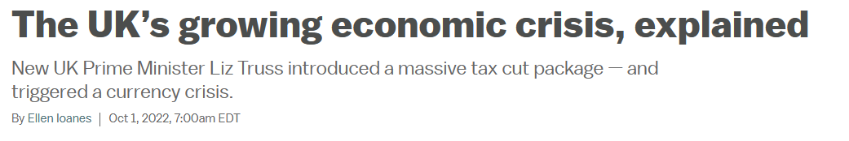
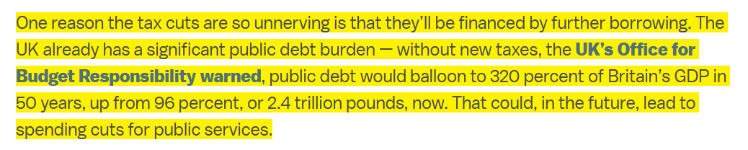
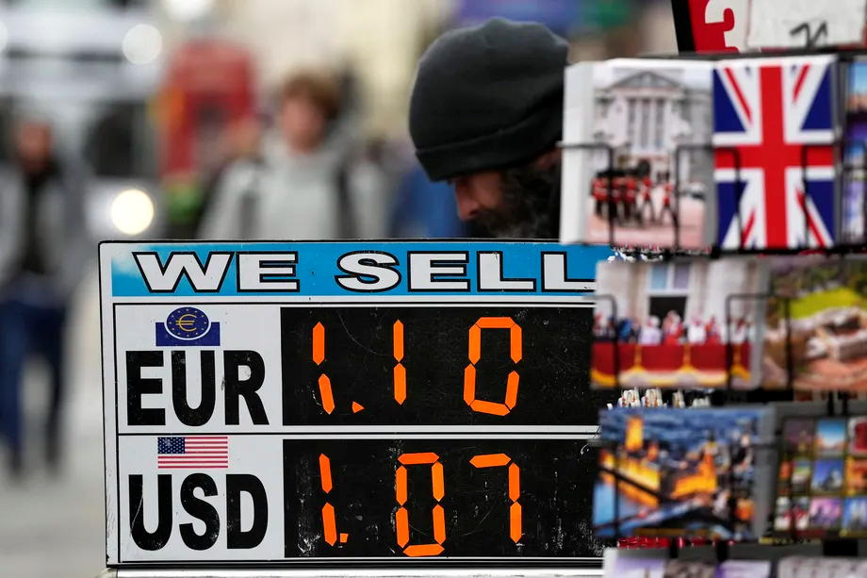

Slide 10


Slide 11
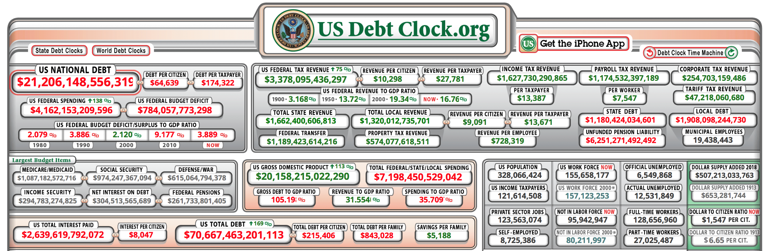

US National Debt
US Debt Clock

Slide 12
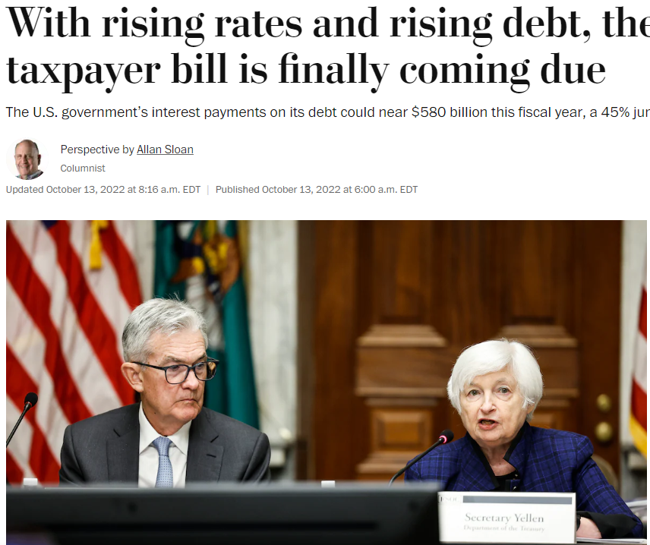

Slide 13
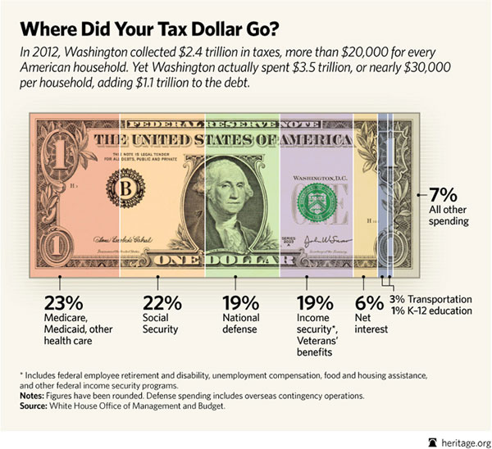

Slide 14
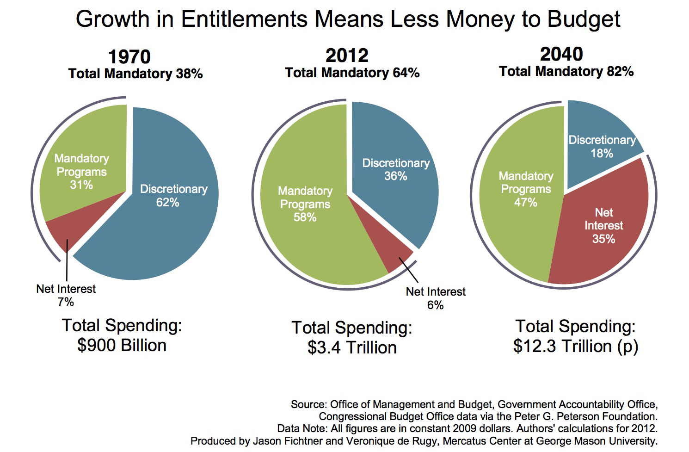
Entitlements- A Federal program that requires payments to any eligible person or unit of government. This mandatory spending must be paid (e.g. Social Security)
Notes:
https://www.nytimes.com/2018/09/25/business/economy/us-government-debt-interest.html

Slide 15
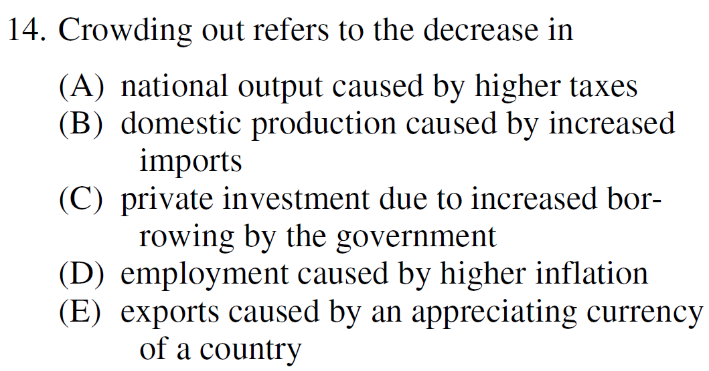
2008 Audit Exam
Notes:
C

Slide 16
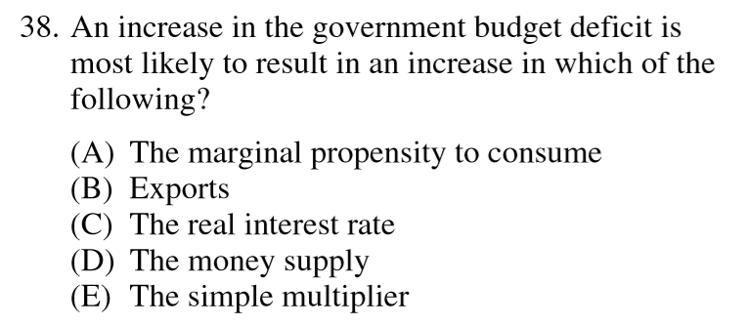
2012 Audit Exam
Notes:
C

Slide 17
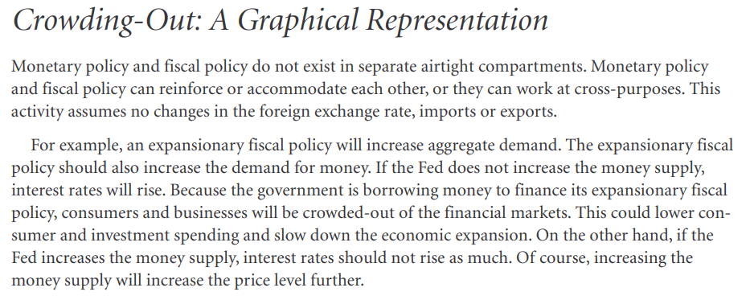
CEE Activity 44: Student Workbook 3rd Edition

Slide 18
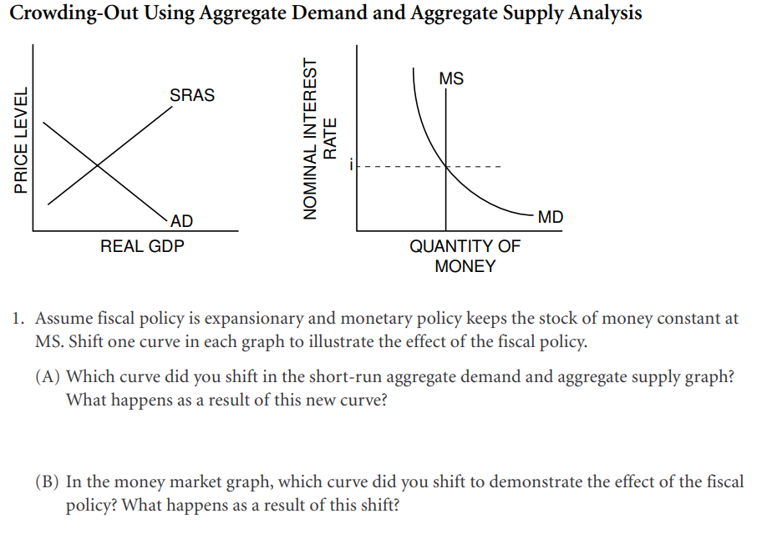
AD 1
MD 1
Shift the AD curve to AD1, as a result of the expansionary fiscal policy. The PL and real GDP both increase.
Shifted the MD curve to the right; MD increased because real GDP increased. Interest rates rise.

Slide 19
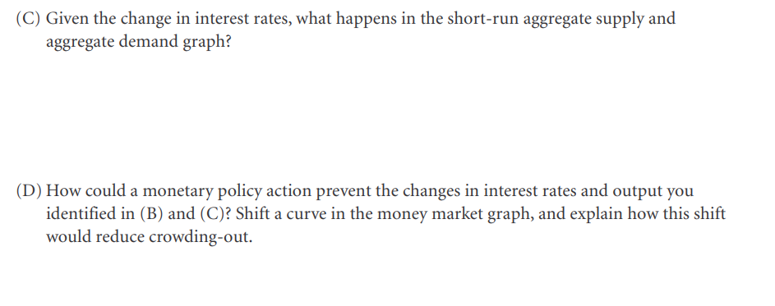
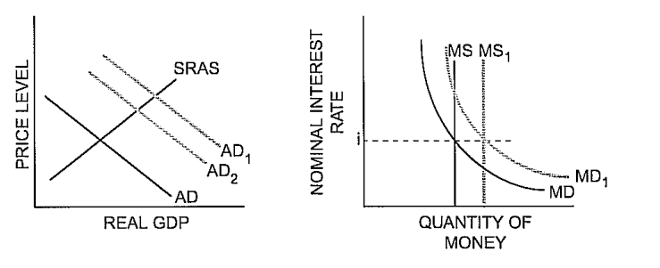
AD shifts back to AD2 b/c the increase in interest rates reduces some private domestic investment and interest-sensitive consumer spending.
Shift the MS curve to MS1. If the MS is increased to MS1, interest rates would move back to i. If interest rates are at i, there would be no crowding-out (or reduction) of investment spending, and the AD would be AD1.

Slide 20
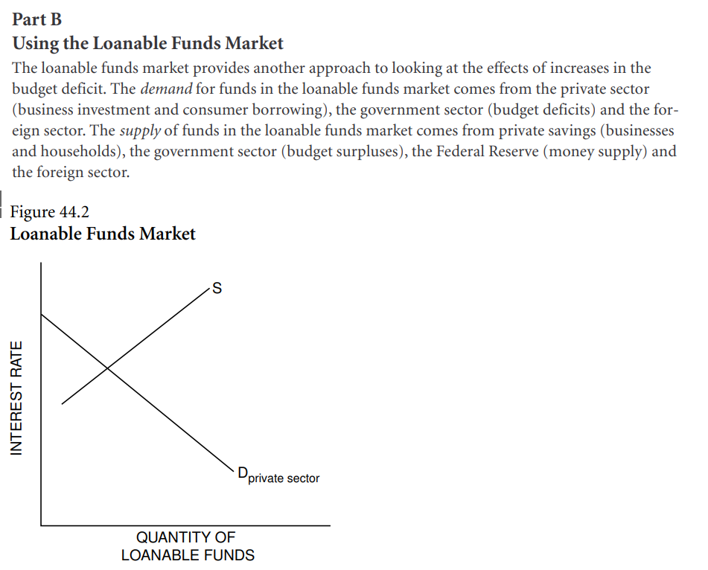

Slide 21
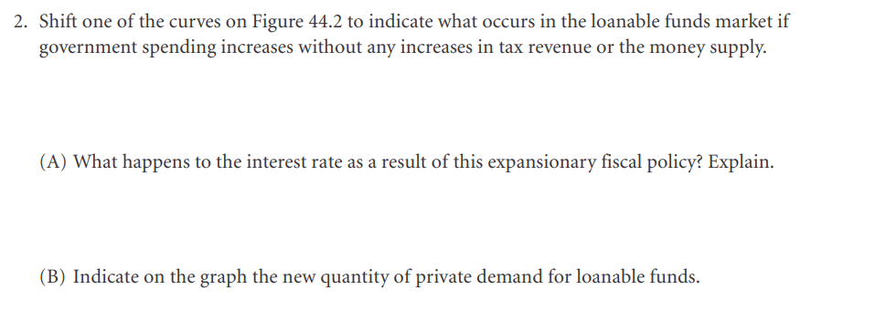
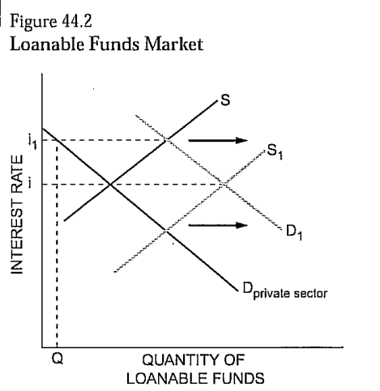
The demand increases, shifting the demand curve to D1. D1 represents the private plus public demand for loanable funds.
There is an increase in the D for loanable funds to pay for the increased government spending. The interest rate rises to i1.
At the higher interest rate (i1), the level of private demand for loanable funds is Q.

Slide 22


Slide 23
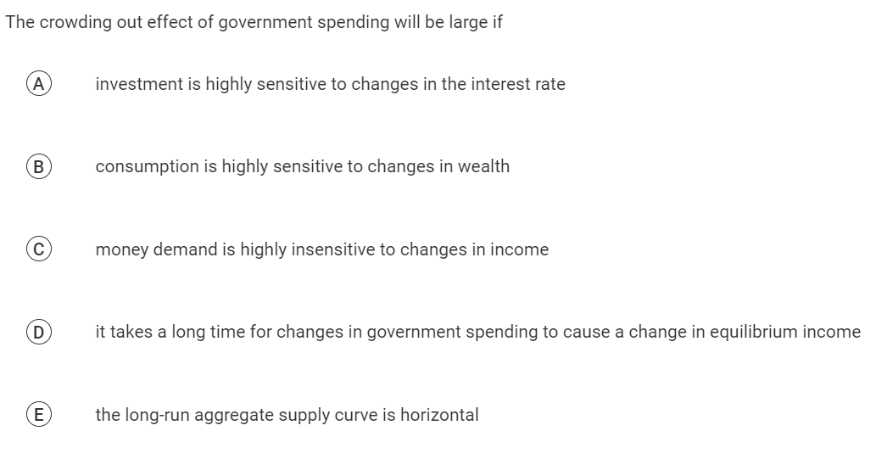

Slide 24
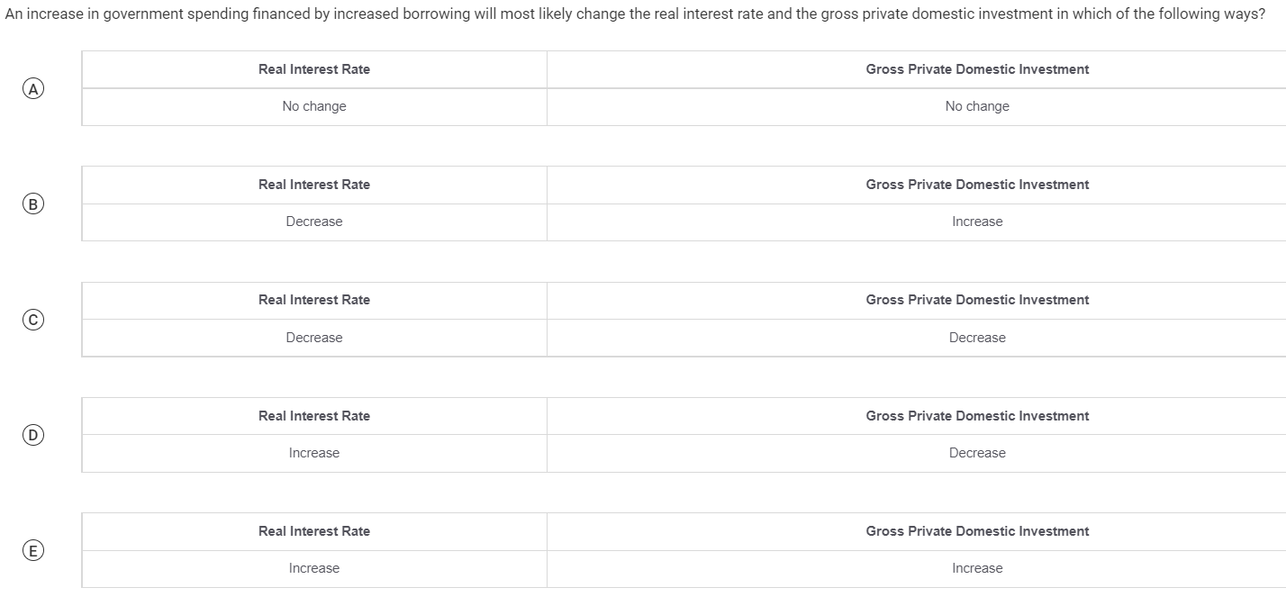

Slide 25
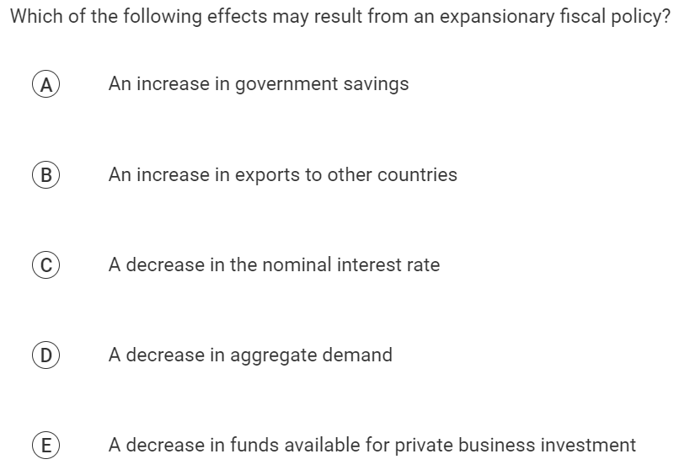

Slide 26
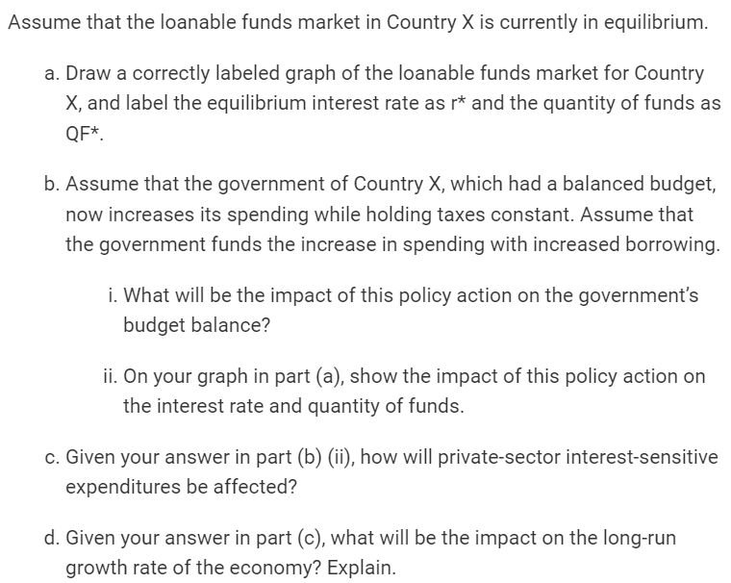
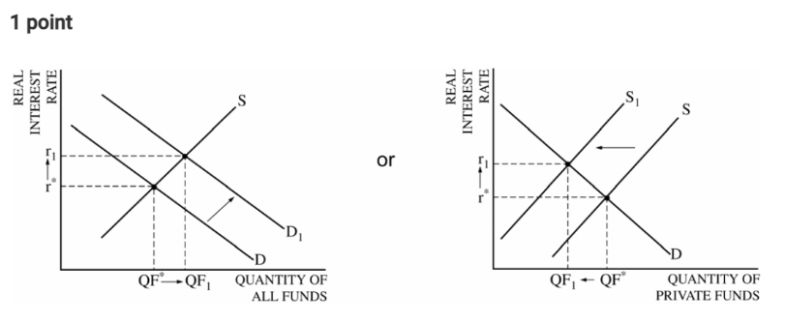
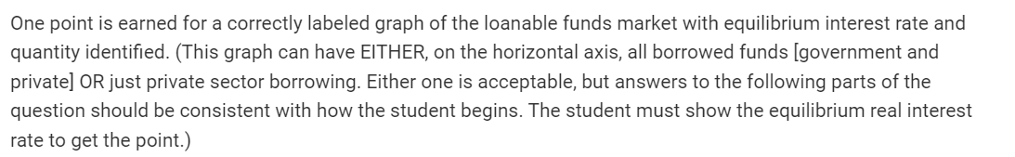

Slide 27
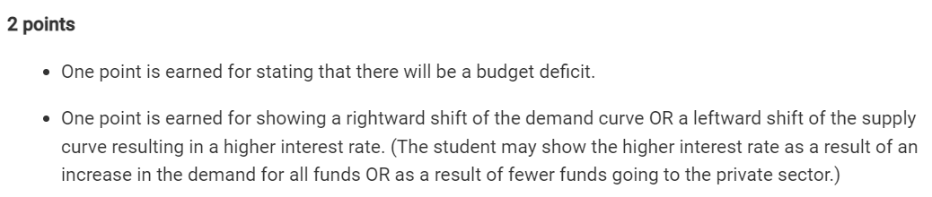

Slide 29
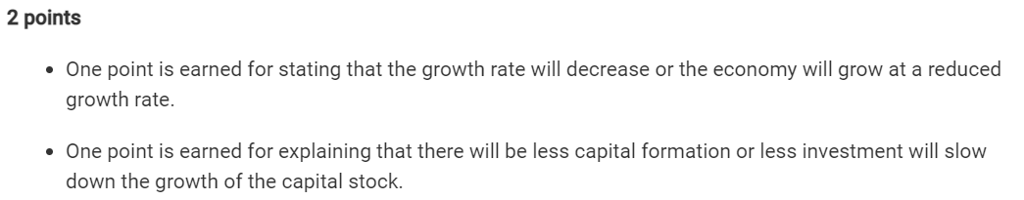

Slide 30
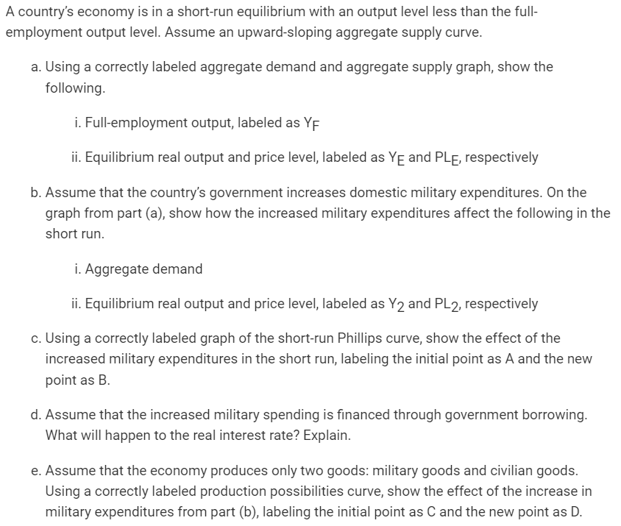
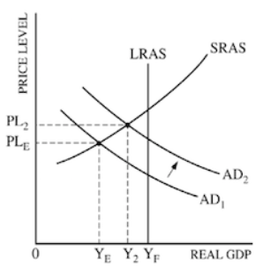
One point is earned for a correctly labeled AD/AS graph with vertical LRAS at YF.\
One point is earned for showing equilibrium output and price level to the left of YF.

Slide 31


Slide 32
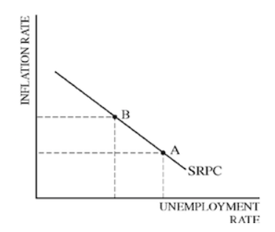
One point is earned for a correctly labeled graph of the short-run Phillips curve.
One point is earned for correctly labeling points A and B on the SRPC that indicate a leftward movement along the SRPC.

Slide 34
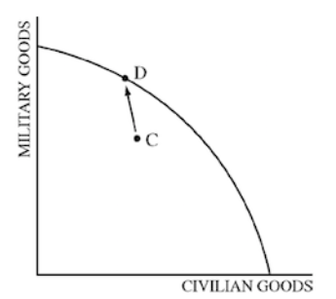
One point is earned for a correctly labeled production possibilities curve.
One point is earned for labeling points C and D, showing a movement toward the curve and an increase in military goods.

Slide 35
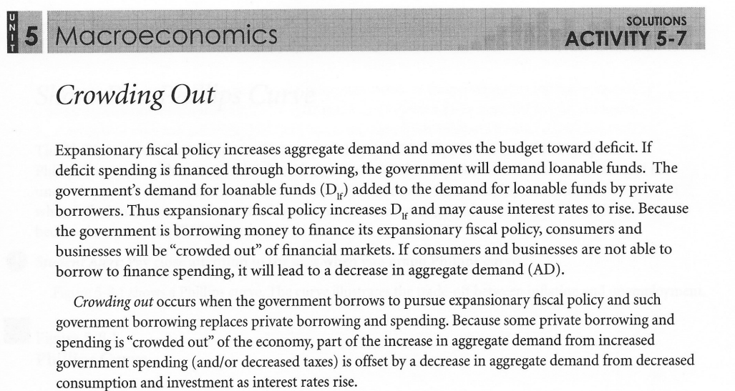

Slide 36
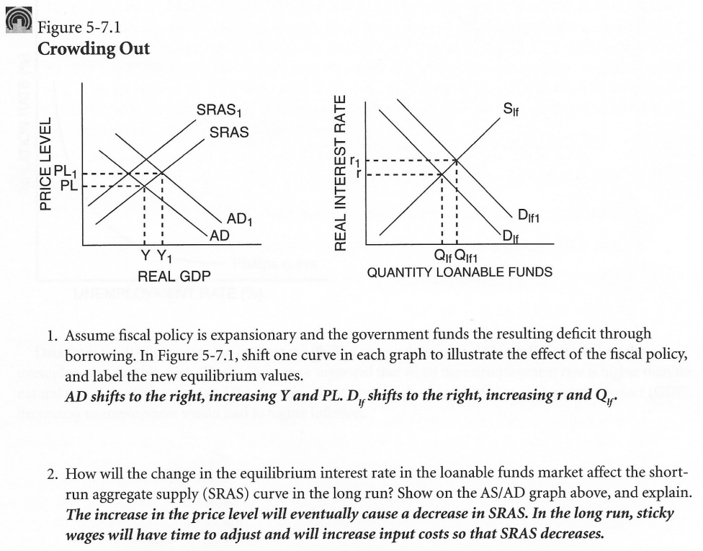

Slide 37
Any Questions?
James Redelsheimer | jred40@gmail.com
mcee.umn.edu | mcee@umn.edu | 612.625.3727

Slide 38
Thank You!
James Redelsheimer | jred40@gmail.com
mcee.umn.edu | mcee@umn.edu | 612.625.3727

