Slide 1
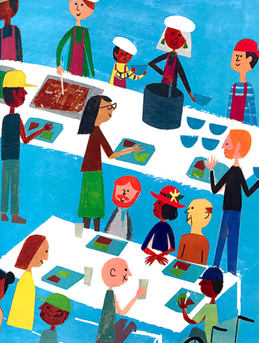



Homelessness in Children’s Literature:
Choices, Changes, and Unintended Consequences
October13, 2022
Lauren H. Shifflett
shiffllh@jmu.edu
Lynne Farrell Stover
stoverlf@jmu.edu

Slide 2
EconEdLink Membership
You can now access CEE’s professional development webinars directly on EconEdLink.org! To receive these new professional development benefits, become an EconEdLink member. As a member, you will now be able to:
Automatically receive a professional development certificate via e-mail within 24 hours after viewing any webinar for a minimum of 45 minutes
Register for upcoming webinars with a simple one-click process
Easily download presentations, lesson plan materials and activities for each webinar
Search and view all webinars at your convenience
Save webinars to your EconEdLink dashboard for easy access to the event
You may access our new Professional Development page here

Slide 3
Professional Development Certificate
To earn your professional development certificate for this webinar, you must:
Watch a minimum of 45-minutes and you will automatically receive a professional development certificate via e-mail within 24 hours.
Accessing resources:
You can now easily download presentations, lesson plan materials, and activities for each webinar from EconEdLink.org/professional-development/

Slide 4

Webinar Objectives
Discuss economic concepts featured in this genre
Define homelessness and its causes
Focus on lessons and activities for 3 specific titles
Review “generic” activities that apply to homelessness
Suggest helpful websites
Introduce titles included on bibliography

Slide 5

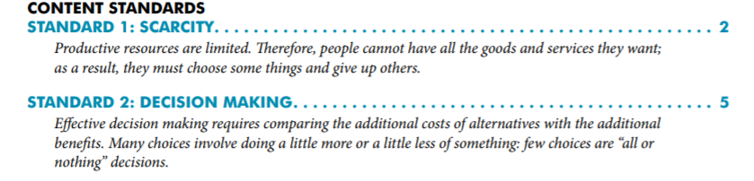
National Standards
https://www.councilforeconed.org/wp-content/uploads/2012/03/voluntary-national-content-standards-2010.pdf

Slide 6

Virginia HISTORY & SOCIAL SCIENCE Standards of Learning
Skills K.1 –C/E .1 The student will demonstrate skills for historical thinking, geographical analysis, economic decision making, and responsible citizenship by h) using a decision-making model to make informed decisions
K.9 The student will a) recognize that people make choices because they cannot have everything they want; and b) explain that people work to earn money to buy the things they want.
1.8 The student will explain that people make choices because they cannot have everything they want.
2.10 The student will explain that scarcity (limited resources) requires people to make choices about producing and consuming goods and services.
3.10 The student will identify examples of making an economic choice and will explain the idea of opportunity cost (what is given up when making a choice).
CE.11 The student will apply social science skills to understand how economic decisions are made in the marketplace by a) explaining that because of scarcity, consumers, producers,
and governments must make choices, understanding that everyone’s choice has an
opportunity cost
CE.13 The student will apply social science skills to understand the role of government in the
United States economy by
b) explaining how and why government provides certain goods and services

Slide 7
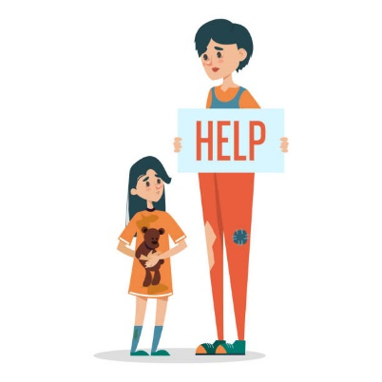
Why Teach Students About Homelessness?
It helps students develop an awareness of economic injustices and become more thoughtful, compassionate, and empathetic towards others.
It prepares students to deal with critical social problems instead of "sheltering" them from the concerns of our society.
It identifies stereotypes and challenges misconceptions about individuals and families who are homeless.

Slide 8

CHOICE
An act of selecting or making a decision when faced with two or more alternatives.
“The day I decided to steal a dog was the same day my best friend, Luanne Godfrey, found out I lived in a car.”
-Georgina Hayes, Elementary School Student

Slide 9

How to Steal a Dog
By Barbara O’Conner
.
Publisher: Square Fish
Copyright Date: 2007
Reading Level: 4.0
Interest Level: 4-7
Story Synopsis: Georgina Hayes, problem solver and list maker, is miserable.
And she has every right to be. She, her hard-working mother,
and annoying younger brother are all living in a car because they were
evicted from their apartment. It’s not like her mother isn’t trying; she’s managing to hold down two jobs. But neither of these jobs comes with a high salary and it looks like it will take time to save the money needed for the security deposit and first month’s rent.
Then Georgina comes up with a plan to make some quick cash.
All she needs to do is find a missing dog and collect the reward money.
There is one major problem with this plan.
Georgina needs to decide if it would it be wrong if she was the reason the dog was “missing” in the first place.

Slide 10
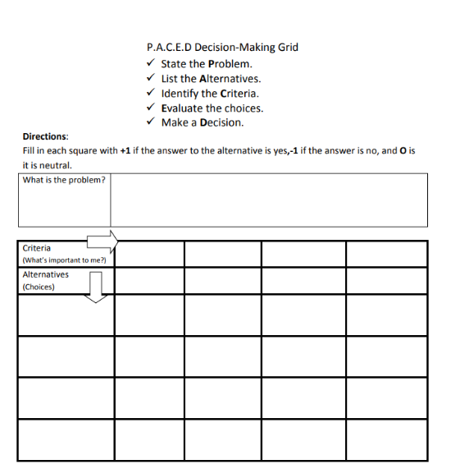
PACED Decision Model
State the problem
List the alternatives
Identify the criteria
Evaluate the alternatives
Make a decision

Slide 11
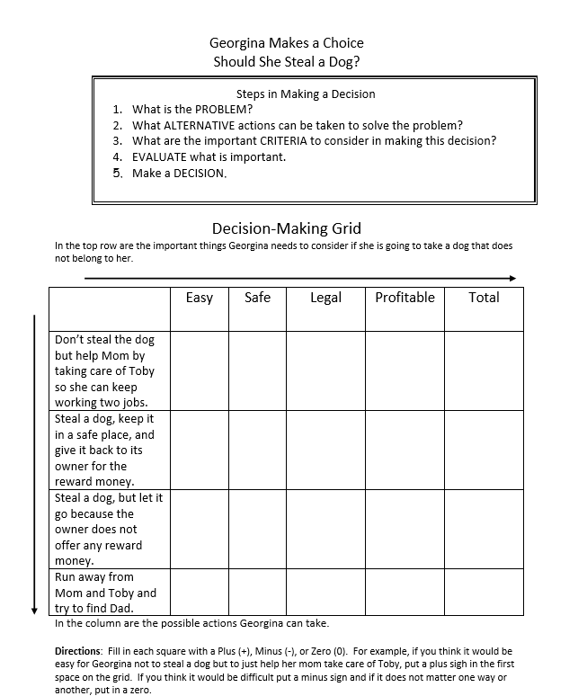

:

Slide 12
EVALUATE THE ALTERNATIVES
Fill in each square with a Plus (+), Minus (-), or Zero (0).
Problem: Georgia’s mom needs money to rent an apartment.
How can she help?
Easy
Safe
Profitable
Legal
+
₊
₋
Don’t Steal the Dog but help take care of Toby so Mom can work two jobs
+
Steal the Dog and keep it in a safe place, returning it for reward money.
-
-
+
-
-
-
-
+
Run Away from Mom and Toby and try to find Dad

Slide 13

Interpreting the PACED Decision Making Grid
The problem:
“Georgia’s mom needs money to rent an apartment. How can she help?”
The answer: “It depends.”
If Georgia wants to help her mom by making money, she steals a dog.
If Georgia wants to help her mom by staying safe, and keeping out of trouble, she does not steal a dog.

Slide 14
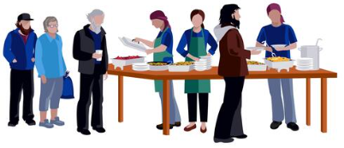
Change
To make (someone or something) different; alter or modify
Page 7- The Richmond is bordered by some fancy neighborhoods…it’s basically a normal neighborhood. It’s where my family used to live. When we volunteered at the shelter, we learned that 25 percent of people who live in the Richmond are at high risk for food insecurity.
And now my family is too.
-Maya, age 10

Slide 15
Shelter
by Christie Matheson
Publisher: Random House
Copyright Date: 2021
Reading Level: 4.7
Interest Level: 4-7
Story Synopsis: Maya, a fifth grader at a distinguished private school, is having a tough time after tragedy strikes her family. Her father is in the hospital, her mother can no longer work, their landlord sold their house and they can no longer afford to pay rent. Deciding to keep these changes from her friends is taking its toll. As if living in a shelter with her mom and younger sister weren’t challenging enough, dealing with dangerous environments, food insecurity, lack of privacy, and school bullies make her life difficult to navigate.

Slide 16
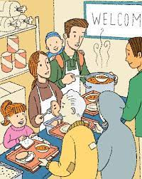
Food Insecurity
Experiencing food insecurity was one of the major changes in Maya’s life.
The fact that her younger sister suffered from food allergies complicated where the family could find foods she could safely eat.

Slide 17

https://static1.squarespace.com/static/55808440e4b05e2c40bdb1d0/t/56254eebe4b0808b4bac2db4/1445285611406/Hunger_and_Food_Security-Lesson.pdf
Almost one in seven U.S. households—over 17 million—suffer from food insecurity, a condition that includes:
Hunger, in more extreme cases;
Having to skip meals;
Having to compromise on nutrition;
Relying on emergency food sources such as food banks, food pantries and soup kitchens.

Slide 18
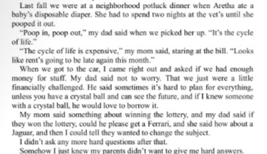

Unintended Consequences
The unexpected and unplanned results of a decision or action.

Slide 19

CRENSHAW
by Kathrine Applegate
Publisher: Square Fish
Copyright Date: 2017
Reading Level: 3.8
Interest Level: 5-9
Story Synopsis: Nine-year-old Jackson Wade and his family are facing some very real problems; hunger, parental illness, joblessness, unpaid bills, and possible homelessness. When Jackson was five, he and his family were forced to live in their car due to their financial circumstances. Not wanting to repeat this experience, he finds himself assuming the role of an adult and is shouldering major stress. It’s no wonder an imaginary friend from childhood shows up to help him cope with the seriousness of his family’s situation.

Slide 20
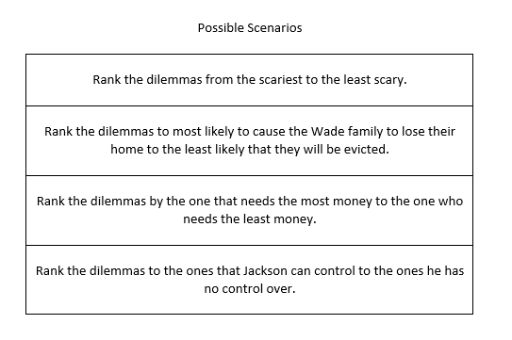
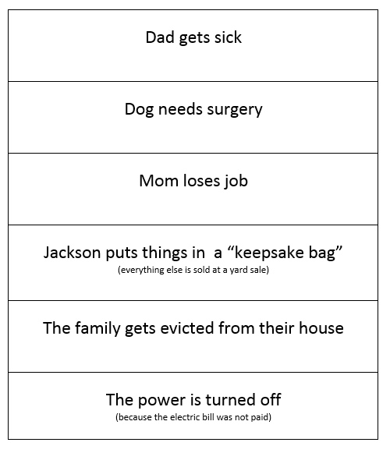

Ranking Activity

Slide 21
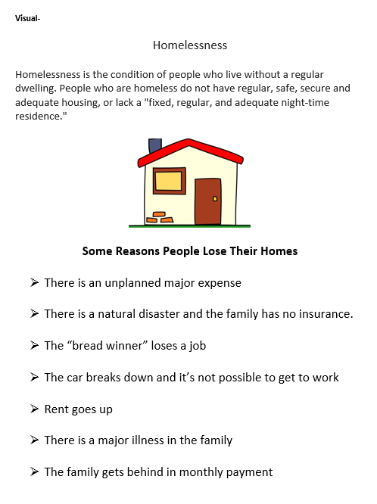



Slide 22

Homelessness Generic Activities
Scarce Housing “Musical Chairs”
Directions-
Display Situation Card Example
Instruct students to write a situation card based on a fictional character
Introduce the activity by telling the students they will be playing an interactive game based on musical chairs. Explain that every chair represents a home.
Play the game.
When the music stops, the person without a “house” must read their situation card to the group and go to the back of the room.
Play as time allows.
Debrief the activity by discussing the situations of the various characters.

Slide 23
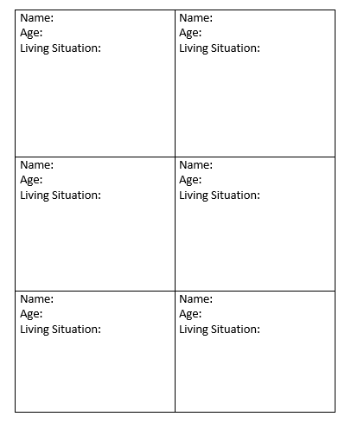

Scarce Housing “Musical Chairs” Situation Card Example
Homelessness Generic Activities
Name: Hansel Woodson
Age: 8 years
Living Situation: Currently living in the forest with my sister Gretel after being abandoned by our father.
We are looking for food and shelter.
Possible Homeless Characters
Peter Pan & the Lost Boys
Maniac Magee
Mowgli
Tarzan
Jane Eyre
Sophie (The BFG)
Snow White
Violet, Klaus & Sunny Baudelaire

Slide 24


Homelessness Generic Activities
Create two lists.
In one column write positive things that happened in the book.
In the other column write the negative things that occurred.
Draw a picture depicting the theme
Everyone Deserves a Home.

Slide 25
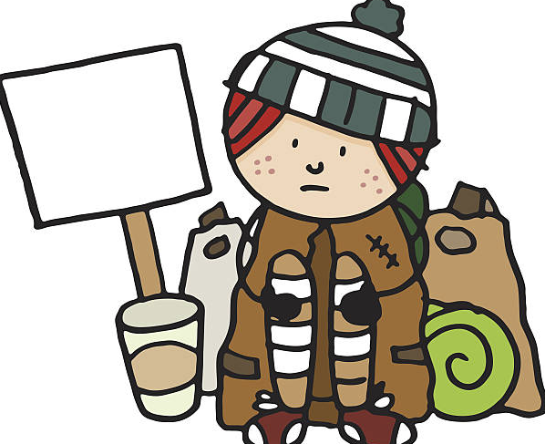
Homelessness Generic Activities
Describe the main character in to book. Recount at least three ways homelessness impacted this character’s life.
How did the following concepts impact the characters in the book?
  Scarcity
  Choice
  Wants
  Decision-making
  Investing in Human Capital

Slide 26




Homelessness Generic Activities
List ten types of dwellings that can be used for shelter.
Rank them from your most favorite to your least favorite.
  Apartment
  Cottage
  Hotel
  House Boat
  Igloo
  Light House
  Log Cabin
  Mobile Home
  Tent
  Yurt

Slide 27
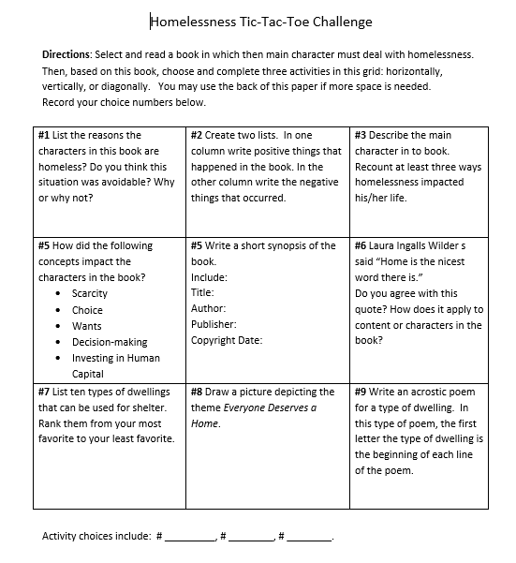
Homelessness Generic Activities
List ten types of dwellings that can be used for shelter.
Rank them from your most favorite to your least favorite
  Apartment
  Cottage
  Hotel
  House Boat
  Igloo
  Light House
  Log Cabin
  Mobile Home
  Tent
  Yurt

Slide 28


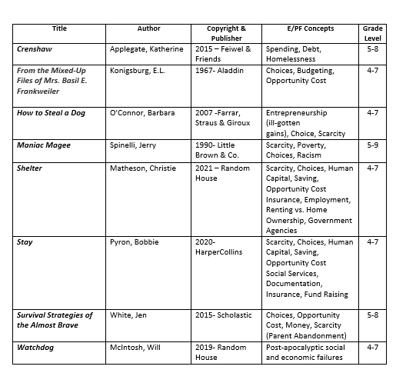



Children’s Chapter Books Featuring Homelessness

Slide 29
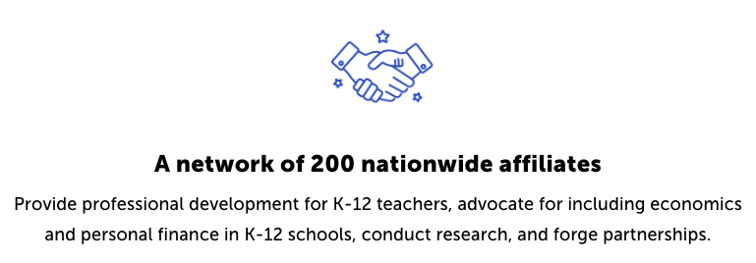
CEE Affiliates
https://www.councilforeconed.org/resources/local-affiliates/

Slide 30




Thank You to Our Sponsors!

