Slide 1
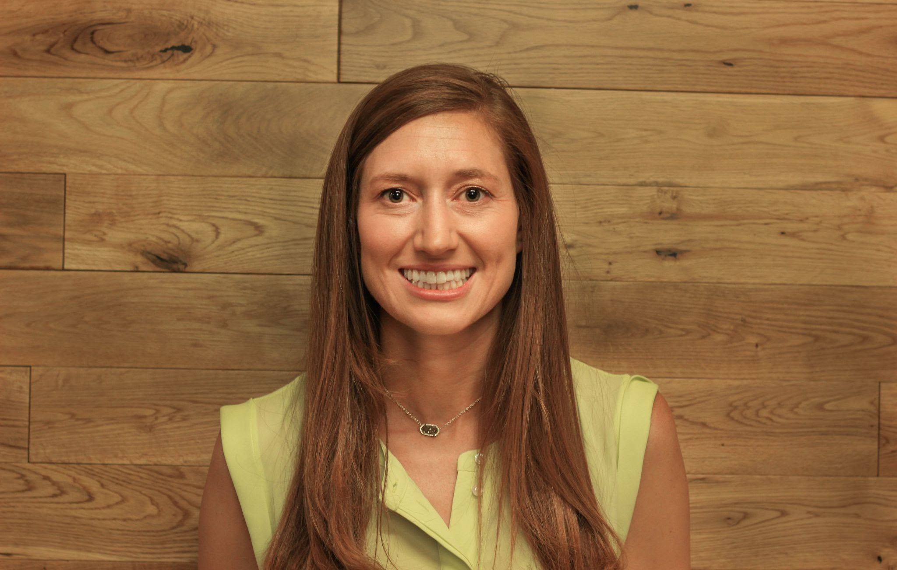
The Economics of Covid-19 and its Impact on Businesses
Presented by Susanna McConnell
May 3, 2022
Susanna.Pierce.McConnell@gmail.com

Slide 2
EconEdLink Membership
You can now access CEE’s professional development webinars directly on EconEdLink.org! To receive these new professional development benefits, become an EconEdLink member. As a member, you will now be able to:
Automatically receive a professional development certificate via e-mail within 24 hours after viewing any webinar for a minimum of 45 minutes
Register for upcoming webinars with a simple one-click process
Easily download presentations, lesson plan materials and activities for each webinar
Search and view all webinars at your convenience
Save webinars to your EconEdLink dashboard for easy access to the event
You may access our new Professional Development page here

Slide 3
Professional Development Certificate
To earn your professional development certificate for this webinar, you must:
Watch a minimum of 45-minutes and you will automatically receive a professional development certificate via e-mail within 24 hours.
Accessing resources:
You can now easily download presentations, lesson plan materials, and activities for each webinar from EconEdLink.org/professional-development/

Slide 4
Agenda
Who are you? Regional Insights
Covid-19 Impacts on Businesses
  Class Tasks: Warm Ups
  Student Project: Company Case Study
    Research, Product, Presentations, Absences
  Extension Activities
Reflection

Slide 5
National Standards
Standard 2: Effective decision making requires comparing the additional costs of alternatives with the additional benefits.
Standard 14: Entrepreneurs take on the calculated risk of starting new businesses, either by embarking on new ventures similar to existing ones or by introducing new innovations.

Slide 6
AP Standards
PRD-3.1: Firms’ production and cost constraints over different input and output levels shape optimal decisions in the short run and long run.
PRD-2: Firms’ short-run decisions to produce output, and long-run decisions to enter or exit a market, are based on profitability.

Slide 7
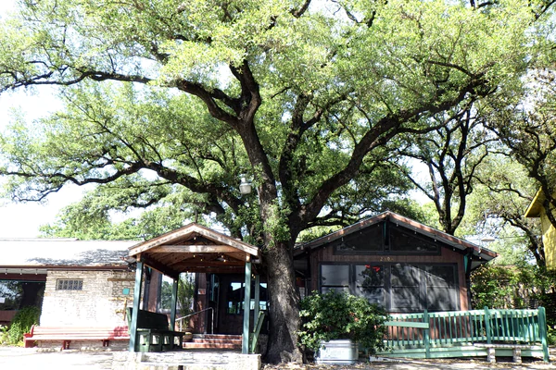
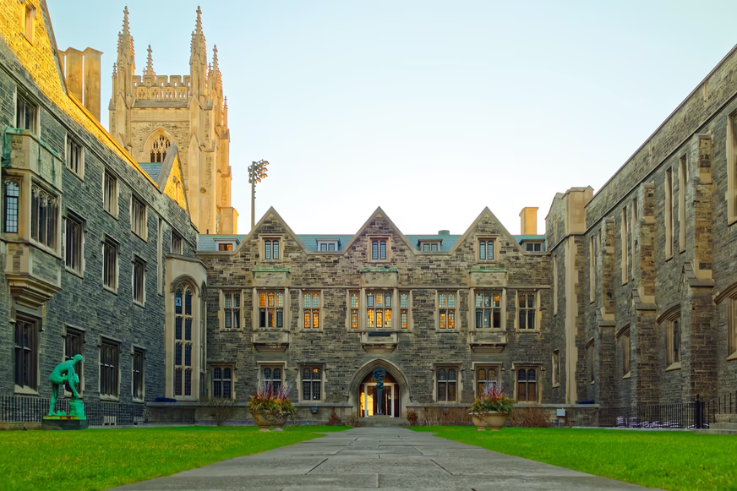

Let’s connect!
Where are you from, and what business shut down since March 2020?
Add your response in the Chat box!

Slide 8
Objectives
Participants will:
  discover economic terminology associated with Covid-19 and business impacts.
  learn strategies to facilitate student thinking and discussions about businesses during and after Covid-19.
  connect with relevant media associated with impacts on businesses from Covid-19.
  reflect on the implementation into their own classroom.

Slide 9
Part 1: Warm Ups
How can you engage students when introducing Covid-19 and its impact on businesses?
Content Connections and Pre-Thinking Activities

Slide 10
Background Content
Unemployment
Government Intervention
Opportunity Costs
Explicit Costs
Implicit Costs
Revenue, Profits
Fixed and Variable Costs
Theory of the Firm
  PC Firm, MC Firm, Oligopoly, Monopoly

Slide 11

How can you use videos to introduce business impacts to students?
Restaurant Industry
Restaurants faced tremendous challenges during Covid-19 and had to shift their operations.

Slide 12
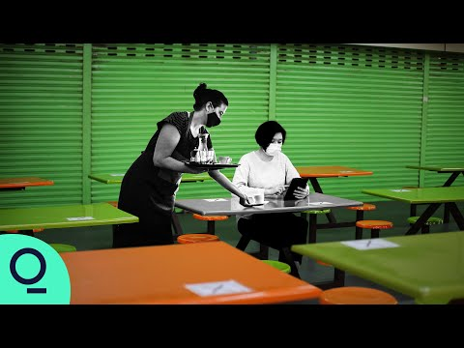
Warm Up #1: Restaurants
What, So What, Now What
What interesting facts did you hear in the video?
So what was the biggest challenge the restaurants faced?
Now what do you think the biggest impact on restaurants will be?
Bloomberg: City Lab

Slide 13
Warm Up #2 Poll:
I feel safe dining indoors at a restaurant now.
National Restaurant Association
Add your response in the chat box!
1- Strongly Agree, 2- Agree, 3- Disagree, 4- Strongly Disagree

Slide 14
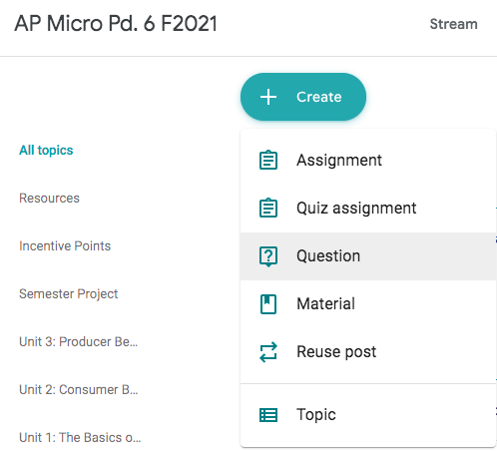
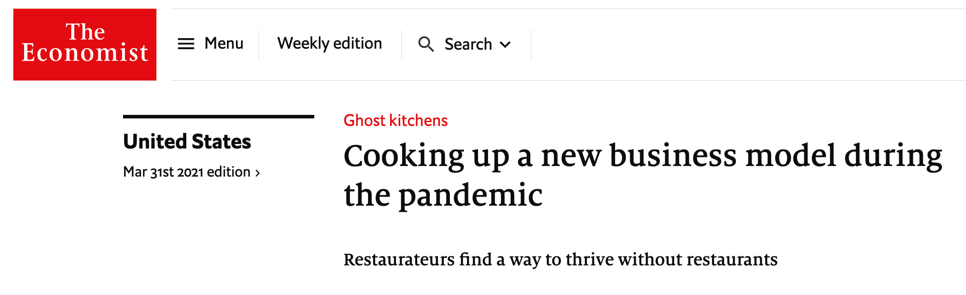
Warm Up #3: How did the restaurant industry have to shift during Covid-19?
Google Classroom Question
Ghost Kitchens

Slide 15
Part 2: Student Project
How can you investigate business impacts during and after Covid-19?
Research Based Project

Slide 16
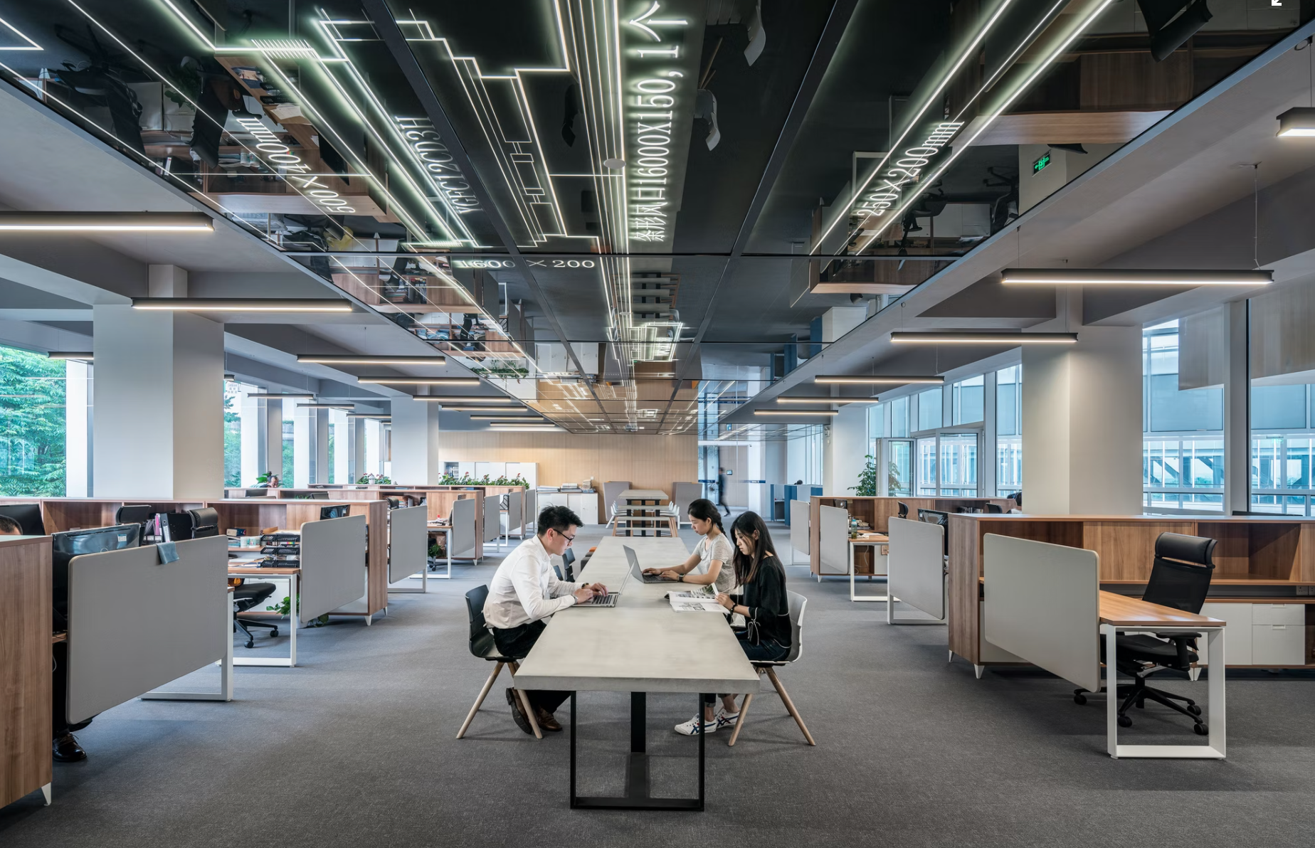
Project Overview
Students…
Sign up for a company of choice.
Research the company.
Compile a slide show.
Present in round tables.

Slide 17
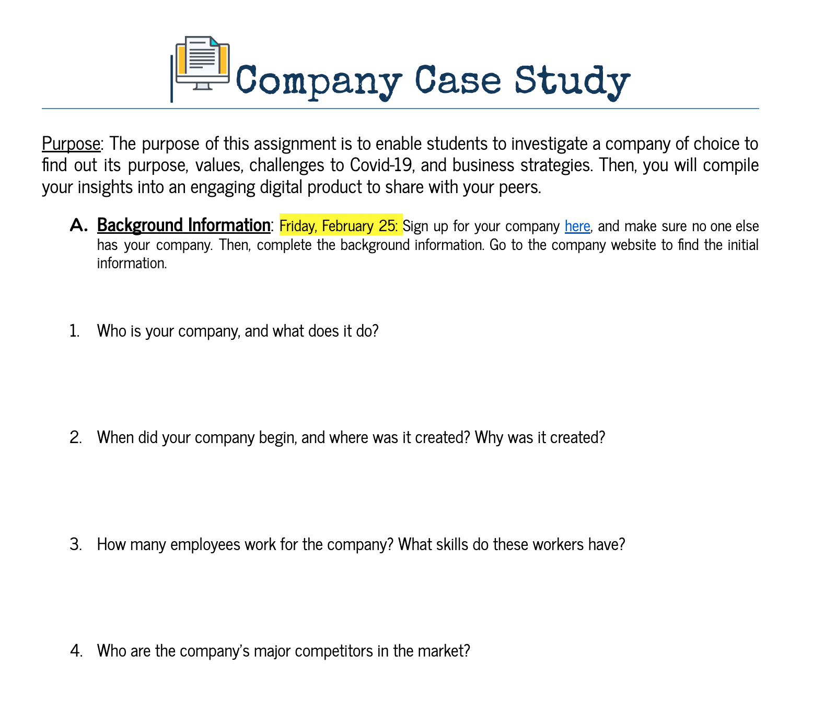
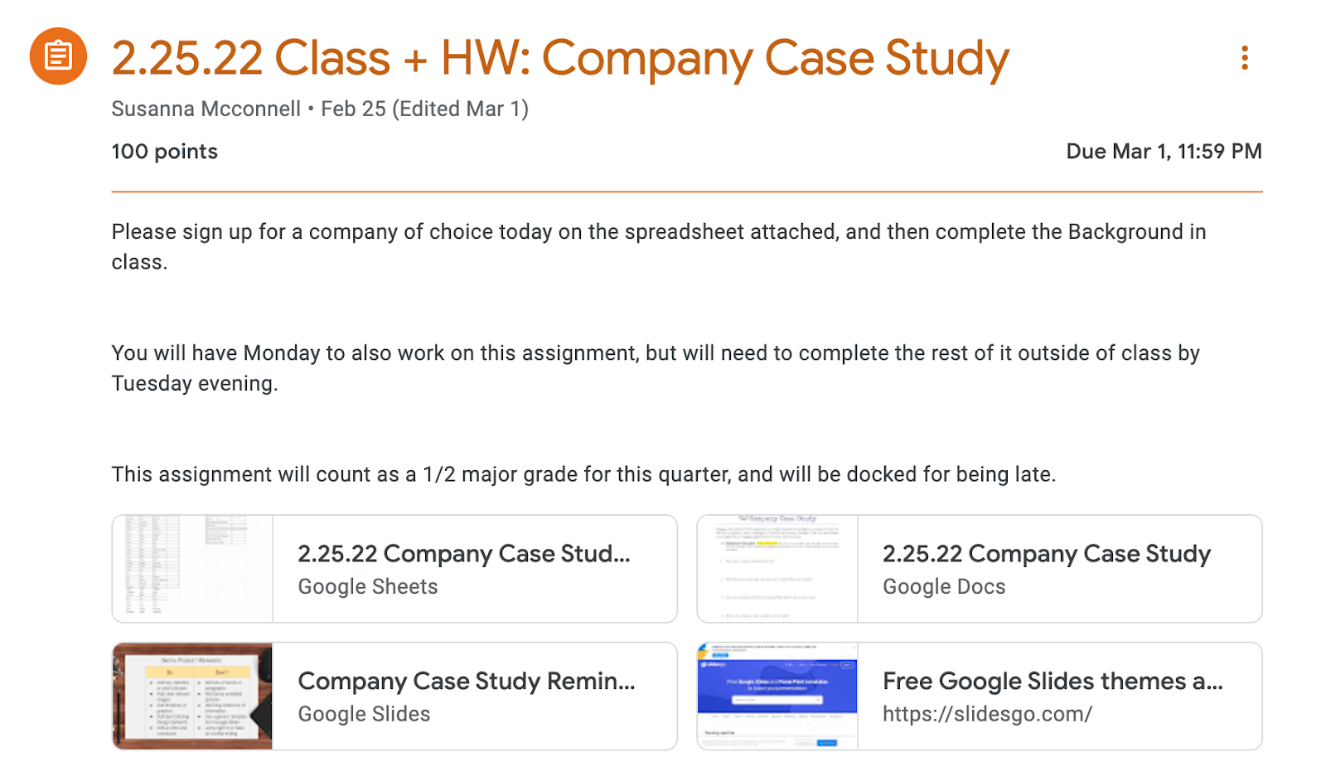
Company Case Study Assignment

Slide 18
Research Explained
Day 1: Sign up for company.
Day 1: Part A - Background + Part B - Current Stats
  HW: Finish Part B
Day 2: Class: Part C - Current Event + Slides Creation
  HW: Finish Slides Creation
Day 3: Slides Creation + Rehearsal (Optional)

Slide 19
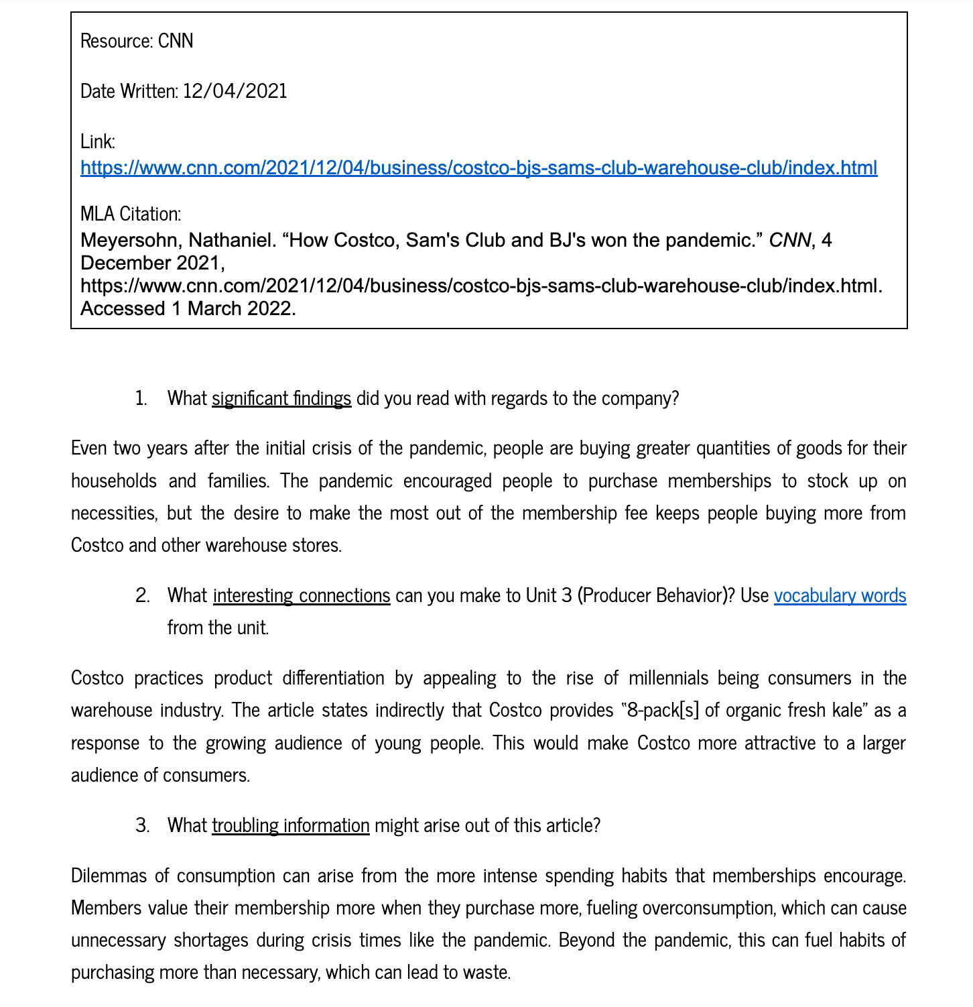
Student Example

Slide 20
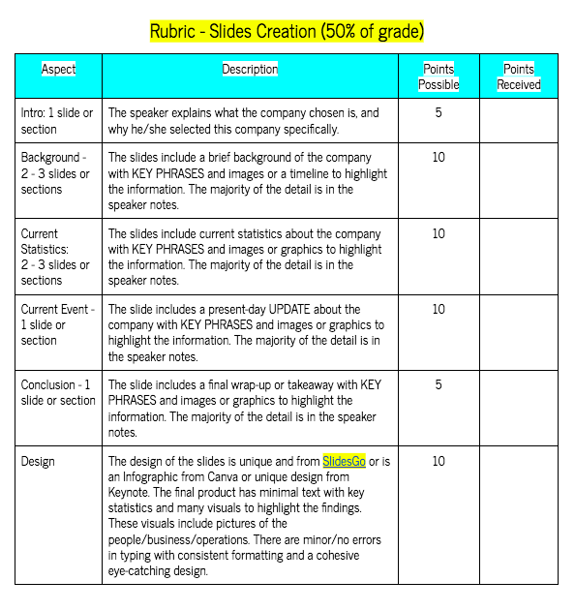
Presentation Explained
Select a template from SlidesGo.
Organize research into 8-10 slides with minimal text.
Add relevant detail in speaker’s notes.

Slide 21
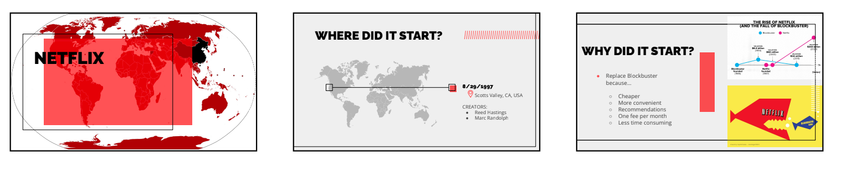
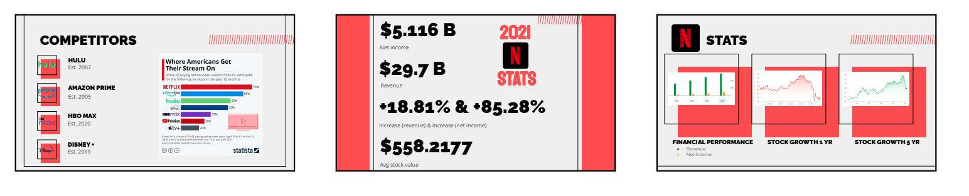
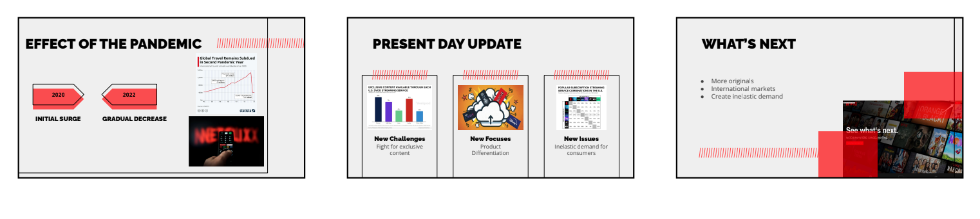
Presentation Example

Slide 22

Participant Chat:
What show did you binge on Netflix, Hulu or Amazon in the past 2 years?
Add your response in the chat box.

Slide 23
Part 3: Round Table
How do you share student research in a class setting?
Round Table

Slide 24
Activity Overview
Create 3-4 groups of 8 -9 people.
Print digital notes template.
Set the ground rules.
Walk around to listen to groups.

Slide 25
Round Table Directions
Select a facilitator and timekeeper per group.
Begin 6 minute round.
Presenter has 4 minutes to share, and 2 mins for questions.
  Listener: Write 4 facts + 1 question
Repeat.
Everyone answers the reflection question.

Slide 26
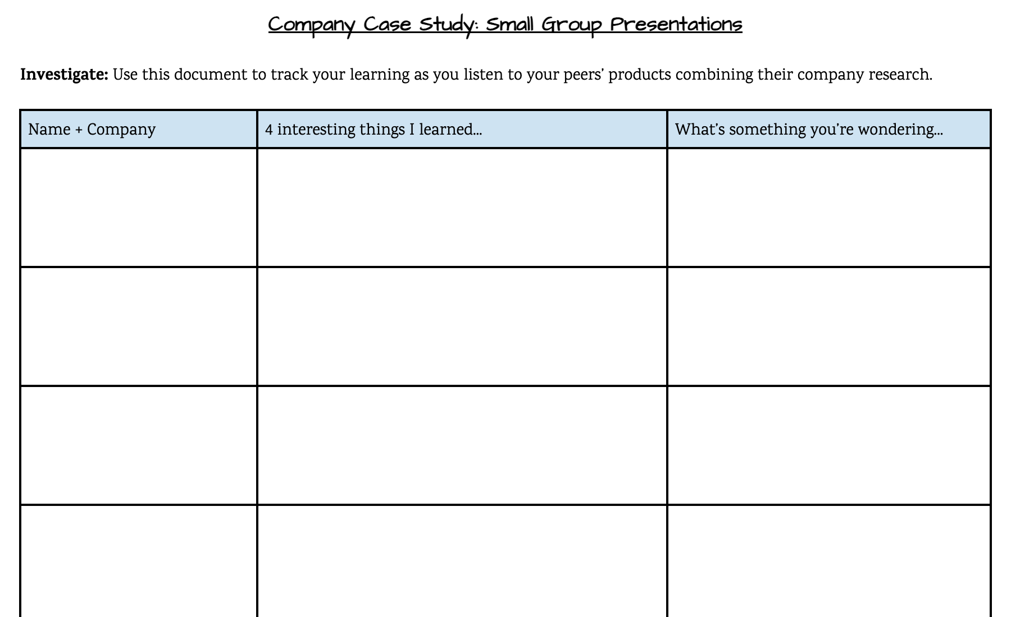
Notes Template

Slide 27
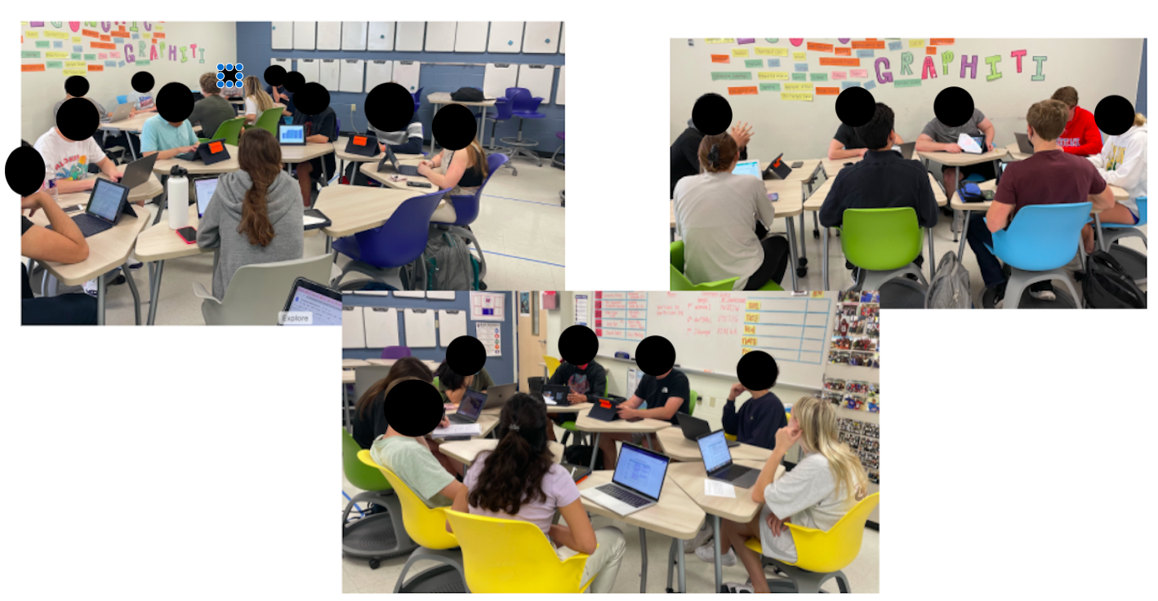
Round Table In Action

Slide 28
Make-Up for Round Table
Student Example: Loom
Students record their presentations using Loom or Screen-recording on IPADs.

Slide 29
Part 4: Extension Activities
How can students connect with media about business impacts?
Real-World Application Days

Slide 30
Real World Application
 | Podcasts | Videos | Articles
RESOURCE | NPR: The Indicator: Get Your Plane Ticket Soon NPR: Pandemic on Music Venues + Insurance NPR: The Indicator: Office Spaces to Homes | Reopen: Austin Restaurant Docu-Series | The Economist: Ghost Kitchens
STRATEGY | What did you hear? What do you think are economics connections? What do you now wonder? | How does this connect to what we’ve been studying? How did this episode extend your thinking? What do you think was the greatest challenge the industry faced? | Main Idea and Meme

Slide 31
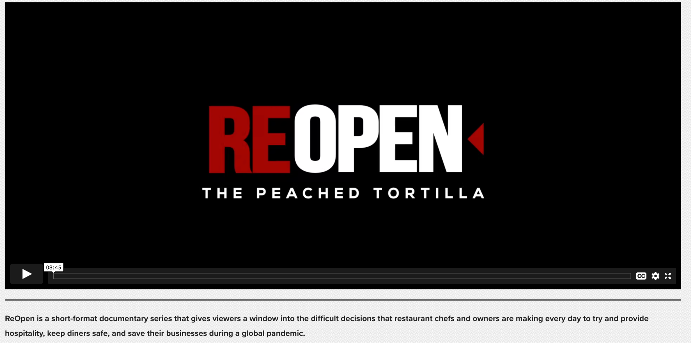
Re Open

Slide 32
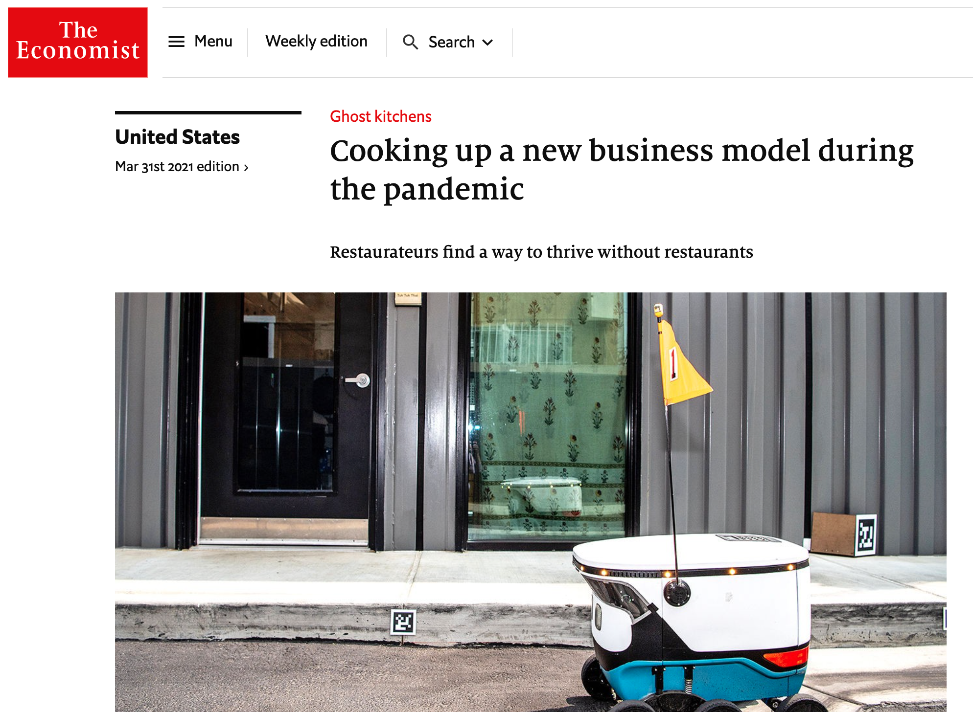
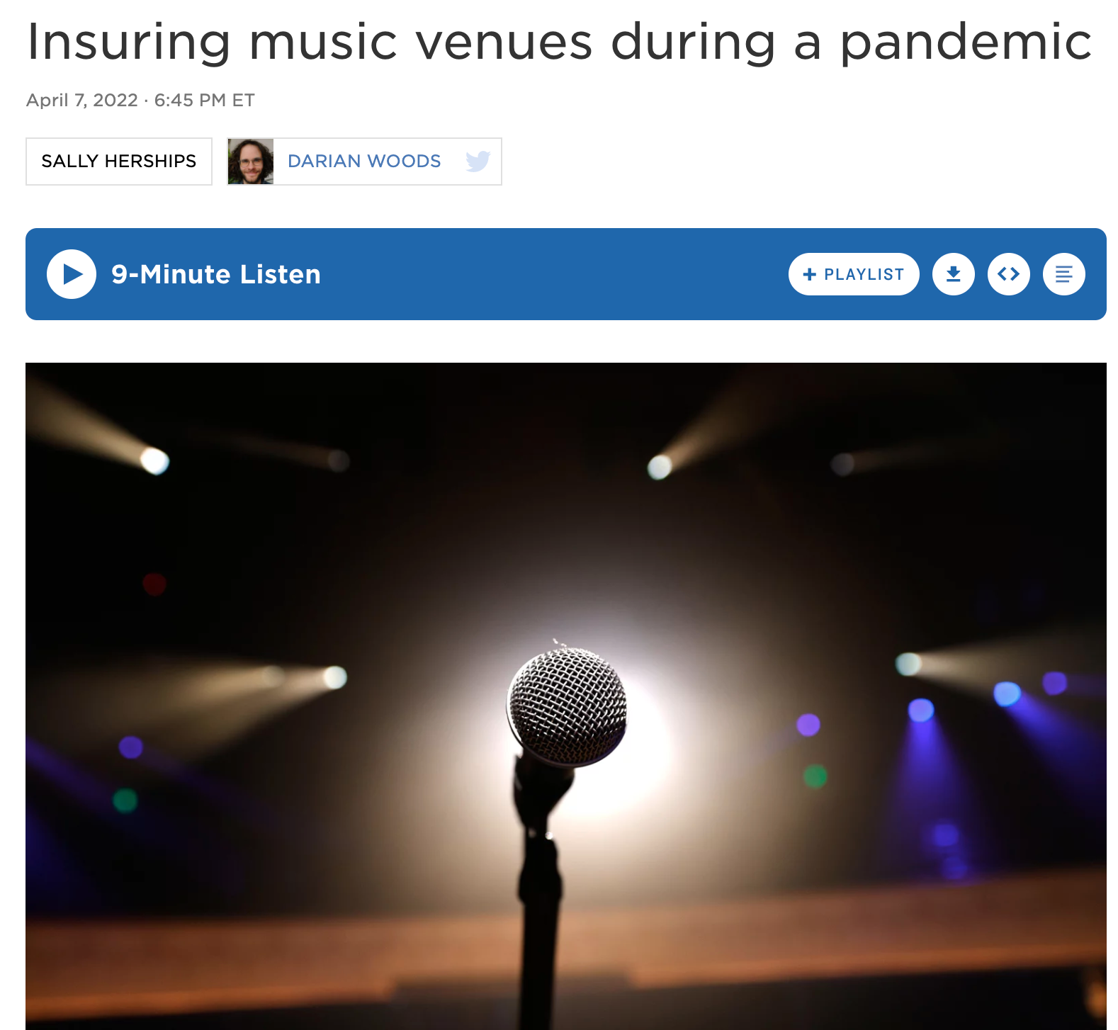
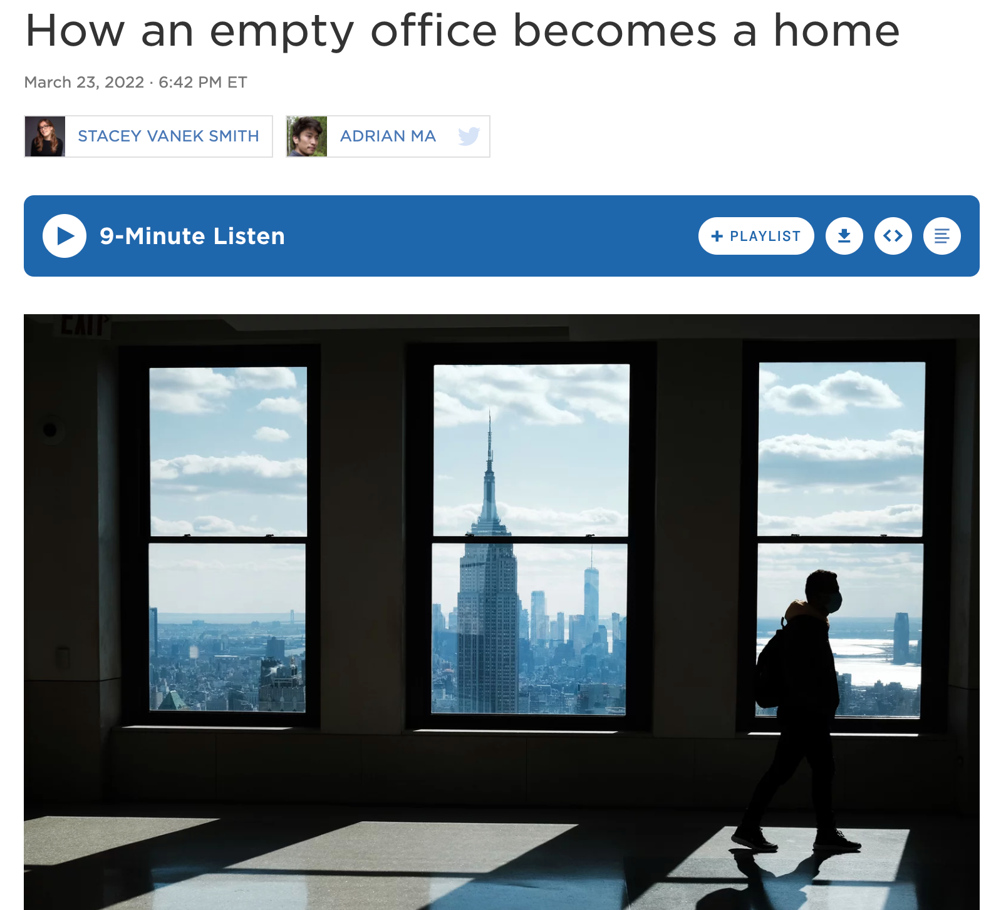
Relevant Media

Slide 33
Review
Strategies for Integrating Covid-19 and Business Impacts
Warm Ups
  Think, Pair, Share
  Poll
  Google Classroom Analysis
Company Case Study
  Sign Up
  Research
  Digital Compilation
Student Showcase
  Round Table
  Individual Recording
Real World Application
  Podcast, Video, Article
    Hear, Think, Wonder
    Connect, Extend, Challenge
    Main Idea + Meme

Slide 34
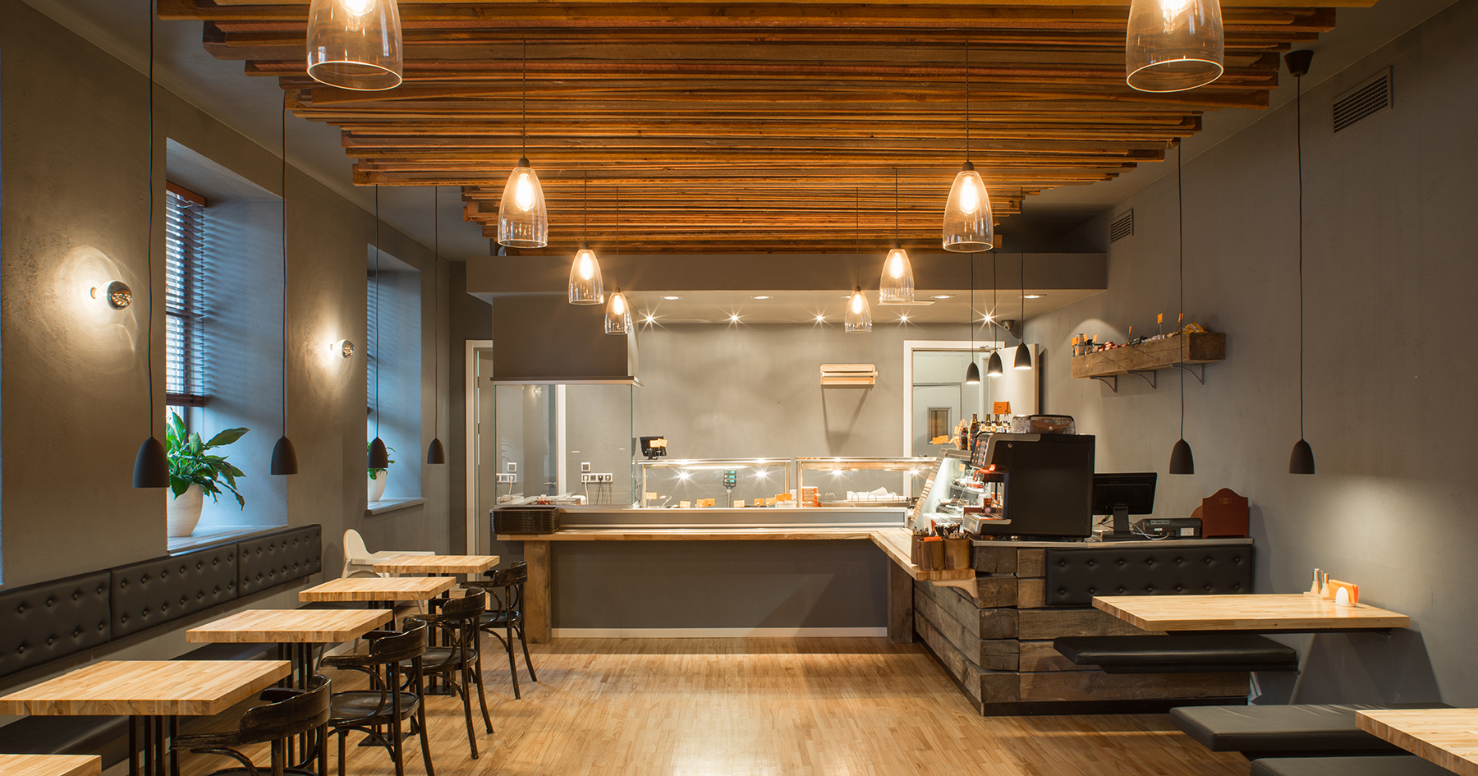
Reflect
How can you use these ideas in your classroom?
Add your response in the chat box.

Slide 35
References
Bloomberg: How Covid-19 Might Make Restaurants Better
The Economist: Ghost Kitchens
NPR: The Indicator: Get Your Plane Ticket Soon
NPR: Pandemic on Music Venues + Insurance
NPR: The Indicator: Office Spaces to Homes
Reopen: Austin Restaurant Docu-Series
Susanna Pierce McConnell: TPT Store - Covid-19 Restaurant Research
Unsplash Photos

Slide 36

CEE Affiliates
https://www.councilforeconed.org/resources/local-affiliates/

Slide 37




Thank You to Our Sponsors!

