Slide 1
Tips and Techniques to Help Your Students Pass the A.P. Economics Tests
Presented by Steven Cullison
Date 4/11/22 steven.cullison@edinaschools.org

Slide 2
EconEdLink Membership
You can now access CEE’s professional development webinars directly on EconEdLink.org! To receive these new professional development benefits, become an EconEdLink member. As a member, you will now be able to:
Automatically receive a professional development certificate via e-mail within 24 hours after viewing any webinar for a minimum of 45 minutes
Register for upcoming webinars with a simple one-click process
Easily download presentations, lesson plan materials and activities for each webinar
Search and view all webinars at your convenience
Save webinars to your EconEdLink dashboard for easy access to the event
You may access our new Professional Development page here

Slide 3
Professional Development Certificate
To earn your professional development certificate for this webinar, you must:
Watch a minimum of 45-minutes and you will automatically receive a professional development certificate via e-mail within 24 hours.
Accessing resources:
You can now easily download presentations, lesson plan materials, and activities for each webinar from EconEdLink.org/professional-development/

Slide 4
Objectives
Efficiently plan instruction to best prepare students for the economics AP Tests
Provide useful tips to students for their independent test preparation

Slide 5
National Standards
List corresponding Nat'l Content Standards in Economics from >
https://www.councilforeconed.org/wp-content/uploads/2012/03/voluntary-national-content-standards-2010.pdf

Slide 6
State Standards
List corresponding regional standards you may have > http://www.nysed.gov/curriculum-instruction

Slide 7
Before the Test
Make your tests authentic
  Use test questions provided by AP
The demand for money increases when national income increases because
spending on goods and services increase
interest rates increase
the budget deficit increase
the money supply increase
the public becomes more optimistic about the future
Notes:
The truth is, for all of the strategies that students may employ during the test, our success is mostly determined in months before the exam. And while it may be too late to act on some of the suggestions that I’m going to make in this section, they may serve you well in future years.
First, I encourage you to make your tests as similar to the AP tests themselves as possible. How do we do this?
- Use tests provided by AP. It’s an unfortunate truth that many of the questions on the AP Micro and Macro tests are worded in unnecessarily complex ways. Experience with these wordings, which may sometimes differ from those you used in instruction, will help to put students at ease during the exam.
Here’s an example: “The demand for money increases when national income increases because…” Now here’s the thing - when I taught this concept in AP Macro, I talked about how increases in GDP or output lead to increases in the demand for money. And so I might be tempted to reword the question, in the interest of fairness…

Slide 8
Before the Test
Make your tests authentic
  Use test questions provided by AP
The demand for money increases when GDP increases because
spending on goods and services increase
interest rates increase
the budget deficit increase
the money supply increase
the public becomes more optimistic about the future
Notes:
There. My students will have an easier time with the question, worded like this, because it fits how we usually talked about it in class. It seems fairer. Except that, when they encounter an alternate way of expressing the concept on the real test, they won’t be prepared! So I recommend keeping the original wording and, ideally, giving students practice with multiple wordings in advance of testing, or you can do this:

Slide 9
Before the Test
Make your tests authentic
  Use test questions provided by AP
The demand for money increases when national income (GDP) increases because
spending on goods and services increase
interest rates increase
the budget deficit increase
the money supply increase
the public becomes more optimistic about the future
Notes:
If you’re writing your test and realise that you have a question which AP has released but which uses a wording you haven’t, provide your own wording in parenthesis as a teachable moment. Kind of a compromise.
Another note on using questions provided by AP rather than writing your own: AP test questions always include 5 choices. I find that when teachers write their own sometimes they only include 4.

Slide 10
Before the Test
Make your tests authentic
  Use test questions provided by AP
  Make them timed
Notes:
On the AP tests, for the MC section, students must answer 60 questions in 90 minutes. That’s a minute and a half per question. First off, students should have experience working under that time pressure, so you shouldn’t provide unlimited time. Due to the constraints of class length, many of us likely already do this.
Less obviously, we should work hard to provide enough time. If your tests are too long, students will develop a habit of rushing more than they should, which will also be problematic at test time. Try to write tests of such length that students have 90 seconds per question.

Slide 11
Before the Test
Make your tests authentic
  Use test questions provided by AP
  Make them timed
  Make them cumulative
Notes:
This, honestly, is one that, other than my final, I haven’t implemented. But I’ve spoken to others who have, and it is a great idea. One of my ultimate goals in my testing is that students have an accurate understanding of their level of readiness for the test. Another way of looking at it: we should be able to predict with some accuracy how students will do on the AP test. Usually, though, even if we use questions provided by AP, students do better on our own tests. Why? Some of it may be lower anxiety, or a familiar space, but it could also be this: often, our tests are tied to units. I might give an exam on resource markets, for example. And that test likely would not include any questions about production possibilities curves, even though we studied them previously. In this circumstance, students can narrow the range of possible correct answers in a way that they cannot on the AP test. On the AP test, any question could ask about anything from the whole of micro or macro economics. That’s harder, and we often don’t provide practice with that until the very end of the course.
Why not have your unit 2 test include some questions covering unit 1 content, and so forth? Yes, that means material from earlier units will be over-represented in tests. But, in exchange, your students will be more ready for the AP test.

Slide 12

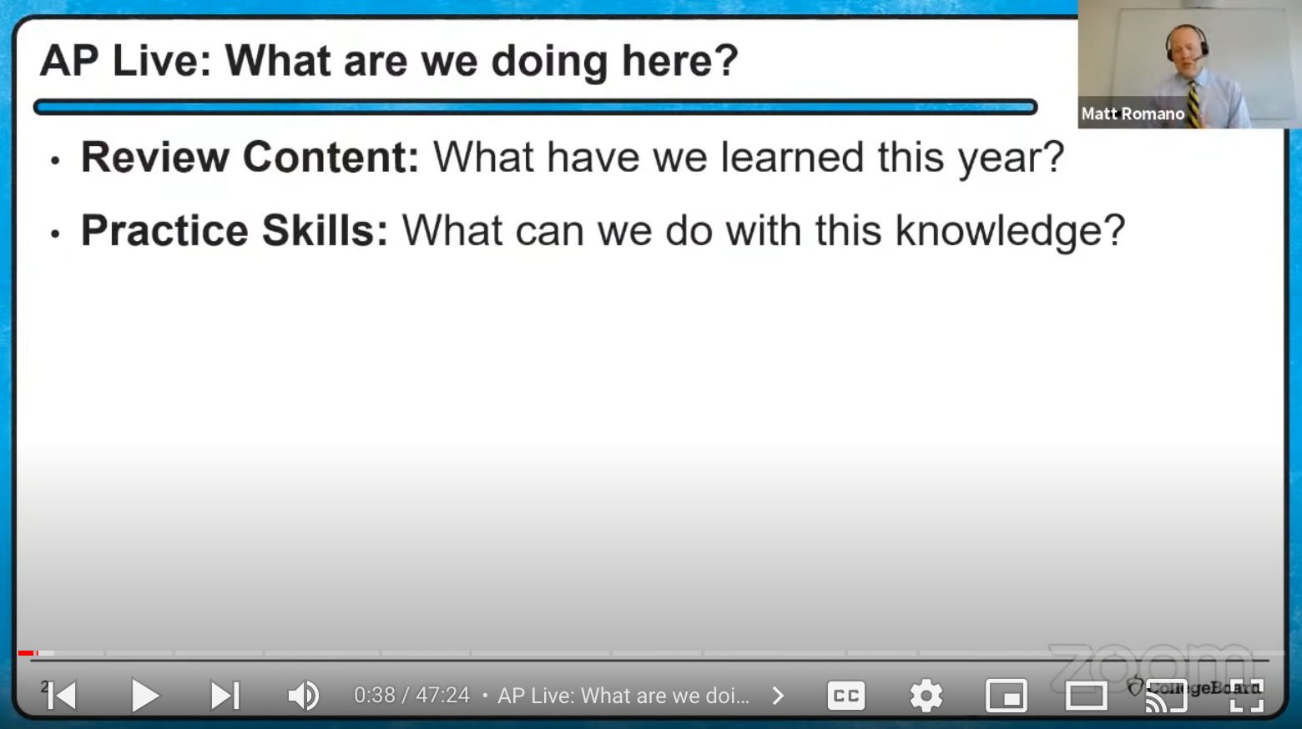
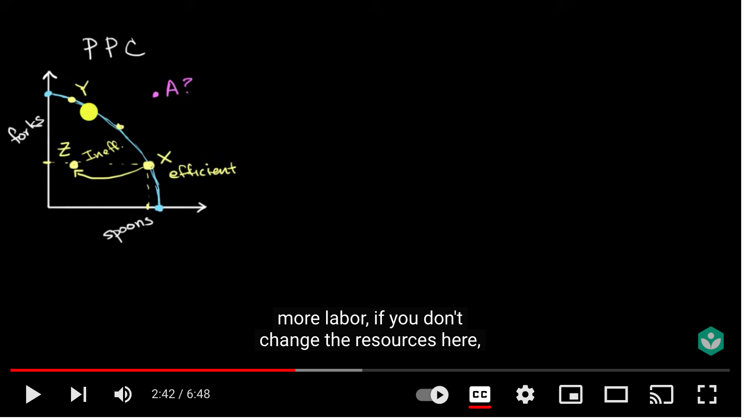
Before the Test
Provide a wide range of resources
  Screencasts made by other instructors
Notes:
Obviously, right? But let me provide some suggestions. First, many students will learn more easily, and review more quickly, from video than from text. They’ve already heard you explain the content. Maybe someone else’s way of describing something will help a student understand something that didn’t click the first time.
This teacher, Jacob Clifford, makes some excellent videos, including videos shorter than a half hour that do a pretty good job of cramming everything on the test into under a half hour.
Collegeboard has released their own videos, many on youtube and some that are found through AP classroom. While these are often longer, you can trust the accuracy of the content to be in line with the test itself.
And students will be familiar with Khan academy, another good option.

Slide 13
Before the Test
Provide a wide range of resources
  Screencasts made by other instructors
  Study guides
    Macro If/Then
Notes:
You can provide your own, of course. And many can be found with a little bit of Googling. I’m especially fond of ones which involve a bit of work by a student, one which requires them to complete it. The Macro If/Then is one I created for students to use during the test itself in a year when it was online and open-note. Already completed study guides, covering the totality of the content, are pretty overwhelming, like reading a textbook, but even denser. I wish I had more study guides of my own devising to share with you, but I don’t at this time.

Slide 14
Before the Test
Provide a wide range of resources
  Screencasts made by other instructors
  Study guides
    Macro If/Then
  ACDC Econ (Guide to Past FRQ Topics)
Notes:
One thing that students often wonder about is which topics are most deserving of their review time. In micro especially, there are a lot of graphs. Which ones are most vital to know? This website (open) archives past exams. The valuable thing here is to see which topics are asked about the most. Generously, the site solves that for us. In Micro, monopoly graphs reign supreme. In macro, unsurprisingly it’s AS/AD, or what is sometimes simply called the macroeconomic model.

Slide 15
Before the Test
Provide a wide range of resources
  Screencasts made by other instructors
  Study guides
    Macro If/Then
  ACDC Econ (Guide to Past FRQ Topics)
  Review sessions
Notes:
Longtime AP Econ teachers, especially those of us that do both micro and macro, will have noticed that the testing schedule this year is not as kind as in past years. We’re testing sooner, providing us with less prep time. For me, that may mean pushing some of my review to before and after school. All the same, I want to make the case for in-class, teacher-led review. Besides the fact that it allows for collaborative review, and is obviously beneficial, there can be an equity issue. Some students may have the ability to stay late or come in early. Maybe they can afford a car, or not to have an after school job, or don’t have to watch their younger siblings. Doing review in-class helps ensure that everyone has access. Still, if you aren’t able to fit it into the schedule, as I’m not entirely going to be able to this year, a compromise may be to stream or record your review sessions to provide some access to those who cannot be present in-person.
I encourage you to offer something in your review sessions that students can’t replicate on their own. Reteaching concepts quickly via lecture? A video can do that. Individually completed practice tests? Nah. But review sessions could be good places to answer student questions, letting them set some of the agenda. Or to communicate to students test-taking strategies. Or to provide collaborative practice. Which brings us to our last resource.

Slide 16

Practice Tests
Notes:
Among the most commonly used resources, both by educators and by students studying independently, are practice tests. I put to you that simply taking a practice test is of only moderate benefit. That said, they can be very helpful, done right. So let’s talk about what that looks like.

Slide 17
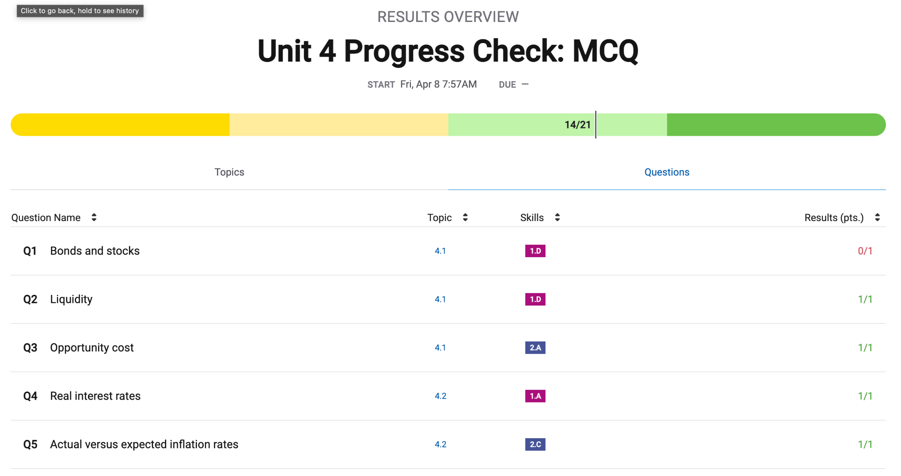
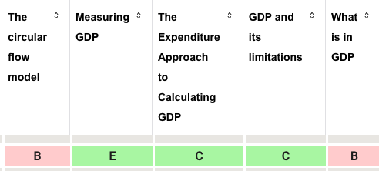
Practice Tests
informing future studies
Notes:
A practice test can be helpful if it is used to inform future studying. What I mean is this: if a student can take a practice test and, using the results, discern those topics they most need to study, then that is helpful.
But this benefit is dependent upon several things. First, there needs to be a way for students to draw patterns from their results. Early in my AP teaching days I would take a released practice exam and categorize the questions myself, creating a guide students could use. In this way, if a student missed question four, they could look and see that question 4 was primarily concerned with production possibilities curves. This, then, would suggest that this was something to go back and study.
AP Classroom makes this process a easier. Using their practice exams, you can see reports for students, indicating, for each, the questions they missed and the categories for each. In the image on this slide, a student missed a question related to stocks and bonds. Feedback like this can help students identify proper areas to focus their studying. On the other hand, maybe they shouldn’t spend time reviewing real interest rates.

Slide 18

Practice Tests
time to use the results
Notes:
The night before the test is, arguably, not the time for a practice test. If the test successfully reveals gaps in knowledge, what can you do with that information? Is there time to ask the teacher or a classmate for help? Is there time to restudy? A practice test is most valuable when students have left time to review based upon the results of the practice test.

Slide 19
Practice Tests
collaboration
Notes:
When students take practice tests in groups, they won’t get data of the sort which might help them plan future studying. Instead, this can be a great way to review content. But only if they do it right.
So often, when working in groups on tasks, students focus on getting the correct answer, and on getting it as quickly as possible. Frequently, this takes the form of a single student, perhaps the most knowledgeable or just the fastest, taking the test while everyone else goes along for the ride. This has little practical value.
One of the keys to productive group test taking is to converse. Don’t assume students will know how to do this, or remember to do this.
Here are my tips for productive conversations during collaborative test taking:

Slide 20
Practice Tests
collaboration
Use the word ‘because’ a lot.
Which of the following is true about gross domestic product (GDP)?
Calculations of GDP include the monetary value of non-market production activities such as households preparing own meals at home.
Calculations of GDP do not include the monetary value of production activities involving negative environmental side effects such as pollution.
Calculations of GDP include the monetary value of illegal production activities such as drug cartels.
Calculations of GDP include the sale of used goods.
Calculations of GDP include the unsold inventories of goods produced within the borders of the country.
Notes:
Every question, at least one person needs to say ‘I think the write answer is blank.’ Push students to follow that with a ‘because’ statement every time.
Consider this practice question. Which of the following is true about GDP? Someone could call out ‘It’s not A,’ and they’d be correct. But that statement doesn’t help their partners prepare for the upcoming test. It adds nothing to their content knowledge. If, instead, they said ‘It’s not A because GDP doesn’t include services we provide for ourselves and for which no money is exchanged,’ then that would provide or reinforce knowledge that could be used on any question on this topic.
Or maybe someone says ‘It’s B because that’s a market failure.’ This student is mistaken, but by providing insight into their reasoning, it’s easier for the students to embark on a discussion about why this is wrong. This discussion, by the way, will benefit all of the students, not just the one whose understanding was lacking. The act of explaining an answer, of teaching, is excellent for reinforcing learning.
Finally, someone would say ‘It’s E because unsold inventories are included as a part of Investment.’
This approach takes a lot more time. If students see a practice test as a task to be completed, then this will seem inefficient. If they see that the purpose of the activity is to prepare to get a higher score on the test, then they may understand that this is, in fact, a very efficient way to do it.

Slide 21
Practice Tests
collaboration
Use the word ‘because’ a lot.
Leave no one behind
Notes:
Students need to take responsibility for each other’s learning and test preparation when collaborating on practice tests. No one has all of the information, and everyone has something to contribute. It’s worthwhile to explicitly communicate this responsibility. And how will students make sure they leave no one behind?

Slide 22
Practice Tests
collaboration
Use the word ‘because’ a lot.
Leave no one behind
  Give everyone time to read and solve each question independently before beginning to discuss answers.
Notes:
It’s so common that someone will read faster, or process faster, and call out an answer. This has several negative effects. First, most obviously, it robs other students of the chance to try it themselves. Second, as a result, other students may stop even trying to read or solve the questions. Being fastest isn’t what’s important. Again, completion isn’t the goal in this activity; it’s learning.

Slide 23
Practice Tests
collaboration
Use the word ‘because’ a lot.
Leave no one behind
  Give everyone time to read and solve each question independently before beginning to discuss answers.
  Don’t move on from a question until everyone understands the reasoning.
Notes:
And, at the other end, groups shouldn’t move on to the next question until everyone in the group understands how to find the right answer.

Slide 24
Practice Tests
collaboration
Use the word ‘because’ a lot.
Leave no one behind
Protect each other’s confidence
Notes:
I left out a third problem that occurs when a single student provides the answers while others are still working: it’s potentially harmful to the confidence of the other students. Unfortunately, many of us associate intelligence with speed. When someone takes longer on a task, they perceive themselves as less capable. Giving each other time to succeed helps to protect their confidence, valuable on a test and for its own sake.
To this end, students need to monitor how they interact. And you have a role in this. There are a couple of common phrases that students use which I suggest you discourage.

Slide 25
Practice Tests
collaboration
Use the word ‘because’ a lot.
Leave no one behind
Protect each other’s confidence
“This is easy!”
Notes:
As soon as I hear this, I like to explain to a student the potential harm. “If you shout that, how do you think it would feel for someone who got it wrong?”

Slide 26
Practice Tests
collaboration
Use the word ‘because’ a lot.
Leave no one behind
Protect each other’s confidence
“How can you not know that?”
“This is easy!”
Notes:
I think this one is more obviously discouraging. It’s the sort of thing my students will say to their friends, not out of malice. I like to remind students that everybody knows different things. If you know something that someone else in the group does not, it’s your job to share your knowledge, not degenerate them.

Slide 27

Practice Tests
Try to explain why the wrong answers are wrong
Notes:
I suggested that, when students collaborate on practice tests, they should use the word ‘because’ a lot. This can be useful when students are working independently as well. It forces students to consider all of the options and to examine their reasoning. If you can explain why all of the wrong answers are wrong, you can feel confident that you’ve really got the content down, and you are probably ready to teach it.

Slide 28
During the Test (Multiple Choice)
1. Try to answer the question before reading the multiple-choice options
A change in which of the following will cause a change in the supply of personal computers (PC’s) in the short run?
Notes:
This is one of my favorite techniques, and maybe one you won’t find elsewhere. I encourage students to think through the possible answers after reading the question, but before reading the possible solutions. Why? In my experience, some of the wrong answers can be a little tempting. AP is really good at writing wrong answers that have an element of truth in them. If, instead, students arrive at possible answers in their heads, and then proceed to consider the multiple choice options, they will be less susceptible to grabbing something that simply sounds good.
So let’s think, which are things that affect the supply of a good? Costs and availability of inputs, prices of other things we could sell, governmental regulations and business taxes, changes in technology, productivity of resources. That’s a good list. Now let’s read my choices to see if any of them are there.

Slide 29
During the Test (Multiple Choice)
1. Try to answer the question before reading the multiple-choice options
A change in which of the following will cause a change in the supply of personal computers (PC’s) in the short run?
Demand for PC’s
Price of disks, which are a complement to PC’s
Technology
Price of PC’s
Consumer’s incomes
Notes:
And one of them is! C - technology.

Slide 30
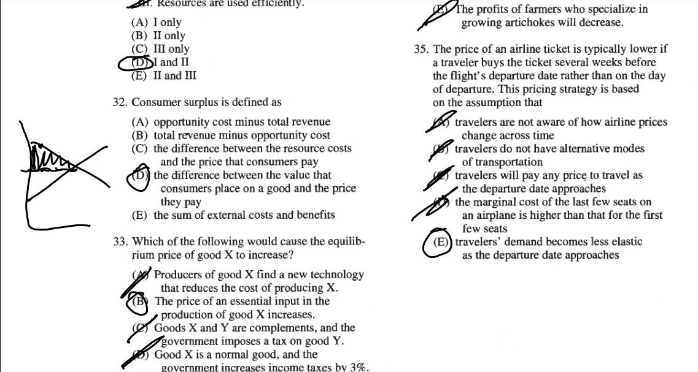
During the Test (Multiple Choice)
2. Write all over the test booklet
Notes:
This hint is one likely many of you will have though of on your own. Students too may gravitate to this naturally. But we can prepare students to be successful using this technique. If you’re like me, to save paper, you print a class set of test booklets and re-use them over the course of test day. Maybe you have multiple versions of the test. Still, I for one used to ask students not to write on my tests, so as not to give hints to those students who would use the same booklet in later class periods. But this approach, while saving paper, is preventing my students from gaining authentic practice with a useful test-taking technique. Thus, if you are willing to pay the cost in paper, providing opportunities for students to take tests and allowing them to write all over the tests, crossing out answers they know are wrong; drawing little pictures of the curves, they will benefit.

Slide 31
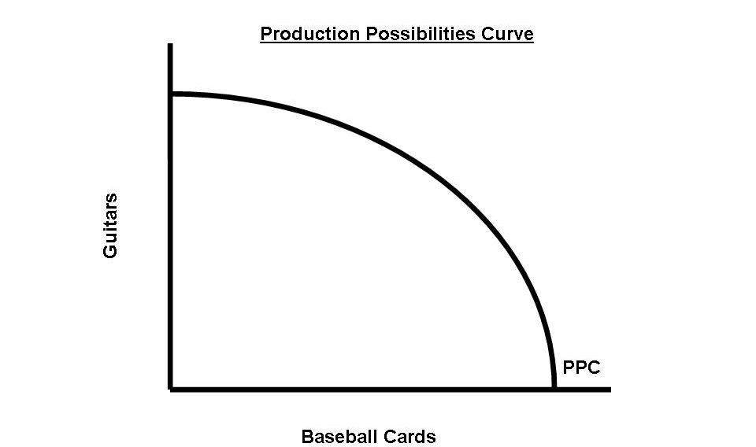
During the Test (Multiple Choice)
3. Check out graphs elsewhere on the test
Notes:
Say question 1 asks you about perfectly competitive firms. It may be that question 34 includes a drawing of the cost curves associated with these firms and could help. This strategy is really useful on unit tests, when there are a larger number of questions around a smaller number of topics, but it can help on the AP test itself. When college board draws a graph, you can trust its accuracy.
As an aside, whatever nation only produced guitars and baseball cards… 9th grade me would very much like to live there.

Slide 32
During the Test (Multiple Choice)
AP provides the following additional tip:
Remember you can answer the questions in any order
Notes:
I can’t take credit for this one. It is provided by the testmakers themselves:
Some students may prefer to skip and come back to questions they’re unsure of. Others may risk bubbling in the wrong spots if they do this. I suggest students only do this if they are already in the habit of using the technique.

Slide 33
During the Test (FRQ)
1. Label everything!
Assume the economy of Andersonland is in a long-run equilibrium with full employment. In the short run, nominal wages are fixed.
Draw a correctly labeled graph of short-run aggregate supply, long-run aggregate supply, and aggregate demand. Show each of the following.
  Equilibrium output, labeled Y1
  Equilibrium price level, labeled PL1
Notes:
Students can so easily do everything right but lose credit because they failed to label lines or axis or points! What’s more, often, the question itself will inform students of the labels for lines and axis. In this example, you’re told at least two of the lines you need to include, and the labels for each axis.

Slide 34
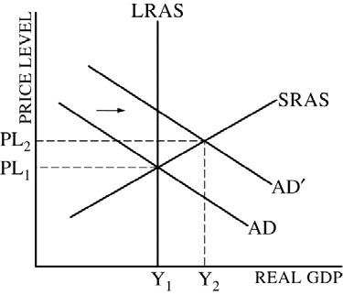
During the Test (FRQ)
1. Label everything!
Notes:
Here’s the exemplar AP Classroom provides as an answer. The question specified output, but the graph is labeled ‘real gdp.’ I believe either wolud have been acceptable.
Notice too the dotted lines. They help to show a grader how Y1 and PL1 or Y2 and PL2 were identified. Solid lines for curves, and dotted lines for reference, to show thought processes, is best practice.
Additionally, it’s clear immediately, again from the labeling, which lines occur when in time. In this FRQ, something caused an increase in aggregate demand. AD shifted right. Me, I would have used AD1 and AD2, so that my subscripts matched the labeling of points on the axis, but that’s me. Even so, the arrow and the apostrophe make it clear which AD came first and which came second. Likewise, PL2 and Y2 clearly correspond with the same moment in time.

Slide 35
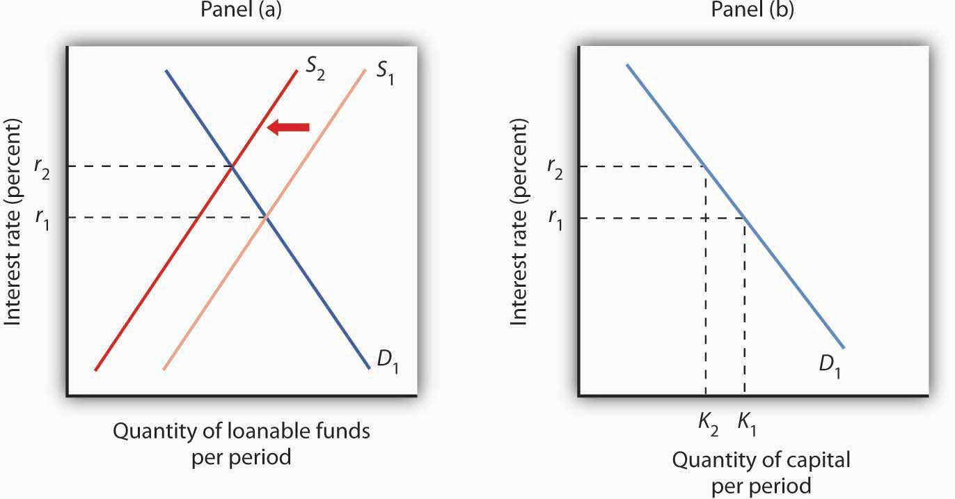
During the Test (FRQ)
1. Label everything!
Notes:
This is especially vital if you have side-by-side graphs. It’s important that it is clear which graph is which!

Slide 36
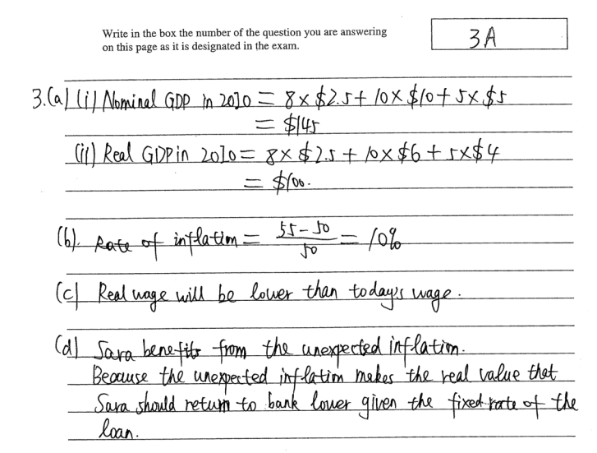
During the Test (FRQ)
Notes:
Another part of labeling is being clear which part of your answer correlates with which part of the question. The questions will be written in an outline format (3a etc.) Students need to make sure that readers know which answer goes with what. This is also a pretty good moment for students to ensure that they’ve answered all parts of the FRQ.

Slide 37
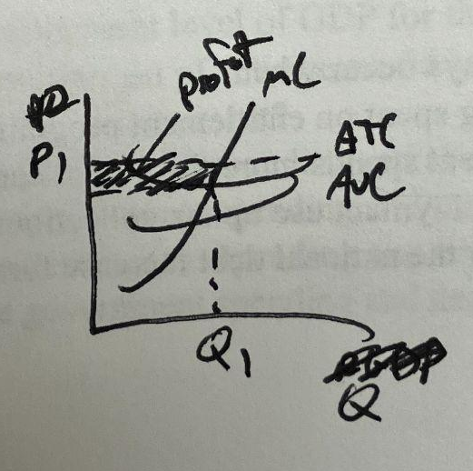
During the Test (FRQ)
2. Draw graphs as big as the space allows
Notes:
Drawing graphs bigger makes it easier to draw things clearly. It reduces the chances that unrelated lines overlap, and the test-takers intention could be misunderstood.

Slide 38

During the Test (FRQ)
3. Don’t show off
Notes:
Sometimes students will be asked for something like ‘Give one example of,’ and confident students will provide multiple answers. Or unconfident students will do so hoping at least one will land. But grading doesn’t work like that. Let’s say a question has two correct answers. If you provide both, you get the point, but you would have with either one. If you provide two answers but one is right and the other is not, you get nothing! There’s no upside.

Slide 39
During the Test (FRQ)
4. Watch for the words ‘explain’ or ‘calculate’
Notes:
When a question includes the word ‘explain,’ then students should include a because statement. Think of it like a teacher asking ‘how do you know?’ after you provide an answer. But students need to watch out for circular answers. I recently gave a test in which students needed to explain why AS would shift, bringing an economy to long-run macroeconomic equilibrium, in response to a recessionary gap. Some students responded that economies need to return to equilibrium. But that’s insufficient! Firms don’t increase output because they’re dedicated to proving this economic model to be accurate!
Likewise, if a question says ‘calculate,’ students should show their work and a number is expected as a part of the answer. It isn’t always graded, but it can be. Likewise, whether a student intends to show their work, or is simply using the paper do do the math, it’s important that students be clear about which number on the page represents their final answer. Circling is one way to do this.

Slide 40
During the Test (FRQ)
AP provides the following additional tips:
Don’t restate the question
You can draw unnecessary graphs
Notes:
One of the great things about this AP test, relative to some, is that you don’t have to write long essays. Cut to the chase. If you’re asked ‘What will happen to gross domestic product?’ A simple ‘increase’ may do!
Even if you aren’t asked to draw a graph, you could draw one to help you solve a problem. I suggest doing so to the side, or crossing it out when done.

Slide 41

Questions?

Slide 42
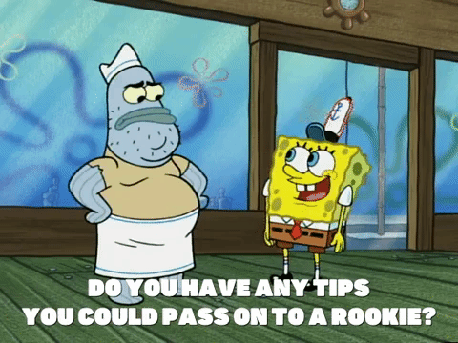
Time Permitting
Please share your favorite tip/suggestion for helping students prepare for or take an AP Econ test in the chat!

Slide 43
Assessment Questions
5 Guiding Questions (list discussion prompts)
Please also forward any supplements (worksheets, rubrics, etc) to us as attachments with your slide deck

Slide 44
References
Any links to clips, titles etc of relevant materials

Slide 45


CEE Affiliates
https://www.councilforeconed.org/resources/local-affiliates/

Slide 46




Thank You to Our Sponsors!

Slide 47

https://bit.ly/CEEConference2021

