Slide 1
Building Empathy in
Personal Finance Instruction

Slide 2
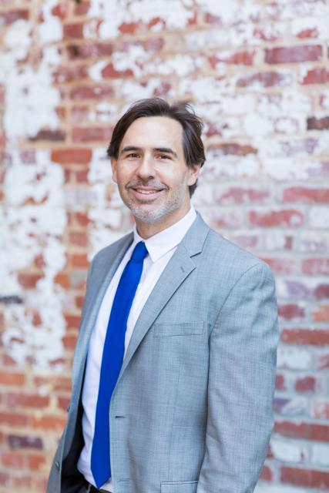
Presenter
Dr. Chris Cannon
Associate Director
Georgia Council on Economic Education
ccannon11@gsu.edu

Slide 3
AGENDA
I. Warm-up Activity
II. Why Empathy
III. The gray area of PF
IV. Actions

Slide 4
Role-playing simulation
Read an internalize the role from the slide that corresponds with your birthday month.
Listen to my Unit Intro carefully

Slide 5
Discussion points:
Can you imagine a student in your class that is similar to your slide?
How did my overall tone sound during my presentation?
How did it make YOU feel specifically when I was discussing certain topics?

Slide 7
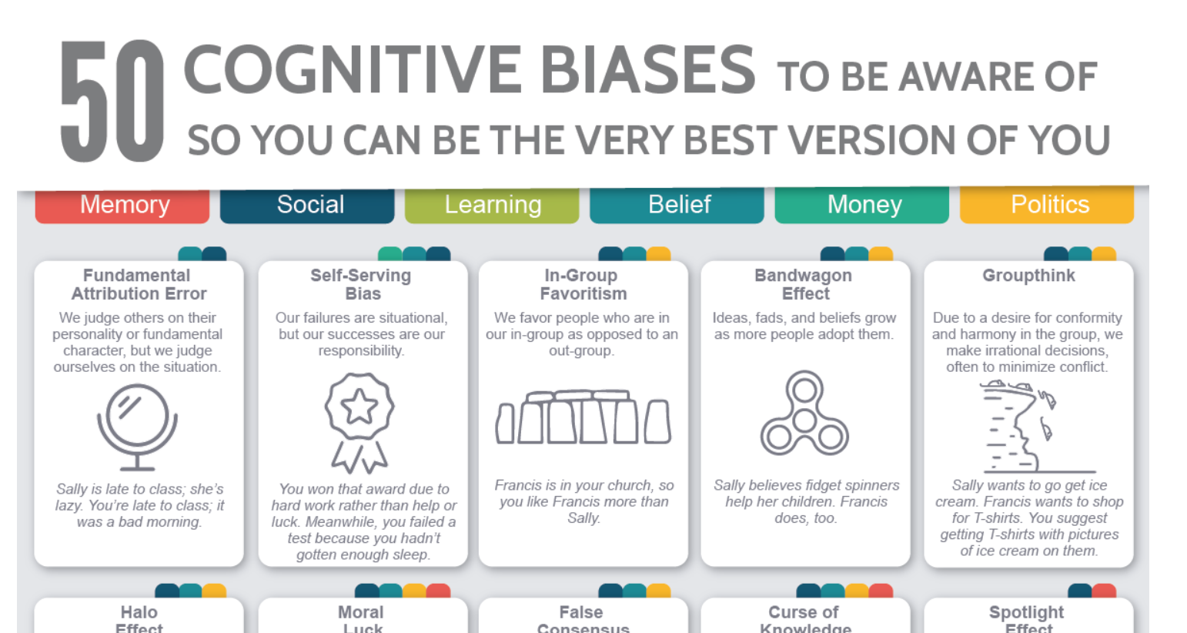
Empathy and Cognitive Bias
Empathy is closely aligned with several cognitive biases

Slide 8
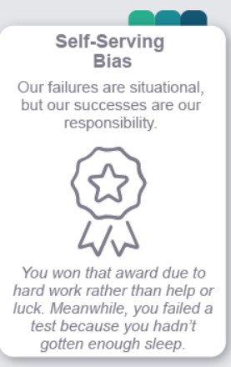

Slide 9
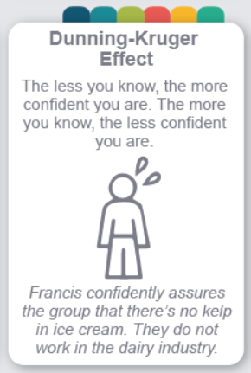

Slide 10
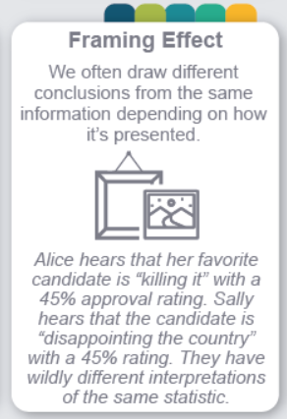

Slide 12
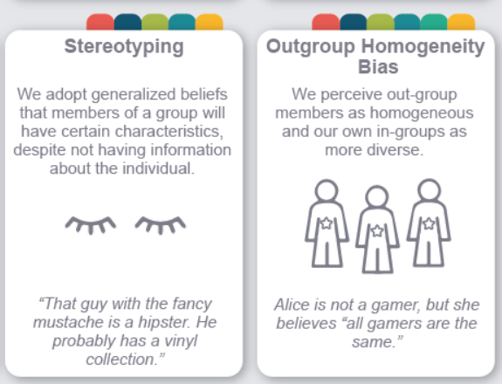

Slide 13
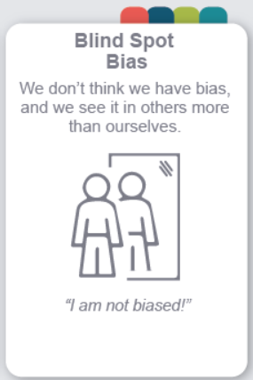

Slide 14
THE GRAY AREA of PERSONAL FINANCE

Slide 15
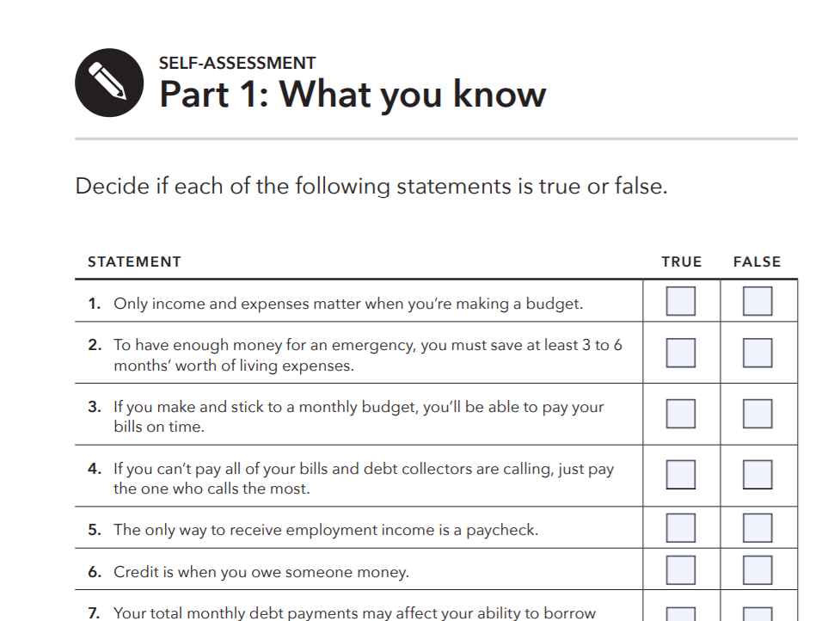
Self-Assessment
Self-
Assessment

Slide 16
Socrative
Socrative.com
Click “login” top right
Login AS A STUDENT using room code
CHRISCANNON

Slide 17
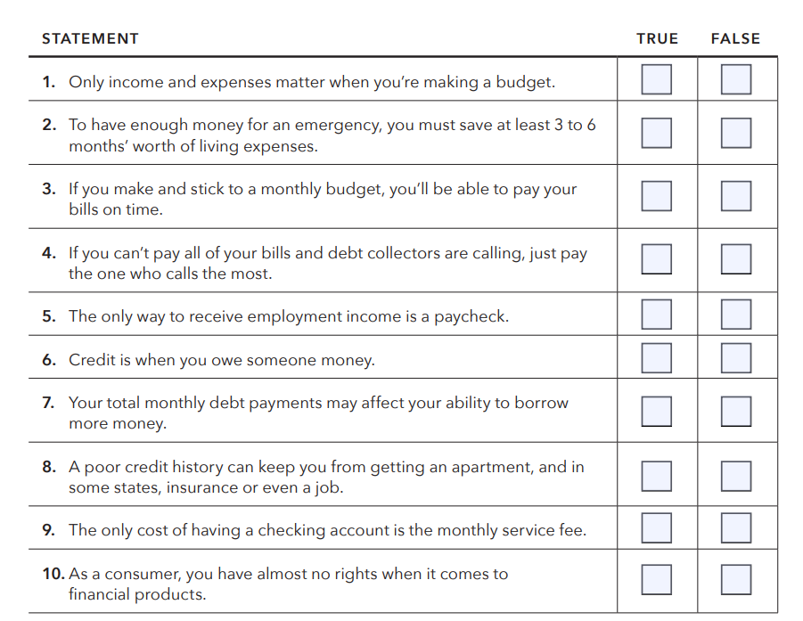

Slide 19
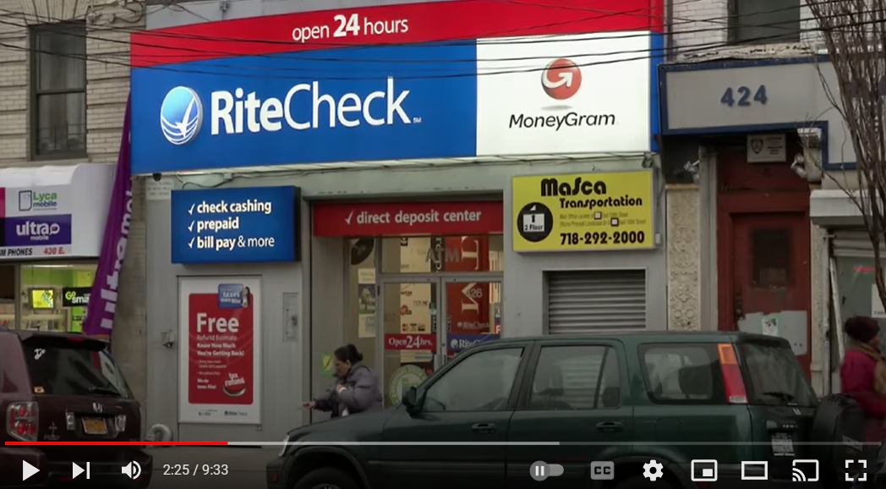
Example of the “Gray Area” when teaching PF
https://www.youtube.com/watch?v=bOdfmb7obog

Slide 20
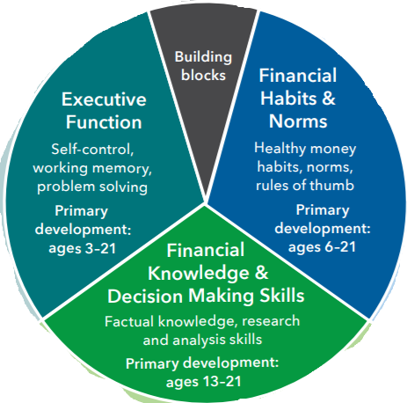

Slide 21
BE REAL
According to some studies, using real numbers and real stories has a greater impact on retention
Encourage personal sharing if comfortable

Slide 22
Watch Your Language
Reduce extremes
Not everything is good/bad
Embrace gray areas
Emphasize the importance of DECISION-MAKING

Slide 23
Judgment
It’s PERSONAL finance, not universal finance
“If it’s in your budget, don’t judge it”
Build empathy while pushing towards more positive choices

Slide 24
Once vs. Repeated
Everyone makes mistakes
One (or even a few) unhealthy choices will not likely permanently ruin your financial health
Students have the benefit of TIME!!!!

Slide 25
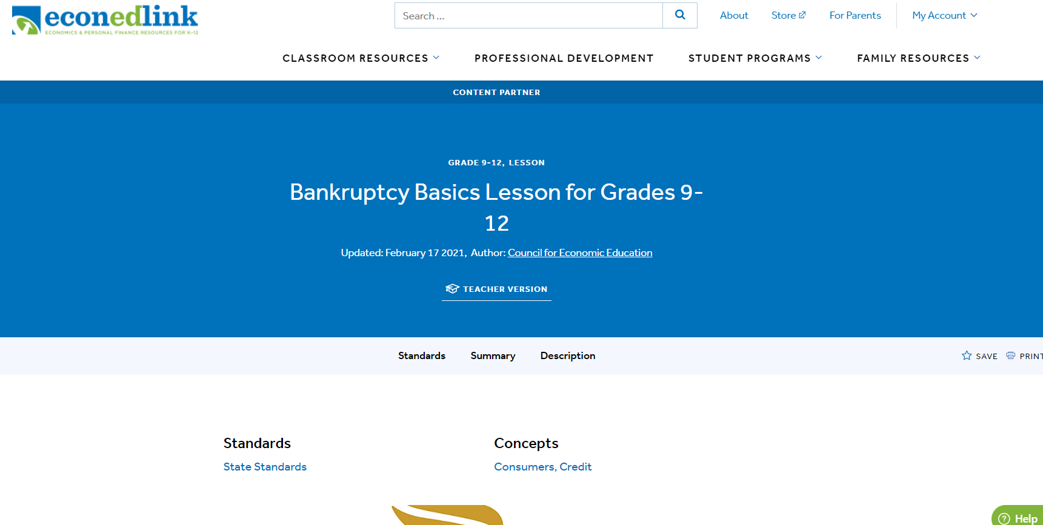
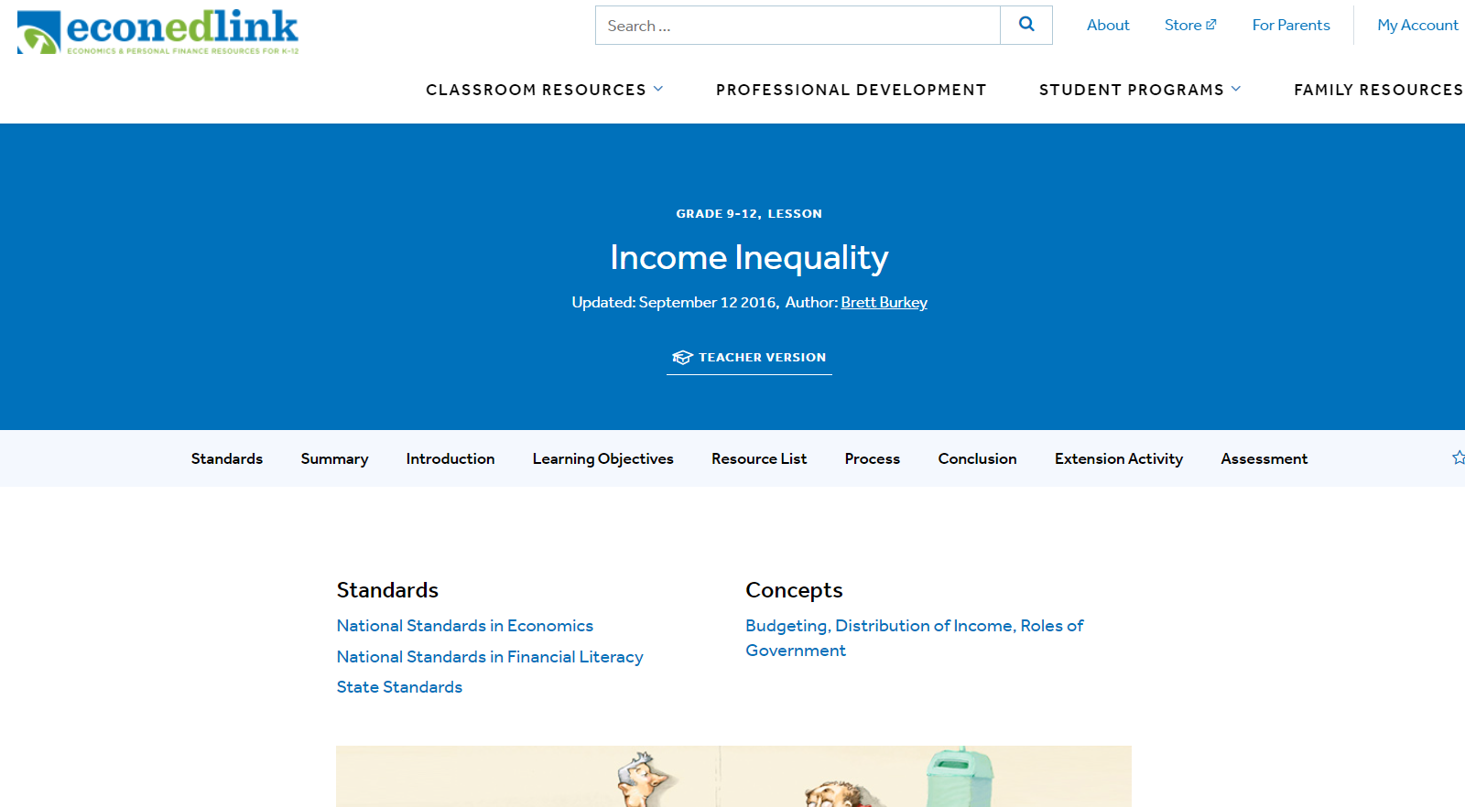
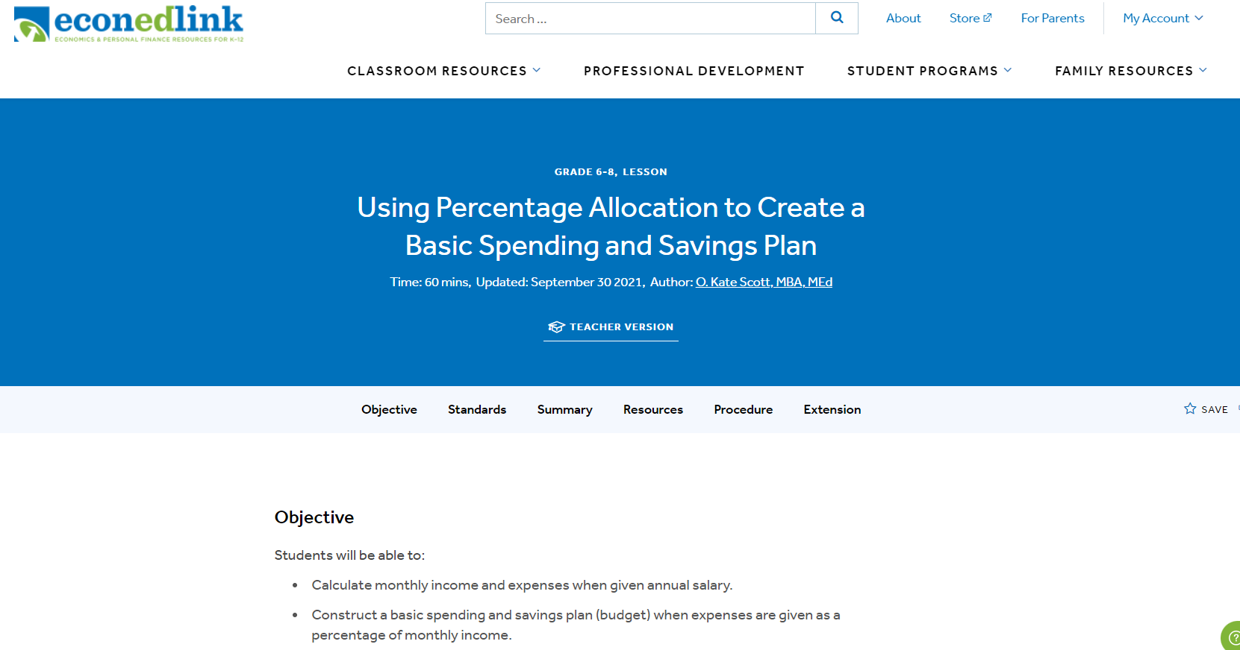
Examples in action

Slide 26
What can I do?
What are some personal finance concepts you find “tricky” or difficult to approach with students and why?
What will you DO to approach these with sensitivity and empathy?

Slide 27
Takeaways
Look through lens of empathy
Guide towards healthy choices, but try to understand unhealthy ones
Start slowly with a few key concepts

