Slide 1
Current Events in Economics - Russian Sanctions
Presented by Steven Cullison
Date 4/11/22 steven.cullison@edinaschools.org

Slide 2
EconEdLink Membership
You can now access CEE’s professional development webinars directly on EconEdLink.org! To receive these new professional development benefits, become an EconEdLink member. As a member, you will now be able to:
Automatically receive a professional development certificate via e-mail within 24 hours after viewing any webinar for a minimum of 45 minutes
Register for upcoming webinars with a simple one-click process
Easily download presentations, lesson plan materials and activities for each webinar
Search and view all webinars at your convenience
Save webinars to your EconEdLink dashboard for easy access to the event
You may access our new Professional Development page here

Slide 3
Professional Development Certificate
To earn your professional development certificate for this webinar, you must:
Watch a minimum of 45-minutes and you will automatically receive a professional development certificate via e-mail within 24 hours.
Accessing resources:
You can now easily download presentations, lesson plan materials, and activities for each webinar from EconEdLink.org/professional-development/

Slide 4
Objectives
To provide an overview of the types of sanctions being used against Russia in 2022 and of their costs and benefits.
To help teachers be better prepared to teach or answer questions on the subject in their classrooms.

Slide 5
Agenda
Types of Sanctions
Costs of Sanctions
Are They Working?
Tying the Content to Your Curriculum

Slide 6
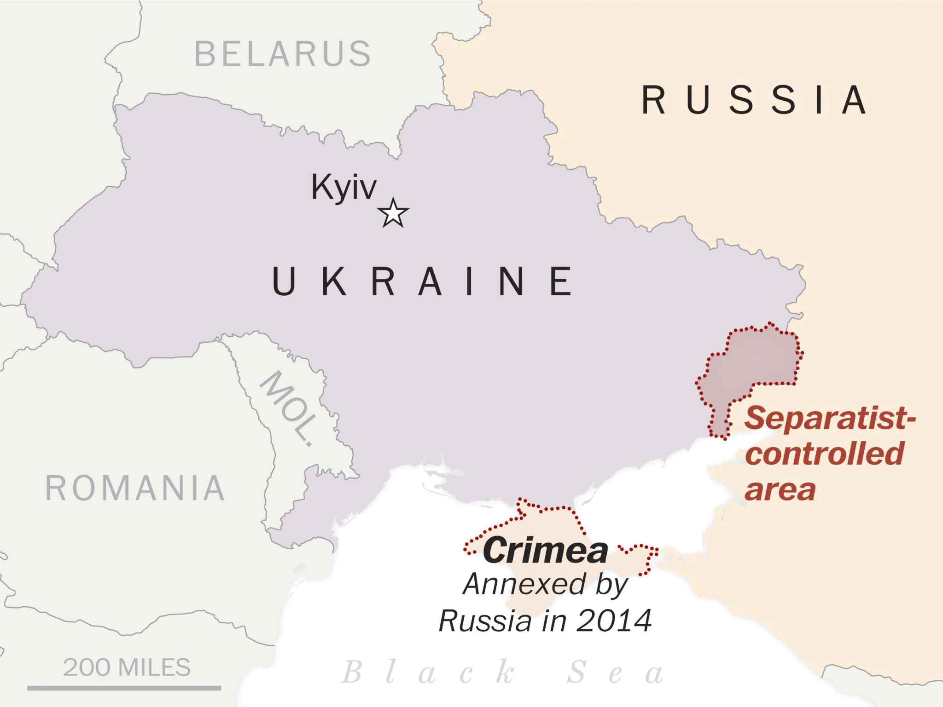


Slide 7

Types of Economic Pressure - Blocking Sanctions
2/22/22: The U.S. institutes ‘full block sanctions’ on two large Kremlin-contolled banks (and some other, smaller institutions.)
Notes:
https://home.treasury.gov/news/press-releases/jy0608
https://www.aljazeera.com/news/2022/2/22/biden-imposes-new-russia-sanctions-decries-beginning-invasion

Slide 8
Types of Economic Pressure - Blocking Sanctions
2/22/22: The U.S. institutes ‘full block sanctions’ on two large Kremlin-contolled banks (and some other, smaller institutions.)
Why this hurts: international trade relies heavily upon U.S. dollars.
Notes:
https://home.treasury.gov/news/press-releases/jy0608
https://www.aljazeera.com/news/2022/2/22/biden-imposes-new-russia-sanctions-decries-beginning-invasion

Slide 9
Wait - Why is Russia using U.S. dollars for everything?
1. The U.S. dollar is the reference currency for the world.
Notes:
https://www.thebalance.com/world-currency-3305931

Slide 10
Wait - Why is Russia using U.S. dollars for everything?
1. The U.S. dollar is the reference currency for the world.
2. The U.S. dollar is widely trusted to retain a steady value.

Slide 11
Wait - Why is Russia using U.S. dollars for everything?
1. The U.S. dollar is the reference currency for the world.
2. The U.S. dollar is widely trusted to retain a steady value.
3. About 40% of the world’s debt is issued in U.S. dollars.

Slide 12
Types of Economic Pressure - Sanctions
2/22/22: The U.S. institutes ‘full block sanctions’ on two large Kremlin-contolled banks (and some other, smaller institutions.)
2/23/22: The European Union issues similar sanctions.

Slide 13
Types of Economic Pressure - Seizure and Freezing
2/22/22: The U.S. also seizes U.S.-held assets of several Russian oligarchs.
2/23/22: The European Union freezes the assets of Russian oligarchs.
Notes:
https://www.aljazeera.com/news/2022/2/22/eu-agrees-on-sanctions-against-russian-individuals-and-entities
https://www.npr.org/2022/02/26/1083276850/us-sanctions-on-russian-oligarchs-miss-richest-of-rich

Slide 14
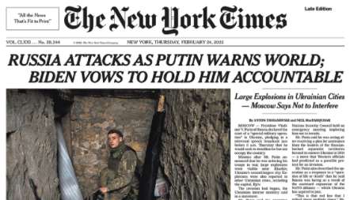
Did Sanctions Fail?

Slide 15
Did Sanctions Fail?
2/24/22: The U.S. bars five more banks from the U.S. financial system, and freezes the assets of four of them.

Slide 16
Further Blocking Sanctions, Seizures, and Freezes
U.S. and international sanctions have since targeted:
Putin himself and many other officials and oligarchs/business leaders
Virtally every major bank
“Disinformation targets”
Large, often state run, businesses
Belarus and some of its leaders
Notes:
https://www.swissinfo.ch/eng/russia-sanctions-list--what-the-west-imposed-over-the-ukraine-invasion/47408496

Slide 17
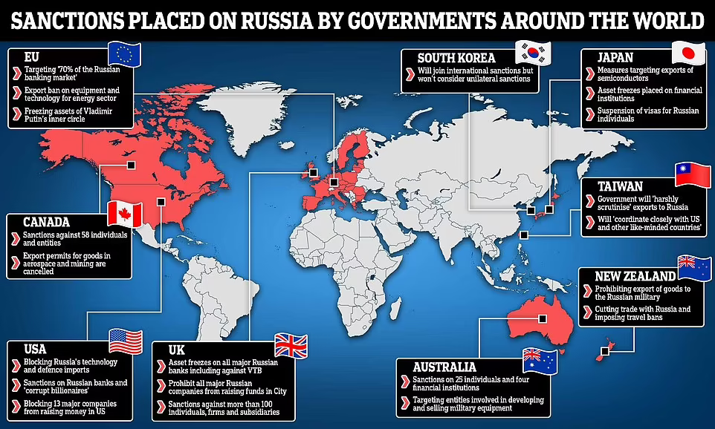
The Importance of International Cooperation in Sanctions
Notes:
https://www.dailymail.co.uk/news/article-10550811/How-Russia-sanctioned-world-Ukraine-invasion.html

Slide 18
Types of Economic Pressure - Embargos
U.S. firms are prohibited from exporting the following to Russia, Belarus, or portions of Ukraine under Russian control:
weapons
software that could have military application
technology that could have military application
Notes:
https://www.akingump.com/en/news-insights/us-government-imposes-expansive-novel-and-plurilateral-export-controls-against-russia-and-belarus.html

Slide 19
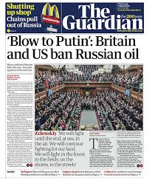
Types of Economic Pressure - Embargos
3/9/22 The U.S. declares it will not import Russian oil.
Notes:
https://tekdeeps.com/prohibition-of-russian-oil-import-to-britain-and-usa/

Slide 20
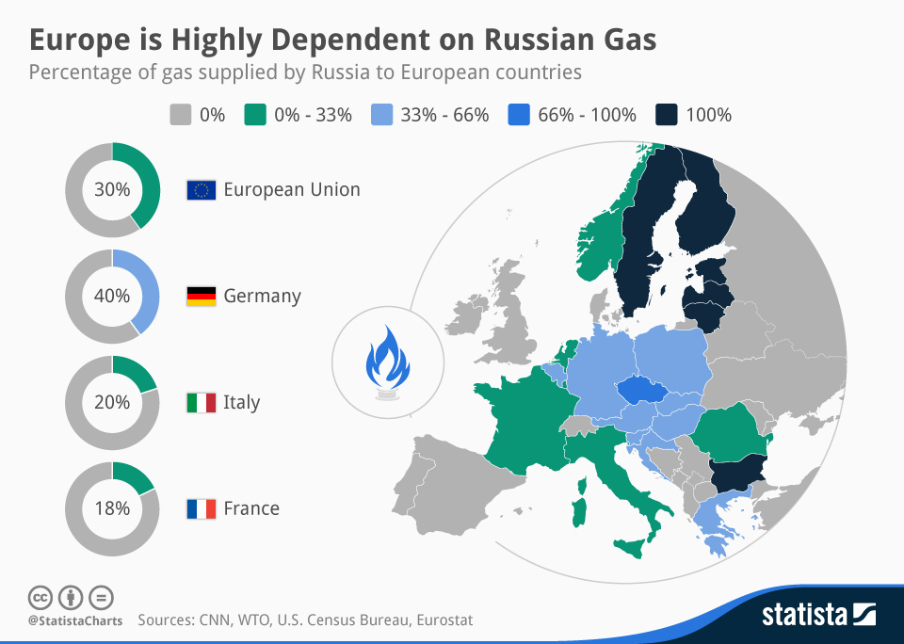
Russian Oil and Gas

Slide 21
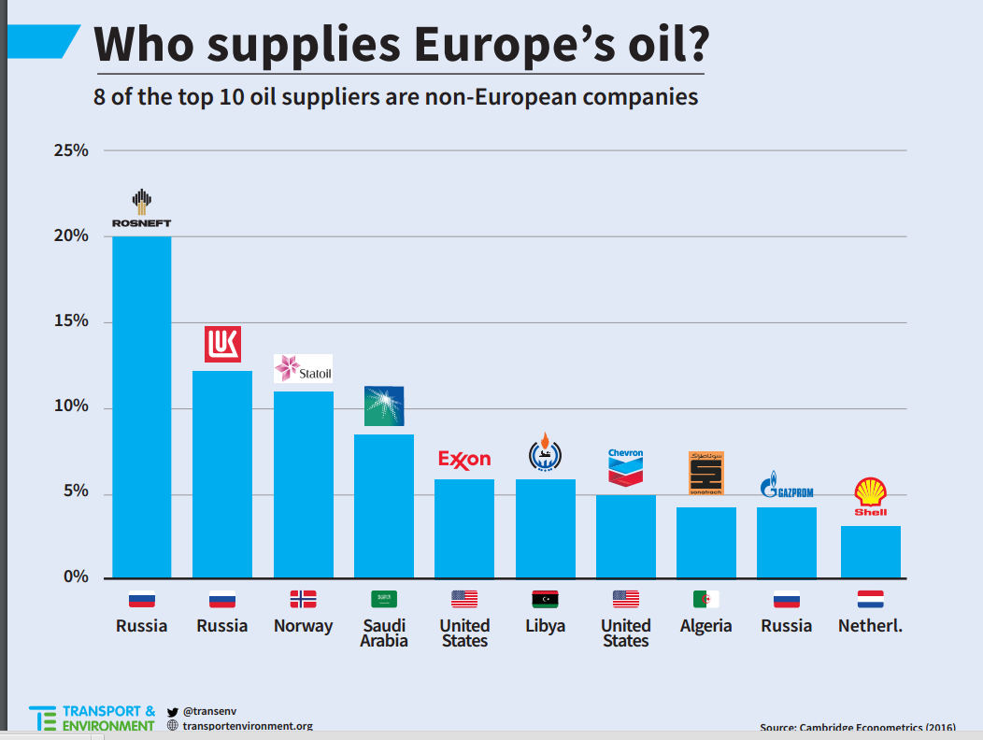
Russian Oil and Gas

Slide 22
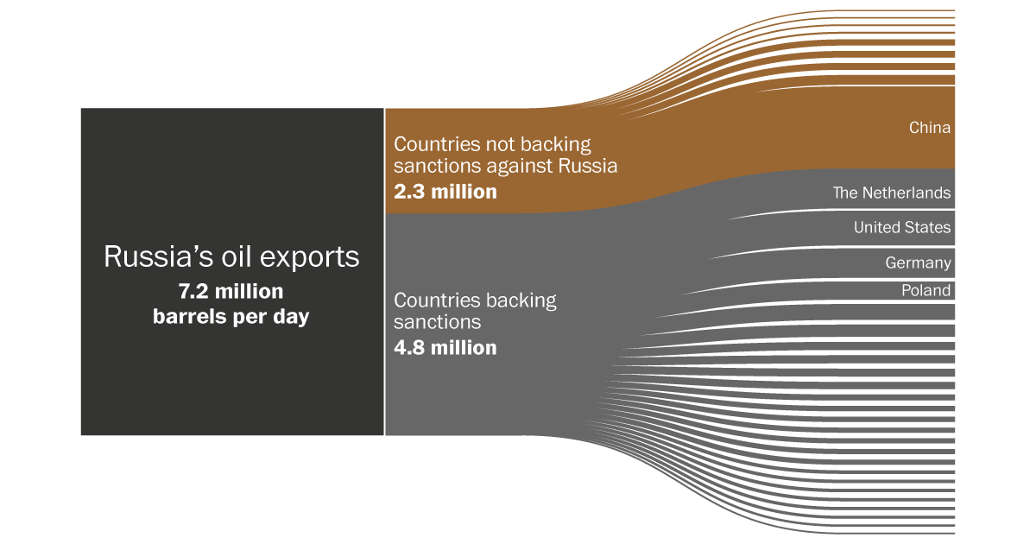
Notes:
https://energypost.eu/europe-increasingly-dependent-oil-imports-russia/

Slide 23
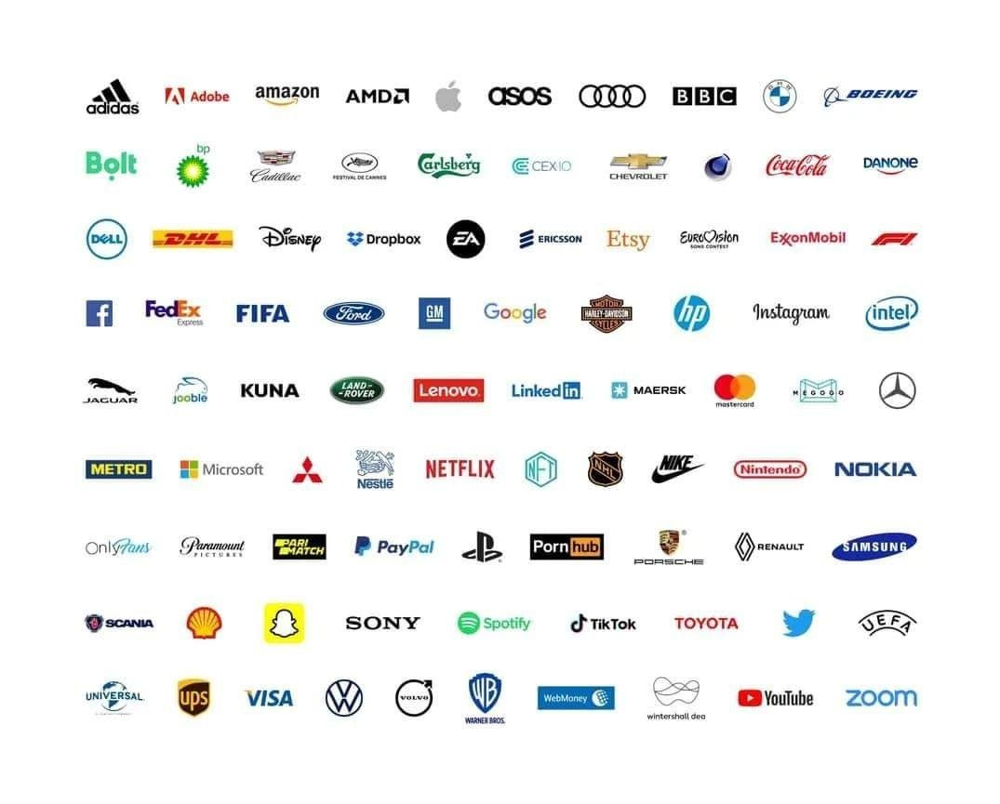
Types of Economic Pressure - Self Sanctioning
Notes:
https://abc7chicago.com/companies-pulling-out-of-russia-coca-cola-mcdonalds-closing-ukraine/11637670/

Slide 24
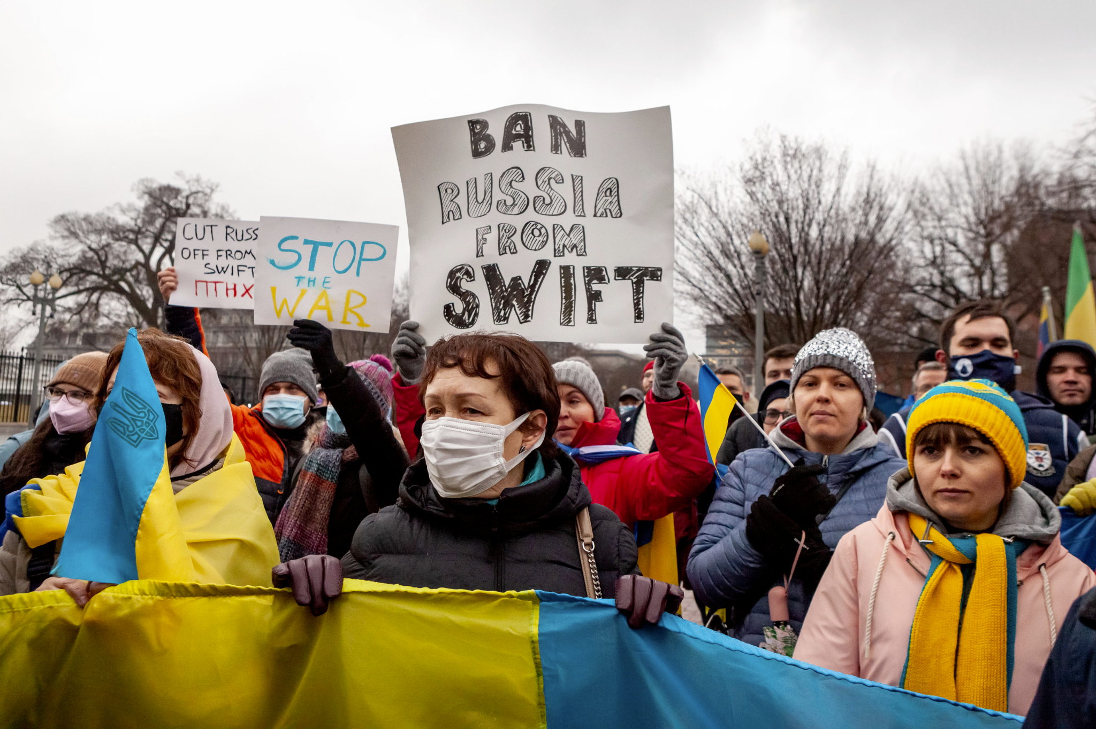
SWIFT
Notes:
https://foreignpolicy.com/2022/03/08/swift-sanctions-ukraine-russia-nato-putin-war-global-finance/
https://www.newyorker.com/business/currency/how-significant-is-russias-partial-ban-from-swift

Slide 25
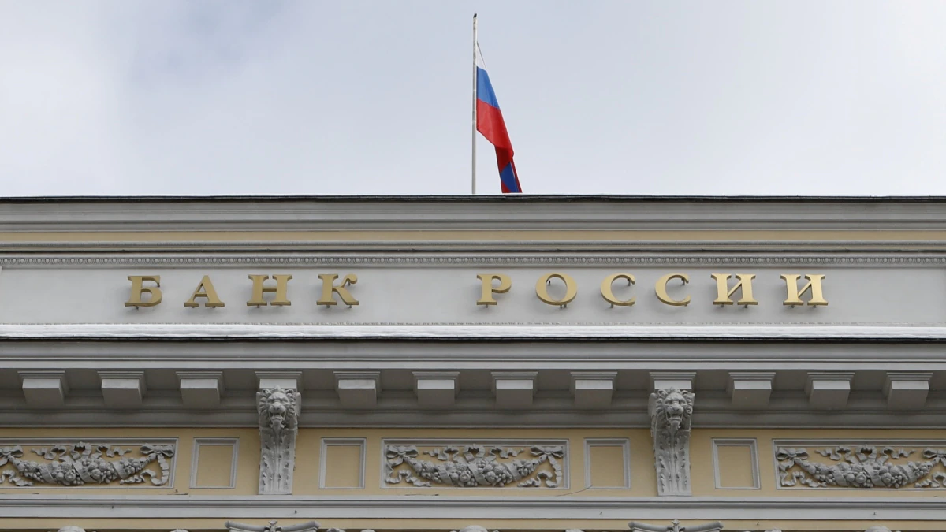
The Impacts on Russia - Debt
Notes:
https://www.theguardian.com/world/2022/mar/11/what-happens-if-russia-cant-pay-its-debts-after-western-sanctions
https://nypost.com/2022/03/24/russia-will-likely-default-on-its-debt-with-april-4-payment-due-of-2-2b-experts/

Slide 26
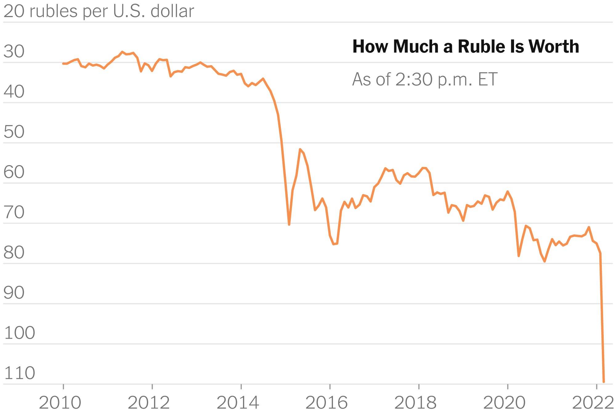
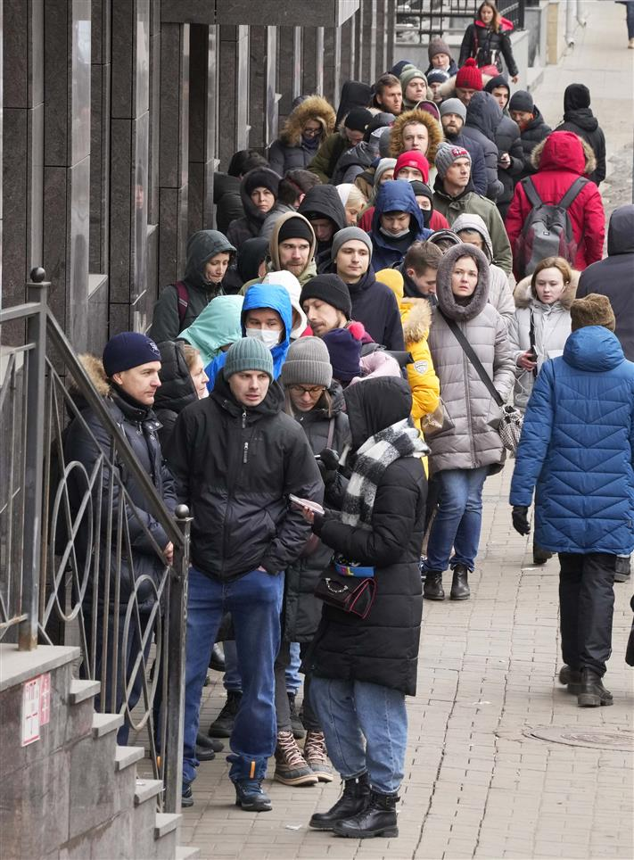
The Impacts on Russia - The Ruble
Notes:
https://www.nytimes.com/2022/02/28/business/russia-sanctions-central-bank-ruble.html
https://www.themoscowtimes.com/2022/03/10/russian-prices-rising-fastest-in-24-years-on-ruble-collapse-a76858

Slide 27
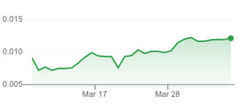
The Impacts on Russia - The Ruble
Notes:
https://www.nytimes.com/2022/02/28/business/russia-sanctions-central-bank-ruble.html
https://www.themoscowtimes.com/2022/03/10/russian-prices-rising-fastest-in-24-years-on-ruble-collapse-a76858

Slide 28
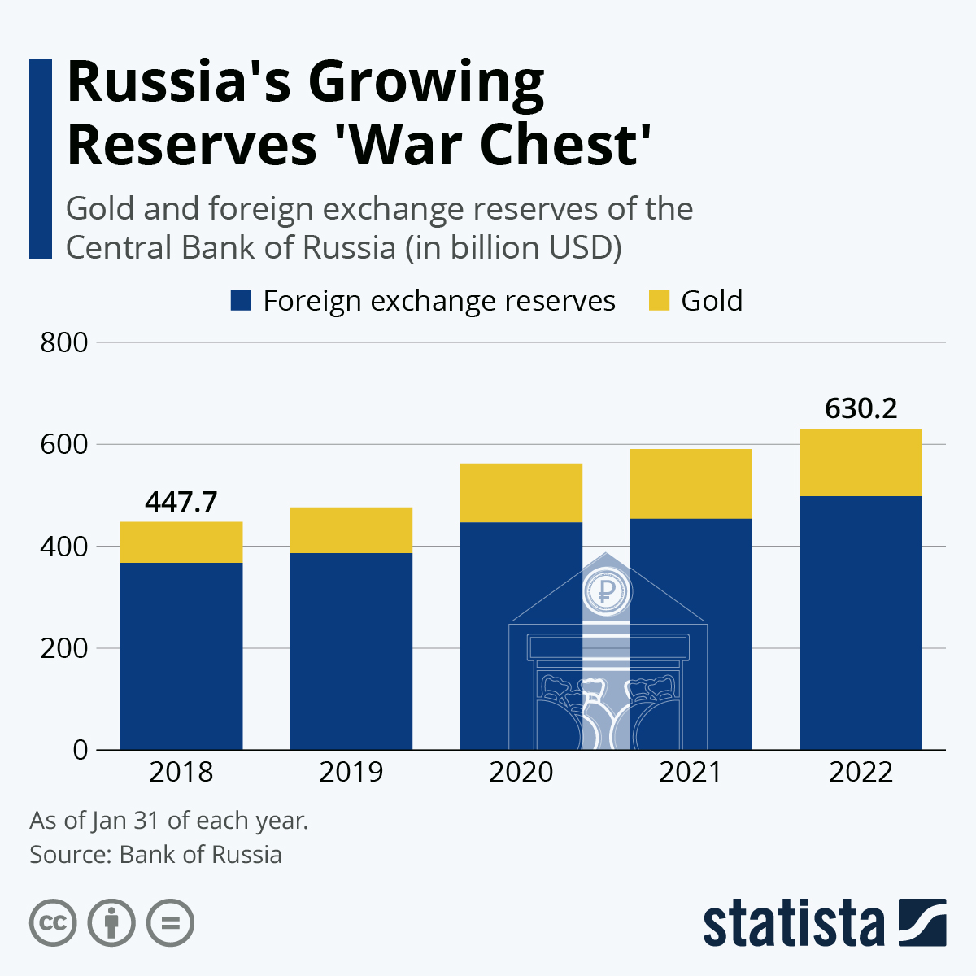
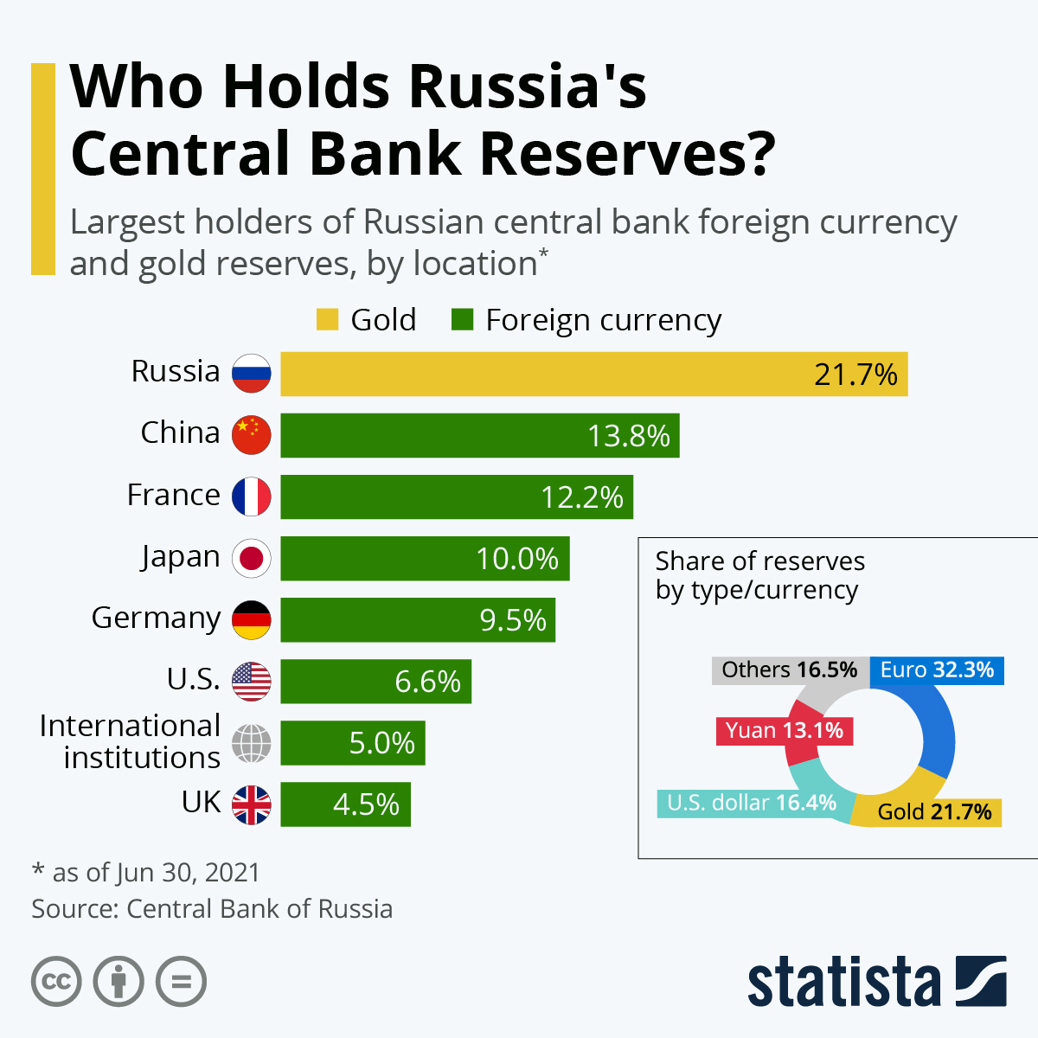
The Impacts on Russia - Foreign Exchange Reserves
Notes:
https://www.statista.com/chart/26942/gold-foreign-exchange-reserves-of-central-bank-of-russia/

Slide 29
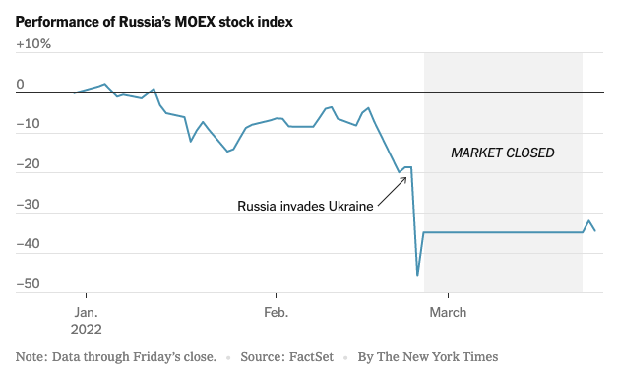
The Impacts on Russia - The Stock Market
Notes:
https://www.nytimes.com/2022/03/26/business/dealbook/russia-stock-market.html

Slide 30
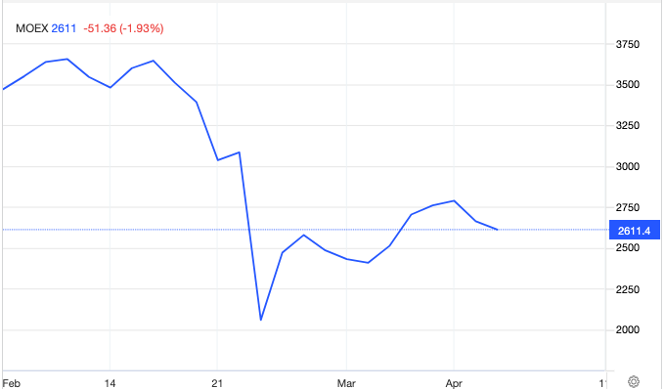
The Impacts on Russia - The Stock Market

Slide 31
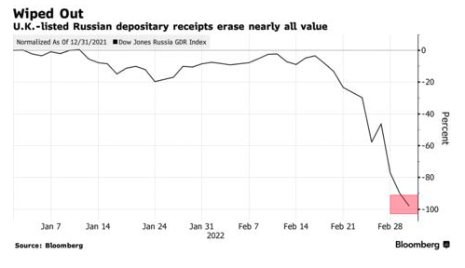
The Impacts on Russia - The Stock Market
Notes:
https://www.axios.com/russia-investors-set-for-big-losses-a66915b7-8235-42c7-a52b-36f03e355939.html

Slide 32
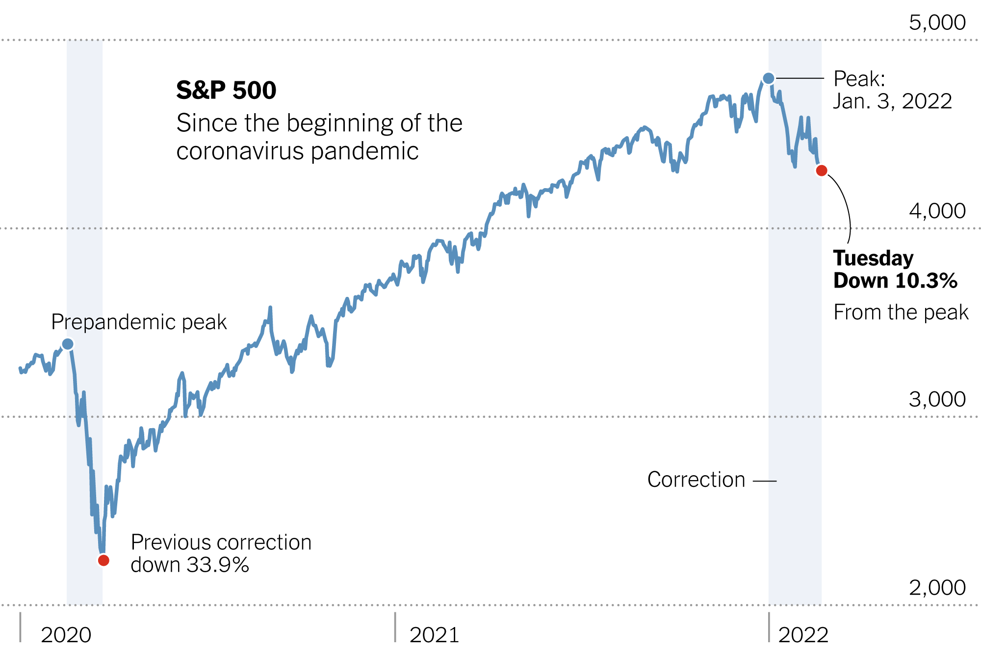
The Costs of Sanctions
lost GDP and jobs
inflation
Notes:
https://www.piie.com/commentary/testimonies/evidence-costs-and-benefits-economic-sanctions
https://www.gibsondunn.com/2020-year-end-sanctions-and-export-controls-update/
https://www.axios.com/russia-investors-set-for-big-losses-a66915b7-8235-42c7-a52b-36f03e355939.html

Slide 33
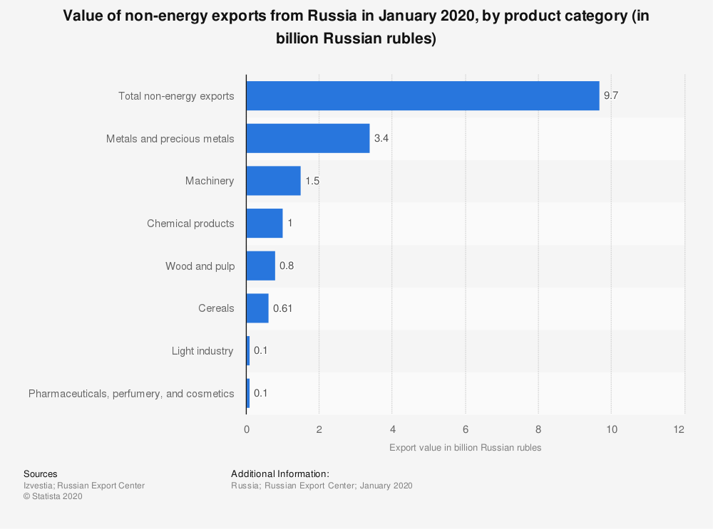
The Costs of Sanctions
reduced access to goods and resources
Notes:
https://www.piie.com/commentary/testimonies/evidence-costs-and-benefits-economic-sanctions
https://www.gibsondunn.com/2020-year-end-sanctions-and-export-controls-update/
https://www.axios.com/russia-investors-set-for-big-losses-a66915b7-8235-42c7-a52b-36f03e355939.html

Slide 34
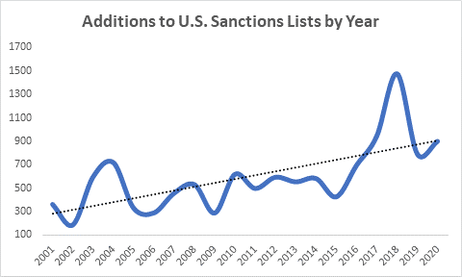
The Costs of Sanctions
reduced trust among trading partners
encouraged economic isolation
Notes:
https://www.piie.com/commentary/testimonies/evidence-costs-and-benefits-economic-sanctions
https://www.gibsondunn.com/2020-year-end-sanctions-and-export-controls-update/
https://www.axios.com/russia-investors-set-for-big-losses-a66915b7-8235-42c7-a52b-36f03e355939.html

Slide 35
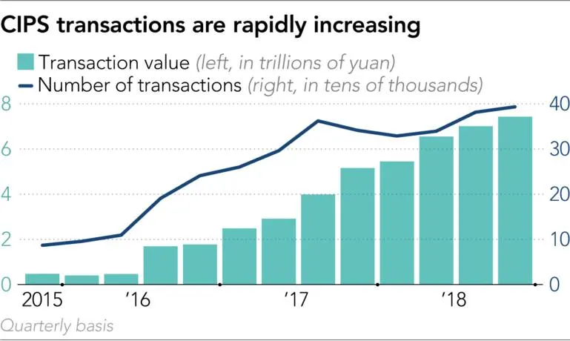
The Costs of Sanctions - One Last One
CIPS - China International

Slide 36
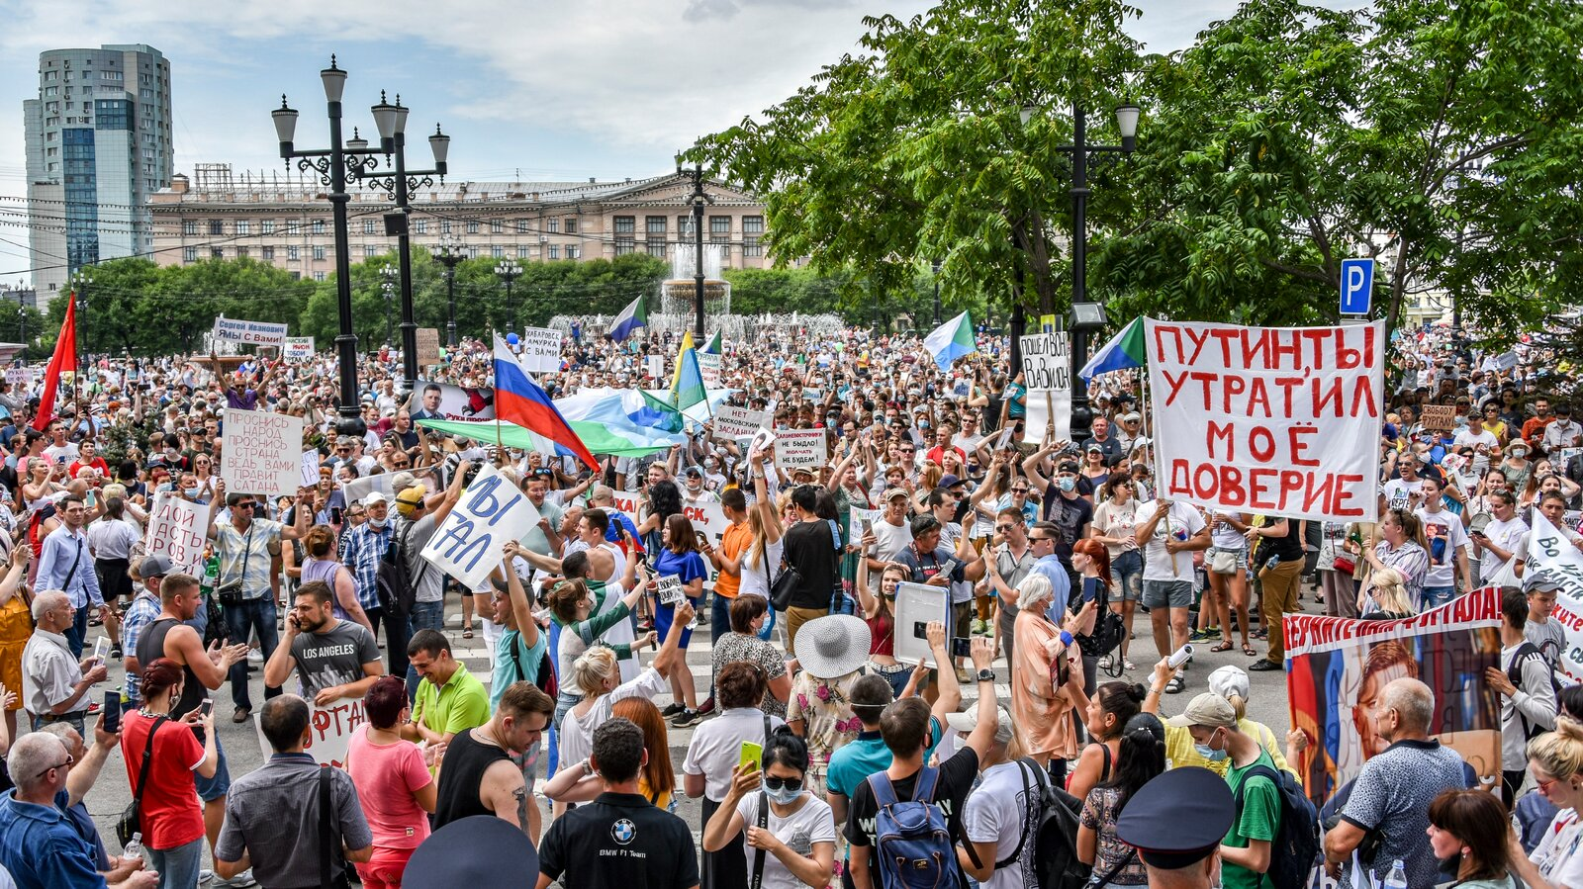
Are Sanctions Working?
To provide pressure on Russia to withdraw, or at least refrain from expanding their military actions

Slide 37
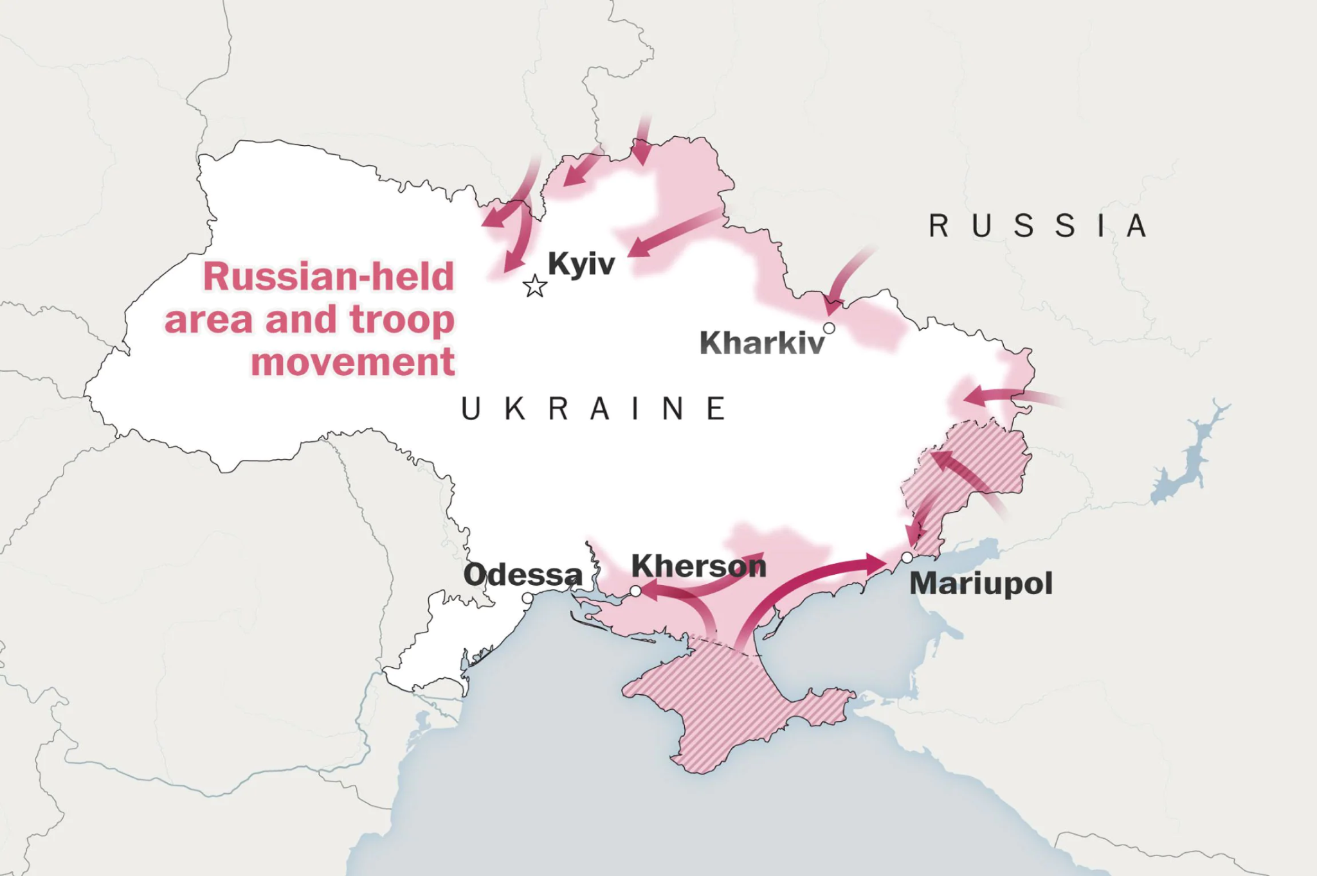
Are Sanctions Working?
To reduce funding available for the war effort

Slide 38
Are Sanctions Working?
To deter future, similar, actions by Russia or other nations

Slide 39
Tying This to Other Learning: CEE National Standards
Scarcity (1.12.2)
Trade (5.12.2)
Specialization (6.12.2)
Markets and Prices (7.12.5)
Money and Inflation (11.12.4)
Income (13.12.4)
Economic Growth (14.12.3)
Economic Fluctuations (15.12.4)
Notes:
https://www.councilforeconed.org/wp-content/uploads/2012/03/voluntary-national-content-standards-2010.pdf

Slide 40
Tying This to Other Learning: State Standards (MN)
Trade-offs/Cost-Benefit Analysis (9.2.3.3.1)
Economic Indicators (9.2.5.9.2)
Free Trade (9.2.5.12.1)
Monetary Policy (9.2.5.11.2)
Resource Markets (9.2.4.7.3)
Currency Markets (9.2.5.12.2)
Current Accounts (No standard)

Slide 41

Questions?

Slide 42
Assessment Questions
5 Guiding Questions (list discussion prompts)
Please also forward any supplements (worksheets, rubrics, etc) to us as attachments with your slide deck

Slide 43
References
Any links to clips, titles etc of relevant materials

Slide 44


CEE Affiliates
https://www.councilforeconed.org/resources/local-affiliates/

Slide 45




Thank You to Our Sponsors!

