Slide 1
WELCOME!
Housekeeping Items:
Please use the chat and/or Q & A function to ask questions or to notify moderator of issues
The session will be recorded and emailed to participants in the next few days
Thank you for joining us.
The webinar will begin shortly.

Slide 2
AP Macro Unit 4: Definitions and Functions of Money
Live Webinar: May 16th, 2022

Slide 3
Instructor Bio
James Redelsheimer has been an AP and Regular Economics teacher at Robbinsdale Armstrong High School in Plymouth, Minnesota since 2003. James is a graduate of St. Olaf and received his Master's degree at the University of St. Thomas. He received the 3M Economics Educator Excellence Award from the Minnesota Council on Economic Education and was named Visa's Practical Money Skills Innovative Educator of the Month.
James enjoys traveling and has been a guest lecturer in the economics department at the Batumi State University in The Republic of Georgia and has received travel grants and fellowships for study travel to learn about the economies of Japan, China, Turkey, Germany, Korea, among others, and studied economics of the environment in Costa Rica. He currently serves as an AP Economics reader, grading AP Economics exams. He enjoys teaching Economics because it relates to students' everyday lives.

Slide 4
Webinar Objectives
In this webinar, teachers will be able to identify and explain
The functions of money.
How the US money supply is calculated.

Slide 5
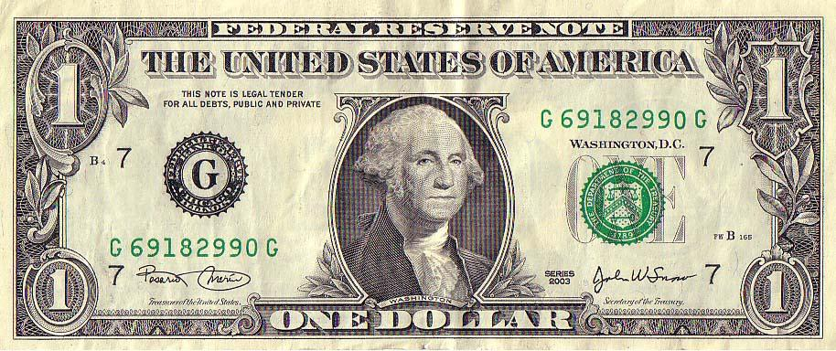
Dollar Decoded
Bills are crowded with numbers and
letters that help the U.S. Treasury track
printing errors & authenticate currency.
Here’s what many of them mean:
Fed bank
that issued
the bill [Chi.]
Last letter tells how many
times serial number has run
Number corresponds to letter in
circle indicating issuing Fed bank.
First letter corresponds
to issuing Fed bank

Slide 6
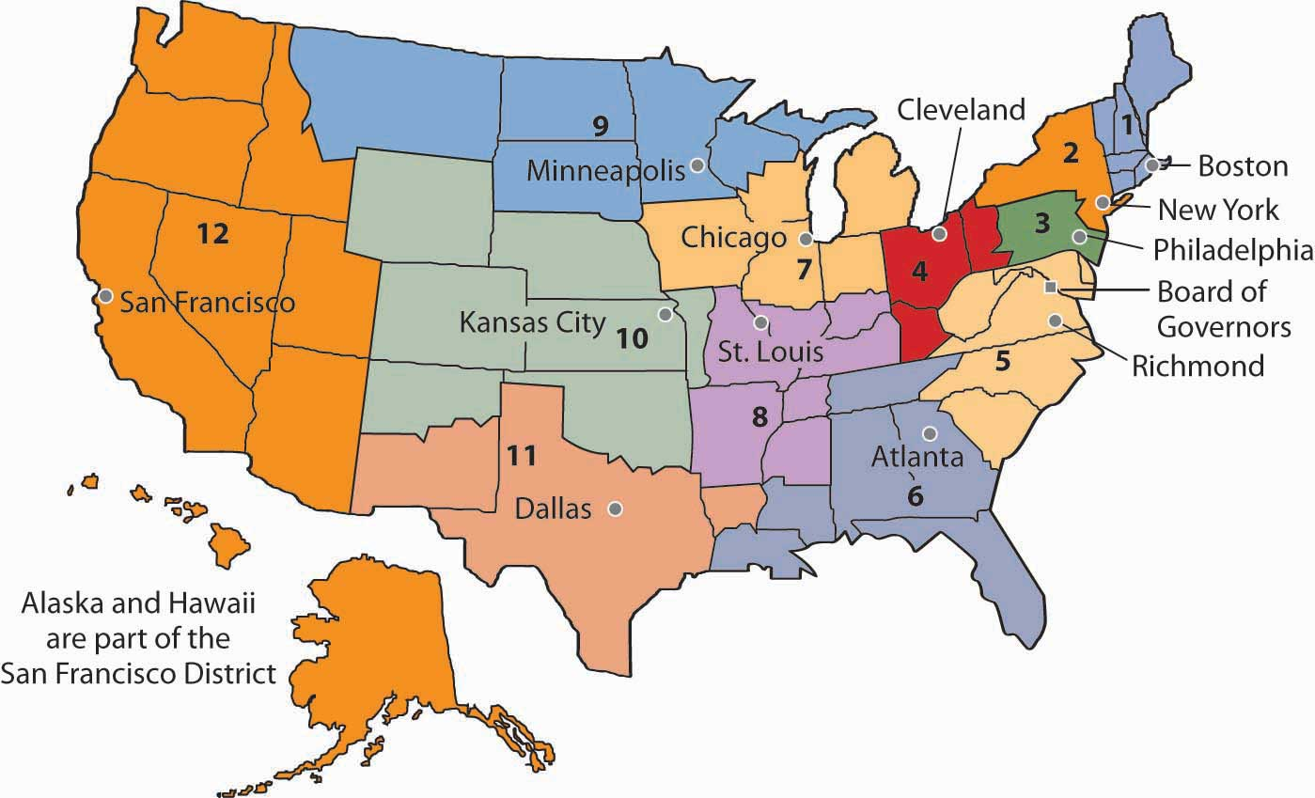
Federal Reserve Districts

Slide 7
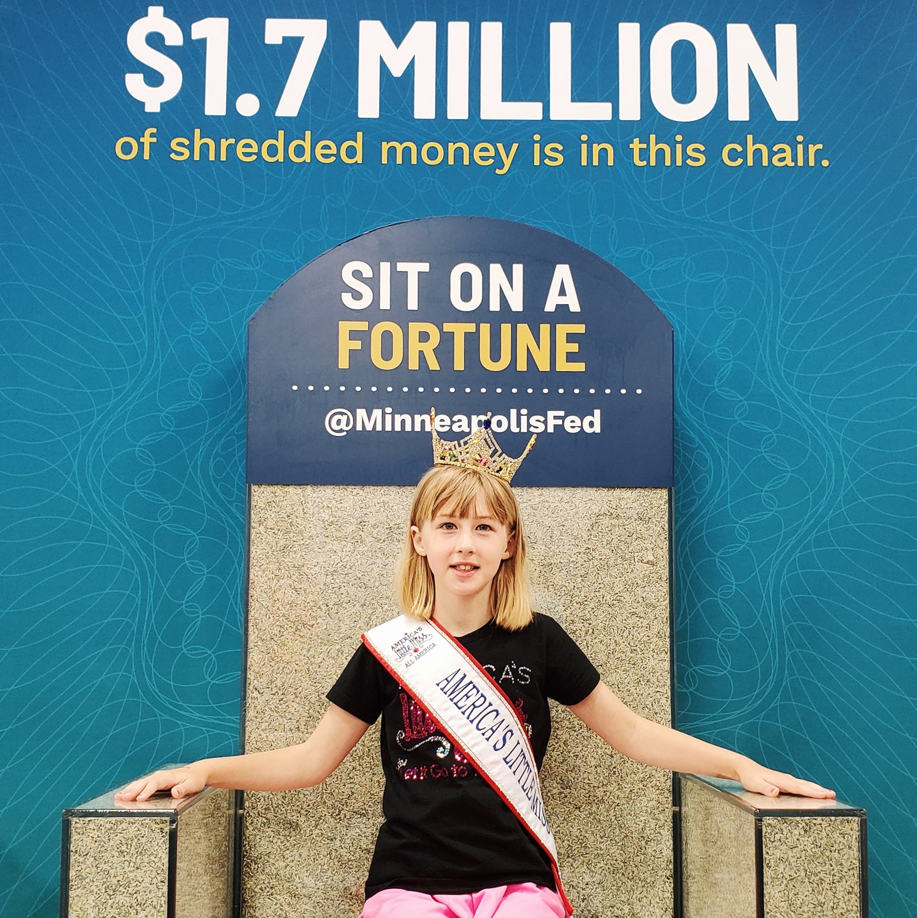

Slide 8
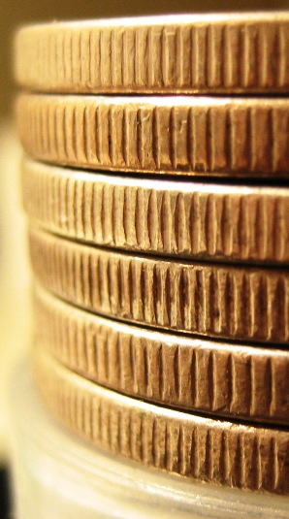
Why do some coins have those little lines around the edges?
The process is called “reeding”
Reason #1: To make it more difficult to counterfeit.
Reason #2: Back when coins were made from precious metals, “reeding” made it impossible to shave coins down without the result being obvious.

Slide 9
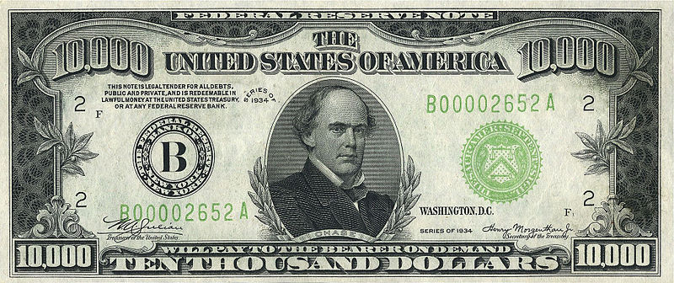
BIGGEST BILL EVAH IN
CIRCULATION TO THE PUBLIC?

Slide 10
As of 2009, there were only 336 known $10,000 bills in circulation; 342 remaining $5,000 bills; and 165,372 remaining $1,000 bills. Due to their rarity, collectors will pay considerably more than the face value of the bills to acquire them.

Slide 11
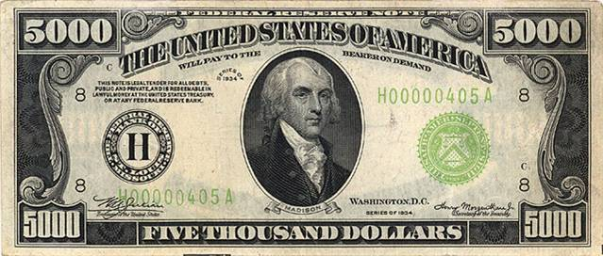
No paper notes larger than $100 have been printed since 1946.

Slide 12
SALVADOR DALI – Made his own currency?

Slide 14
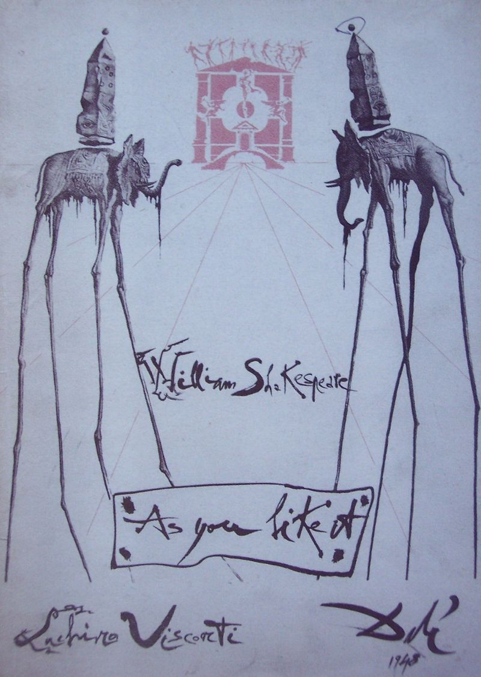

Slide 15
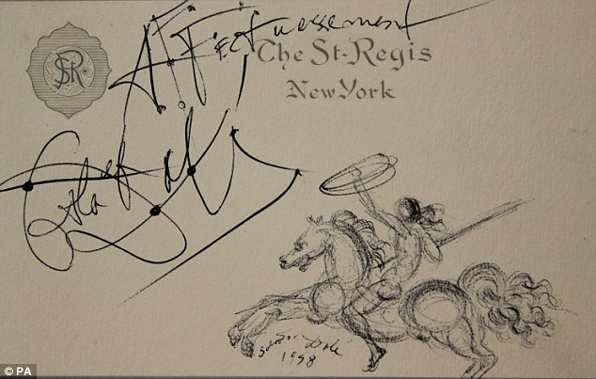

Slide 16
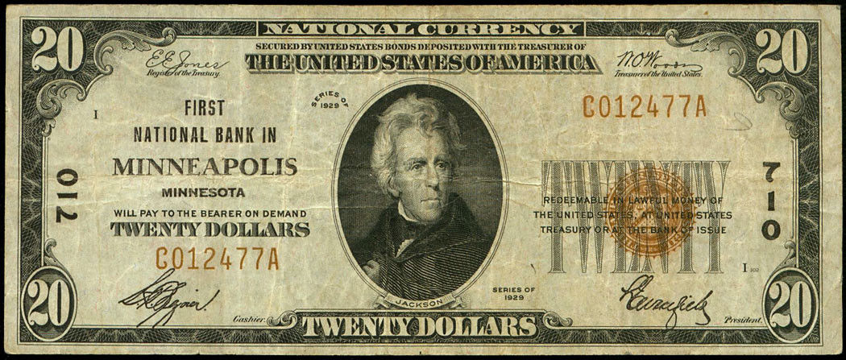

Slide 17
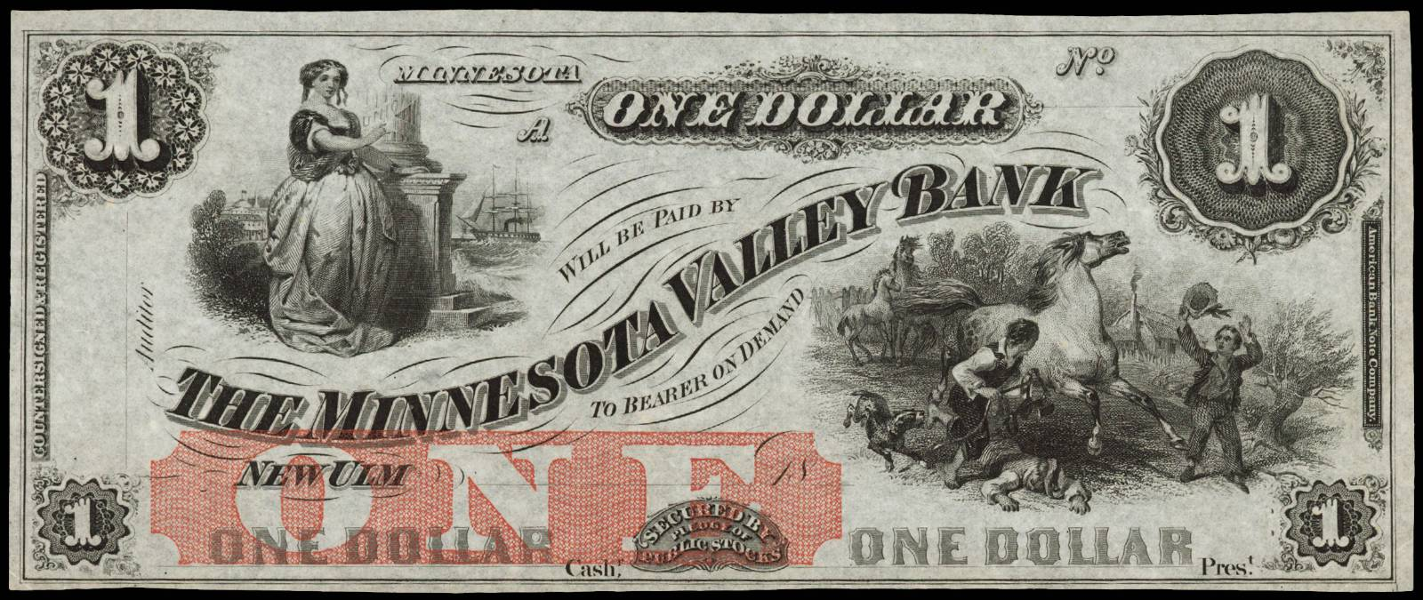

Slide 18
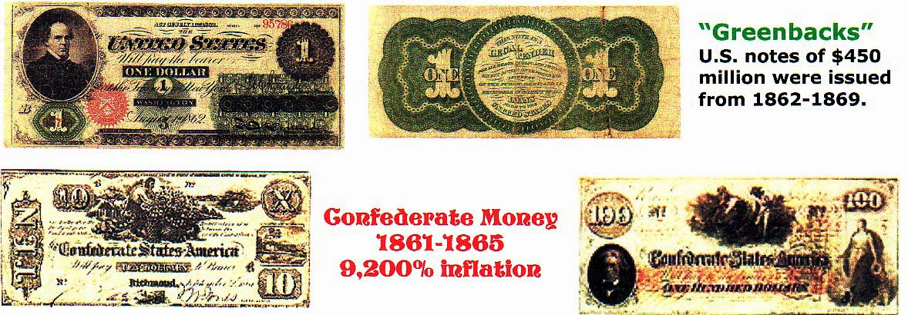

Slide 19
Money!!!
Who is on the…
$100 Bill
$50 Bill
$20 Bill
$10 Bill
$5 Bill
$2 Bill
50 Cent
Dime
$500
$1000 Bill
$100,000 Bill
Franklin
Grant
Jackson
Hamilton
Lincoln
Jefferson
JFK
FDR
McKinley
Cleveland
11. Wilson
Bonus:
“E Pluribus Unum” means….
“Out of Many, One”
Double Bonus:
$10,000 Bill?
Salmon P. Chase

Slide 20
Barter – goods and services were traded without the exchange of money.
However, before trade could occur, there had to
be a “double coincidence of wants”. Each trader
had to have something the other wanted.
I would love to sell you these shoes but I don’t like chicken
I’ll trade you a chicken for a pair of shoes.
In a barter economy a chicken
farmer who wants to buy shoes
may have to first trade chickens
for oranges and then oranges for
shoes because the guy selling
shoes wants only oranges.
Money eliminates this problem.

Slide 21
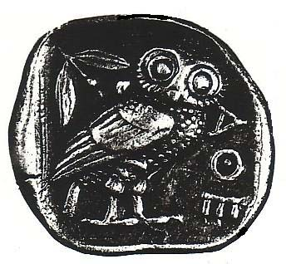

Slide 22
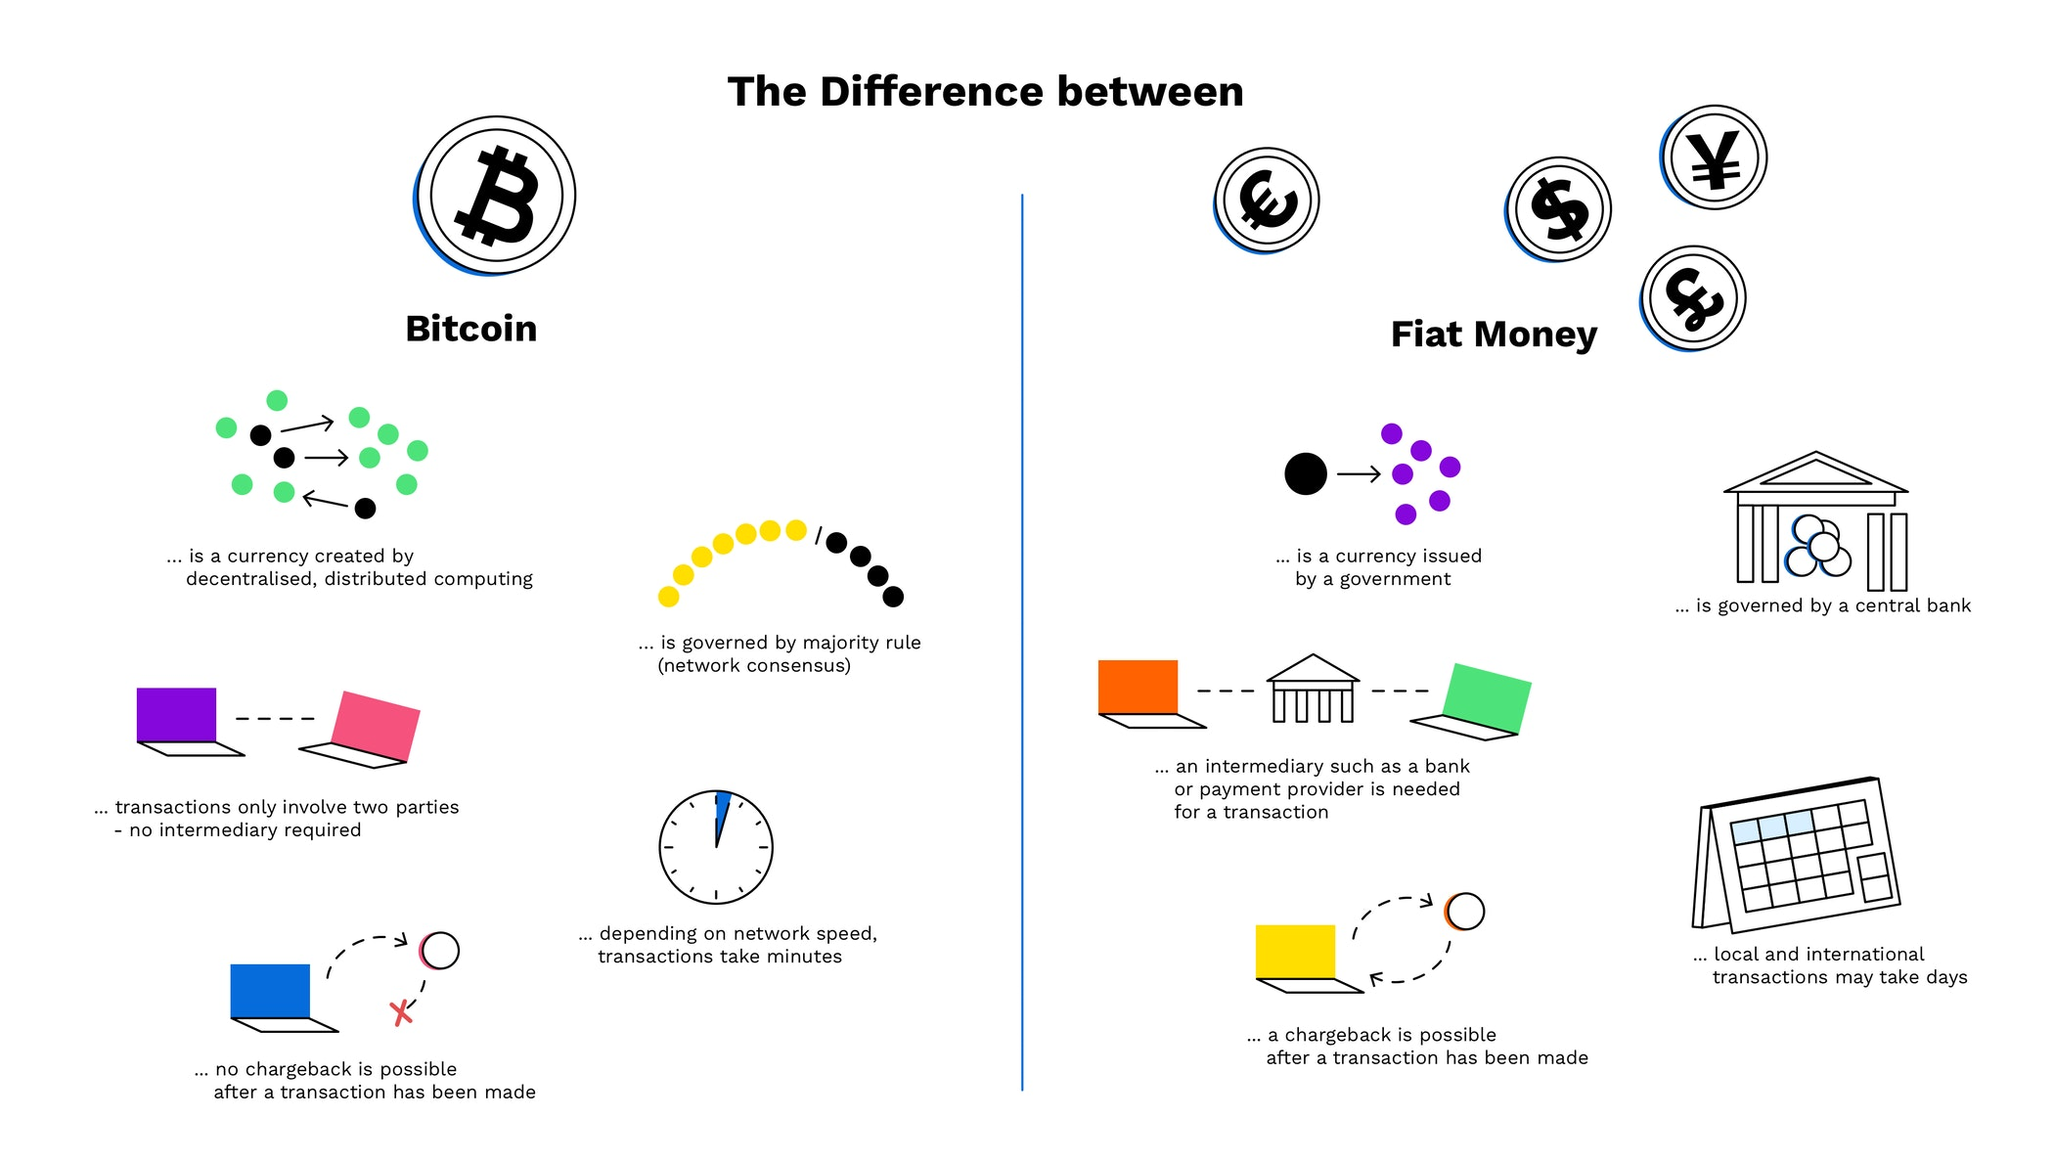

Slide 23
Money In The American Economy
Currency + Demand Deposits equal M1
M1
M2
M1
Completely
Liquid
2% 50% 48%
plus savings deposits, MMA’s, and small Time Deposits, everything else equal M2

Slide 24
Classifying Money
Liquidity- ease with which an asset can be accessed and used as a medium of exchange.
M1 (Highest Liquidity) –
1. Currency in circulation.
2. Checkable bank deposits (checking accounts).
3. Traveler’s checks.
M2 (Near-Moneys) - M1 plus the following:
1. Savings deposits (money market accounts)
2. Time deposits (CDs = certificates of deposit).
3. Money market funds.
M1 and M2 money often earn little to no interest so the opportunity cost of holding liquid money is the interest you could be earning.

Slide 25
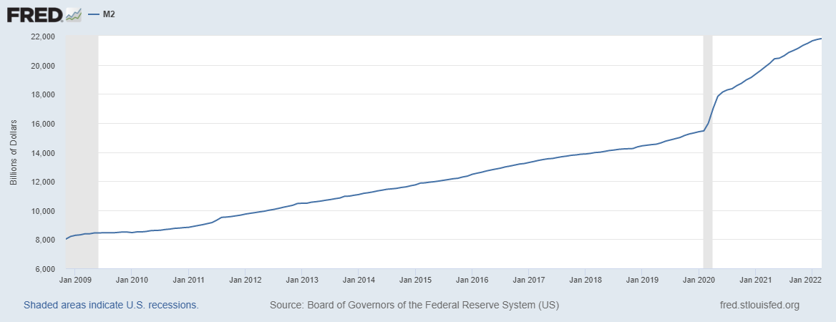
M2 in the US

Slide 26
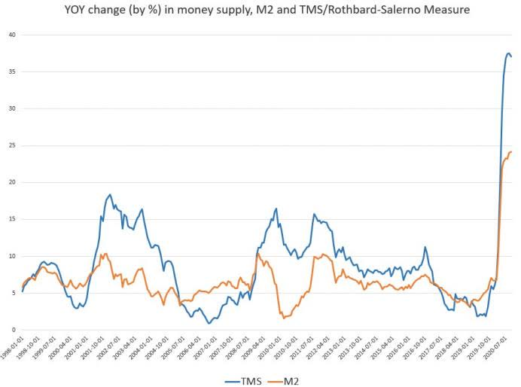

Slide 27
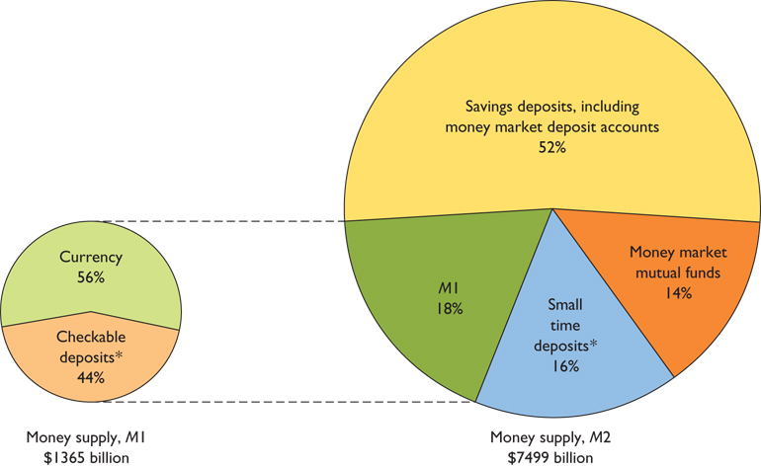

Slide 28
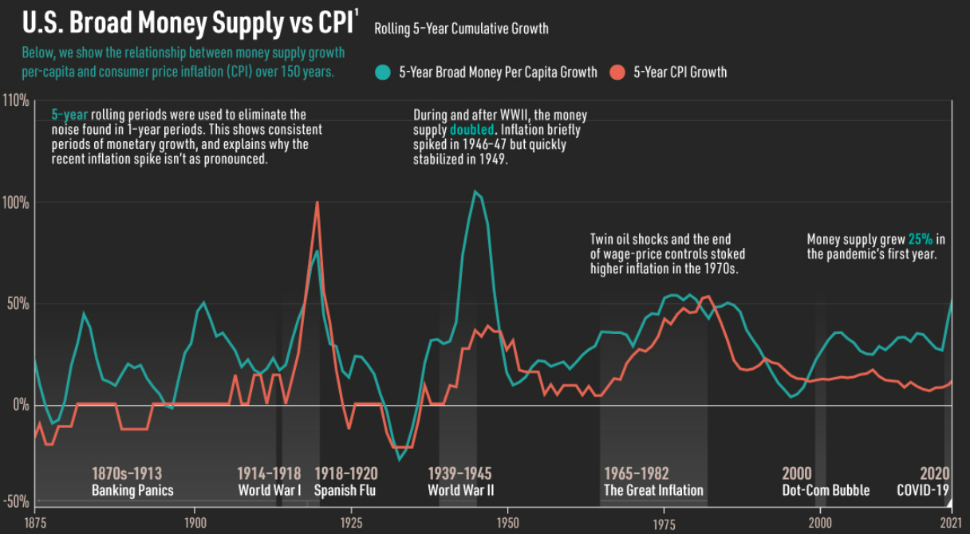

Slide 30
Central banks indirectly change the money supply by changing the monetary base
Money
Supply
Monetary Base:
Bank Reserves plus currency
in circulation
Checkable
Deposits
Bank
Reserves
Currency in
Circulation

Slide 31
What is the initial change in the money supply when the Fed buys $1000 of bonds?
Money
Supply
Monetary
Base
Checkable
Deposits
NO CHANGE
Bank
Reserves
Money supply doesn’t change until the money is loaned out
+$1000
Currency in
Circulation

Slide 32
Central banks indirectly change the money supply by changing the monetary base
Money
Supply
Monetary
Base
Checkable
Deposits
Bank
Reserves
Currency in
Circulation

Slide 33
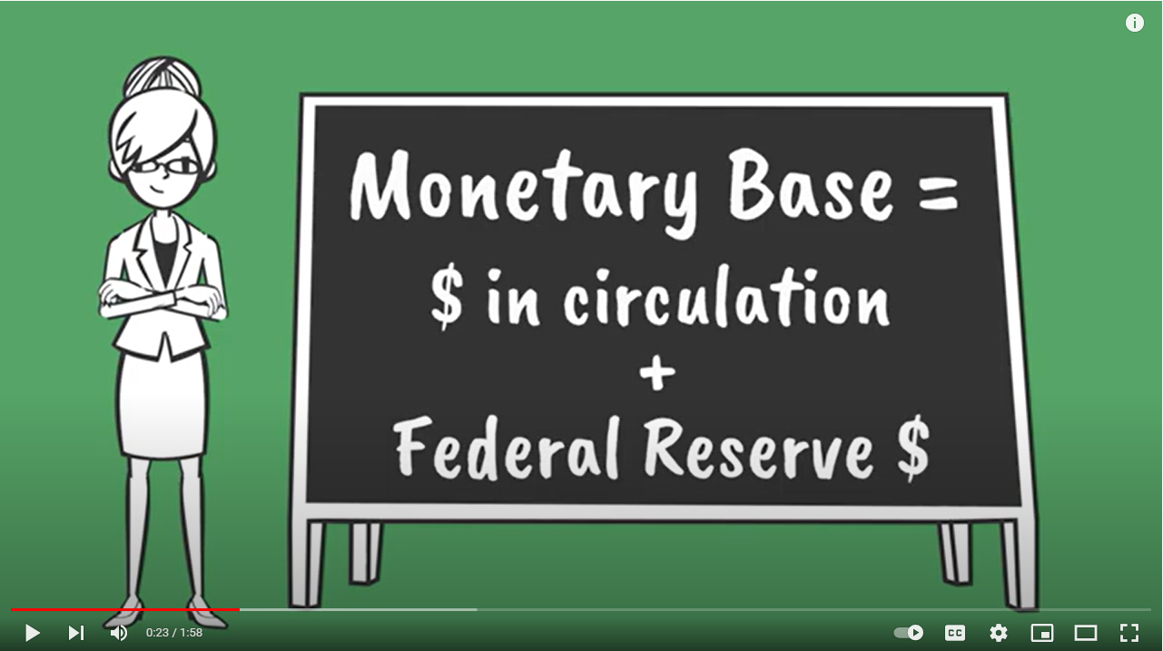

Slide 34
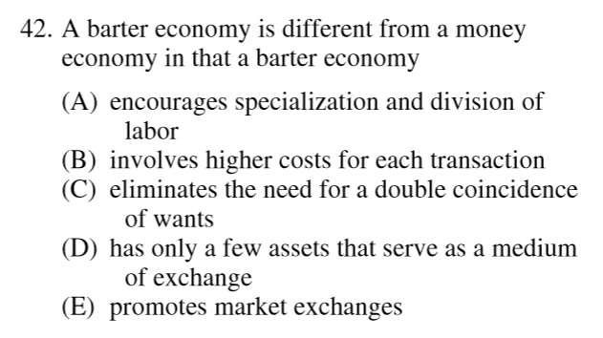
2012 Audit Exam

Slide 36
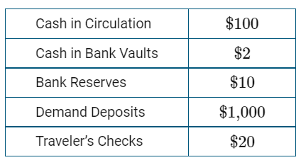
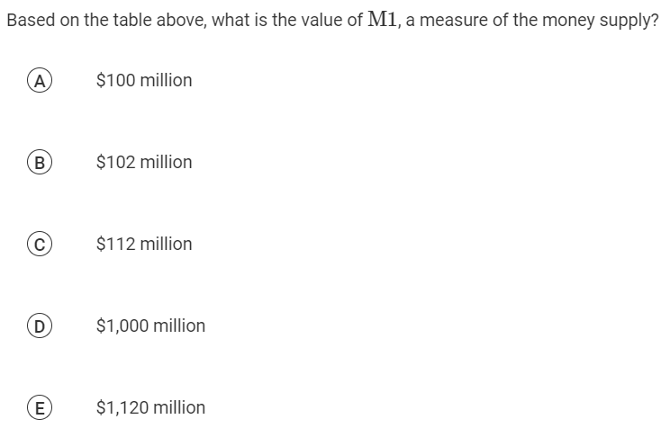

Slide 37
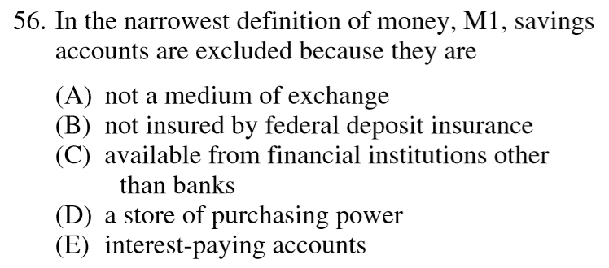
2012 Audit Exam
Notes:
A

Slide 38
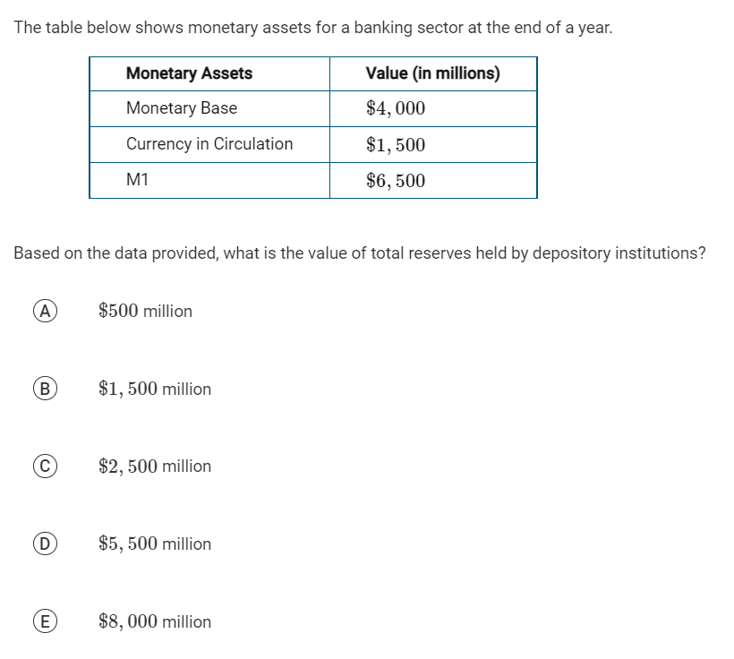

Slide 40
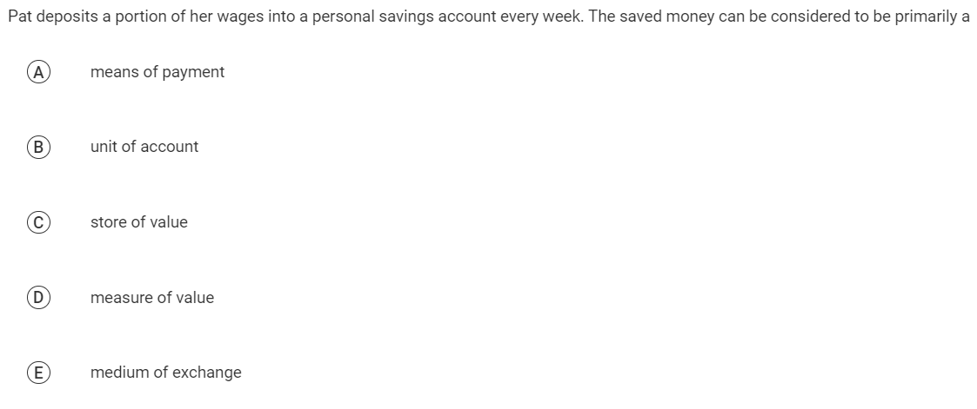

Slide 41
Practice- For each of the following examples, identify if it is considered M1 money supply, M2 money supply, or not counted (NC) in the U.S. money supply.
A $20 bill given to you by your grandma?
M 1

Slide 42
Practice- For each of the following examples, identify if it is considered M1 money supply, M2 money supply, or not counted (NC) in the U.S. money supply.
2. You have $400,000 equity in real estate?
NC

Slide 43
Practice- For each of the following examples, identify if it is considered M1 money supply, M2 money supply, or not counted (NC) in the U.S. money supply.
3. $100 in your savings account
M 2

Slide 44
Practice- For each of the following examples, identify if it is considered M1 money supply, M2 money supply, or not counted (NC) in the U.S. money supply.
4. $10 Trillion dollars of Zimbabwe currency
NC

Slide 45
Practice- For each of the following examples, identify if it is considered M1 money supply, M2 money supply, or not counted (NC) in the U.S. money supply.
5. A $300 certificate of deposit
M 2

Slide 46
Practice- For each of the following examples, identify if it is considered M1 money supply, M2 money supply, or not counted (NC) in the U.S. money supply.
6. Bitcoin worth $10,000
NC

Slide 47
The response states that the monetary base will increase by $60,000 and explains that the central bank bond purchase increases reserves by $60,000 and the monetary base is the sum of reserves and currency in circulation.

Slide 49
Additional Resources
Curriculum:
Additional MCEE K-12 Resources: z.umn.edu/TeacherResources
Council for Economic Education (National):
EconEdLink
ReadyAssessments

Slide 50
Any Questions?
mcee.umn.edu | mcee@umn.edu | 612.625.3727

Slide 51
Thank You
James Redelsheimer | jred40@gmail.com
mcee.umn.edu | mcee@umn.edu | 612.625.3727

