Slide 1

Discussion Starter
What do you want to know about cryptocurrency, NTFs (non-fungible tokens), and other digital “assets”?
Notes:
🍐 This is a Pear Deck Text Slide
🍐 To edit the type of question, go back to the "Ask Students a Question" in the Pear Deck sidebar.

Slide 2
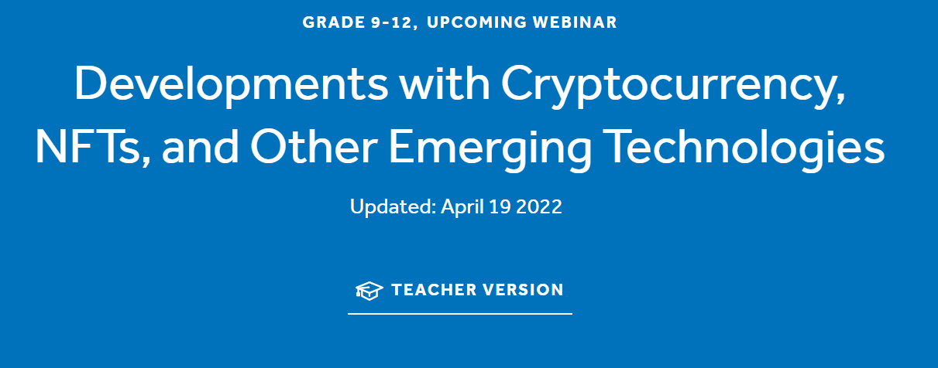
Presented by Tawni Hunt Ferrarini, PhD
April 21, 2022 tferrarini@lindenwood.edu
https://www.tawni.org/

Slide 3
EconEdLink Membership
You can now access CEE’s professional development webinars directly on EconEdLink.org! To receive these new professional development benefits, become an EconEdLink member. As a member, you will now be able to:
Automatically receive a professional development certificate via e-mail within 24 hours after viewing any webinar for a minimum of 45 minutes
Register for upcoming webinars with a simple one-click process
Easily download presentations, lesson plan materials and activities for each webinar
Search and view all webinars at your convenience
Save webinars to your EconEdLink dashboard for easy access to the event
You may access our new Professional Development page here

Slide 4
Professional Development Certificate
To earn your professional development certificate for this webinar, you must:
Watch a minimum of 45-minutes and you will automatically receive a professional development certificate via e-mail within 24 hours.
Accessing resources:
You can now easily download presentations, lesson plan materials, and activities for each webinar from EconEdLink.org/professional-development/

Slide 5
Agenda
Highlight key learning objectives
Link to national and state standards
Integrate the crypto craze, a current event, into the social studies or personal finance curriculum
Relate the topic of speculative cryptocurrencies, non-fungible tokens (NTFs), and other emerging digital assets in a well-diversified portfolio of investments
Provide a “Once Over Lightly” Review

Slide 6
Objectives
Define the three functions of stable money in a prospering economy
Distinguish sound money from financial investments
Introduce speculative investments and other emerging technological investments such as non-fungible tokens
Compare sound money to cryptocurrencies and other speculative assets
Relate both to growth and prosperity

Slide 7

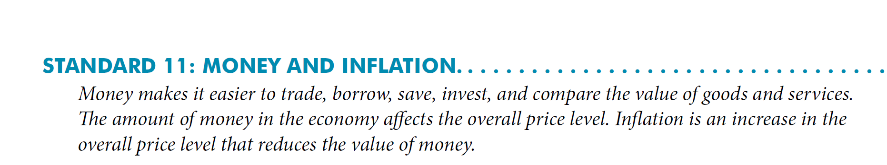
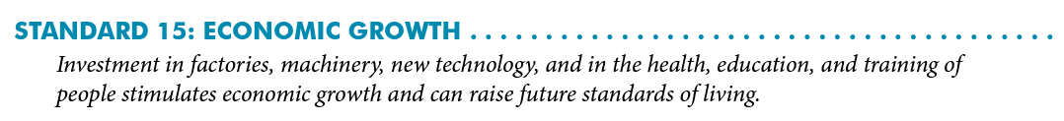
National Standards
s

Slide 8
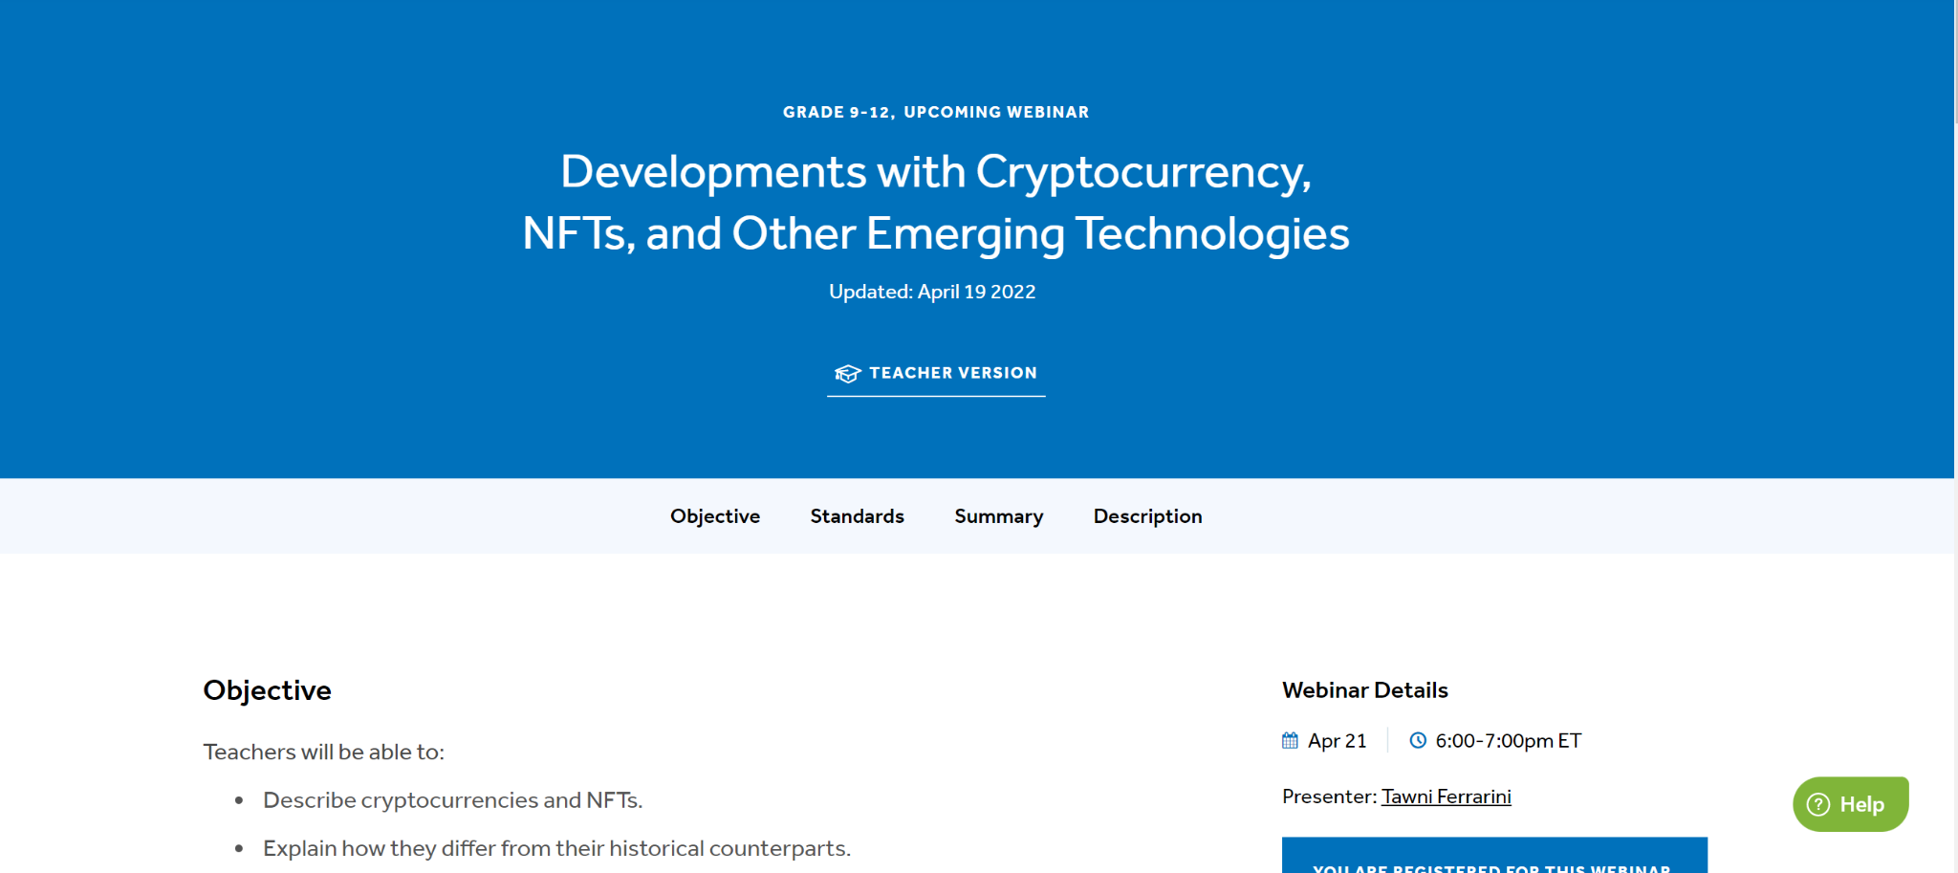
State Standards
List corresponding regional standards you may have > http://www.nysed.gov/curriculum-instruction

Slide 9
State Standards
List corresponding regional standards you may have > http://www.nysed.gov/curriculum-instruction

Slide 10

Your earn $1000. Which would you choose?
Buy $1000 worth of Bitcoin and hold for 3 months.
Hold $1000USD for 3 months.
Notes:
🍐 This is a Pear Deck Draggable™ Slide.
🍐 To edit the type of question, go back to the "Ask Students a Question" in the Pear Deck sidebar.

Slide 11




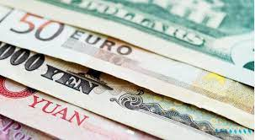
Three Functions of Sound, Fiat Money in Modern Society
1. Medium of exchange
2. Store of value
3. Unit of account

Slide 12



Three Functions of Sound, Fiat Money in Modern Society
1. Medium of exchange
2. Store of value
3. Unit of account
Sound money backed by limited government supports:
All of this contributes to:
Growth in production and income through voluntary trade without necessarily increasing resources.
Investment in capital is
a plus!
Specialization, division of labor, and operation on basis of comparative advantage.

Slide 13
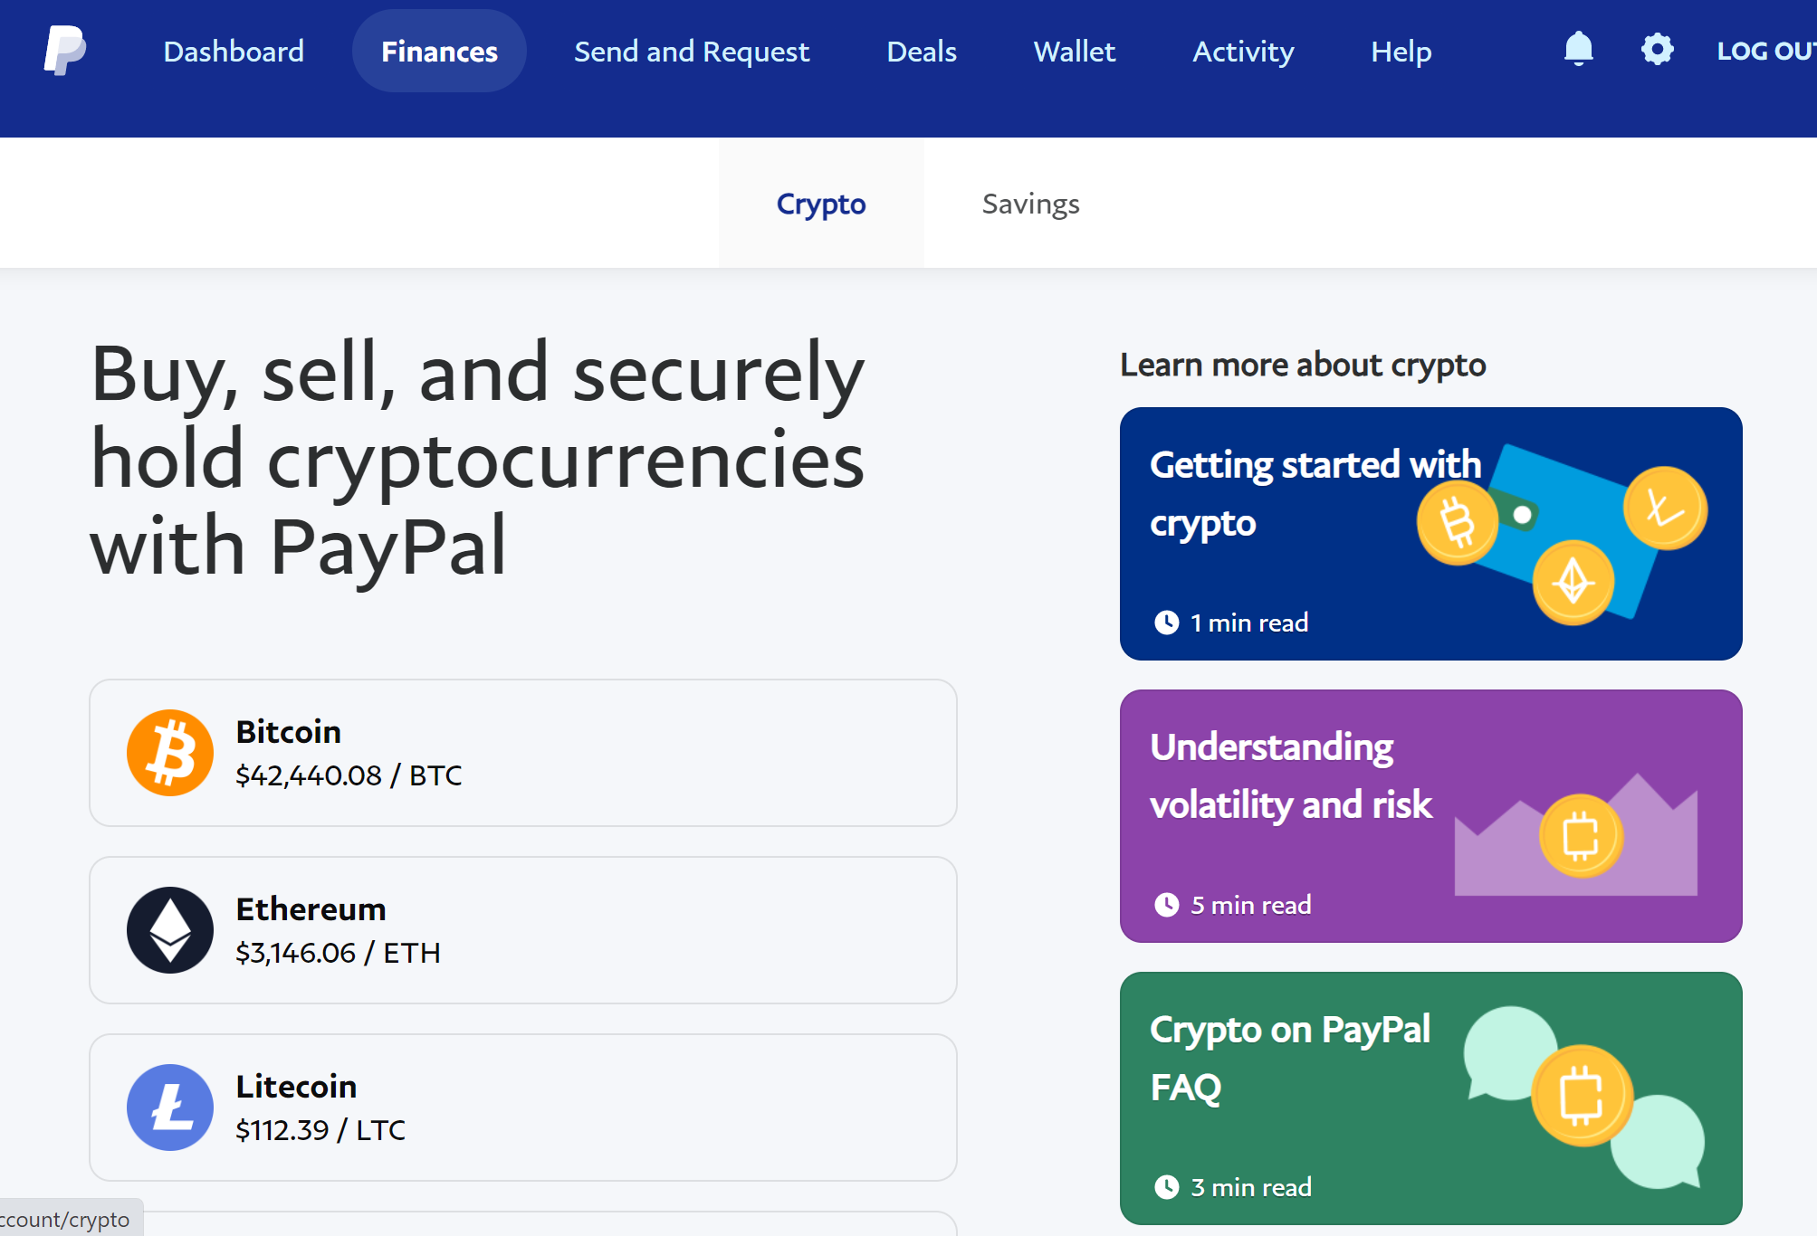

Assessment for Sound Money
Have you purchased cryptocurrency using PayPal, Coinbase, or another venue?

Slide 14
Assessment for Sound Money
Purchased crypto, NTF, or other digital tech?
Have you accepted cryptocurrency using PayPal, Coinbase, or another venue in payment for something?

Slide 15
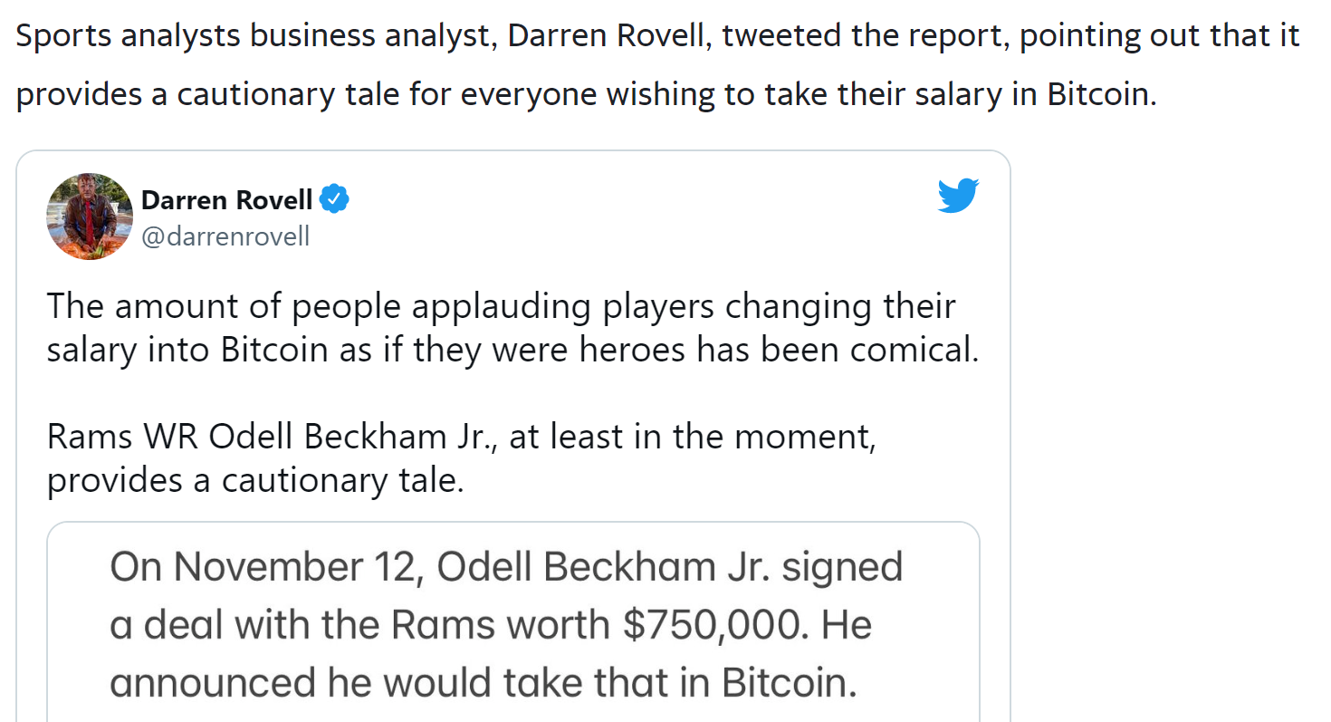
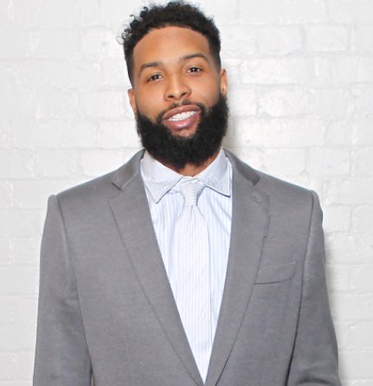
Some Have: NFL
Cleveland Browns’ Odell Beckham Jr.
Adejumo, O. (2022, January 26). Issues arise with NFL's star Bitcoin salary. Yahoo! Retrieved April 21, 2022, from https://www.yahoo.com/video/issues-arise-nfl-star-bitcoin-163331473.html

Slide 16
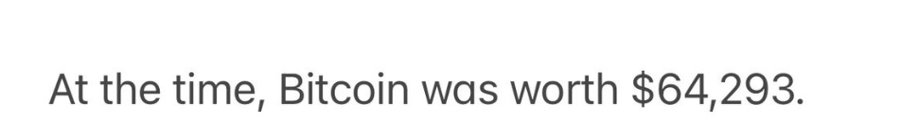
So, $750,000 translated into:
11 Bitcoin
1,100 Bitcoin
11,000 Bitcoin
11,000,000 Bitcoin
Notes:
🍐 This is a Pear Deck Multiple Choice Slide. Your current options are: A: 11 Bitcoin, B: 1,100 Bitcoin, C: 11,000 Bitcoin, D: 11,000 Bitcoin,
🍐 To edit the type of question or choices, go back to the "Ask Students a Question" in the Pear Deck sidebar.

Slide 17
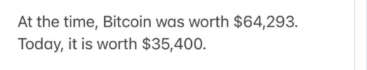
So, $750,000 translated into:
11 Bitcoin
1,100 Bitcoin
11,000 Bitcoin
11,000,000 Bitcoin
Jan 26, 2022

Slide 18
Fast forward to January 2022 and take into the change in the value of Bitcoin, the 11 Bitcoin in Nov changed to what?
11 Bitcoin
1,100 Bitcoin
6 Bitcoin
11,000,000 Bitcoin
Jan 26, 2022
Notes:
🍐 This is a Pear Deck Multiple Choice Slide. Your current options are: A: 11 Bitcoin, B: 1,100 Bitcoin, C: 6 Bitcoin, D: 11,000 Bitcoin,
🍐 To edit the type of question or choices, go back to the "Ask Students a Question" in the Pear Deck sidebar.

Slide 19
Fast forward to January 2022 and take into the change in the value of Bitcoin, the 11 Bitcoin in Nov changed to what?
55% drop
11 Bitcoin
1,100 Bitcoin
6 Bitcoin
11,000,000 Bitcoin
Jan 26, 2022

Slide 20

Fast forward to January 2022 and take into the change in the value of Bitcoin, the 11 Bitcoin in Nov changed to what in USDs?
55% drop
11 Bitcoin
1,100 Bitcoin
6 Bitcoin
11,000,000 Bitcoin
Jan 26, 2022
OBJ’s pay

Slide 21
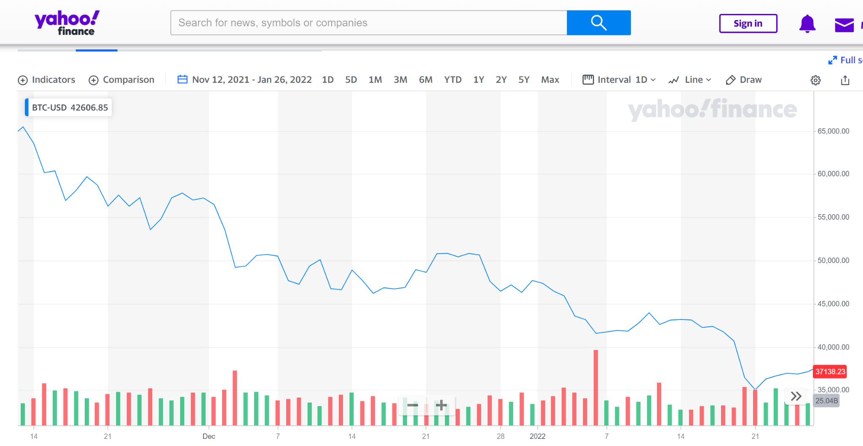
Crytos, NFT, etc. are volatile

Slide 22
But wait!
There are 2021 taxes.
There is another layer. The Federal and California tax for OBJ is 50.3%. That is right, over half of his pay will be taxed. Which amount does OBJ use to calculate taxes due?
11 Bitcoin
6 Bitcoin
$412,953
$750,000
Notes:
🍐 This is a Pear Deck Multiple Choice Slide. Your current options are: A: 11 Bitcoin, B: 6 Bitcoin, C: $412,953 USD, D: $750,000 USD,
🍐 To edit the type of question or choices, go back to the "Ask Students a Question" in the Pear Deck sidebar.

Slide 23
But wait! There are taxes.
Federal and California tax for OBJ is 50.3%. That is right, over half of his pay will be taxed. Which amount is taxed?
11 Bitcoin
6 Bitcoin
$412,953
$750,000

Slide 24
But wait! There are taxes.
Federal and California tax for OBJ is 50.3%. That is right, over half of his pay will be taxed. Which amount is taxed?
11 Bitcoin
6 Bitcoin
$412,953
$750,000
2021 Taxes Due: $377,250

Slide 25
But wait! There are taxes.
Federal and California tax for OBJ is 50.3%. That is right, over half of his pay will be taxed. Which amount is taxed?
11 Bitcoin
6 Bitcoin
$412,953
$750,000
2022 Salary Value: $412,953
2021 Taxes Due: - $377,250
=$35,703 Net Pay (~Bitcoin)
vs.
$372,750 Net Pay USD

Slide 26
Growth through Savings and Investment
Growth and prosperity
Diversified Investment
Prudent Savings (not immediate consumption)
Production is based on comparative advantage and people trade for the rest

Slide 27

Saving/Dissaving

Slide 28

From the local store to installment credit to small loans to credit cards to cryptocurrency

Slide 29

What is cryptocurrency?
Crytocurrency is a peer-to-peer electronic cash system.
  Provides an alternative to the current system of money
  Do not have to go through the central banking system, a financial institution, or electronic payment system such as Paypal*

Slide 30
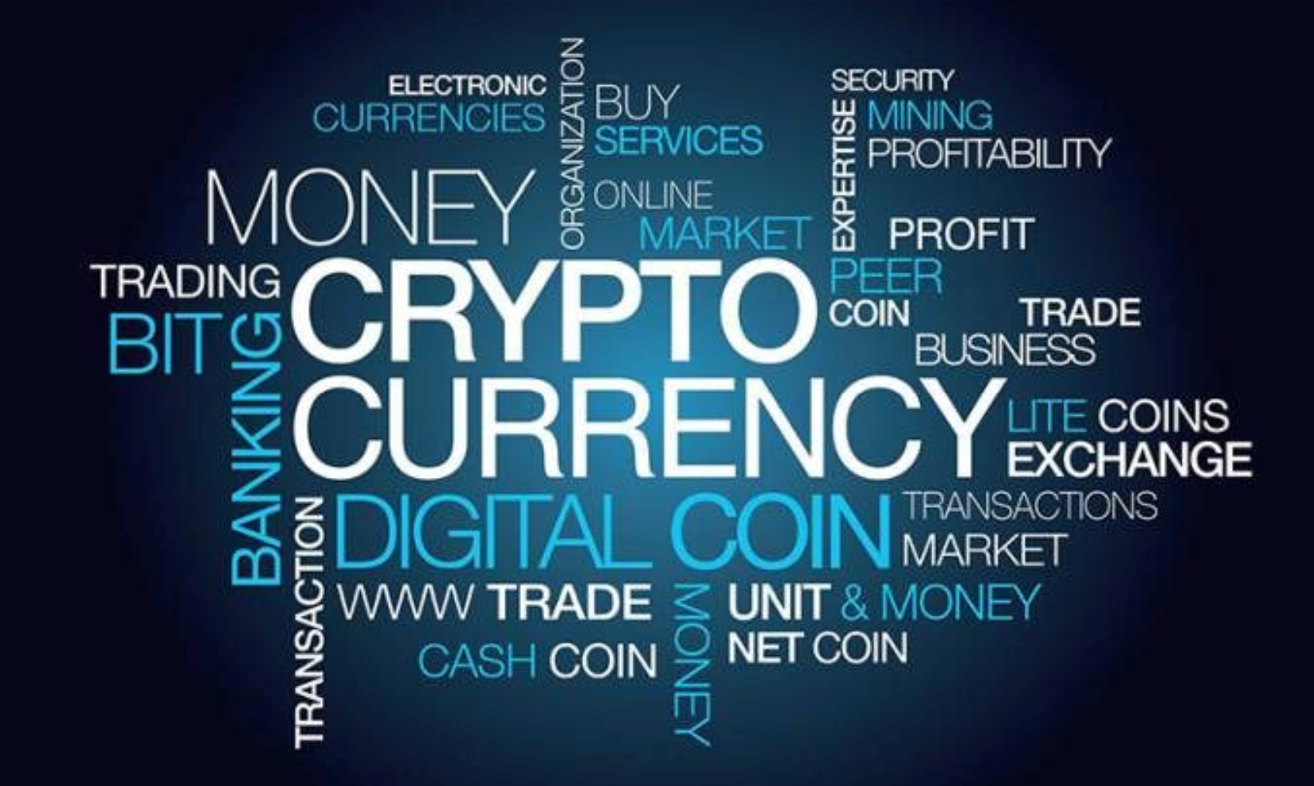
bitcoin
Bitcoin is the most notable cryptocurrency. There thousands of others.
  Was introduced by “Satoshi Nakamoto” in late 2008 and early 2009
  Concurrent with the Great Recession of 2008
  Thousands of competitive cryptocurrencies exist, including ETHEREUM, LITECOIN, DOGECOIN, and others
Image source: https://www.iflg.uk.com/blog/should-cryptocurrency-be-part-my-divorce-settlement

Slide 31
What is blockchain technology?
Blockchain describes the computerized networks that allow peer-to-peer transactions without central planners, government, banks, or financial intermediaries of any type.
It is maintained by a network of computer “geeks” or “geniuses” known as miners. They are paid cryptocurrency for their work.
References:
"Bitcoin: Money or Financial Investment?," by Scott A. Wolla, Page One Economics®, March 2018
Explainer: What is a blockchain? - MIT Technology Review, June 14, 2021
Bitcoin and Beyond: The Possibilities and Pitfalls of Virtual Currencies – Federal Reserve Bank of St. Louis, October 21, 2014

Slide 32





Three traits of cryptocurrency in a blockchain
(a decades old computerized network)
Transparent
Authenticated
Can be audited
This Photo by Unknown Author is licensed under CC BY-SA

Slide 33
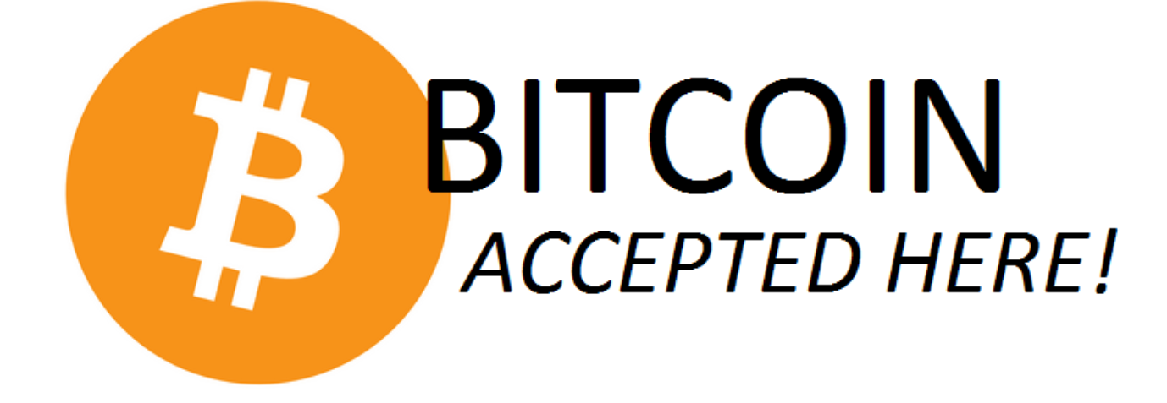





Who uses it?
Peer-to-peer exchanges
A few retailers like Overstock, Expedia, Dish, subway, and Microsoft
Mt. Gox (2010-14), the largest Bitcoin exchange which was based in Tokyo, Japan
Above is my list from 2018 of retailers accepting Bitcoin. Little has changed in four years. See: https://www.buybitcoinworldwide.com/who-accepts-bitcoin/

Slide 34
Cryptocurrency
It is…
At this time, it is not…
Different than “fiat” money
A part of a decentralized system subject to no government regulation or insurances
Governed by consensus of its users
Network is supported by the transactions by consumers, savers, producers, and investors through blockchain technology
A widely utilized medium of exchange
Unit of account
Store of value

Slide 35
Your earn $1000. Which would you choose?
Buy $1000 worth of Bitcoin and hold for 3 months.
Hold $1000USD for 3 months.
Notes:
🍐 This is a Pear Deck Draggable™ Slide.
🍐 To edit the type of question, go back to the "Ask Students a Question" in the Pear Deck sidebar.

Slide 36
Bottom line…
Proceed with caution and information. Invest what you can lose.
Bitcoin is a speculative asset at this point.

Slide 37
Upside to Bitcoin
It is transparent, authenticated, and can be audited.
From the first chain forward, you can trace the origins of the chain and everything that makes it up.
It is not directly subjected to government policy influences, political interests, and short-sightedness.
It makes use of blockchain technology – an advancement in technology.

Slide 38
Blockchain Technology
Used to track healthcare services by patients and their providers
Mobilized in the supply chain to track everything from original extraction of natural resources to final consumer
NTFs allow artists to create original art and sell it without the risk of copyright infringement
In theory, it allows consumers and others to trace property – even intellectual property (NFT).

Slide 39
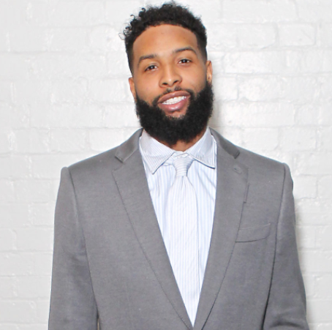
Blockchain Technology

Slide 40
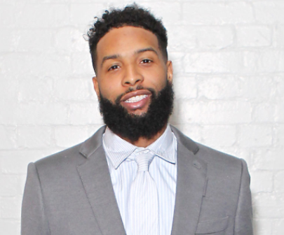
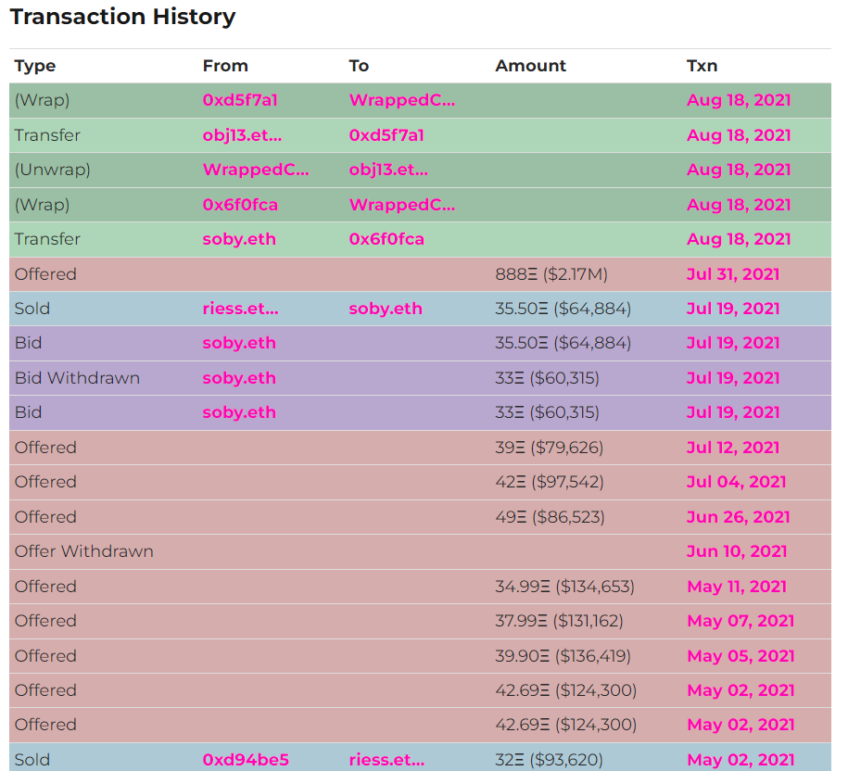
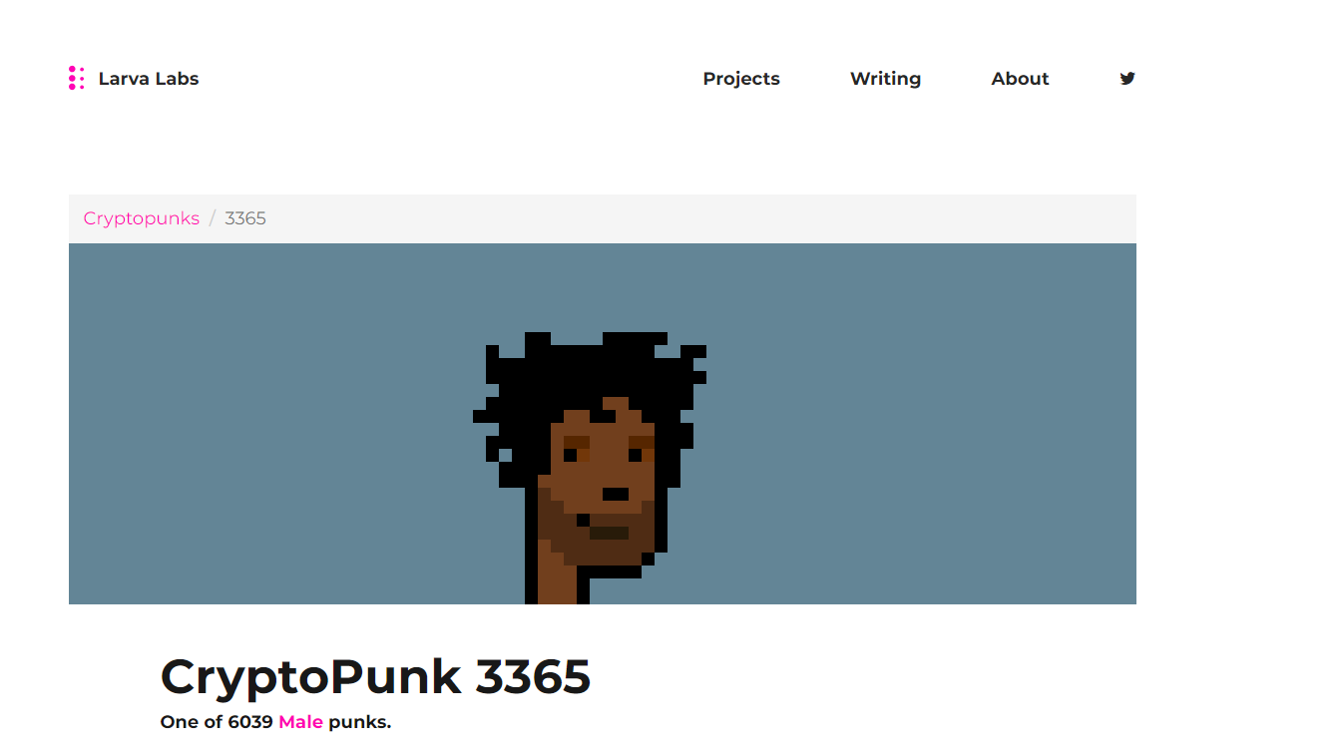
Blockchain Technology
NTF
Supply and Demand
History of his NTFs

Slide 41
As an educator…
It provides teachable moments for family members and students
Educate others about blockchain technology, long-term investment practices, cryptocurrencies, and sound money
Understand when “speculative” investments make sense

Slide 42

My “Bitcoin” Story
LIVE! LAUGH! LEARN!
Within a year, I lost 70 percent of the value of my cryptocurrency portfolio with an initial investment of $841!!!
Yikes! It was not a growing asset.
Since December of 2017, “Bitcoin” has not used it to purchase anything, I haven’t been paid in Bitcoin, BUT….

Slide 43
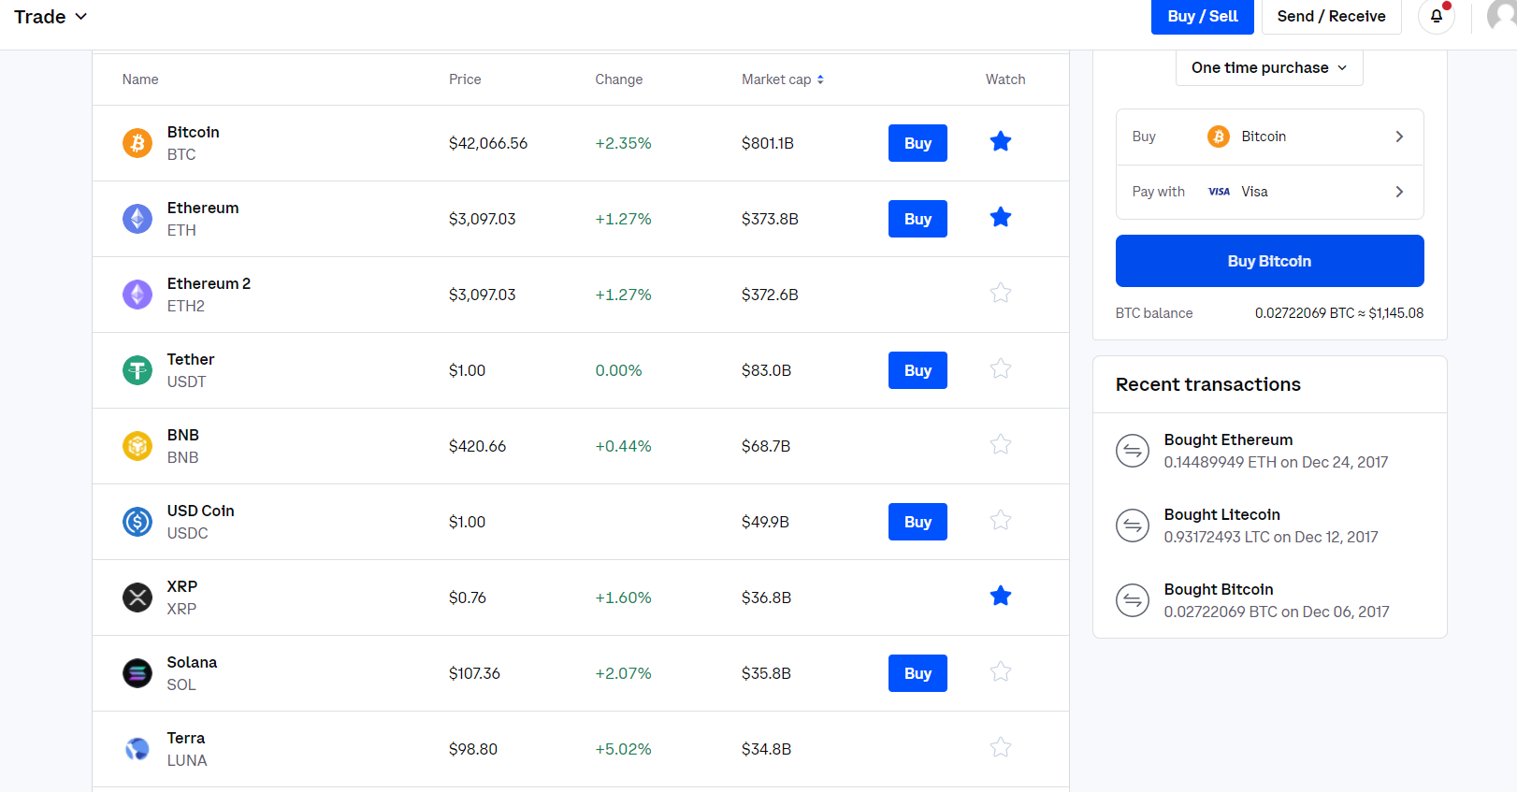
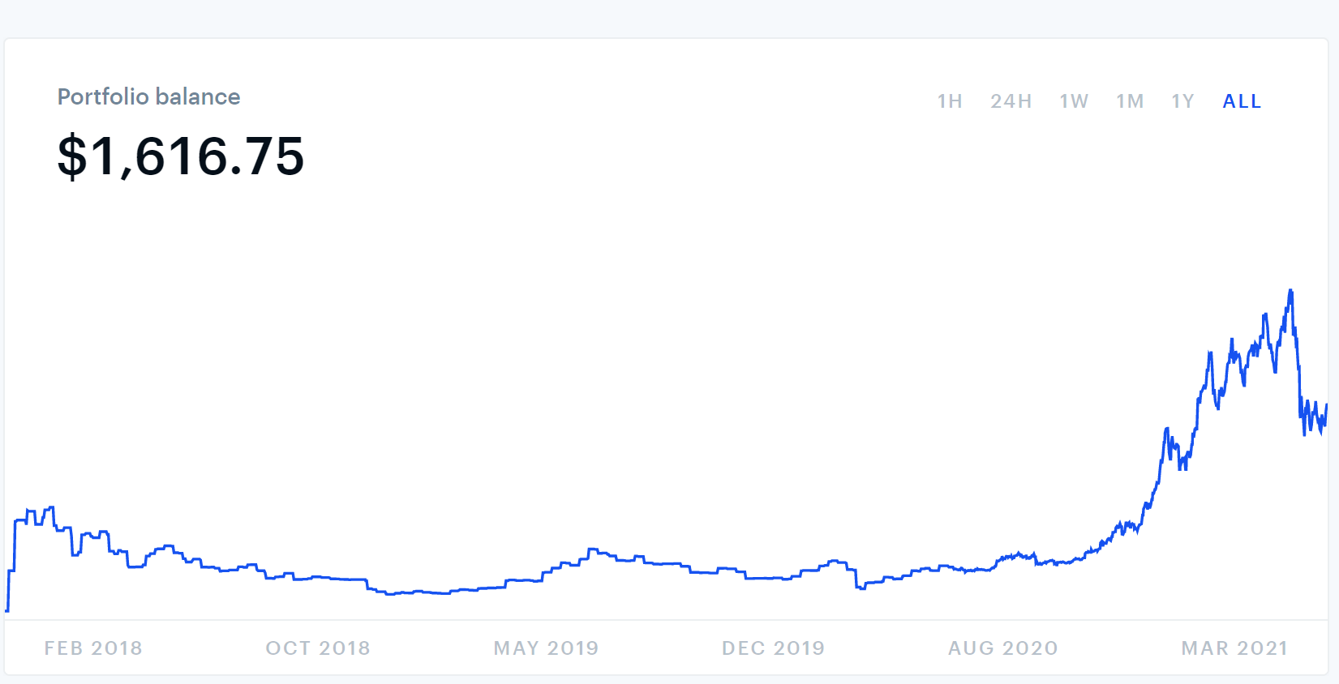
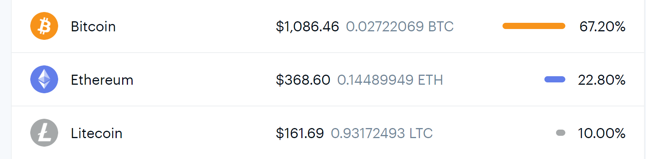
My portfolio has grown in value…

Slide 44
Advice from all of you…
I have $250 USD what advice to you give?
Buy Bitcoin
Buy NFT
Save it for a “rainy” day (withdrew $$ due to car problems)
Invest it in an index fund

Slide 45
References
EconEdLink.org Search “Cryptocurrency”
Böhme, Rainer, Nicolas Christin, Benjamin Edelman, and Tyler Moore. 2015. "Bitcoin: Economics, Technology, and Governance." Journal of Economic Perspectives, 29 (2): 213-38.
Clark, J.R., M. Scott Niederjohn, and William C. Wood. 2018. “Understanding Bitcoin: Money, Asset, or Bubble?” Social Education.
Wolla, Scott. 2017. “Bitcoin: Money or Financial Investment? (Page One Economics),” St. Louis Federal Reserve Bank, https://files.stlouisfed.org/files/htdocs/publications/page1-econ/2018/03/01/bitcoin-money-or-financial-investment_SE.pdf.

Slide 46

CEE Affiliates
https://www.councilforeconed.org/resources/local-affiliates/

Slide 47




Thank You to Our Sponsors!

