Slide 1
Gary N. Petmecky Parkview High School Lilburn, Ga

Slide 2
Econedlink Fundamentals of A.P. Economics Webinar Series

Slide 3
Econedlink AP Macroeconomics Collection

Slide 4
Econedlink AP Microeconomics Collection

Slide 5
Econedlink “Preparing for the A.P. Exam

Slide 6
Real vs. Nominal

Slide 7
Why?
Economic decisions in the “real” world are often based on real values, not nominal values.
Ex: Real GDP, real interest rates.
To understand the different models used in Economics, students must understand the distinction between real and nominal.

Slide 8
AP Macro CED This is topic 2.6

Slide 9
Lot of different approaches to teaching this material.

Slide 10
Econedlink has two activities you can use. I am not going to go through these because they are presented on their site. What Causes Inflation? What Does a Dollar Really Buy?

Slide 11
Councilforeconed.org

Slide 13
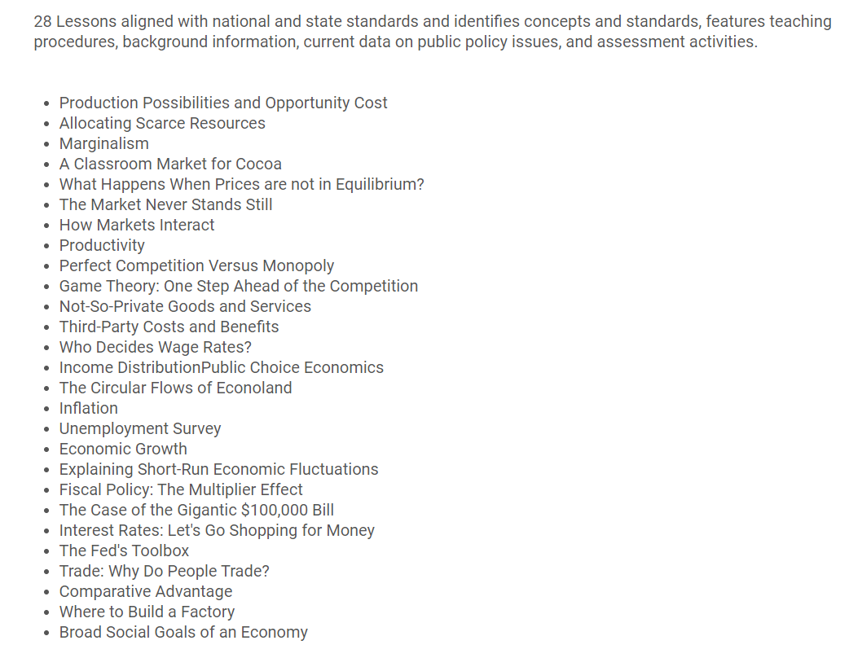

Slide 14
Inflation: a general rise in prices and a fall of purchasing power.

Slide 15
Consumer Price Index: measures the change in prices paid by consumers for goods and services. The CPI measures the cost of a fixed basket of goods and services, in a given year, relative to the base year.

Slide 16
Bls.gov

Slide 17
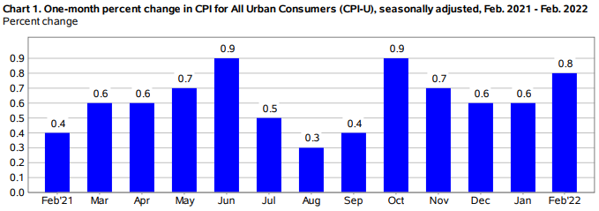

Slide 18
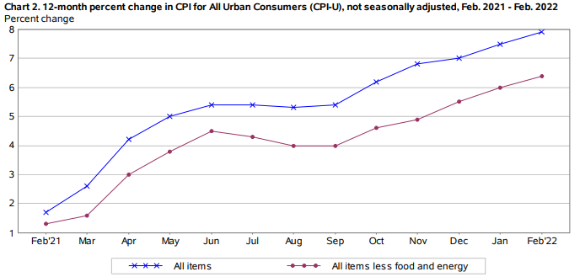

Slide 19
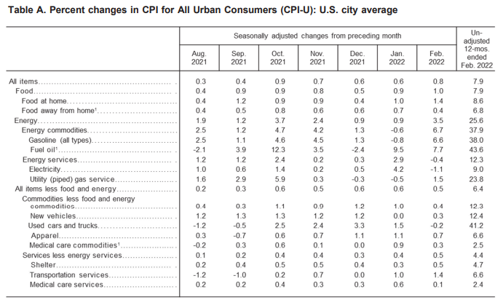

Slide 20
The CPI measures the change in income needed in order to maintain the same standard of living over time under a new set of prices compared to the original set up prices.
For example if CPI goes up 7% in a year, your income would have to go up 7% to purchase the same goods and services.

Slide 21
The Consumer Price Index is the most commonly used index.

Slide 22
When comparing things like wages, gas prices, GDP… you need to adjust for inflation to find out how much they have really changed. In other words, take inflation out of the picture, to get real.

Slide 23
Students must use price indices to compare nominal and real variables over time periods.

Slide 24
Real = (Nominal/PI) X 100

Slide 25
Is gasoline expensive now?

Slide 26
Current Inflation Statistics from BLS

Slide 27
Is gasoline expensive now?
Year | Nminal Price of Gas | CPI (1982-1984)=100 | Real Price of Gas
1973 | $0.39 | 44.4
1980 | $1.25 | 82.4
1990 | $1.16 | 130.7
2000 | $1.51 | 172.2
2005 | $2.34 | 197.6
Nov 2008 | $4.12 | 212.4
2010 | $2.67 | 216.7
January 2016 | $1.69 | 236.5
Now |  | 283.7

Slide 28
Calculate the Real Price of gasoline using the following: Real = (Nominal /PI) X 100

Slide 29
Is gasoline expensive now?
Year | Nominal Price of Gas | CPI (1982-1984)=100 | Real Price of Gas
1973 | $0.39 | 44.4 | .87
1980 | $1.25 | 82.4 | 1.51
1990 | $1.16 | 130.7 | .887
2000 | $1.51 | 172.2 | .876
2005 | $2.34 | 197.6 | 1.18
Nov 2008 | $4.12 | 212.4 | 1.93
2010 | $2.67 | 216.7 | 1.23
January 2016 | $1.69 | 236.5 | .67
Now |  | 283.7

Slide 30
What are the top grossing movies of all time?

Slide 31
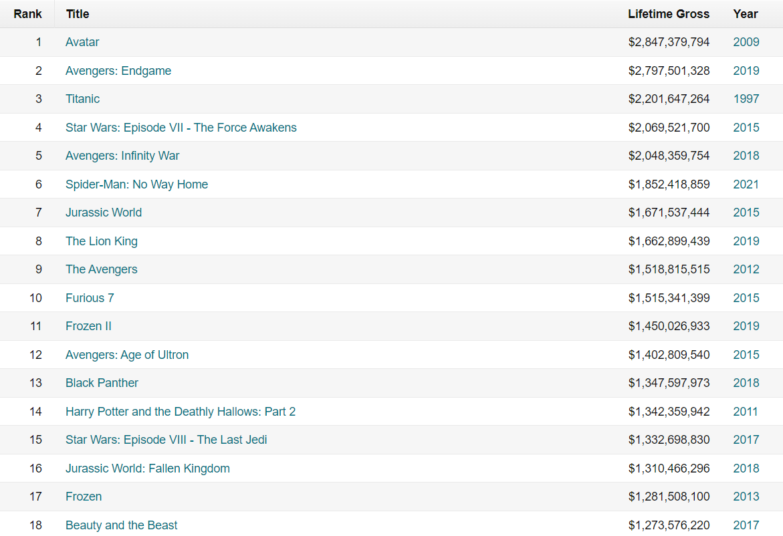

Slide 32
Those are the top grossing movies in nominal dollars? Note: there is debate over this because of theater vs. DVD/TV showings.

Slide 33
What are the top grossing movies in real dollars? Note: there is debate over this because of theater vs. DVD/TV showings.
This information can be found at boxofficemoji.com. It has been updated through 2020.

Slide 34
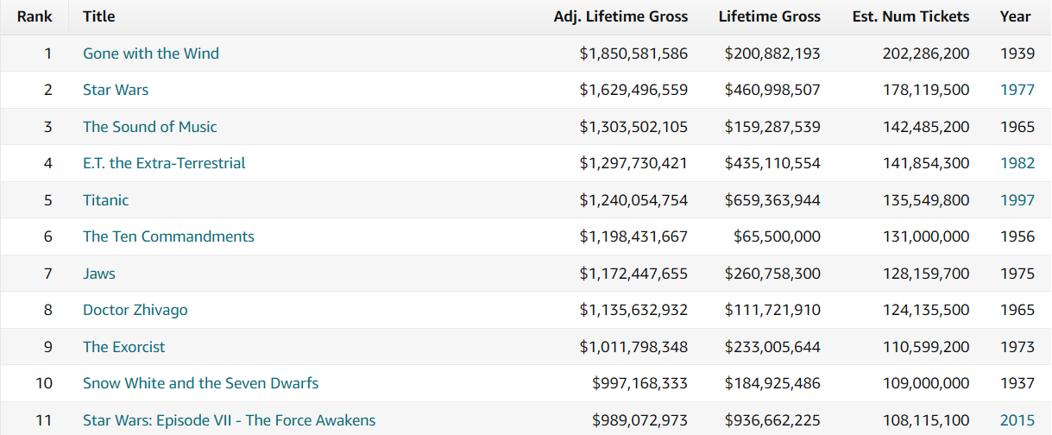

Slide 35
I have also done the same thing for wages.

Slide 36
Students tell me they are in school so they can eventually join the real world. So what is the real world?

Slide 37
Real world = (Nominal world /PI) X 100

Slide 38
The Federal Reserve Bank of Minneapolis has a inflation calculator.

Slide 39
Real vs. Nominal GDP

Slide 40
Assume we have an economy that only produces two products:
Product | Year 1 Q | Year 1 P | Year 2 Q | Year 2 P
Apples | 10 | $1 | 12 | $1.50
Bananas | 6 | $.50 | 10 | $1
Is this economy ((28-13)/ 13) * 100 = 115.3% better?

Slide 41
Nominal GDP is total value of all final goods and services produced in a given year at current prices.
Real GDP is the total value of all final goods and services produced in a given year, using the prices in the base year.

Slide 42
You can calculate Real GDP by weighing the price of goods and services in their base year.

Slide 43
Assume we have an economy that only produces two products:
Product | Year 1 Q | Year 1 P | Year 2 Q | Year 2 P
Apples | 10 | $1 | 12 | $1.50
Bananas | 6 | $.50 | 10 | $1
Now we see this economy is really ((17-13)/ 13) * 100 = 30.7% better.?

Slide 44
Nominal GDP can also be converted to Real GDP by using the GDP Deflator.

Slide 45
Students get scared by the GDP deflator. Just think of it as another price index.
The CPI measures price changes for consumer goods.

Slide 46
Students get scared by the GDP deflator. Just think of it as another price index.
The PPI measures price changes for producer goods.

Slide 47
Students get scared by the GDP deflator. Just think of it as another price index.
The GDP Deflator measures price changes for all goods and services.

Slide 48
Students get scared by the GDP deflator. Just think of it as another price index.
I tell them to just think of it as another price index.
The GDP Deflator measures price changes for all goods and services.

Slide 49
Real = (Nominal/PI) * 100
PI = Real/Nominal
We usually use CPI for this but what if we used all goods and services?
Real GDP = (NominalGDP /GDP Deflator) * 100

Slide 50
Another way to look at this is in terms of inflation rates.
Real = Nominal – Inflation Rate
For example, Nominal GDP grew by 4% and the rate of inflation was 2%. What is Real rate of growth for GDP?

Slide 51
Types of questions the AP exam has asked in the past.

Slide 52
They give the student nominal/ and or real data and they give CPI data. They then make the students calculate the missing piece.
Real = (Nominal/PI) * 100
This might be in word form or table form.
Give you students lots of practice opportunities off of AP Classroom.

Slide 53
Summary
Economic decisions in the “real” world are often based on real values, not nominal values.
To understand the different models used in Economics, students must understand the distinction between real and nominal.

Slide 54
What are your questions?

