Slide 1
Gary N. Petmecky Parkview High School Lilburn, Ga

Slide 2
Econedlink Fundamentals of A.P. Economics Webinar Series

Slide 3
Econedlink AP Macroeconomics Collection

Slide 4
Econedlink “Preparing for the A.P. Exam

Slide 5
Econedlink AP Microeconomics Collection

Slide 6
Price Indices and Inflation

Slide 7
AP Macro CED Topic 2.4 and 2.5

Slide 8
Why?
Macroeconomics is all about two main “problems” in an economy. Unemployment and inflation.
To fully understand the economy, students must know what inflation is and how to calculate it.
Student need to understand it when they start applying it with the AS/AD model.

Slide 9
If you go back to the simple circular flow model that shows a closed, private economy, you can show students how inflation occurs.

Slide 10
Goods and Services
Product Market
Goods and Services
Payment for Goods and Services
Payment for Goods and Services
Households
Businesses
Rent, wages, interest, profit
Factor Market
Rent, wages, interest, profit
Land, Labor, Capital, Entrepreneurship
Land, Labor, Capital, Entrepreneurship

Slide 11
Goods and Services
Product Market
Goods and Services
Payment for Goods and Services
Payment for Goods and Services
Households
Inflation
Businesses
Rent, wages, interest, profit
Factor Market
Rent, wages, interest, profit
Land, Labor, Capital, Entrepreneurship
Land, Labor, Capital, Entrepreneurship

Slide 12
Inflation: a general rise in prices and a fall of purchasing power.

Slide 13
Congrats! You got a raise.
Teachers often wait to use this with monetary policy but I do it here and then revisit it when I get to monetary policy.

Slide 14
1. Make three small Ziplock bags of identical rewards for each class. I use various small candies.
Congrats! You got a raise.
Setup:
2. Make a Ziplock bag of un-popped popcorn and a Ziplock bag of uncooked hard kidney beans.

Slide 15
2. Announce to the class that you have a bag of candy that you would like to auction off to the highest bidder. The currency that will be used is popcorn seeds.
Congrats! You got a raise.
Procedure:
1. Walk around the room and hand out various amounts of popcorn seeds to each person. Keep count of the total you hand out as you do it. Tell them that each kernel is 10 cents.
(I usually give each person anywhere from 2 to 5 seeds. I also will have about 5% of the class get nothing. You can then link this back to unemployment.)

Slide 16
3. Auction off the bag of candy to the highest bidder. Note that students will ask if they can combine their “money”. I encourage this.
Congrats! You got a raise.
Procedure:
4. Record how much money was in the economy and how much the bag of candy sold for. This is for the monetary policy unit. Keep this data.

Slide 17
5. Announce that you have second IDENTICAL bag of candy that you would like to auction off to the highest bidder.
Congrats! You got a raise.
Procedure:
6. Walk around the room and hand back the amount of corn seeds collected in the first round plus about 50% more. Tell them, Congrats! You got a raise. Again, keep track of how much you give out.
(I usually give less to the group that got the candy the first time around. I also make sure different people are unemployed.

Slide 18
7. Auction off the second bag of candy to the highest bidder. Since not everyone spent their money in the first round, and you gave more to the kids who didn’t win the first round you can usually count on a different group of kids will win this auction.
Congrats! You got a raise.
Procedure:
8. Record how much money was in the economy and how much the bag of candy sold for.

Slide 19
9. Announce that you have third, and final, IDENTICAL bag of candy that you would like to auction off to the highest bidder.
Congrats! You got a raise.
Procedure:
10. This time, you are adding the kidney beans to the economy. They are $1 each Walk around the room and hand back the amount of corn seeds collected in the first round plus a bunch of kidney beans. Again, tell them, Congrats! You got a raise. Again, keep track of how much you give out.
(Again, I usually give less to the group that already got candy. I also make sure different people are unemployed.

Slide 20
11. Auction off the final bag of candy to the highest bidder.
Congrats! You got a raise.
Procedure:
12. Record how much money was in the economy and how much the bag of candy sold for.
13. Be sure to keep all of your data so you can refer back to it when you teach monetary policy.

Slide 21
1. Discuss why the price of the candy went up each round. Emphasize that the price of the candy went up even though each bag was identical in each round.
Congrats! You got a raise.
Debrief:
Introduce the concept of inflation as too much money chasing too little goods.

Slide 22
2. Discuss the concept that each round they got the same amount of candy, but the price was higher. This sets up the concept of real v. nominal.
Congrats! You got a raise.
Debrief:

Slide 23
Current Inflation Statistics from BLS

Slide 25
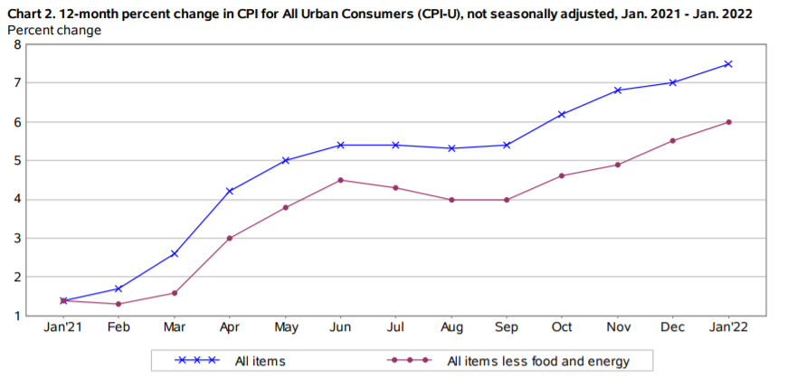

Slide 26
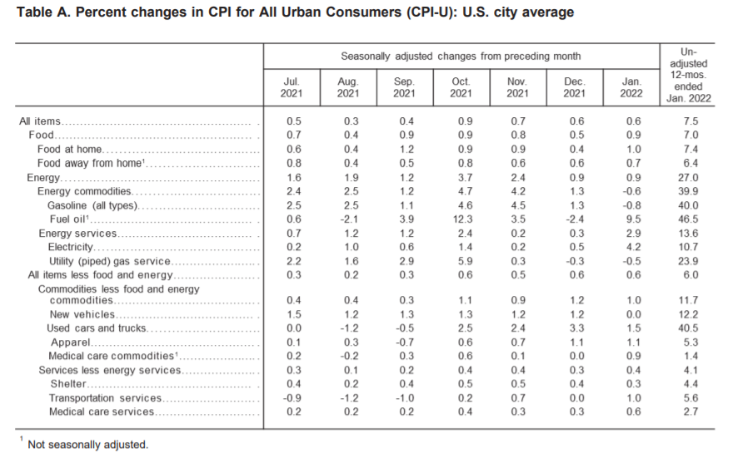

Slide 27
Econedlink has two activities you can use. I am not going to go through these because they are presented on their site. What Causes Inflation? What Does a Dollar Really Buy?

Slide 28
Consumer Price Index: measures the change in prices paid by consumers for goods and services.
It measures the cost of a fixed basket of goods and services, in a given year, relative to the base year.
Go back to the candy auction and discuss these concepts.

Slide 29
The CPI measures the change in income needed in order to maintain the same standard of living over time under a new set of prices compared to the original set up prices.
For example if CPI goes up 7% in a year, your income would have to go up 7% to purchase the same goods and services.

Slide 30
Students must know how to calculate CPI.

Slide 31
CPI = Price of market basket in a given year X 100 Price of the SAME basket in the base year

Slide 32
Product | Year 1 Q | Year 1 P | Total Price in yr 1 | Year 2 P | Total Price in yr 2 | Year 3 P | Total Price in yr 3
Pizza | 4 | $7 |  | $8 |  | $11.50
Soda | 24 | $.50 |  | $.75 |  | $1.00
Total | ------ | -------- |  | ---------

Slide 33
Product | Q | Year 1 P | Total Price in yr 1 | Year 2 P | Total Price in yr 2 | Year 3 P | Total Price in yr 3
Pizza | 4 | $7 | $28 | $8 | $32 | $11.50 | $46
Soda | 24 | $.50 | $12 | $.75 | $18 | $1.00 | $24
Total | ------ | -------- | $40 | --------- | $50 | ----------- | $70

Slide 34
Given that year 1 is the base year, what is the CPI for the base year?

Slide 35
Product | Q | Year 1 P | Total Price in yr 1 | Year 2 P | Total Price in yr 2 | Year 3 P | Total Price in yr 3
Pizza | 4 | $7 | $28 | $8 | $32 | $11.50 | $46
Soda | 24 | $.50 | $12 | $.75 | $18 | $1.00 | $24
Total | ------ | -------- | $40 | --------- | $50 | ----------- | $70

Slide 36
CPI = (price of market basket in given year/price of same basket in the base year ) X 100

Slide 37
CPI for Year 1: $40/$40 * 100 = 100

Slide 38
In the base year the index will always be 100. If quantities change between years, you would not be looking at the same basket.

Slide 39
Given the market basket price in year 1 (the base year) is $40 and the market basket price in year 2 is $50, what is the CPI for year 2?

Slide 40
Product | Q | Year 1 P | Total Price in yr 1 | Year 2 P | Total Price in yr 2 | Year 3 P | Total Price in yr 3
Pizza | 4 | $7 | $28 | $8 | $32 | $11.50 | $46
Soda | 24 | $.50 | $12 | $.75 | $18 | $1.00 | $24
Total | ------ | -------- | $40 | --------- | $50 | ----------- | $70

Slide 41
CPI = (price of market basket in given year/price of same basket in the base year ) X 100

Slide 42
CPI for Year 1: $50/$40 * 100 = 125
I always ask them, “does this sound correct? Did prices increase or decrease? If they increased, you must have a larger number here (inflation), if prices decreased you must have a smaller number (deflation).
This way they know if they got the formula correct.

Slide 43
What does a CPI of 125% mean?

Slide 44
CPI for Year 1: $50/$40 * 100 = 125 This means prices have gone up 25% since the base year. In other words, a 25% inflation rate.
Your income would have to go up 25% to purchase the same goods and services as the base year.

Slide 45
Inflation Rate: the percent change in prices in a given period.

Slide 46
Percent Change: (Difference in two number/original number) X 100

Slide 47
Product | Q | Year 1 P | Total Price in yr 1 | Year 2 P | Total Price in yr 2 | Year 3 P | Total Price in yr 3
Pizza | 4 | $7 | $28 | $8 | $32 | $11.50 | $46
Soda | 24 | $.50 | $12 | $.75 | $18 | $1.00 | $24
Total | ------ | -------- | $40 | --------- | $50 | ----------- | $70

Slide 48
Price in Year 1: $40/$40 * 100 = 100 Price in Year 2: $50/$40 * 100 = 125 Price in Year 3: $70/$40 * 100 = 175 What is the percent change in price between year 1 and 2?

Slide 49
Year 1: $40/$40 * 100 = 100 Year 2: $50/$40 * 100 = 125
125 – 100 X 100 = 25% 100

Slide 50
Price in Year 1: $40/$40 * 100 = 100 Price in Year 2: $50/$40 * 100 = 125 Price in Year 3: $70/$40 * 100 = 175 What is the percent change in price between year 1 and 3?

Slide 51
Year 1: $40/$40 * 100 = 100 Year 3: $70/$40 * 100 = 175
175 – 100 X 100 = 75% 100

Slide 52
Price in Year 1: $40/$40 * 100 = 100 Price in Year 2: $50/$40 * 100 = 125 Price in Year 3: $70/$40 * 100 = 175 What is the percent change in price between year 2 and 3?

Slide 53
Year 1: $50/$40 * 100 = 125 Year 3: $70/$40 * 100 = 175
175 – 125 X 100 = 40% 125
Not 50%

Slide 54
I often take practice math “worksheet” problems and divide them up into single questions, enlarge them and post them around the room. The kids then have to get out of their seats to work them. I don’t allow pictures and I do encourage discussion.

Slide 55
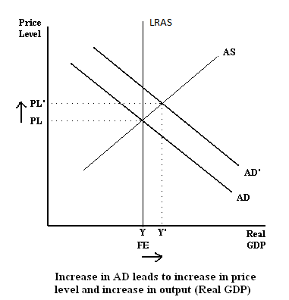

Slide 56
Disinflation: a reduction in the rate of inflation.

Slide 57
CPI Shortcomings:

Slide 58
Substitution Bias: Prices do not change uniformly. If the price of apples goes up we will substitute oranges. The CPI is weighted and does not account for this change until the weights are changed.

Slide 59
The introduction of new goods gives us access to new goods which reduces the cost of maintaining the same quality of life.

Slide 60
In both cases, the CPI will overstate inflation. If we are able to purchase different or better goods then the effects of inflation are not as great.

Slide 61
Unexpected inflation hurts people differently.

Slide 62
Savers are hurt.
Imagine you have $20,000 saved to purchase a new car. You show up at the dealer only to find that a 5% inflation rate has increased the price of the car to $21,000.

Slide 63
Borrowers are helped.
If you borrow $20,000 to purchase a new car today. You will then pay that money back over the next 7 years. With unexpected inflation, you are paying back that loan, with dollars that are not worth as much as when you borrowed the money.

Slide 64
Lenders are hurt.
They lend the money out and are then paid with dollars that are not worth as much as when they lent out the money.

Slide 65
Summary?
Macroeconomics is all about two main “problems” in an economy. Unemployment and inflation.
To fully understand the economy, you must know what inflation is, how to calculate it.
Student need to understand it when you start applying it with the AS/AD model.

