Slide 1
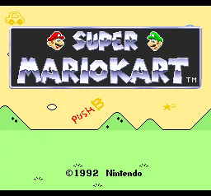
and pro-poor environmental development
Andrew Reid Bell, BU
Mar 10, 2022
Source: https://www.reddit.com/r/gaming/comments/69bwny/mariokart_psa_remember_to_always_push_b/

Slide 2
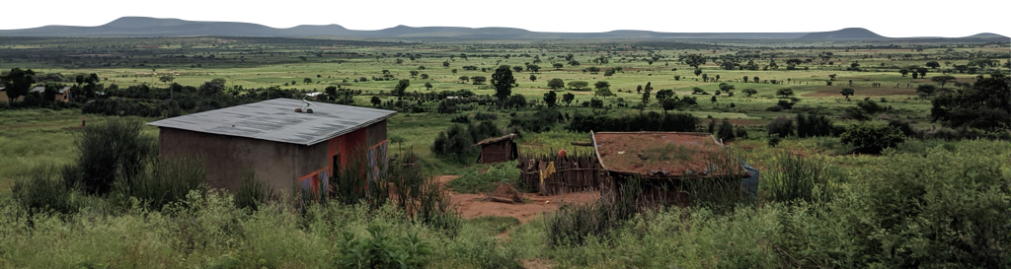
Agenda
  The pro-poor development problem
  The Mario Kart Perspective
  Teaching Systems and Feedbacks
Bibliography at bit.ly/37lD4lm
⁴Timmer (2005)

Slide 3
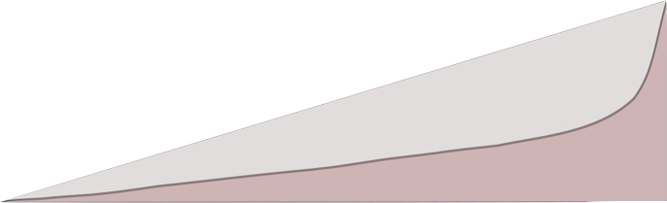
Pro-poor (and inclusive) growth
Recent (~ late 1990s) discussions on economic growth and participation among the least well-off. A range of:
absolute measures, concerned with population living below a line (poverty alleviation), and
relative measures, concerned with distribution of access and resources across a population (equity and equality)¹
equal distribution
actual distribution
low
wellbeing
high
Bibliography at bit.ly/37lD4lm
¹Ravallion (2004)

Slide 4
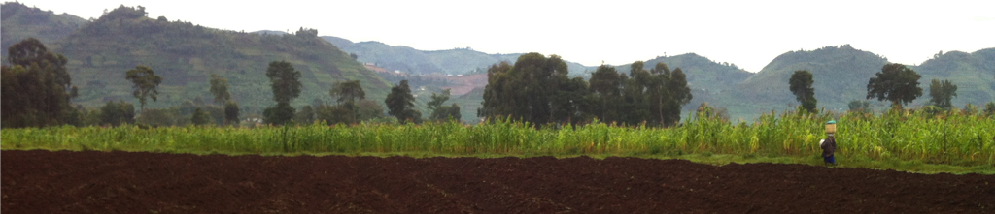
Pro-poor environmental development
Why should environment professionals care?
A lack of options precludes good decision-making, and good environmental stewardship
In agriculture, evidence that medium-scale, market integrated family farms are the best stewards for agricultural landscapes².
A core driving question for my work is (in order for such a world to happen):
How can we build out option sets for the rural poor who would no longer be farming?
Bibliography at bit.ly/37lD4lm
²Collier (2010)

Slide 5
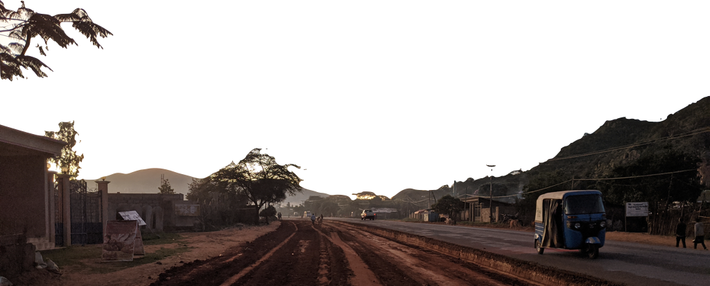
Agriculture: the gateway* to growth
*Historically, most states have developed via agriculture, through the path of:
Food security
Agricultural diversification
Commercialization
Enabling of other economic sectors³
And then a (relative) decline in importance
Bibliography at bit.ly/37lD4lm
³Timmer (2005)

Slide 6
That won’t work anymore.
Too much of a good thing?
Modern economic conditions are not what they were in the post-Green Revolution 1960s-70s
Global food commodity production has depressed prices to a level that discourages investment and innovation⁴
The remaining poor can’t necessarily do as the recently poor did.
Need to think outside of agriculture, or think about agriculture differently for it to enable pro-poor growth.
Think Mario Kart.
Bibliography at bit.ly/37lD4lm
⁴Timmer (2005)

Slide 7
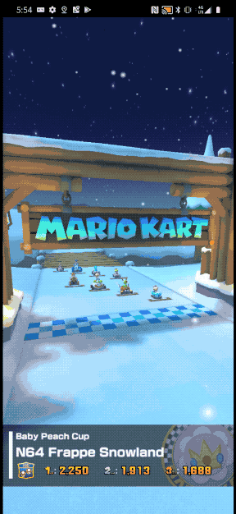
Don’t leave. I’m going somewhere with this.
Today’s Mario Kart is fancier than in my youth, but still the same game
It endures because it is fun for anyone to play.
And it is fun because it is built with a design principle of equity:
  Karts at the back of the race
  (me, your grandparents, your youngest sibling)
  go faster, and get better items
This principle, now emulated across the gaming world, is called
Rubberbanding⁵
Bibliography at bit.ly/37lD4lm
⁵Alexander et al. (2013)

Slide 8









The three parts of rubberbanding
Rubberbanding works because Nintendo can (costlessly):
    See who is in the back, and how far they are from the front
    Generate ’boosts’ for the karts
    Target those boosts toward the back
So cool! But how easy is that in the real world?
Bibliography at bit.ly/37lD4lm
Bell (2021)

Slide 9
Rubberbanding in the Global North
Modern welfare state
low
wellbeing
high
Targeted pro-poor social programs
Progressive taxation
Universal social programs (health, childcare, etc.)⁶
Bibliography at bit.ly/37lD4lm
⁶Marx et al. (2016)

Slide 10
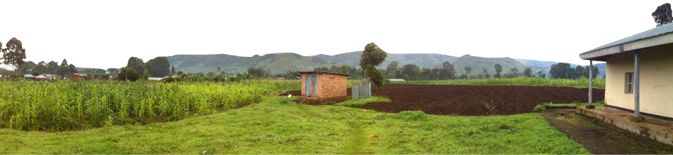
Rubberbanding in the Global South
(Typically) weaker institutions and lower capacity
However, I will show bits of ‘rubberbanding’ from my* work that demonstrate potential for pro-poor environmental development in the Global South.
I’ll speak first to the challenge of measurement, and how engagement by smartphones is already helping to address this.
Then I’ll give a few examples of what targeted boosts could look like in practice.
*Also Patrick’s
Present a vision of what ‘mariokartized’ environmental development could be
Measuring where people are
Generating boosts
Targeting boosts at the back

Slide 11
Part 1 – Measuring welfare / wellbeing
The poorest people are often the least integrated,
least registered, with the least access
Traditional social data collection has no way to really capture this at scale
All of this changes with mobile phones – not in a creepy ‘track people’s movement’ way, but in a transformative engagement way
        Android phones are cheap
        Mobile wallets make services accessible
Money historically spent to fuel and house enumerators may now fuel a positive development externality of access to mobile services

Slide 12
Part 1 – Measuring welfare / wellbeing
Lastly, it lets us step toward the regular, gridded data collection of the natural sciences and the ability to:
        catch anomalies,
        understand impact of interventions, and (importantly),
know who is in the back and by how much

Slide 13
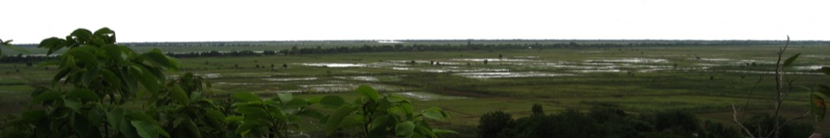
Our first experiment with Android
Purposive sample of tech-competent farming household members in Northern Bangladesh (n = 500)
Phones preloaded with tasks, randomly versioned by return interval:
  Weekly
  Monthly
  Seasonally⁷
Bibliography at bit.ly/37lD4lm
⁷Bell et al. (2016, 2019)

Slide 14
Implementation in Android ODK
Bibliography at bit.ly/37lD4lm
⁷Bell et al. (2016, 2019)

Slide 15
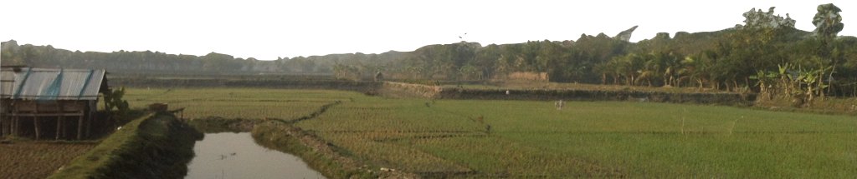
Variation and recall
We looked at mean and variation for all ‘summing’ tasks
People did ok recalling ‘planned’ things like labor
It was much harder to recall things that just happened – shocks, illnesses, food, spending
Bibliography at bit.ly/37lD4lm
⁷Bell et al. (2016, 2019)

Slide 16
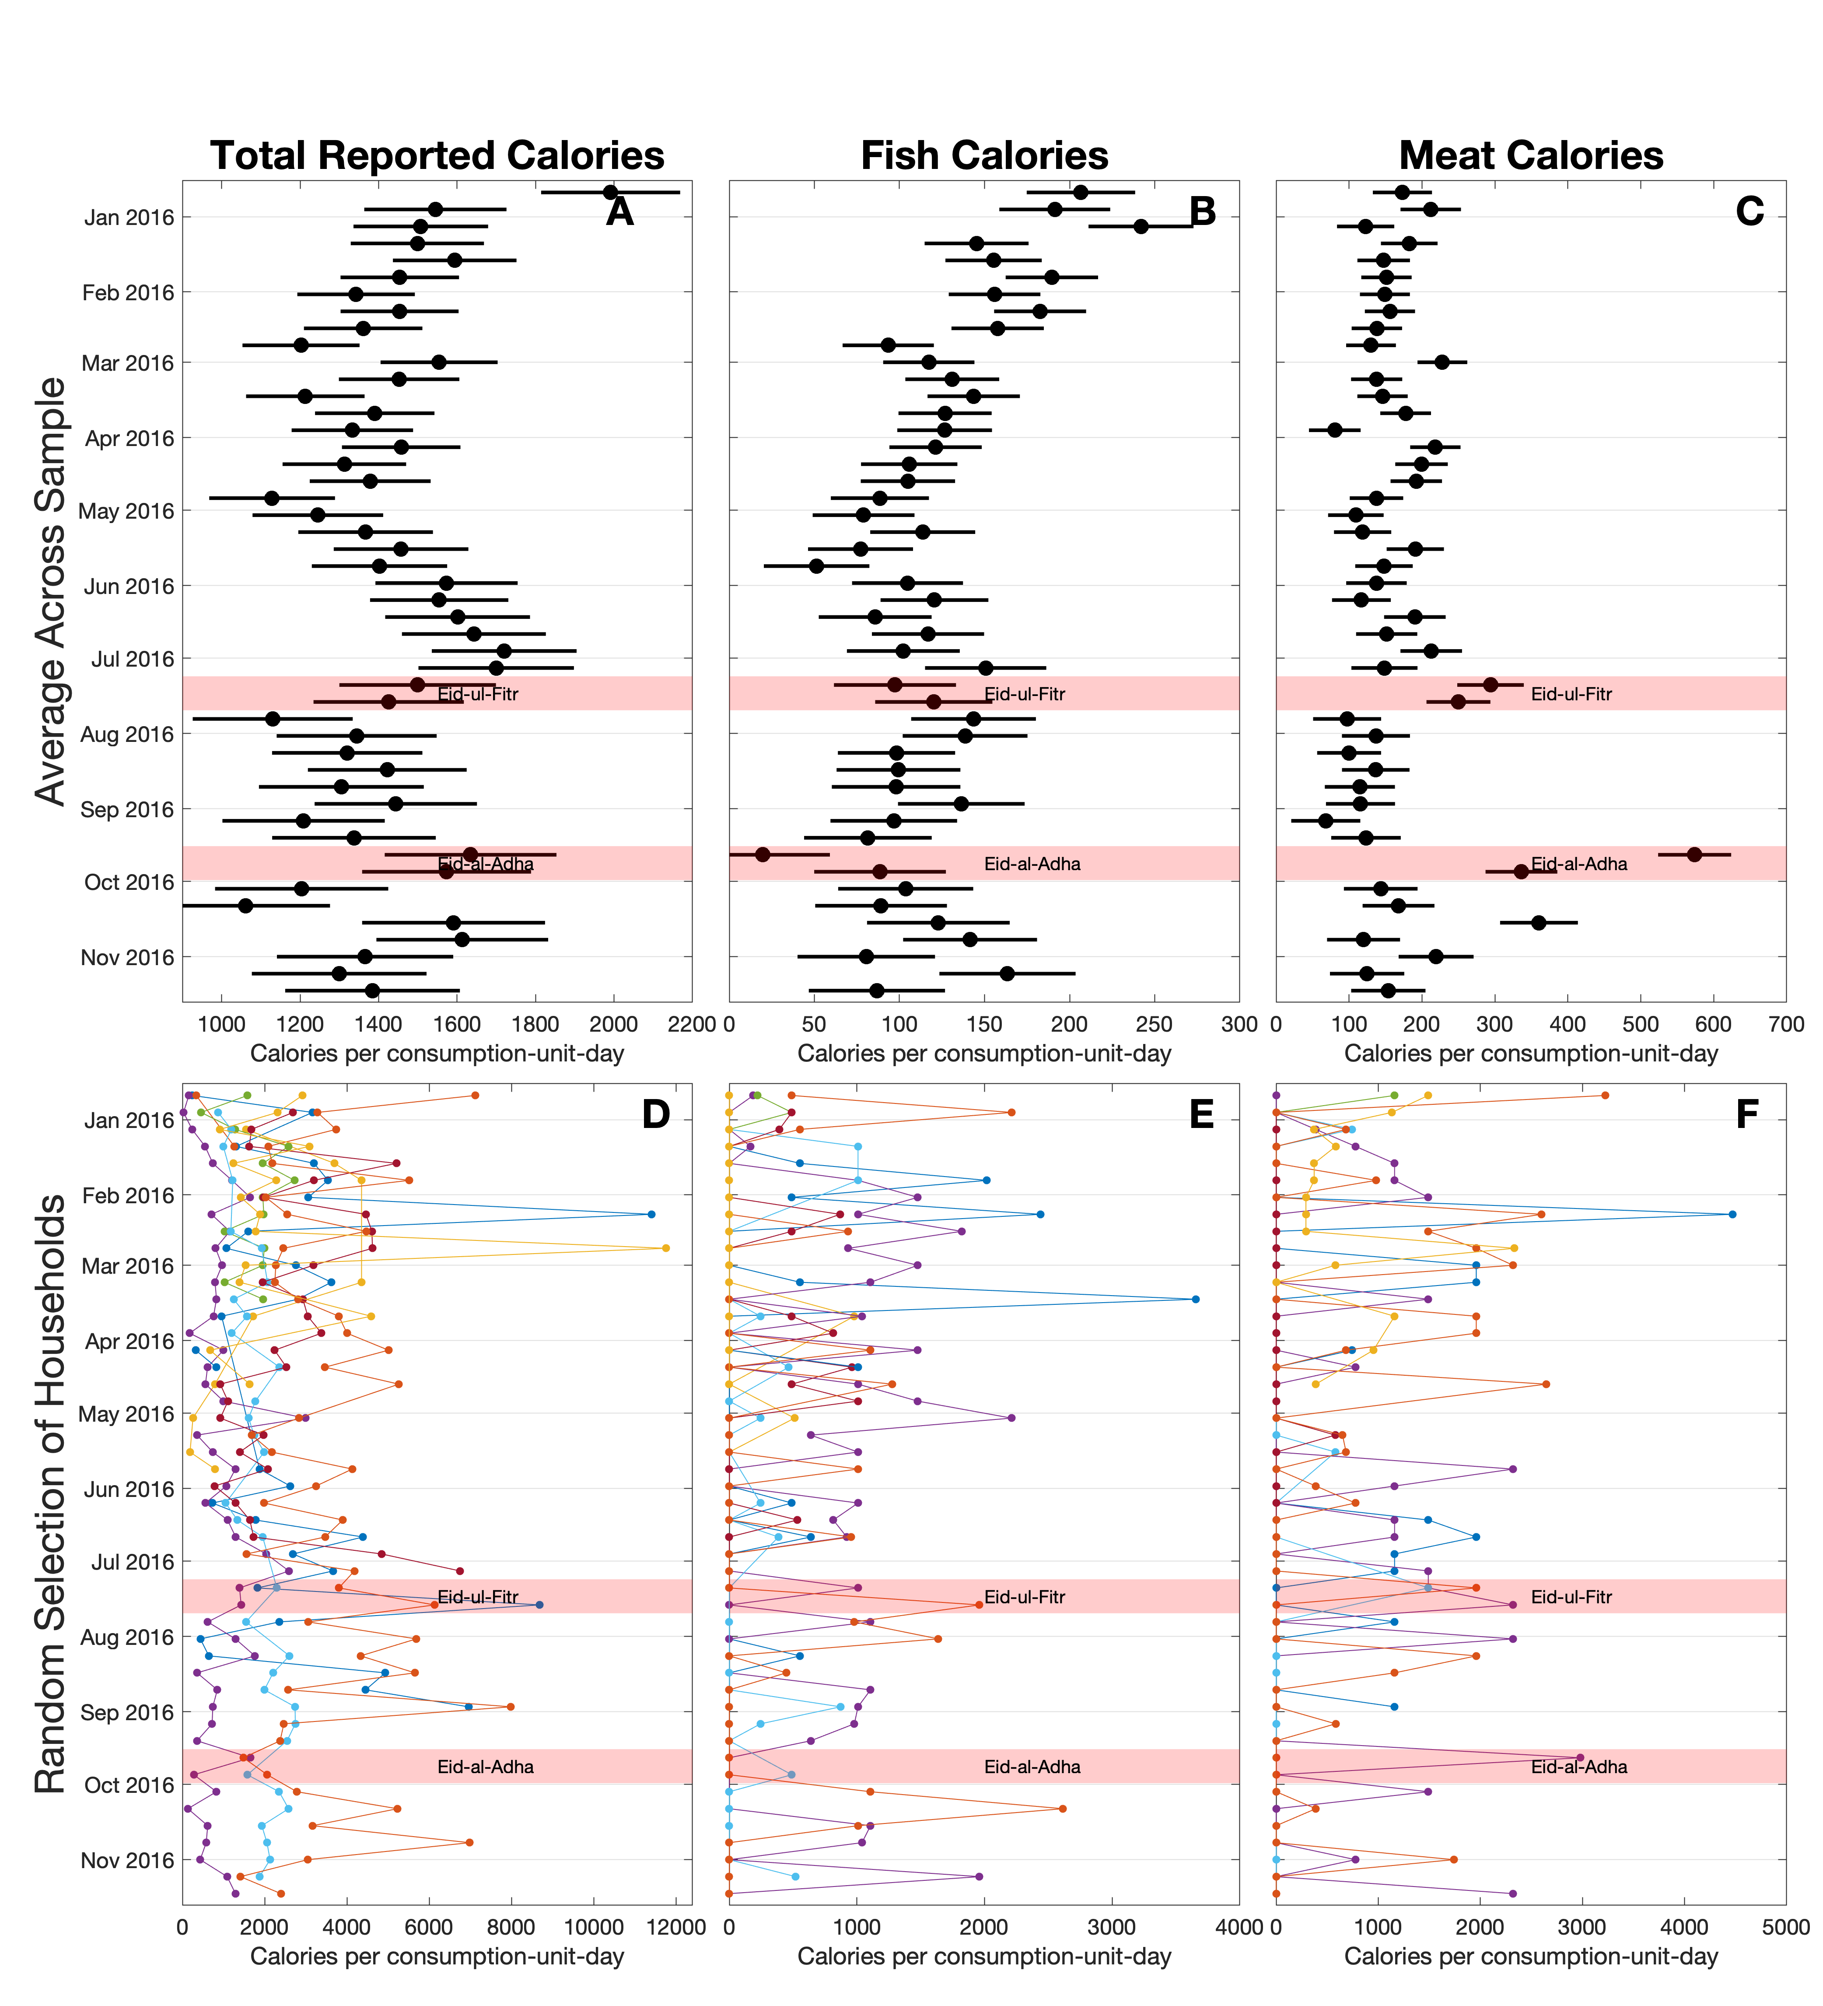

Reporting food
Mean and variation in calories and meat protein explain physical wellbeing better than any one week of food recall
Another dimension along which high-frequency data can transform how we do social science
Active and past projects by our group and related work by colleagues is being assembled at our platform ‘mobile and smartphone data science’ :
http://msds.tools
Bell et al. (2021)

Slide 17
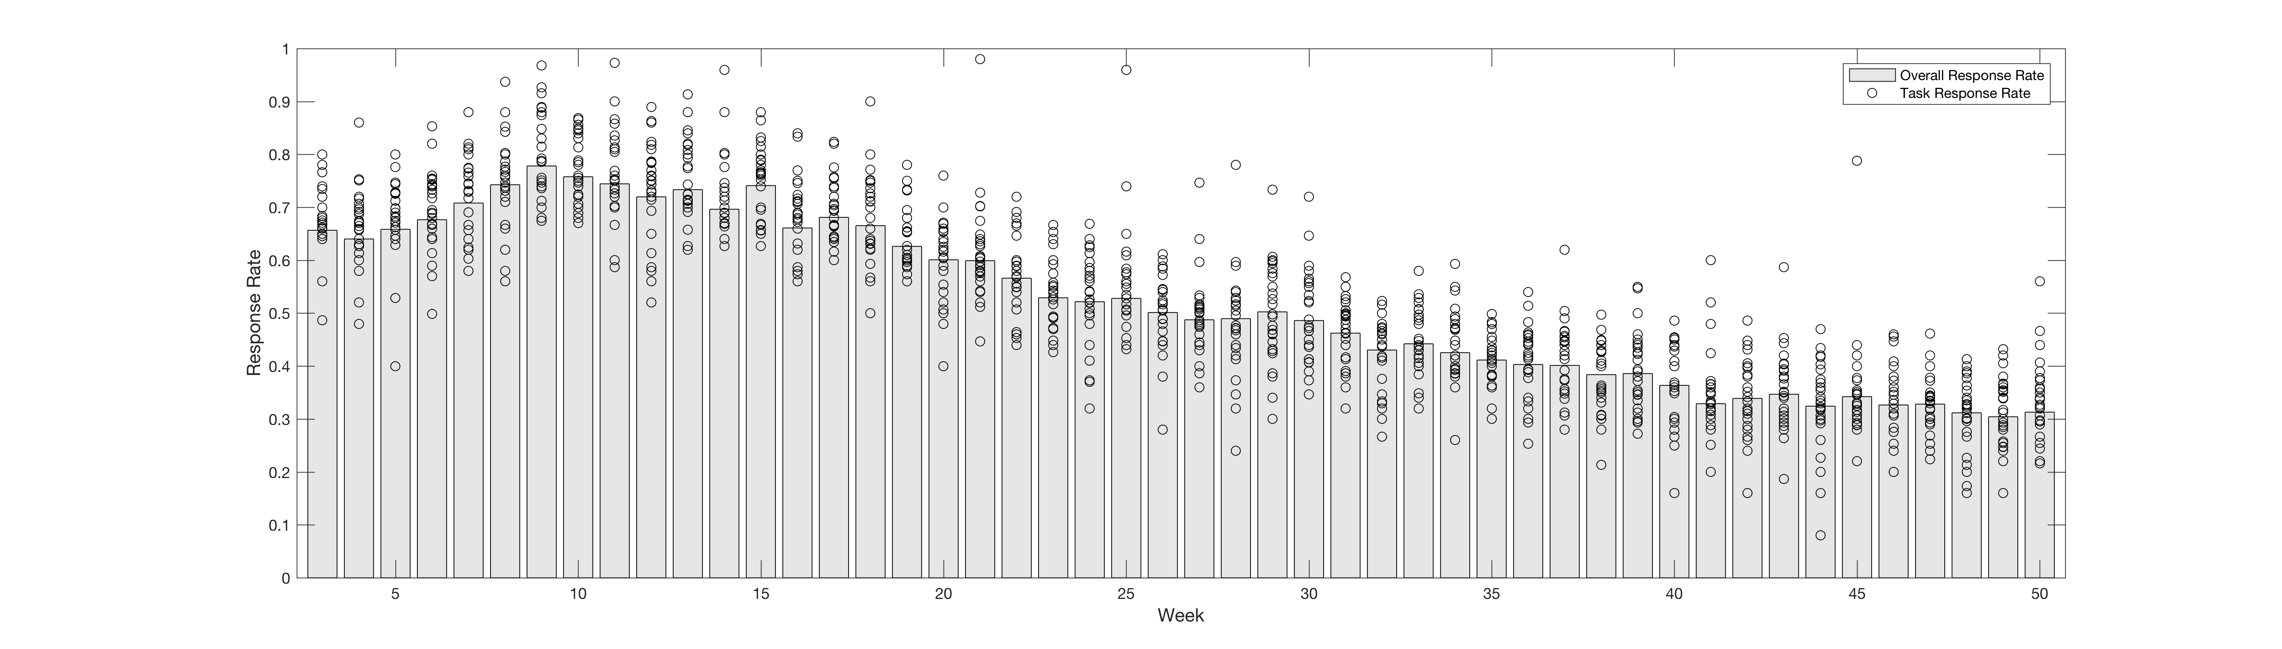
Attrition
Sustained Engagement
Things looked great through 4 months
(and then participants earned their devices outright)
We can sustain engagement, but we have to be smart

Slide 18
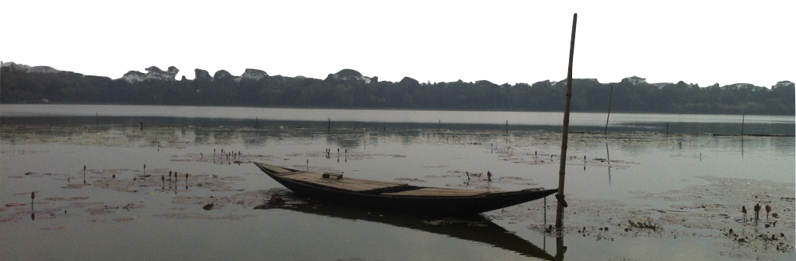
Part 2 – Boosts and pro-poor targeting
If this were trivial to do, we wouldn’t have the imbalance that we do between the Global North and South
Many of the most valuable things in the Global South (minerals, tourism markets, e.g.) still mostly get taken away
There are some instances where there is potential to better reward undervalued contributions, one of which is:
Payments for Ecosystem Services (PES)

Slide 19
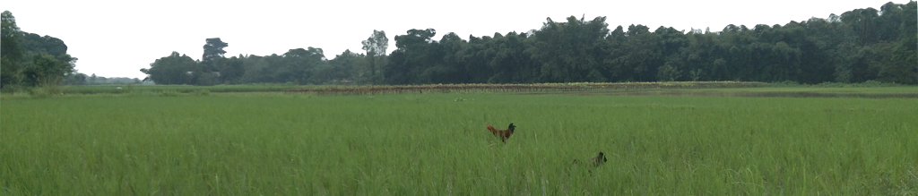
Part 2 – Boosts and pro-poor targeting
Targeting is the hardest part
Whatever instrument you can imagine,
(Micro-finance, index insurance, etc.)
benefits typically flow to those with greater access¹¹
Group-level institutions/instruments may only be as pro-poor as the pre-existing level of collective action
Let me try to sell you on ‘thoughtful’ trickle-down benefits
Bibliography at bit.ly/37lD4lm
¹¹Poulton et al. (2006)

Slide 20
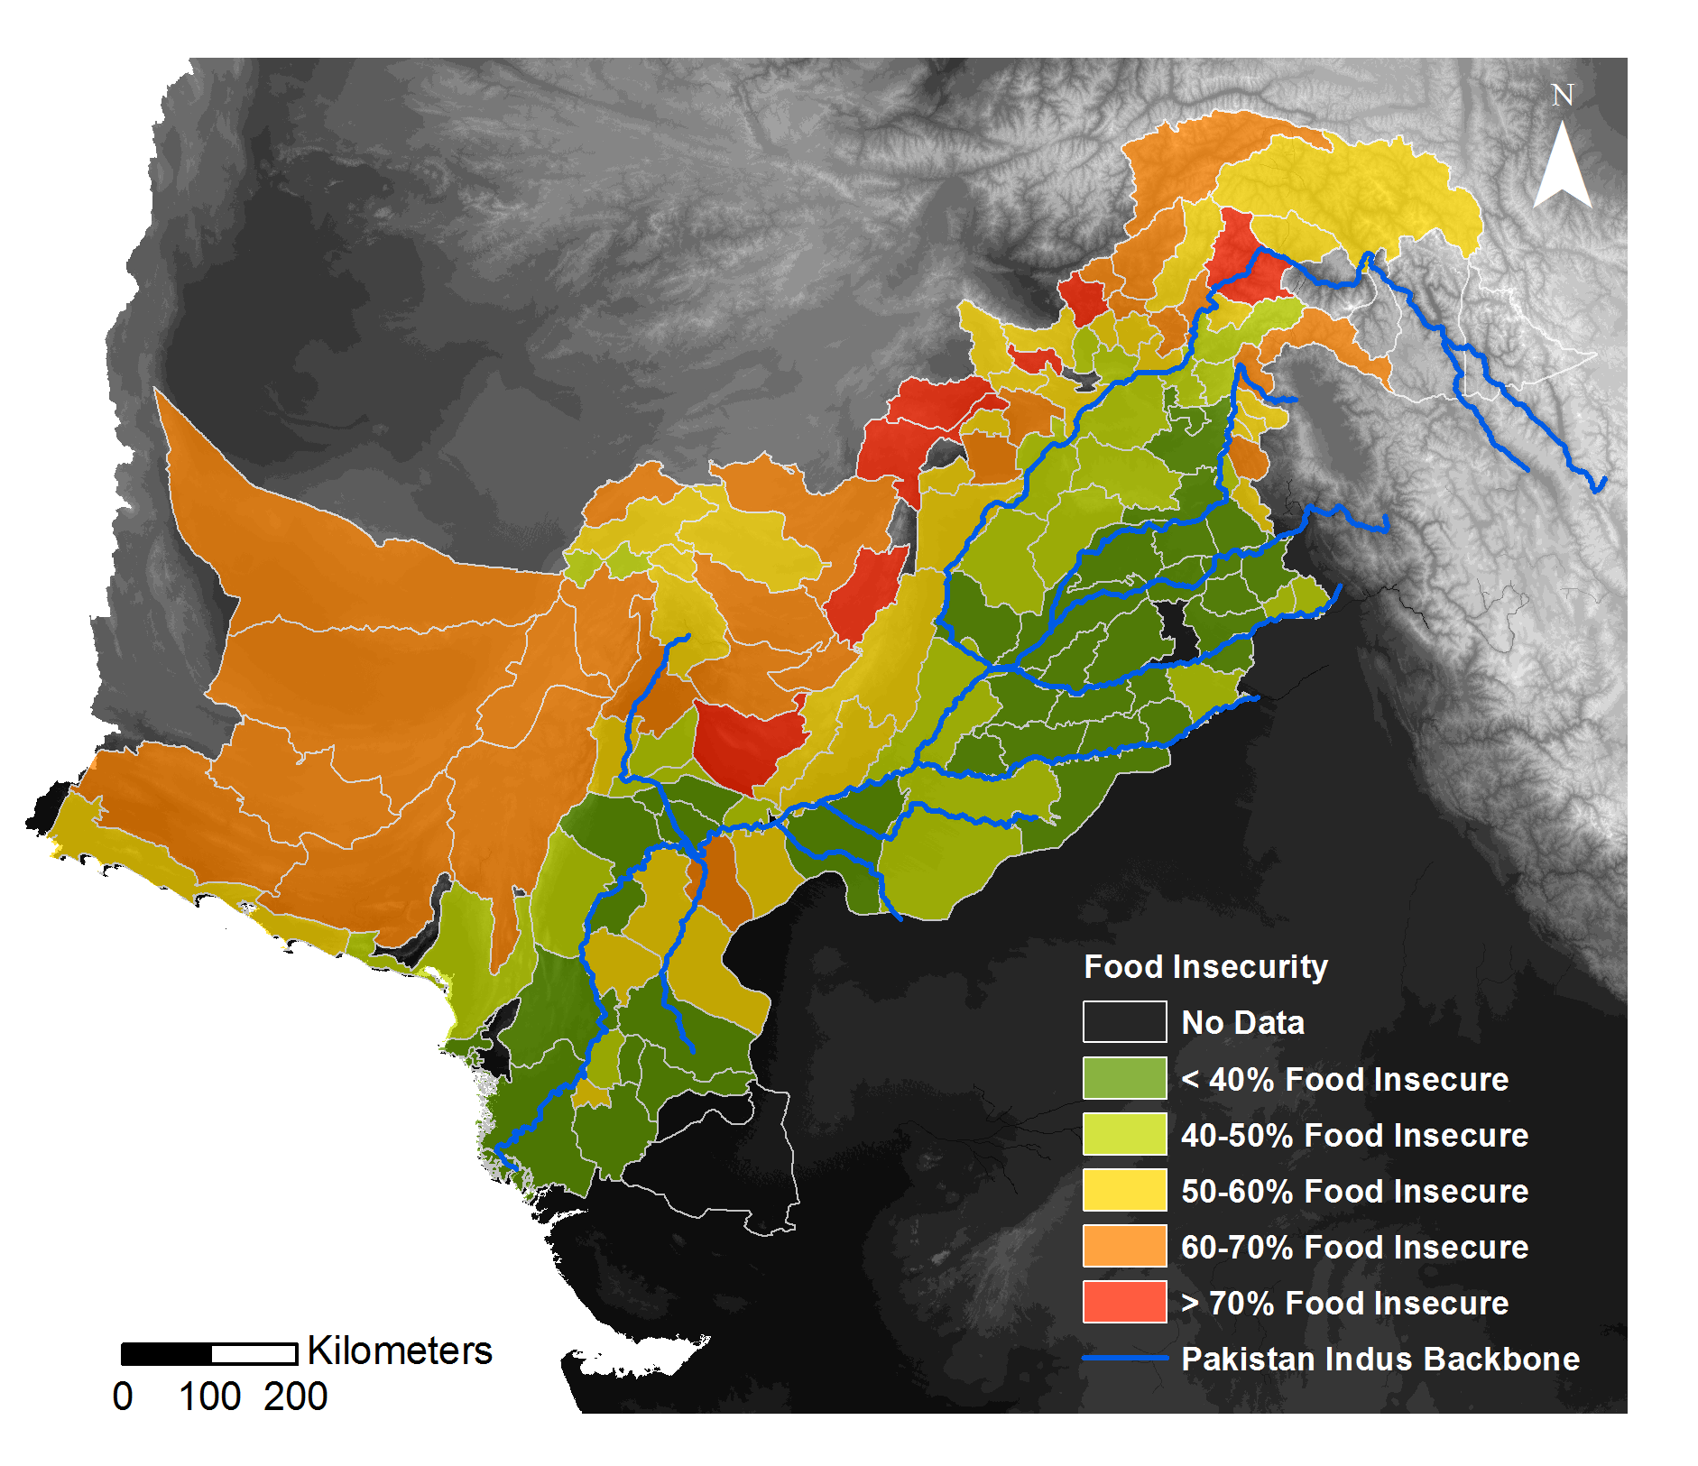
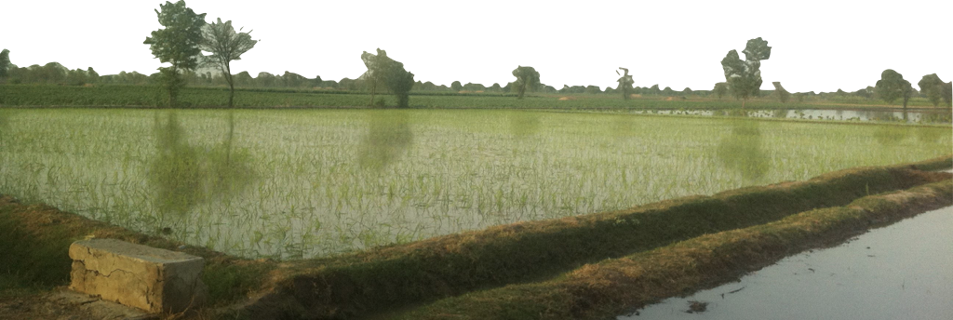
Trickle-down irrigation benefits in Pakistan
Pakistan hosts the world’s largest gravity-fed irrigation system
Thousands of kms of main channels built by the British, with millions of kms of local linkages built by ‘communities’ to connect with this system
A century of neglect and local tinkering
Decades of declining cost recovery
A governance and management nightmare (or opportunity)
Sources: SDPI (Food Security Data); gadm.org (Boundaries); usgs.gov (DEM and Streams)

Slide 21
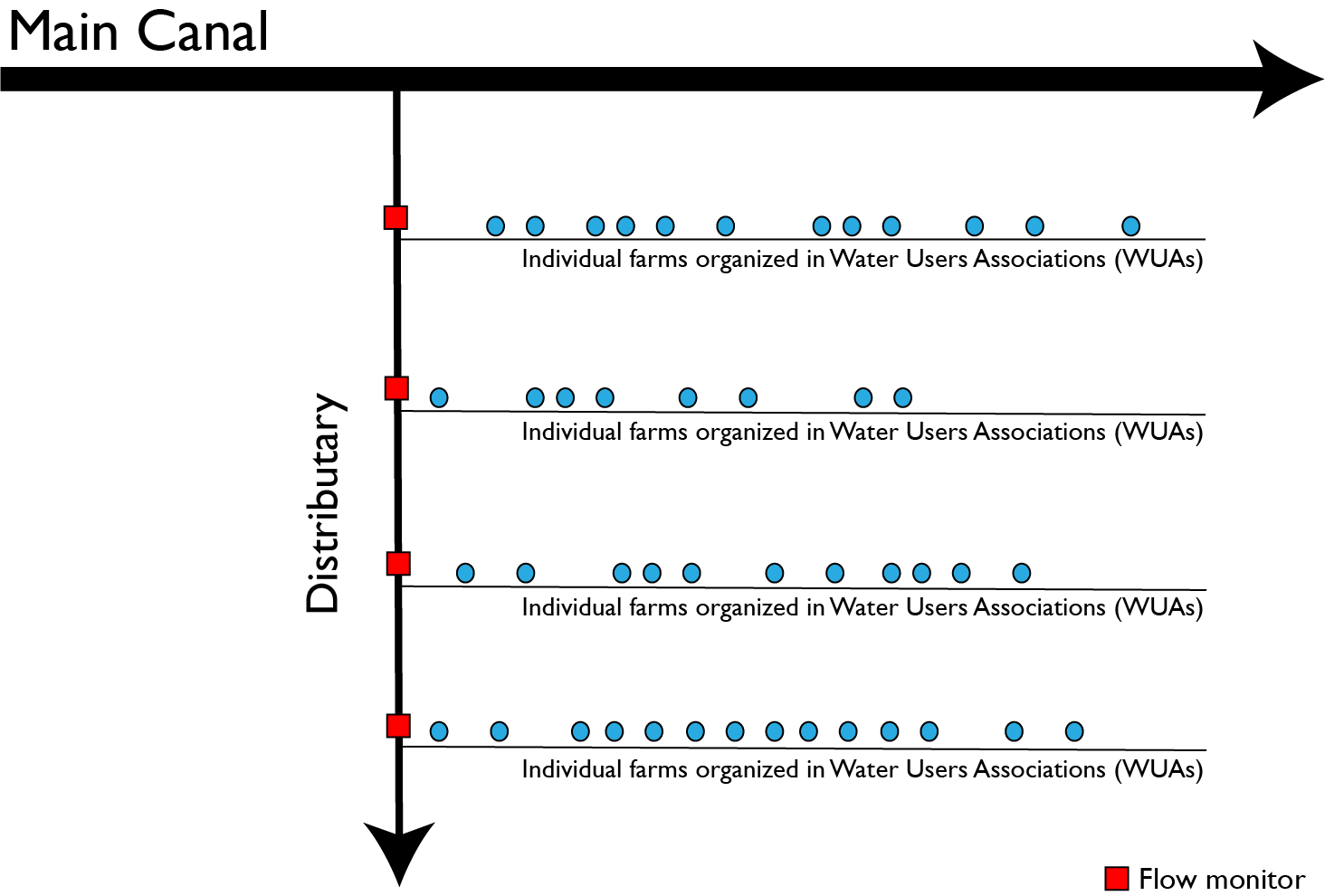
Trickle-down irrigation benefits in Pakistan
In one experiment, we identified a willingness to pay for canal water 2 orders of magnitude greater than current charges¹²
This was among farmers spending on diesel to pump groundwater, and was conditional on experiencing improved reliability
We explored what this would mean across different scales/configurations of irrigation network with an agent-based model¹³
Asking more from farmers, and investing those fees in improving reliability, led to:
Improved production along with Reduced inequality
Bibliography at bit.ly/37lD4lm
^{12,13}Bell et al. (2014, 2016)

Slide 22
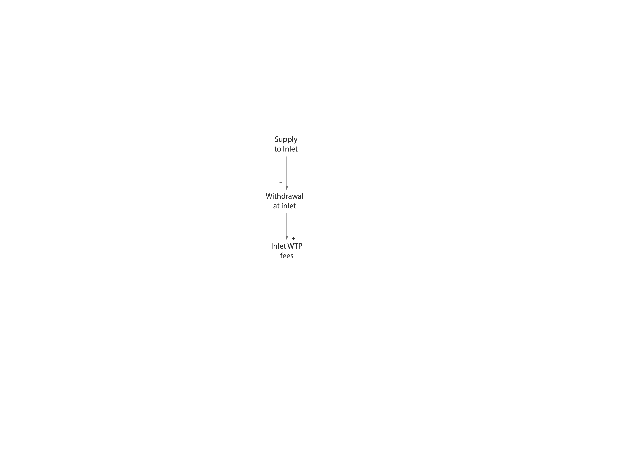
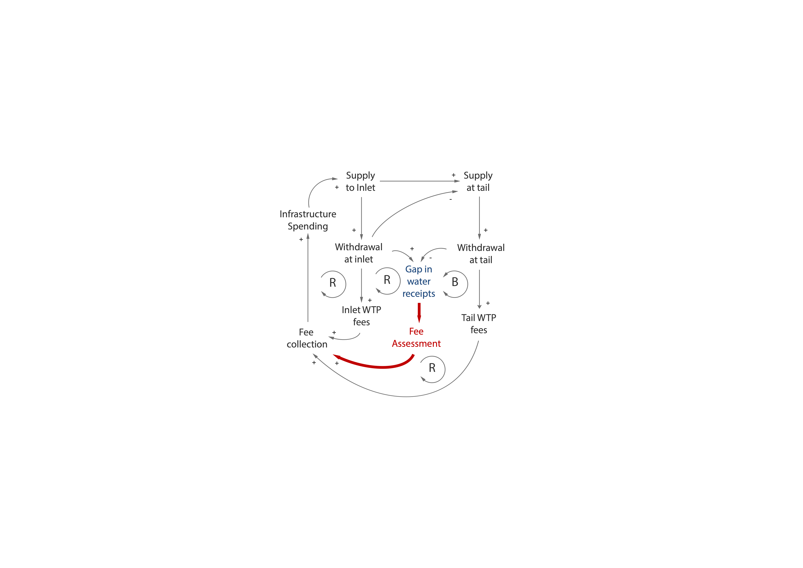
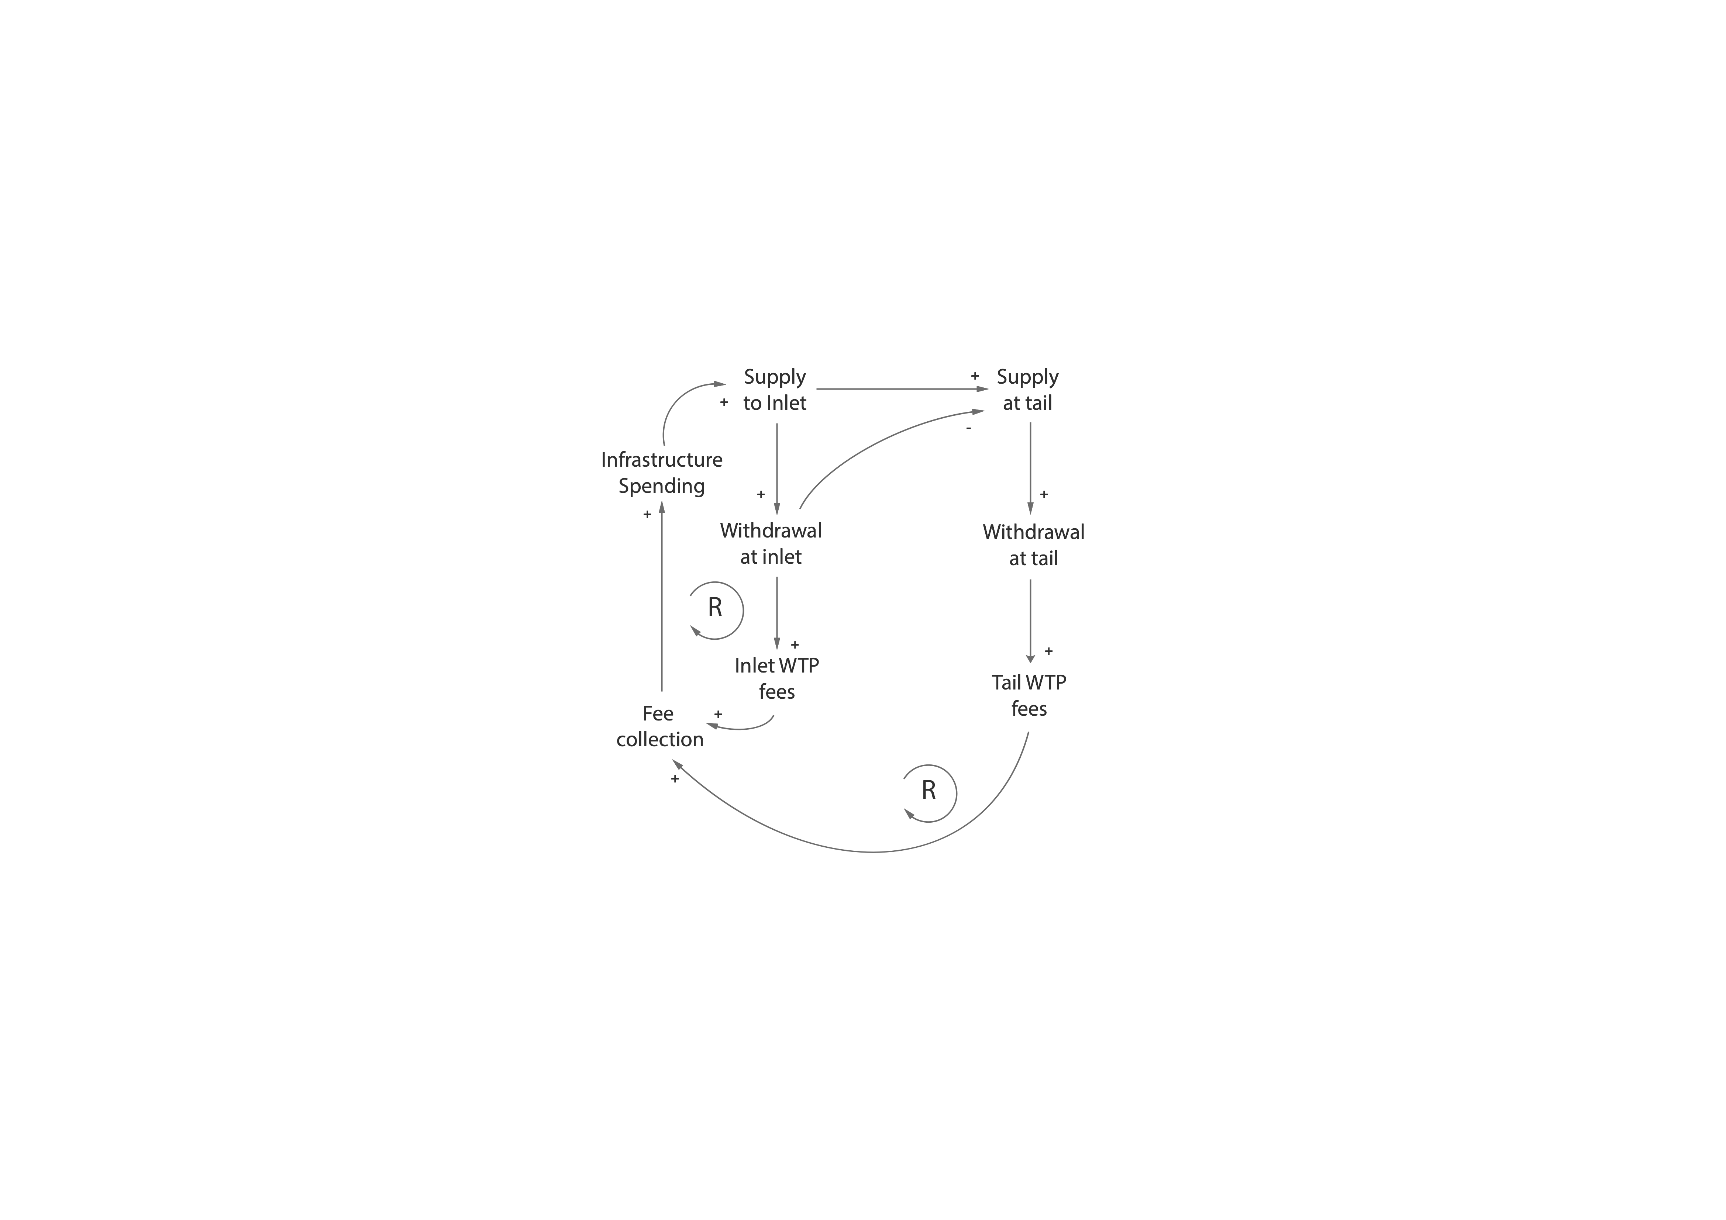
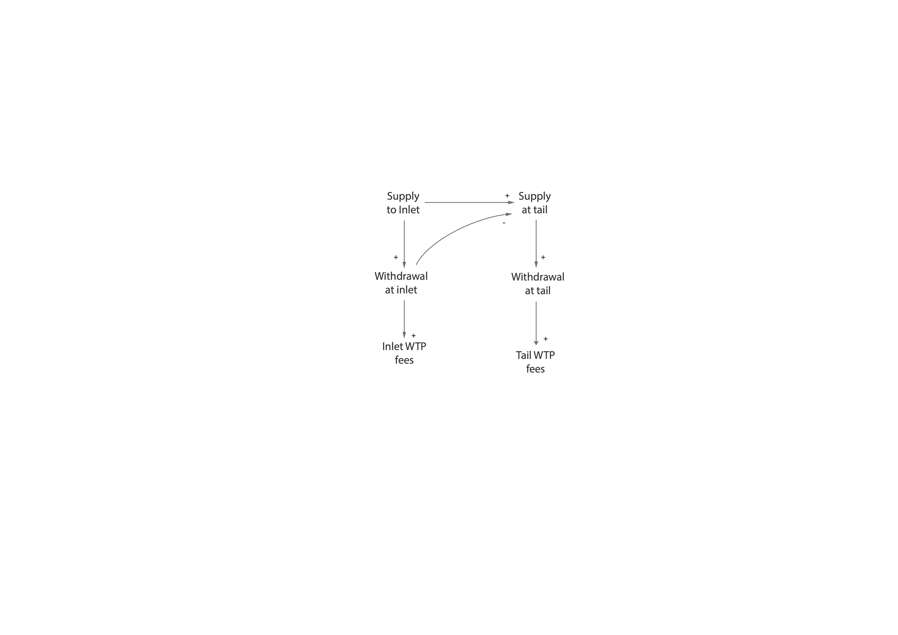
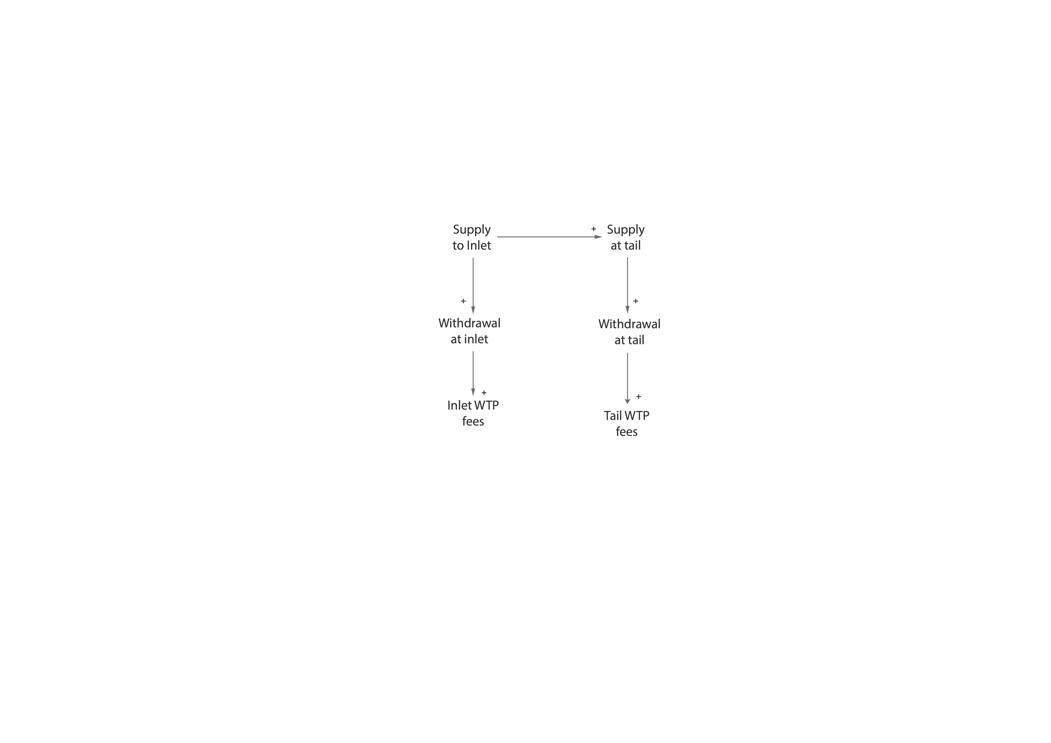
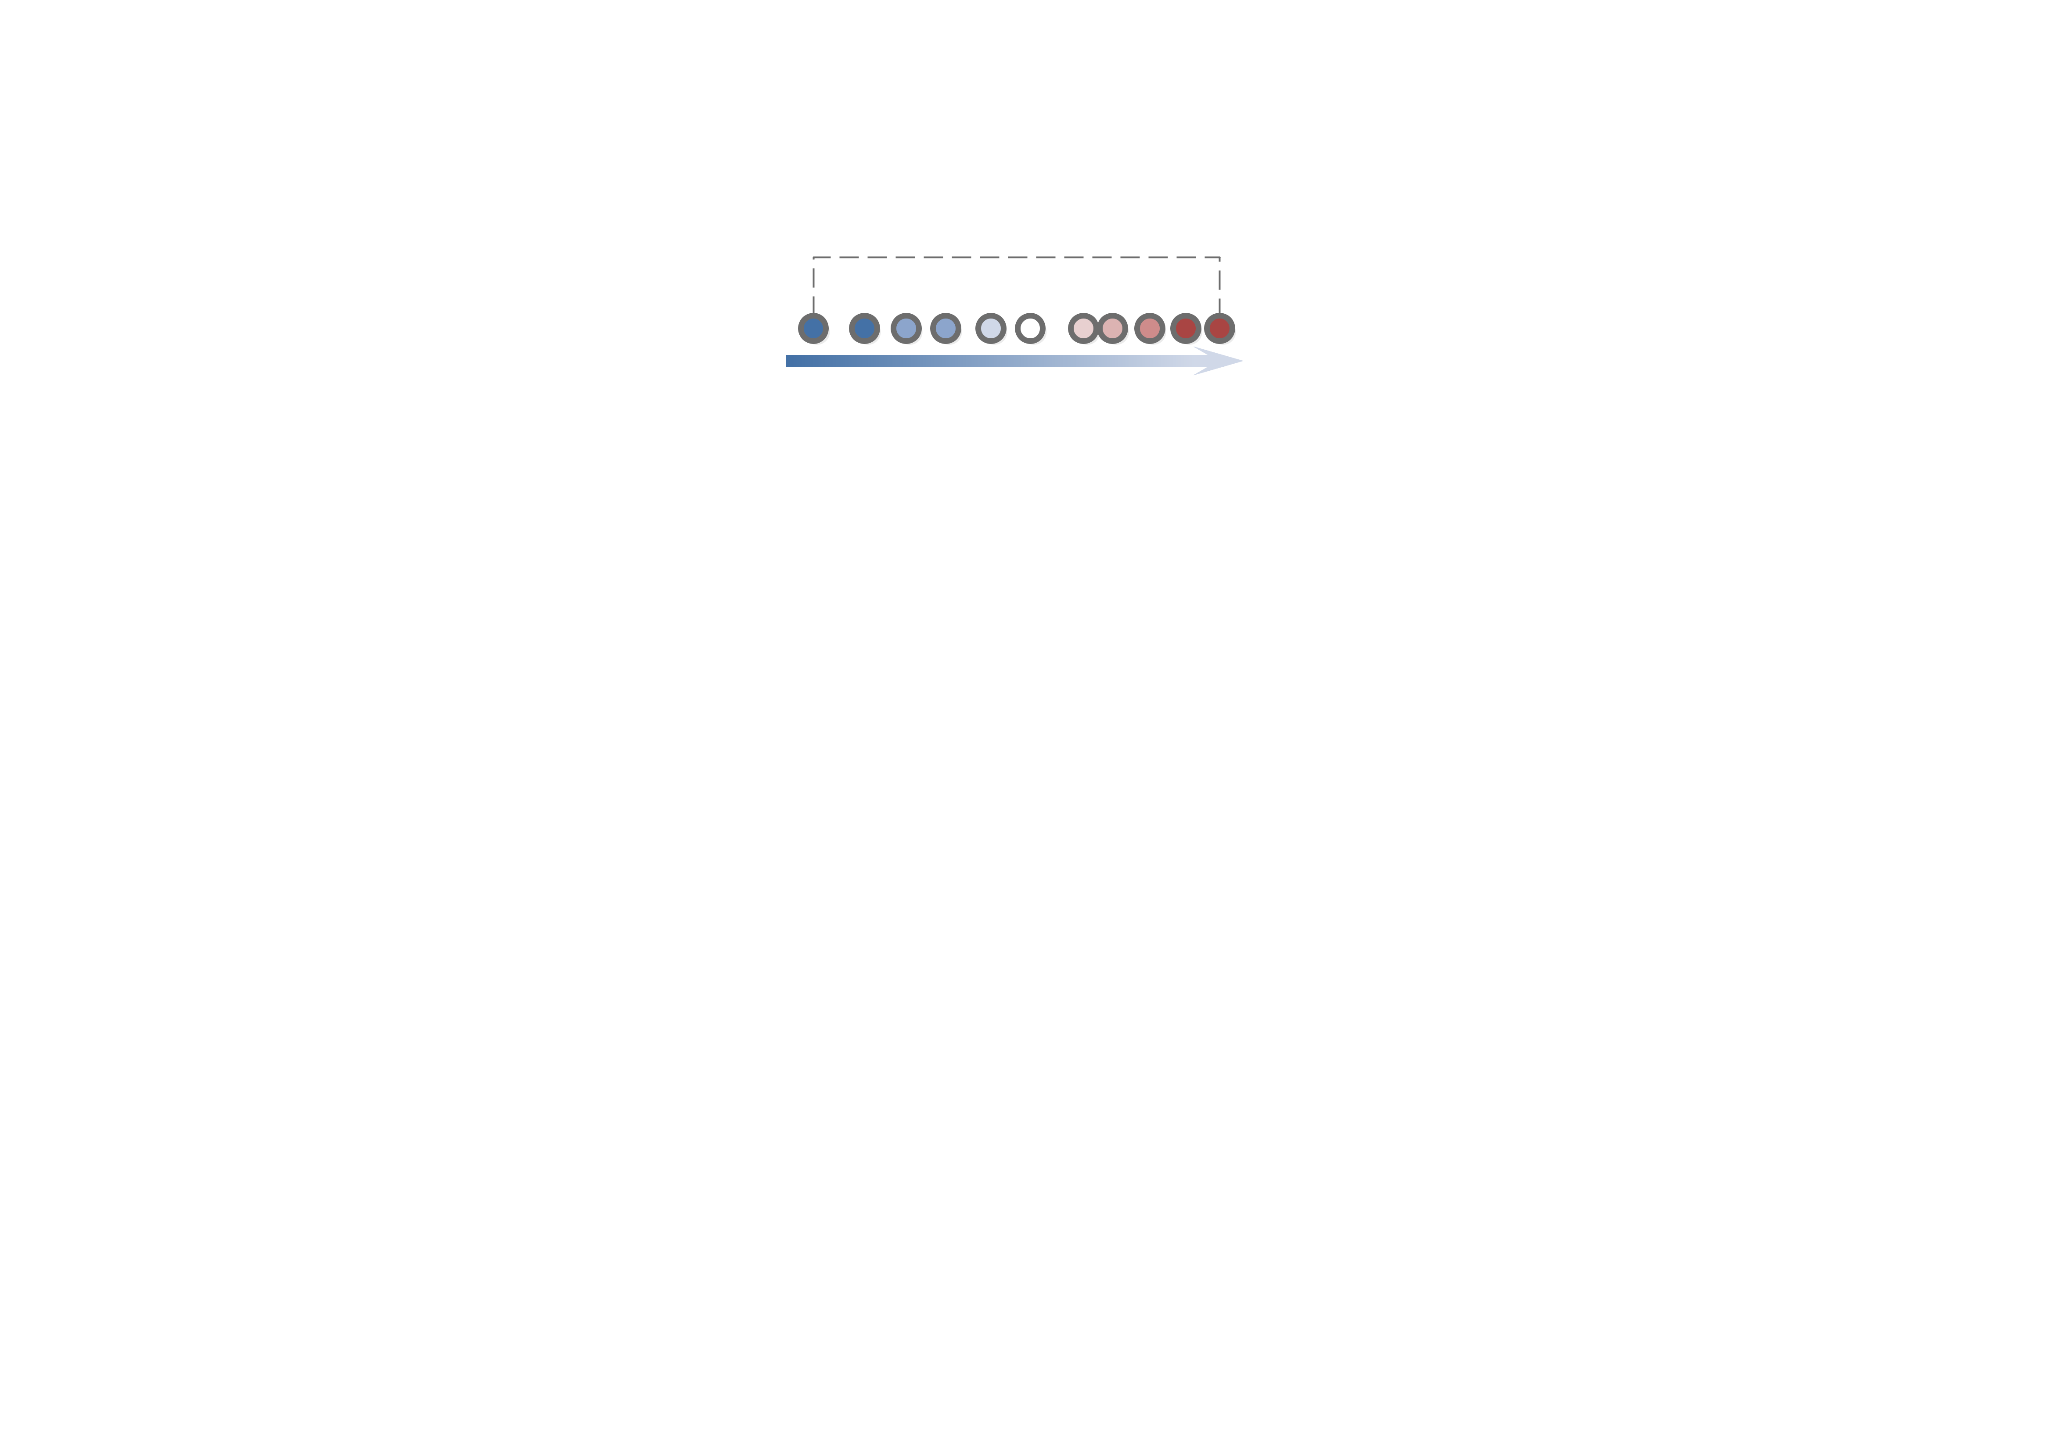
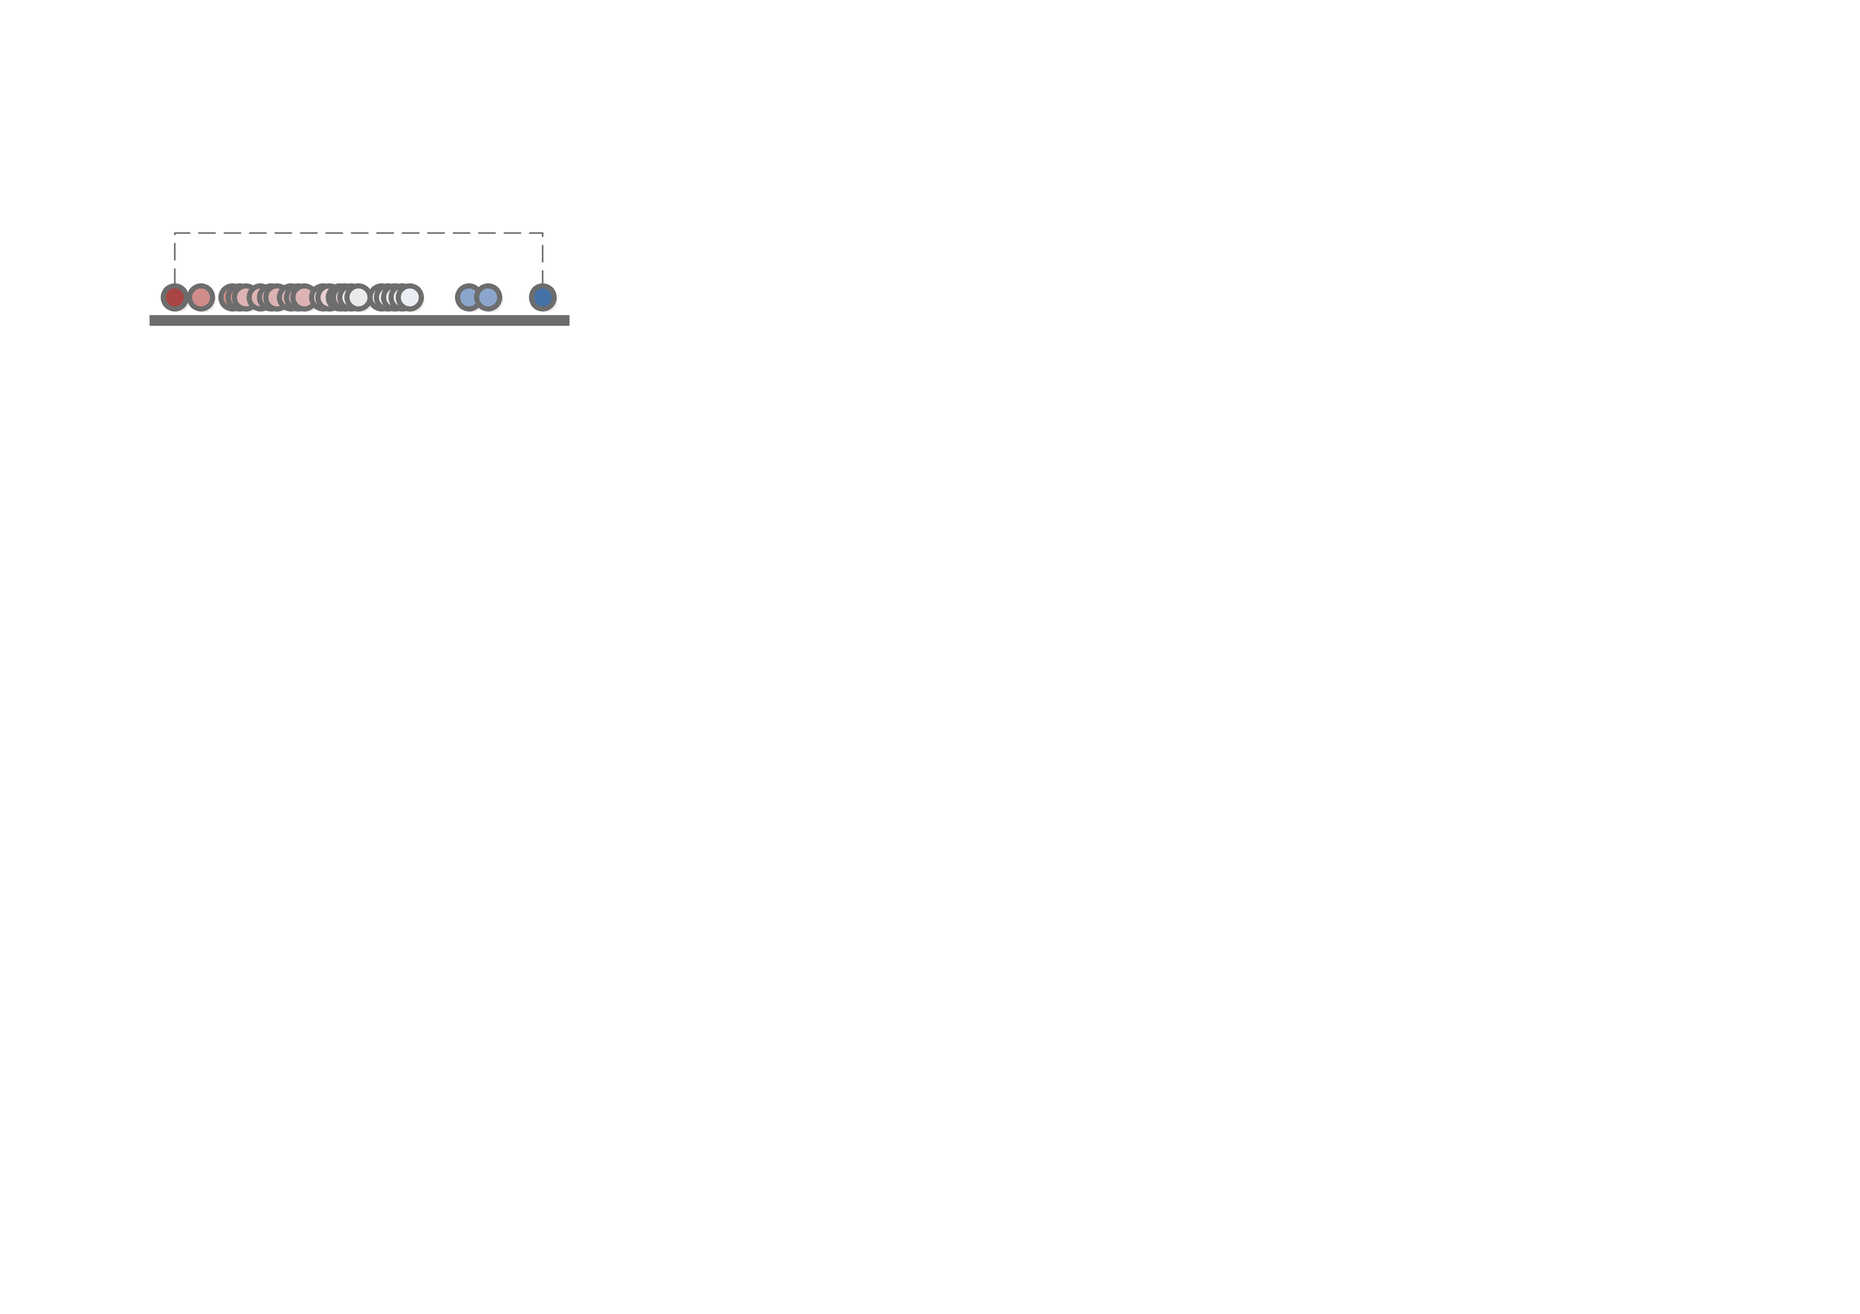
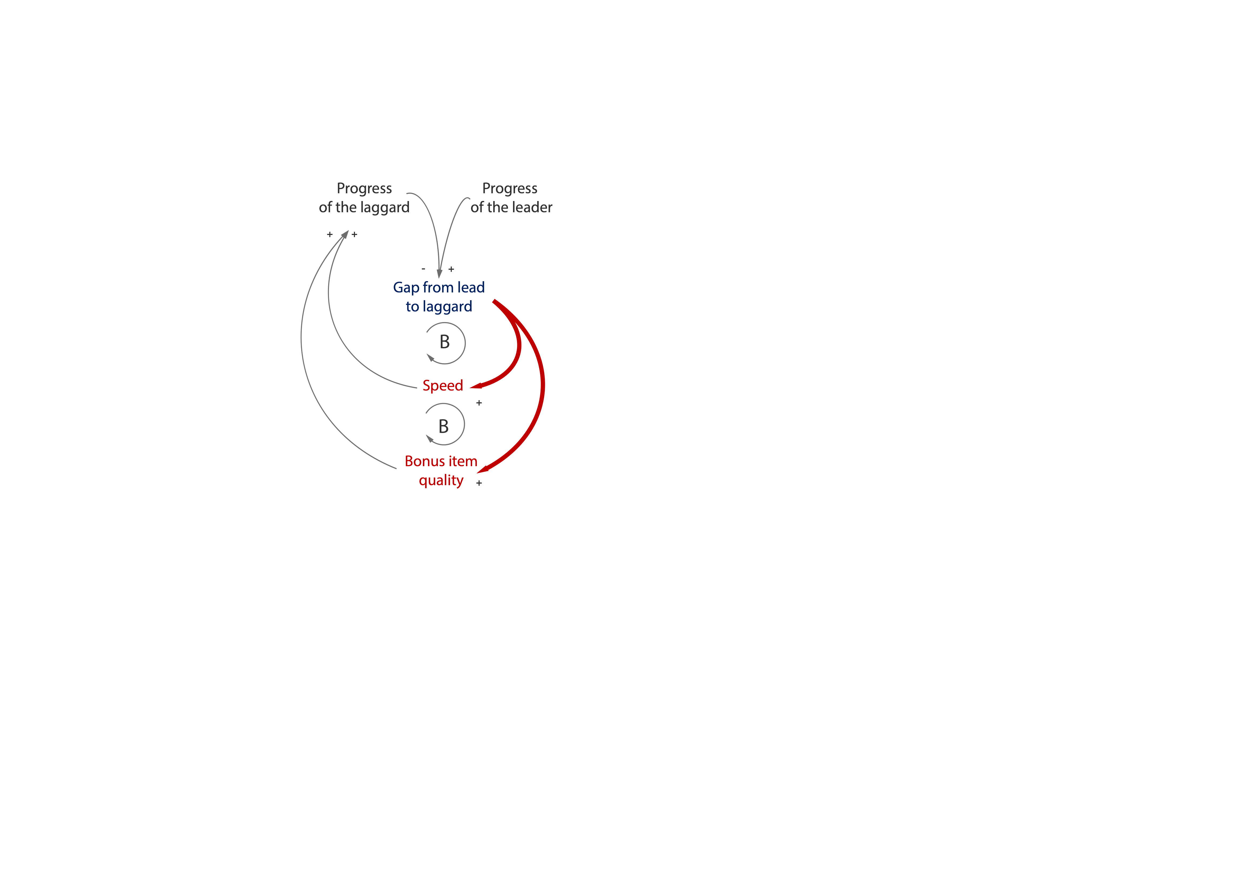
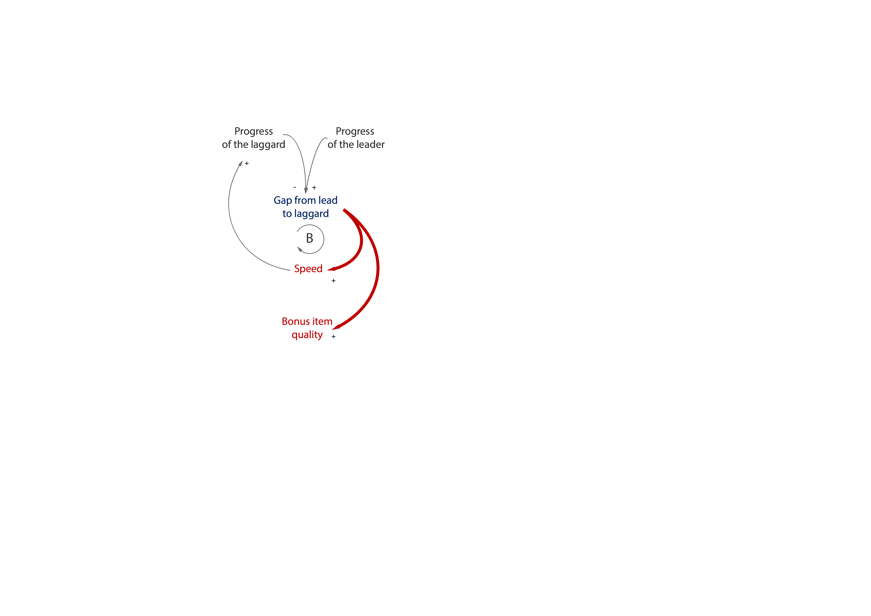
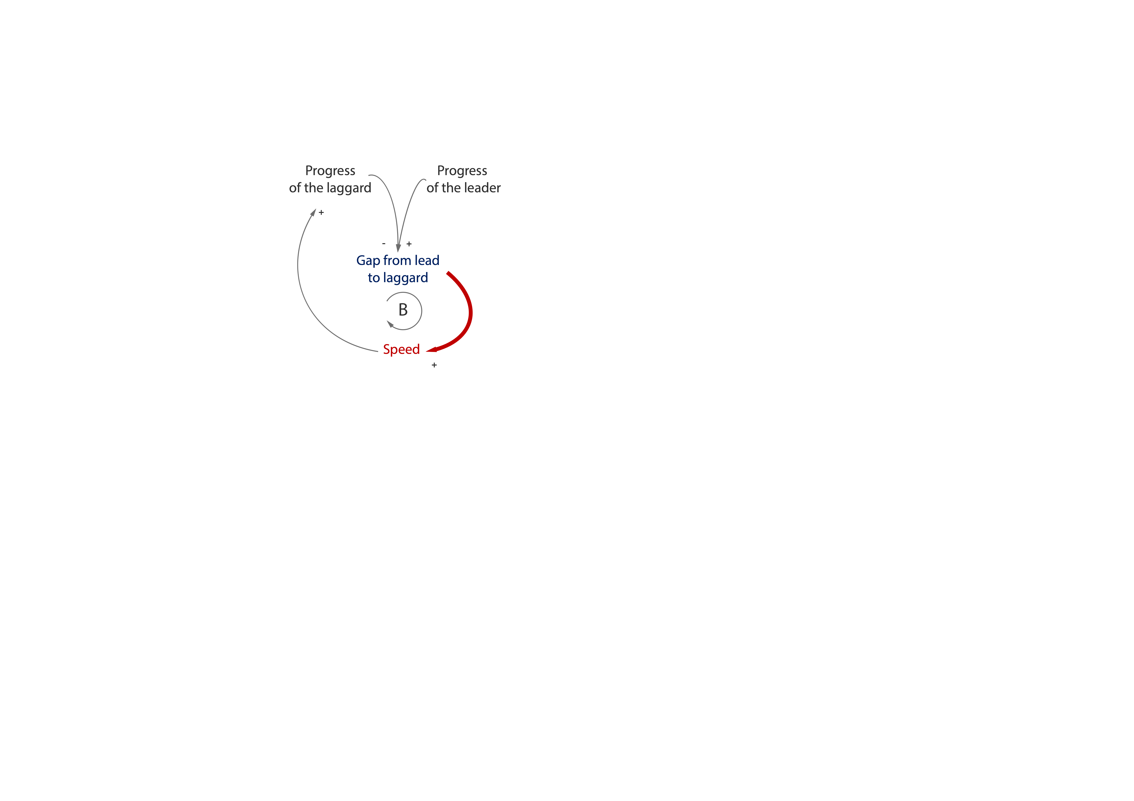
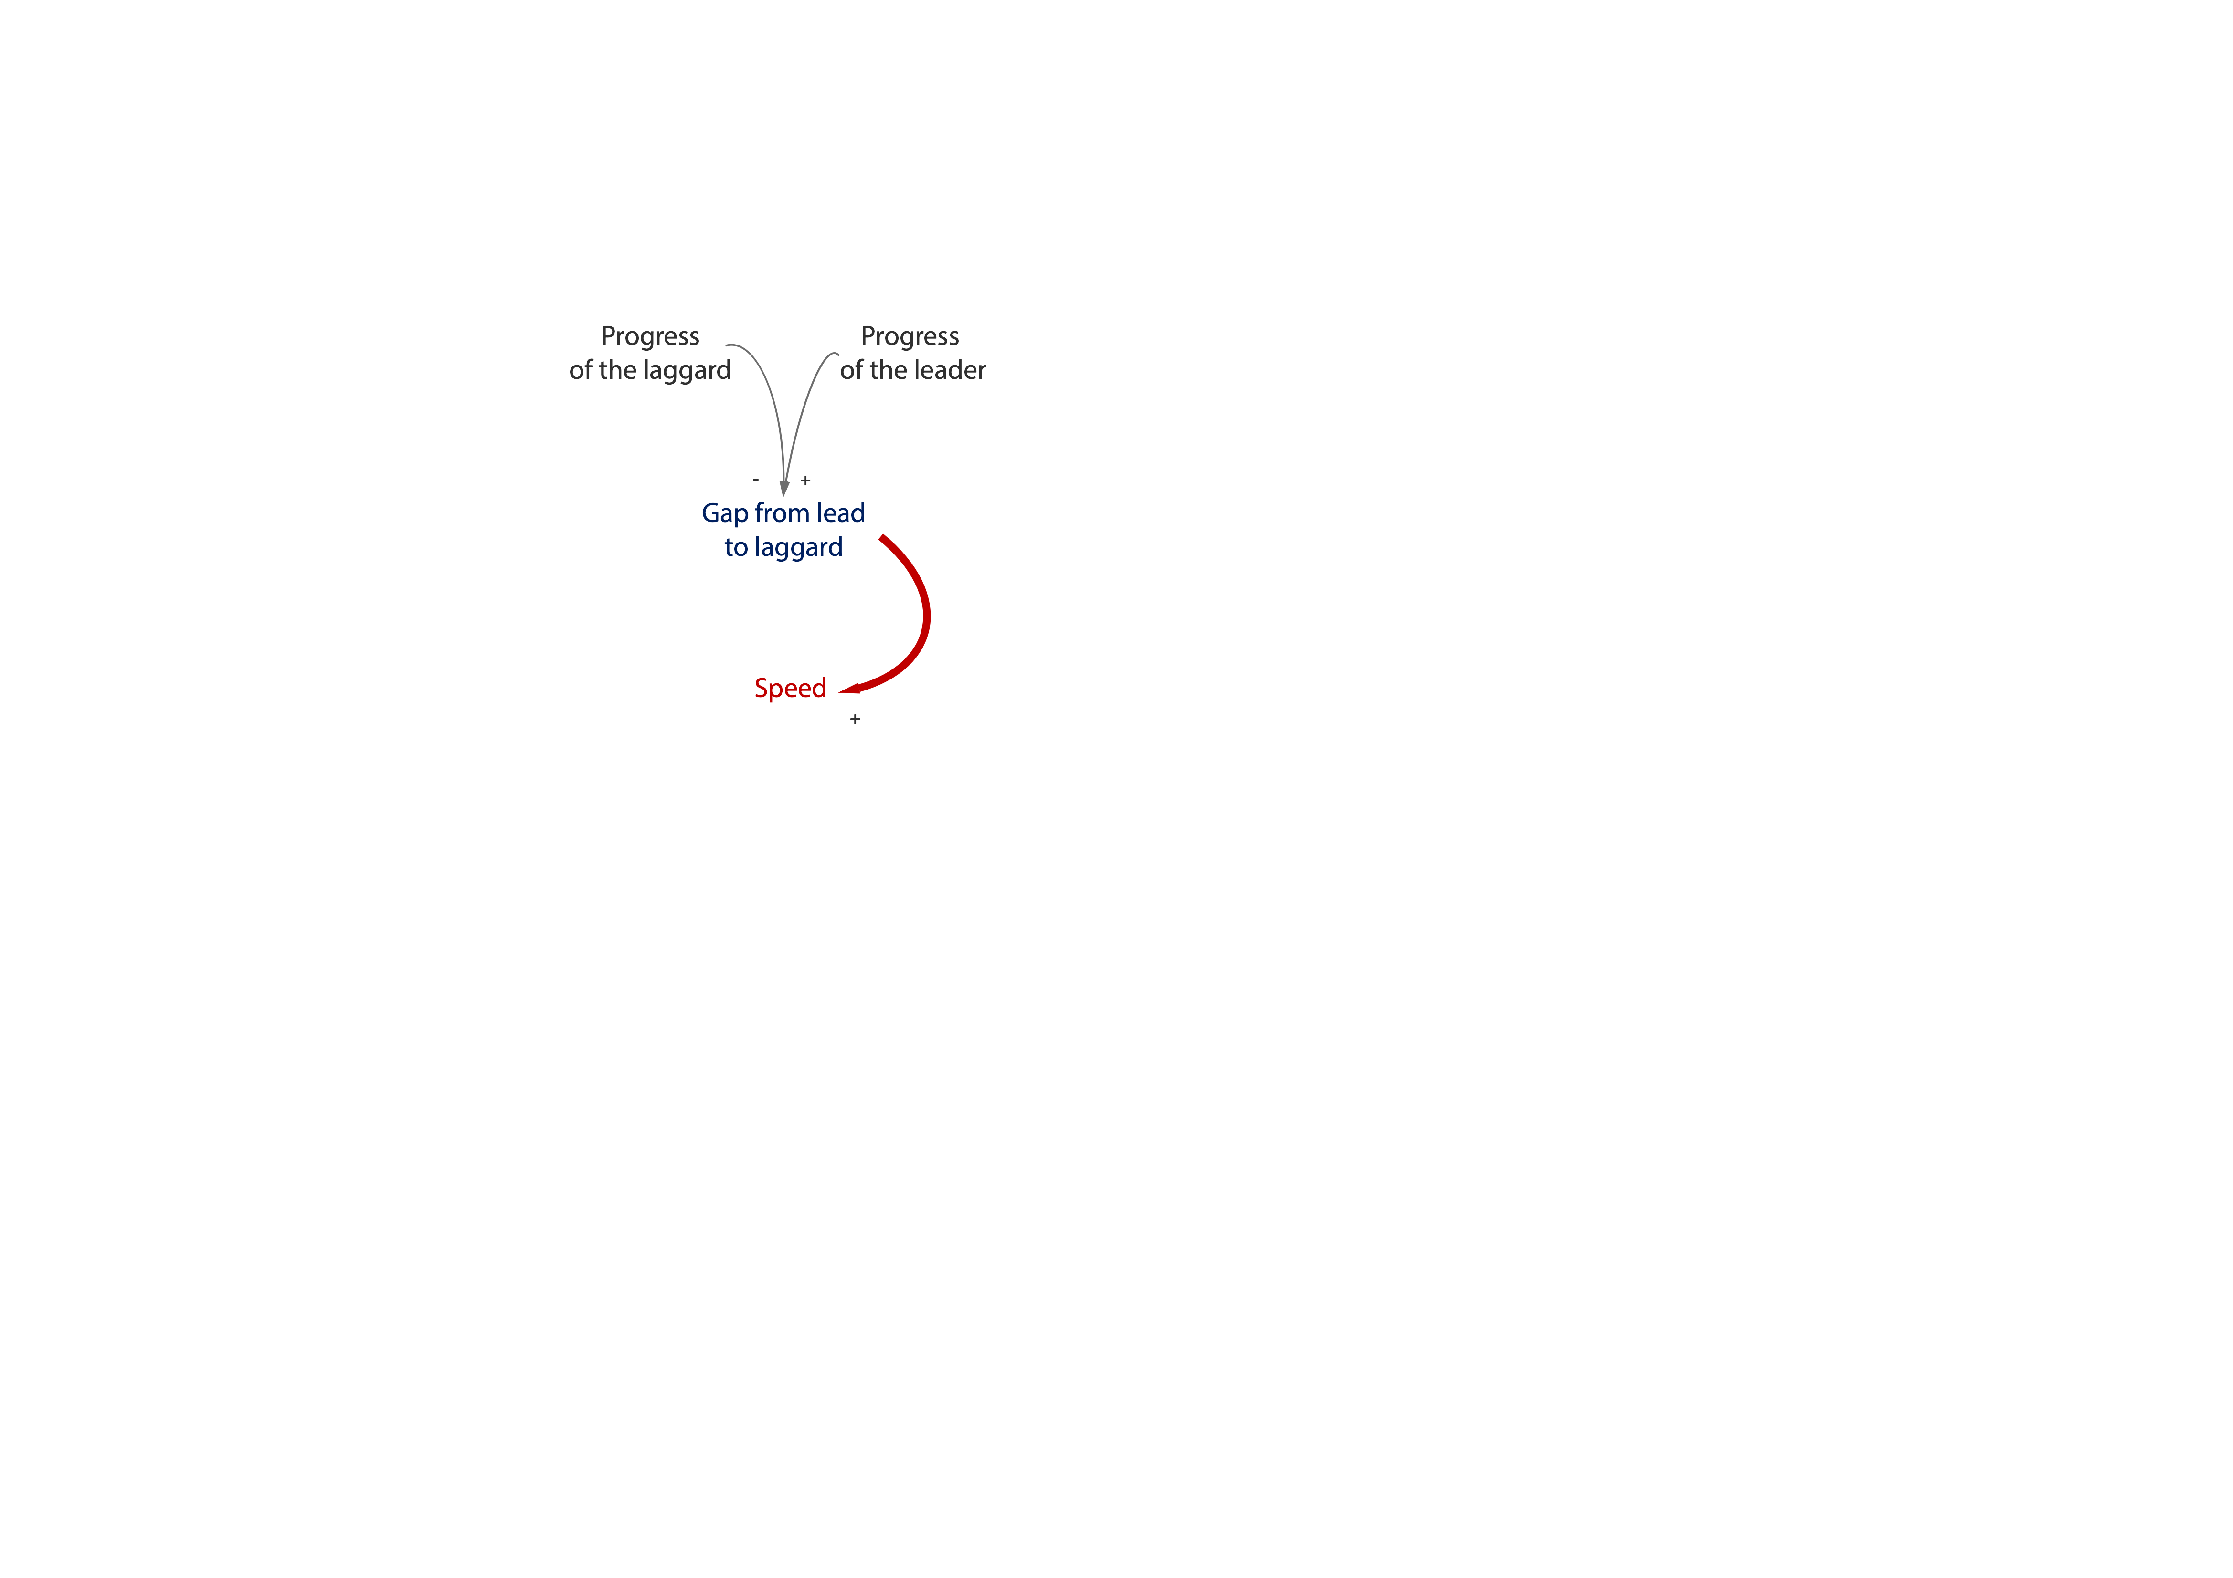
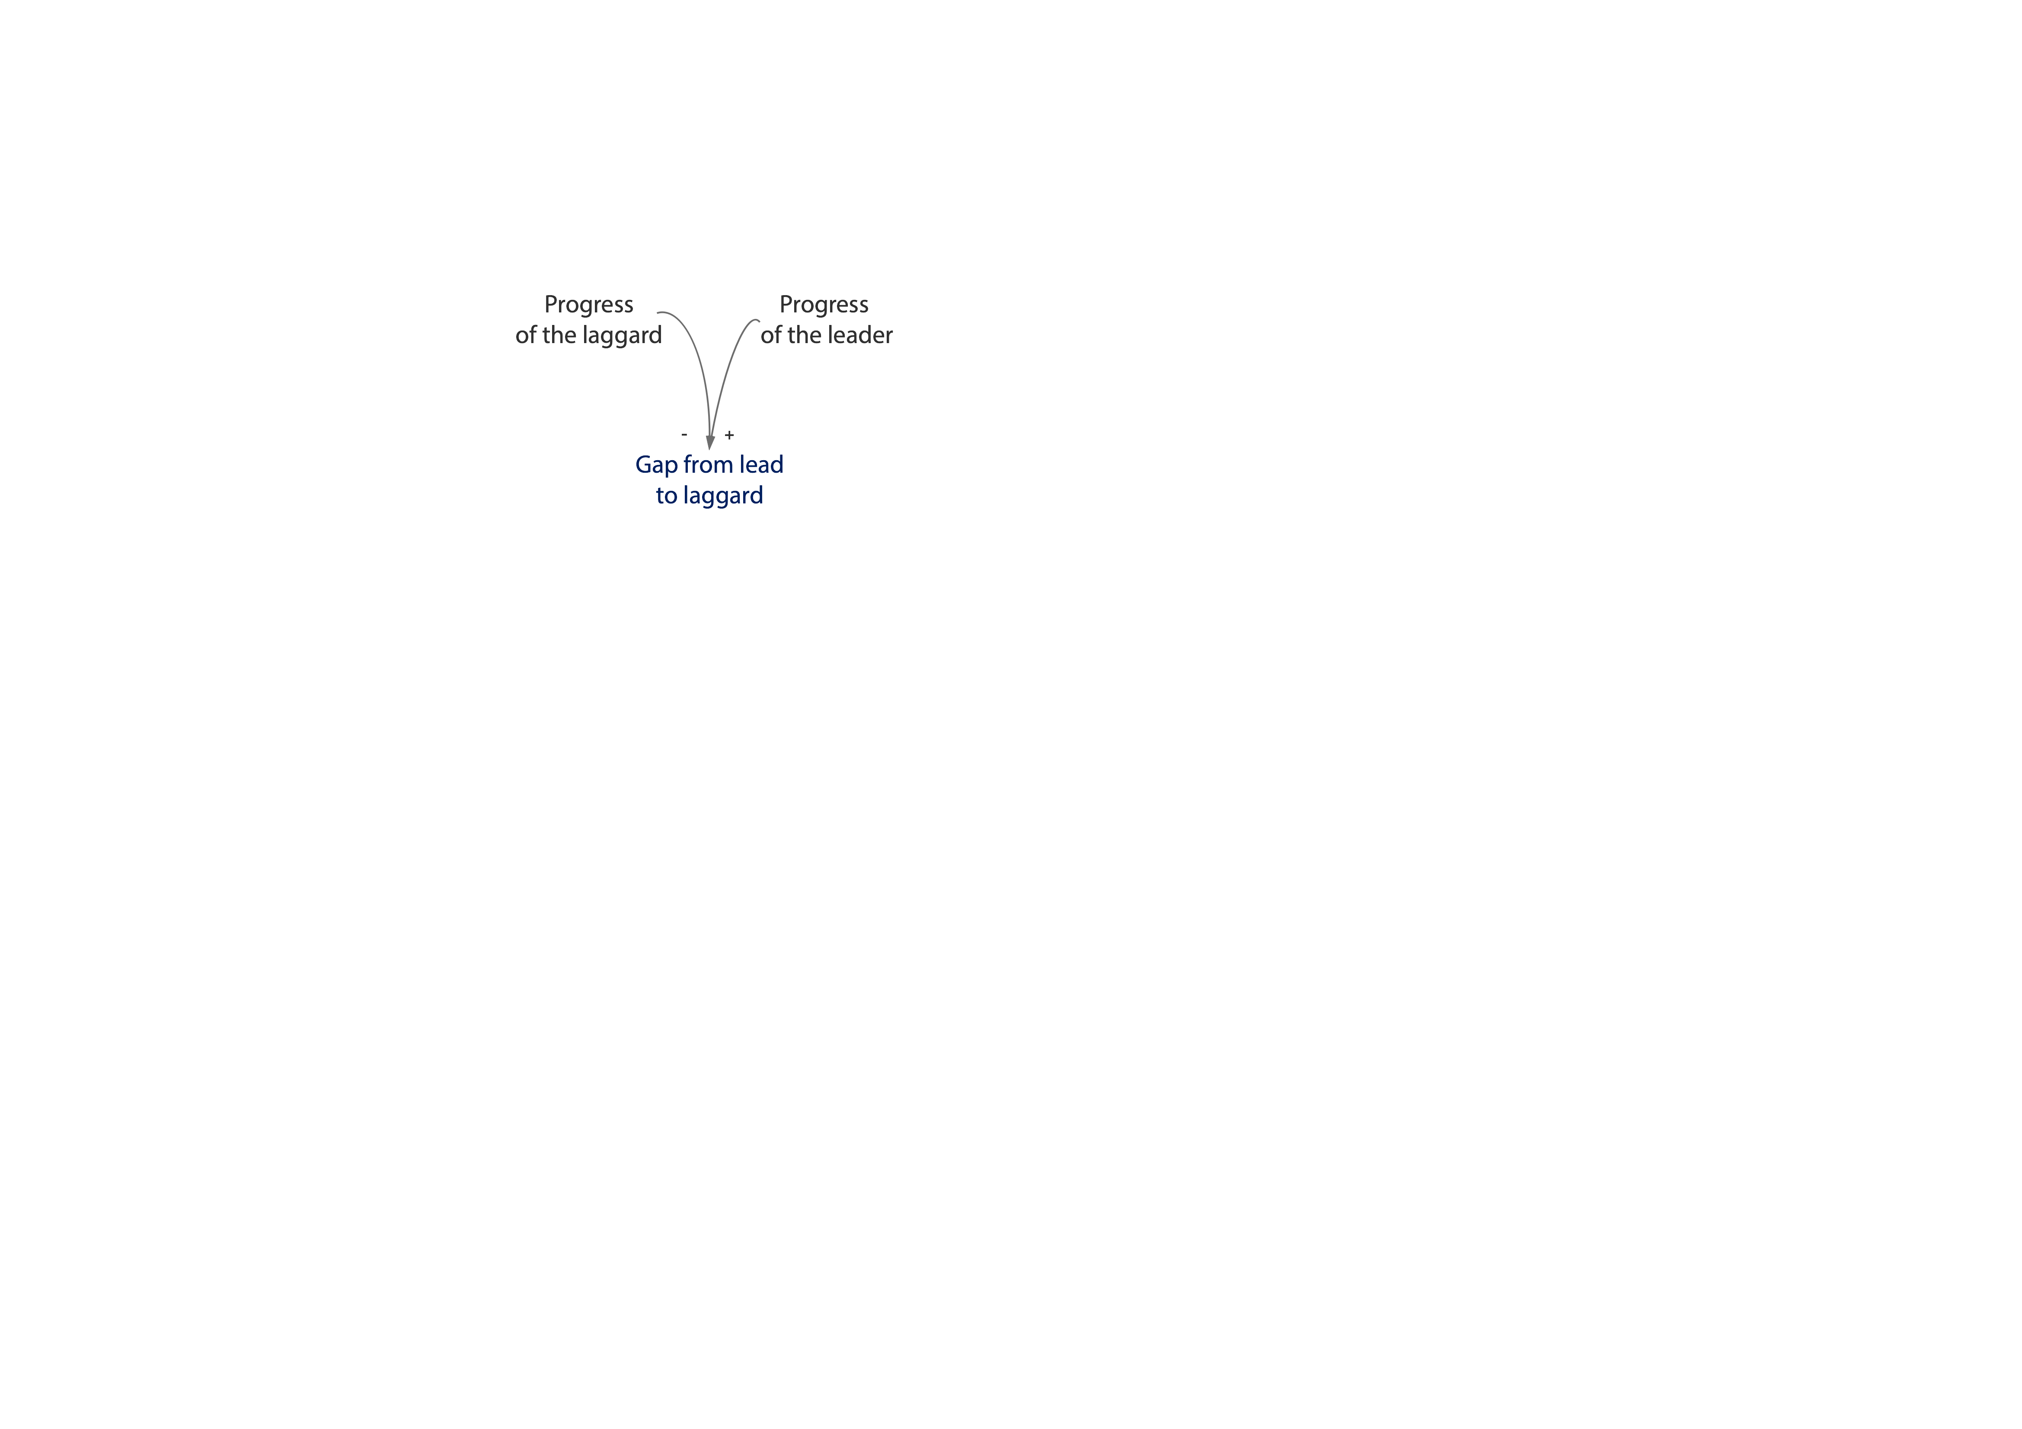
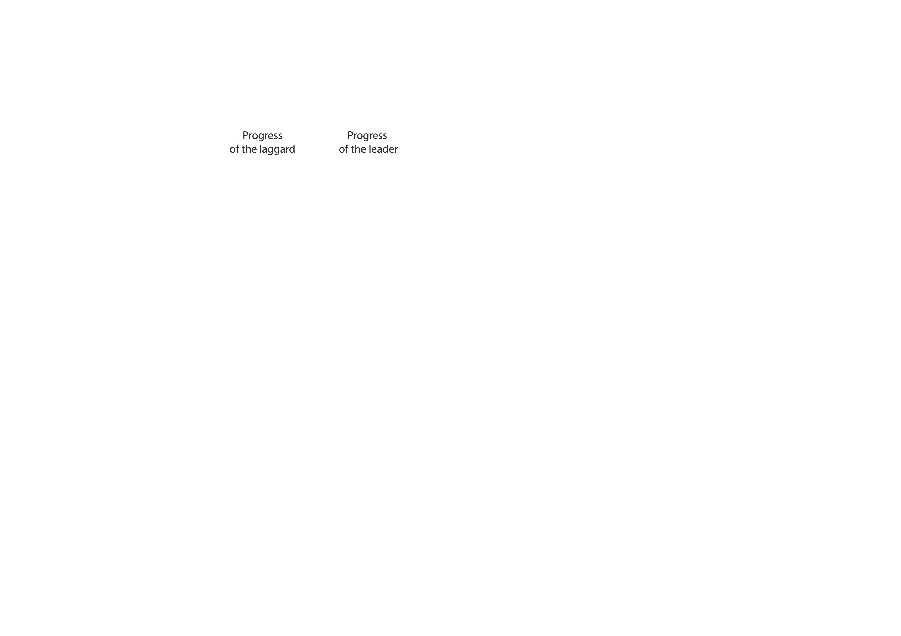
Trickle-down irrigation feedbacks
Mario Kart
Irrigation
Bell (2021)

Slide 23
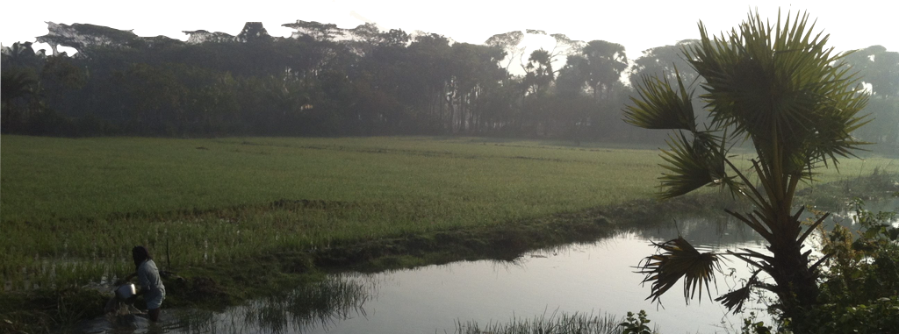
Win win. Right?
Pro-poor and trickle down
BUT Irrigation and hydraulic communities are a very specific (public goods) example
Where else can we find conditions where those in the middle can’t help but help those behind them when they help themselves
I.e., where they generate non-excludible benefits for their peers
I’ll close this section with a look at work in Malawi

Slide 24
PES for Malawi’s Shire River Basin
Colonial legacy of land clearing and ridging across Malawi’s agricultural landscape
Massive sedimentation into rivers whose hydropower provides > 90% of grid power
Conservation agriculture (don’t till, add cover, add legumes) is widely recommended but poorly heeded.
Paying farmers to practice CA is a widely studied process
Is it worthwhile to pay for CA?

Slide 25
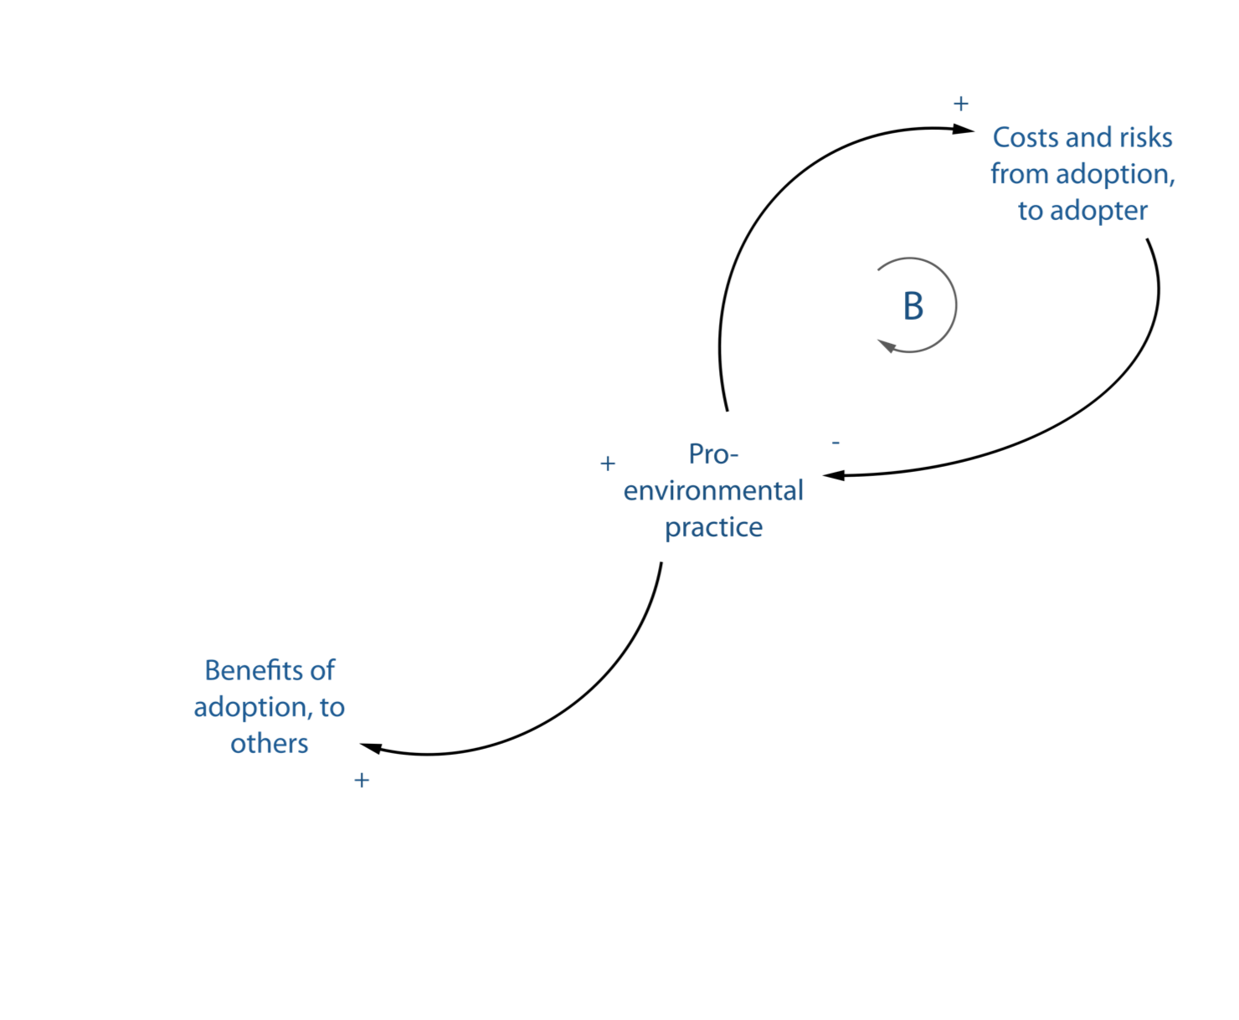
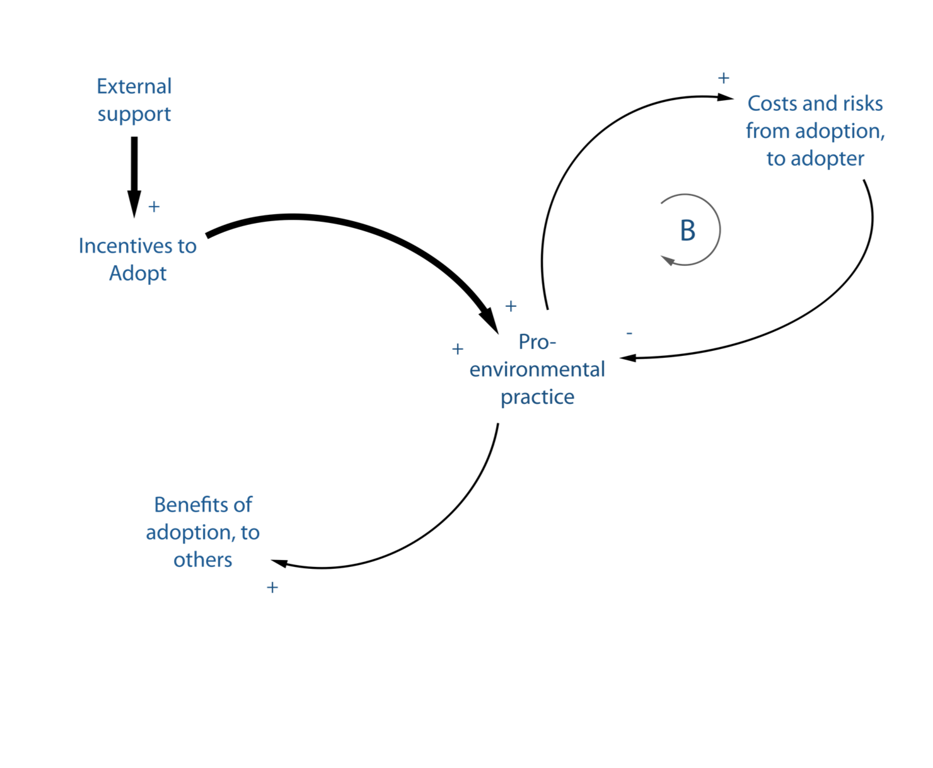
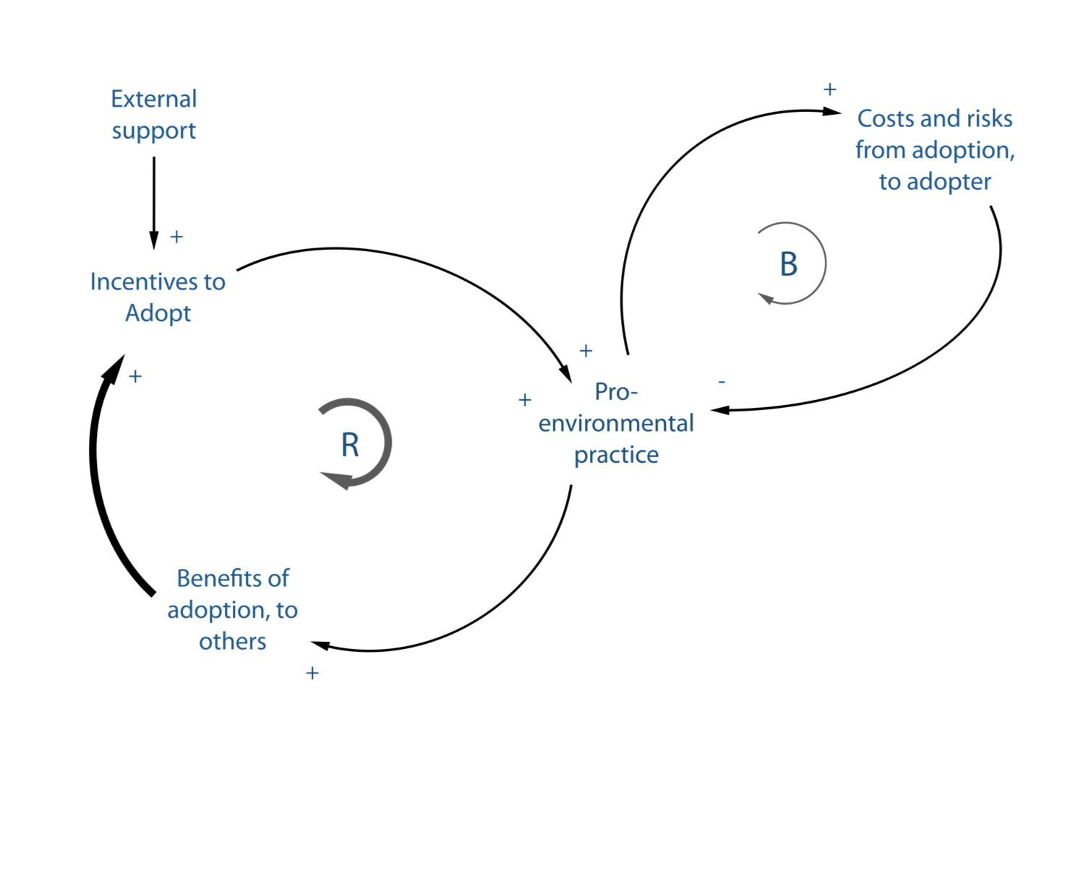
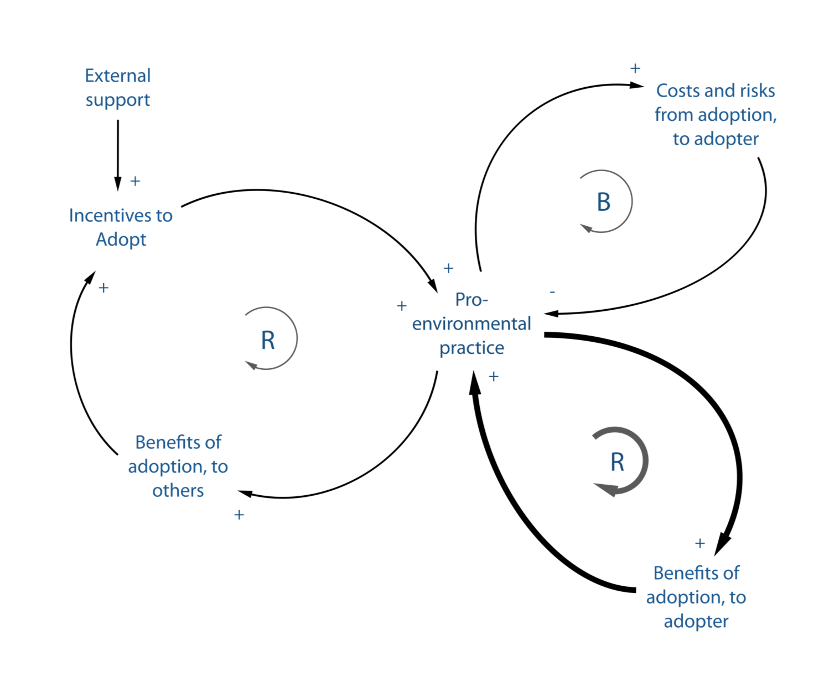
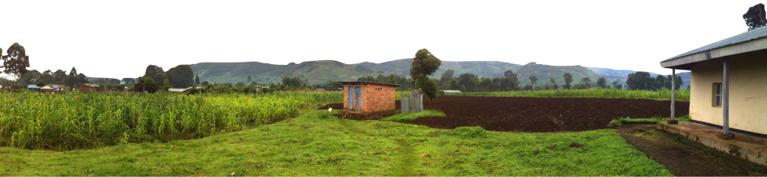
Yes, in theory.
PES encourage pro-environmental practices (like CA) that otherwise are too costly or risky
May begin with external support, but
Ideally have beneficiaries who pay for it themselves¹⁰
In many contexts (like CA), practice over time can lead to private, reinforcing benefits
Bibliography at bit.ly/37lD4lm
¹⁰Bell et al. (2018)

Slide 26
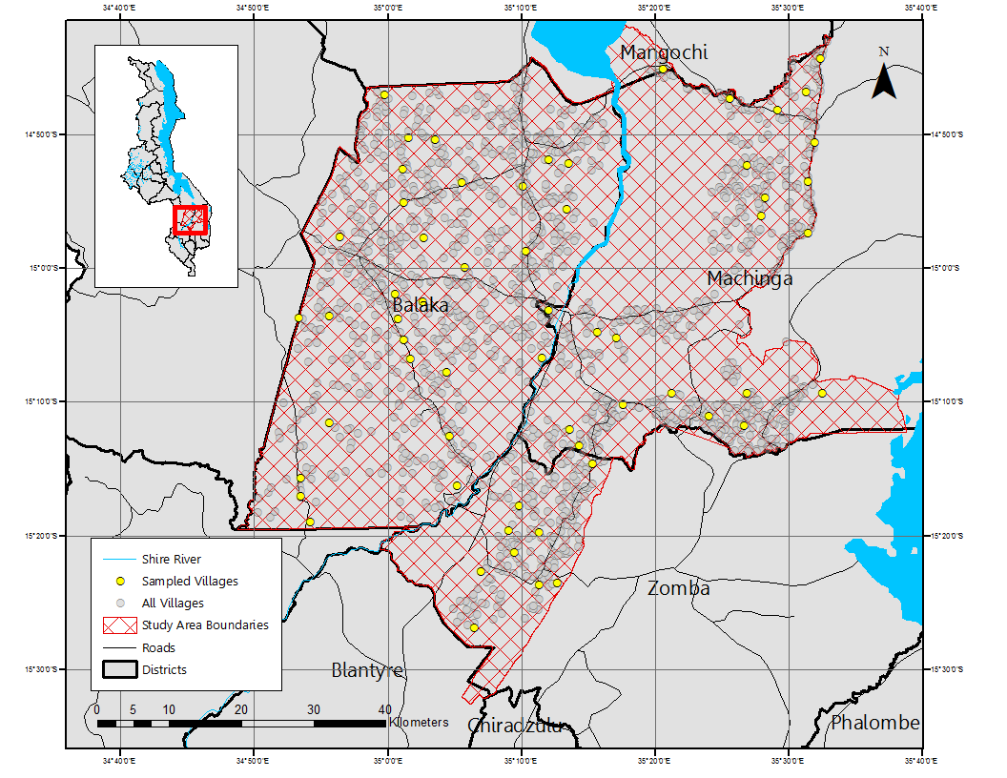
Yes, in practice.
We ran a randomized control trial of a few different incentive treatments across 60 villages in the upper Shire River Basin
Economic incentive only – no training or other encouragement
On average after two years, adoption* of CA on 21% of land, vs. 12% in control
*adoption really takes longer to evaluate, but this is how project cycles work
Bibliography at bit.ly/37lD4lm
¹⁰Bell et al. (2018)

Slide 27
Avoiding sediment to begin with
Across a range of assumptions, we estimate from O($10 to $1000) per ton to avoid sediment loading to Shire River
Considering the direct costs of dredging, and the opportunity costs of load shedding, this is a much cheaper approach for the hydropower provider
Bibliography at bit.ly/37lD4lm
¹⁰Bell et al. (2018)

Slide 28
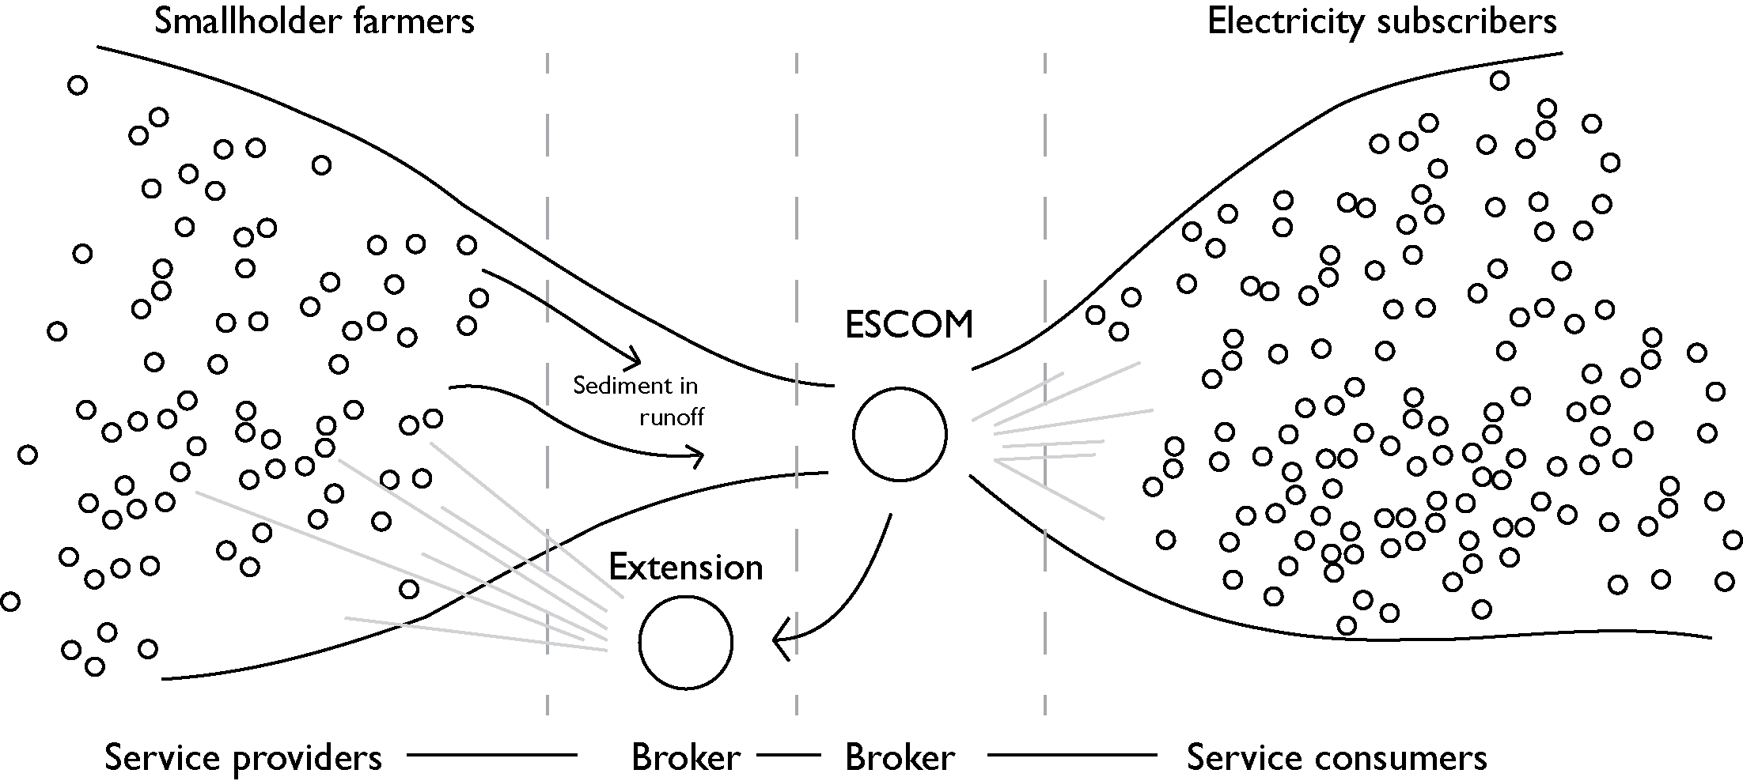
Lowering transaction costs
Enable us to value and build a market for a valuable, locally provided service
Generating ‘boosts’
Rewarding existing contributions

Slide 29
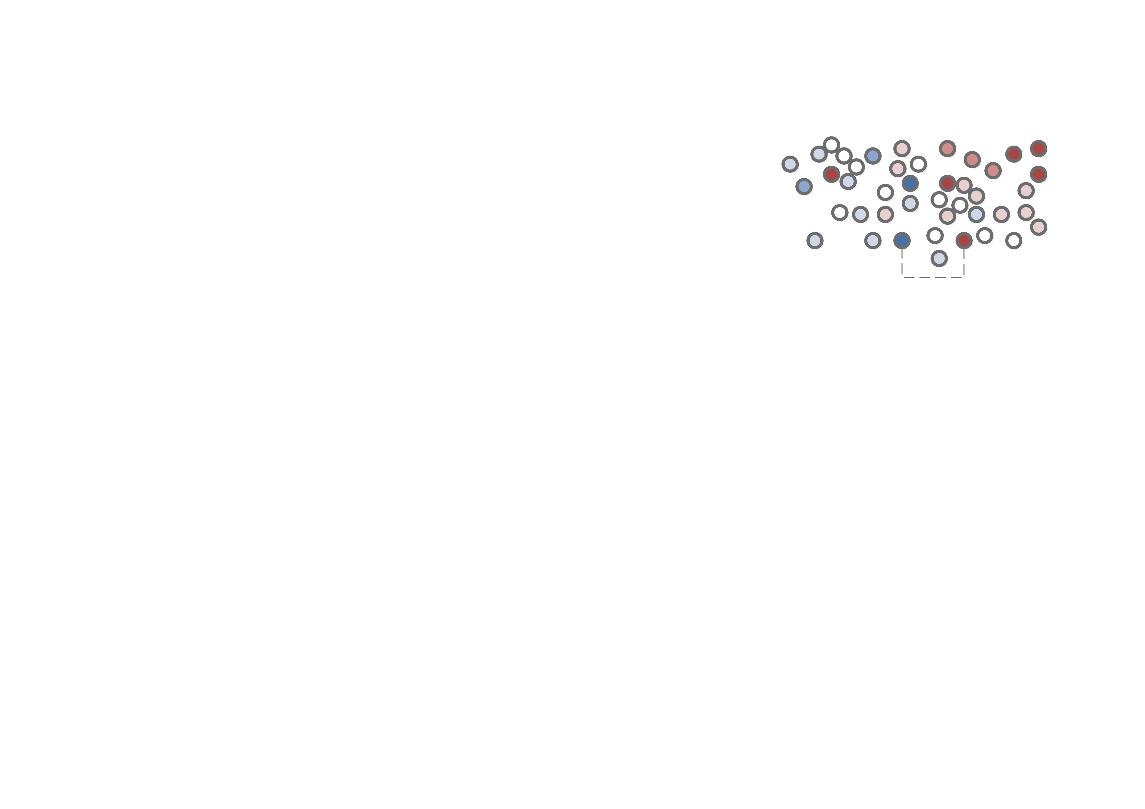
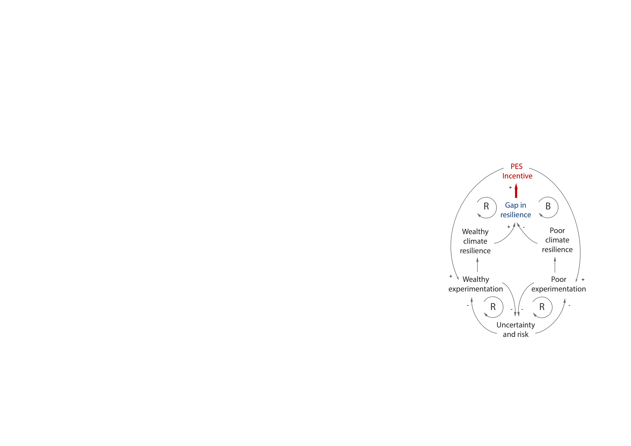
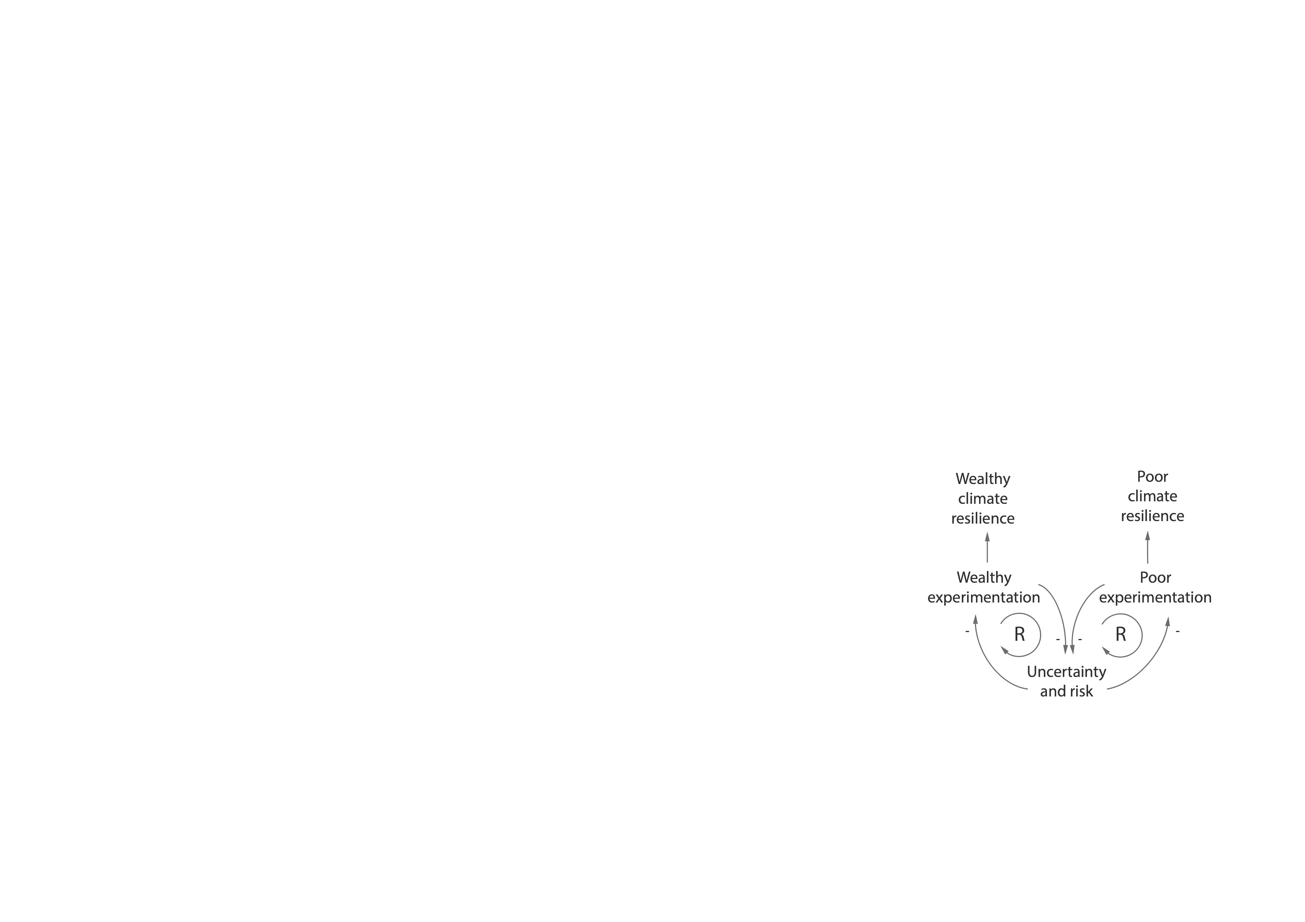
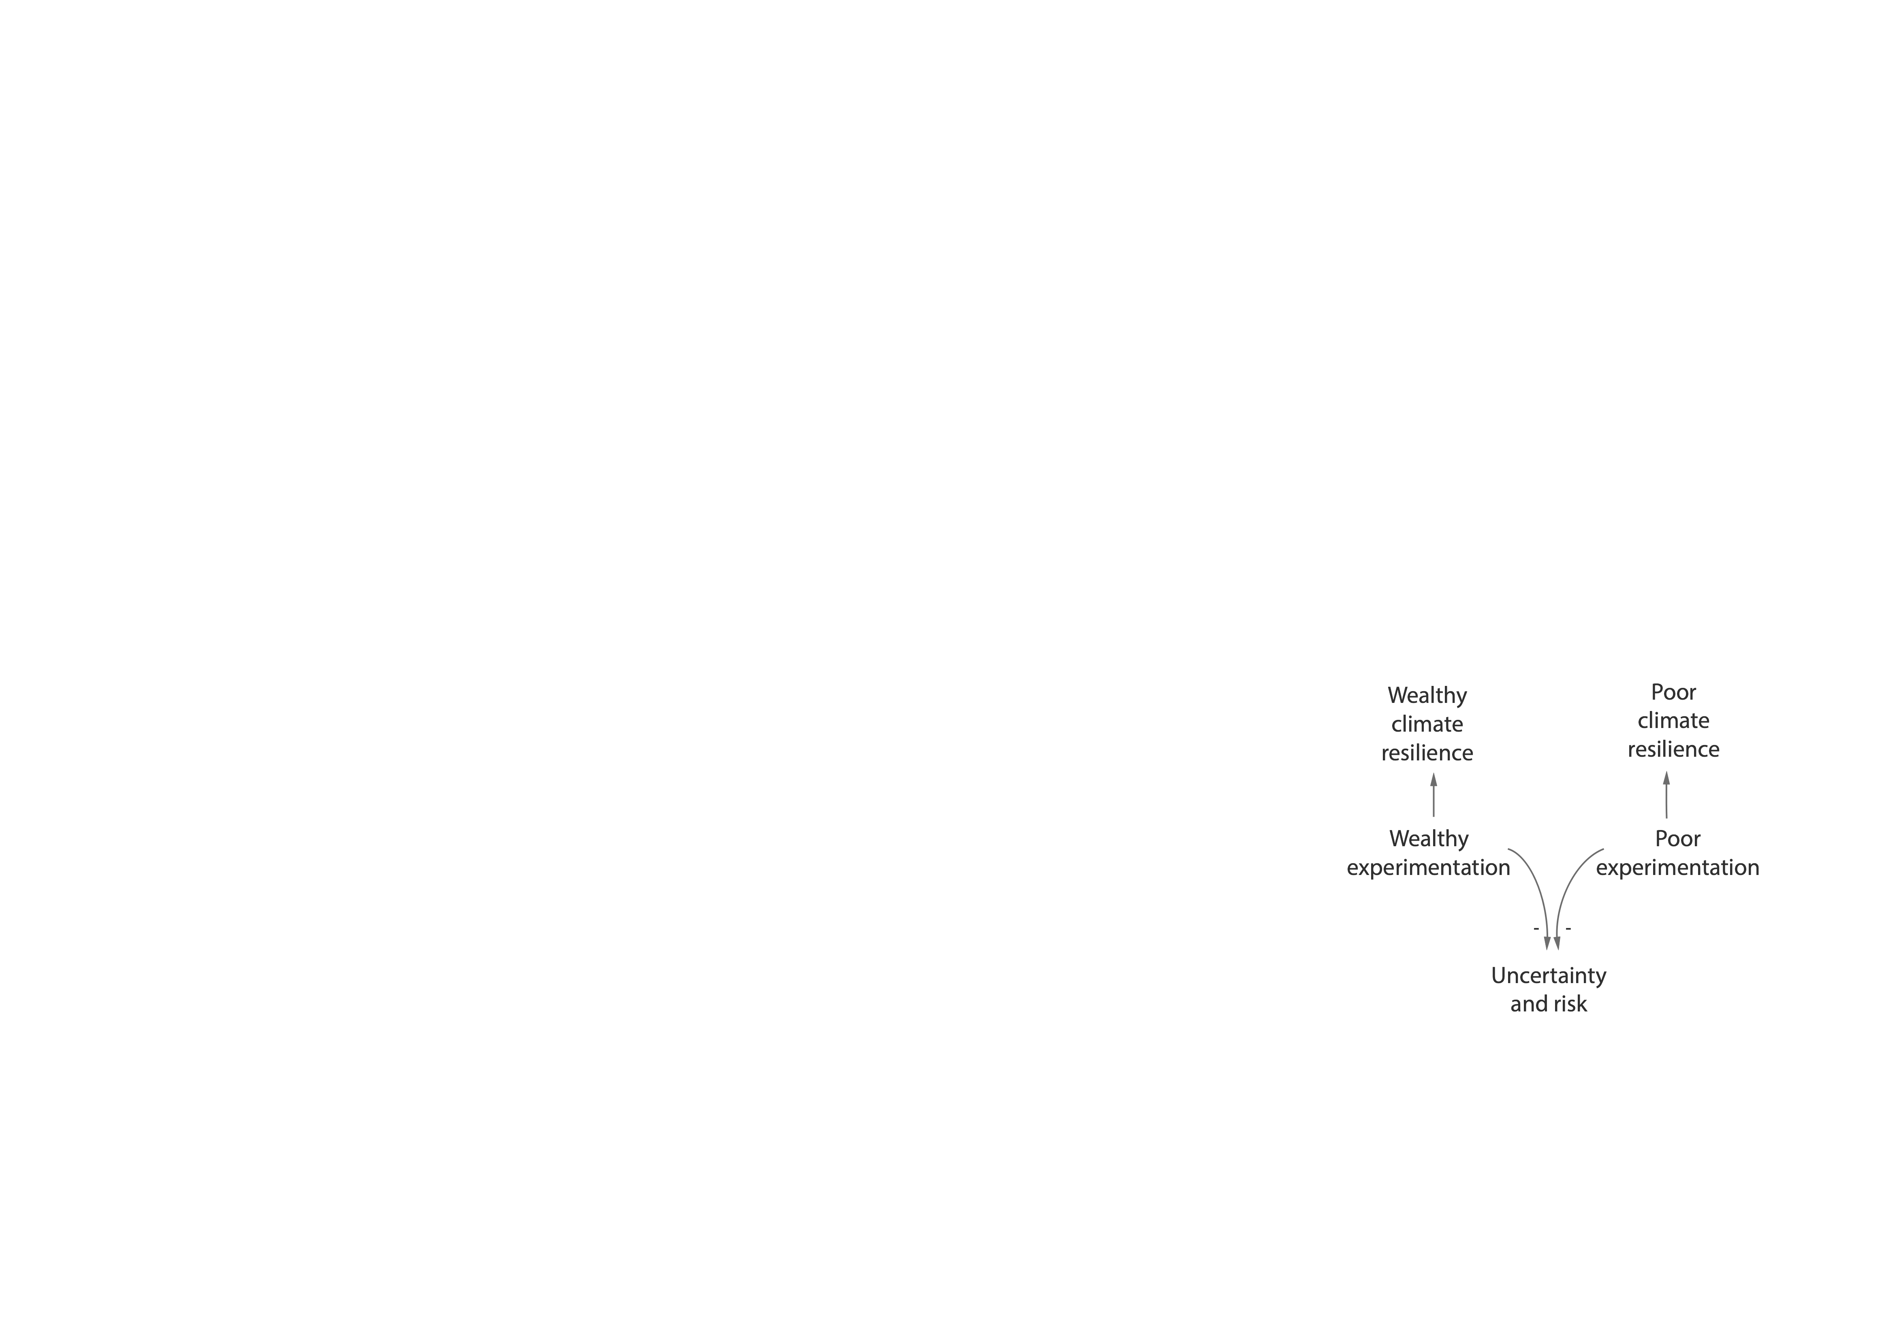
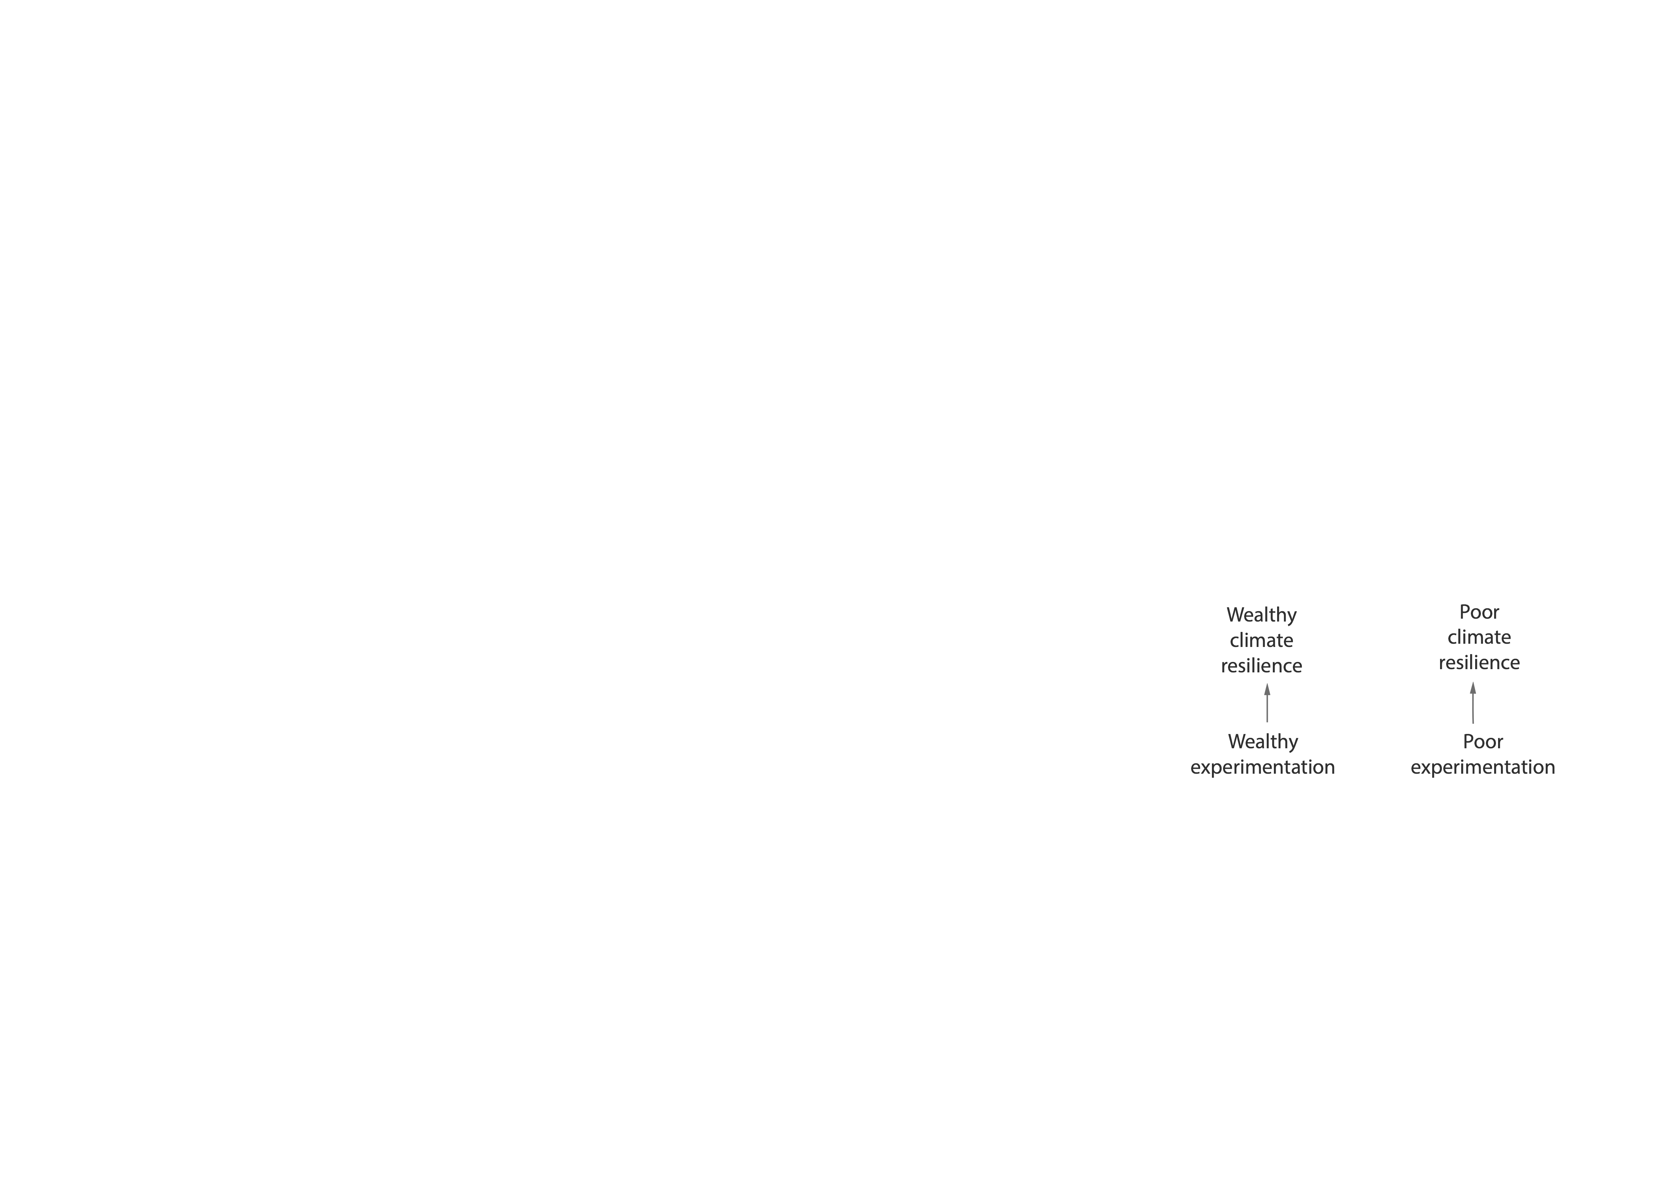
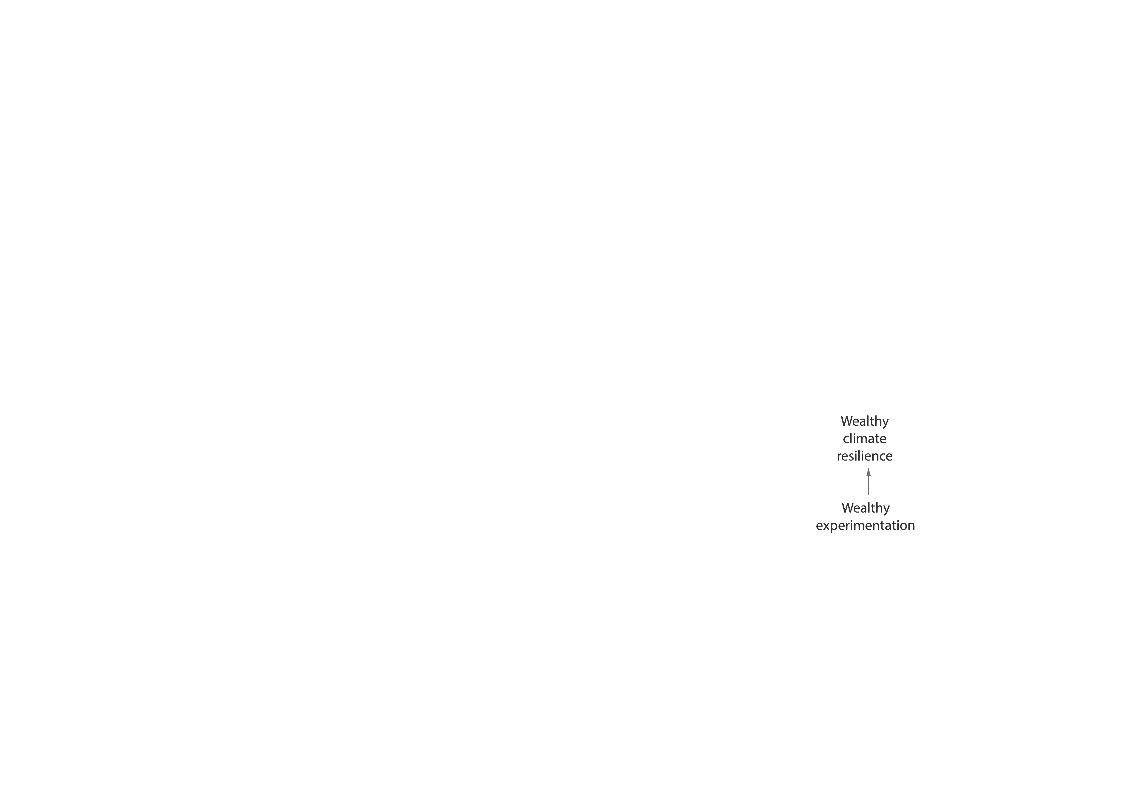
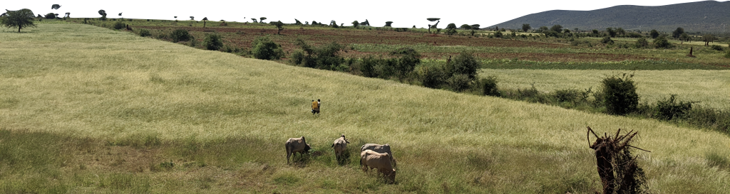
Risk sharing, in feedbacks
Not pro-poor … at least, not yet.
Participants in our program weren’t the smallest plots or the worst off
But, we only got to see early adoption
If those new adopters reshaped others’ understanding and willingness, we might see adoption by those less well-off over time
Not as literally ‘trickle down,’ but perhaps ‘crowd in’
Bell (2021)

Slide 30

What this could become, at scale
Recall the three pillars of rubberbanding:
In this program we could have:
Mobile-network engagement across region providing regular signals of where people are, and who is at the back
Incentives for, and private benefits to, adoption of conservation practice
Mechanism for crowding in participation via targeting of early adopters in precarious areas
Measuring where people are
✓
✓
✓
Generating boosts
Targeting boosts at the back

Slide 31
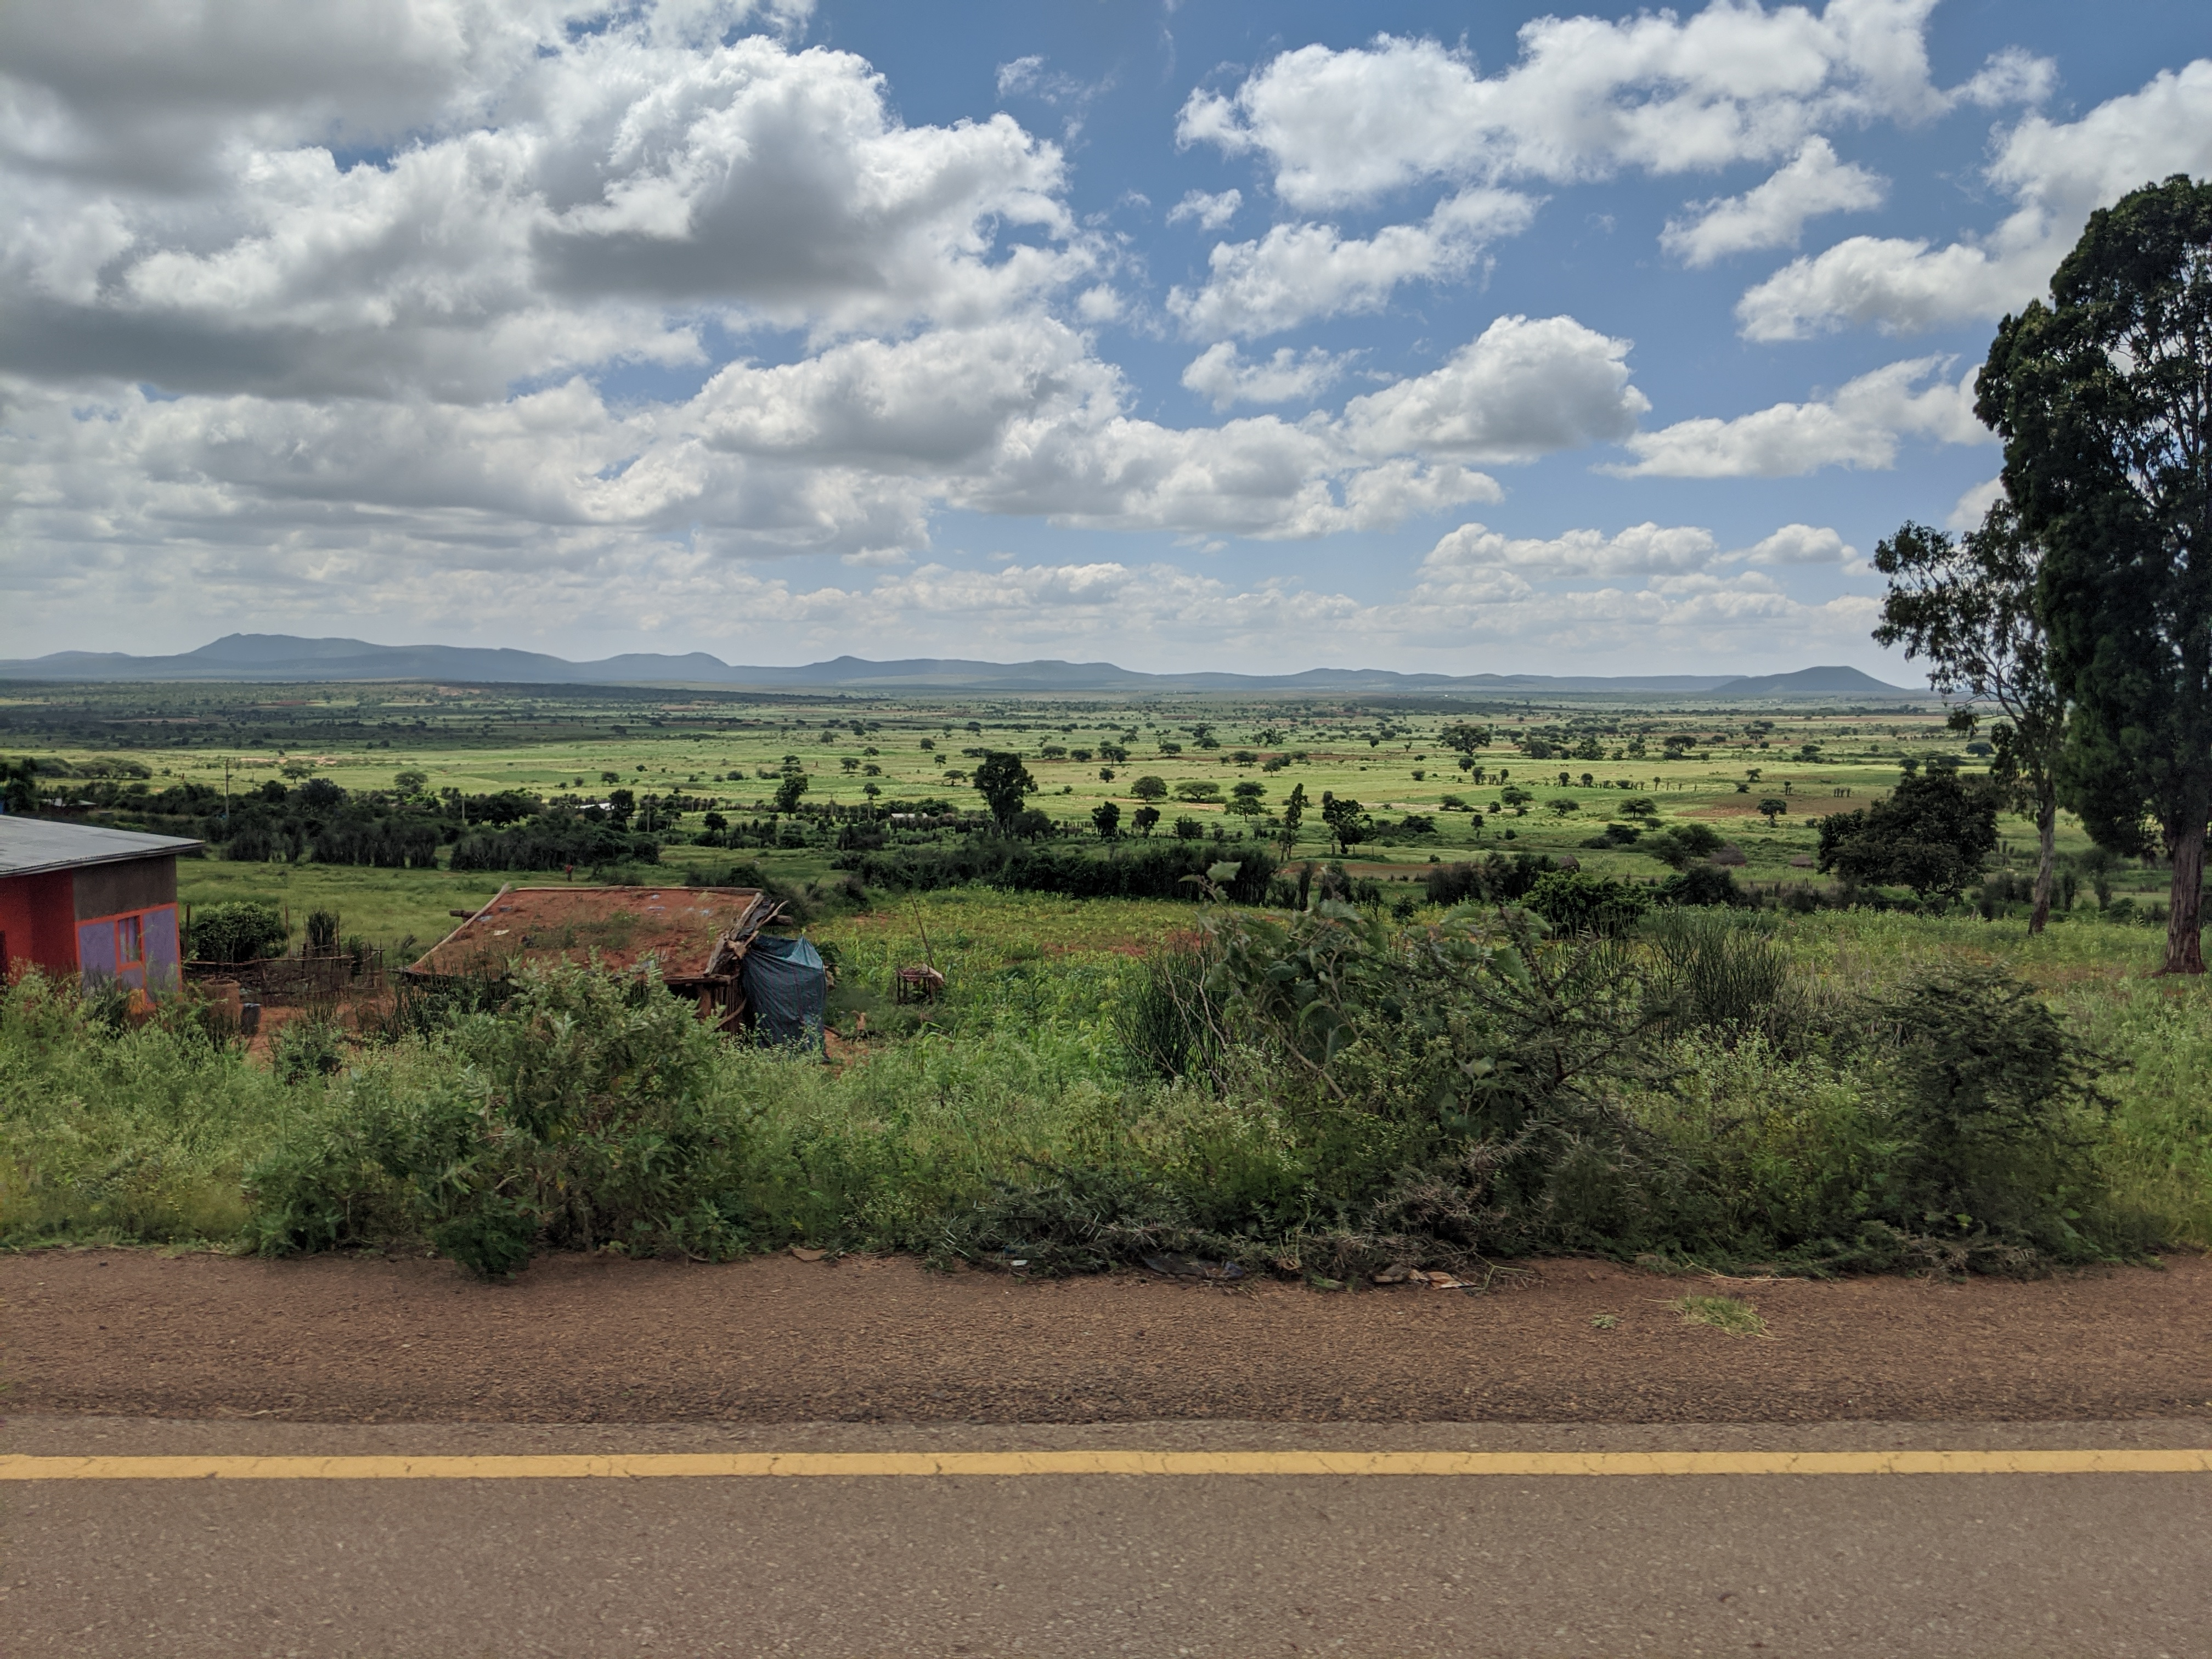
Some key messages
Mobile phones are transforming our ability to engage
(to see the back, to provide benefits, to make payments conditional)
Interventions won’t reach to the back unless we’re thoughtful about how they can
(triggering local processes for trickle-down, crowd-in, or diffusion)
Let’s talk just a bit about how to talk systems and feedbacks

Slide 32
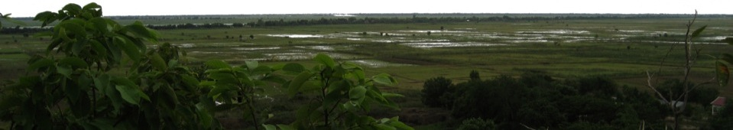
Causal loop modeling
A good first step towards building an operational model
Identify important system components, and sketch out their interactions
+
-
Mating
Fish
Harvest
+
-
+
+
Powerpoint is a clunky place to do causal models … let’s close in Kumu.io

