Slide 1
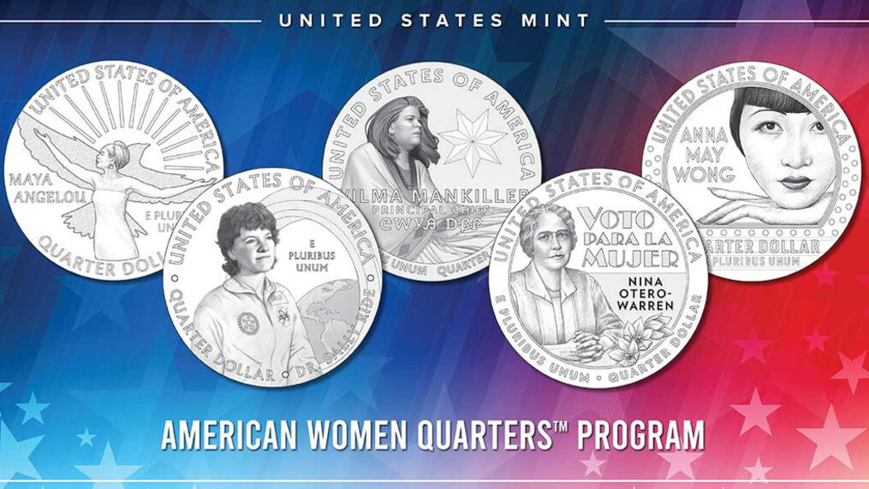
Women’s History Month
Women on the Money
Resources, Activities, and Lessons featuring the New American Women Quarters
Lynne Farrell Stover
JMU Center for Economic Education
stoverlf@jmu.edu

Slide 2
EconEdLink Membership
You can now access CEE’s professional development webinars directly on EconEdLink.org! To receive these new professional development benefits, become an EconEdLink member. As a member, you will now be able to:
Automatically receive a professional development certificate via e-mail within 24 hours after viewing any webinar for a minimum of 45 minutes
Register for upcoming webinars with a simple one-click process
Easily download presentations, lesson plan materials and activities for each webinar
Search and view all webinars at your convenience
Save webinars to your EconEdLink dashboard for easy access to the event
You may access our new Professional Development page here

Slide 3
Professional Development Certificate
To earn your professional development certificate for this webinar, you must:
Watch a minimum of 45-minutes and you will automatically receive a professional development certificate via e-mail within 24 hours.
Accessing resources:
You can now easily download presentations, lesson plan materials, and activities for each webinar from EconEdLink.org/professional-development/

Slide 4
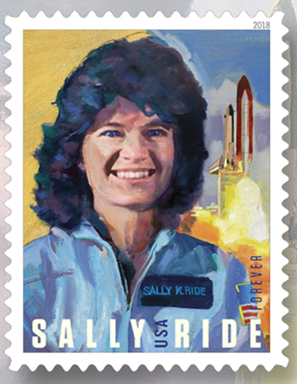
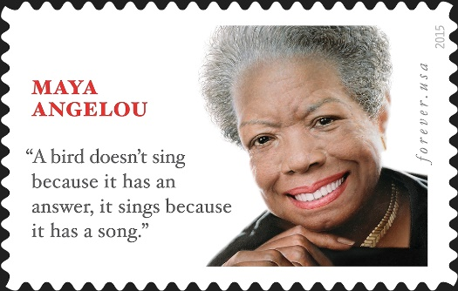
Agenda
This session features:
Information about the new Women of Quarters Program
Children’s book connections
Featured books’ lesson plans and activities
Extension lessons
Links to support materials
Q & A session

Slide 5
Objectives
Teachers will be able to:
Explore the new US Mint’s Women on Quarters program.
Learn how to use coins as a teaching tool.
Discover age appropriate lessons and activities based on the women featured on coinage.
Discuss the role of women in society.

Slide 6
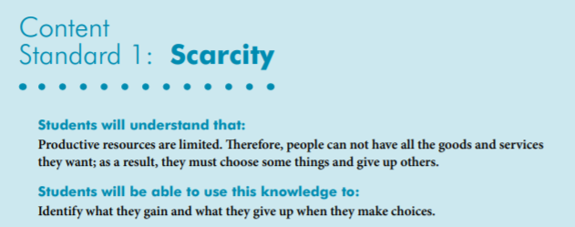

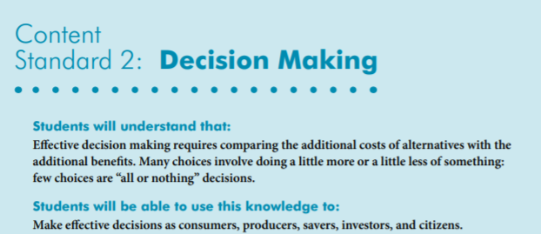
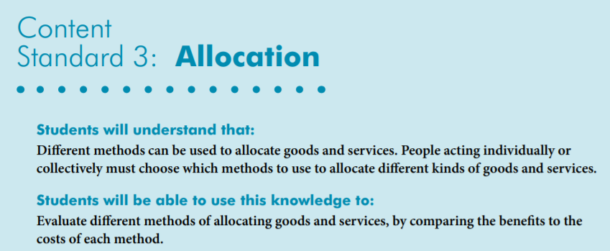
National Standards
https://www.councilforeconed.org/wp-content/uploads/2012/03/voluntary-national-content-standards-2010.pdf

Slide 7

Virginia HISTORY & SOCIAL SCIENCE Standards of Learning
Economics
1.1-3.1 The student will demonstrate skills of historical thinking, geographical analysis, economic decision making, and responsible citizenship by h) using a decision-making model to make informed decisions.
K.8 The student will match simple descriptions of work that people do with the names of those jobs.
3.8 The student will demonstrate an understanding of different cultures and the natural, human, and capital resources they used in the production of goods and services.
3.9 The student will recognize that because people and regions cannot produce everything they want, they specialize in what they do best and trade for the rest.
3.10 The student will identify examples of making an economic choice and will explain the idea of opportunity cost (what is given up when making a choice).
Civics
1.10 The student will apply the traits of a good citizen by
a) focusing on fair play, exhibiting good sportsmanship, helping others, and treating others with respect.

Slide 8


Women’s History Month was first celebrated in the United States in March, 1981. For educators and students, the month provides a wonderful opportunity to explore and study women’s contributions, struggles, and triumphs throughout history.
This month honors women who come from all walks of life, races, ages and religions and often had to overcome major obstacles to achieve their goals.

Slide 9
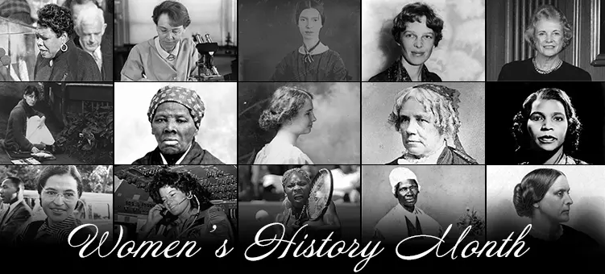
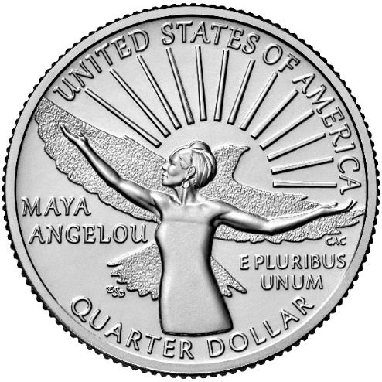


Women on the Money
Webinar Content:
National Women’s History Month
Women on Quarters Program
Related Children’s Books
Coin Information
Lessons and Activities
Angelou with her arms outstretched, in front of a flying bird and sunrise.

Slide 10
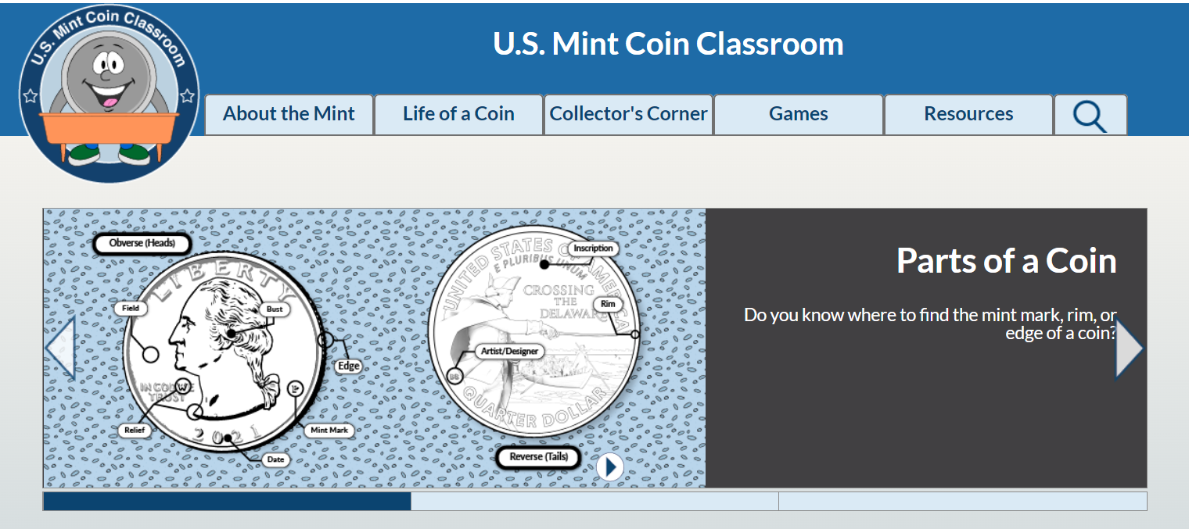
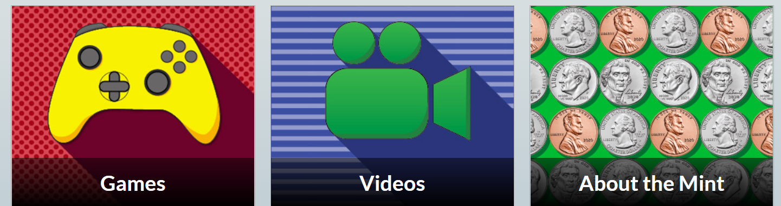
https://www.usmint.gov/learn/kids

Slide 11
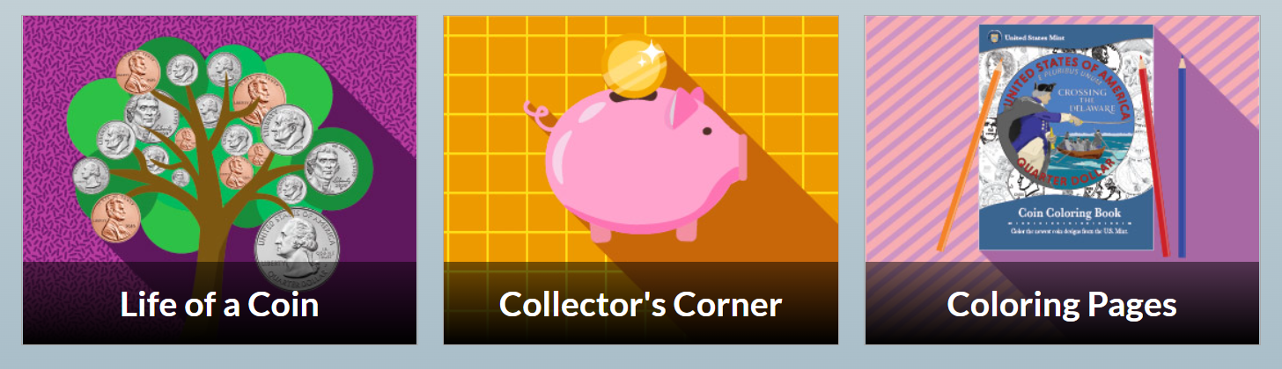
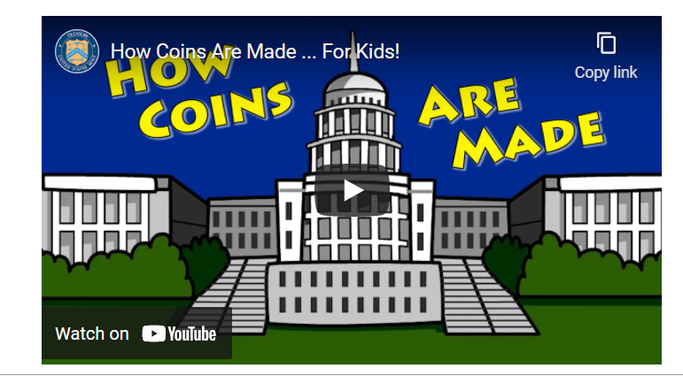
https://www.usmint.gov/learn/kids

Slide 12
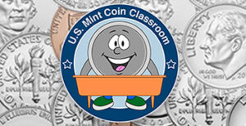
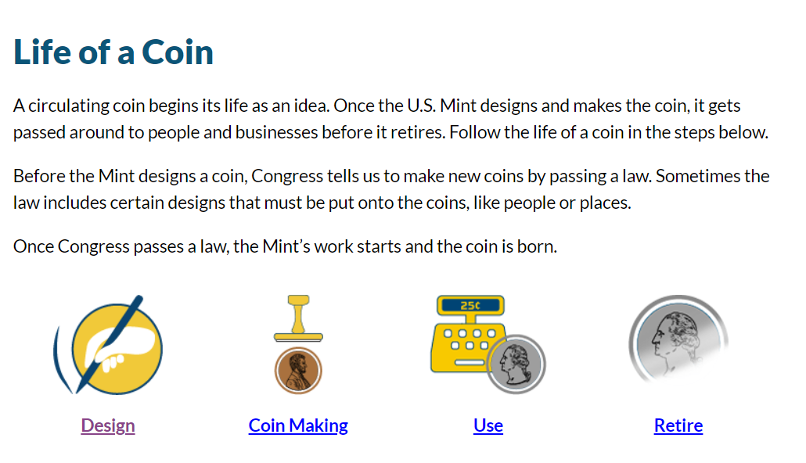
https://www.usmint.gov/learn/kids/coins-life

Slide 13
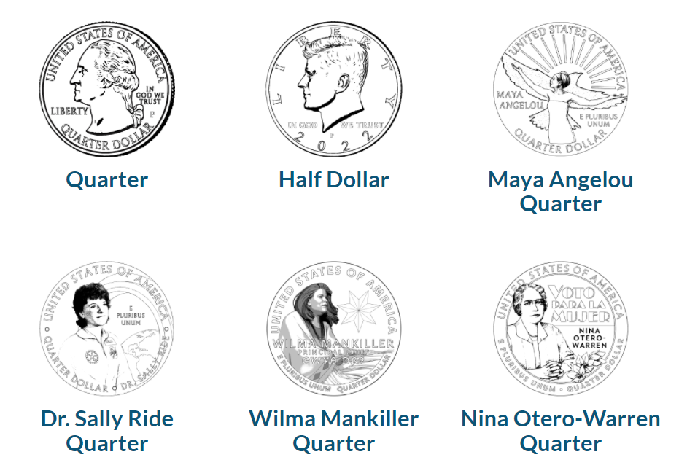


Quarter Color Pages
https://www.usmint.gov/learn/kids/resources/coloring-pages

Slide 14
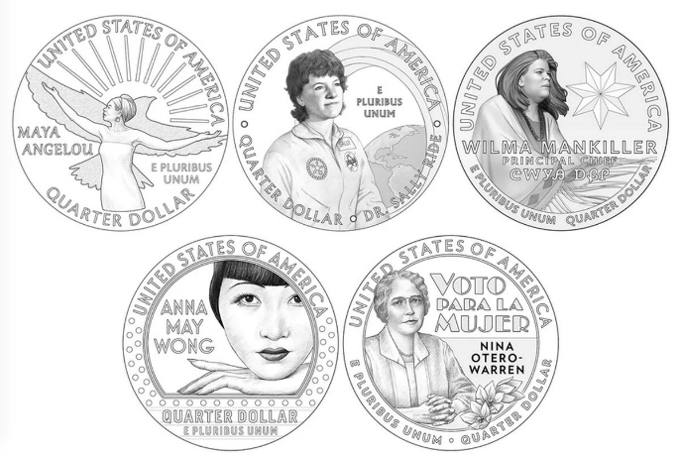

American Women on Quarters
The Distinguished American women celebrated on the 2022 quarters will be:
Maya Angelou - distinguished celebrated writer, performer, and social activist
Dr. Sally Ride - physicist, astronaut, educator, and first American woman in space
Wilma Mankiller -first female principal chief of the Cherokee Nation
Nina Otero-Warren - a leader in New Mexico’s suffrage movement and the first female superintendent of Santa Fe public schools
Anna May Wong - first Chinese American film star in Hollywood

Slide 15
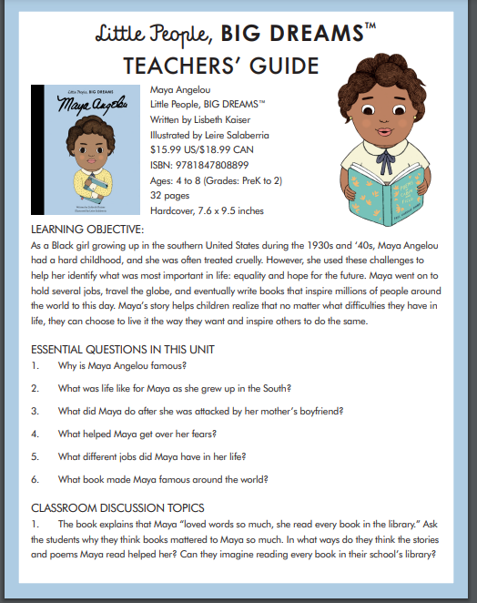
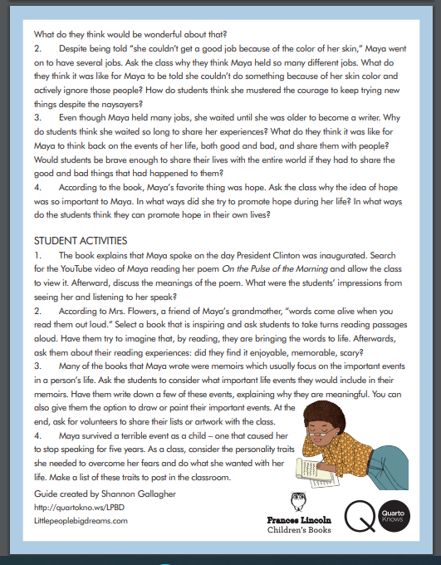
https://www.quartoknows.com/public/dynamic/files/product_file/Maya-Angelou-Teachers-Guide-97818478088994095.pdf
Publisher’s Teacher Guide

Slide 16

Who Was Maya Angelou?
Book Synopsis: Born in Missouri in 1928, Maya Angelou had a difficult childhood. Jim Crow laws segregated blacks and whites in the South. She moved to California and became the first black—and first female—streetcar operator before following her interest in dance. She became a professional performer in her twenties and toured the U.S. and Europe as an opera star and calypso dancer. But Angelou's writing became her defining talent. Her poems and books, including I Know Why the Caged Bird Sings, brought her international acclaim.
Publisher: Grosset & Dunlap Copyright Date: 2016
Reading Level: 5.8
Interest Level: 4-7
April 4, 1928-May 28, 2014

Slide 17
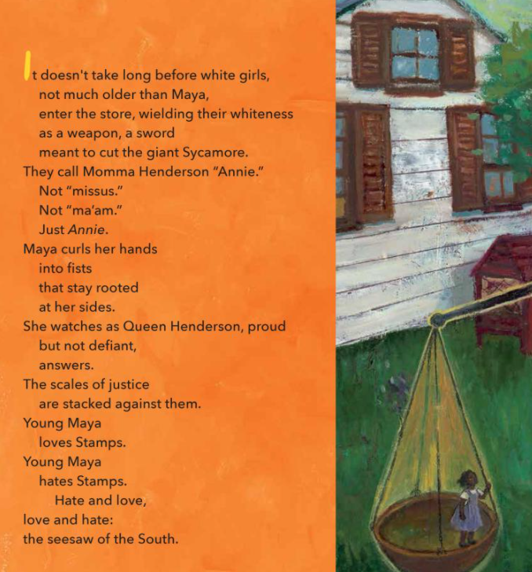

Rise!: From Caged Bird to Poet of the People, Maya Angelou
Publisher: Lee & Low
Copyright Date: 2019
Reading Level: 4.9
Interest Level: 2-5

Slide 18

Who Was Sally Ride?
by Megan Stein
Publisher: Grosset & Dunlap
Copyright Date: 2013
Reading Level: 5.9
Interest Level: 4-7
Book Synopsis: A portrait of the first female astronaut in space provides coverage of topics ranging from her professional tennis skills and achievements as a robotics developer to her history-making shuttle mission and contributions through Sally Ride Science.
May 26, 1951-July 23, 2012

Slide 19

Sally Ride
[She Persisted Series]
by Arta Abawi
Publisher: Penguin Copyright Date: 2021
Reading Level: 5.0
Interest Level: 3-6
Book Synopsis: As the first American woman in space, Sally Ride broke barriers and made her dreams come true. But she wanted to do even more! After leaving NASA, she created science and engineering programs that would help other girls and women make their dreams come true as well.

Slide 20
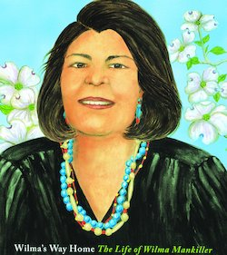
Wilma's Way Home: The Life of Wilma Mankiller
by Doreen Rappaport
Publisher: Hyperion
Copyright Date: 2019
Reading Level: 5.1
Interest Level: 2-5
Story Synopsis: A picture-book biography of Wilma Mankiller, the first female chief of the Cherokee Nation.
November 18, 1945 - April 6, 2010

Slide 21
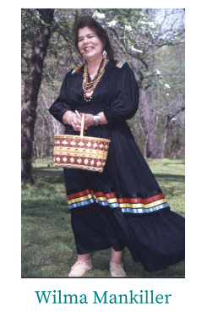
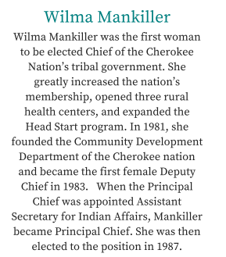
https://www.womenshistory.org/sites/default/files/document/2017-08/NativeAmericanHeritageMonthPoster.pdf

Slide 22
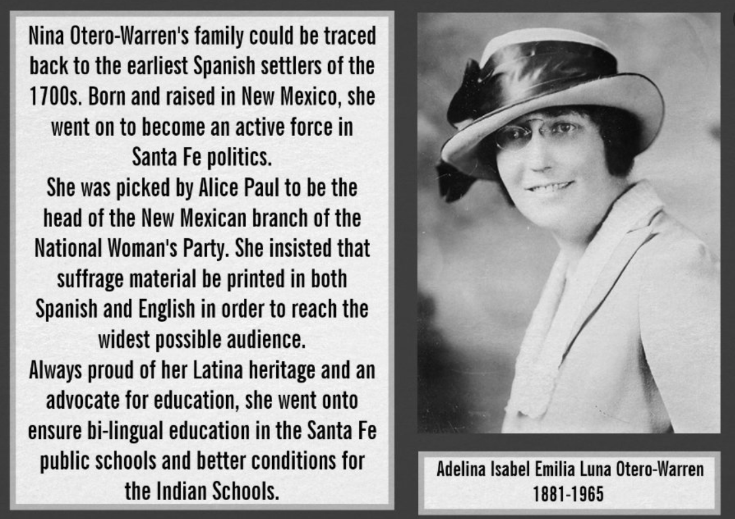
Nina Otero-Warren

Slide 23

Shining Star:
The Anna May Wong Story
by Paula Yoo
Publisher: Lee & Low Copyright Date: 2009
Reading Level: 6.0
Interest Level: 2-5
Story Synopsis: A biography of Chinese American film star Anna May Wong who, in spite of limited opportunities, achieved her dream of becoming an actress and worked to represent her race on screen in a truthful, positive manner.
January 13 1905 – February 3 1961

Slide 24
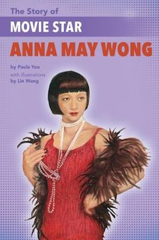

The Story of Movie Star Anna May Wong
by Paula Yoo
Publisher: Lee & Low Copyright Date: 2018
Reading Level: 6.8
Interest Level: 3-6

Slide 25
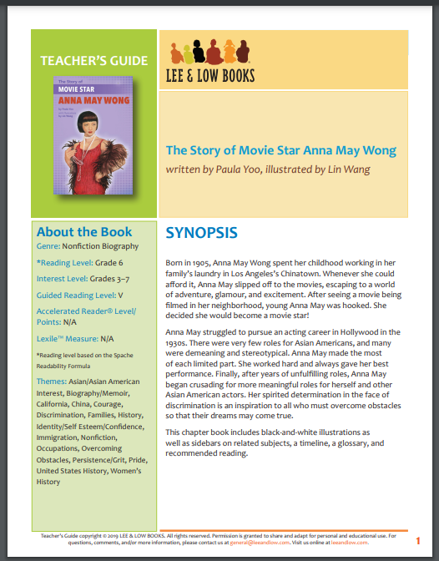
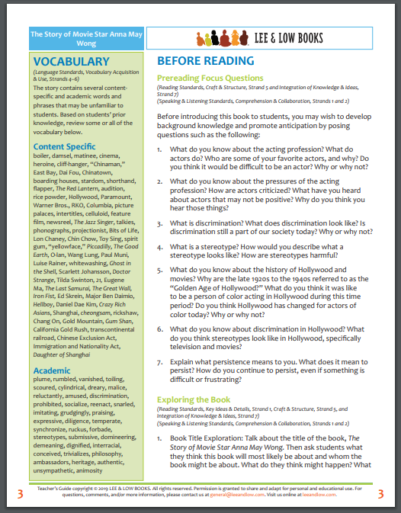
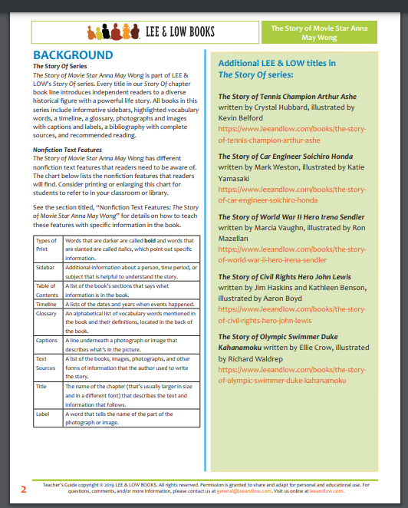
Publisher’s Eight Page Teacher’s Guide
https://www.leeandlow.com/uploads/loaded_document/688/STORYOFANNAMAYWONG_TeachersGuide.pdf

Slide 26
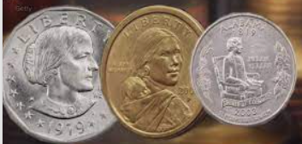
Women on Coins
Women have been featured on US money before, but the notes and coins were not widely used. Most recently women's rights activist Susan B Anthony and Native American Sacagawea appeared on dollar coins, but both coins quickly went out circulation.

Slide 27
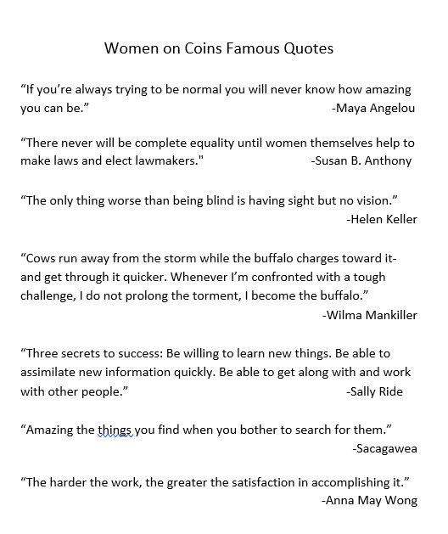
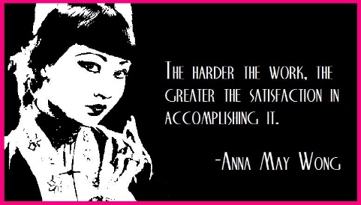
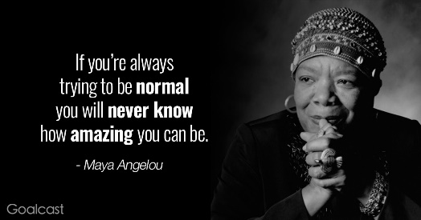
Lessons & Activities

Slide 28

Quick Quote Ideas
Compare and Contrast
Rank
Re-write as text message
Illustrate
Directions: Rewrite the displayed quotes on index cards. Select one of the tasks and when complete, share it with the class.

Slide 29
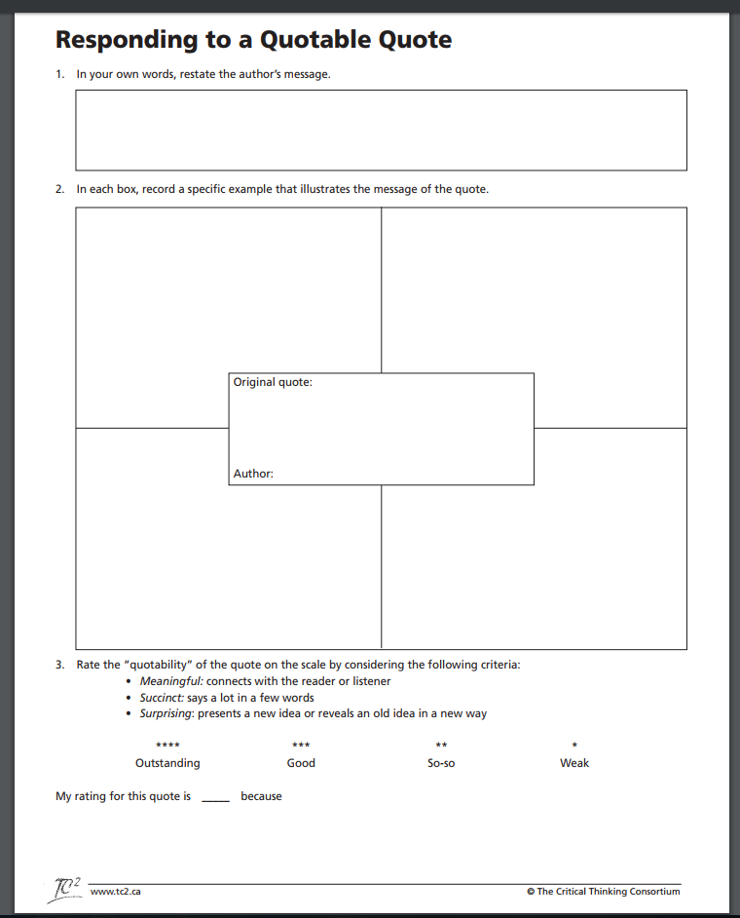
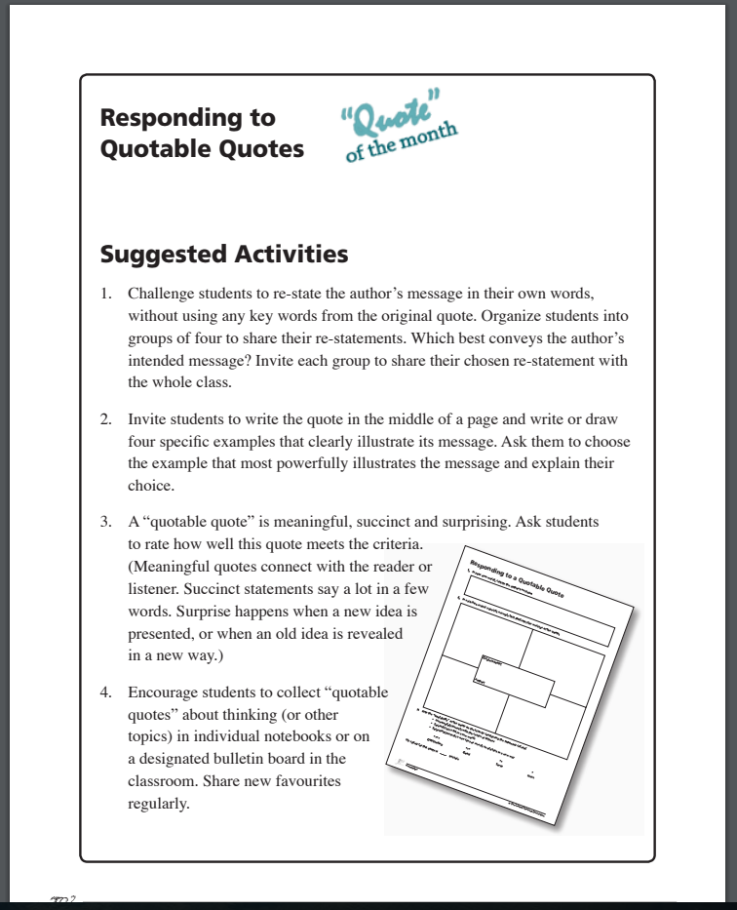
https://tc2.ca/pdf/profresources/Asimov_lesson.pdf

Slide 30
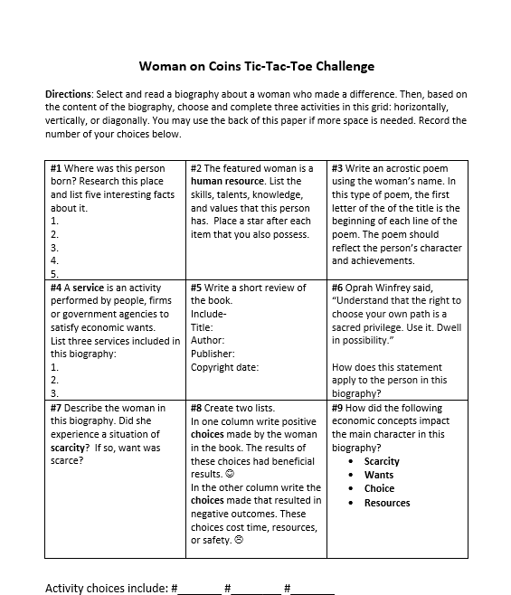



Slide 31
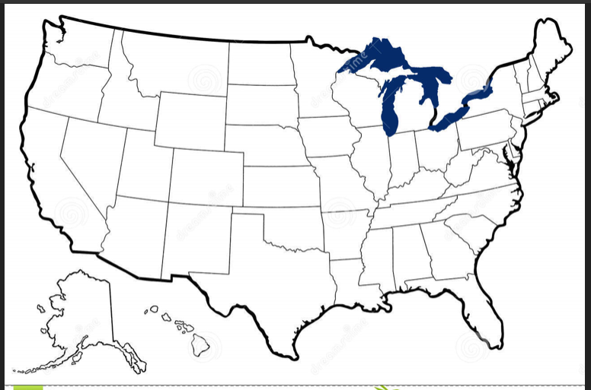
Hurray for State Quarters Activities
Geography
Extensions
Give each of the students a state quarter and have them place the quarter in the correct area on a large black line map of the United States.

Slide 32
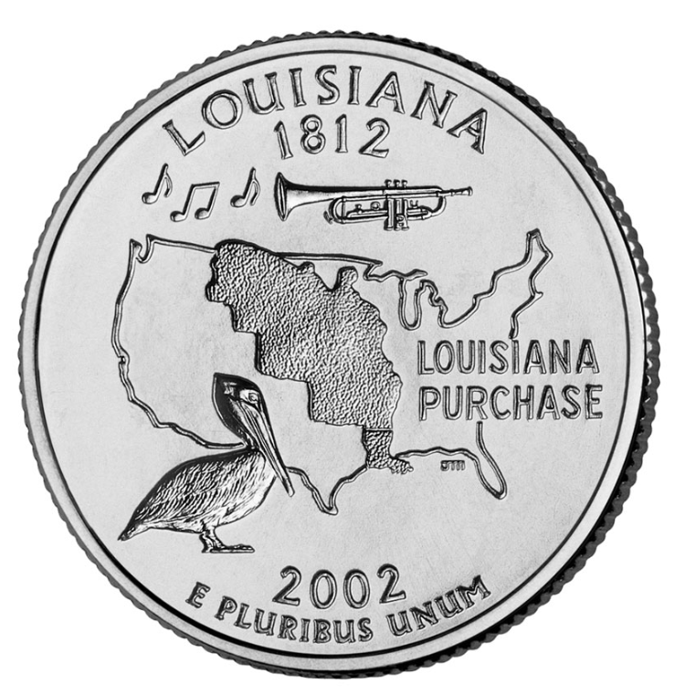
Hurray for State Quarters Activities
Research
Extensions
Give each student (or small group) a state quarter and have them list several things that they think they could research from the symbols depicted on the coin. For example, Louisiana’s coin suggests that a trombone, the Louisiana Purchase, a pelican, jazz, and the Mississippi Delta are all important to this state. (Note: It is not necessary to have every state represented in your collection and it is fine if there is some repetition. I have never had a problem with missing quarters although there have been times when the students have traded one of their own coins for one that they may have wanted for their personal collection.)

Slide 33
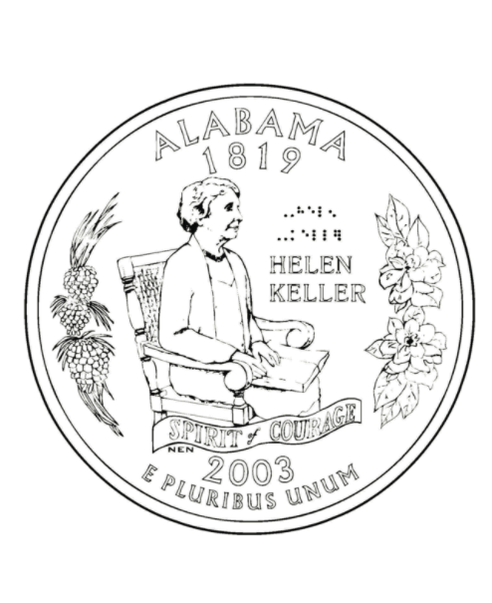
Five Topics Challenge

Slide 34
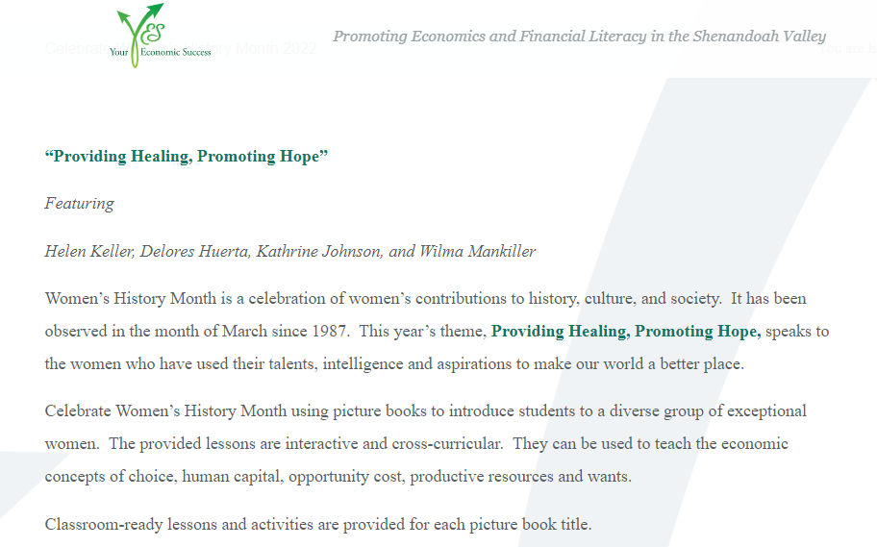

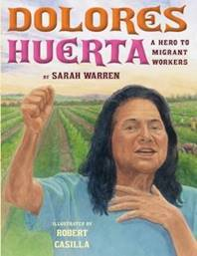
Women’s History Month
Lessons Based on Picture Book Biographies
Celebrate Women’s History Month 2022 - YES (youreconomicsuccess.org)

Slide 35
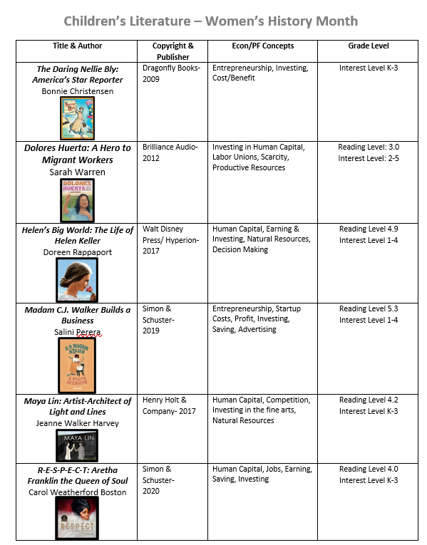
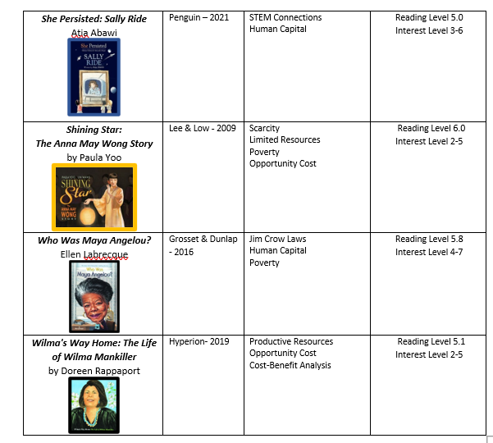
Women’s History Month Bibliography

Slide 36
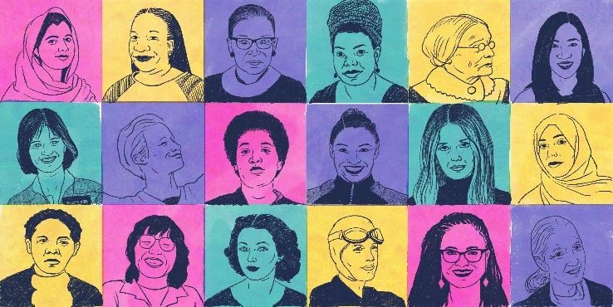
Points to Ponder
How do you think these women-related issues will effect our nation’s economic future?
When more women work, economies grow.
Increasing women’s and girls’ educational attainment contributes to women’s economic empowerment and more inclusive economic growth.
Women’s economic equality is good for business.
In 2020, women earned 84% of what men earned, according to a Pew Research Center
What lessons can our students learn when they study the lives of strong women?

Slide 37
Comments?
Questions?
Concerns?

Slide 38

CEE Affiliates
https://www.councilforeconed.org/resources/local-affiliates/

Slide 39




Thank You to Our Sponsors!

