Slide 1
Female Pioneers Use Economics Presented by Colleen Gray, Dr. Mary Clare Peate March 3, 2022 gracyc@umn.org, maryclare@mru.org

Slide 2
EconEdLink Membership
You can now access CEE’s professional development webinars directly on EconEdLink.org! To receive these new professional development benefits, become an EconEdLink member. As a member, you will now be able to:
Automatically receive a professional development certificate via e-mail within 24 hours after viewing any webinar for a minimum of 45 minutes
Register for upcoming webinars with a simple one-click process
Easily download presentations, lesson plan materials and activities for each webinar
Search and view all webinars at your convenience
Save webinars to your EconEdLink dashboard for easy access to the event
You may access our new Professional Development page here

Slide 3
Professional Development Certificate
To earn your professional development certificate for this webinar, you must:
Watch a minimum of 45-minutes and you will automatically receive a professional development certificate via e-mail within 24 hours.
Accessing resources:
You can now easily download presentations, lesson plan materials, and activities for each webinar from EconEdLink.org/professional-development/

Slide 4
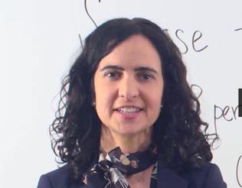
Dr. Mary Clare Peate, MRU Curriculum Director
Background in Education & Economics
Proud econ nerd
Hopped between education and economics-related jobs before finally joining the two!

Slide 5
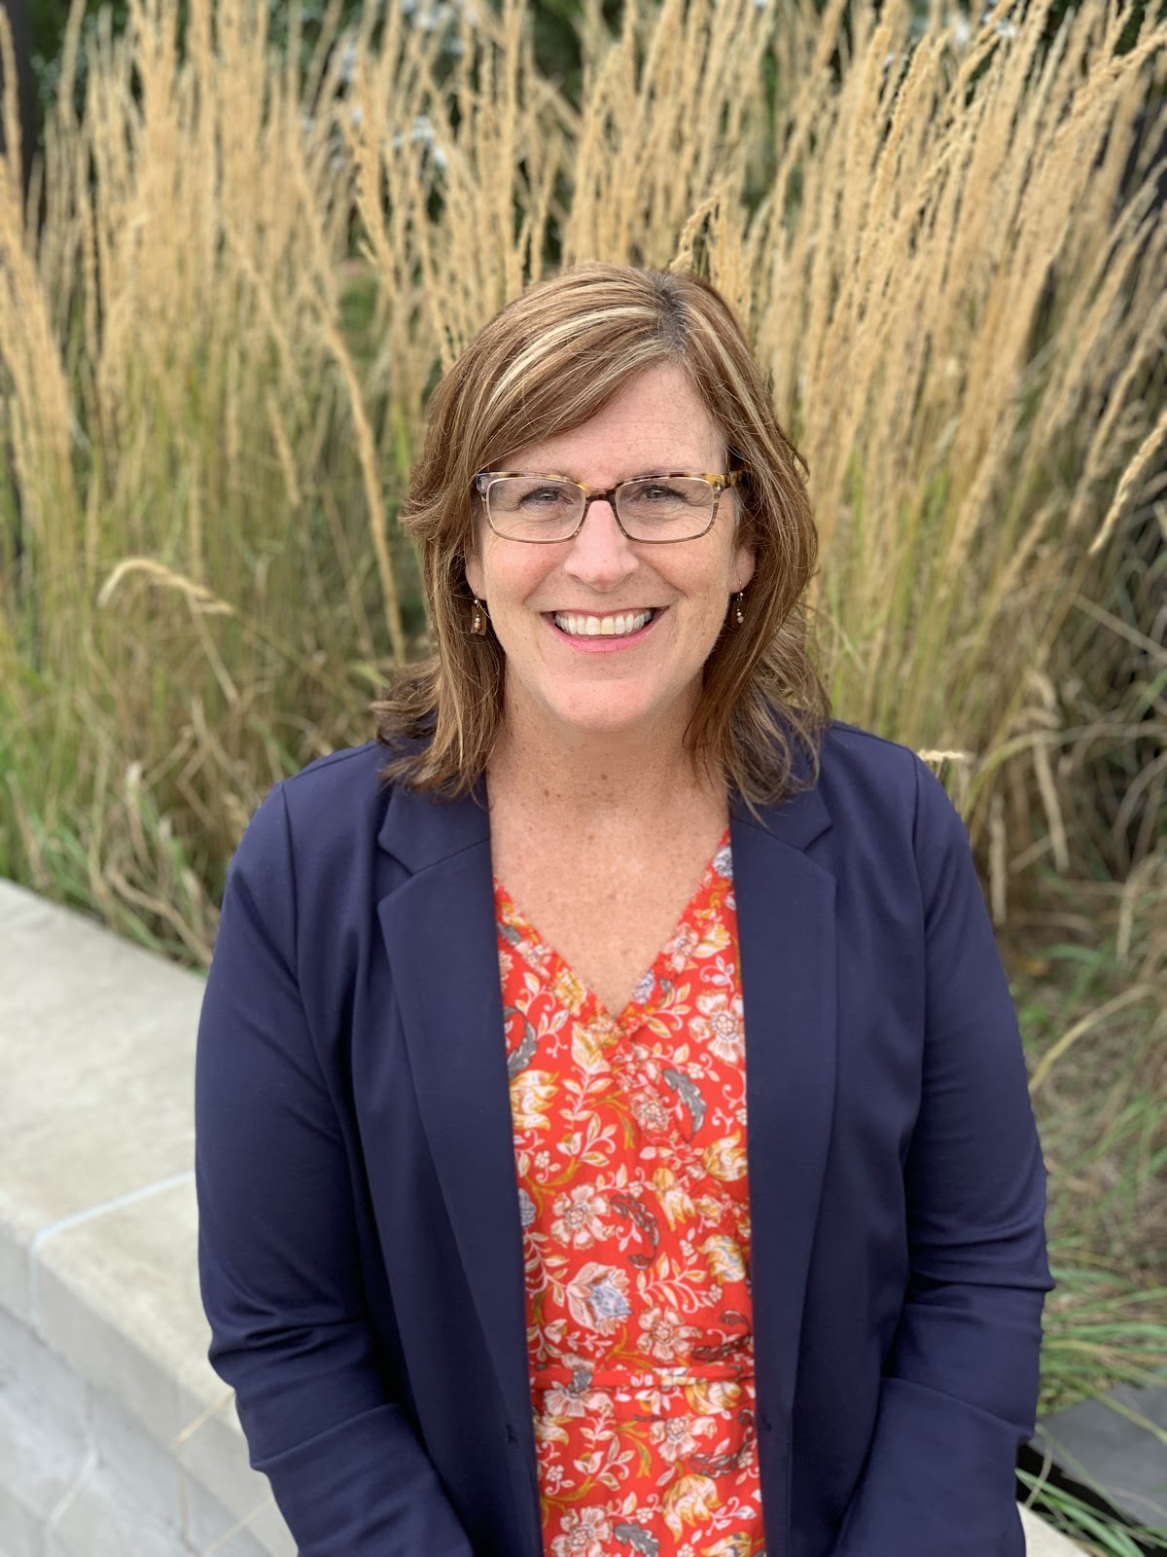
Colleen Gray, MCEE Education Director
Background in Education, Non-Profit Management & Business
Passion for economics education began as a fifth grade teacher
Committed to helping teachers understand and confidently deliver K-12 economics standards

Slide 6
Agenda
Preview the Mini Movers and Shakers series
Female Pioneer #1 & Opportunity Cost: Mae Jemison
Female Pioneer #2 & Incentives: Serena Williams
Female Pioneer #3 & Decision-making: Indra Nooyi
Mix & Match pioneers with econ concepts!
Q&A

Slide 7
Objectives
Participants will
Learn how to connect historical figures with economic concepts.
Explore 3 specific ways to use the biographies of these female pioneers to reenforce and apply the concepts of opportunity cost, decision-making, and incentives.
Learn how to adapt ready-to-go activities for their own classroom.

Slide 8
National Standards
Scarcity: Whenever a choice is made, something is given up because resources are limited.
Decision-Making: A cost is what you give up when you decide to do something. A benefit is what satisfies your wants.
Incentives: People’s views of rewards and penalties differ because people have different values. Therefore, an incentive can influence different individuals in different ways.

Slide 9
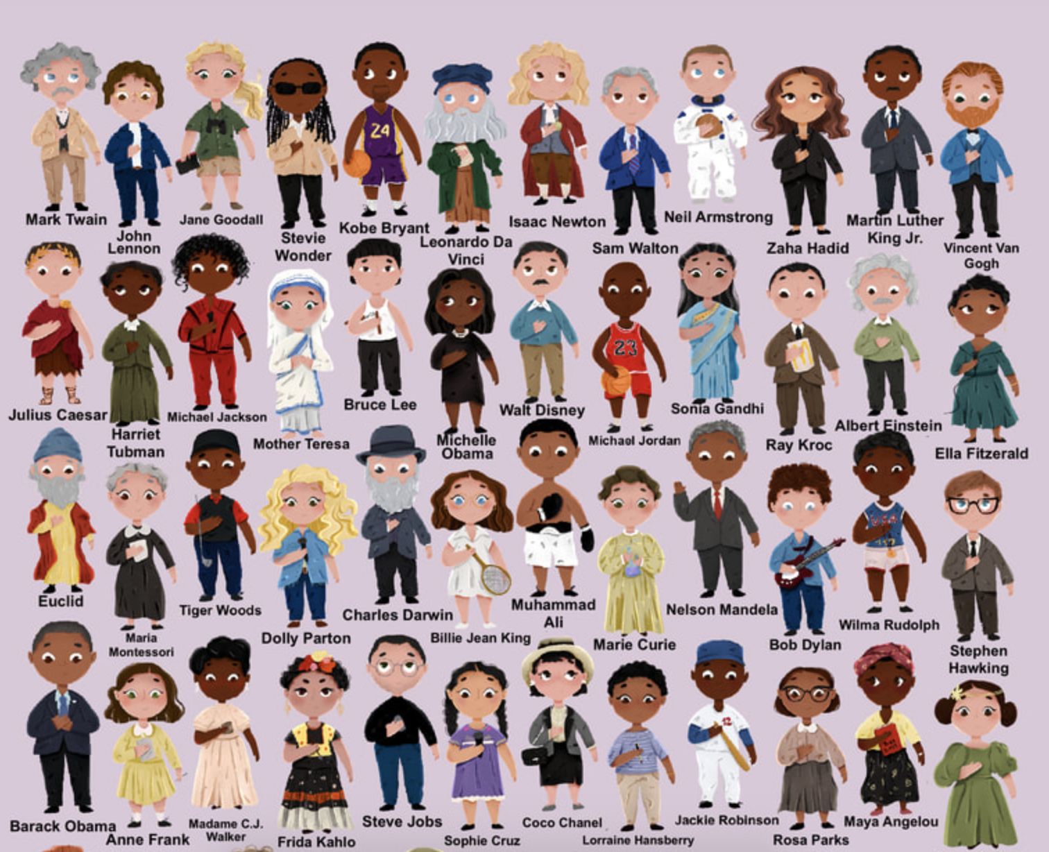
Mini Movers and Shakers Book Series
-Simple stories about inspiring individuals
-Recommended for students aged 3-11
Image credit: Mary Nhin & Yuliia Zolotova

Slide 10
Meet the Female Pioneers
Mae Jemison
Serena Williams
Indra Nooyi
Image credit: Mary Nhin & Yuliia Zolotova

Slide 11
Female Pioneers, Economics, and Your Students
These female pioneers used economics concepts as they rose to greatness
Your students use economic concepts all the time
Everyone uses economics!

Slide 12
+
Opportunity Cost
Image credit: Mary Nhin & Yuliia Zolotova

Slide 13
Mae Jemison
First African American female to journey to space.
She had many talents and interests, including science, dance, and cheerleading, when she was a young child.
She had always wanted to be an astronaut but felt discouraged and pursued medicine instead after college.
While practicing medicine, she studied engineering at night because she hadn’t totally given up on her dream
She was inspired to apply to NASA when she saw a female astronaut and an African American astronaut

Slide 14
Mae Jemison
When she chose to study medicine, what did she have to give up? What was her opportunity cost of studying medicine?
What are some things Mae Jemison might have had to give up in order to study engineering at night?
What was Mae’s scarce resource?
Link to more questions here

Slide 15
Putting it Into Practice
Example of how to engage students in an exercise demonstrating Opportunity Cost related to Mae Jemison:
Opportunity Cost Activity - Mae Jemison
Share in the chat how you might engage your students to identify Opportunity Cost.

Slide 16
Female Pioneers in Economics JamBoard

Slide 17
+
Incentives
Image credit: Mary Nhin & Yuliia Zolotova

Slide 18
Serena Williams
One of the greatest athletes of all time.
Her father was surprised by how much professional tennis athletes made and decided to train his children
Her parents hung signs with inspirational quotes all around the tennis court.
Sadly, she faced discrimination when she began playing in tournaments.
She won many trophies before she began to win cash prizes.

Slide 19
Serena Williams
What was Serena Williams’ father’s incentive for training her and her sisters to be professional tennis players?
What is an example of another positive incentive Serena Williams received to encourage her to excel at tennis?
While Serena Williams was playing tennis, what was one negative incentive that might have discouraged her from playing?
More questions at the link

Slide 20
Putting it Into Practice
Invite students to stand in a circle and join the circle with something safe enough to toss between students.
Tell students when the item is caught by someone in the circle, the student identifies one incentive described in Serena Williams’s story and then tosses the ball to a classmate.
The student who catches the item names the incentive as either positive or negative and then tosses the item to another classmate.
Repeat until all incentives have been identified.

Slide 21
Female Pioneers in Economics JamBoard

Slide 22
+
Decision-making
Image credit: Mary Nhin & Yuliia Zolotova

Slide 23
Indra Nooyi
First female CEO of PepsiCo.
She had many interests as a young child, including rock & roll! (She was in a rock band)
She earned degrees in physics, math, and chemistry before focusing on business.
She became the first female CEO of PepsiCo and made the decision to pivot to healthier products. Many people disagreed with this decision. Ultimately, she was vindicated.

Slide 24
Indra Nooyi
Once Indra Nooyi became CEO of PepsiCo, what is one decision she made?
What was the benefit of this decision?
What was the cost of this decision?
Did other people agree with her when she made this decision?
The book says that her decision was right. How do you think people judged whether or not her decision was right?
More questions at this link

Slide 25
Putting it Into Practice
Female Pioneers in Economics: PACED Decision Making Grid

Slide 26
Female Pioneers in Economics JamBoard

Slide 27
Mix & Match
Mae Jemison
Serena Williams
Indra Nooyi
Opportunity Cost
Incentives
Decision making
Other econ concepts??

Slide 28
Mix & Match
Female Pioneers in Economics JamBoard

Slide 29
Additional Resources
Mini Movers and Shakers: Jane Goodall
Economist Spotlight: Dr. Sadie T.M. Alexander
Economist Spotlight: Dr. Willene A. Johnson

Slide 30
Additional Resources
Webinar Resources Folder: Female Pioneers
Additional MCEE K-12 Resources: z.umn.edu/TeacherResources
Council for Economic Education (National):
EconEdLink
ReadyAssessments
Econ Lowdown

Slide 31
Thank You
Mary Clare Peate | maryclare@mru.org
Colleen Gray | grayc@umn.edu
mcee.umn.edu | mcee@umn.edu | 612.625.3727

Slide 32
Assessment Questions
What did you learn today about female pioneers
How can you use what you learned in your classroom?

Slide 33
References
Mae Jemison
Serena Williams
Indra Nooyi

Slide 34
CEE Affiliates
https://www.councilforeconed.org/resources/local-affiliates/

Slide 35
Thank You to Our Sponsors!

Slide 36
We’ve gone Virtual!
Teach Economics?
Your students may have what it takes to compete in the nation’s only high school economics competition!
Why Play?
• Fun team learning experience
• Great for college applications
• No other challenge like this
• Online participation makes access easy
• Chance for cash prizes
How it Works
Teams register
Teachers enroll team(s) of 3- 4 high school students from the same school. Multiple teams allowed.
Teams compete within their state
Compete to win your state competition for a chance to advance to the National Semi-Finals.
National Semi-Finals: May 3-20, 2021
Teams answer multiple-choice questions on macroeconomics, microeconomics, and international & current events.
National Finals: May 22-24, 2021
Teams analyze an economic issue and present their solution. Top teams engage in the Finals Quiz Bowl where they face-off answering questions to claim the National Title.
Two divisions based on experience level
David Ricardo for first-time competitors who have taken no more than one economics course.
Adam Smith for returning competitors, AP, International Baccalaureate, and honors students.
Register Today at NationalEconomicsChallenge.org

Slide 37
FIND YOUR LOCAL COMPETITION AND REGISTER TODAY!
The National Personal Finance Challenge is a competition that provides high school students with an exciting and motivating opportunity to build, apply, and demonstrate their knowledge of money management.
Through online exams and a personal finance simulation, teams showcase their expertise in earning income, buying goods and services, saving, using credit, investing, as well as protecting and insuring.
Teams of up to four students, with one teacher/coach, can qualify to represent their state at the National Personal Finance Challenge by winning their local competition.
NATIONALS
Semi-Finals: First round elimination via online multiple-choice questions.
Finals: Case study round virtually co-hosted by the Cleveland Fed on June 3.
personalfinancechallenge.org

Slide 38
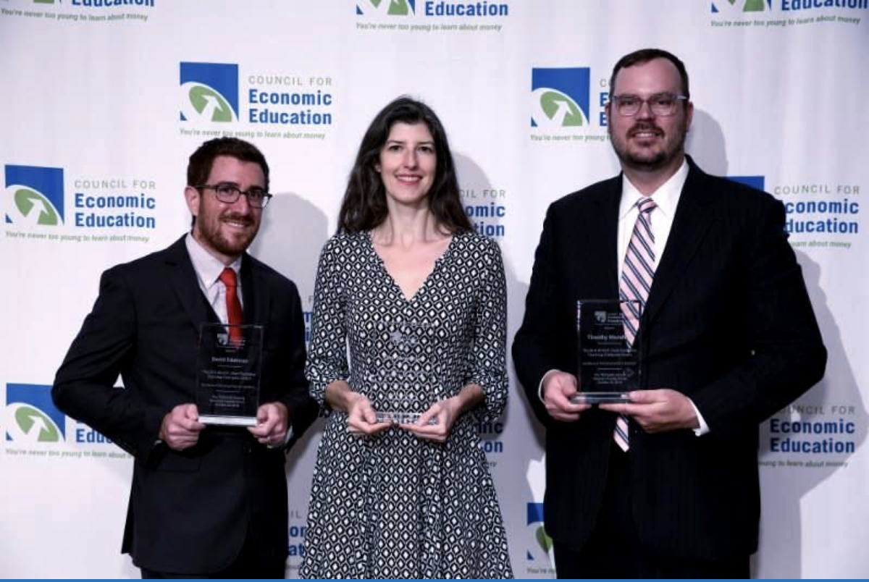
The 2021 Sloan Teaching Champion Award
Winners receive:
A cash award of $5,000
A cash award of $2,500 for their school to support economic education
Recognition at our annual Visionary Awards convening
This award promotes economic education by honoring three outstanding teachers who incorporate exemplary teaching techniques that improve their students’ economic understanding in and out of the classroom.
This award is open to New York metropolitan area high school teachers of all subjects, not just teachers of economics. Applicants must demonstrate how they integrate economics into their teaching.
Sound like you or someone you know?
Applicants must teach in one of the
Twelve New York state counties (New York, Kings, Bronx, Richmond, Queens, Nassau, Suffolk, Westchester, Putnam, Rockland, Orange and Dutchess)
Eight New Jersey counties (Bergen, Passaic, Essex, Hudson, Middlesex, Union, Morris, Monmouth), or these
Two Connecticut counties (Fairfield and New Haven)
Application will be launched on Friday February 19th 2021
You can access the application here.
CONTACT
Please feel free to e-mail us at rrivera@councilforeconed.org
with any questions you have.

