Slide 1
NCCEE
Presents
Empowering Women to Make Financial Decisions
-

Slide 2
NCCEE
Who We Are
Notes:
Amber

Slide 3
Webinar Summary
During this webinar, we will discuss the knowledge, tools and tips needed to empower women to take charge of their own financial decisions.
Notes:
Stephanie

Slide 4
Objectives
Teachers will be able to:
Describe why it is important for women to be empowered to make their own financial decisions.
Explain the steps necessary to gain the knowledge and confidence for women to make financial decisions.
Notes:
Stephanie

Slide 5
Standards Covered
Personal Financial Education
Standard 2: Spending
Economics
Standard 2: Decision Making
Notes:
Stephanie

Slide 6
Agenda
Statistics
5 “to do’s” of being an informed financial consumer
Self-paced mini activity
How can this can be used in your classroom
Q&A
Notes:
Stephanie

Slide 7
Statistics
Notes:
Stephanie

Slide 9
Key Statistics
Just over 2/3 of women now invest outside of retirement, up from 44% in 2018.
Half of women have become more interested in investing during the pandemic.
Fidelity data over the last decade reveals women outperform men by .4% on average.
Nearly 70% of women confidently manage their household budget, but just 19% select investments that align with their goals with the same confidence.
About 2/3 said they’d be more likely to invest if they had clear steps to do so.
Notes:
Stephanie

Slide 10
Why do you need to be an informed financial consumer?
Notes:
Stephanie

Slide 11
5 Things You Need to Do to Be an Informed Financial Consumer
Notes:
Amber
Empowered

Slide 12
How Much Money Do You Need?
Notes:
Amber

Slide 13
How Much Money Do You Need?
Lifestyle
Know Your Worth
Negotiate
Live Longer
Notes:
Lifestyle
Calculate the Cost of Your Lifestyle from life skills that matter.
1) Your total debt. (Credit cards, student loans, car loan, mortgage, etc.) Your monthly debt payment is determined by how quickly you want to be debt free.
2) Your monthly living expenses. (Utilities, phone, cable/WiFi, food, insurances, transportation, clothes, etc.) Calculate how much money you spent over the past year on all your basic living expenses and divide by 12 to determine your monthly average.
3) Cost of unbudgeted expenses. (Entertainment, recreation, gifts, trips, one-time purchases, emergencies, etc.) Add up all of your unbudgeted expenses for the past year and divide by 12 to determine your monthly average.
4) Cost of stuff and experiences you want. These are possessions and experiences you want, but think you can’t afford. Include anything you want to change about your life and its associated costs. When you finally put a real dollar amount on your aspirations, suddenly they seem a bit more achievable than you previously assumed!
Lifestyle (Invest In What’s Next)
Know Your Worth
Industry Data
BLS
Negotiate
SHRM→ In March 2019, 17 percent of full- or part-time workers reported in an online survey they negotiated their salary and got more money at their current or most recent job, Glassdoor found, with slightly more men than women doing so. In March 2016, 10 percent of workers overall said they negotiated and received more money.
Global staffing firm Robert Half in Menlo Park, Calif., also found an uptick in professionals trying to negotiate a higher salary. In 2018, 68 percent of men and 45 percent of women negotiated their salaries; in 2017, 46 percent of men and 34 percent of women did so.
When women do negotiate, we get it but the opportunity isn’t as clear.
Personality
Live Longer
The life expectancy tables used to determine Social Security benefits estimate that a woman who turns 65 in 2022 has a life expectancy of nearly 87 years. For a 65-year old man in 2022, the life expectancy is 84 years. According to Forbes.
Delay Retirement
Change it up
What does retirement look like and how much will you get
Pension problem
67.9% of all Teachers are women, while 27.5% are men.

Slide 14
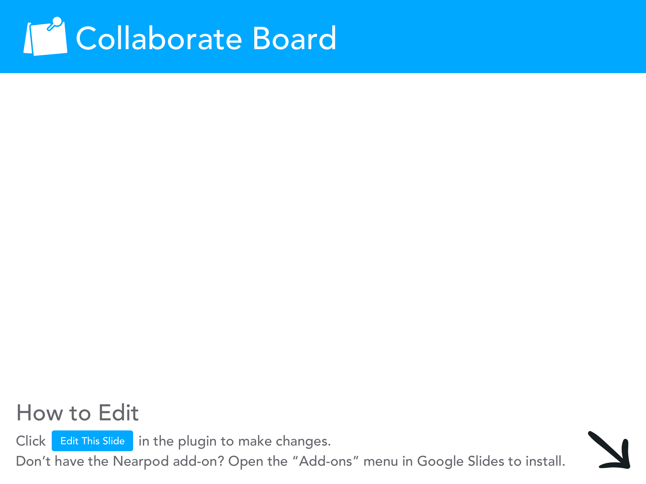

Slide 15
Know Where Your Money Goes
Notes:
Amber

Slide 16
Know Where Your Money Goes
The Jargon Problem
Apps and Tracking
Credit Card Spending
Benefits
Notes:
Amber
The Jargon Problem
First step, is to take a free course. PF 101
Apps
Paper Pen, Digital, Alerts, Sit back and observe
Credit Card Spending
Beware of the discount, cash back and 0% interest trap
Know how interest works
Benefits
What do you have at work?
Retirement
Should you have more?
Social Security

Slide 17
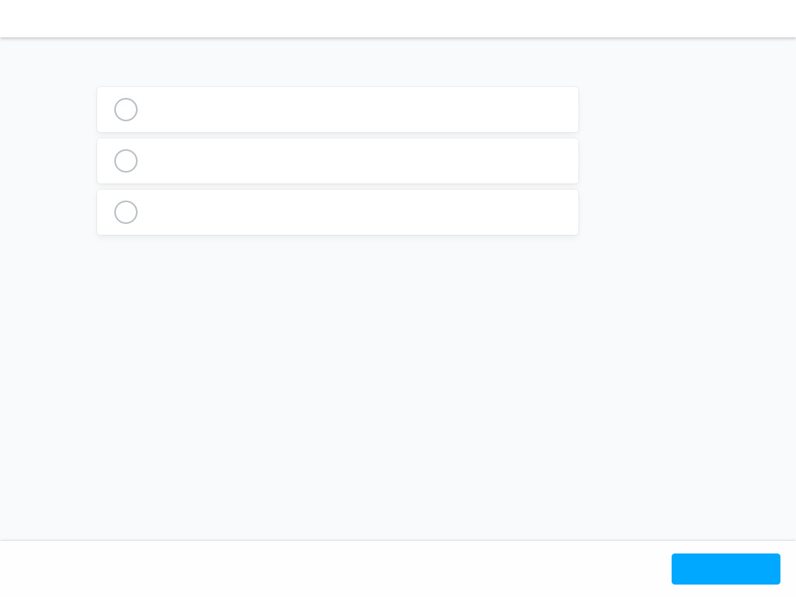
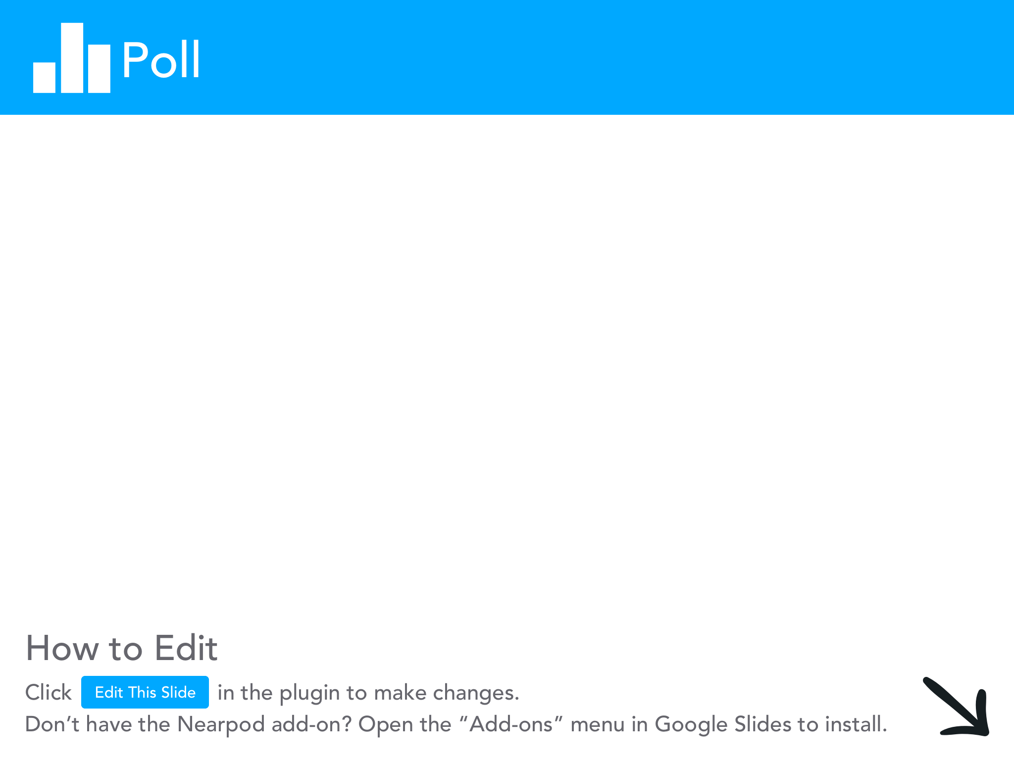

Slide 18
How to Protect Your Money
Notes:
Amber

Slide 19
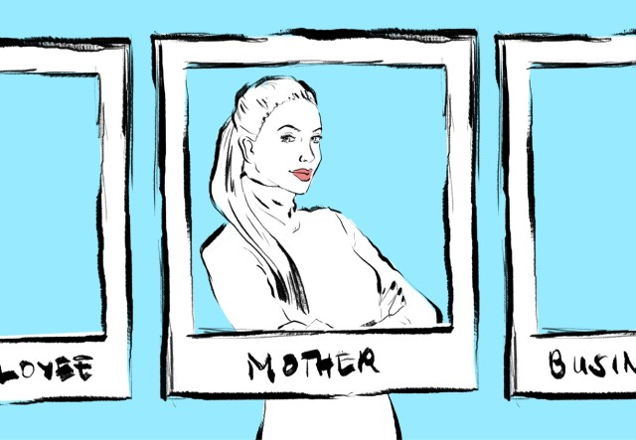
How to Protect Your Money
Emergency Fund
Insurance
Prenuptial Agreement?
Leaving the Workforce
Notes:
Amber
Emergency Fund
Something or a plan
Insurance
Key findings
Single women spend nearly twice as much of their income on health insurance as single men. Single women spent an average of $2,406 on health insurance in 2020, or 6.8% of their annual income. Single men paid $1,896, on average, or 3.9% of their yearly income.
Single women put a higher percentage of their income toward health insurance than men in every age breakdown. This gap widens with age. For example, single women 65 and older spend 11.7% of their annual income on health insurance — more than three percentage points higher than men of the same age (8.4%).
The same scenarios hold across every income breakdown. Single women who earn less than $15,000 a year pay a whopping 20.7% of their income, on average, toward health insurance — versus 15.7% for men.
It’s not just health insurance either, as single women put higher percentages of their income toward auto and life insurance than single men. Women put 2.4% of their income, on average, toward auto insurance, versus 1.9% for men. And women put 0.7% of their income, on average, toward life insurance, versus 0.4% for men.
Prenuptial Agreement?
Have protections in place
Leaving the Workforce
Investment in Childcare
Cost of Leaving the workforce isn’t just your salary
No retirement contributions
Building career

Slide 20
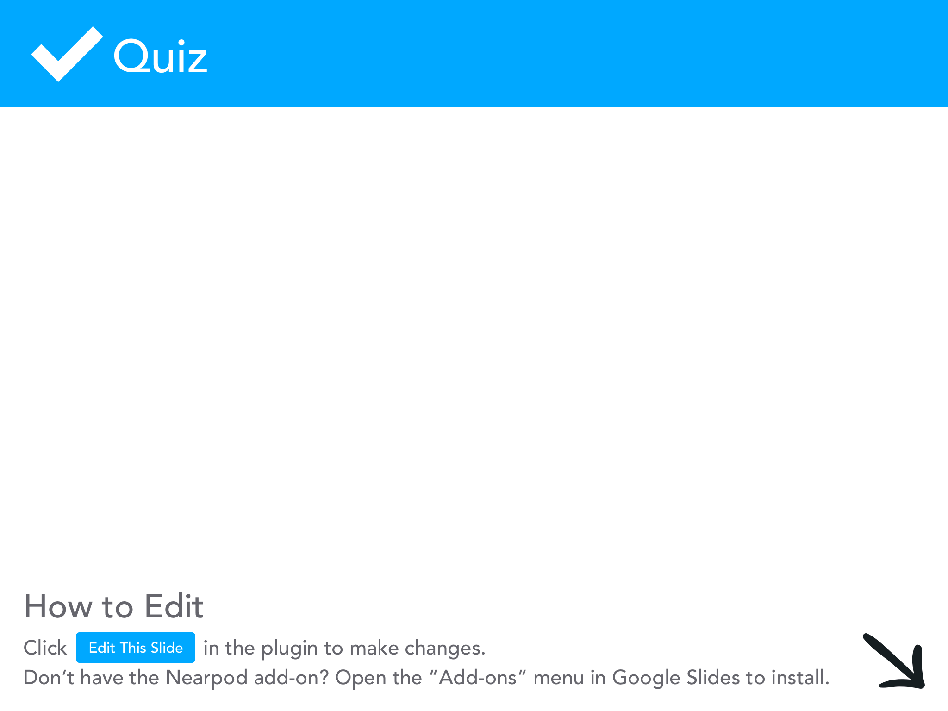

Slide 21
How to Spend Your Money
Notes:
Amber

Slide 22
How to Spend Your Money
Recognize the Obvious
Spend money for you!
Loans
Investing
Notes:
Amber
Recognize the Obvious
Pink Tax
Hair, makeup, skin care, clothing
Comparison trap
Competitive personalities
Spend money for you!
Figure out what makes you happy
Trip to target or trip to the Keys?
Loans
You need consistent income
How do you get a loan if you need it
Investing
Conservative vs. risk takers in investing approach
We’re scared
Start simple and ask questions

Slide 24
Know how to leave your money
Notes:
Amber

Slide 25
Know how to leave your money
Estate Planning
Long-term care
Know what you have
Leave a legacy…if you want.
Notes:
Amber
Estate Planning
Long-term care
Know what you have
Leave a legacy…if you want.

Slide 26
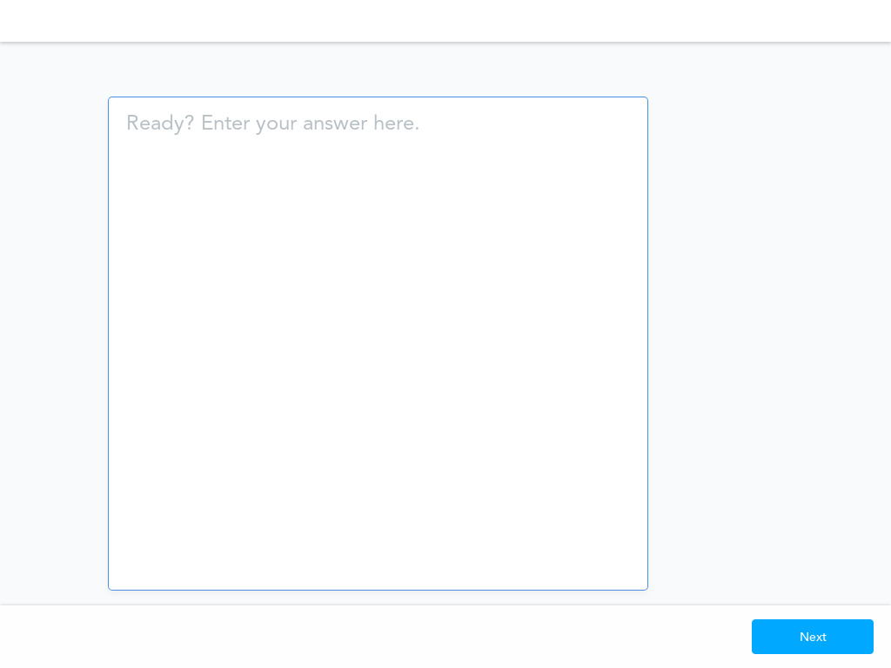

Slide 27
Benefit of Women Making Empowered Financial Decisions
Notes:
Stats I’ll share are from CNBC
Economists have long said that greater pay transparency could help close racial and gender wage gaps.
Women on average make about 82 cents for every $1 earned by a white non-Hispanic man, according to the National Women’s Law Center, and it’s even more stark for women of color: Black women make 62 cents, Native American women make 57 cents and Latina women make 54 cents for every dollar a white man earns.
Sharing salary information with colleagues can be a huge help, but discussing money continues to be taboo, says Alison Sullivan, a career trends expert with Glassdoor. This could discourage women from gathering internal pay data and making the case for a raise. Though 45% of women say they feel comfortable sharing their pay with a coworker, only 29% have actually done so.
And 28% of employees overall say their company discourages them from discussing their pay with coworkers.
Importantly, discussing pay with colleagues is considered legal and protected activity for most private-sector employees under the National Labor Relations Act.
Empower other women
Transparency….let’s bring others alone versus competing

Slide 28
Roadmap
Notes:
Amber

Slide 29
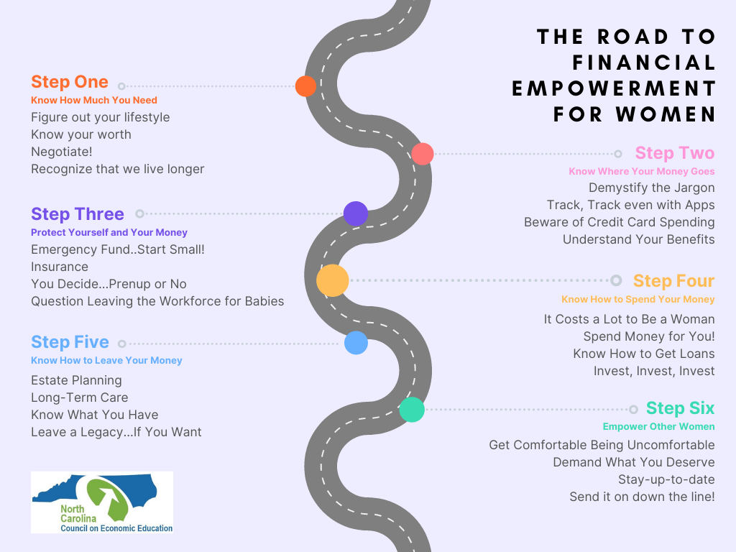

Slide 30
Mini Activity
Notes:
Stephanie

Slide 31
Financial Situation #1
Notes:
Stephanie
Sara recently graduated with a degree in marketing. She started a job that pays her $48,000 per year. Her monthly net income is $2,800. She’s moving into her own one-bedroom apartment in the city. She doesn’t own a car, but she has subway expenses. She also adopted a dog, so she now has to pay for dog food and vet bills.
Given her new job, what is the first thing she should do?

Slide 32
Sara recently graduated with a degree in marketing. She started a job that pays her $48,000 per year. Her monthly net income is $2,800. She’s moving into her own one-bedroom apartment in the city. She doesn’t own a car, but she has subway expenses. She also adopted a dog, so she now has to pay for dog food and vet bills.
Notes:
Stephanie
Sara recently graduated with a degree in marketing. She started a job that pays her $48,000 per year. Her monthly net income is $2,800. She’s moving into her own one-bedroom apartment in the city. She doesn’t own a car, but she has subway expenses. She also adopted a dog, so she now has to pay for dog food and vet bills.
Given her new job, what is the first thing she should do?

Slide 34
Financial Situation #2
Notes:
Stephanie
Derek and his wife Diana have two children under 4 years of age. Derek works as a school administrator and earns $70,000 per year. Diana is an hospitality coordinator for a world-wide hotel and earns a yearly salary of $46,200. They are concerned about the cost of childcare.
What would you recommend Diana does?

Slide 35
Derek and his wife Diana have two children under 4 years of age. Derek works as a school administrator and earns $70,000 per year. Diana is an hospitality coordinator for a world-wide hotel and earns a yearly salary of $46,200. They are concerned about the cost of childcare.
Notes:
Stephanie
Derek and his wife Diana have two children under 4 years of age. Derek works as a school administrator and earns $70,000 per year. Diana is an hospitality coordinator for a world-wide hotel and earns a yearly salary of $46,200. They are concerned about the cost of childcare.
What would you recommend for Diana?

Slide 37
Financial Situation #3
Notes:
Stephanie
Ellie loves to travel but can’t seem to find the money to do so. She notices that she spends a ton of her time dining out, visiting friends, and going to Broadway shows. She’s nervous to look at her credit card balance since she usually just pays the minimum and has a high limit.
What would you recommend Ellie do if she wants to travel more?

Slide 38
Ellie loves to travel but can’t seem to find the money to do so. She notices that she spends a ton of her time dining out, visiting friends, and going to Broadway shows. She’s nervous to look at her credit card balance since she usually just pays the minimum and has a high limit.
Notes:
Stephanie
Ellie loves to travel but can’t seem to find the money to do so. She notices that she spends a ton of her time dining out, visiting friends, and going to Broadway shows. She’s nervous to look at her credit card balance since she usually just pays the minimum and has a high limit.
What would you recommend Ellie do if she wants to travel more?

Slide 39
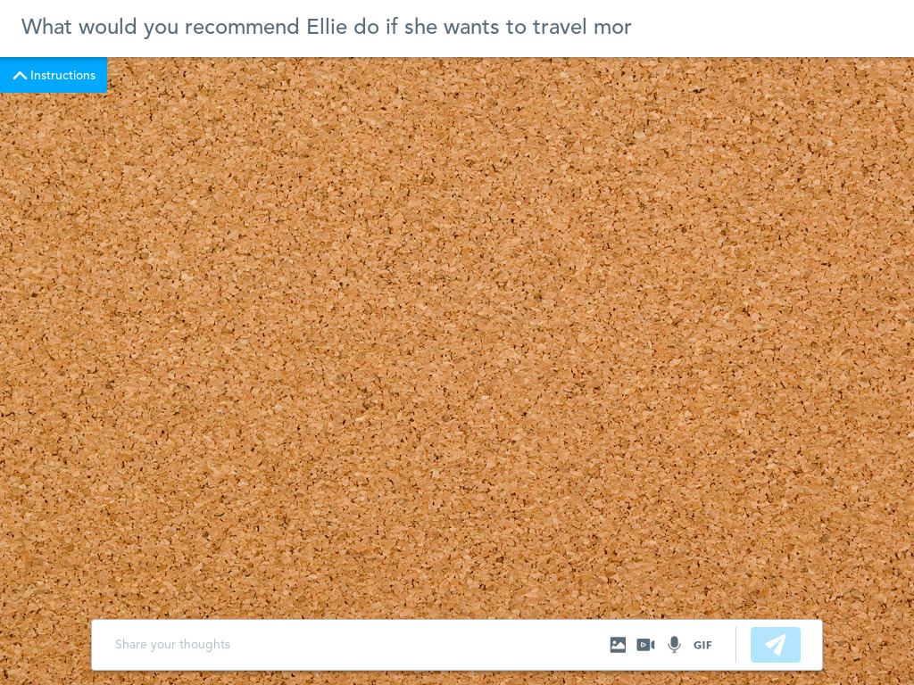

Slide 40
Financial Situation #4
Notes:
Stephanie
Kenza was born and raised in a small town. She loves animals and got a full-time job as a vet tech after she graduated from high school. The vet gave her on-the-job training. Kenza wants to leave home and get an apartment with a friend. She realizes having a roommate to share the costs of living will help keep her expenses low. Her annual income will be just under $25,000. Kenza’s monthly net income is $1,458. There is a bus that runs between her job and the apartment she wants to rent. She and her friend go out every weekend and have fun.
What recommendations could you give Kenza to help her future self?

Slide 41
Kenza was born and raised in a small town. She loves animals and got a full-time job as a vet tech after she graduated from high school. The vet gave her on-the-job training. Kenza wants to leave home and get an apartment with a friend. She realizes having a roommate to share the costs of living will help keep her expenses low. Her annual income will be just under $25,000. Kenza’s monthly net income is $1,458. There is a bus that runs between her job and the apartment she wants to rent. She and her friend go out every weekend and have fun.
Notes:
Stephanie
Kenza was born and raised in a small town. She loves animals and got a full-time job as a vet tech after she graduated from high school. The vet gave her on-the-job training. Kenza wants to leave home and get an apartment with a friend. She realizes having a roommate to share the costs of living will help keep her expenses low. Her annual income will be just under $25,000. Kenza’s monthly net income is $1,458. There is a bus that runs between her job and the apartment she wants to rent. She and her friend go out every weekend and have fun.
What recommendations could you give Kenza to help her future self?

Slide 43
How can this be used in the classroom?
Notes:
Stephanie
-Manage of Damage activity
-Have students create their own scenarios
-Dollars and Sense activity
-Create a roadmap (Canva)
Cool resource for your students to use to create resumes, infographics, logos, these roadmaps, etc

Slide 44
How can this be used in the classroom?
Manage or Damage
FDIC resource called Capacity, Character, Collateral, Capital and then goes into the Manage or Damage activity
Have students create their own scenarios
Dollars & Sense
Federal Reserve Bank of Richmond resource
Have students create their own roadmap!

Slide 45
Key Takeaways
Get Comfortable Being Uncomfortable
Demand What You Deserve
Stay-up-to-date and in the know
Send it on down the line!

Slide 47
Resources to Help!
https://www.ellevest.com/
https://usa.visa.com/dam/VCOM/regional/na/us/about-visa/documents/visa-millennial-study-2019.pdf
https://www.zippia.com/teacher-jobs/demographics/
https://www.nytimes.com/2020/10/24/business/millennial-personal-finance.html
https://www.bizjournals.com/bizwomen/news/latest-news/2021/10/millennial-women-investing.html?page=all
https://lifeskillsthatmatter.com/how-much-money-you-need/
https://www.cnbc.com/2022/03/09/women-are-using-great-resignation-to-negotiate-raises-or-quit.html
https://www.fidelity.com/bin-public/060_www_fidelity_com/documents/about-fidelity/FidelityInvestmentsWomen&InvestingStudy2021.pdf
https://www.fidelity.com/bin-public/060_www_fidelity_com/documents/about-fidelity/FidelityInvestmentsWomen&InvestingStudy2021.pdf
https://www.businessinsider.com/gender-wage-pay-gap-charts-2017-3#the-gender-wage-gap-varies-widely-depending-on-the-state-1
https://herfirst100k.com/
https://herfirst100k.com/free-resources
https://www.forbes.com/advisor/retirement/plan-for-long-retirement/#:~:text=What's%20Your%20Life%20Expectancy%3F,life%20expectancy%20is%2084%20years.
https://hermoney.com/earn/careers/how-to-negotiate-a-raise-for-women-the-new-rules-for-2022/
https://www.gobankingrates.com/banking/savings-account/40-percent-women-have-less-than-100-in-savings-accounts-new-survey-finds/
https://www.valuepenguin.com/insurance-costs-gender-gap-study
https://www.visualcapitalist.com/a-breakdown-of-americans-monthly-credit-card-spending/
https://files.consumerfinance.gov/f/documents/cfpb_building_block_activities_budget-scenarios_handout.pdf
https://preen.ph/42384/people-think-women-cant-handle-mother-career-woman
https://www.economist.com/finance-and-economics/2018/03/08/investment-by-women-and-in-them-is-growing

Slide 48
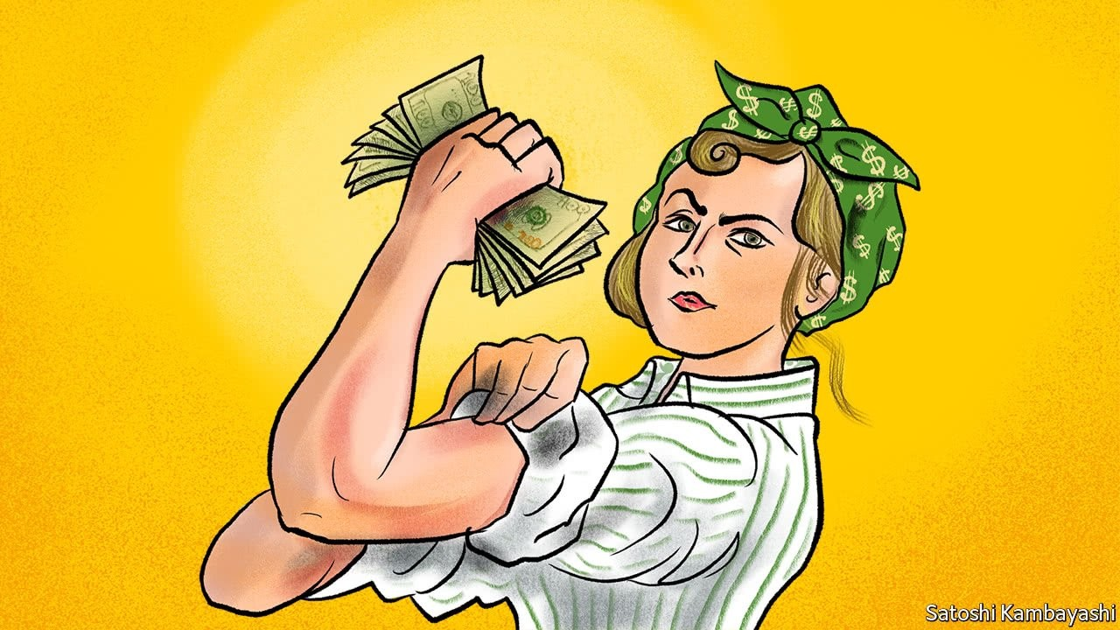
Closing and Questions

