Slide 1
The European Union: Past, Present, and Future
Presented by Theodore Opderbeck 3/1/2022 opderbeckt@waldwickschools.org

Slide 2
EconEdLink Membership
You can now access CEE’s professional development webinars directly on EconEdLink.org! To receive these new professional development benefits, become an EconEdLink member. As a member, you will now be able to:
Automatically receive a professional development certificate via e-mail within 24 hours after viewing any webinar for a minimum of 45 minutes
Register for upcoming webinars with a simple one-click process
Easily download presentations, lesson plan materials and activities for each webinar
Search and view all webinars at your convenience
Save webinars to your EconEdLink dashboard for easy access to the event
You may access our new Professional Development page here

Slide 3
Professional Development Certificate
To earn your professional development certificate for this webinar, you must:
Watch a minimum of 45-minutes and you will automatically receive a professional development certificate via e-mail within 24 hours.
Accessing resources:
You can now easily download presentations, lesson plan materials, and activities for each webinar from EconEdLink.org/professional-development/

Slide 4
Agenda
Examine the historical development of the European Union while discussing the challenges along the way
Analyze the Euro Area and the adoption of the Euro as a single currency
Discuss the positive and negative aspects of a large free trade zone and the use of a single currency and central banking issues
To examine some current and future problems facing the European Union.
To present lesson plan ideas and digital formative assessment tools to creatively engage students.

Slide 5
Objectives
To analyze the historical development of the European Union, the Euro Area, and the Euro as a single currency.
To evaluate the strengths and weaknesses of the EU and to discuss successes, failures, and challenges.
To examine some potential future areas of conflicts and possible resolutions.
To introduce dynamic learning activities and project ideas to engage students.

Slide 6
National Standards
Council for Econ Ed Standard 20: Fiscal and Monetary Policy
Federal government budgetary policy and the Federal Reserve System’s monetary policy influence the overall levels of employment, output, and prices.
.https://www.councilforeconed.org/wp-content/uploads/2012/03/voluntary-national-content-standards-2010.pdf

Slide 7
National Standards
Council for Econ Ed Standard 5: Trade
Voluntary exchange occurs only when all participating parties expect to gain. This is true for trade among individuals or organizations within a nation, and among individuals or organizations in different nations.
https://www.councilforeconed.org/wp-content/uploads/2012/03/voluntary-national-content-standards-2010.pdf

Slide 8
State Standards
12.E4 THE TOOLS OF ECONOMIC POLICY IN A GLOBAL ECONOMY: Globalization and increased economic interdependence affect the United States economy significantly. The tools that the policy makers have available to address these issues are fiscal policy, monetary policy, and trade policy.
http://www.nysed.gov/common/nysed/files/programs/curriculum-instruction/ss-framework-9-12.pdf

Slide 9
Question of the Day
Which nation is the most recent addition to the European Union?
Estonia
Croatia
Cyprus
Latvia
https://european-union.europa.eu/principles-countries-history/country-profiles_en

Slide 10
Economics and Cross Curricular Applications
Comparative Economic Systems
International Economics
Free Trade vs. Protectionism
Monetary and Fiscal Policy
Political Science
Current Events
Sociology
International Law

Slide 11
Big Framing Questions
How did the European Union evolve? What social, geopolitical, and economic factors contributed to its creation?
How does the single currency (monetary union) work? What are the advantages/disadvantages of a single currency?
What are some of the successes and challenges faced since the EU and Euro Area have formed?
What does the future look like concerning the EU and the Euro?

Slide 12
Important Concepts
European Union
Euro Area
Single Currency/ Economic and Monetary Union
Monetary / Fiscal Policy
Free Trade

Slide 13
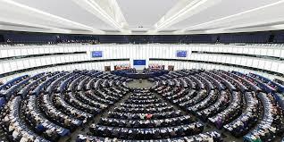
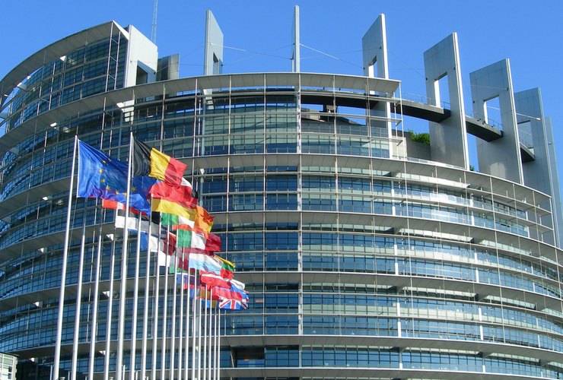
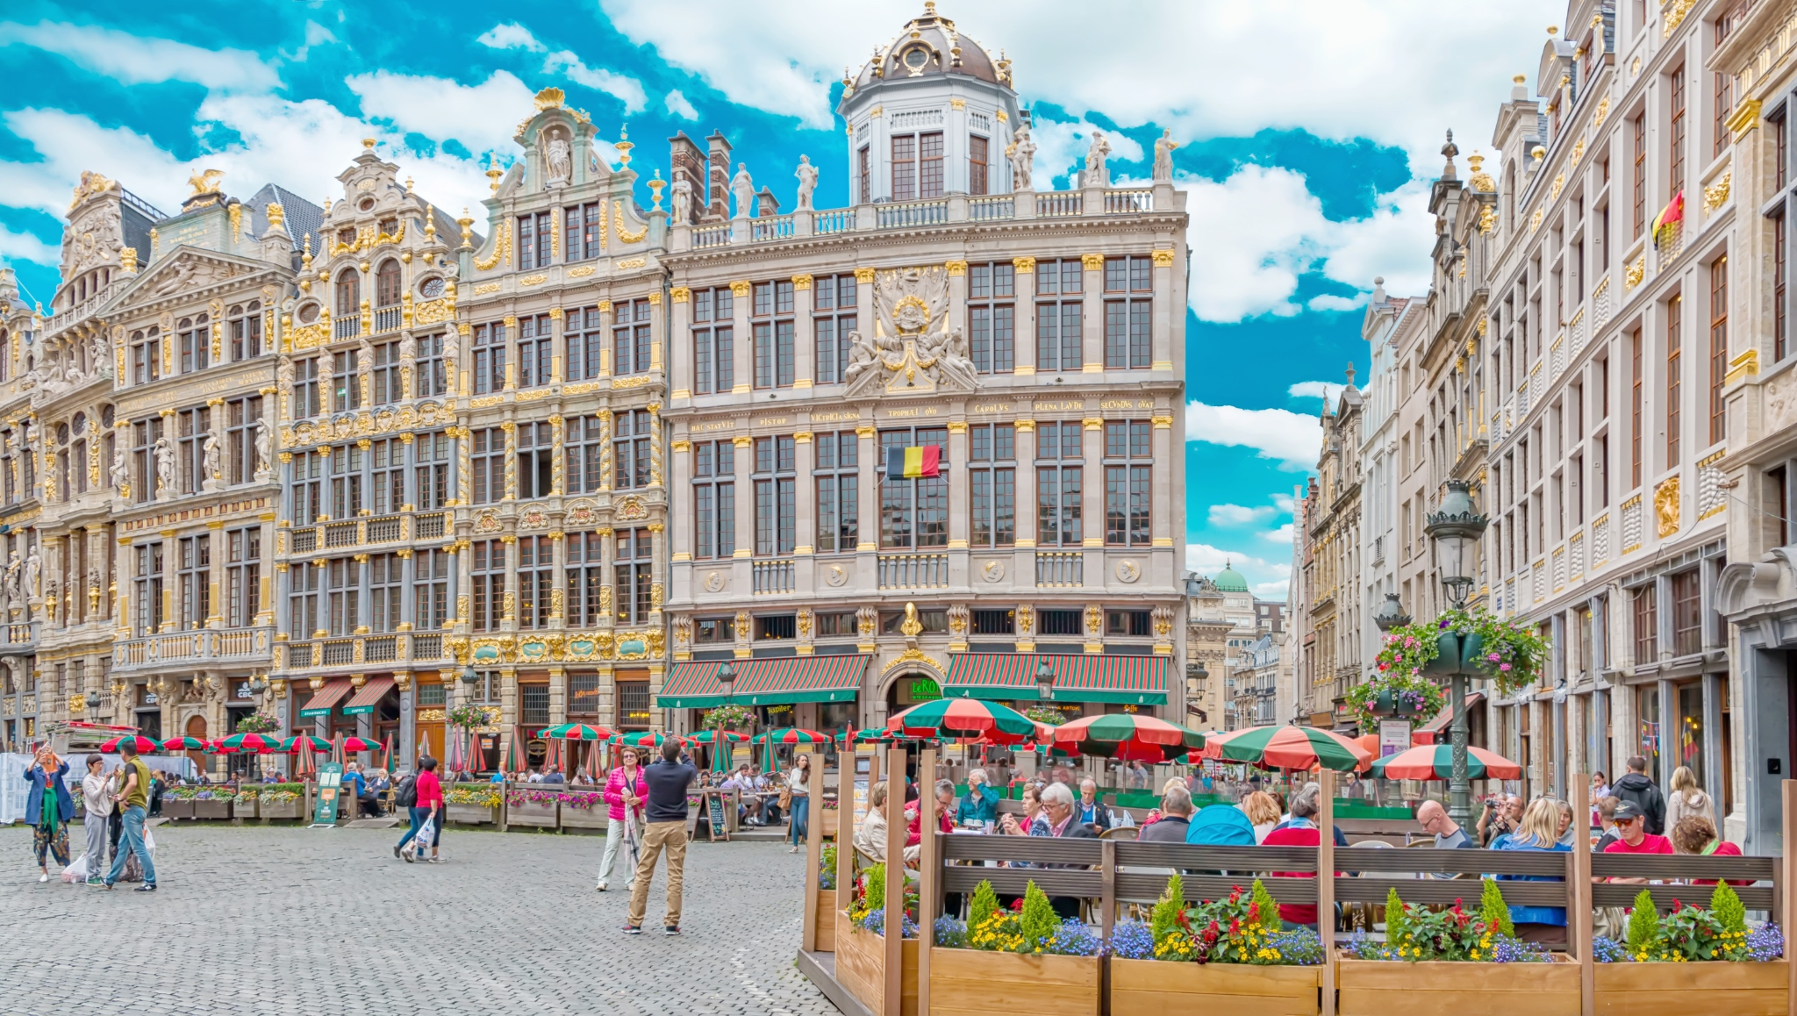
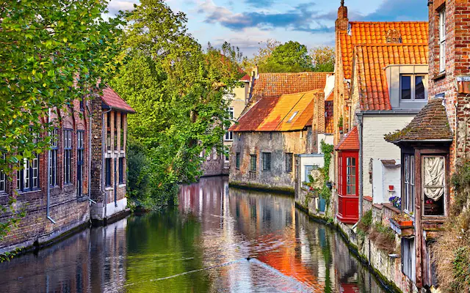
Educator’s Trip to Brussels - 2011

Slide 14
The U.S. and EU Compared
Population:
U.S. = 329.5 million
EU = 447.7 million
Gross Domestic Product:
U.S. = 20.94 trillion
EU = 17.1 trillion
GDP Per Capita:
U.S. = $56,200
EU = $44,203

Slide 15
The U.S. and EU Partnership
Total Trade: $1.1 Trillion (2019)
U.S. has a $130 billion trade deficit with the EU
If taken together as a single trading block, the EU is the largest trade partner with the U.S.

Slide 16
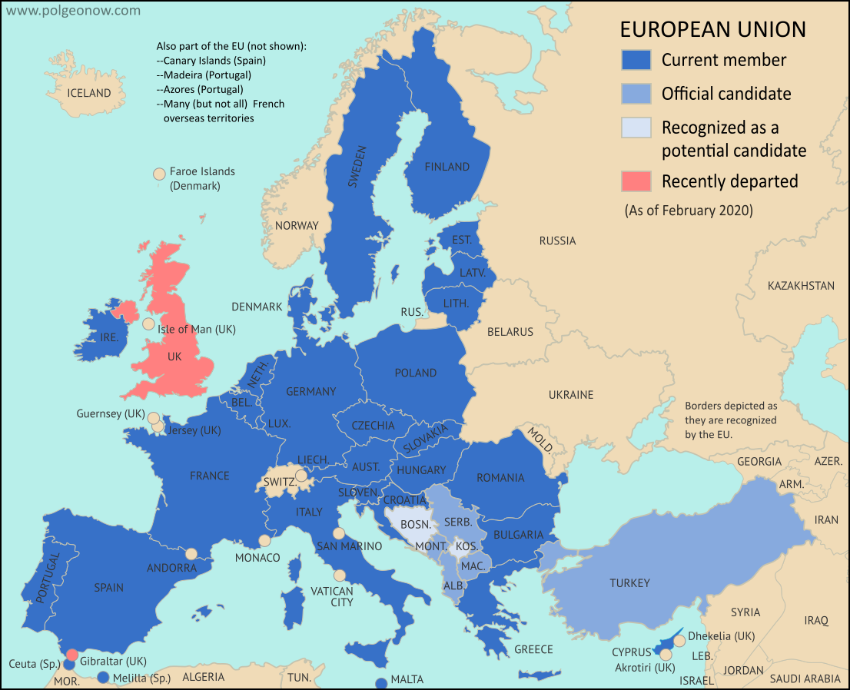
The European Union

Slide 17
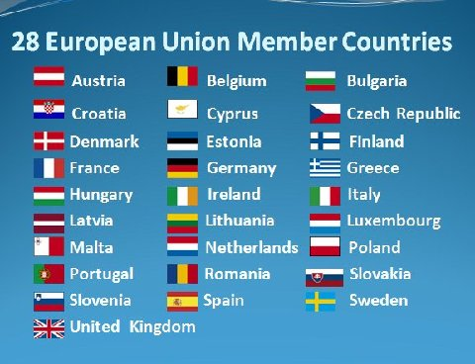
The European Union Countries
https://european-union.europa.eu/principles-countries-history/country-profiles_en

Slide 18
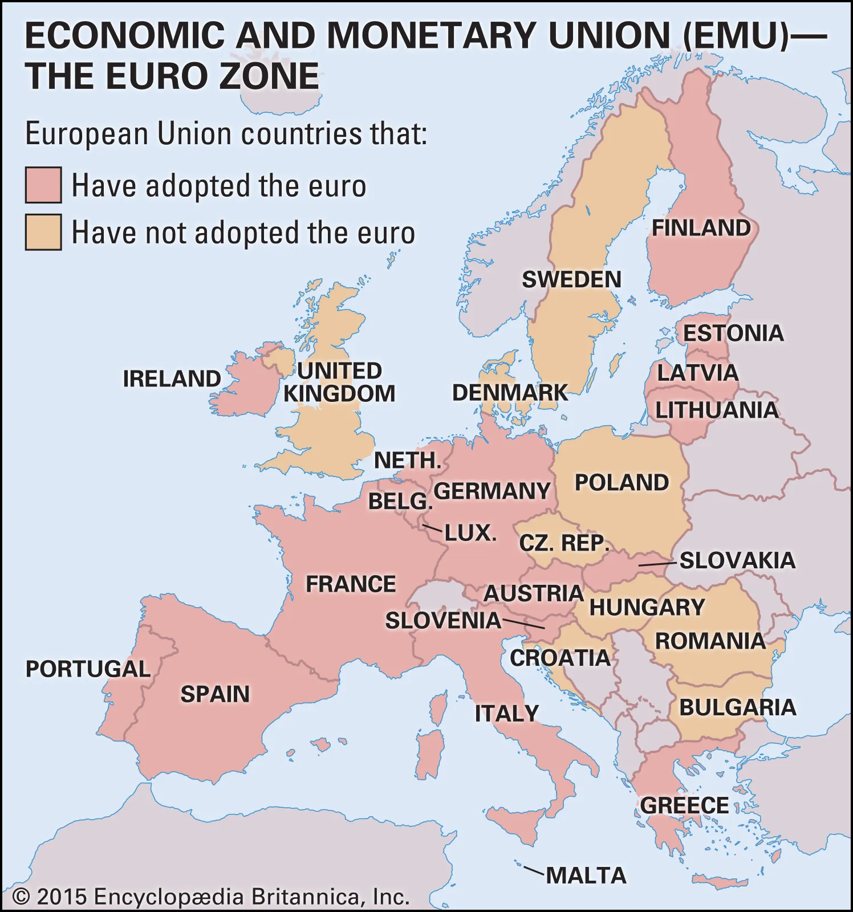
The Euro Area

Slide 19
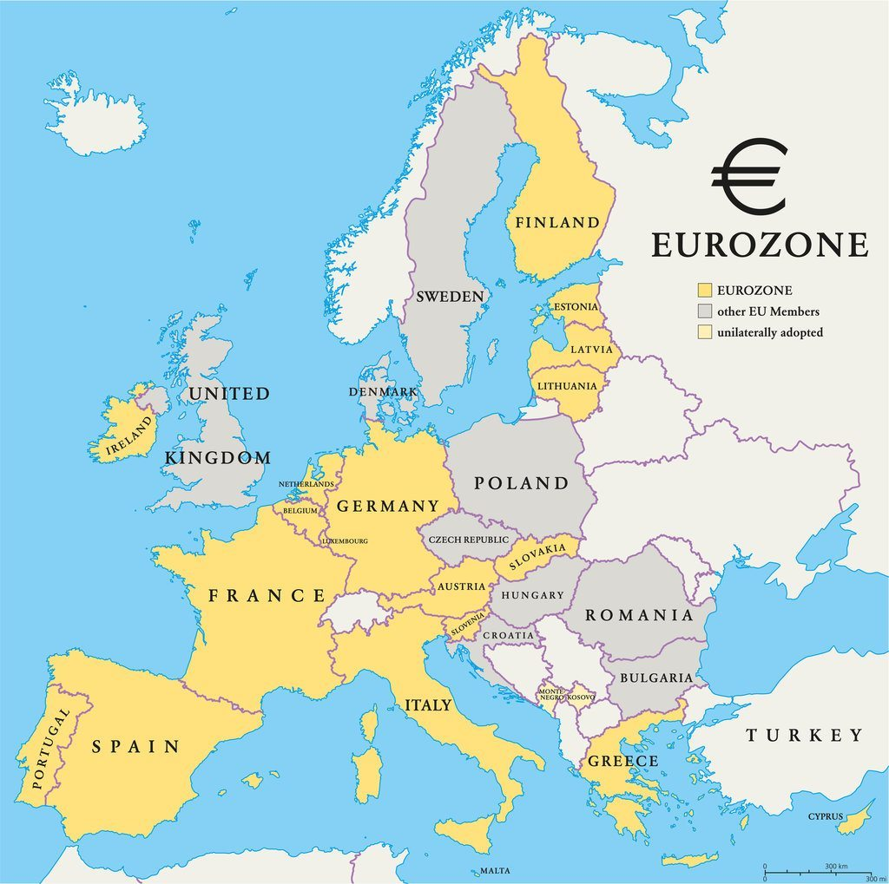
The Euro Area
https://fred.stlouisfed.org/categories/32947#:~:text=The%20euro%20area%20

Slide 20
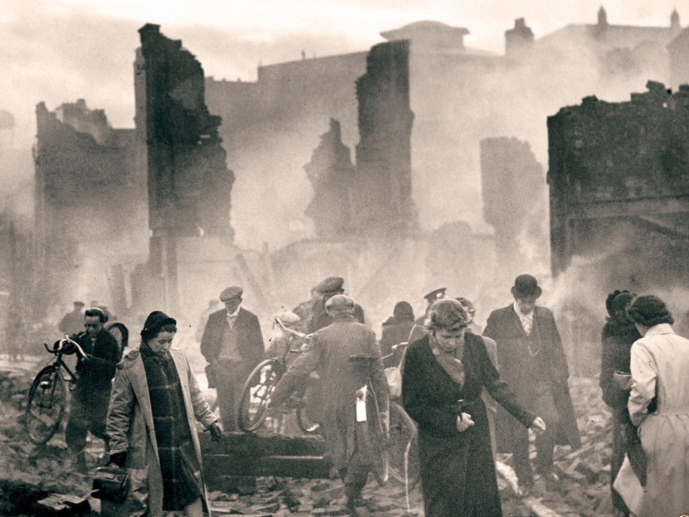
The European Union
Early History
Post World War II - A Devastated and Divided Europe
A Desire to Unify Europe and prevent future conflict
The U.S. promotes the European Organization for Economic Cooperation (EOEC) to aid in the Marshall Plan and reconstruction
Further Cold War divisions

Slide 21
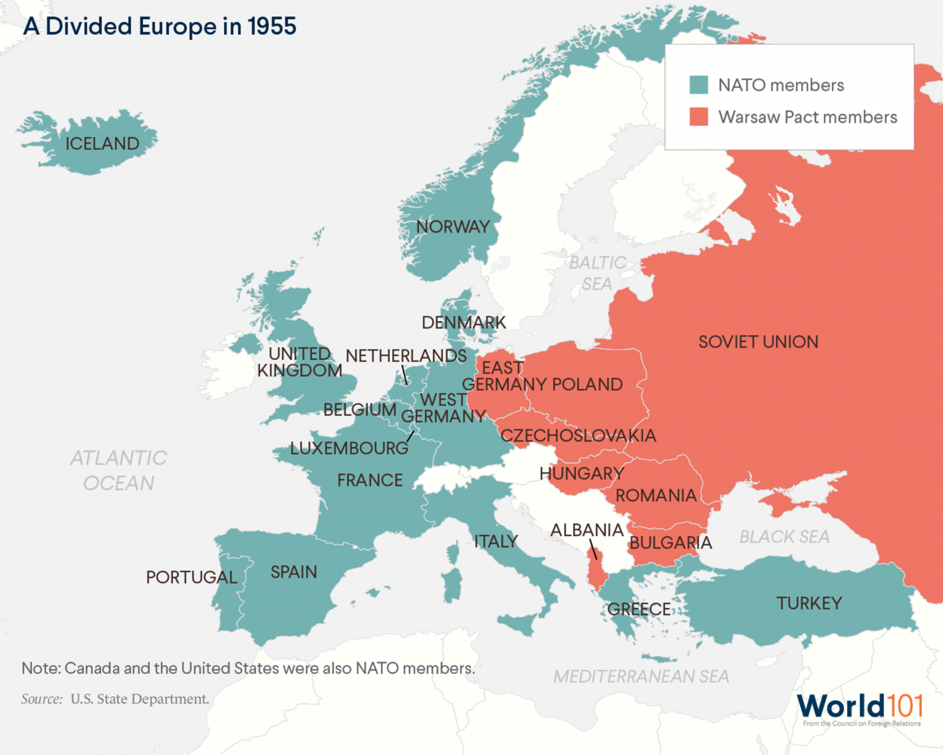

Slide 22
The European Union
Early History
1951: The European Coal and Steel Community - The Schuman Declaration
A plan to pool coal and steel productive resources
Six founding members:
Belgium, France, Germany, Italy, Luxembourg, Netherlands
The European Coal and Steel Community was the precursor to the EU

Slide 23
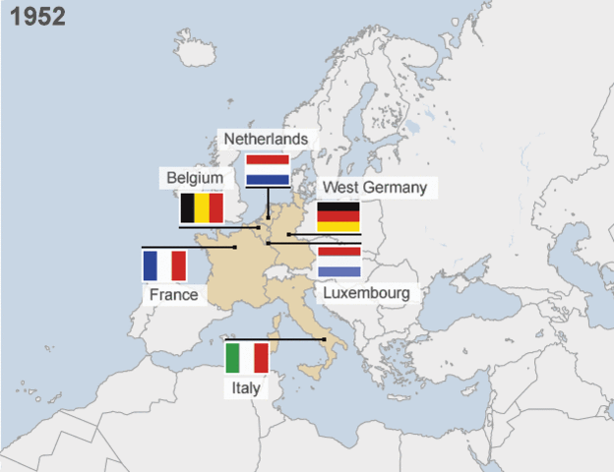

Slide 24
The European Union
Early History
1957: The European Coal and Steel Community forms the European Economic Community (EEC) and expands cooperation to more industries. Treaty of Rome
Creation of a true “common market”
Based on four freedoms:
Freedom of movement of people
Freedom of movement of goods
Freedom of movement of services
Freedom of movement of capital
Elimination of tariffs and trade barriers

Slide 25
The European Union
Early History
1960: European Free Trade Association created (includes countries not in the original six of the EEC)
Austria
Denmark
Norway
Portugal
Sweden
Switzerland
United Kingdom
Today the EFTA consists of Iceland, Liechtenstein, Norway, and Switzerland

Slide 26
The European Union
Historical Developments
1962: Common Agricultural Policy
Gives EEC nations joint control over food production
1965: Merger Treaty
Combines the administration of the European Coal and Steel Community, the European Economic Community, and Euratom (European Atomic Energy Community)
Signed in Brussels - creates a single European administrative arm - the European Commission

Slide 27
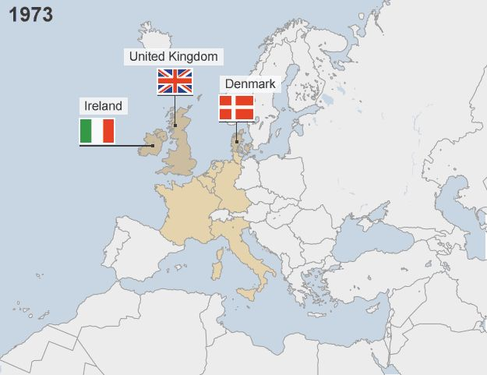
The European Union
Historical Developments
1970: European Commission adopts laws to address environmental concerns
1973: Three new countries join the European Communities: Denmark, Ireland, and the United Kingdom

Slide 28
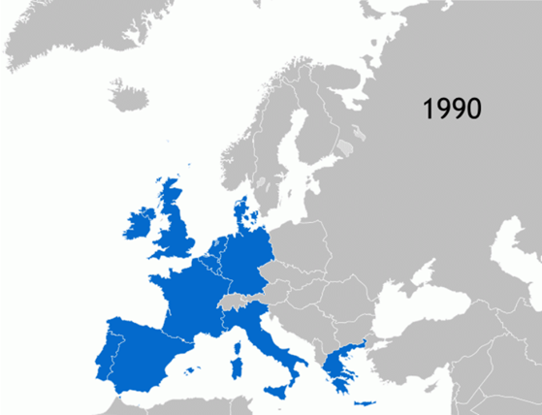
The European Union
Historical Developments
1981: Greece becomes the tenth nation to join the European Communities
1986: Spain and Portugal are added as members

Slide 29
The European Union
Historical Developments
1992: Maastricht Treaty (Netherlands)
Sets guidelines for a future single currency
Creates an official single market, the European Union which officially launches on 1/1/93
1995: Sweden, Finland, and Austria join the European Union

Slide 30
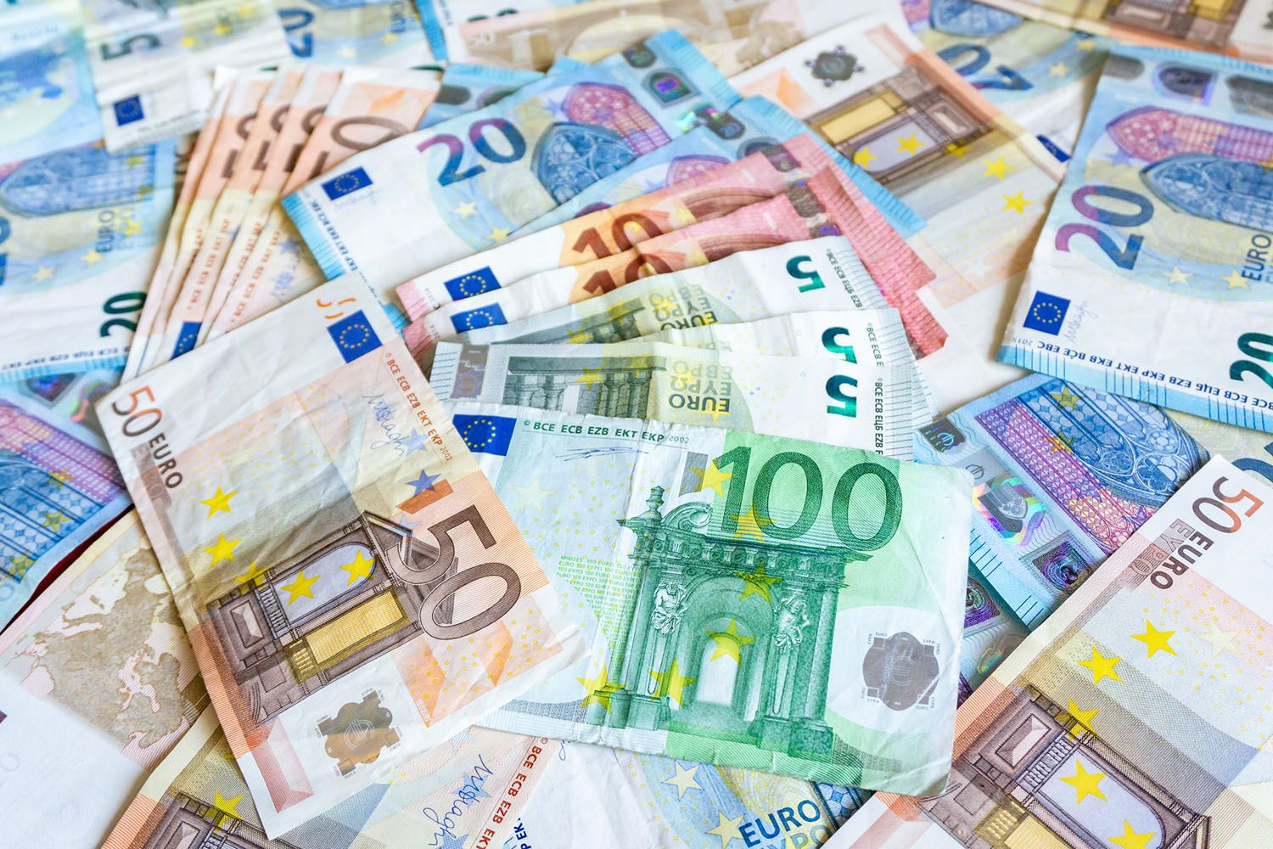
The European Union
Historical Developments
January 1, 1999: The Euro is born!
It is initially introduced in 11 countries for commercial and financial transactions only

Slide 31
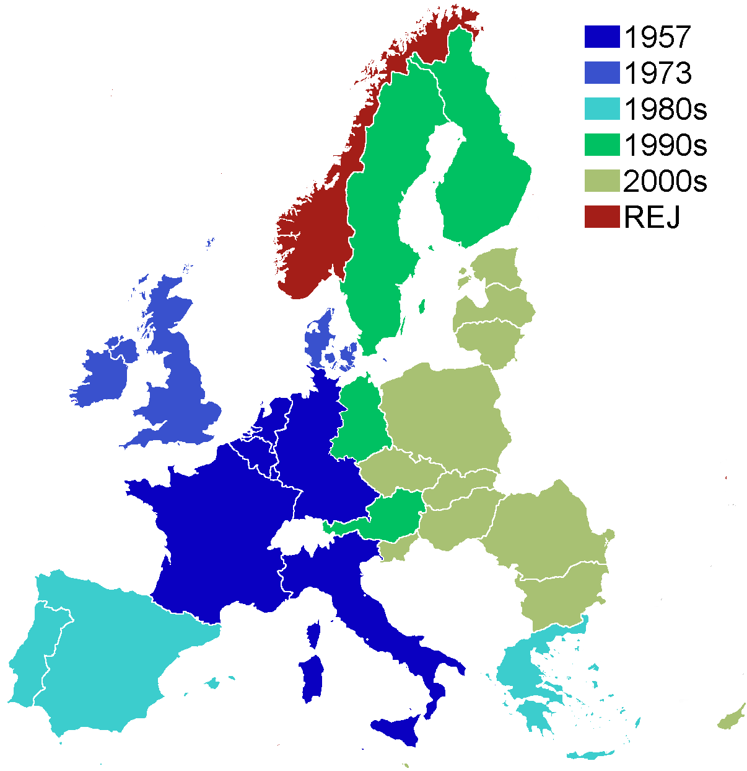
The European Union
Historical Developments
January 1, 2002: Euro notes and coins launch in 12 nations
2003/2004: 11 new nations join the European Union-
Czechia, Cyprus, Estonia, Hungary, Latvia, Lithuania, Malta, Poland, Slovakia, Slovenia
January, 2007: Bulgaria, Romania join

Slide 32
The European Union
Historical Developments
December 2012: The EU wins the Nobel Peace Prize recognizing six decades of promoting peace, cooperation, democracy, reconciliation, and human rights
July 2013: Croatia becomes the 28th and latest member of the EU.
2016: Great Britain votes to leave the European Union - “Brexit”

Slide 33
The European Union
Membership Requirements
Any nation wishing to join the EU must meet the “Copenhagen Criteria”:
Free market economy
A stable democracy and rule of law
Acceptance of all EU legislation
Eventual acceptance of the Euro
Current candidate nations: Albania, Montenegro, North Macedonia, Serbia, Turkey
https://european-union.europa.eu/principles-countries-history/joining-eu_en#:~:text=Any%20country%20that%20satisfies%20the,legislation%2C%20including%20of%20the%20euro.

Slide 35
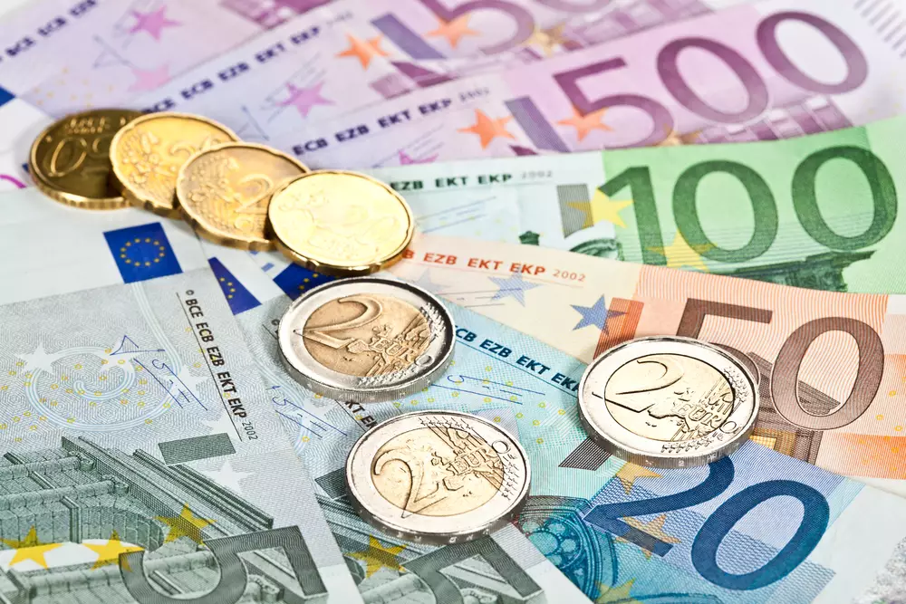
Requirements to Join the Euro Area (Adopt the Euro)
Nations in the EU must eventually adopt the Euro. The requirements according to the “Convergence Criteria” are:
Price stability
Sound and stable public finances
Exchange rate stability
Healthy long term interest rates
https://www.consilium.europa.eu/en/policies/joining-the-euro-area/convergence-criteria/

Slide 36
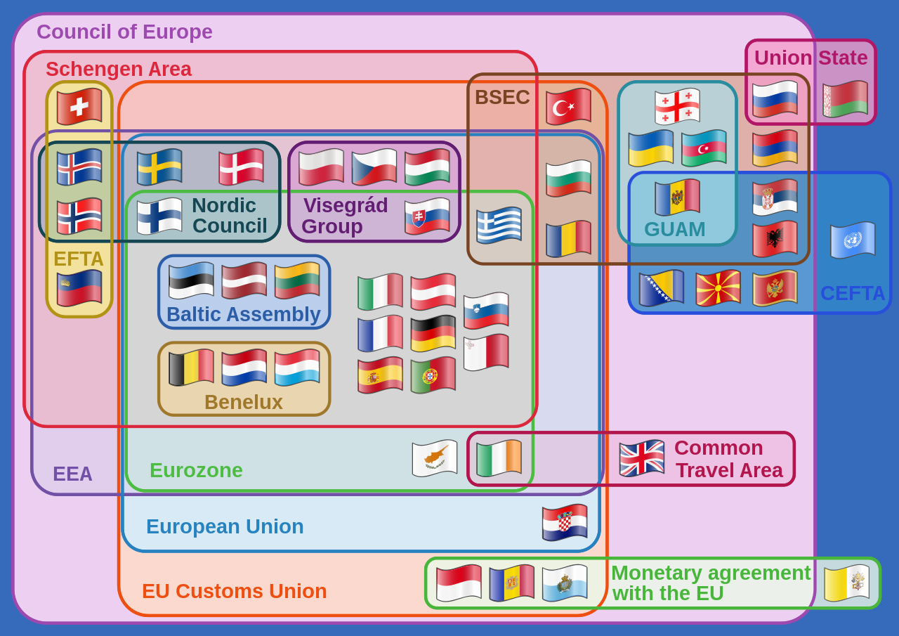
Structure of the EU
The EU is a “Supranational” organization: a multinational organization where member nations cede some authority and autonomy to the group, whose decisions are binding on all members.
www.investopedia.com
Ex: Environmental policy - all EU nations must follow EU law in implementing any mandates
Issue: all EU nations are still sovereign but also must abide by EU policies

Slide 37
Structure of the EU
European Council: heads of state from all EU nations - decides overall political direction
European Commission: (Executive) initiates and executes laws
European Parliament: (Legislative) most laws must be approved by the European Parliament to be passed. 705 elected seats (elections held every 5 years by EU citizens)
European Court of Justice (Judicial) interprets EU laws to be sure these laws are applied fairly in all EU nations
Court of Auditors (Treasury) - oversees all the accounts and budgets of EU institutions
European Ombudsman - safeguards rights of EU citizens by ensuring openness and accountability

Slide 38
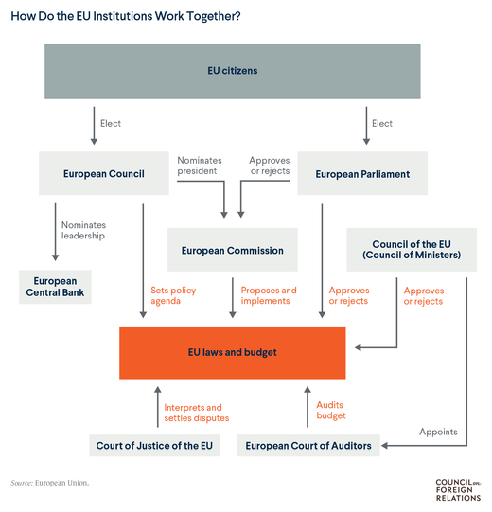

Slide 39
The ECB - European Central Bank
Euro Area: nations that have adopted the Euro as per the Convergence Criteria established in the Maastricht Treaty
European Central Bank (comparable to the Federal Reserve)
Responsible for monetary policy decisions
Single Mandate: price stability - keep inflation below a target of 2%
Regulate and supervise national central banks and commercial banks throughout the Euro Area
Create and distribute euro banknotes and coins
Act as lender of last resort

Slide 41
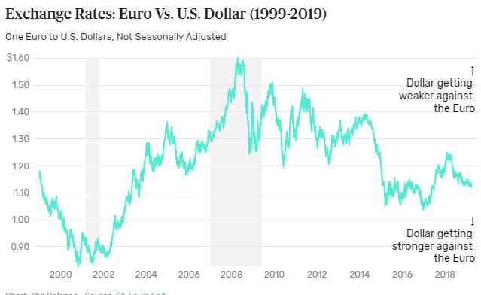

Slide 42
The EU and Euro Area: Successes
Peace and Stability
Free Trade and Single Currency
Promotion of Democracy and Individual Rights
Business Growth and Trade
Environmental Protection
International Diplomacy
Humanitarian Aid
https://www.coe.int/en/web/about-us/achievements
https://european-union.europa.eu/priorities-and-actions/achievements_en

Slide 43
The EU and Euro Area: Challenges
Fiscal Imbalance: does a “rising tide lift all ships?”
Asymmetric economic growth, stagnation, inflation
Can a common policy apply to so many different nations and economies?
Bureaucracy: is the structure of the EU efficient at solving real problems?
Some have argued that the EU is good at developing policy but lacks the means to effect real change.
Cultural Issues: Can nations with different languages, cultures, ways of life, etc. work cooperatively as a single unit?
Lack of Ability to Solve Actual Problems: ex - Refugee/Immigration issues in mid 2010’s and COVID.
Brexit and other internal threats

Slide 44
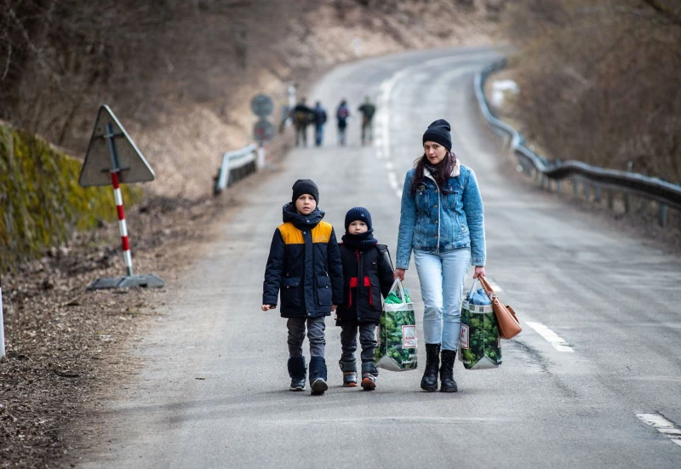
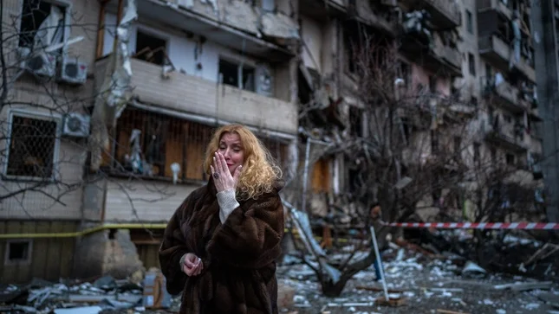
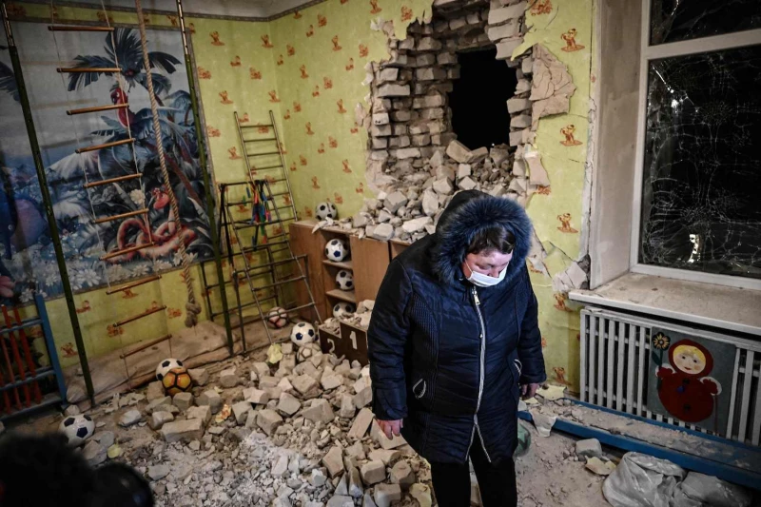
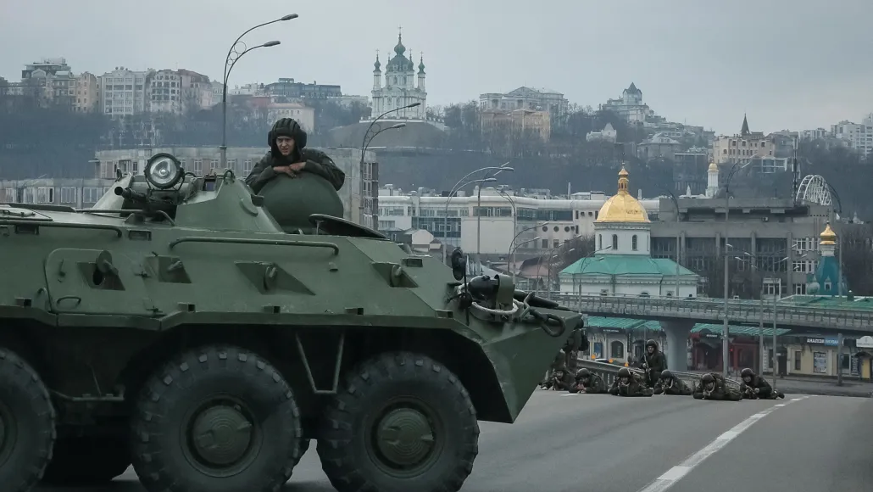
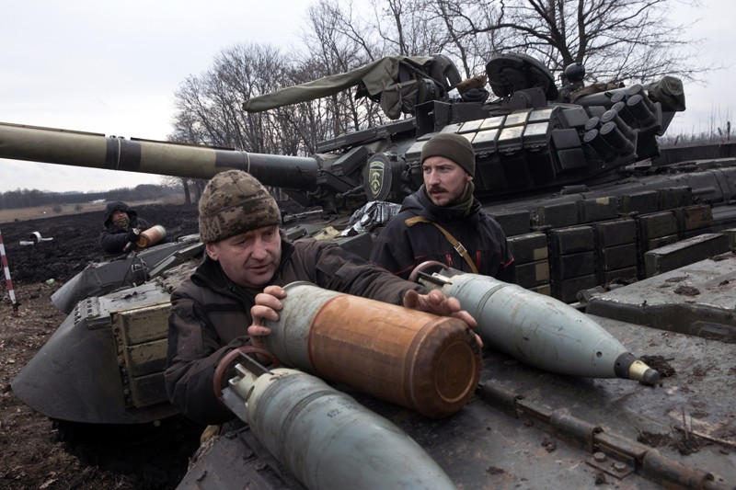
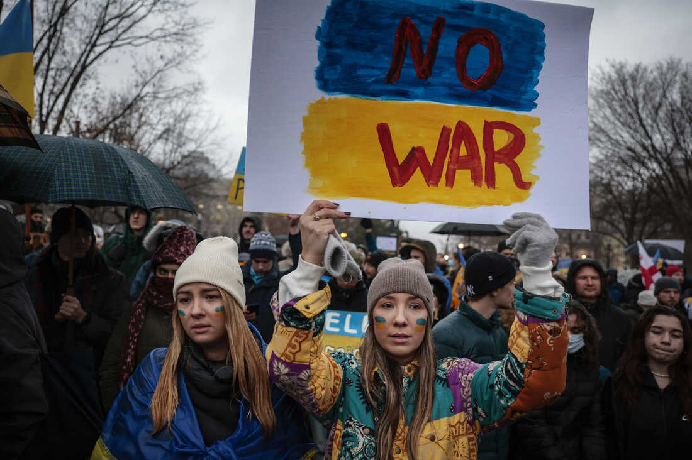
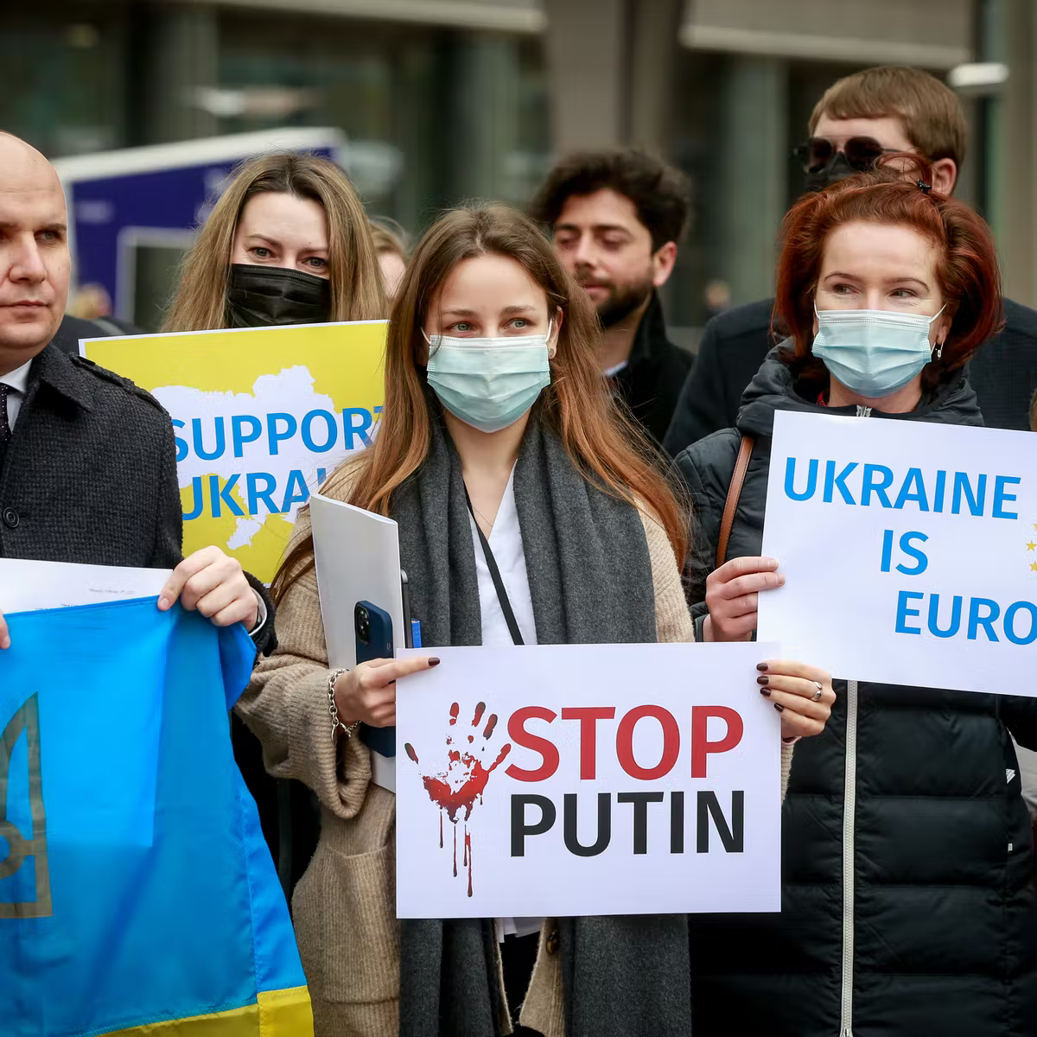

Slide 45
The EU’s Response to the Russian Invasion of Ukraine
Economic Sanctions
Freezing assets of all members of Russian Duma
Freezing assets of Putin and prominent leaders
Restrictions and bans on imports and tourism services
Export restrictions
Restrictions on financial transactions and investments
Block selected Russian banks from SWIFT (Society for Worldwide Interbank Financial Telecommunication)
Travel Ban to the EU from Russia for political leaders
Blocking Russian Media Outlets in the EU
Closing EU airspace to Russian airplanes
$500 million weapons to Ukraine - First time in history.

Slide 46
The EU’s Response to the Russian Invasion of Ukraine
Ukrainian Refugees
https://www.politico.eu/article/ukraine-refugees-european-union-war-russia-temporary-protection-debate/
https://euobserver.com/migration/154432
https://www.vox.com/22948699/ukraine-refugee-crisis-us-eu-russia-war
Possibility of up to five million Ukrainian refugees
Most fleeing to Poland, Moldova, Romania, Hungary, Slovakia

Slide 47
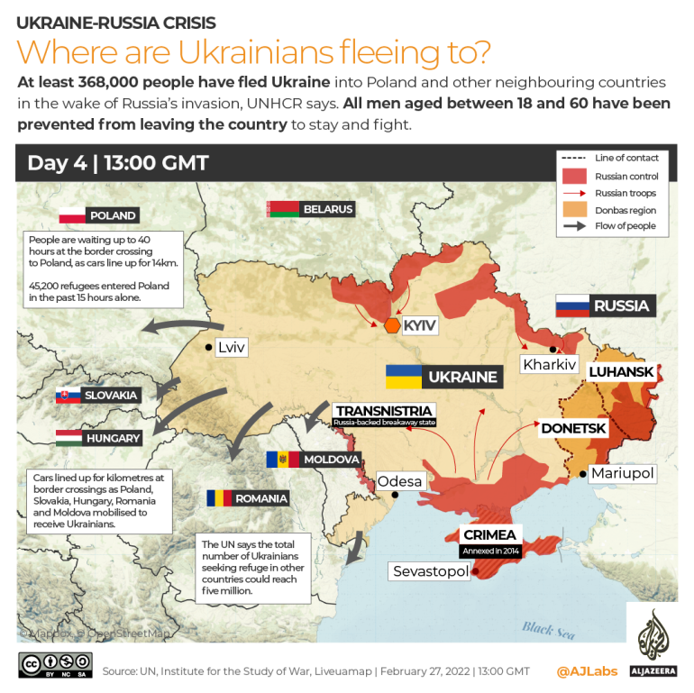

Slide 48
The Future of the EU and Euro Area
https://ec.europa.eu/commission/presscorner/detail/en/ip_21_4610
https://foreignpolicy.com/2020/02/06/europes-post-brexit-future-is-looking-scary/
https://www.cnbc.com/2021/05/11/what-is-the-conference-on-the-future-of-europe-.html
https://carnegieeurope.eu/strategiceurope/62445

Slide 49
Digital Assessment Tool: BLOOKET!
Blooket.com
Tutorial: https://www.youtube.com/watch?v=hhn7dAP6BF8

Slide 50
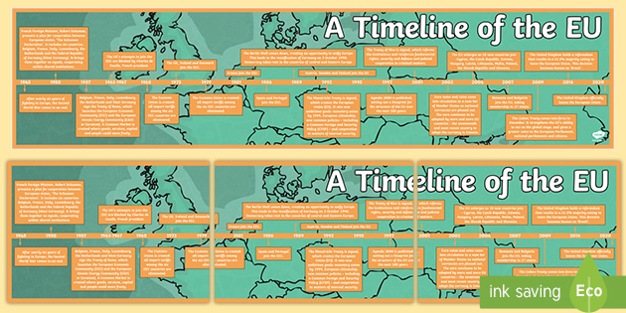
Student Projects Ideas
Create a digital timeline of key events in the founding and development of the European Union.
Use www.sutori.com or another timeline learning tool.

Slide 51
Student Projects Ideas
Analyze the major past successes and failures of the EU and the challenges that lay ahead. Use one of the following as a springboard to debate whether the EU and Euro Area has been more a success or a failure. Also make a prediction about what the future holds:
-Jamboard https://jamboard.google.com/
https://jamboard.google.com/d/1ZbjxJldt0cfp-zGDt6ItYmDUqfIoHjXfLWhjCyxooZU/edit?usp=sharing
-Socratic Seminar https://www.facinghistory.org/resource-library/teaching-strategies/socratic-seminar
-”Old School” debate

Slide 52
Student Projects Ideas
Choose an issue from the following list which the countries in the EU typically grapple with: Examples -
-Immigration
-Aging Population
-Environmental Policy and Climate Change
-Innovation and Economic Growth
Prepare a policy brief to be delivered to a mock EU Council that:
-Defines the problem
-Recommend policies to deal with the issue
https://www.euro-challenge.org/challenge-sheets

Slide 53
CIrcle in a Circle Presentation Format
Create an inner circle of the research groups and and a corresponding outer circle with the same number of groups. For instance, three inner groups and a circle of three outer groups around them.
Have the outer and inner groups face each other and give them 10 minutes to present their research to each other. When ten minutes is up, have the outer group rotate so they face a new inner group. Repeat the presentation process until all the groups have met up with each other.

Slide 54
Student Projects Ideas
Sample for Policy Presentation:
https://docs.google.com/presentation/d/1s26QjKzn1qnB8IucDRzsmsAn41JR21ZjsMbzYCQrN-g/edit?usp=sharing

Slide 55
Formative Assessment Options
Socrative: b.socrative.com Room Name: Opderbeck
Google Forms: https://www.google.com/forms/about/
Quizlet Live: www.quizlet.com
Kahoot: www.kahoot.com
Blooket: www.blooket.com

Slide 56
References/ Resources
https://european-union.europa.eu/index_en
https://www.britannica.com/topic/European-Union/Creation-of-the-European-Economic-Community
https://www.npr.org/templates/story/story.php?storyId=128389419

Slide 57
CEE Affiliates
https://www.councilforeconed.org/resources/local-affiliates/

Slide 58
Thank You to Our Sponsors!

Slide 59
The Conference is your pathway to learn about the opportunities to incorporate personal finance and economics into your K-12 classroom and to exchange ideas with hundreds of peers.
Register by August 15, 2020 to receive the early bird special discount: $79 Early Bird ($99 thereafter)
Register Today >>>
https://www.councilforeconed.org/events/conference

