Slide 1

Tawni Hunt Ferrarini, PhD
Presentee
22 Feb 2022
TFerrarini@lindenwood.edu

Slide 2



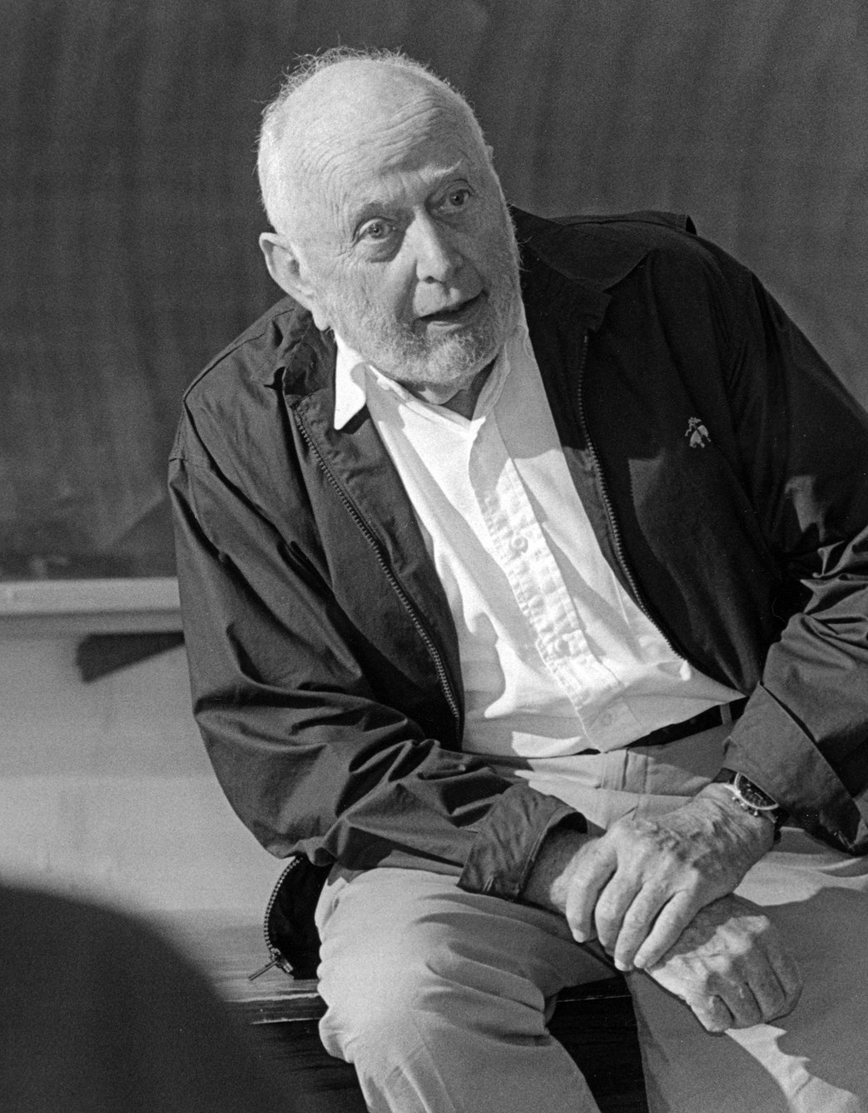

Tawni’s story…
Robert W. Plaster Professor of Economic Education and
Senior Economist at the Hammond Institute, Plaster College of Business and Entrepreneurship at Lindenwood University
First generation college student whose family farm did NOT survive the back-to-back recession of the 80s
PhD in economics with a BA in mathematics. My dissertation was chaired by Douglass C. North, Nobel Laureate in Economics, 1993
Love to travel around the world with Australia, not Antarctica, being my last continent to visit
My son, daughter-in-law, and furry family are my pride and joy.

Slide 3
Tawni Hunt Ferrarini, Professor of Economics Education
Lindenwood University * tawni.ferrarini@gmail.com* Tawni.org
In this economics webinar, apply the tools of economists and other social scientists to
Provide an overview of GDP, Circular Flow, Unemployment, and Inflation.
Illustrate how to utilize different resources to engage student learning.
Identify different web and online resources to improve content.

Slide 4


CIRCULAR FLOW OF THE MACROECONOMY
How is the food that you purchased last and the gas you put in your car linked to others’ wages and salaries?
OUTPUT
INCOME
Notes:
🍐 This is a Pear Deck Text Slide
🍐 To edit the type of question, go back to the "Ask Students a Question" in the Pear Deck sidebar.

Slide 5

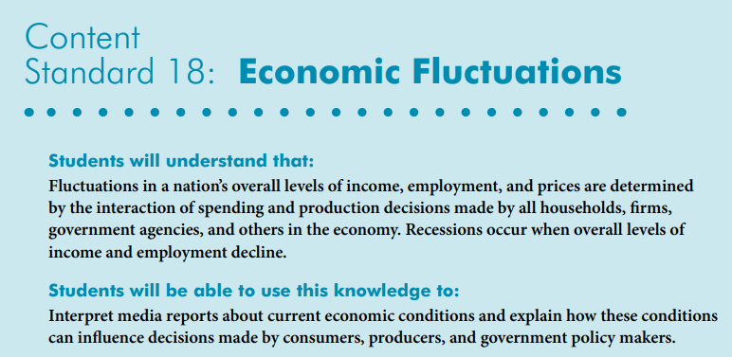

Slide 6
Overview
Investigate NVECS 18: Economic Fluctuations
Explore the key interactions of spending and production decisions made by all households, firms, government agencies, and others in the economy
Interpret reports about current economic conditions with attention draw to unemployment and inflation
Explain how changes in unemployment, inflation, and the health of the U.S. economy can influence decisions made by consumers, producers, and government policy makers
Conclusions
References
Questions and Answers

Slide 7
Circular Flow
Connecting the dots between output and income in a simple economy.
Notes:
🍐 This is a Pear Deck Web Slide.
🍐 To edit the type of question, go back to the "Ask Students a Question" in the Pear Deck sidebar.

Slide 8
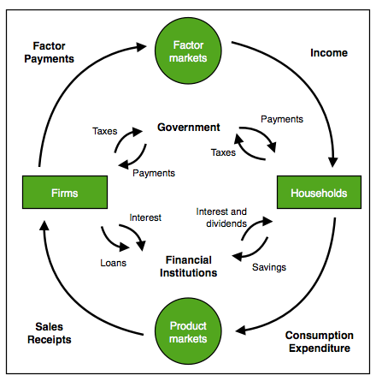
Connecting the dots…
What is produced is consumed.
What is consumed is produced.
Assume no government or financial institutions for the moment.

Slide 9

Bell Ringer
Are we coming out of a recession?
Yes * No * I don’t know
(Reply in chat box if you are not in Peardeck.)
SEE BITMOJI. TAKE ACTION!!!!
Notes:
🍐 This is a Pear Deck Multiple Choice Slide. Your current options are: A: Yes, B: No, C: I don't know,
🍐 To edit the type of question or choices, go back to the "Ask Students a Question" in the Pear Deck sidebar.

Slide 10
Macro Objectives
Identify the last key recessions in the U.S.
Define a business cycle and describe the interplay of key economic indicators
Compare and contrast a recession and a depression

Slide 11


Good Online Learning Practices

Slide 12
Active Learning
You will:
  Identify key macro episodes in U.S. history
  Investigate the relationships between key macroeconomic indicators - GDP (nominal and real), national income, unemployment, and inflation
  Describe a recession and explain how it differs from a depression
  Place the U.S. economy on the business cycle

Slide 13
How to participate?
Sit back, watch the webinar, and listen.
Join us in PearDeck on your device of choice.
  Check in the GoToMeeting chat box for the join code for joinpd.com

Slide 14
Drag and drop
Name | Period | Duration
COVID* | 02-04/2020 | Not a recession
Great Recession | 12/2007–06/ 2009 | (1y/6m)
 | 01/1980–07/1980 07/1981–11/ 1982 | (6m) and (1y/4m)
 | 11/1973–03/1975 | (1y/4m)
 | 02/1945–10/1945 | (8m)
Great Depression | 08/1929–03/1933 | (3y/7m)
Notes:
🍐 This is a Pear Deck Draggable™ Slide.
🍐 To edit the type of question, go back to the "Ask Students a Question" in the Pear Deck sidebar.

Slide 15
Drag and drop
Name | Period | Duration
COVID | 02/2020 – | TBD
Great Recession | 12/2007–06/ 2009 | (1y/6m)
Back-2-Back Recessions #2 yellow | 01/1980–07/1980 07/1981–11/ 1982 | (6m) and (1y/4m)
Stagflation Blue dot | 11/1973–03/1975 | (1y/4m)
Postwar Economy Flag purple | 02/1945–10/1945 | (8m)
Great Depression | 08/1929–03/1933 | (3y/7m)

Slide 16
Choice
Period | GDP decline (peak to trough) | Unemployment | CPI | Stock Mkt
COVID 02/2020–TBD
Great Recession 12/2007–06/2009 (1y/6m)
Back-2-Back Recessions 01/1980–07/1980 (6m) and 07/1981–11/ 1982 (1y/4m)
Stagflation 11/1973–03/1975 (1y/4m)
Postwar Economy 02/1945–10/1945 (8m)
Great Depression 08/1929–03/1933 (3y/7m)
During a recession what happens to production (GDP), employment, and unemployment?
Notes:
🍐 This is a Pear Deck Multiple Choice Slide. Your current options are: A: Each increases, B: Each decreases, C: Production and employment increase while unemployment falls, D: Production and employment decrease while unemployment rises,
🍐 To edit the type of question or choices, go back to the "Ask Students a Question" in the Pear Deck sidebar.

Slide 17
What’s FRED say?

Slide 18
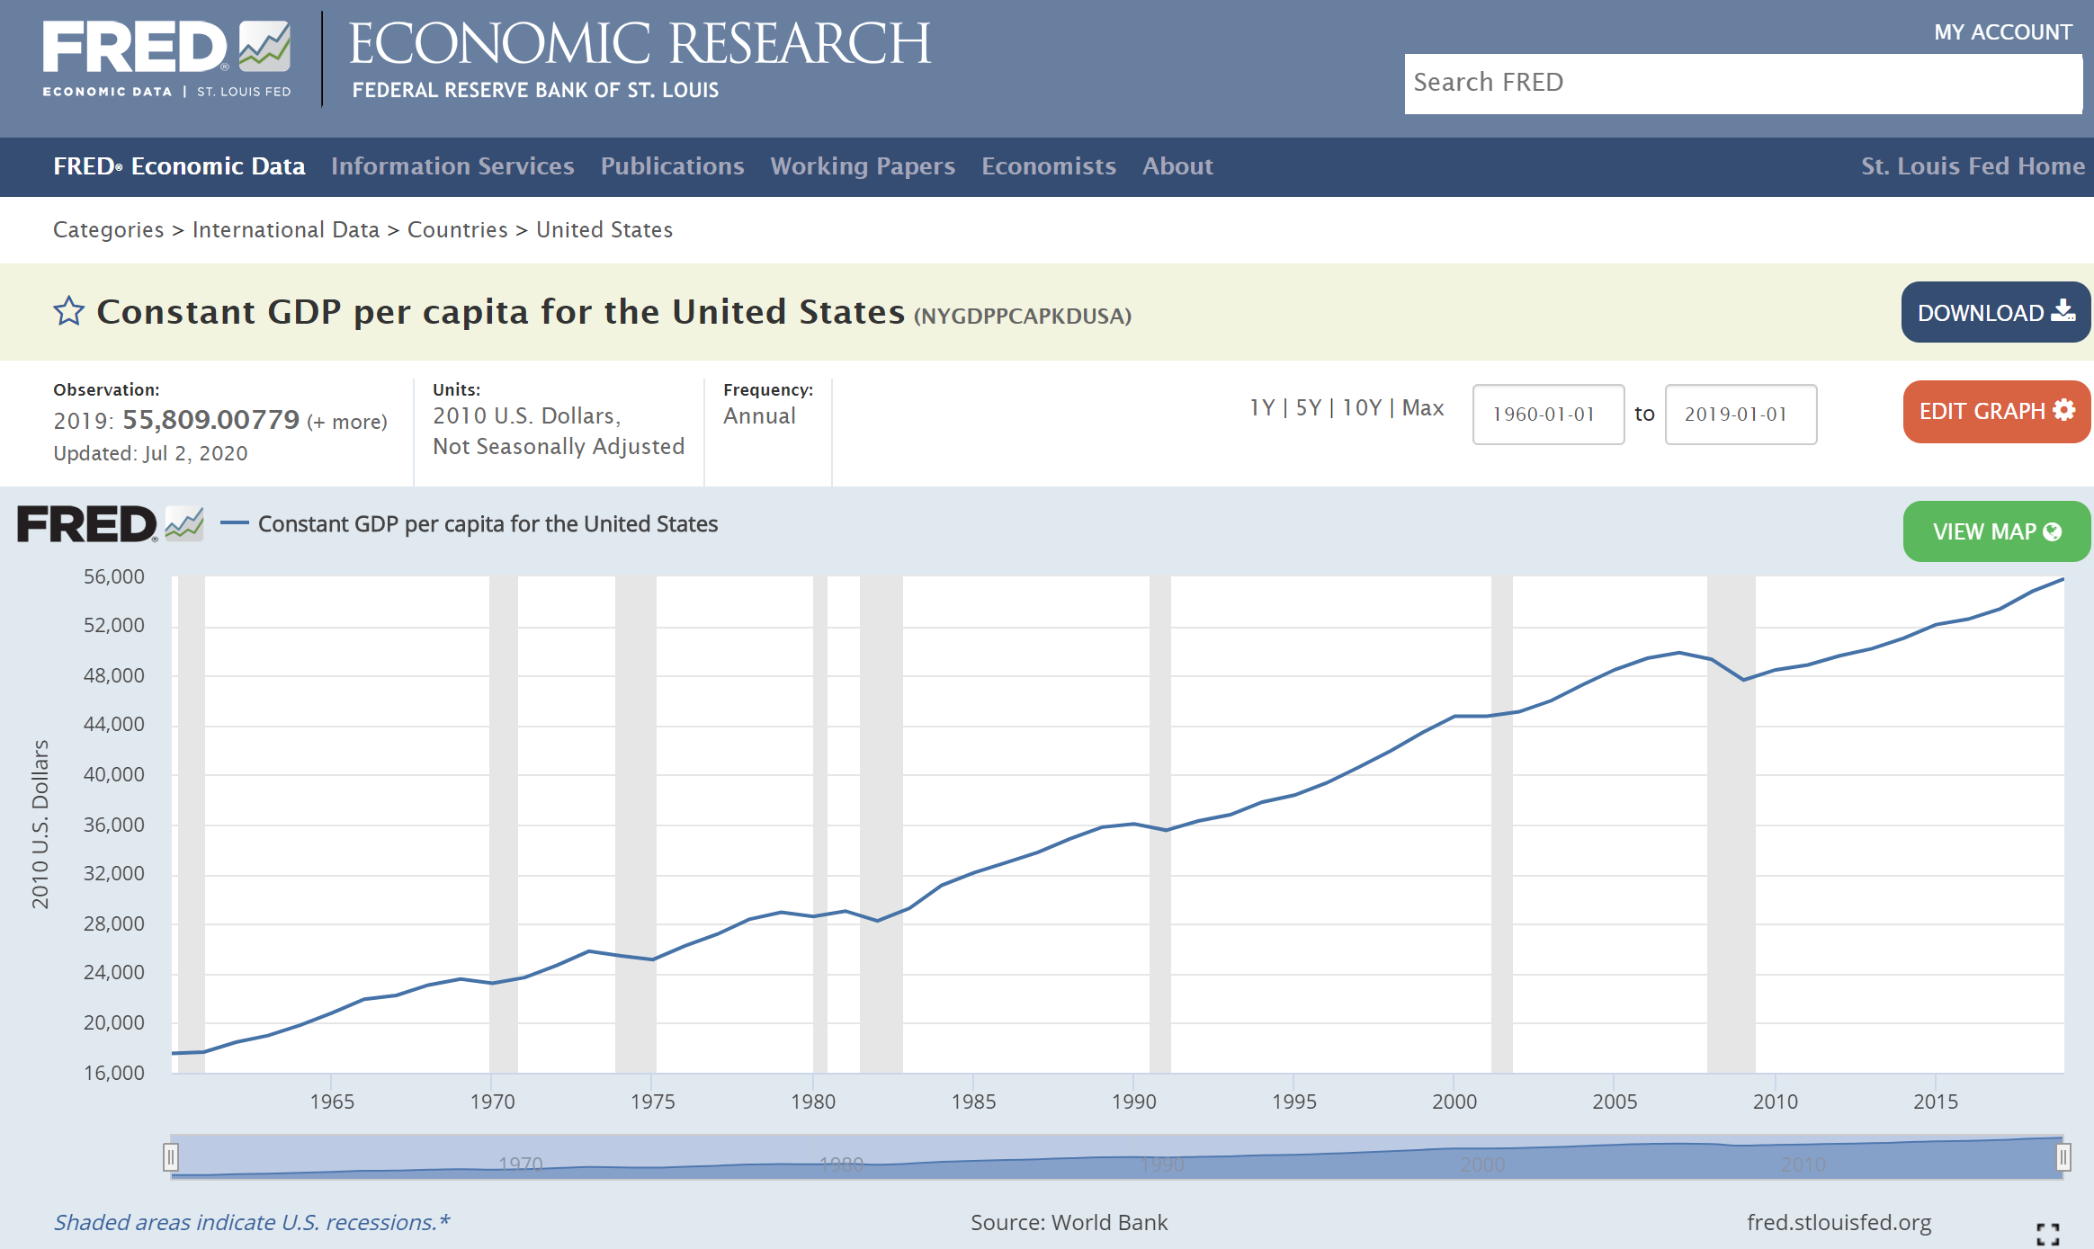
FRED Data
Notes:
🍐 This is a Pear Deck Draggable™ Slide.
🍐 To edit the type of question, go back to the "Ask Students a Question" in the Pear Deck sidebar.

Slide 19
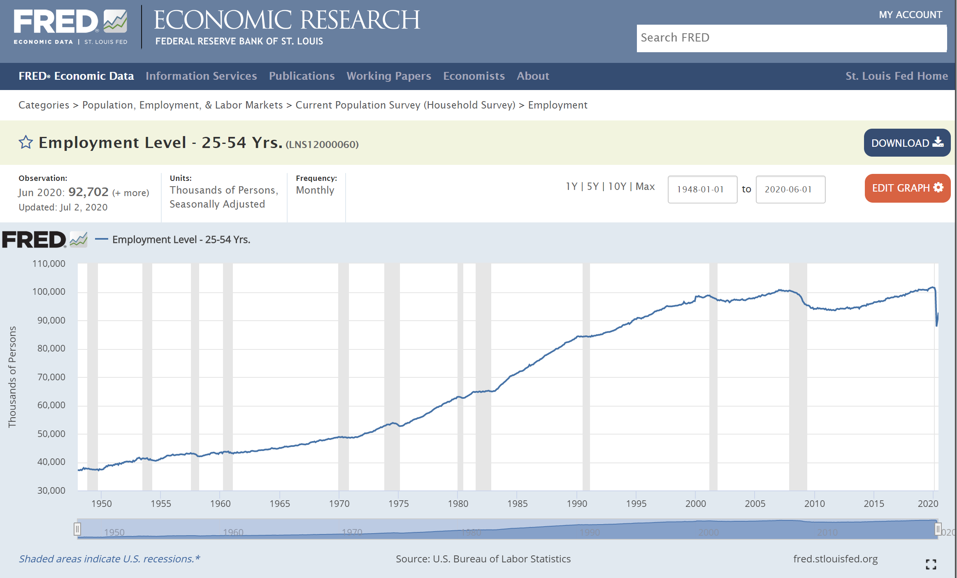
Employment Levels
Notes:
🍐 This is a Pear Deck Draggable™ Slide.
🍐 To edit the type of question, go back to the "Ask Students a Question" in the Pear Deck sidebar.

Slide 20
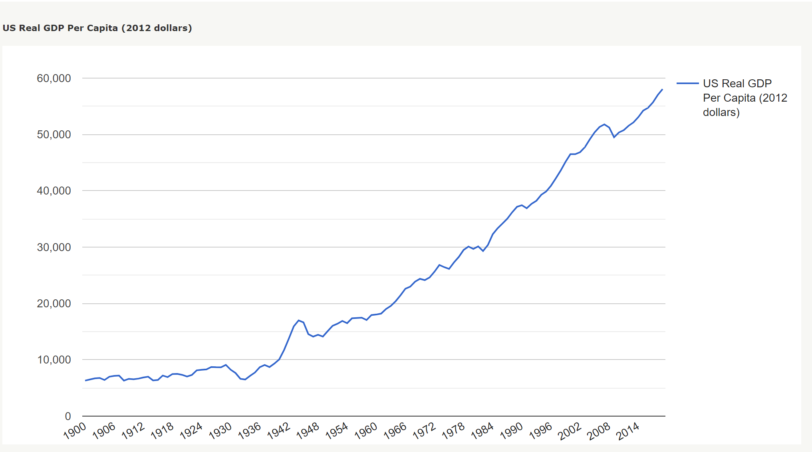
RGDPpc
"Graphing Various Historical Economic Series" MeasuringWorth, 2020.

Slide 21
Choice
Period | GDP decline (peak to trough) | Unemployment
COVID 02/2020–TBD
Great Recession 12/2007–06/ 2009 (1y/6m) | -05% | +10%
Back-2-Back Recessions 01/1980–07/1980 (6m) and 07/1981–11/ 1982 (1y/4m) | -02% -03% | +08% +11%
Stagflation 11/1973–03/1975 (1y/4m) | -03% | +09%
Postwar Economy 02/1945–10/1945 (8m) | -13% | +05%
Great Depression 08/1929–03/1933 (3y/7m) | −27% | +21%
During a recession, production (GDP) and employment decline while unemployment rises.

Slide 22
Price Levels
Period | GDP decline (peak to trough) | Unemployment | Consumer Price Level (CPI)
COVID 02/2020 –TBD
Great Recession 12/2007–06/2009 (1y/6m) | -05% | +10%
Back-2-Back Recessions 01/1980–07/1980 (6m) and 07/1981–11/ 1982 (1y/4m) | -02% -03% | +08% +11%
Stagflation 11/1973–03/1975 (1y/4m) | -03% | +09%
Postwar Economy 02/1945–10/1945 (8m) | -13% | +05%
Great Depression 08/1929–03/1933 (3y/7m) | −27% | +21%
During a recession what happens to price levels?
Notes:
🍐 This is a Pear Deck Multiple Choice Slide. Your current options are: A: Increase, B: Decrease, C: Stay the same, D: Other,
🍐 To edit the type of question or choices, go back to the "Ask Students a Question" in the Pear Deck sidebar.

Slide 23
Let’s Investigate
Guiding question “During a recession what happens to price levels?”
  Look at the “Inflation Rates” using historical data.
  Calculate in/deflation rates for the year and a recessionary period using BLS techniques.
  Summarize findings and insert into table.
  Draw a conclusion.

Slide 24
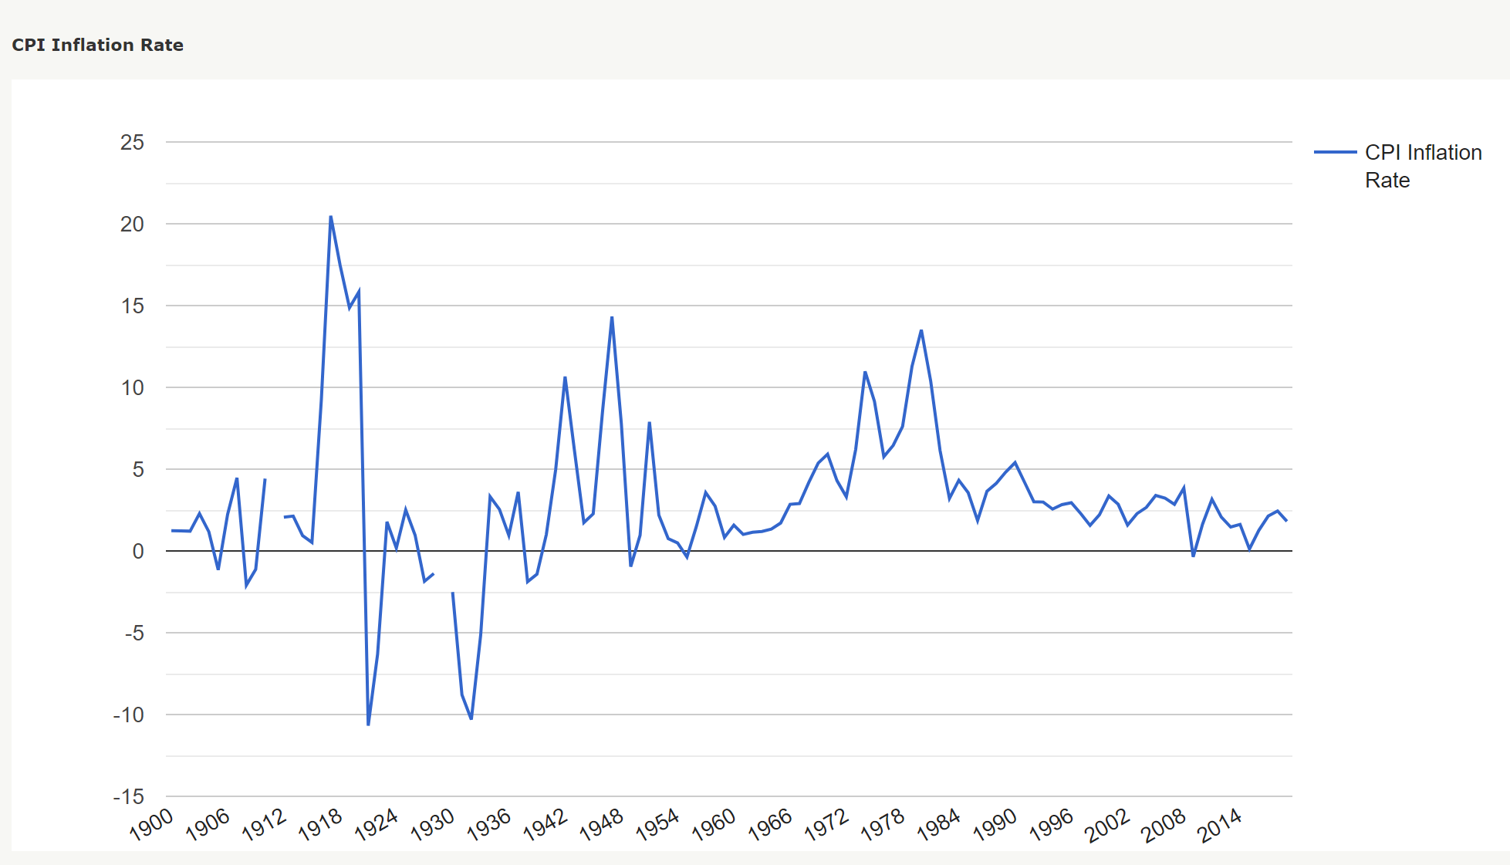
Inflation Rates from Price Levels (CPI)
Citation: "Graphing Various Historical Economic Series," MeasuringWorth, 2020.
URL: www.measuringworth.com/graphs

Slide 25
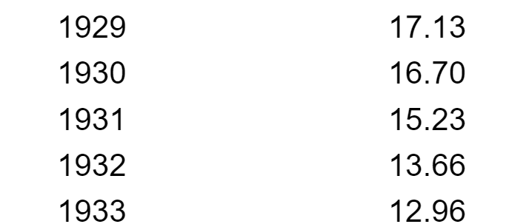
Inflation Rates from Price Levels (CPI)
Calculate
Citation: "Graphing Various Historical Economic Series," MeasuringWorth, 2020.
URL: www.measuringworth.com/graphs
Calculate Rate of In/Deflation by year or period
  Do the math
  Use a calculator
Calculate Rate of In/Deflation
[CPI(t)-CPI(t-1)]/CPI(t-1)*100, %

Slide 26
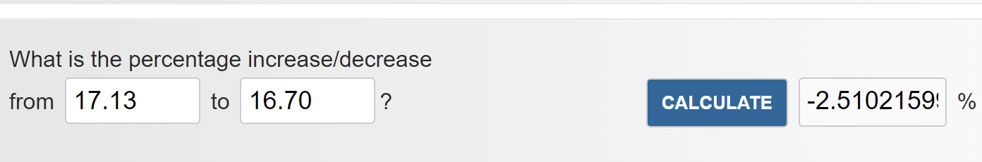
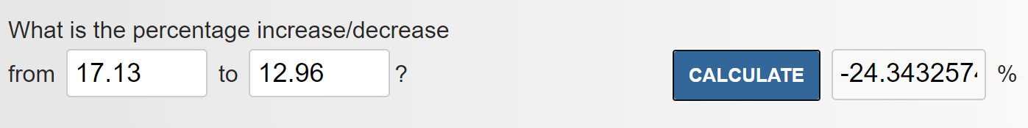
Inflation Rates from Price Levels (CPI)
Calculate
Calculate Rate of In/Deflation
[CPI(t)-CPI(t-1)]/CPI(t-1)*100, %
Calculate Rate of In/Deflation by year or period
  Do the math
  Use a calculator 1929-30
  Use a calculator 1929-33
Citation: "Graphing Various Historical Economic Series," MeasuringWorth, 2020.
URL: www.measuringworth.com/graphs

Slide 27
Price Levels
Period | GDP decline (peak to trough) | Unemployment | Consumer Price Level (CPI) | Stock Mkt
COVID 02/2020 –TBD
Great Recession 12/2007–06/2009 (1y/6m) | -05% | +10% | Moderate
Back-2-Back Recessions 01/1980–07/1980 (6m) and 07/1981–11/ 1982 (1y/4m) | -02% -03% | +08% +11% | Moderate
Stagflation 11/1973–03/1975 (1y/4m) | -03% | +09% | Inflation 1973 44CPI – 1975 55CPI
Postwar Economy 02/1945–10/1945 (8m) | -13% | +05% | Relatively constant
Great Depression 08/1929–03/1933 (3y/7m) | −27% | +21% | Deflation (Students insert calculations here.)

Slide 28
Price Levels
Period | GDP decline (peak to trough) | Unemployment | Consumer Price Level (CPI) | Stock Mkt
COVID 02/2020 –TBD
Great Recession 12/2007–06/2009 (1y/6m) | -05% | +10% | Moderate
Back-2-Back Recessions 01/1980–07/1980 (6m) and 07/1981–11/ 1982 (1y/4m) | -02% -03% | +08% +11% | Moderate
Stagflation 11/1973–03/1975 (1y/4m) | -03% | +09% | Inflation 1973 44CPI -1975 55CPI
Postwar Economy 02/1945–10/1945 (8m) | -13% | +05% | Relatively constant
Great Depression 08/1929–03/1933 (3y/7m) | −27% | +21% | Deflation
During a recession what happens to price levels depends on forces and causes.

Slide 29
Stock Markets
Period | GDP decline (peak to trough) | Unemployment | Consumer Price Level (CPI) | Stock Mkt
COVID 02/2020 –TBD
Great Recession 12/2007–06/2009 (1y/6m) | -05% | +10% | Moderate
Back-2-Back Recessions 01/1980–07/1980 (6m) and 07/1981–11/ 1982 (1y/4m) | -02% -03% | +08% +11% | Moderate
Stagflation 11/1973–03/1975 (1y/4m) | -03% | +09% | Inflation 1973 44CPI – 1975 55CPI
Postwar Economy 02/1945–10/1945 (8m) | -13% | +05% | Relatively constant
Great Depression 08/1929–03/1933 (3y/7m) | −27% | +21% | Deflation (Students insert calculations here.)

Slide 30
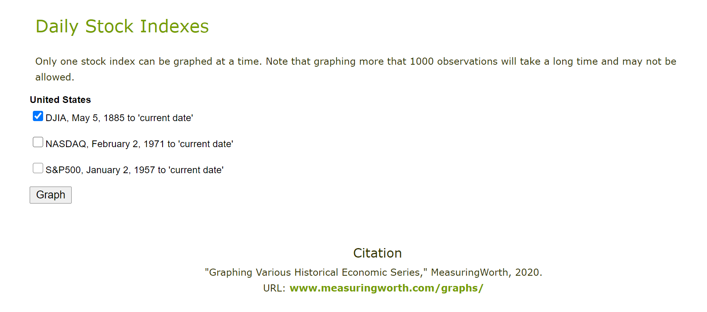
Things get involved.
Huge data sets
DJIA from 1885 on
NASDAQ 1971 on
S&P500, 1957 on

Slide 31
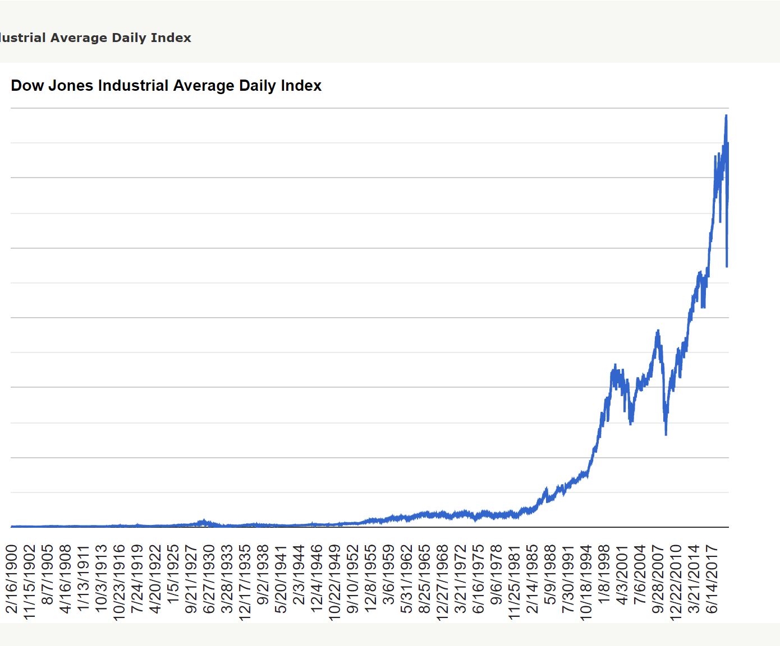
Stock Market

Slide 32
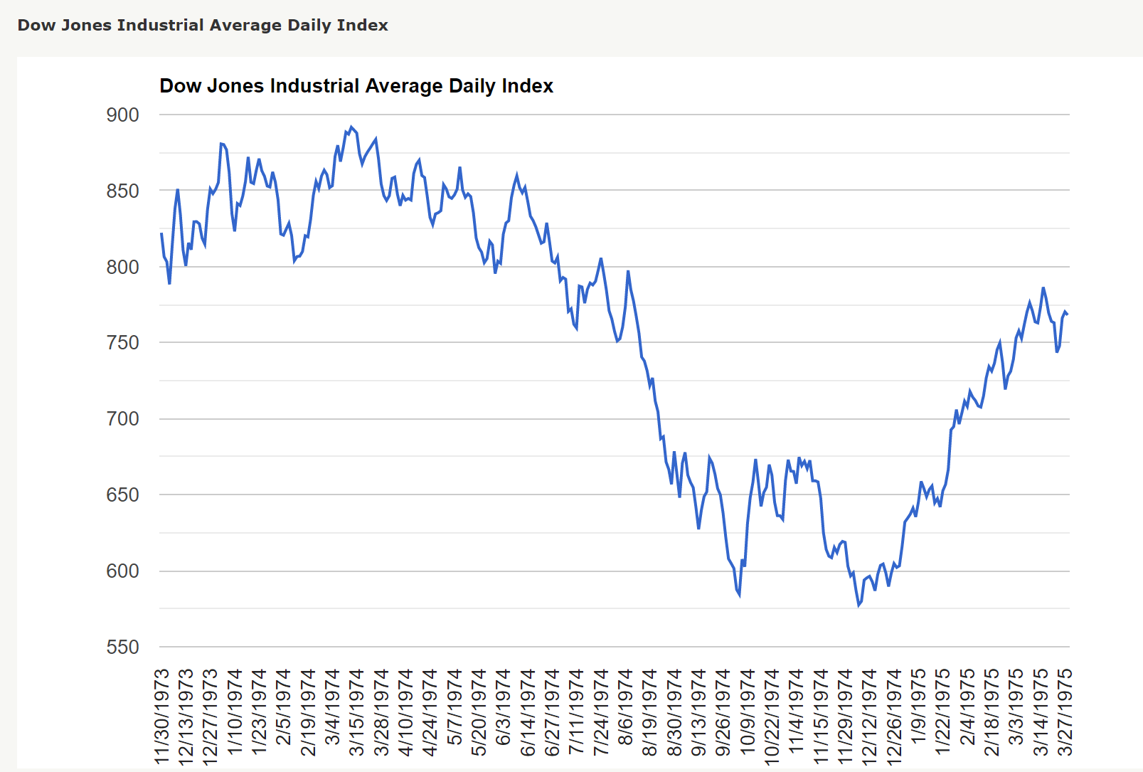
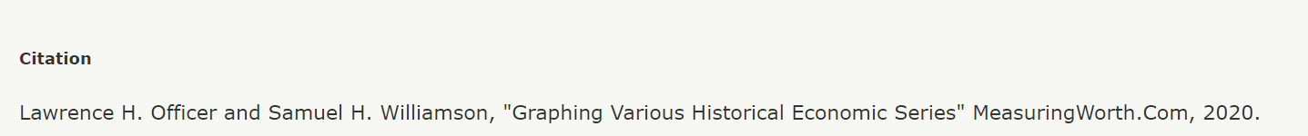
Visuals
Stagflation 11/1973-03/1975
Students fill in table for each period.

Slide 33
Depression?
Period | GDP decline (peak to trough) | Unemployment | Consumer Price Level (CPI) | Stock Mkt
COVID 02/2020 –TBD | TBD | TBD | TBD, holding their own to date | TBD, holding for well- diversified portfolios
Great Recession 12/2007–06/2009 (1y/6m) | -05% | +10% | Moderate | Plummeted but moved upward in a relatively short period
 |  |  | Inflation 1973 44CPI – 1975 55CPI
 |  |  | Relatively constant
Great Depression 08/1929–03/1933 (3y/7m) | −27% | +21% | Deflation (Students insert calculations here.) | Plummeted for extended period
What turns a recession into a depression?
Notes:
🍐 This is a Pear Deck Text Slide
🍐 To edit the type of question, go back to the "Ask Students a Question" in the Pear Deck sidebar.

Slide 34
Harry S. Truman
“It's a recession when your neighbor loses his job; it's a depression when you lose yours.”

Slide 35
Turning Outward
Moving from the classroom to the world beyond…
What does the NBER say? (Visit the website)
What do local business people say? (Host a video chat)
What do the regional experts report? (Link to a speech and ask to answer questions with short responses)

Slide 36
Business Cycle
Business cycles are recurrent expansions and contractions that are common to large parts of the economy. The National Bureau of Economic Research (NBER)—the private organization that is the de facto arbiter of U.S. business cycle dating—defines a recession as “a significant decline in economic activity spread across the economy, lasting more than a few months, normally visible in real GDP, real income, employment, industrial production, and wholesale-retail sales.”
Philadelphia FED

Slide 37
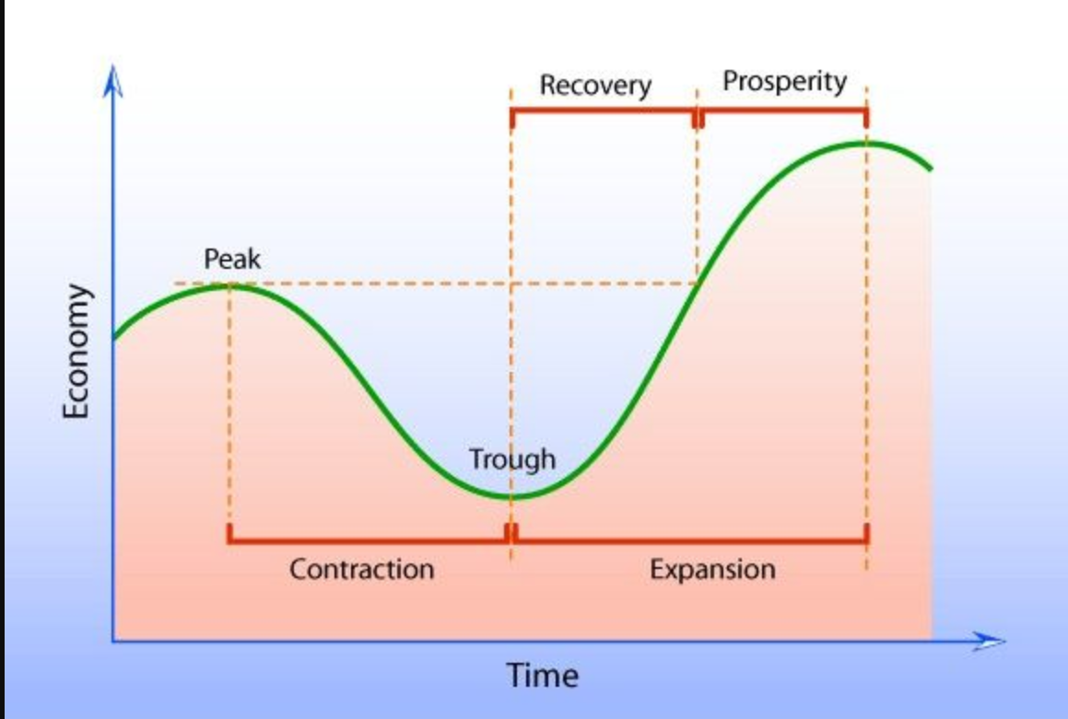
Business Cycle
Citation: https://www.pinterest.com/pin/570549846513119766/ (Seeking permission to use from Mindlever Education.)

Slide 38
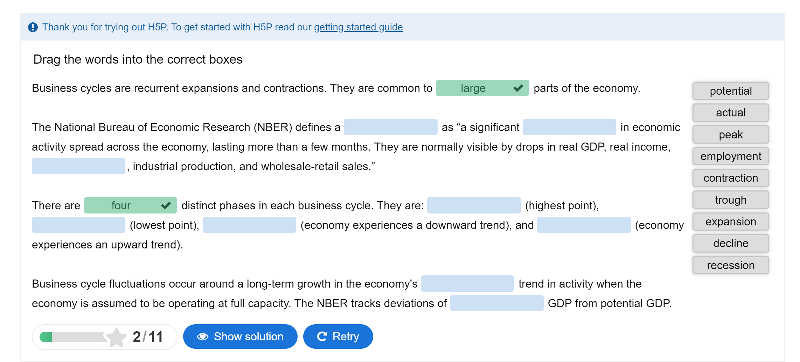

Summative Assessment
Citation: Ferrarini, Tawni. 2020. Economics of Business Cycles at https://h5p.org/node/951353
Notes:
🍐 This is a Pear Deck Web Slide.
🍐 To edit the type of question, go back to the "Ask Students a Question" in the Pear Deck sidebar.

Slide 39
U.S. Economy Today?
Real GDP
Real income
Employment
Industrial production
Wholesale-retail sales

Slide 40
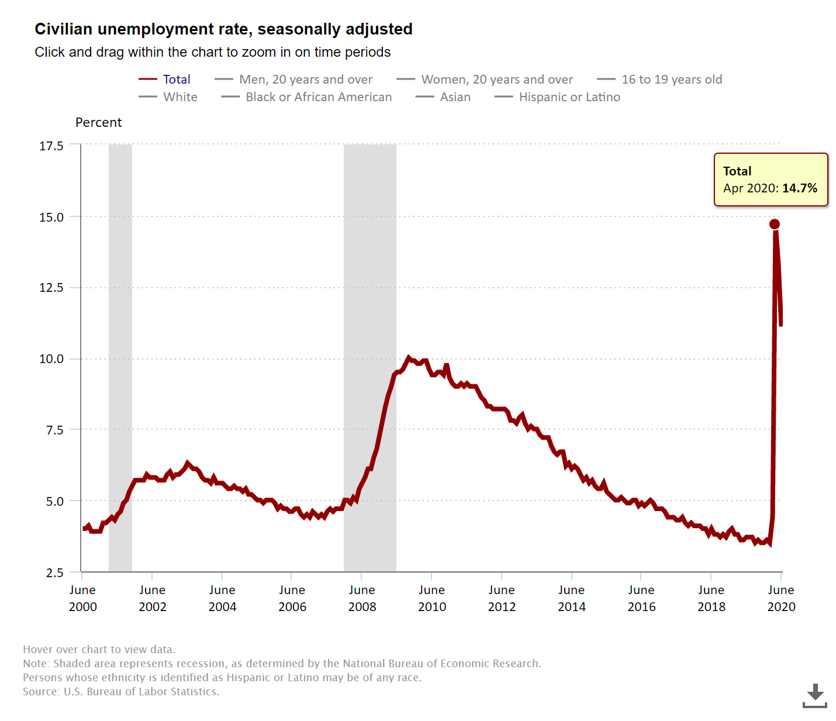
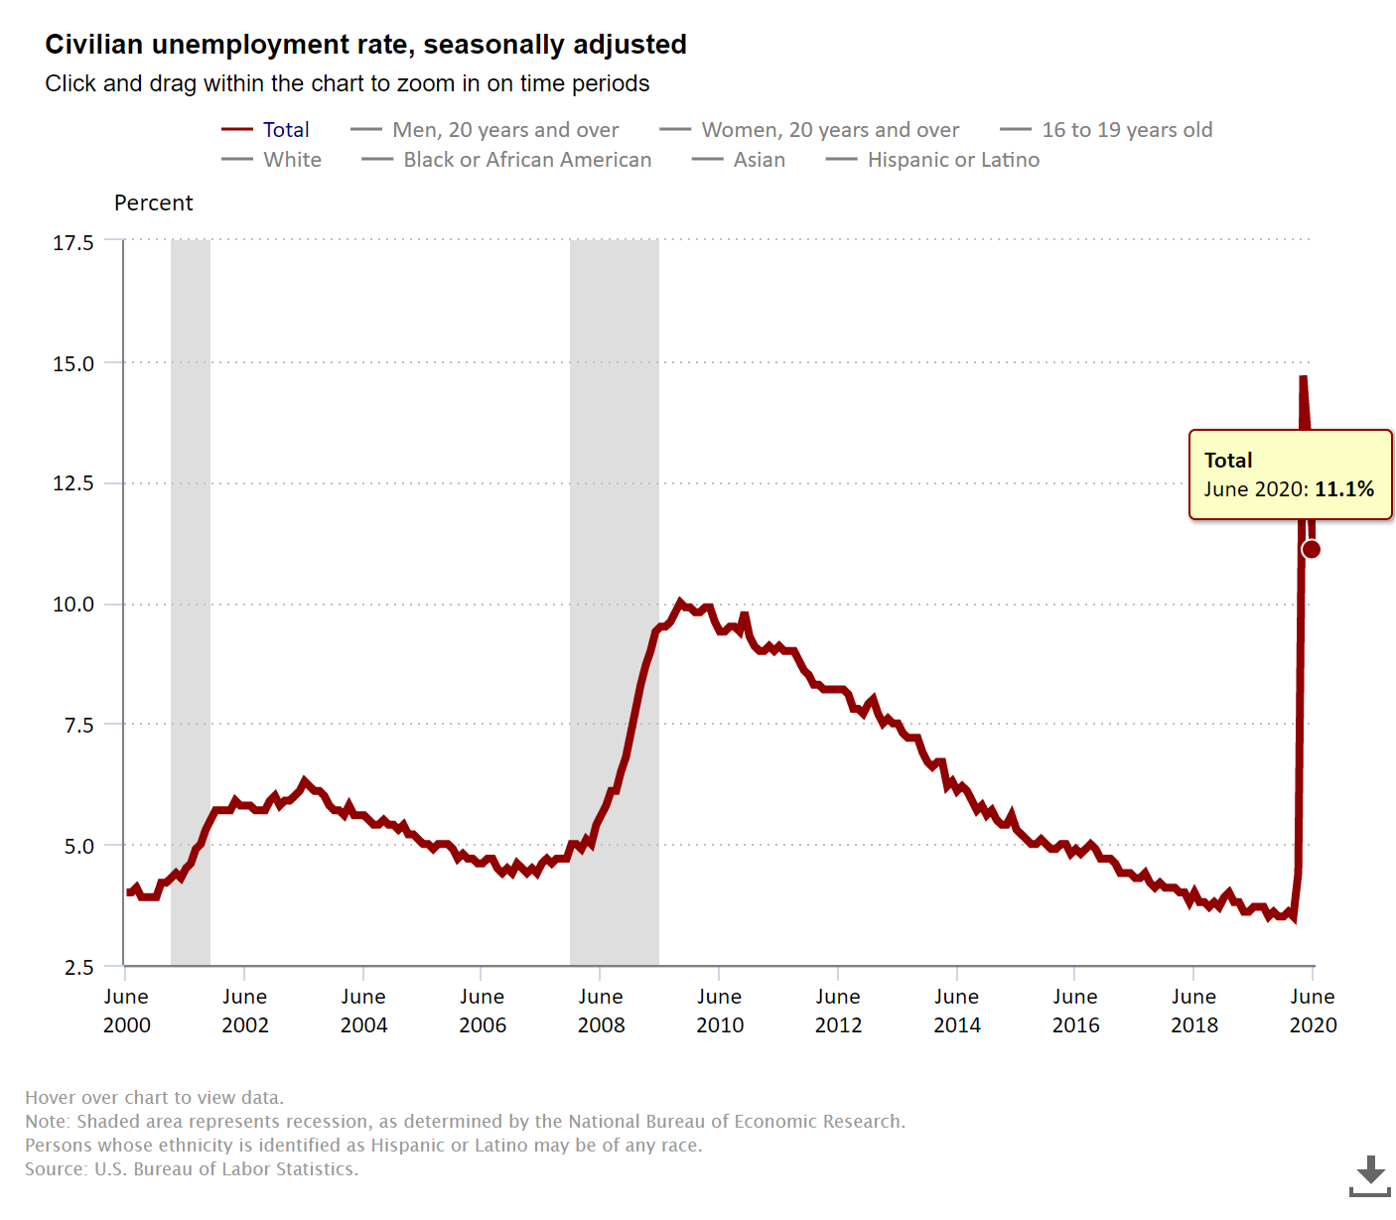
Concluding question
The recent drop in the rate of unemployment from 14.76% in April down to 11.1% in June. Can you explain using some of what was presented here?
Where would you place the U.S. economy on its business cycle?
Notes:
🍐 This is a Pear Deck Multiple Choice Slide. Your current options are: A: recession but expanding, B: recession and still contracting, C: other,
🍐 To edit the type of question or choices, go back to the "Ask Students a Question" in the Pear Deck sidebar.

Slide 41
Wrapping Up
Covered our objectives using the CFD as our homebase
Applied our good teaching practices and actively used data
Investigated four key U.S. recessions and the Great Depression
Distinguished GDP and NI and connect the two and folded in unemployment and inflation
Left the causes and consequences of policies to explain the uniqueness of each through competing macro theories

Slide 42
Once Over Lightly
Investigate NVECS 18: Economic Fluctuations
Explore the key interactions of spending and production decisions made by all households, firms, government agencies, and others in the economy
Interpret reports about current economic conditions with attention draw to unemployment and inflation
Explain how changes in unemployment, inflation, and the health of the U.S. economy can influence decisions made by consumers, producers, and government policy makers

Slide 43
CONCLUSIONS
Production and income are connected and can serve as proxies for each other.
The macroeconomy is dynamic and change is ubiquitous.
Connecting students lives to its changes helps better prepare them to live in the world outside of the classroom.

Slide 44
References
Audio The Business Cycle - The Economic Lowdown Podcast Series, Episode 18 (08:48)
Interactives (Virtual classroom activities, preparatory interactives, or follow-up reinforcements) Economics of the Business Cycle H5P Interactive ** EconEdLink Resources Business Cycle Video and Quiz ** EconEdLink AP Macro An Introduction to Business Cycles and Macroeconomic Indicators
Learning Activity Suggestions Case Study – Compare and Contrast Great Recession and Great Depression ** Calculate Unemployment in the Classroom** Short Essay Assignment Summarizing the Controversies on What Causes Booms and Busts
Videos Intro to Business Fluctuations @ Marginal Revolution University (02:58) ** The Business Cycle @ Kahn Academy (11:15)
Visuals and Data BLS.gov (Current data) ** FRED St. Louis, FED (Current data) ** MeasuringWorth.com (Historical data)

Slide 45


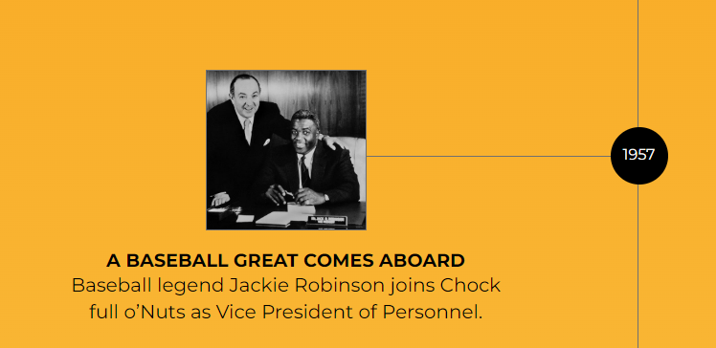
Bring your entrepreneur to our next EEAH webinar… Don’t have one???
Choose Jackie Robinson!
Our 1st Black VP in Corporate U.S.A.

Slide 46


Register for a book here while we take questions and answers.

Slide 47
References
Buck, J. (2020, April 14). Jackie Robinson and Jack Buck | KMOX - Podcast. YouTube. Retrieved February 3, 2022, from https://www.youtube.com/watch?v=ibmOfEQs1qY.
Gwartney, J., & Haworth, C. (1974). Employer Costs and Discrimination: The Case of Baseball. Journal of Political Economy, 82(4), 873–881. http://www.jstor.org/stable/1837153.
Schug, M. C., Wood, W. C., Ferrarini, T. H., & Niederjohn, M. S. (2019). Economic episodes in American history. Wohl Publishing.

Slide 48




Thank You to Our Sponsors!

