Slide 1
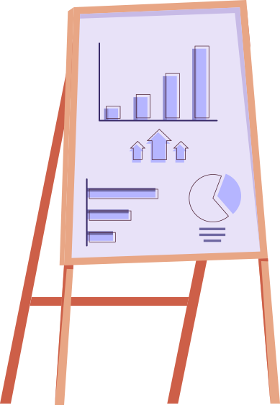
Econ Boot Camp
Macro Topics
Monetary Policy, Fiscal Policy, Exchange Rates, Trade
2.23.22

Slide 2
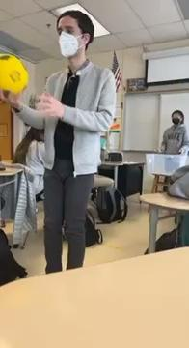
Hello!
@AlexMLamon
lamonteach@gmail.com
Lead Teacher of Business Education in Livingston, NJ
Council for Economic Education Master Teacher
AP Reader for AP Macroeconomics
Notes:
Introduction and tell me who you teach
Review game strat

Slide 3
EconEdLink Membership
You can now access CEE’s professional development webinars directly on EconEdLink.org! To receive these new professional development benefits, become an EconEdLink member. As a member, you will now be able to:
Automatically receive a professional development certificate via e-mail within 24 hours after viewing any webinar for a minimum of 45 minutes
Register for upcoming webinars with a simple one-click process
Easily download presentations, lesson plan materials and activities for each webinar
Search and view all webinars at your convenience
Save webinars to your EconEdLink dashboard for easy access to the event
You may access our new Professional Development page here

Slide 4
Today’ Topics
Fiscal Policy
1
Monetary Policy
2
International Trade
3
Taxation and spending
Federal Reserve’s tool chest
Trade and exchange rates

Slide 5
We’re Back to Normal!
Kinda maybe?

Slide 6
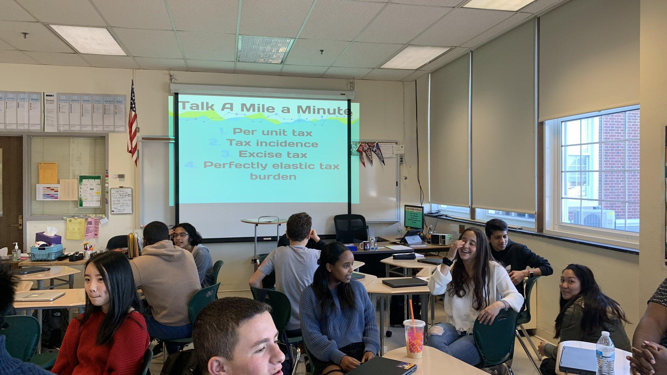
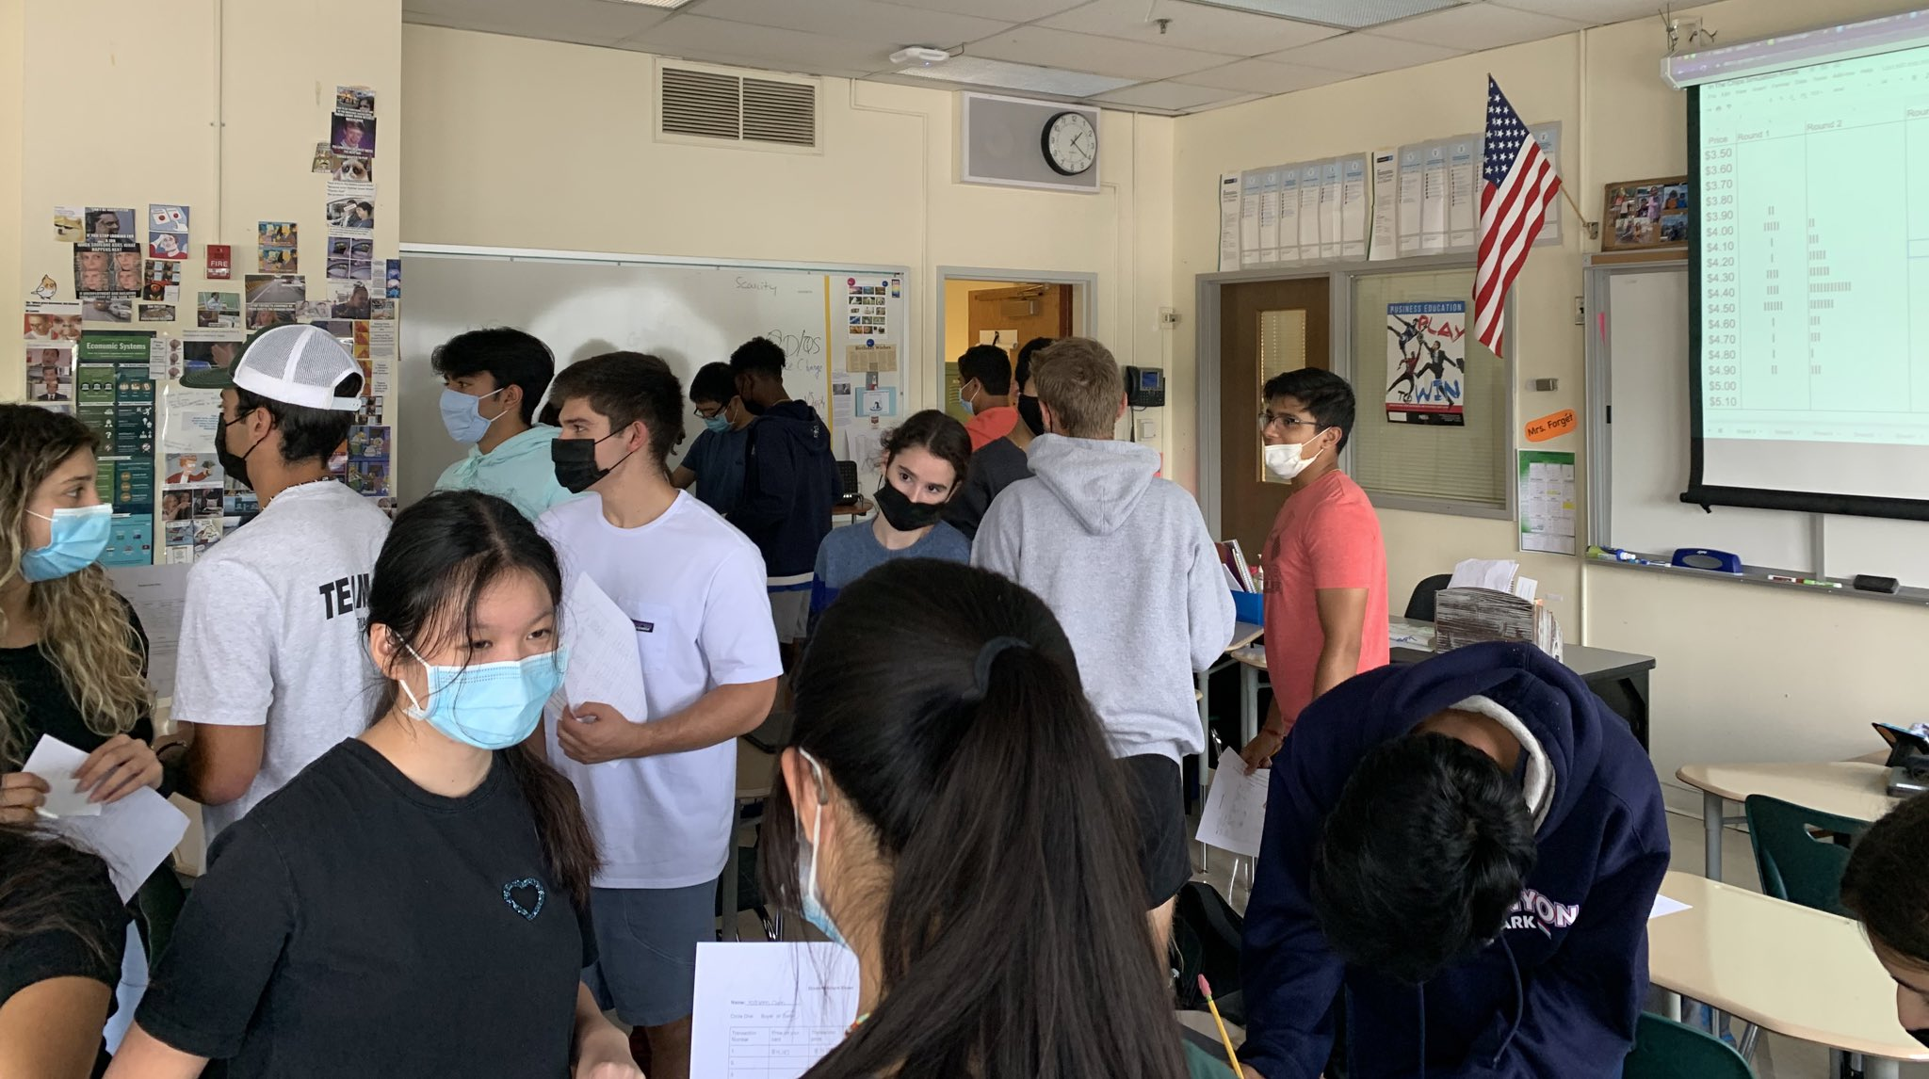
October 2019
October 2021
October 2020
Notes:
What’s a positive/success you’re having in a current situation and one stressor?

Slide 7
Maximizing Your Utility
TOOLBOX SESSION
2.5 hours is a lot
Take what you like, what will work best in your context for your students, and leave the rest
Participate as much as you need, however you need.
Notes:
Overview of my class strategies, fiscal policy, monetary policy and international, with breaks and open space for questions after each content session. Participate frequently whenever!

Slide 8
Typical Class Setup
01
02
03
04
Video Content
Practice & Simulations
AP Level Tests
Reassessments
Students watch my video on the module before class
Most class time is student centered
Including exam corrections
To focus on student’s mastery
Notes:
Show examples of playlist and practice problems here
More of these strategies have lead to higher passing rate, increasing enrollments, positive student behaviors

Slide 9
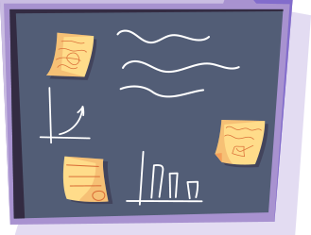
1
Fiscal Policy
1: What are students struggling with?
2: What are your needs when it comes to teaching fiscal policy?
3: Do you have anything to share to help teachers teach fiscal policy?
Notes:
Answer one question in the chat.

Slide 10
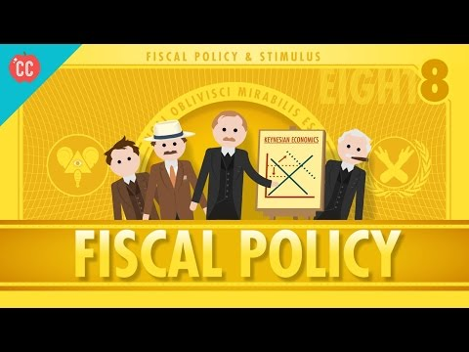
Resource Starter: Crash Course
Notes:
Forex
Paper trade game

Slide 11
Econ Quiz Time!
Notes:
Student misconceptions: relationship b/t taxing/spending and the greater economy and the difference b/t discretionary fiscal policy and non, aka automatic stablizers

Slide 12
Brush Up on Content:
CEE Fiscal Policy Webinar
Today’s focus is teaching strategies but content is critical, too.

Slide 13
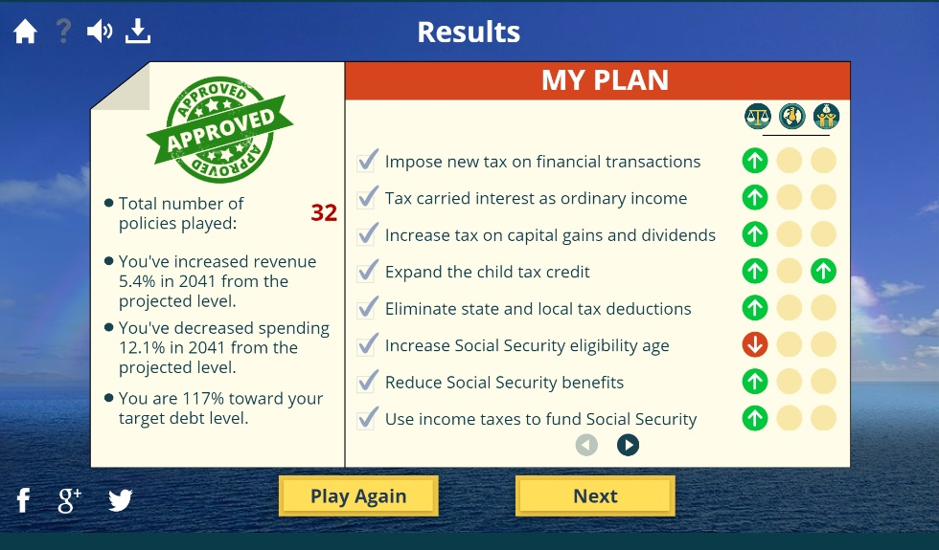
Play The Fiscal Ship
Play the Game
CEE Supporting Lesson Plan
Students manage debt while working to make good on governing priorities

Slide 14
Exploring The Budget
Interactive for students to explore, inquire, and learn

Slide 15
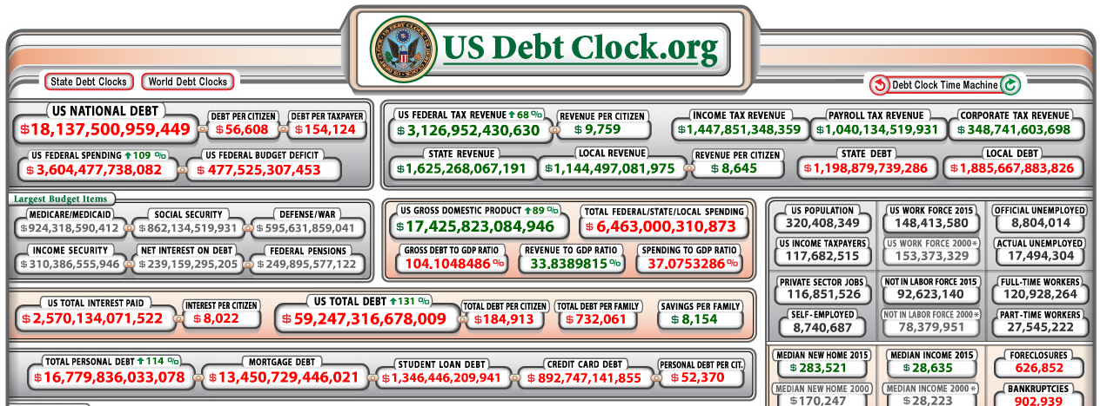
US Debt Clock
This interactive is scary but true - teaching it with context is important!
Notes:
Debt as a necessary evil?

Slide 16
Review Circles
Even numbers
(Inside circle)
Odd numbers
(Outside circle)
CEE Assessment Questions

Slide 17
Bonus: Bailouts
How do we allocate funds in a crisis event?
CEE Lesson Plan

Slide 18
^_^
BREAK/Open Space!
Take 5 minutes
Walk away from your computer OR
Explore some resources, ask me questions, let’s talk econ!
My teaching pacing: Spending multiplier, AD & AS Model, Fiscal Policy, Deficits & Debt

Slide 19
2
Monetary Policy
1: What are students struggling with?
2: What are your needs when it comes to teaching monetary policy?
3: Do you have anything to share to help teachers teach monetary policy?
Notes:
Answer one question in the chat.
Monetary Policy
Brain break (money)
Fractional reserve banking simulation
FOMC simulation

Slide 20
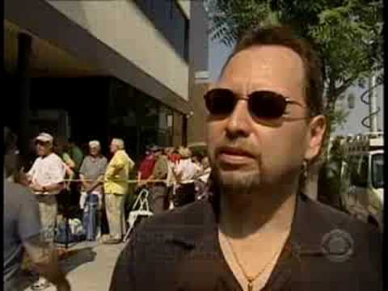
Bank Runs
Notes:
Is my money safe? Good intro to banking, FDIC

Slide 21
Econ Quiz Time!
Notes:
Student misconceptions: how the purchase and sale of bonds by the fed influence the money supply

Slide 22
Brush Up on Content:
CEE Monetary Policy Webinar
Today’s focus is teaching strategies but content is critical, too.

Slide 23
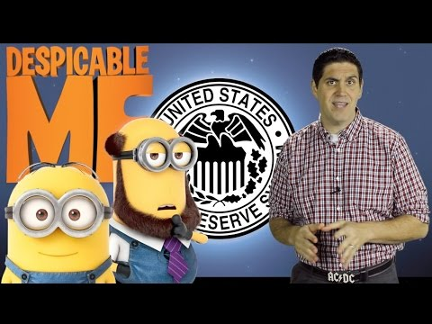
Old & New Tools of the Fed
Fed Video Series
Econ Movies Series
Once your students stop thinking of “the fed” as some police force, things get easy.
Or, maybe there’s an analogy here?
Notes:
Include quant easing as a current event

Slide 24
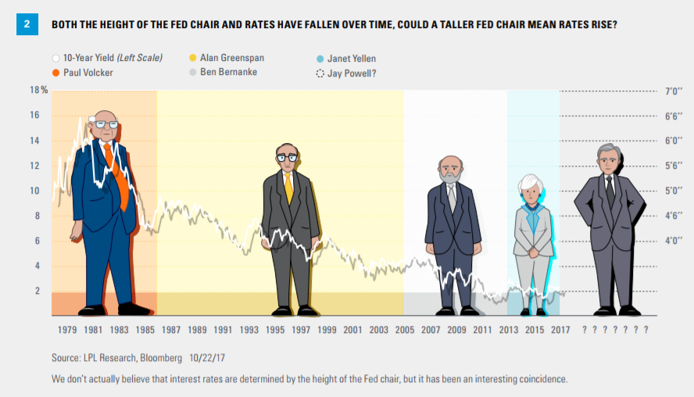

Slide 25
Fractional Reserve Banking Sim
Overview
Some students serve as bankers, most as borrowers
Balance Sheets: Banker, Borrower
Students keep record here during the simulation
Loan Certificates & Reflection
Bankers write on these for records
Reflection keeps learning objectives at the forefront

Slide 26
Macro is all about relationships
Cause & Effect Cheat Sheet

Slide 27
FOMC Simulation
Slides
An overview of the simulation for you and the students
Dallas Fed Lesson Plan
Full lesson plan and materials
Beige Book
For student research, always search the most recent edition

Slide 28
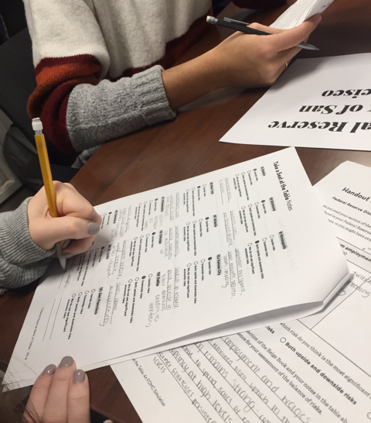
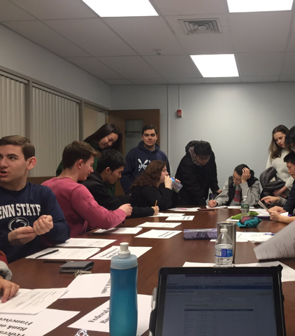

Slide 29
^_^
BREAK/Open Space!
Take 5 minutes
Walk away from your computer OR
Explore some resources, ask me questions, let’s talk econ!
My teaching pacing: Banks & Money Creation, The Fed, Monetary Policy, Money Market, Loanable Funds

Slide 30
3
International Trade
1: What are students struggling with?
2: What are your needs when it comes to teaching international trade?
3: Do you have anything to share to help teachers teach international trade?
Notes:
Answer one question in the chat.
Monetary Policy
Brain break (money)
Fractional reserve banking simulation
FOMC simulation

Slide 31
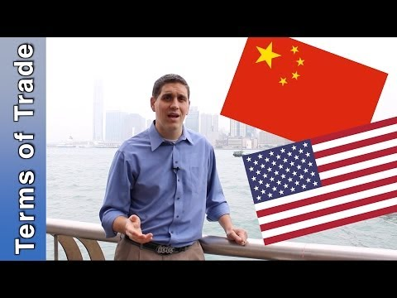
Hong Kong Trade

Slide 32
Econ Quiz Time!
Notes:
Student misconceptions: appreciation vs depreciation, terms of trade, supply and demand graphs of two countries currencies

Slide 33
Brush Up on Content:
CEE Trade Webinar &
CEE Forex Webinar
BONUS: Practice for students so they can brush up,too.

Slide 34
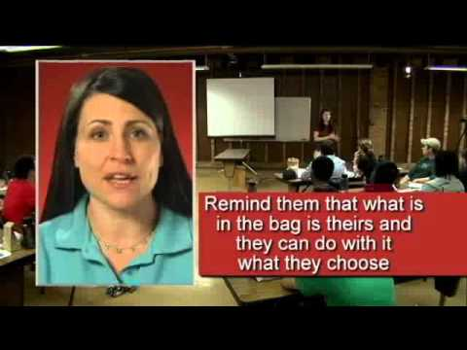
Brown Bag Trading Simulation
CEE Video Overview
See a teacher overview then demo the lesson
Lesson plan
Pros & Cons of Free Trade
There are several variations
Is free trade always good?

Slide 35
International Interactives
Where do we import tea from? How about horse hair?
International trade on the high seas

Slide 36
International Trade Simulation
Lesson Plan
Students produce & sell paper shapes with a different amount of resources in their country
Instructions: Teacher, Student
For your records and to display to the class
Shape Guide & Reflection
Bankers write on these for records
Reflection keeps learning objectives at the forefront

Slide 37
Balance of Payments
Current Account Balance
Global trade trends via the CA
Is our CA deficit a problem?
Interactive - compare our net exports globally

Slide 38
^_^
International questions?
My teaching pacing: Trade, Balance of Payments, Forex Market, Exchange Rates

Slide 39
Thanks!
@AlexMLamon
lamonteach@gmail.com
Get these slides right now:
bit.ly/350aKtG

