Slide 1
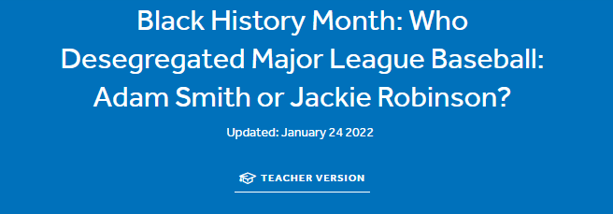
Tawni Hunt Ferrarini, PhD
Scott Niederjohn, PhD
Presenters
08 Feb 2022
TFerrarini@lindenwood.edu
Scott.Niederjohn@cuw.edu

Slide 2
EconEdLink Membership
You can now access CEE’s professional development webinars directly on EconEdLink.org! Receive numerous professional development benefits as an EconEdLink member. At no money cost:
Receive a professional development certificate via e-mail within 24 hours after participating in a webinar for 45 minutes or more;
Register for upcoming webinars with a simple one-click process;
Download presentations, lesson plan materials, and activities for each webinar;
Search and view full library of on-demand and upcoming webinars;
Save webinars to your EconEdLink dashboard for easy access to the event
Access the new Professional Development page at econedlink.org.

Slide 3
Professional Development Certificate
Watch and participate for 45-minutes, and earn a professional development certificate for this webinar.
Receive a professional development certificate via email within 24 hours.
Download webinar presentations, lesson plan materials, and activities at: EconEdLink.org/professional-development/.

Slide 4
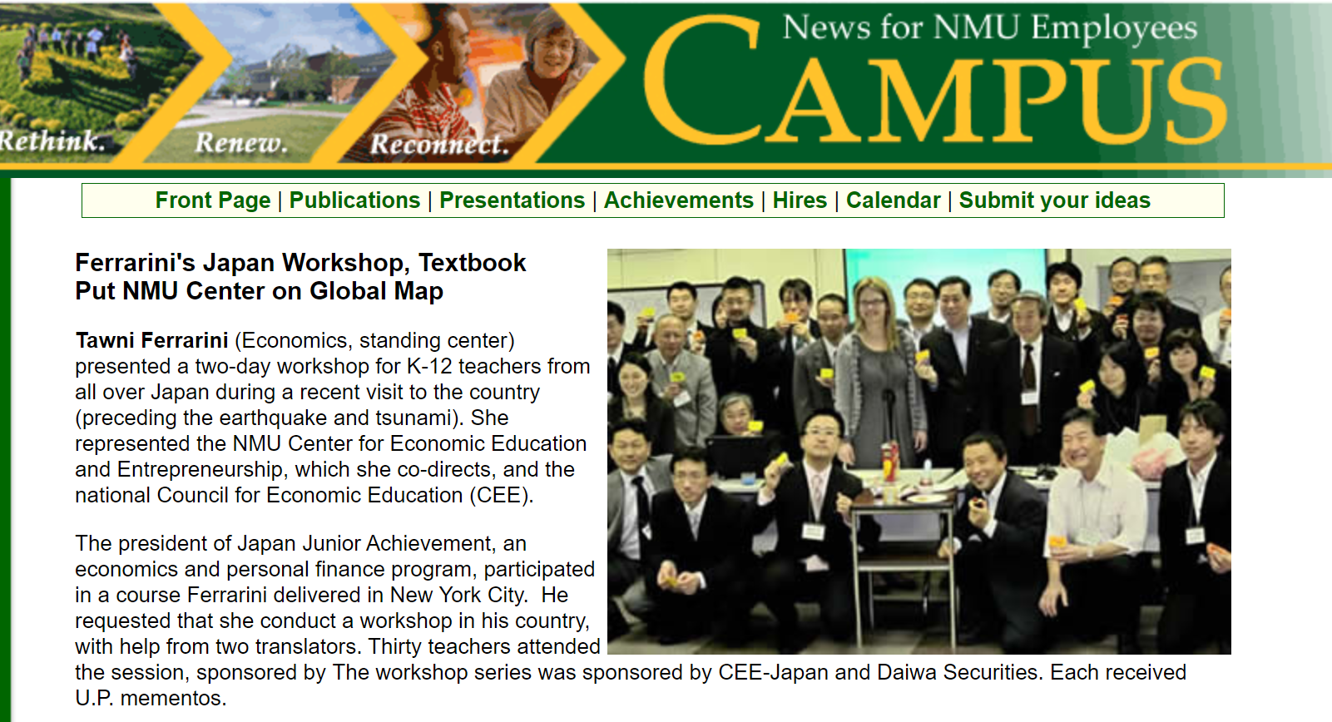

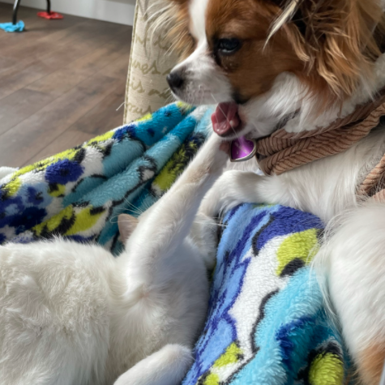
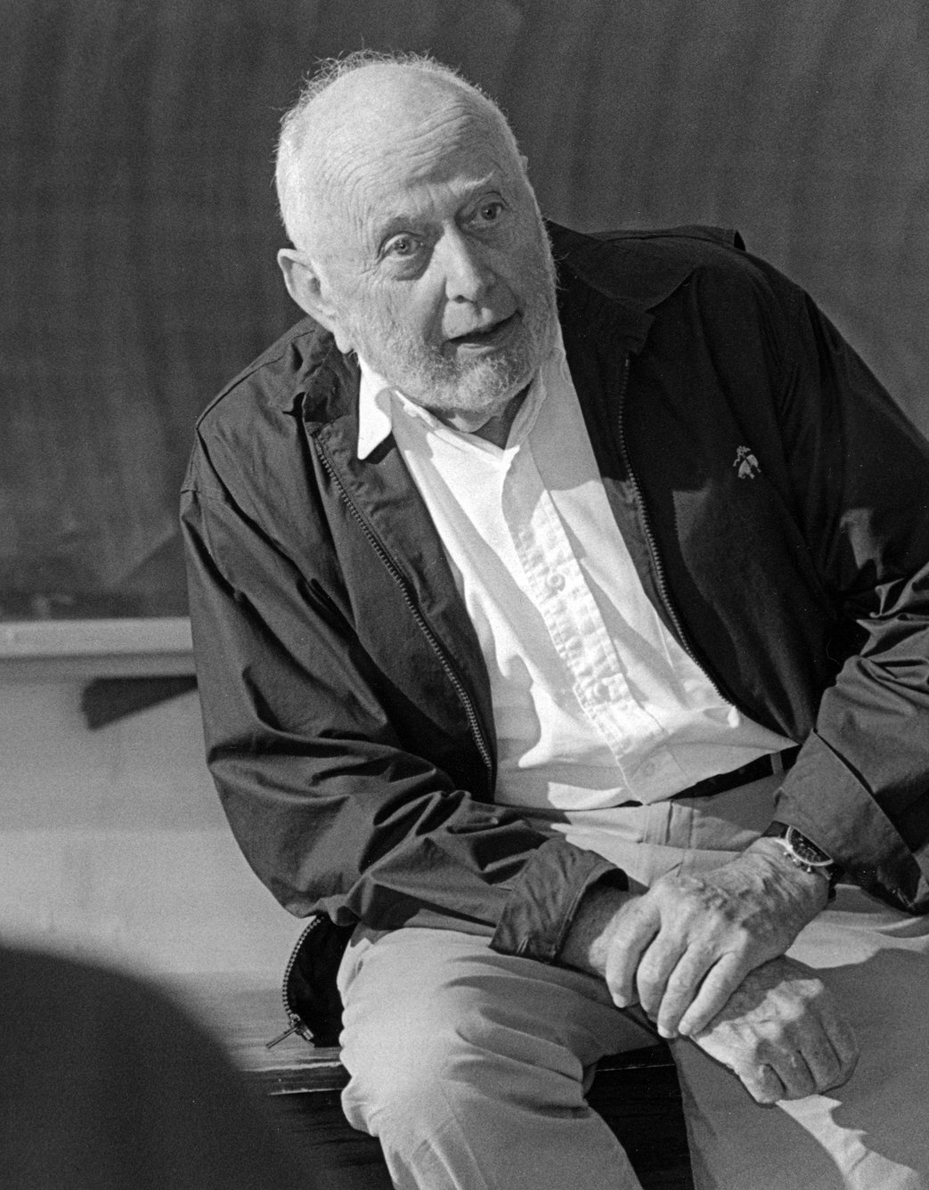
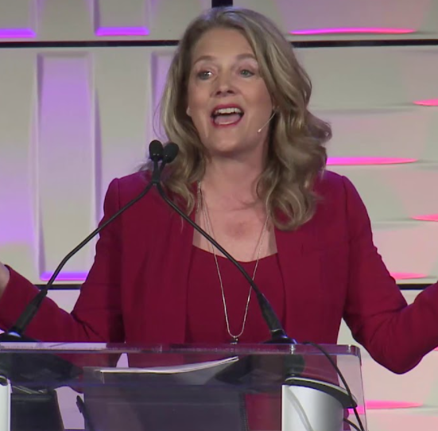
Tawni’s story…
Robert W. Plaster Professor of Economic Education and
Senior Economist at the Hammond Institute, Plaster College of Business and Entrepreneurship at Lindenwood University
First generation college student whose family farm did NOT survive the back-to-back recession of the 80s
PhD in economics with a BA in mathematics. My dissertation was chaired by Douglass C. North, Nobel Laureate in Economics, 1993
Love to travel around the world with Australia, not Antarctica, being my last continent to visit
My son, daughter-in-law, and furry family are my pride and joy.

Slide 5


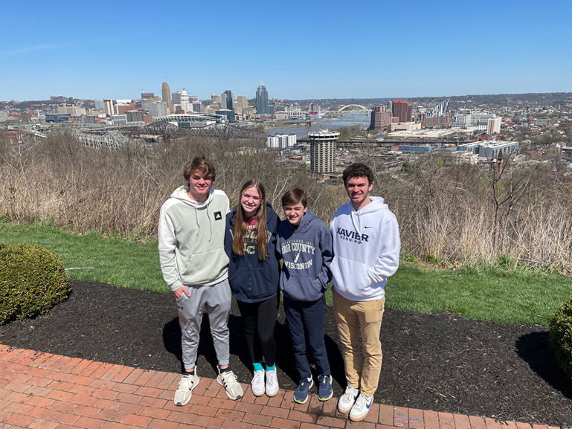
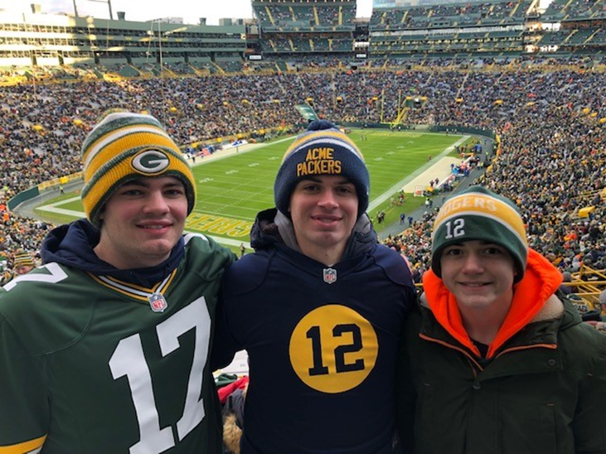

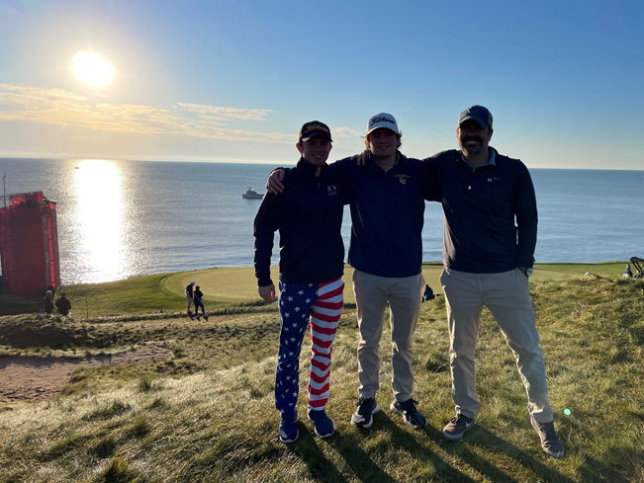

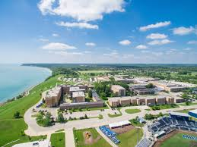

Slide 6
Tawni Hunt Ferrarini, Professor of Economics Education
Lindenwood University * tawni.ferrarini@gmail.com* Tawni.org
In this economics webinar, apply the tools of economists and other social scientists to
Demonstrate how profits and open markets motivate people to move toward no discrimination in baseball.
Show how markets encourage buyers and sellers to interact harmoniously and cooperatively.
Explain how entrepreneurs take on the calculated risk of starting new businesses, either by embarking on new ventures similar to existing ones or by introducing new innovations.
Learn strategies on entrepreneurial innovation is an important source of economic growth, especially in those markets once closed by discrimination.

Slide 7

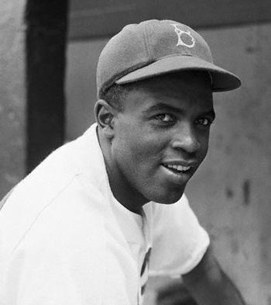
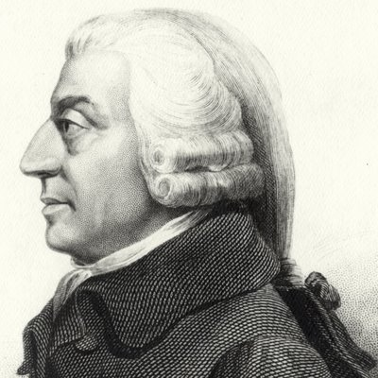

WHO INTEGRATED MAJOR LEAGUE BASEBALL: JACKIE ROBINSON OR ADAM SMITH?
Share your thoughts!
An Introduction to Chapter 25
Notes:
🍐 This is a Pear Deck Text Slide
🍐 To edit the type of question, go back to the "Ask Students a Question" in the Pear Deck sidebar.

Slide 8
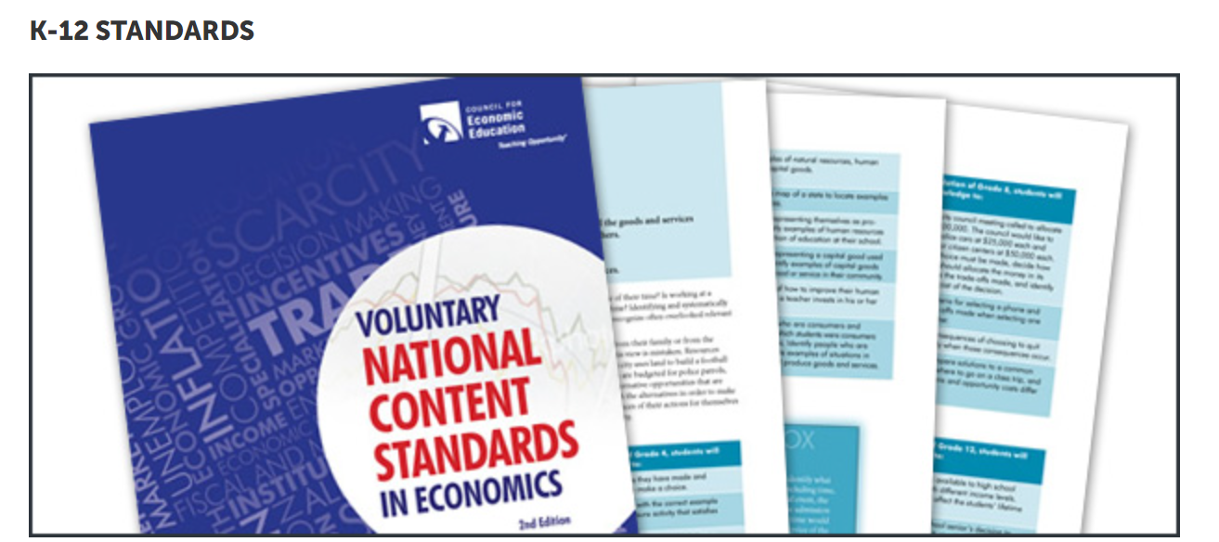
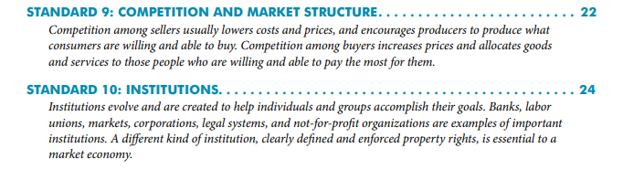
Notes:
🍐 This is a Pear Deck Web Slide.
🍐 To edit the type of question, go back to the "Ask Students a Question" in the Pear Deck sidebar.

Slide 9
Example of a
DEI Statement
“Cultivate a state of equitable engagement and promote a culture of unity while helping to ensure the recruitment and retention of diverse faculty, staff, and students within the SOE.”
College of Education and Human Services. (n.d.). School of Education diversity ... - Lindenwood University. Diversity, Equity, and Inclusion Committee. Retrieved February 3, 2022, from https://www.lindenwood.edu/files/resources/soe-dei-brochure.pdf

Slide 10
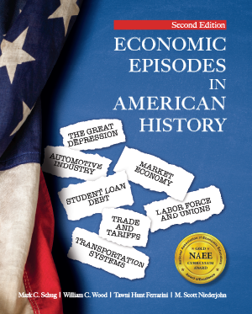
OVERVIEW
Racial discrimination in the 1940s and 1950s
What insights might economics and its 6 Core Principles provide to explain the integration of Major League Baseball?
  Choices
  Costs
  Incentives
  Rules of the game – competition
  Voluntary trade creates wealth
  Unintended consequences
Conclusions
References
Questions and Answers
Thanks and Sign up for an EEAH BOOK, yes, your own copy!
Chapter 25: http://www.wohlpublishing.com/economicepisodes/
Notes:
🍐 This is a Pear Deck Web Slide.
🍐 To edit the type of question, go back to the "Ask Students a Question" in the Pear Deck sidebar.

Slide 11
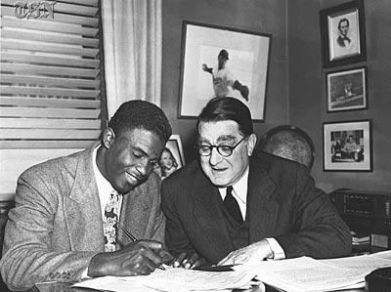
JACKIE ROBINSON AND BASEBALL
Branch Rickey, President of the Brooklyn Dodgers, signed Jackie Robinson in 1946 to be the first African American player in the major leagues.
It took courage to make the offer and to sign the contract.
Racial segregation in 1946 was widespread.
There was no DEI policy.

Slide 12
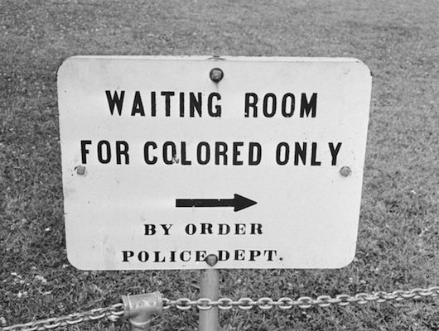
RACIAL DISCRIMINATION
Jim Crow laws were enacted by several state and local governments as a way to segregate African Americans from whites.
Institutions formally and informally influence behavior and affect choices.

Slide 13
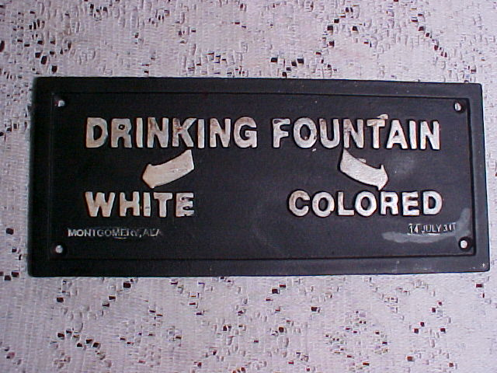
RACIAL DISCRIMINATION
In the South, nearly every aspect of life was separate including public schools, buses, railroad passenger cars, restrooms, swimming pools, pool halls, and restaurants.

Slide 14
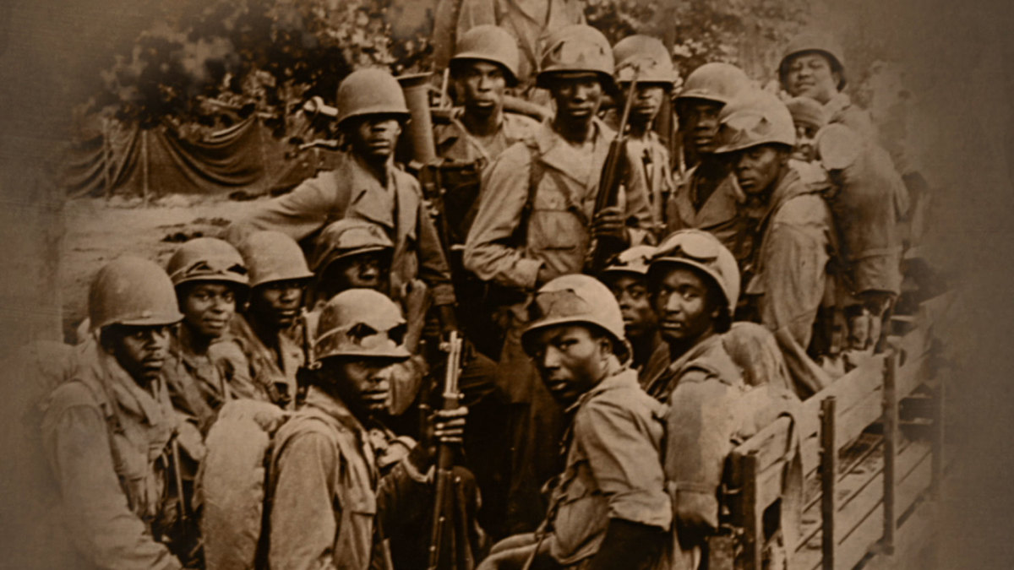
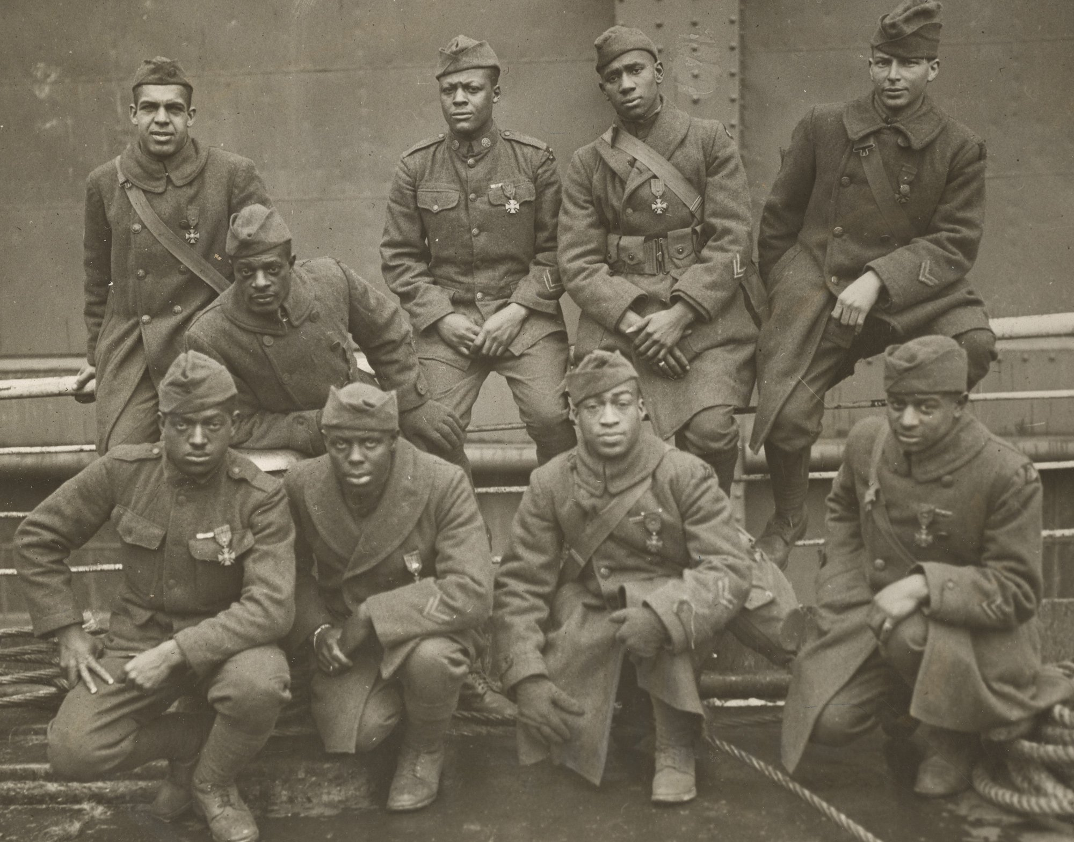
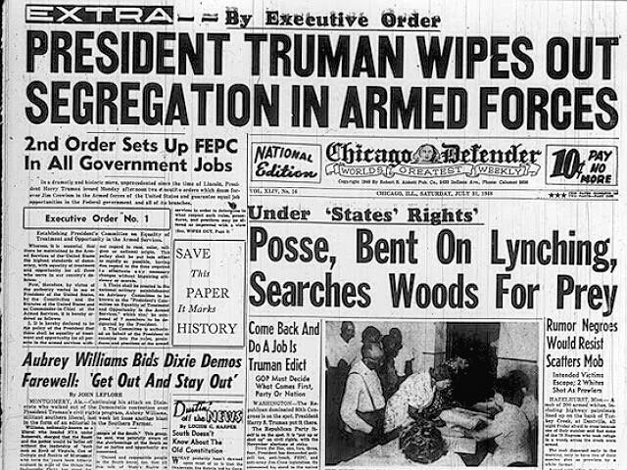
RACIAL DISCRIMINATION
The U.S. armed forces and several federal agencies were segregated.
In the 1920s, an African American man could not enlist in the U.S. Navy.
The Library of Congress provides more images and information.
Notes:
🍐 This is a Pear Deck Web Slide.
🍐 To edit the type of question, go back to the "Ask Students a Question" in the Pear Deck sidebar.

Slide 15
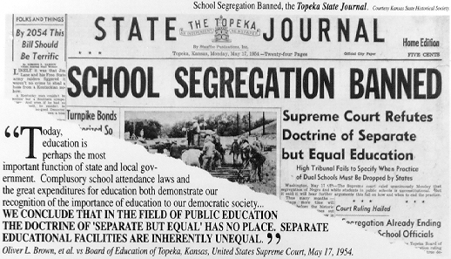
SUPREME COURT 1954
In 1954, the U.S. Supreme Court declared state-sponsored school segregation to be unconstitutional.
See Brown v. Board of Education (1954).

Slide 16
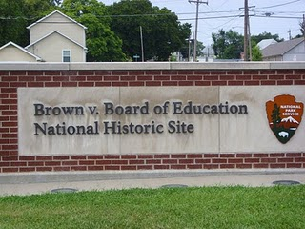
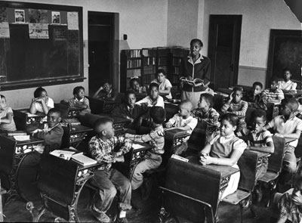
BUT, LITTLE CHANGED RIGHT AWAY
It would take years and additional court decisions and legislation before schools and other institutions would take actions regarding desegregation.

Slide 17
WHY SOME AND NOT OTHERS?
Yet, some markets abandoned racial segregation well before more court decisions and the passage of the Civil Rights Act of 1964 and the Voting Rights Act of 1965.
Why might some markets – like Major League Baseball – move more quickly toward racial integration than others?

Slide 18
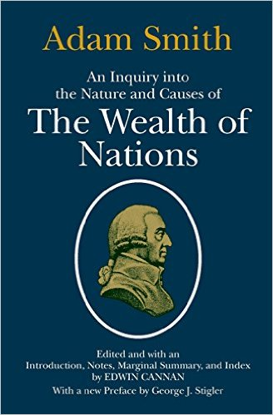
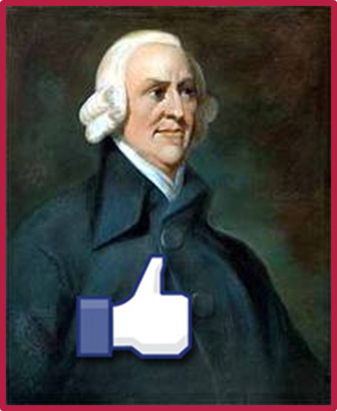
JACKIE ROBINSON OR ADAM SMITH?
Did Adam Smith’s invisible hand contribute to the desegregation of major league baseball?
Invisible hand: People acting in their own self-interest promotes positive social outcomes even when it is not intentional.

Slide 19
PEOPLE CHOOSE
MLB club owners – Branch Rickey in particular – decided to sign African American players.
Jackie Robinson agreed.
Both regarded the choice as the best combination of benefits and costs they could attain.

Slide 20
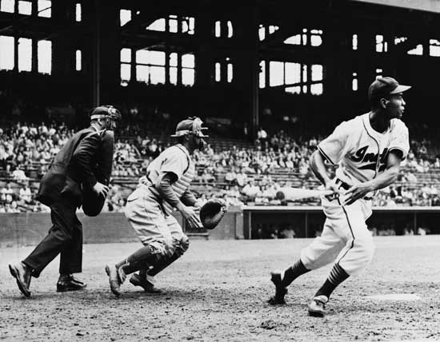
PEOPLE’S CHOICES INVOLVE COSTS
Questions of cost loomed large:
What are some costs for all parties involved?
Before 1947, club owners worried that white fans would stay away if they signed African American players.
They worried that white players would refuse to play with African American players – boycotts, fights, strikes, or worse.
They worried that revenues would decline.
Notes:
🍐 This is a Pear Deck Text Slide
🍐 To edit the type of question, go back to the "Ask Students a Question" in the Pear Deck sidebar.

Slide 21
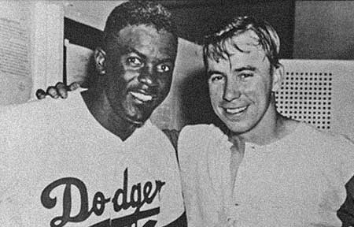
PEOPLE’S CHOICES INVOLVE COSTS
Robinson endured bean balls, racial epithets, spitting, and spikings.
In 1946, Pee Wee Reese, from Kentucky, refused to sign a petition by players to boycott playing with a black player.
Reese told the boycott leaders: “I’m not signing that. No way!”

Slide 22
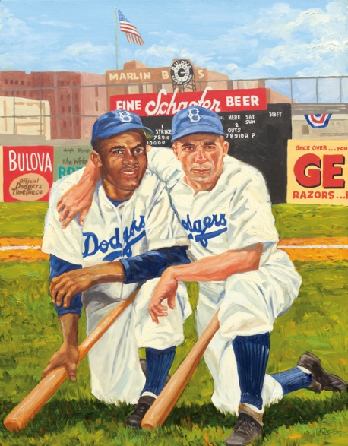
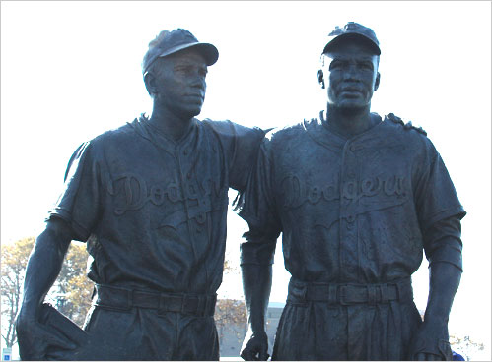

PEOPLE’S CHOICES INVOLVE COSTS
During the first 1947 road trip to Cincinnati, the crowd heckled Robinson during pre-game practice.
Pee Wee Reese, short stop and team captain, placed his arm around Robinson.
His actions, not words, silenced the crowd.
Hear Jackie talk about the unintentional power of Reese’s peaceful action. (1min)
Notes:
🍐 This is a Pear Deck Web Slide.
🍐 To edit the type of question, go back to the "Ask Students a Question" in the Pear Deck sidebar.

Slide 23
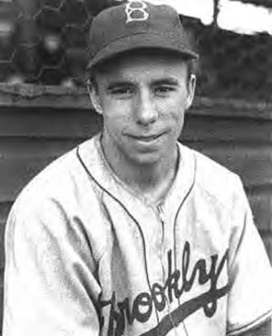
PEOPLE’S CHOICES INVOLVE COSTS
Reese played down his display of courage. The NY Times quoted Reese as saying:
“I just wanted to play baseball.
I’d just come back from serving in the South Pacific with the Navy in World War II.
I had a wife and daughter to support.
I needed the money. I just wanted to get on with it.”

Slide 24
“Boys, I hear some of you don’t want to play with Robinson. Some you have drawn up a petition. Well you know what you can use that petition for….I’m the manager of this ball club, and I’m interested in one thing: winning. . . . This fellow is a real great ballplayer. He’s going to win pennants for us. He’s going to put money in your pockets and money in mine. And here’s something else to think about when you put your head back on the pillow. From everything I hear, he’s only the first. Only the first, boys! There’s many more coming right behind him and they have the talent and they’re gonna come to play. . . . Unless you fellows look out and wake up, they’re going to run you right out of the ballpark.”
--Brooklyn Dodgers’ Manager Leo Durocher

Slide 25
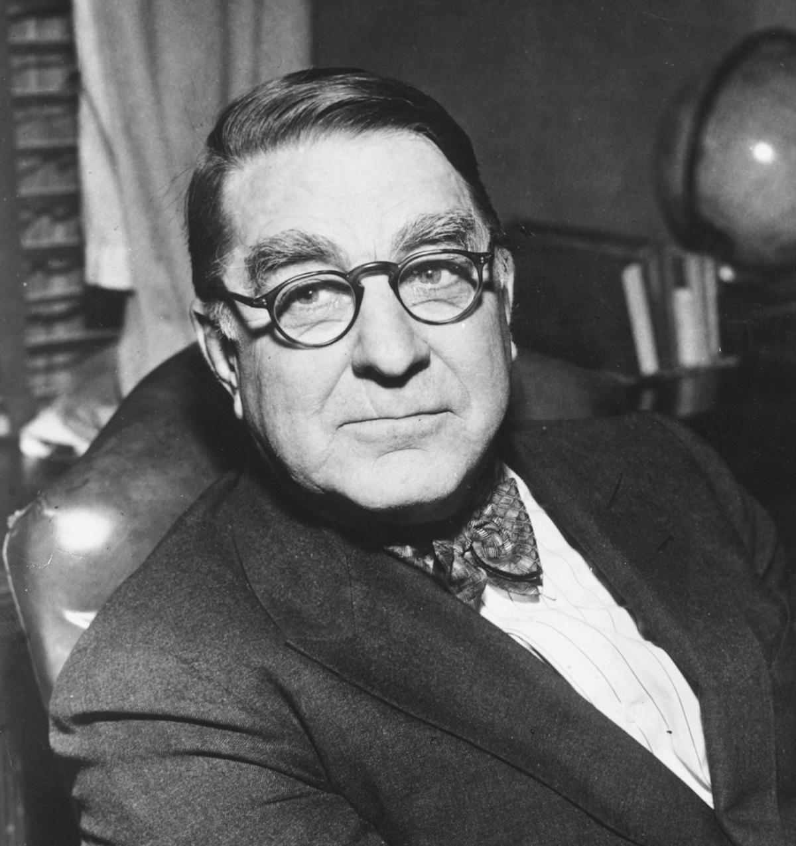
PEOPLE RESPOND TO INCENTIVES
What are incentives to owners of MLB clubs to integrate?
Earning profits
Winning and all that goes with it
Notes:
🍐 This is a Pear Deck Text Slide
🍐 To edit the type of question, go back to the "Ask Students a Question" in the Pear Deck sidebar.

Slide 26
PEOPLE RESPOND TO INCENTIVES
“Every dollar is green.”

Slide 27
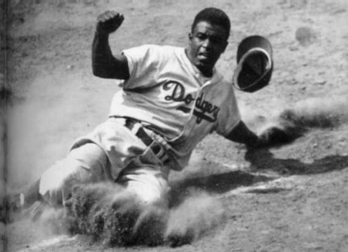
PEOPLE RESPOND TO INCENTIVES
What are incentives to MLB players?
Earning better salaries
Winning and all that goes with it
“Every dollar is green…”

Slide 28
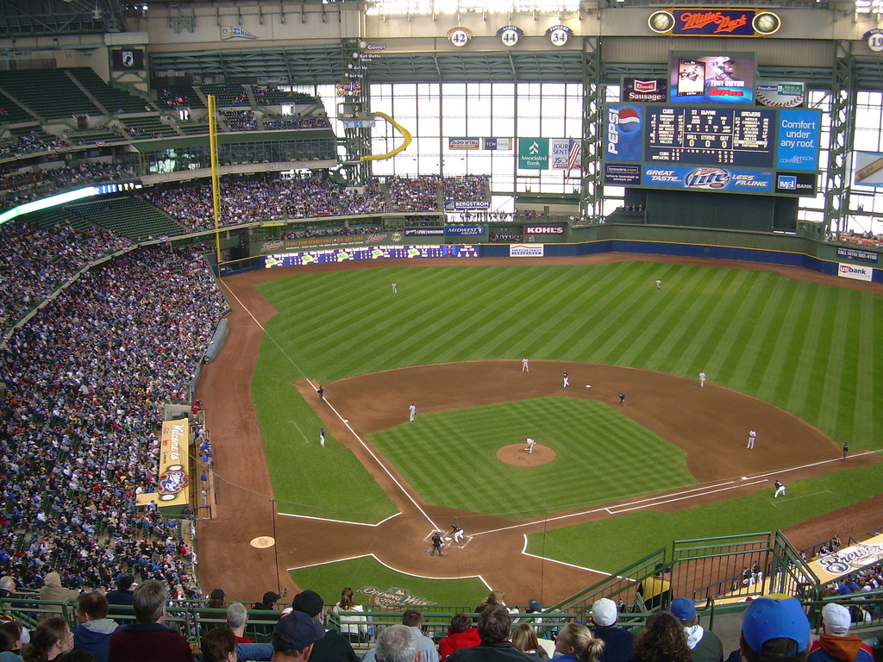
WELCOME TO OUR BASEBALL DRAFT
Bringing this activity into your classroom.

Slide 29
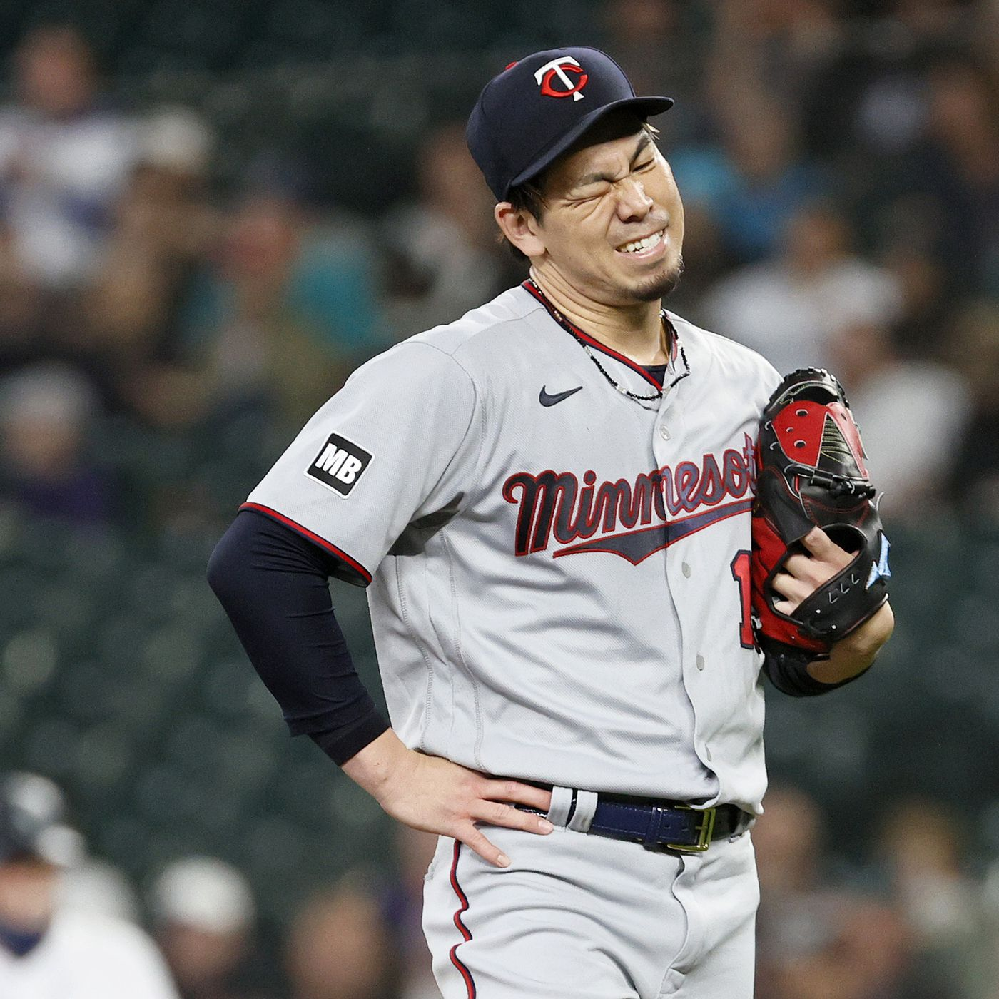
WELCOME TO OUR BASEBALL DRAFT
Student #1 Right Field Bats .120 40 time: 9.1 sec
Share your thoughts about FAN APPEAL?
Notes:
🍐 This is a Pear Deck Draggable™ Slide.
🍐 To edit the type of question, go back to the "Ask Students a Question" in the Pear Deck sidebar.

Slide 30

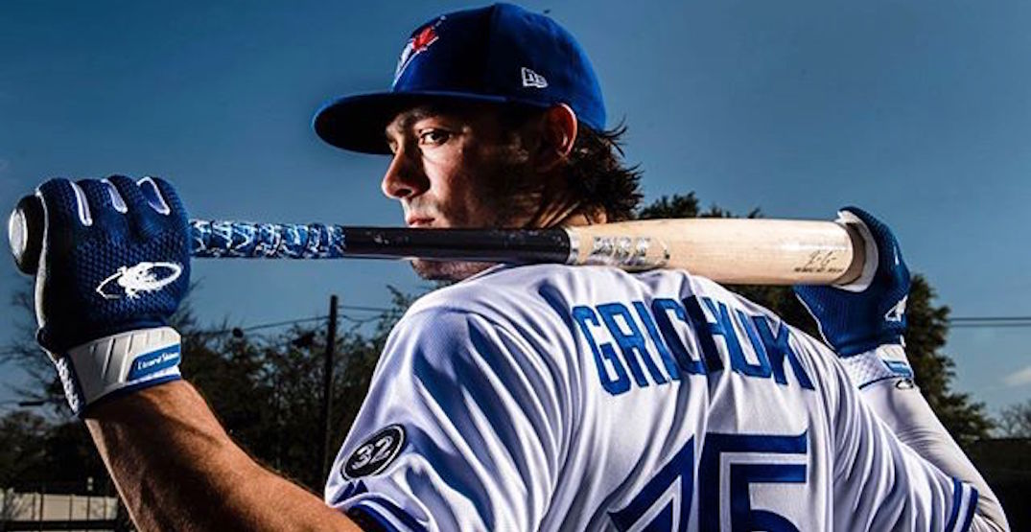
WELCOME TO OUR BASEBALL DRAFT
Student #1 Right Field Bats .120 40 time: 9.1 FAN APPEAL? | Student #2 Center Field Bats .180 40 time: 7.0 sec FAN APPEAL?

Slide 31
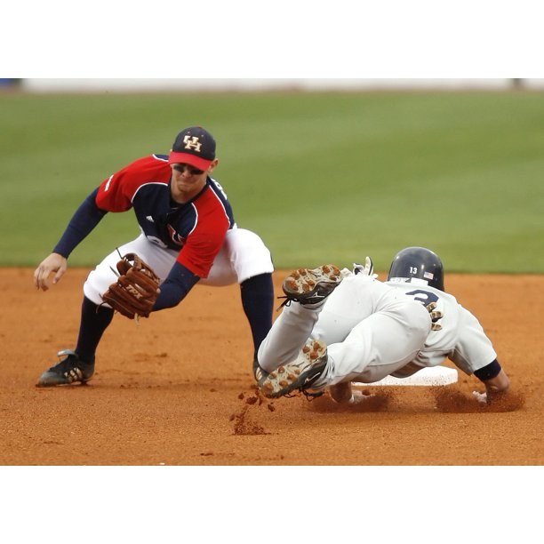
WELCOME TO OUR BASEBALL DRAFT
Student #1 Right Field Bats .120 40 time: 9.1 FAN APPEAL? | Student #2 Center Field Bats .180 40 time: 7.0 sec FAN APPEAL? | Student #3 Short Stop Bats .355 40 time: 4.5 sec FAN APPEAL?

Slide 32
WELCOME TO OUR BASEBALL DRAFT
Student #1 Right Field Bats .120 40 time: 9.1 FAN APPEAL? | Student #2 Center Field Bats .180 40 time: 7.0 sec FAN APPEAL? | Student #3 Short Stop Bats .355 40 time: 4.5 sec FAN APPEAL?
Notes:
🍐 This is a Pear Deck Draggable™ Slide.
🍐 To edit the type of question, go back to the "Ask Students a Question" in the Pear Deck sidebar.

Slide 33
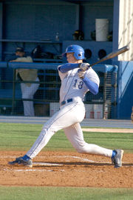
WHICH PLAYER WOULD YOU DRAFT?
The most productive player!
Promises to bring paying fans in a competitive market…

Slide 34
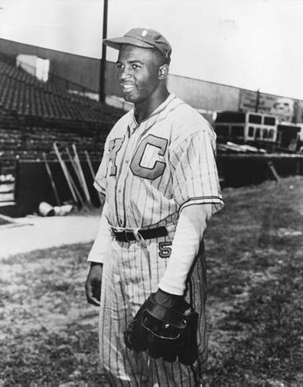
INCENTIVES MATTER
You are a owner of a major league baseball team.
You know great athletic talent is nearby and could help you win.
You know that talent wants to work for you and is eager as you are to win.
Some other club owners wanted to hire the best players regardless of race but…
They had an agreement to only sign white players.

Slide 35
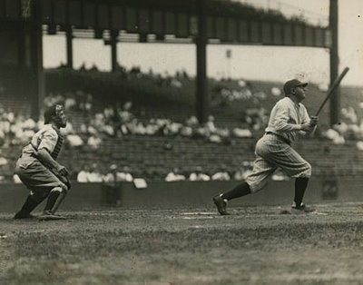
PEOPLE CREATE ECONOMIC SYSTEMS:
THE RULES OF THE GAME
Baseball clubs are exempt from federal anti-trust laws.
This was the result of a 1922 Supreme Court ruling in the case of the Federal Baseball Club of Baltimore, Inc. v. National League of Professional Baseball Clubs.

Slide 36
PEOPLE CREATE ECONOMIC SYSTEMS: THE RULES OF THE GAME
Despite the fact that major league baseball clubs operated a legal cartel, the rules of the game encouraged competition.
Competition erodes the ability of a cartel to enforce the agreements among its members.

Slide 37
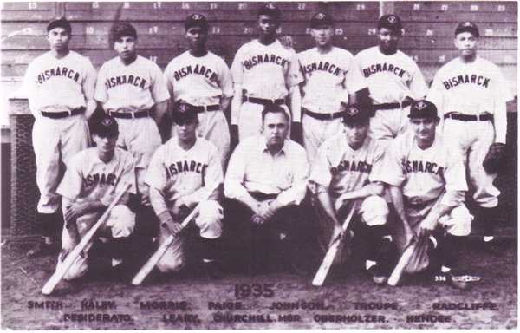
COMPETITION FROM THE SEMI-PROS
Satchel Paige
Semi-professional ball was very popular in the days before television.
The pressure to win was great.
Some of these teams experimented with signing African American players.
In 1935, the Bismarck ND team fielded a half white and half African American team.
Who was dominant pitcher of the Bismarcks in 1935?

Slide 38
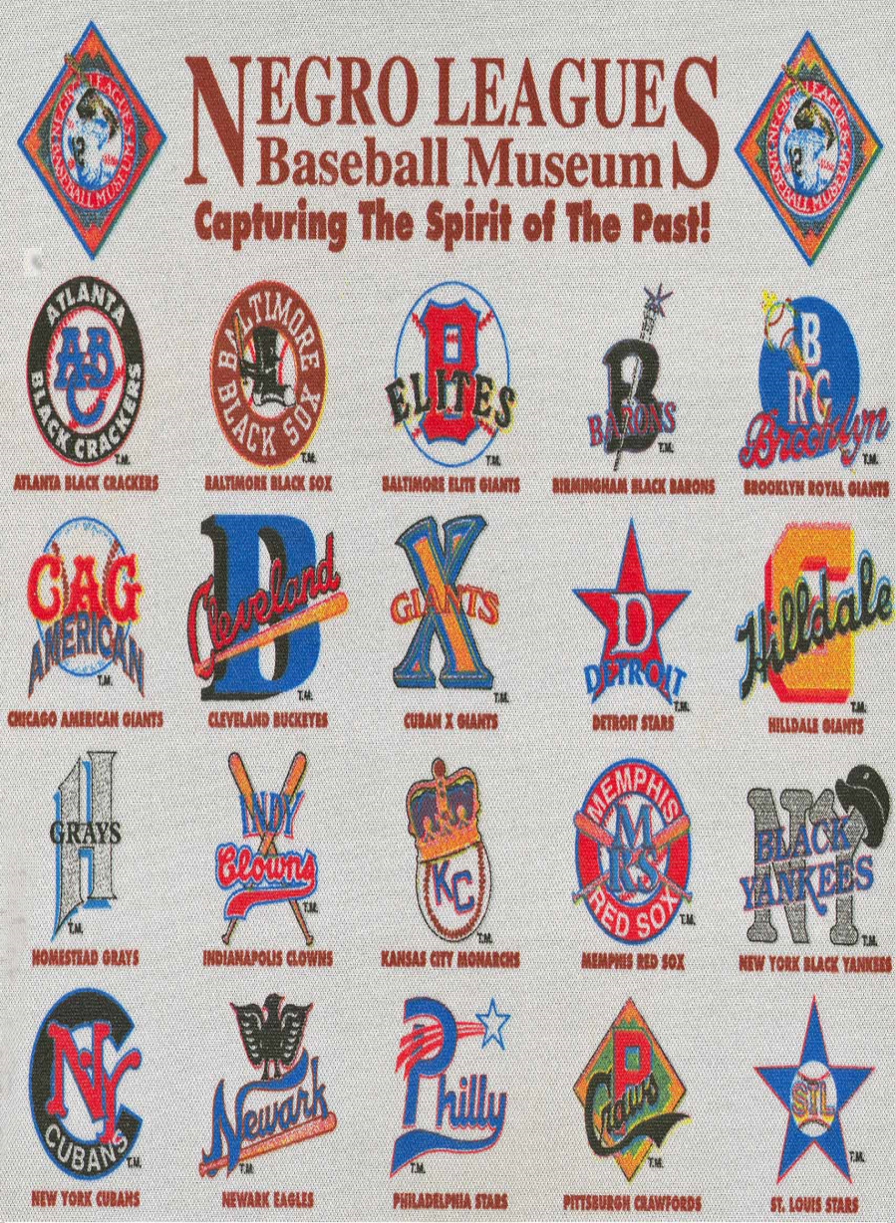
COMPETITION EMERGES FROM THE NEGRO LEAGUES
Dozens of African American professional and semi-professional baseball teams played from 1887 to 1950.
The most successful was the Negro National League founded in 1920 by Rube Foster, who was eventually elected to the Baseball Hall of Fame.

Slide 39
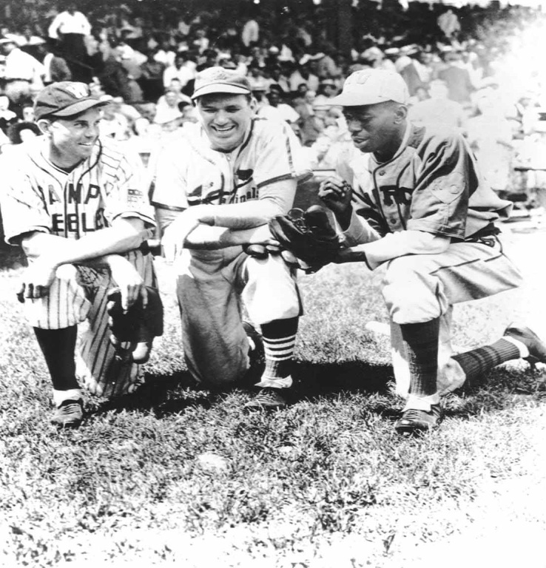
COMPETITION FROM BARNSTORMERS
Then there were the barnstorming African American teams like the Omaha Tigers and the Miami Giants.
Barnstorming teams traveled circuits in the south or Midwest, for example.

Slide 40

COMPETITION: PAIGE AND DEAN
Dizzy Dean
The most famous barnstormers were the Satchel Paige All Stars (all African American players) and the Dizzy Dean All Stars (all white players).
They toured the nation every October from 1934 to 1945 and were watched by thousands of fans.
Satchel Paige

Slide 41
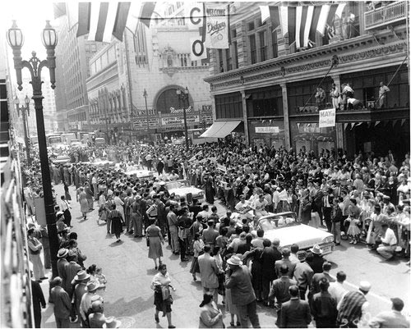
COMPETITION IN MARKETS
Competition in big baseball markets like New York City was more intense than it was in smaller baseball markets.
After World War II, New York City had three professional baseball teams – the Brooklyn Dodgers, the New York Yankees and the New York Giants.

Slide 42
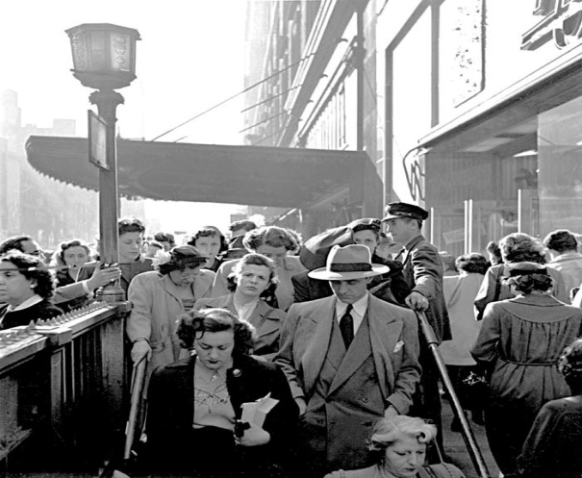
COMPETITION TO WIN IN NYC
Fans love to follow winning teams.
Mass transit allowed them to shift loyalties easily from one club to another.
Winning teams attract fans.
Spectacular players draws fans in from all over.

Slide 43
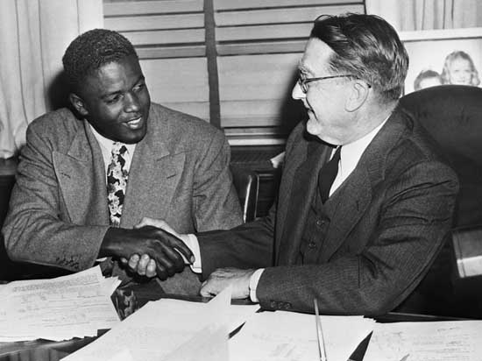
PEOPLE GAIN FROM VOLUNTARY TRADE
In 1946, the Brooklyn Dodgers finished two games behind the Cardinals.
They hoped to do better.
In 1946, Rickey signed Robinson who played that year with the Montreal Royals.
Both sides -- Robinson and Rickey -- expected to gain.
1947 was the rookie year for Jackie Robinson with the Dodgers.

Slide 44
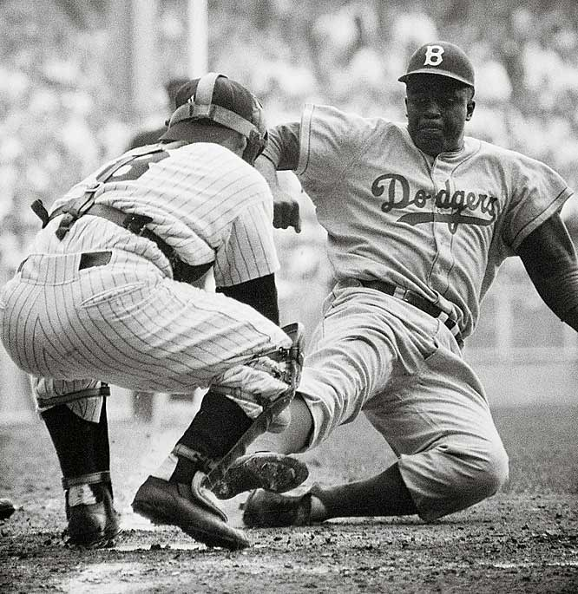
PEOPLE GAIN FROM VOLUNTARY TRADE
Overnight, Robinson became the largest attraction in baseball.
Huge crowds turned out to see him play.
In 1947, the Dodgers won the National League pennant.
They won it again in 1949, 1952, 1953, 1955, and 1956.
The Dodgers won the World Series in 1955.

Slide 45
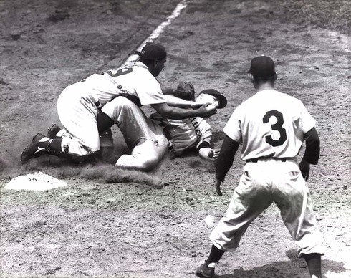
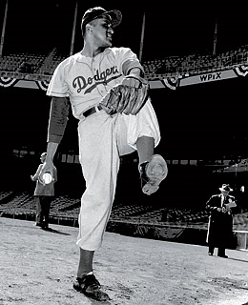
PEOPLE GAIN FROM VOLUNTARY TRADE
Rickey was aware of his overnight success.
He quickly signed more African American players such as Roy Campanella and Don Newcombe.

Slide 46
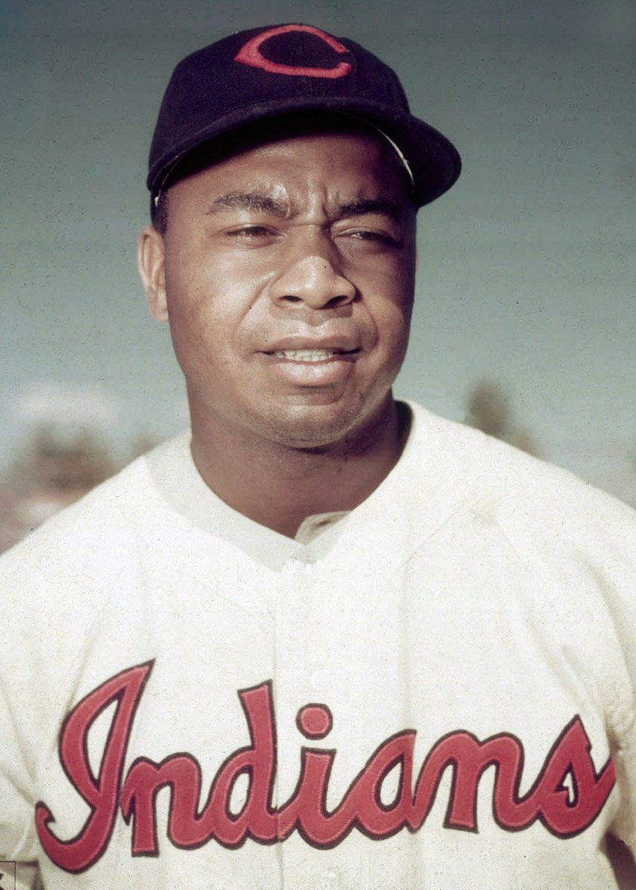
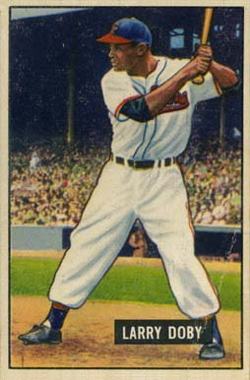
PEOPLE GAIN FROM VOLUNTARY TRADE
Bill Veeck, the owner of the Cleveland Indians, signed outfielder Larry Doby who started playing weeks after Robinson in July of 1947.
Doby became the first African American player in the American League.
Doby suffered the same indignities as Jackie Robinson but he did not get the same media attention Robinson received.

Slide 47
PEOPLE’S CHOICES SOMETIMES CREATE UNINTENDED CONSEQUENCES

Slide 48
PEOPLE’S CHOICES SOMETIMES CREATE UNINTENDED CONSEQUENCES
A negative unintended consequence of racial integration was the demise of the Negro Leagues.
By 1952, 150 black players were playing MLB.
The Negro National League disbanded in 1948.
A few leagues continued to field teams into the 1950s, but the quality of play just wasn't there.
It was all over by the early 1960s.

Slide 49
PEOPLE’S CHOICES SOMETIMES CREATE UNINTENDED CONSEQUENCES
Team owners considered the unintended consequences of signing on black players.
  Would white fans would stay away?
  Would players engage in boycotts, fights, or strikes?
  Would revenues would decline?
Fortunately, these worries faded into the background over time.

Slide 50
THE RESULTS OF RACIAL INTEGRATION
Before 1947, owners worried fans might turn away when they signed African American players. Do the stats support their concerns?
James Gwartney and Charles Haworth found, on average:
  Each additional African American team player was associated with between 55,000 and 60,000 additional annual home-team admissions during the 1950s.
  For the period from 1950-1955, the inclusion of an African American player on a major league team resulted in an additional 3.75 wins per year.

Slide 51
PEOPLE’S CHOICES SOMETIMES CREATE UNINTENDED CONSEQUENCES
Rickey may have only intended to field a winning team, win the pennant, and earn a profit.
However, the signing of Robinson helped desegregate major league baseball.
Was this an unintended consequence of Adam Smith’s invisible hand?

Slide 52

DISCRIMINATION COMES WITH COSTS
Watch (1m:42s)
Notes:
🍐 This is a Pear Deck Web Slide.
🍐 To edit the type of question, go back to the "Ask Students a Question" in the Pear Deck sidebar.

Slide 53

ONCE OVER LIGHTLY
Racial discrimination was widespread in the 1940s and 1950s.
Economic thinking helps to explain the integration of Major League Baseball.
  Choices
  Costs
  Incentives
    Rules of the game – competition
    Voluntary trade creates wealth
    Unintended consequences

Slide 54
CONCLUSIONS
Adam Smith’s invisible hand was a big help to Jackie Robinson and Branch Rickey in ending racial discrimination in Major League Baseball.
Markets punish profit-seeking businesses that discriminate on the basis of race, gender, sexual orientation, or religion.
Racial discrimination often requires the force of law to sustain it for the long term.
Elected officials don’t bear the financial costs of racist policies but profit-seeking businesses in competitive markets do.
TOGETHER… They helped each other.

Slide 55



Bring your entrepreneur to our next EEAH webinar… Don’t have one???
Choose Jackie Robinson!
Our 1st Black VP in Corporate U.S.A.
Notes:
🍐 This is a Pear Deck Web Slide.
🍐 To edit the type of question, go back to the "Ask Students a Question" in the Pear Deck sidebar.

Slide 56
UPCOMING EEAH WORKSHOPS
February 19th on Zoom: Professional Development with EconomicsWisconsin
March 5th on Zoom: Florida Council on Economic Education
March 9th on-site: New Jersey Council on Economic Education
April 2nd on-site: San Diego Center for Economic Education
April 6th in Las Vegas: CCSD Curriculum and Professional Development Center
July 13th at Lambeau Field in Green Bay, WI
For more information: Contact us

Slide 57

Register for a book here while we take questions and answers.
Notes:
🍐 This is a Pear Deck Web Slide.
🍐 To edit the type of question, go back to the "Ask Students a Question" in the Pear Deck sidebar.

Slide 58
References
Buck, J. (2020, April 14). Jackie Robinson and Jack Buck | KMOX - Podcast. YouTube. Retrieved February 3, 2022, from https://www.youtube.com/watch?v=ibmOfEQs1qY.
Gwartney, J., & Haworth, C. (1974). Employer Costs and Discrimination: The Case of Baseball. Journal of Political Economy, 82(4), 873–881. http://www.jstor.org/stable/1837153.
Schug, M. C., Wood, W. C., Ferrarini, T. H., & Niederjohn, M. S. (2019). Economic episodes in American history. Wohl Publishing.

Slide 59




Thank You to Our Sponsors!

