Slide 1
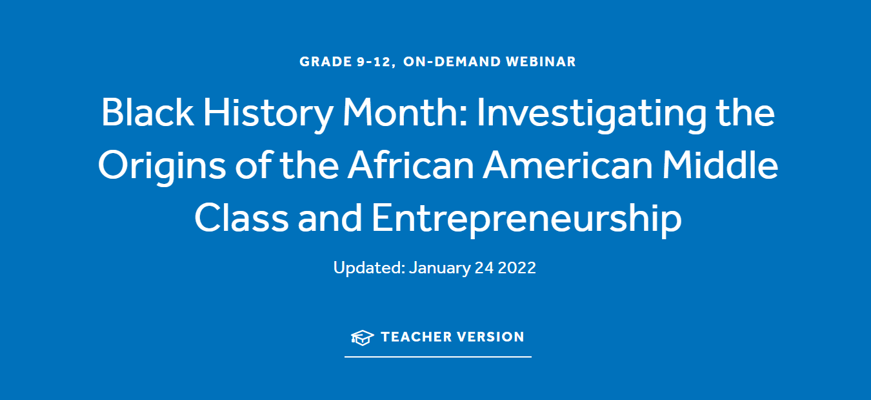
Tawni Hunt Ferrarini, PhD
Presentee
22 Feb 2022
TFerrarini@lindenwood.edu

Slide 2



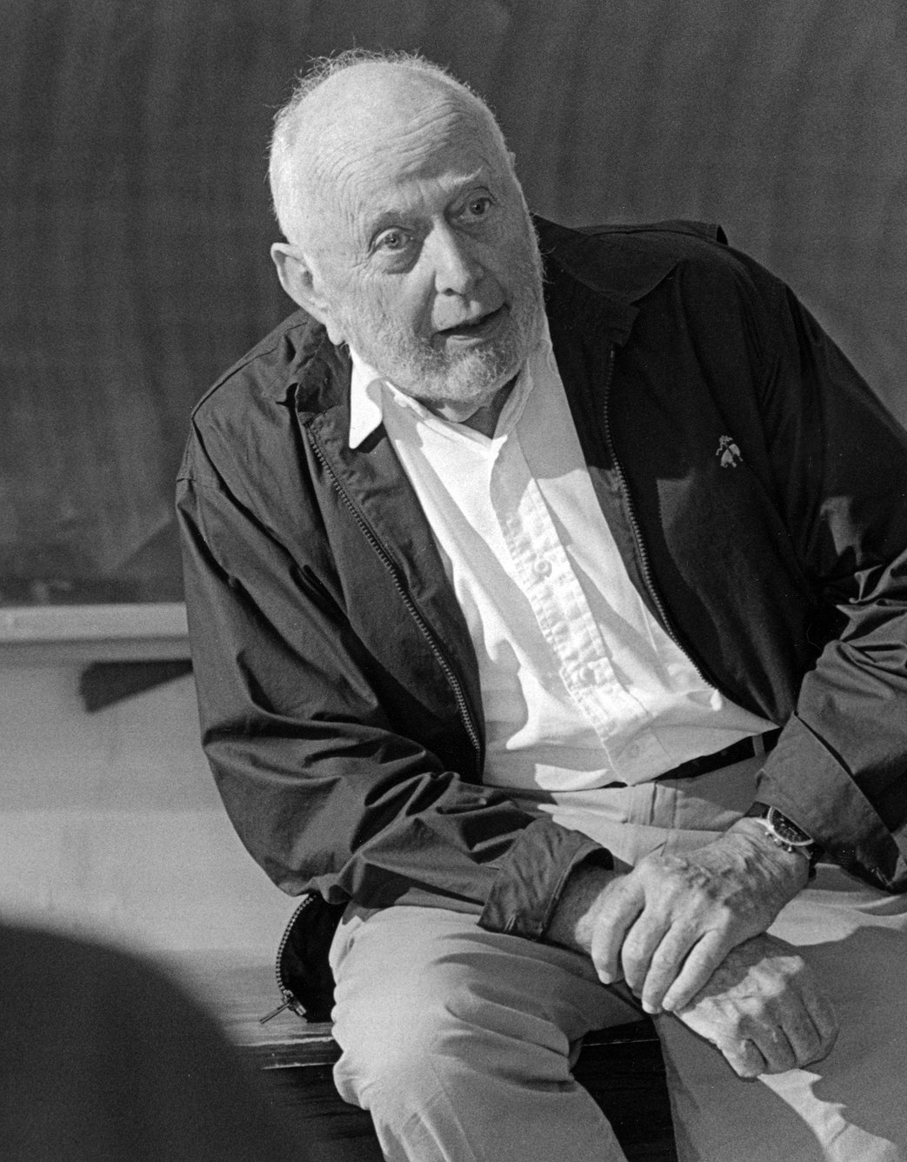

Tawni’s story…
Robert W. Plaster Professor of Economic Education and
Senior Economist at the Hammond Institute, Plaster College of Business and Entrepreneurship at Lindenwood University
First generation college student whose family farm did NOT survive the back-to-back recession of the 80s
PhD in economics with a BA in mathematics. My dissertation was chaired by Douglass C. North, Nobel Laureate in Economics, 1993
Love to travel around the world with Australia, not Antarctica, being my last continent to visit
My son, daughter-in-law, and furry family are my pride and joy.

Slide 3
Tawni Hunt Ferrarini, Professor of Economics Education
Lindenwood University * tawni.ferrarini@gmail.com* Tawni.org
In this economics webinar, we apply the tools of economists and other social scientists to
Investigate the origins of the African American Middle Class
Identify the link between the investment in human capital and internal migration and, on average, an increase in real income per person
Describe the relationship between investment and “free” labor markets and lifting people to new standards of living

Slide 4


Education and Income Gains
How are investments in human capital and growth in real income per person related?
EDUCATION
INCOME
Notes:
🍐 This is a Pear Deck Text Slide
🍐 To edit the type of question, go back to the "Ask Students a Question" in the Pear Deck sidebar.

Slide 5

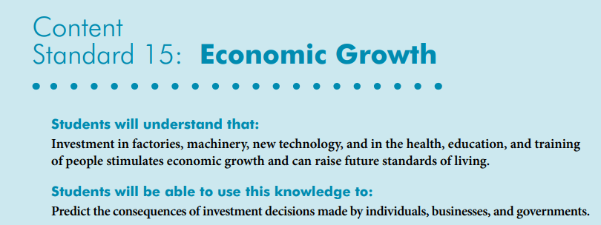

Slide 6


Good Online Learning Practices

Slide 7

Overview
Investigate NVECS 15: Economic Growth via 6 Core Principles
Explore the economics of human capital and labor migration (free to choose)
Link investments in human capital and labor migration to economic growth and prosperity within the middle class
Link markets that reward laborers (and entrepreneurs) for advancing the people in low-, middle-, and high-income groups
Conclusions
References
Questions and Answers
Ch27

Slide 8
Circular Flow
Connecting the dots between output and income in a simple economy.
Notes:
🍐 This is a Pear Deck Web Slide.
🍐 To edit the type of question, go back to the "Ask Students a Question" in the Pear Deck sidebar.

Slide 9
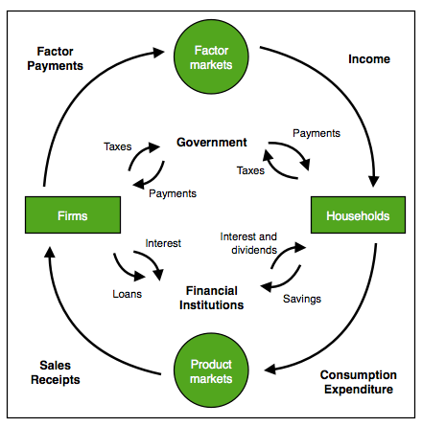
Connecting the dots…
What is produced is consumed.
What is consumed is produced.
Assume limited government or stable financial institutions in a closed economy. For the moment, that is, assume G=T=S=I=Ex=Im=0

Slide 10

Connecting the dots…
What is produced is consumed.
What is consumed is produced.
SEE BITMOJI. TAKE ACTION!!!!
Notes:
🍐 This is a Pear Deck Web Slide.
🍐 To edit the type of question, go back to the "Ask Students a Question" in the Pear Deck sidebar.

Slide 11
Bell Ringer
Does the prosperity attached to the person who advances with education come at the expense of someone else?
Yes * No * I don’t know
(Reply in chat box if you are not in Peardeck.)
Notes:
🍐 This is a Pear Deck Multiple Choice Slide. Your current options are: A: Yes, B: No, C: I don't know,
🍐 To edit the type of question or choices, go back to the "Ask Students a Question" in the Pear Deck sidebar.

Slide 12
Connections
The economics of human capital involves looking at individuals’ skills, knowledge, expertise, and abilities.
Investments in human capital are expected to generate positive returns.
These returns include higher lifetime earnings, more job security, and more.
Check out: “Education Pays” by the BLS

Slide 13
Human Capital
Definition:
Anything that involves a person’s skills, knowledge, abilities, and experiences.
Examples

Slide 14
Human Capital
Definition:
Anything that involves a person’s skills, knowledge, abilities, and experiences.
High school education/GED
College education (two- and four-year and beyond)
Examples
On-the-job-training/apprenticeships
?
Experience

Slide 15
Human Capital
Definition:
Anything that involves a person’s skills, knowledge, abilities, and experiences.
High school education/GED
College education (two- and four-year and beyond)
Examples
Migration - moving to locations with higher expected returns
On-the-job-training/apprenticeships
Experience

Slide 16
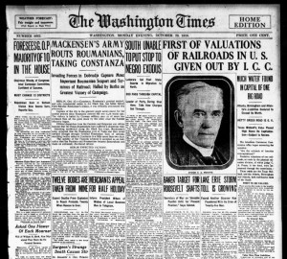
Human Capital and Migration
Migration and the historical context of “The Great Migration”
African Americans migrate out of the South.
Pull factors: Opportunities promising higher rates of return drew them to different areas other than the agrarian South.
Push factors: Discrimination pushed them to other parts of the country. That is, the costs of staying were too high.
The Great Migration in Library of Congress Primary Sources

Slide 17
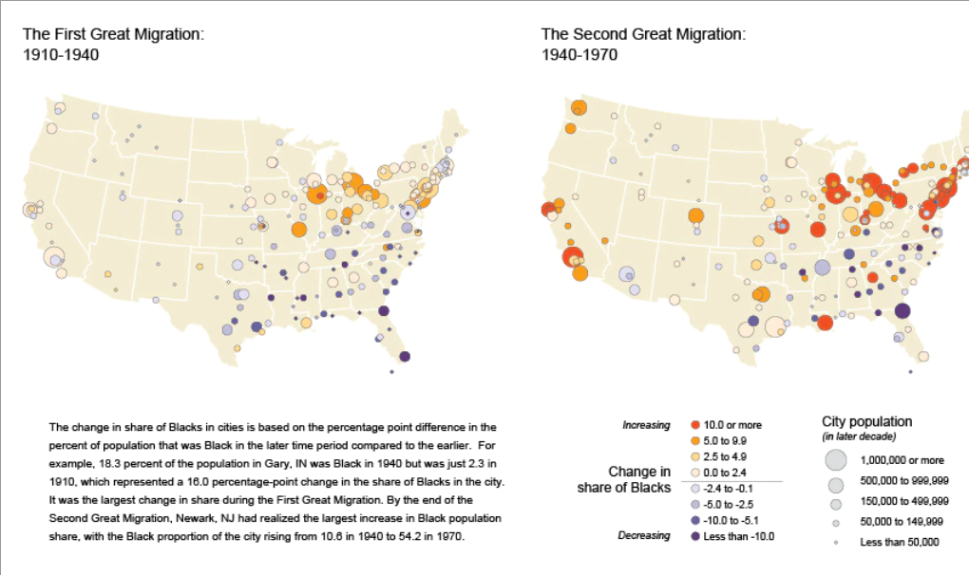
Human Capital and Migration
Migration and the historical context of “The Great Migration”
African Americans migrate out of the South.
Pull factors: opportunities promising higher rates of return drew them to different areas other than the agrarian South.
Push factors: Discrimination pushed them to other parts of the country. That is, the costs of staying were too high.

Slide 18
What story do the data reveal?

Slide 19
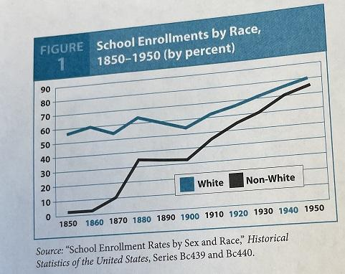
School Enrollment: Non-white trends
Notes:
🍐 This is a Pear Deck Draggable™ Slide.
🍐 To edit the type of question, go back to the "Ask Students a Question" in the Pear Deck sidebar.

Slide 20
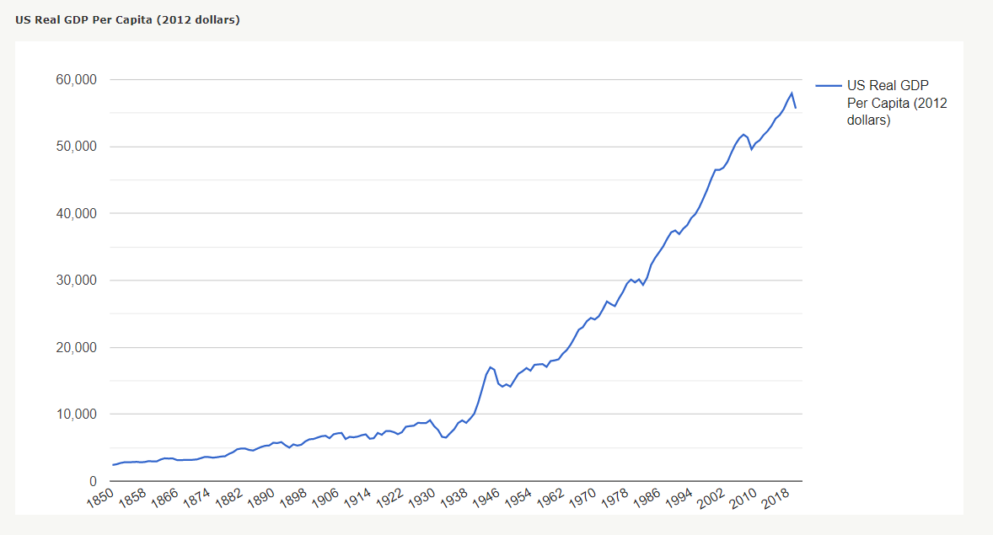
Real GDP per person
Notes:
🍐 This is a Pear Deck Draggable™ Slide.
🍐 To edit the type of question, go back to the "Ask Students a Question" in the Pear Deck sidebar.

Slide 21
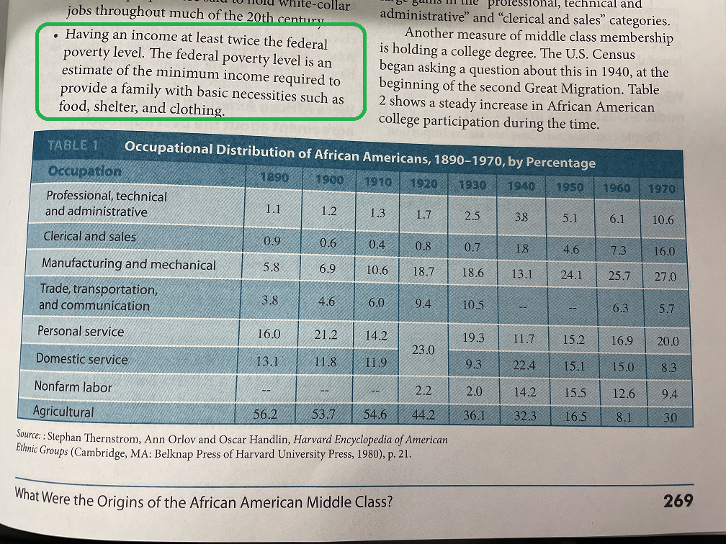
Occupational Distributions of African Americans, 1890-1950, by %
Notes:
🍐 This is a Pear Deck Draggable™ Slide.
🍐 To edit the type of question, go back to the "Ask Students a Question" in the Pear Deck sidebar.

Slide 22
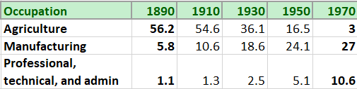
Occupational Distributions of African Americans, 1890-1950, by %
AG?
Notes:
🍐 This is a Pear Deck Draggable™ Slide.
🍐 To edit the type of question, go back to the "Ask Students a Question" in the Pear Deck sidebar.

Slide 23
Occupational Distributions of African Americans, 1890-1950, by %
AG?
-95%
Notes:
🍐 This is a Pear Deck Draggable™ Slide.
🍐 To edit the type of question, go back to the "Ask Students a Question" in the Pear Deck sidebar.

Slide 24
Occupational Distributions of African Americans, 1890-1950, by %
MTFG?
Notes:
🍐 This is a Pear Deck Draggable™ Slide.
🍐 To edit the type of question, go back to the "Ask Students a Question" in the Pear Deck sidebar.

Slide 25
Occupational Distributions of African Americans, 1890-1950, by %
366%
MTFG?
Notes:
🍐 This is a Pear Deck Draggable™ Slide.
🍐 To edit the type of question, go back to the "Ask Students a Question" in the Pear Deck sidebar.

Slide 26
Occupational Distributions of African Americans, 1890-1950, by %
PROF?
Notes:
🍐 This is a Pear Deck Draggable™ Slide.
🍐 To edit the type of question, go back to the "Ask Students a Question" in the Pear Deck sidebar.

Slide 27
Occupational Distributions of African Americans, 1890-1950, by %
864%
PROF?
Notes:
🍐 This is a Pear Deck Draggable™ Slide.
🍐 To edit the type of question, go back to the "Ask Students a Question" in the Pear Deck sidebar.

Slide 28
Real GDP per person
Markets reward diversity, equity, and inclusion when individual rights to person and property are protected in an unbiased and even-handed fashion.*
Notes:
🍐 This is a Pear Deck Draggable™ Slide.
🍐 To edit the type of question, go back to the "Ask Students a Question" in the Pear Deck sidebar.

Slide 29
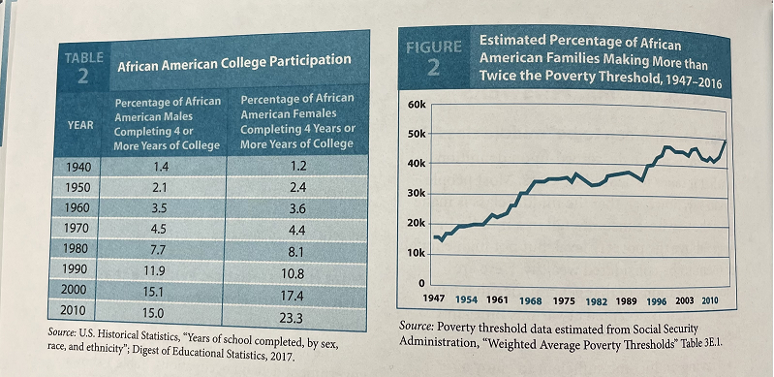
In the Middle
Expanded investment in human capital
% of Families Making More than Twice the Poverty Threshold

Slide 30
Social, Political, Business, and Economic Approaches to Advancements

Slide 31
Examples
In 1954, the U.S. Supreme Court declared state-sponsored school segregation to be unconstitutional.
  See Brown v. Board of Education (1954).
Yet, some markets abandoned racial segregation well before more court decisions and the passage of the Civil Rights Act of 1964 and the Voting Rights Act of 1965.
  Consider baseball and the experiences of skilled athletes like Jackie Robinson.

Slide 32
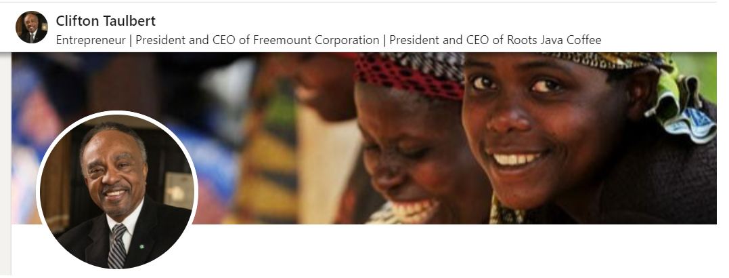
Active Learning: Let’s investigate.
Economic Influences
Read about Clifton Taulbert at cliftontaulbert.com/about-clifton-taulbert/.
Summarize his investment in education and migration experience.
Link “success” to his investment in human capital and “migration”.
Notes:
🍐 This is a Pear Deck Text Slide
🍐 To edit the type of question, go back to the "Ask Students a Question" in the Pear Deck sidebar.

Slide 33
Reflections
How did Clifton increase his human capital other than be gaining more time in school?
How was his investment in human capital similar to his investments in buildings, ice machines, and more?
How is “migration” a means by which a person can seek and find more “profitable” opportunities?
How can someone like Clifton achieve middle-income status even if they are not born into this class?

Slide 34
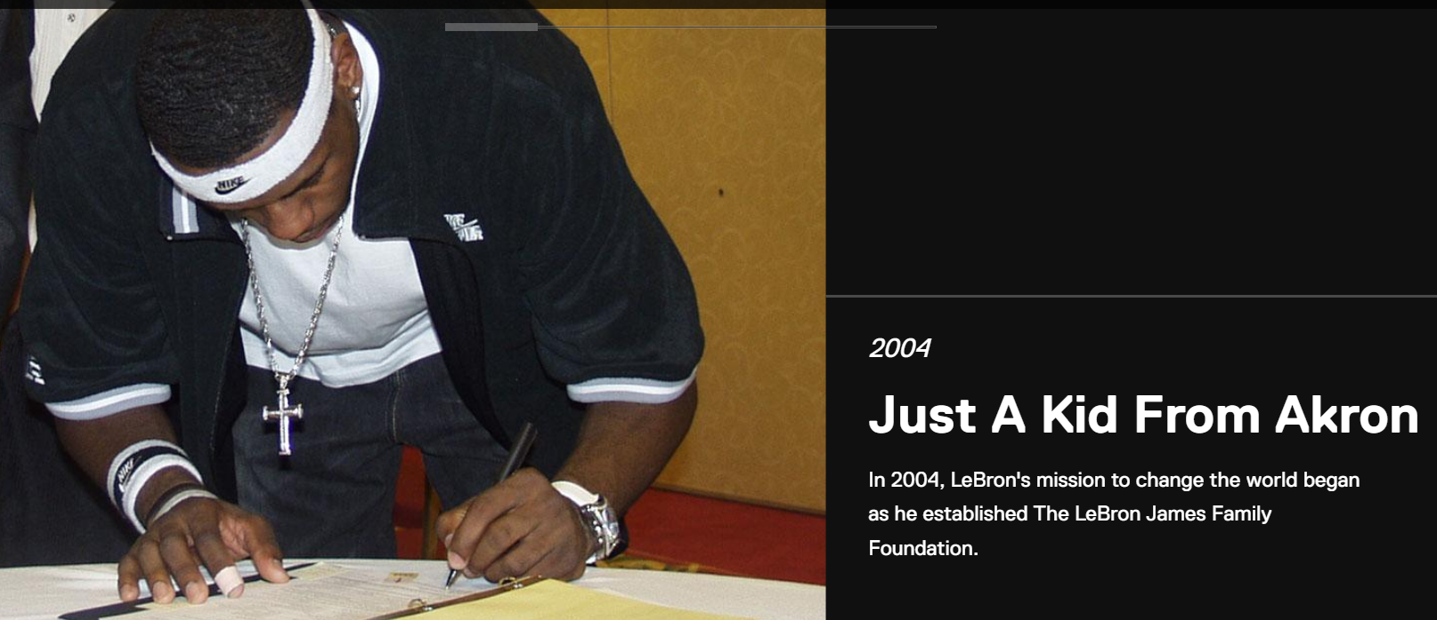
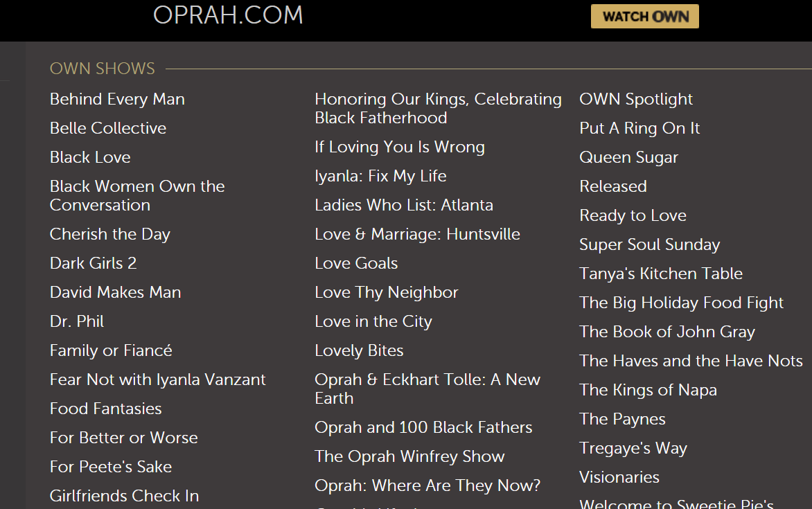
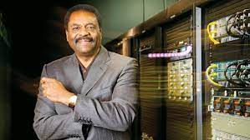
Lebron James

Slide 35
Once Over Lightly
Investigate NVECS 15: Economic Growth via 6 Core Principles
Explore the economics of human capital and labor migration (free to choose)
Link investments in human capital and labor migration to economic growth and prosperity within the middle class
Link markets that reward laborers (and entrepreneurs) for advancing the people in low-, middle-, and high-income groups
Conclusions
References
Questions and Answers
Ch27

Slide 36
References
Buck, J. (2020, April 14). Jackie Robinson and Jack Buck | KMOX - Podcast. YouTube. Retrieved February 3, 2022, from https://www.youtube.com/watch?v=ibmOfEQs1qY.
Wesson, S. (2013, February 12). The Great Migration in Library of Congress primary sources. The Great Migration in Library of Congress Primary Sources | Teaching with the Library of Congress. Retrieved February 22, 2022, from https://blogs.loc.gov/teachers/2013/02/the-great-migration-in-library-of-congress-primary-sources/
Schug, M. C., Wood, W. C., Ferrarini, T. H., & Niederjohn, M. S. (2019). Economic episodes in American history. Wohl Publishing.
Wesson, S. (2013, February 12). The Great Migration in Library of Congress primary sources. The Great Migration in Library of Congress Primary Sources | Teaching with the Library of Congress. Retrieved February 22, 2022, from https://blogs.loc.gov/teachers/2013/02/the-great-migration-in-library-of-congress-primary-sources/

Slide 37


Slide 38




Thank You to Our Sponsors!

