Slide 1
Gary N. Petmecky Parkview High School Lilburn, Ga

Slide 2
Econedlink Fundamentals of A.P. Economics Webinar Series

Slide 3
Econedlink AP Macroeconomics Collection

Slide 4
Econedlink AP Microeconomics Collection

Slide 5
Econedlink “Preparing for the A.P. Exam

Slide 6
The Circular Flow Model

Slide 7
Why?
You can refer back to the circular flow diagram when teaching the following concepts.
GDP
Effects of unemployment
Effects of inflation
Monetary Policy
Fiscal Policy
Net Exports

Slide 8
I try to link everything I can, back to the circular flow model. It is something the kids can wrap their heads around. It gives them solid ground that they can relate to.

Slide 9
I introduce the circular flow diagram though Econoland. Councilforeconed.org

Slide 11
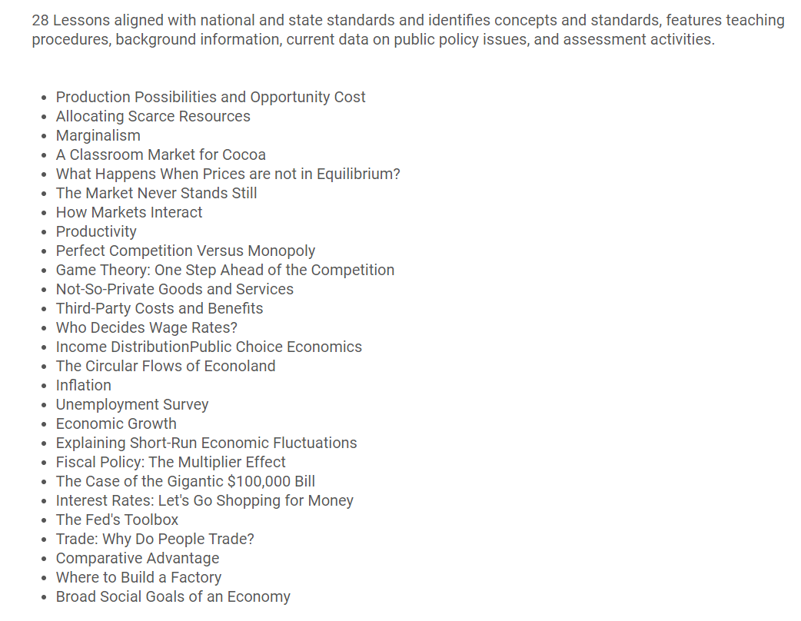

Slide 12
Households: This is you and me. In the Macro Economy, our roles are to provide the factors of production to the economy and then to purchase goods and services.

Slide 13
Businesses: In the Macro Economy, the role of the business is to provide goods and services. They do this by purchasing the factors of production from the households.

Slide 15
Households

Slide 16
Households
Businesses

Slide 17
Next, we need to introduce the two markets. A market is a mechanism that brings the buyers (demanders) and seller (suppliers) together to exchange goods and services.

Slide 18
The product market is where households purchase goods and services and the businesses sell the goods and services.

Slide 19
Households
Businesses

Slide 20
Goods and Services
Product Market
Goods and Services
Payment for Goods and Services
Payment for Goods and Services
Households
Businesses

Slide 21
The second market in the circular flow model is the factor market. This is sometimes called the resource market.

Slide 22
Households
Businesses
Factor Market

Slide 23
The factor market is where businesses purchase factors of production that the households sell.

Slide 24
The factor market is where businesses purchase factors of production that the households sell.

Slide 25
Households
Businesses
Factor Market
Land, Labor, Capital, Entrepreneurship
Land, Labor, Capital, Entrepreneurship

Slide 26
All of the factors are “owned” by the households. They sell these factors to the businesses. The payments for these factors have specific names.

Slide 27
The payment for land is rent. The payment for labor is wages. The payment for capital is interest. The payment to the entrepreneur is profit.

Slide 28
Households
Businesses
Rent, wages, interest, profit
Factor Market
Rent, wages, interest, profit
Land, Labor, Capital, Entrepreneurship
Land, Labor, Capital, Entrepreneurship

Slide 29
Putting both markets together we get the basic circular flow model. It includes two of the four aggregates in macroeconomics.

Slide 30
Goods and Services
Product Market
Goods and Services
Payment for Goods and Services
Payment for Goods and Services
Households
Businesses
Rent, wages, interest, profit
Factor Market
Rent, wages, interest, profit
Land, Labor, Capital, Entrepreneurship
Land, Labor, Capital, Entrepreneurship

Slide 31
When you draw this the only rules are that the two markets have to be opposite of each other and households and businesses must be opposite each other. The arrows then have to flow to correctly show the flow of goods, services, factors, and money.

Slide 32
Goods and Services
Product Market
Goods and Services
Payment for Goods and Services
Payment for Goods and Services
Households
Businesses
Rent, wages, interest, profit
Factor Market
Rent, wages, interest, profit
Land, Labor, Capital, Entrepreneurship
Land, Labor, Capital, Entrepreneurship

Slide 33
I purchased magnetic paper, cut it into strips and then wrote all of these parts on them. I have used these in a variety of ways.

Slide 34
1. Bring students up by row and each person must place one of the parts. The first time I do it, I do it in an organize fashion. I then randomize the parts.

Slide 35
2. I have three different copies. If I have a few extra minutes at the end of class, I invite students to come to the board and practice with them.

Slide 36
3. Relay races.

Slide 37
Any other ideas.

Slide 38
The Macroeconomy consists of the four aggregates. Household, Businesses, Government and Foreign Sector. We can add each of these into the circular flow diagram.

Slide 39
Goods and Services
Product Market
Goods and Services
Payment for Goods and Services
Payment for Goods and Services
Money
G & S
Households
Taxes
Government
Businesses
Taxes
Government Services
Government Services
Money
Factors of Prod.
Rent, wages, interest, profit
Factor Market
Rent, wages, interest, profit
Land, Labor, Capital, Entrepreneurship
Land, Labor, Capital, Entrepreneurship

Slide 40
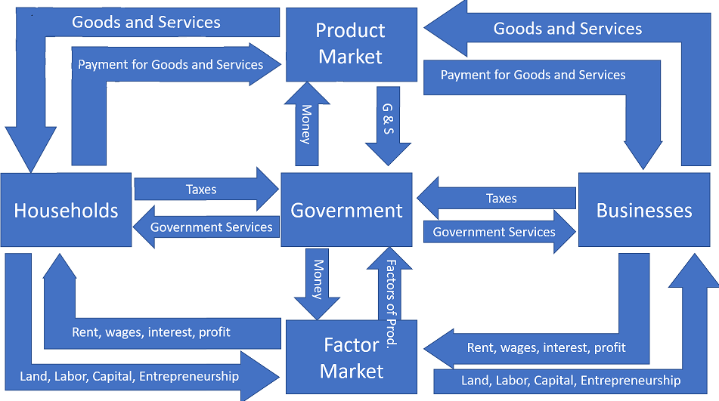
Xn
Foreign Sector
Exports out/$ In
Imports in/ $ out
GDP = C+I+G+Xn
C
G
I
Factors in/ $ out
Foreign Sector
Factors out/ $ out

Slide 41
Lets go back to a simple circular flow diagram. Closed: No foreign sector. Private: No government.

Slide 42
Goods and Services
Product Market
Goods and Services
Payment for Goods and Services
Payment for Goods and Services
Households
Businesses
Rent, wages, interest, profit
Factor Market
Rent, wages, interest, profit
Land, Labor, Capital, Entrepreneurship
Land, Labor, Capital, Entrepreneurship

Slide 43
What are the two major problems an economy can face?
Unemployment
Inflation

Slide 44
Goods and Services
Product Market
Goods and Services
Payment for Goods and Services
Payment for Goods and Services
Households
Unemployment
Businesses
Rent, wages, interest, profit
Factor Market
Rent, wages, interest, profit
Land, Labor, Capital, Entrepreneurship
Land, Labor, Capital, Entrepreneurship

Slide 45
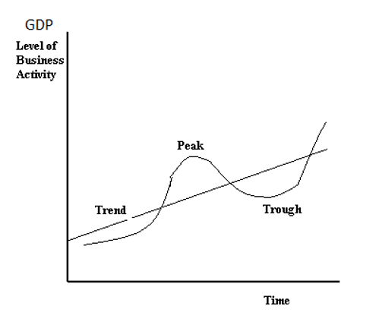

Slide 46
Goods and Services
Product Market
Goods and Services
Payment for Goods and Services
Payment for Goods and Services
Households
Businesses
Rent, wages, interest, profit
Factor Market
Rent, wages, interest, profit
Land, Labor, Capital, Entrepreneurship
Land, Labor, Capital, Entrepreneurship

Slide 47
Goods and Services
Product Market
Goods and Services
Payment for Goods and Services
Payment for Goods and Services
Households
Inflation
Businesses
Rent, wages, interest, profit
Factor Market
Rent, wages, interest, profit
Land, Labor, Capital, Entrepreneurship
Land, Labor, Capital, Entrepreneurship

Slide 48
The Circular Flow Diagram with Monetary Policy and Fiscal Policy

Slide 49
Goods and Services
Product Market
Goods and Services
Payment for Goods and Services
Payment for Goods and Services
Expansionary Monetary Policy
when faced with high unemployment
Easy Money Policy
Financial Market
Households
Businesses
Rent, wages, interest, profit
Factor Market
Rent, wages, interest, profit
Land, Labor, Capital, Entrepreneurship
Land, Labor, Capital, Entrepreneurship

Slide 50
Goods and Services
Product Market
Goods and Services
Payment for Goods and Services
Payment for Goods and Services
Contractionary Monetary Policy
when faced with high inflation
Tight Money
Policy
Financial Market
Households
Businesses
Rent, wages, interest, profit
Factor Market
Rent, wages, interest, profit
Land, Labor, Capital, Entrepreneurship
Land, Labor, Capital, Entrepreneurship

Slide 51
Expansionary Fiscal Policy (decrease taxes)
Goods and Services
Product Market
Goods and Services
Payment for Goods and Services
Payment for Goods and Services
Money
G & S
Households
Taxes
Government
Businesses
Taxes
Government Services
Government Services
Money
Factors of Prod.
Rent, wages, interest, profit
Factor Market
Rent, wages, interest, profit
Land, Labor, Capital, Entrepreneurship
Land, Labor, Capital, Entrepreneurship

Slide 52
Expansionary Fiscal Policy (Increase Government Spending)
Goods and Services
Product Market
Goods and Services
Payment for Goods and Services
Payment for Goods and Services
Money
G & S
Households
Taxes
Government
Businesses
Taxes
Government Services
Government Services
Money
Factors of Prod.
Rent, wages, interest, profit
Factor Market
Rent, wages, interest, profit
Land, Labor, Capital, Entrepreneurship
Land, Labor, Capital, Entrepreneurship

Slide 53
Contractionary Fiscal Policy (Increase taxes)
Goods and Services
Product Market
Goods and Services
Payment for Goods and Services
Payment for Goods and Services
Money
G & S
Households
Taxes
Government
Businesses
Taxes
Government Services
Government Services
Money
Factors of Prod.
Rent, wages, interest, profit
Factor Market
Rent, wages, interest, profit
Land, Labor, Capital, Entrepreneurship
Land, Labor, Capital, Entrepreneurship

Slide 54
Contractionary Fiscal Policy (Decrease Government Spending)
Goods and Services
Product Market
Goods and Services
Payment for Goods and Services
Payment for Goods and Services
Money
G & S
Households
Taxes
Government
Businesses
Taxes
Government Services
Government Services
Money
Factors of Prod.
Rent, wages, interest, profit
Factor Market
Rent, wages, interest, profit
Land, Labor, Capital, Entrepreneurship
Land, Labor, Capital, Entrepreneurship

Slide 55
Foreign Sector
Exports out/$ In
Foreign Sector

Slide 56
Summary:

Slide 57
Don’t overlook the importance of the Circular Flow Diagram!
You can use the circular flow diagram when teaching the following concepts.
GDP
Effects of unemployment
Effects of inflation
Monetary Policy
Fiscal Policy
Net Exports

Slide 58
What are your questions?

