Slide 1
Dreamers and Wishes Part I
Children’s Picture Books Featuring the Immigrant Experience
Lynne Farrell Stover
JMU Center for Economic Education
stoverlf@jmu.edu

Slide 2
Professional Development Certificate
To earn your professional development certificate for this webinar, you must:
Watch a minimum of 45-minutes and you will automatically receive a professional development certificate via e-mail within 24 hours.
Accessing resources:
You can now easily download presentations, lesson plan materials, and activities for each webinar from EconEdLink.org/professional-development/

Slide 3
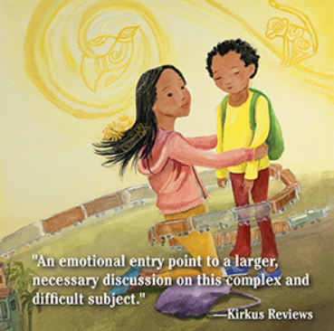
Session Agenda
In this session we will:
Examine National and State Standards
Discuss the changing themes in teaching immigration
Explore featured titles and the lessons and activities based on their content
Share a related bibliography & additional resources

Slide 4
National Standards
https://www.councilforeconed.org/wp-content/uploads/2012/03/voluntary-national-content-standards-2010.pdf

Slide 5
Virginia HISTORY & SOCIAL SCIENCE Standards of Learning
On January 28, 2021, The Virginia Board of Education authorized the Virginia Department of Education (VDOE) proceed with the review and revision process of the History and Social Science Standards of Learning consistent with the schedule adopted by the Board in September 2000. It is anticipated that the Standards revision will be completed before November 2022.

Slide 6
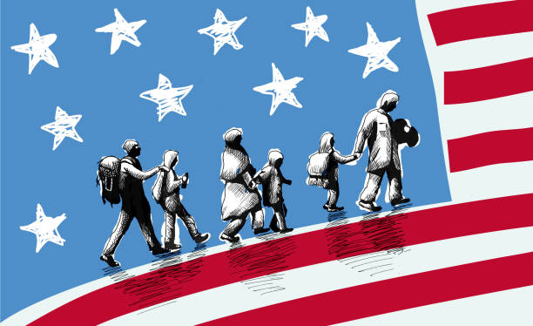
Teaching Immigration
Possible considerations and topics:
Define immigration
Discuss why people immigrate
Explore immigration stories
Consider themes such as economic issues, living conditions, education, language difficulties, issues of prejudice

Slide 7
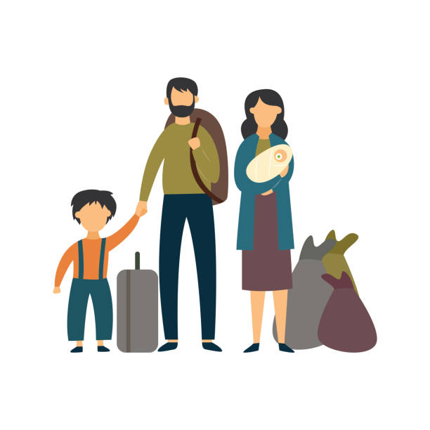
Terms and Definitions:
Migration can take place over short or long distances and it can be a one-way movement or temporary. Some people choose to migrate (voluntary) or others may be forced to move (forced).
Emigration is when people are leaving or exiting a country
Immigration is when people are moving into a country
A refugee is someone who has left their home and does not have a new home to go to. Often refugees do not carry many possessions and have no idea of where they may finally settle.

Slide 8
Why do people migrate?
Economic migration - to find work or follow a particular career path.
Social migration - for a better quality of life or to be closer to family or friends.
Political migration - to escape political persecution or war.
Environmental - to escape natural disasters such as flooding.
Push Factors are negative things that make people want to move to a new area e.g war
Pull Factors are positive aspects that attract people to move to a place e.g good employment opportunities
Migration usually happens as a result of a combination of these push and pull factors.

Slide 9
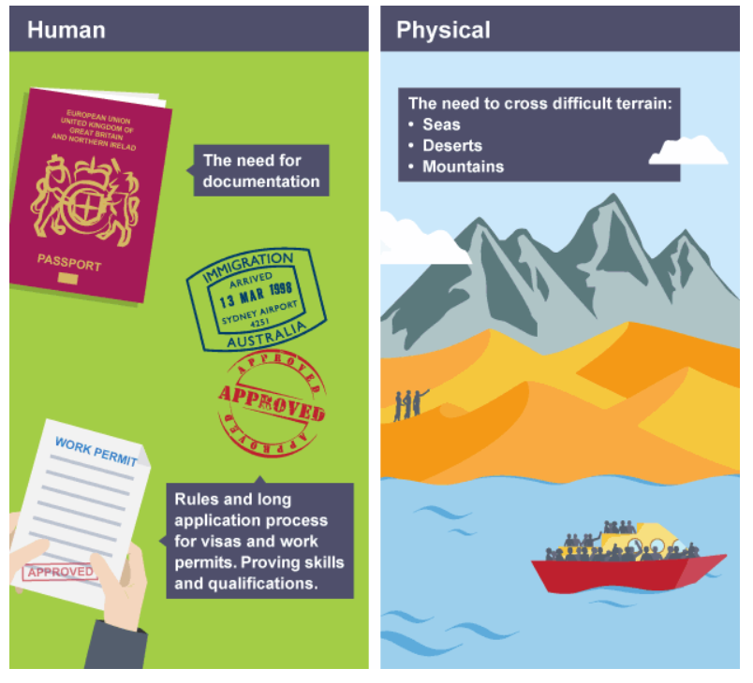
Barriers to Migration
Migration movements are rarely smooth.
People who are migrating have to negotiate a number of barriers when moving between countries.
A number of obstacles can get in the way such as legal restrictions, family attachments, and costs incurred etc.
https://www.bbc.co.uk/bitesize/guides/z3p4b82/revision/1

Slide 10
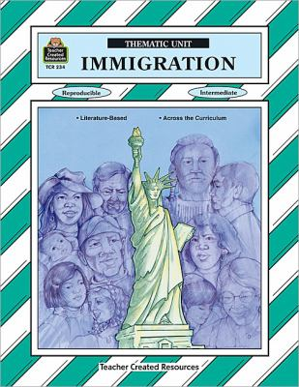
Times have changed…
Immigration: Thematic Unit
Teacher Created Materials, Inc., 1993
Content includes:
Family Trees & Genealogy
Teaching Units: Molly’s Pilgrim, How Many Days to America, and Hello My Name is Scrambled Eggs
Immigration Word Bank
Statue of Liberty Math
Ellis Island
Easy-to-make Pinata
Thanksgiving
Idioms

Slide 11
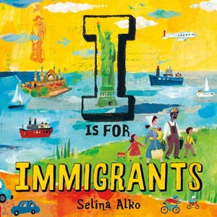
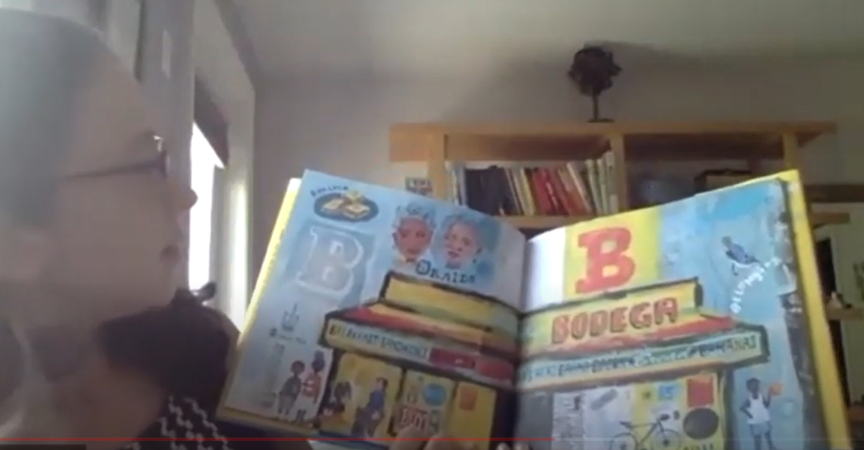
https://www.youtube.com/watch?v=NvbwCsV_zv8
Publisher: Henry Holt & Co.
Copyright Date: 2021
Reading Level: 2.0
Interest Level: K-3

Slide 12
Book Synopsis: What do African dance, samosas, and Japanese gardens have in common? They are all gifts the United States received from immigrants: the vibrant, multifaceted people who share their heritage and traditions to enrich the fabric of our daily lives. From Jewish delis to bagpipes, bodegas and Zen Buddhism, this joyful ABC journey is a celebration of immigrants: our neighbors, our friends.

Slide 13
Possible Topics:
Day of the Dead (Holidays and Celebrations)
Drums (Music)
Dumplings and Empanadas (Food and Drink)
Ellis Island (Travel)
Evil Eye (Superstitions)
Challenge the students to use the illustrations to find at least five different topics to use for an extended enrichment activity.

Slide 14
What topics do you see?

Slide 15
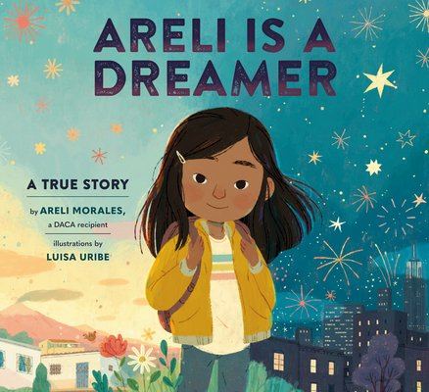
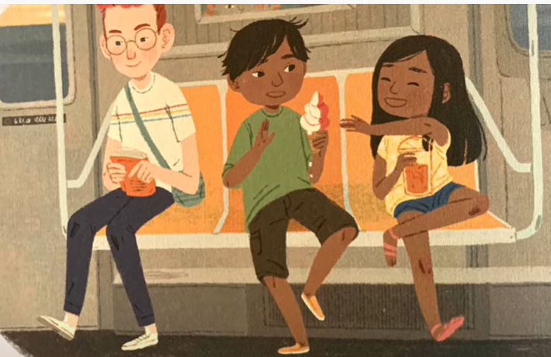
https://www.youtube.com/watch?v=ws-6ea0rWl0
Publisher: Random House
Copyright Date: 2021
Reading Level: 2.0
Interest Level: K-3

Slide 16
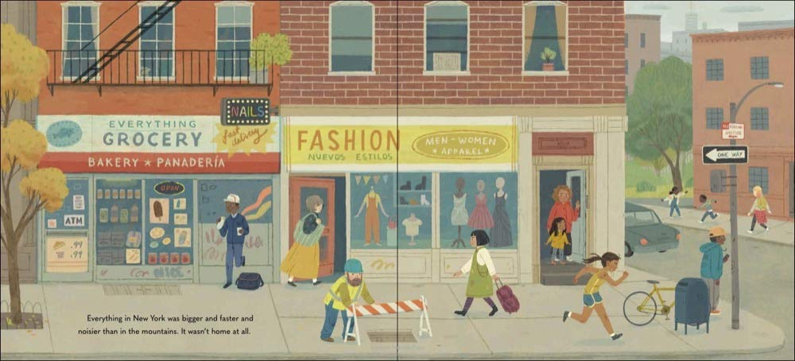
Story Synopsis: When Areli was just a baby, her mama and papa moved from Mexico to New York with her brother, Alex, to make a better life for the family--and when she was in kindergarten, they sent for her, too. Everything in New York was different. Gone were the Saturdays at Abuela’s house, filled with cousins and sunshine. Instead, things were busy and fast and noisy. Areli’s limited English came out wrong, and schoolmates accused her of being illegal. But with time, America became her home.
And she saw it as a land of opportunity, where millions of immigrants who came before her paved their own paths.
She knew she would, too

Slide 17
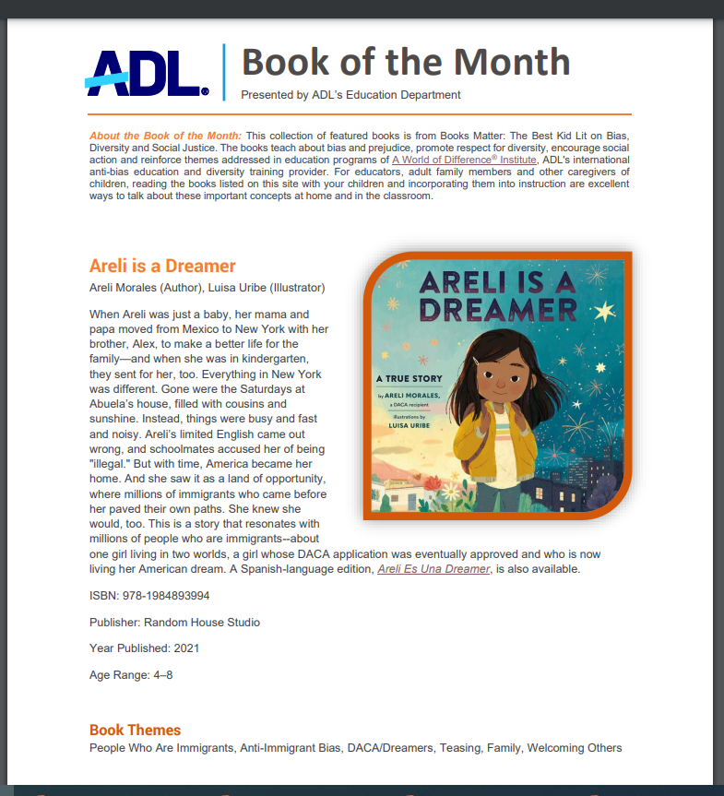
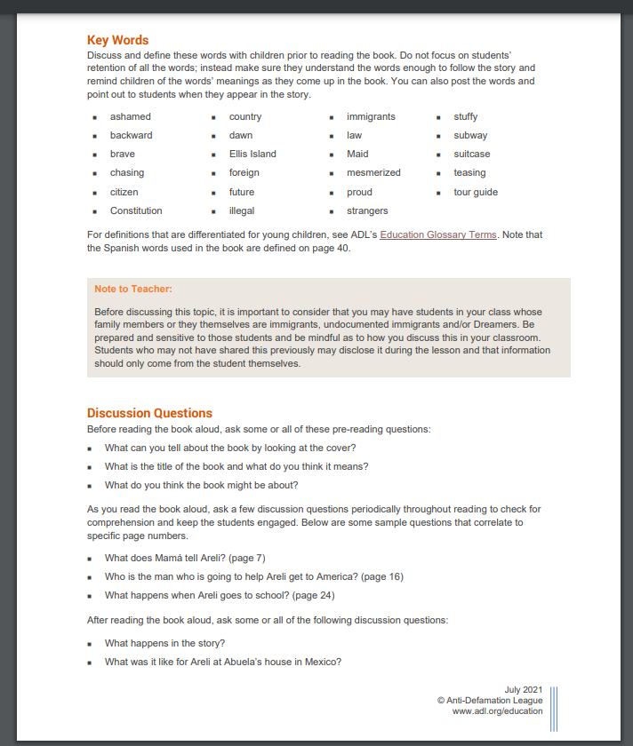
https://www.adl.org/media/16576/download

Slide 18
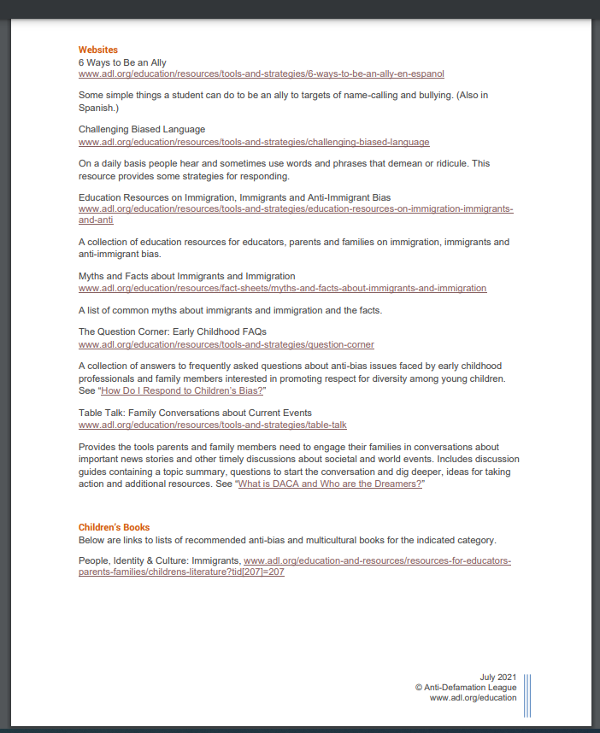
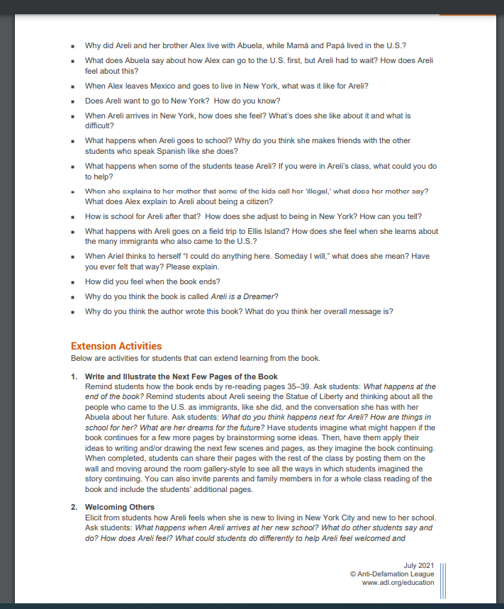
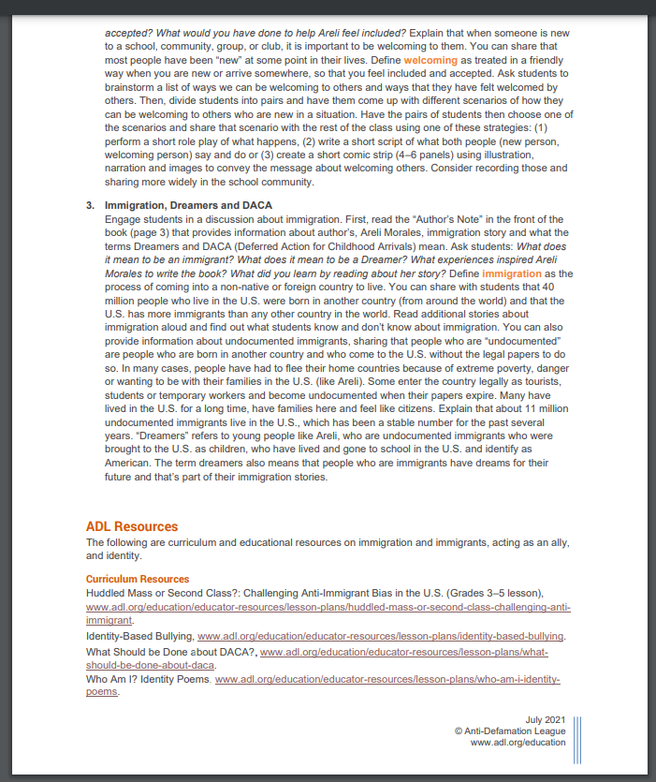

Slide 19
Information from Author’s Note:
Immigration is defined as the process of coming into a non-native or foreign country to live.
40 million people who live in the U.S. were born in another country (from around the world) and that the U.S. has more immigrants than any other country in the world.
People who are “undocumented” are people who are born in another country and who come to the U.S. without the legal papers to do so.
In many cases, people have had to flee their home countries because of extreme poverty, danger or wanting to be with their families in the U.S.
Some enter the country legally as tourists, students or temporary workers and become undocumented when their papers expire.
About 11 million undocumented immigrants live in the U.S., which has been a stable number for the past several years.
“Dreamers” refers to young who are undocumented immigrants who were brought to the U.S. as children and identify as American.

Slide 20
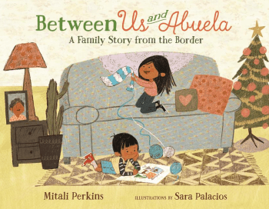
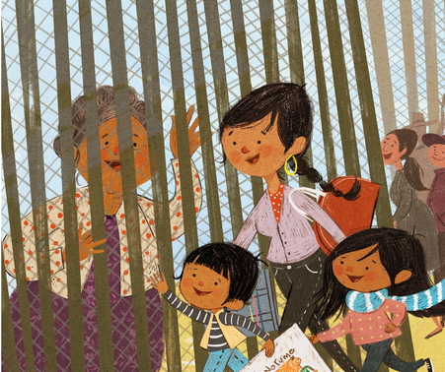
Between Us and Abuela
https://www.youtube.com/watch?v=PfAI-5LcbyI
Publisher: Farrar, Straus Straus, Giroux
Copyright Date: 2019
Reading Level: 2.9
Interest Level: P-2

Slide 21
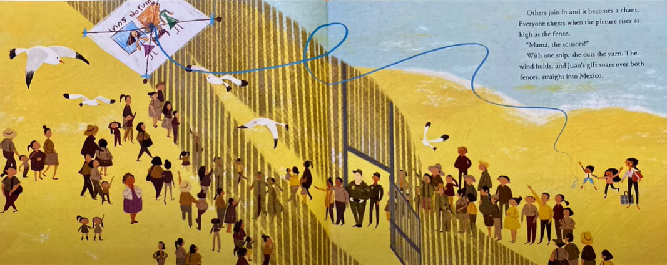
Story Synopsis: It's almost time for Christmas, and Maria is traveling with her mother and younger brother, Juan, to visit their grandmother on the border of California and Mexico. For the few minutes they can share together along the fence, Maria and her brother plan to exchange stories and Christmas gifts with the grandmother they haven't seen in years. But when Juan's gift is too big to fit through the slats in the fence, Maria has a brilliant idea. She makes it into a kite that soars over the top of the iron bars.

Slide 22
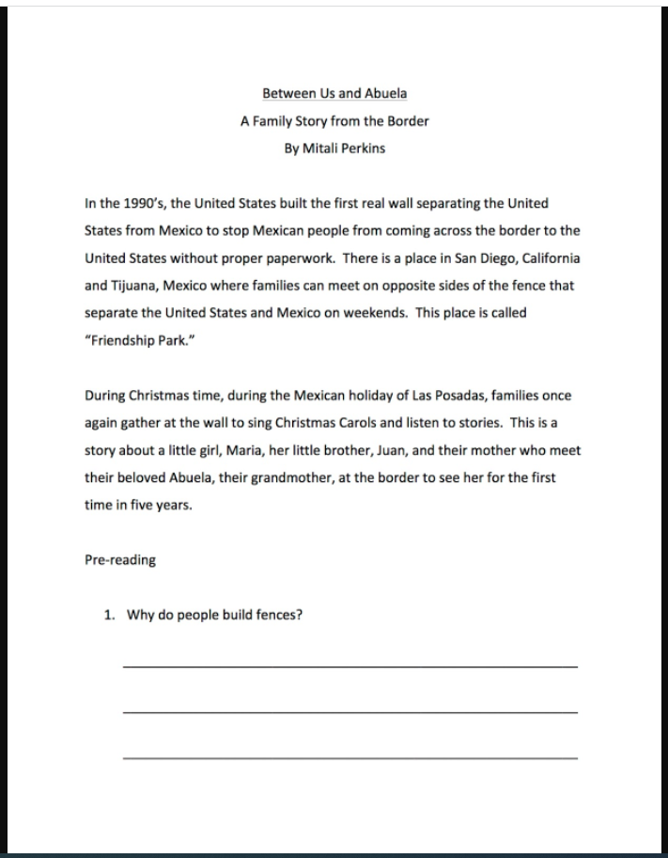
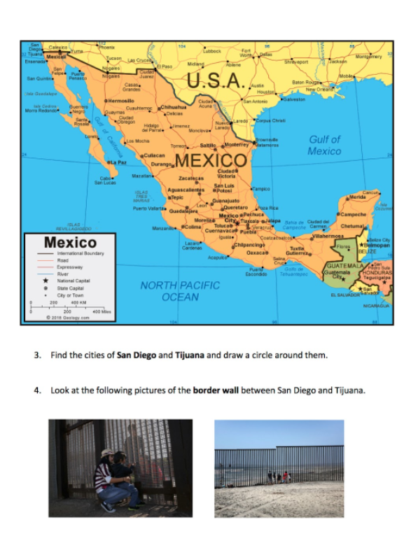
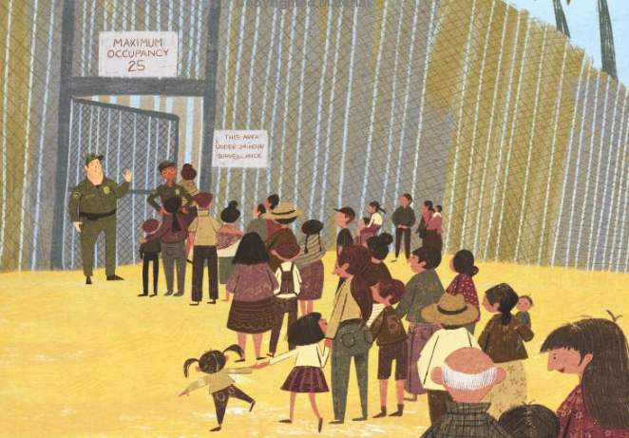
Mitali Perkins’ Study Guide https://www.mitaliperkins.com/p/between-us-and-abuela.html
Why do people build fences?

Slide 23
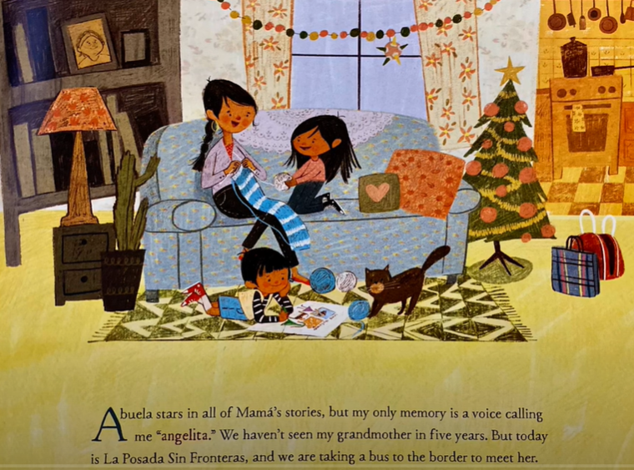
Economics is everywhere!
Can you name the productive
resources in this illustration?
Natural
Human
Capital

Slide 24
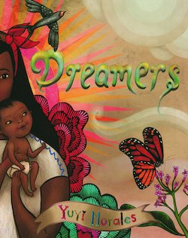
Dreamers
by Yuyi Morales
Publisher: Holiday House
Copyright Date: 2018
Reading Level: 2.2
Interest Level: K-3
A picture book autobiography

Slide 25
Dreamers Soñadores
Story Synopsis: Yuyi Morales brought her hopes, her passion, her strength, and her stories with her, when she came to the United States in 1994 with her infant son. She left behind nearly everything she owned, but she didn't come empty-handed. She brought her skills, determination, and work ethic with her.

Slide 26
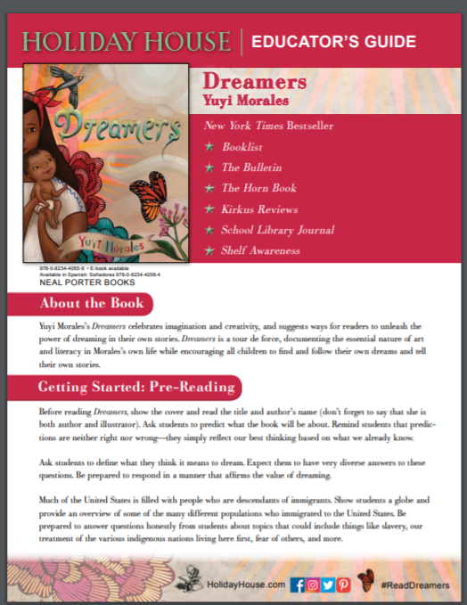
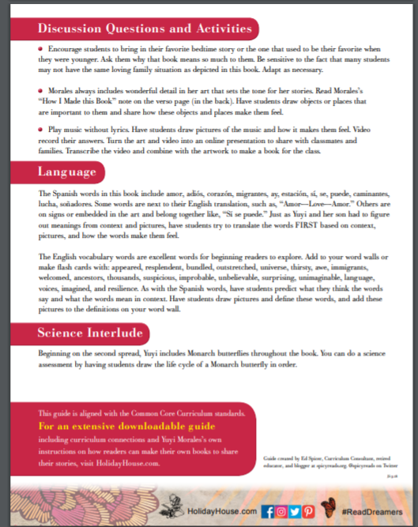
https://holidayhouse.com/wp-content/uploads/2019/01/Dreamers.pdf

Slide 27
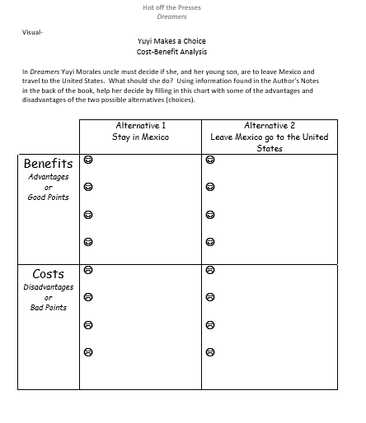
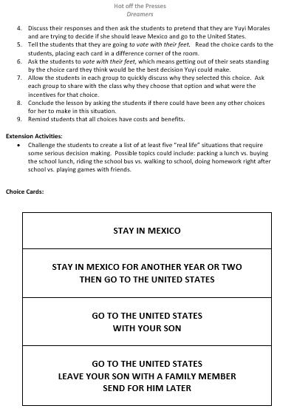
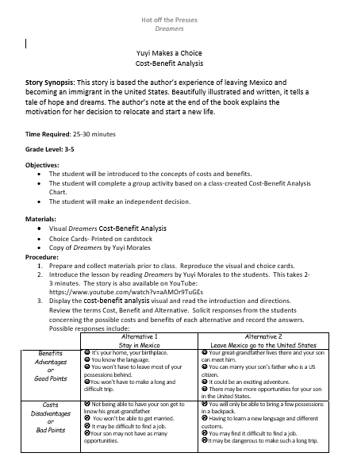
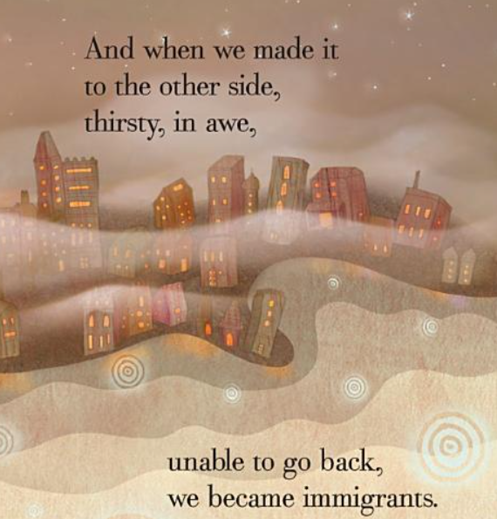
LESSON
Yuyi Makes a Choice
Cost-Benefit Analysis

Slide 28
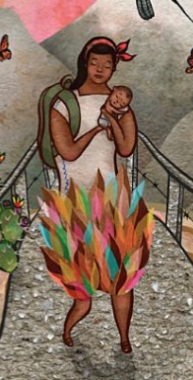
Vote With Your Feet

Slide 29
38 Page Study Guide
http://images.randomhouse.com/teachers_guides/9780399257742.pdf

Slide 30
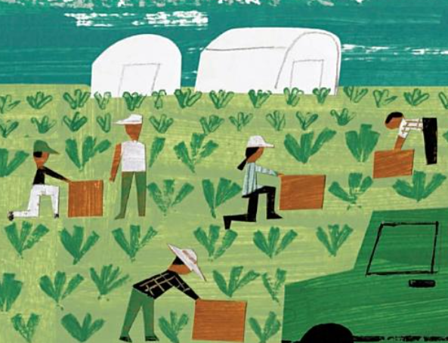
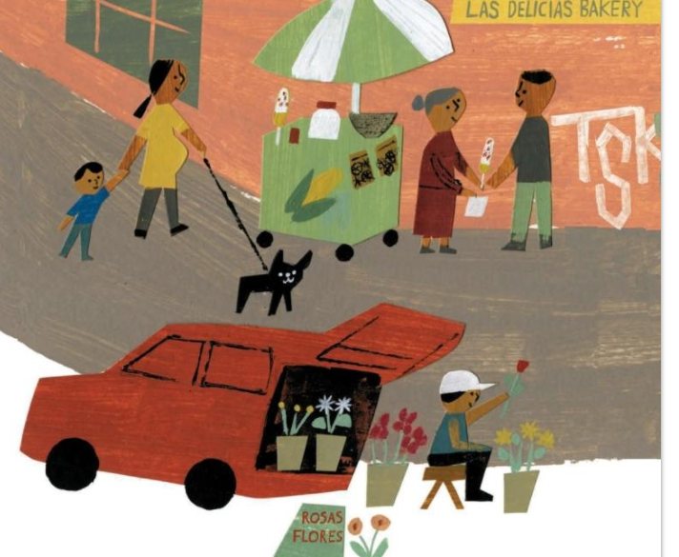
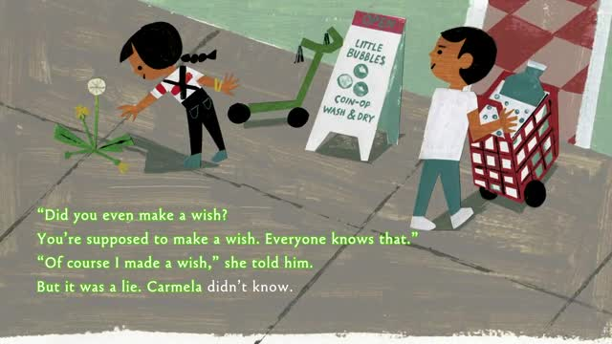
Lesson and Activity Ideas
Concepts:
Choices
Goods & Services
Markets
Money
Productive Resources

Slide 31
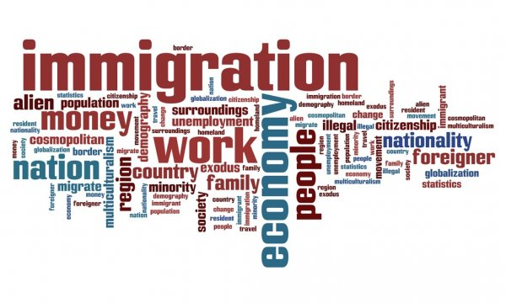
For your consideration:
Do you think situations dealing with immigration and refugees are appropriate to address with younger students?
Is it helpful for students to learn about how experiences characters in books were resolved…or not? Are they able to apply “lessons learned” to their own lives?
Which do you think is more challenging: adapting a secondary lesson for an elementary classroom, or advancing an elementary lesson for high school students?
It seems that many new children’s books are addressing controversial social issues. Why do you think this is so?

Slide 32
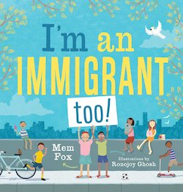
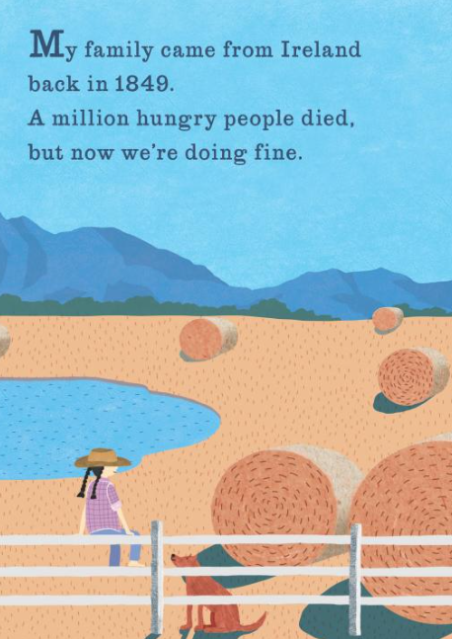
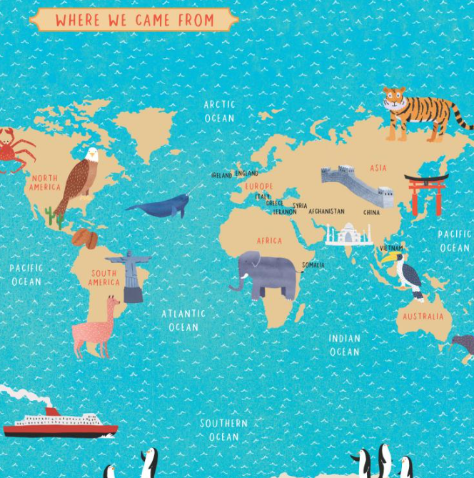
For your consideration:
Just like the United States, other nations are composed of immigrants.
How have these counties dealt with this through out their history?
How are they currently addressing the situation of refugees and immigrants?

Slide 33
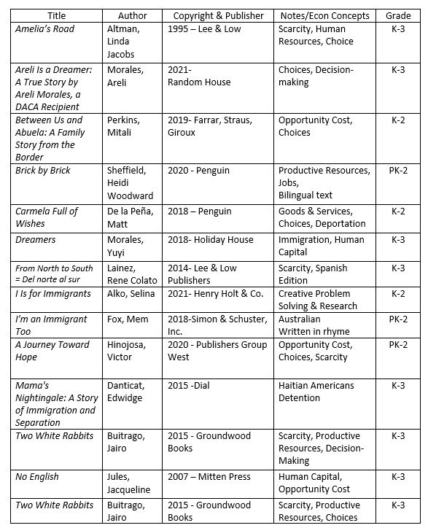
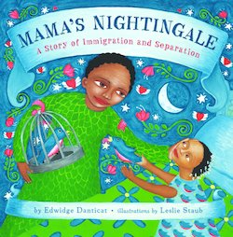
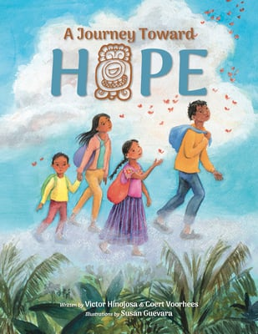
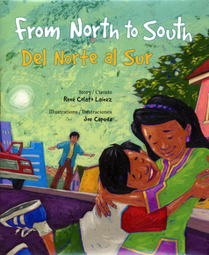
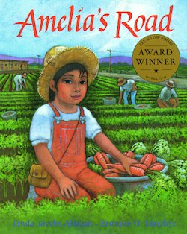

Slide 34
CEE Affiliates
https://www.councilforeconed.org/resources/local-affiliates/

Slide 35
Thank You to Our Sponsors!

Slide 36
stoverlf@jmu.edu

