Slide 1
EconEdLink: Black History Month “The Possibilities of Black Upliftment” Dr. William Anderson University of Denver 2/17/2022 Love1stedcon@gmail.com

Slide 2
EconEdLink Membership
You can now access CEE’s professional development webinars directly on EconEdLink.org! To receive these new professional development benefits, become an EconEdLink member. As a member, you will now be able to:
Automatically receive a professional development certificate via e-mail within 24 hours after viewing any webinar for a minimum of 45 minutes
Register for upcoming webinars with a simple one-click process
Easily download presentations, lesson plan materials and activities for each webinar
Search and view all webinars at your convenience
Save webinars to your EconEdLink dashboard for easy access to the event
You may access our new Professional Development page here

Slide 3
Professional Development Certificate
To earn your professional development certificate for this webinar, you must:
Watch a minimum of 45-minutes and you will automatically receive a professional development certificate via e-mail within 24 hours.
Accessing resources:
You can now easily download presentations, lesson plan materials, and activities for each webinar from EconEdLink.org/professional-development/

Slide 4
Objectives
EWBAT: Discuss and critically think about the ways in which the American education system has created systemic issues in the education of Black children.
EWBAT: Analyze the ways in which the “good” being done in education can (and too often does) pit Black students against the people very people educators are looking to help
EWBAT: Consider what can be done to move beyond the limited definition of Black success peddled in schools, to co-authored and home grown student success

Slide 5
National Standards
CCSS.ELA-LITERACY.RH.11-12.3
Evaluate various explanations for actions or events and determine which explanation best accords with textual evidence, acknowledging where the text leaves matters uncertain.
CCSS.ELA-LITERACY.RH.11-12.7
Integrate and evaluate multiple sources of information presented in diverse formats and media (e.g., visually, quantitatively, as well as in words) in order to address a question or solve a problem.
CCSS.ELA-LITERACY.RH.11-12.9
Integrate information from diverse sources, both primary and secondary, into a coherent understanding of an idea or event, noting discrepancies among sources.

Slide 6
Norms
• It’s all LOVE
• Things may get uncomfortable…That’s okay.
• Just consider it.
• Chances are we will not solve all the problems here today.
• DO NOT let the work stop here.

Slide 7
Agenda
• Intro/Norms
• Zen PowerPoint
• F. Douglas on the 4th of July…and Black education…
• Are narrow visions/definitions of Black success are making us unsuccessful?
• Finding the ”success” that is all around us, and helping students to co-author/create what success is to them

Slide 8
“Zen PowerPoint/Slides Presentations”
• A PowerPoint or slide presentation that has no words following the opening slide
• Pushes the presenter to find an image(s) that can convey entire ideas
• Challenges the presenter to know their content well enough that they can not use the words on a slide as support to their presentation
• Gives the audience a visual to connect with the learning
• Fun

Slide 10
F. Douglas on the 4th of July…and Black education…
“What, to the American slave, is your 4th of July? I answer: a day that reveals to him, more than all other days in the year, the gross injustice and cruelty to which he is the constant victim. To him, your celebration is a sham; your boasted liberty, an unholy license; your national greatness, swelling vanity; your sounds of rejoicing are empty and heartless; your denunciations of tyrants, brass fronted impudence; your shouts of liberty and equality, hollow mockery; your prayers and hymns, your sermons and thanksgivings, with all your religious parade, and solemnity, are, to him, mere bombast, fraud, deception, impiety, and hypocrisy — a thin veil to cover up crimes which would disgrace a nation of savages. There is not a nation on the earth guilty of practices, more
shocking and bloody, than are the people of these United States, at this very hour”.
Fredrick Douglas 1852

Slide 11
F. Douglas on the 4th of July…and Black education…
In the chat respond:
What point is Fredrick Douglas trying to make with this statement?
Why make it like this?

Slide 12
F. Douglas on the 4th of July…and Black education…
Black students in the Condition of Education 2020
Millions of Black parents expect public schools to help their children to be better. Millions of Black students depend on public education to pursue their happiness. We tried hard to find a significant improvement for Black students in the Condition of Education 2020. Yet, what the data demonstrate is disappointing and discouraging.
The poverty rate is still the highest for Black students.
A lack of internet access at home has become a barrier for Black students to learn.
A high percentage of Black students attend high-poverty schools.
More Black students with disabilities receive services for emotional disturbances.
The disproportion between Black students and Black teachers has not been improved.
The achievement gap between Black and white students has not been closed.
School dropout rate keeps high among Black students.
Graduation rates and college enrollment rates remain low among Black students.
https://nsba.org/-/media/NSBA/File/CPE-Black-Students-2020-Report-FINAL.pdf

Slide 13
F. Douglas on the 4th of July…and Black education…
What, to the Black student, is our education system? I answer: a system that reveals to them, more than all other systems, the gross injustice and cruelty to which they are the constant victims. To them (Black students) our celebration is a sham; our boasted education, and unholy license; our schooling greatness, swelling vanity; our sounds of rejoicing are empty and heartless; our denunciation of ignorance, brass fronted impudence; our shouts of liberty & equality through education, hollow mockery; our well wishes, and hymns, our lectures and assignments, with all our academic parade, and solemnity, are, to them, mere bombast, fraud, deception, impiety, and hypocrisy – a thin veil to cover up educational crimes. There are few “developed” place on the earth guilty of practice, more shocking, and hypocritical, than are the educational system of the United States at this very hour.
Adapted by: william anderson

Slide 14
F. Douglas on the 4th of July…and Black education…
In the Chat Respond:
Excluding the individual effort of many… as an education system, does the previous statement have merit given the educational outcomes we have seen and continue to see for Black children? Why or why not?

Slide 15
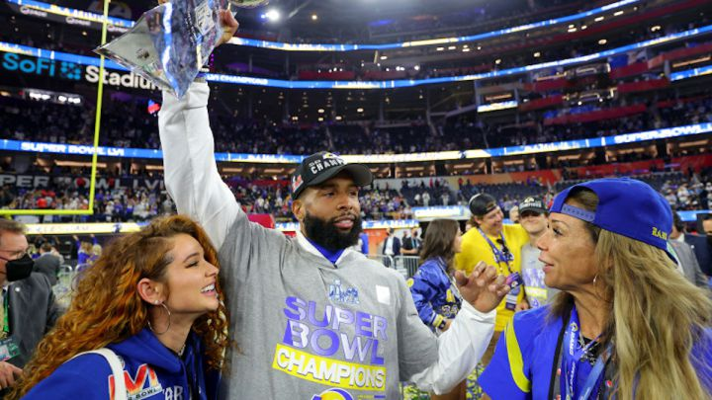
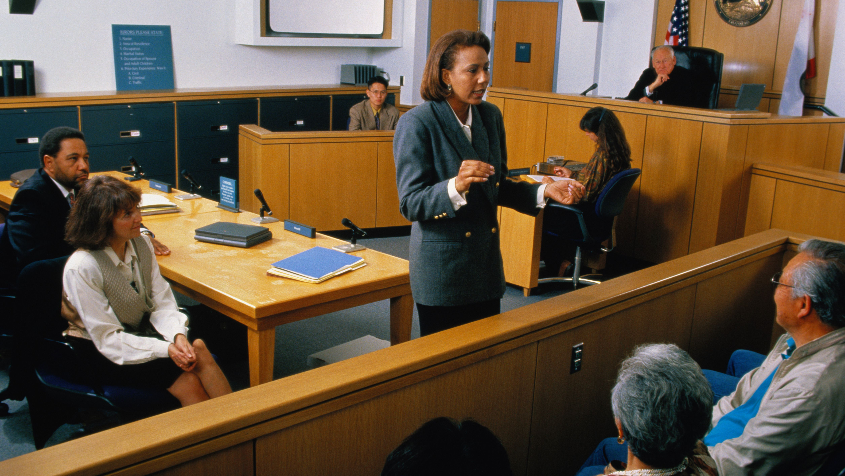
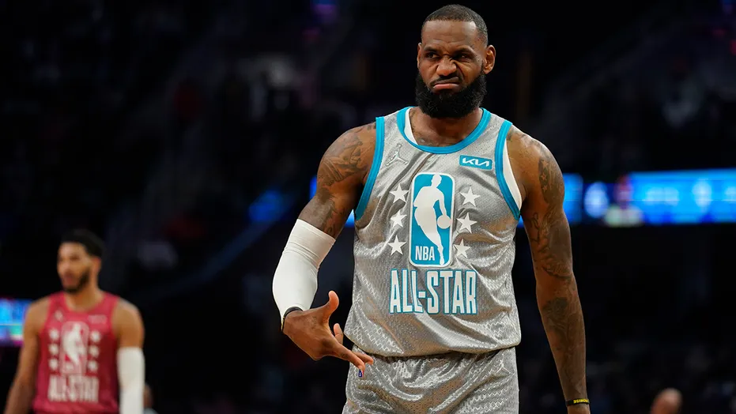
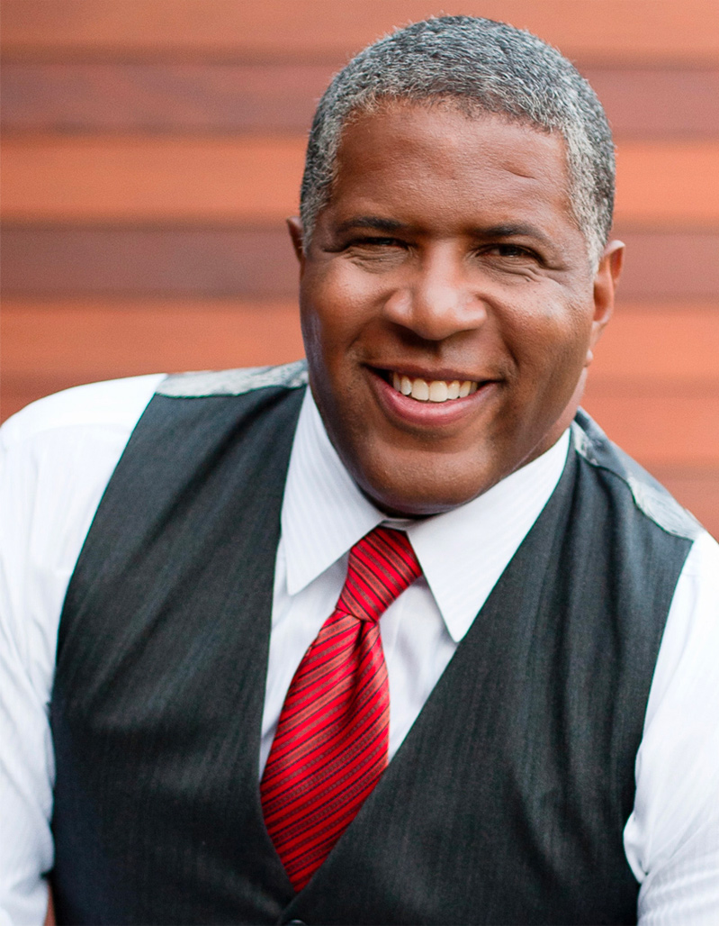
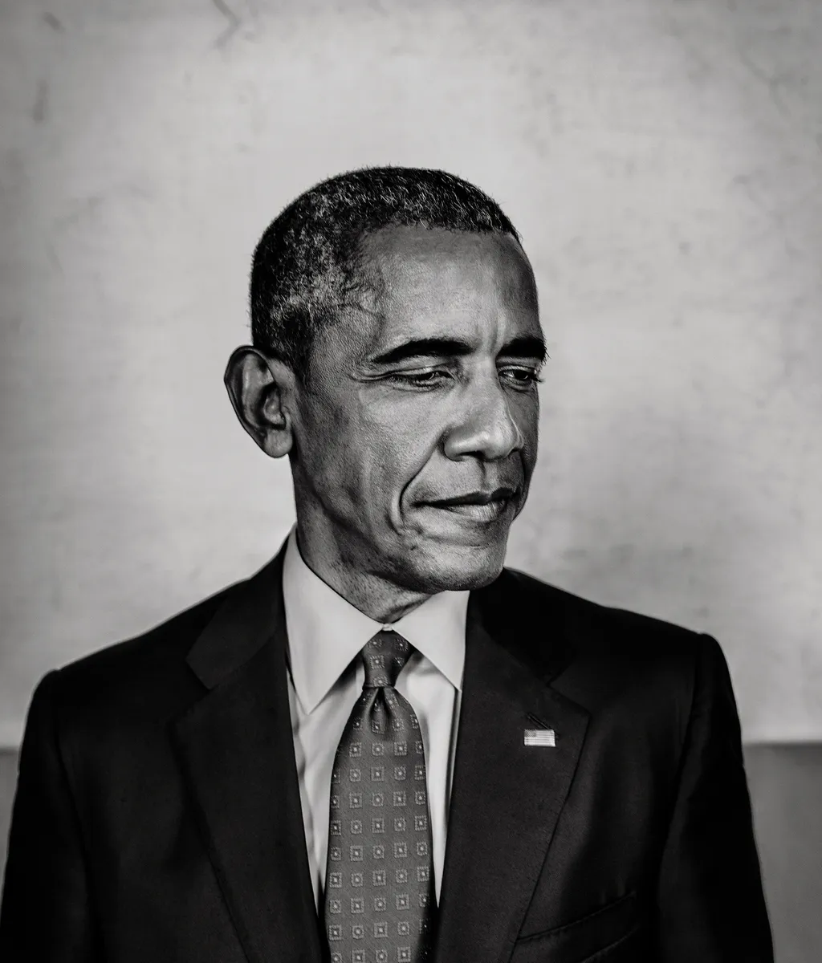
Are narrow visions/definitions of Black success making Black students unsuccessful

Slide 16
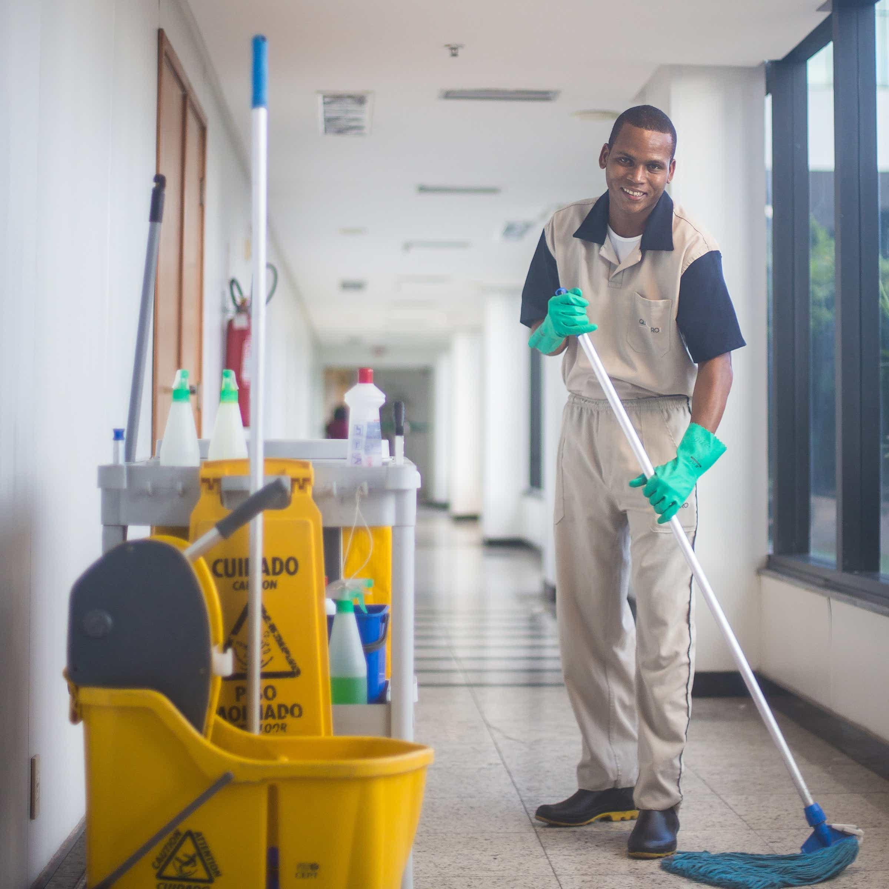
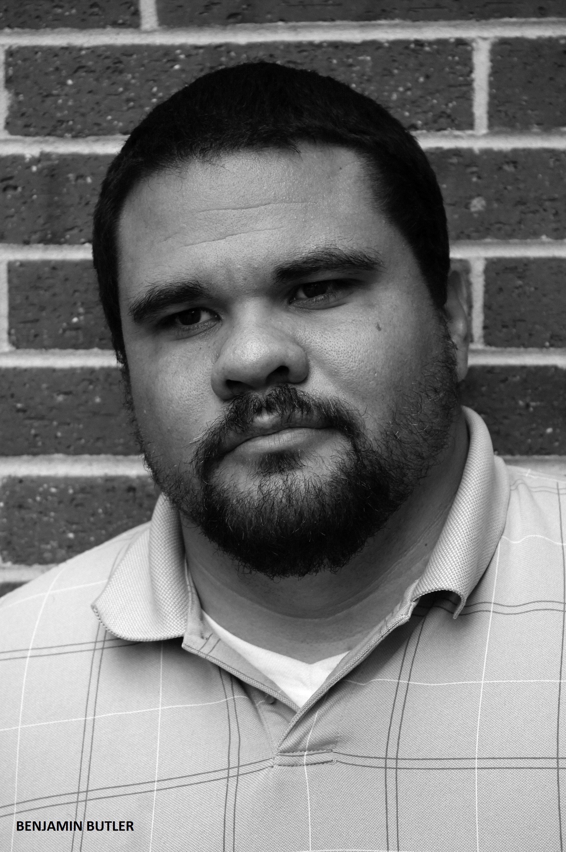
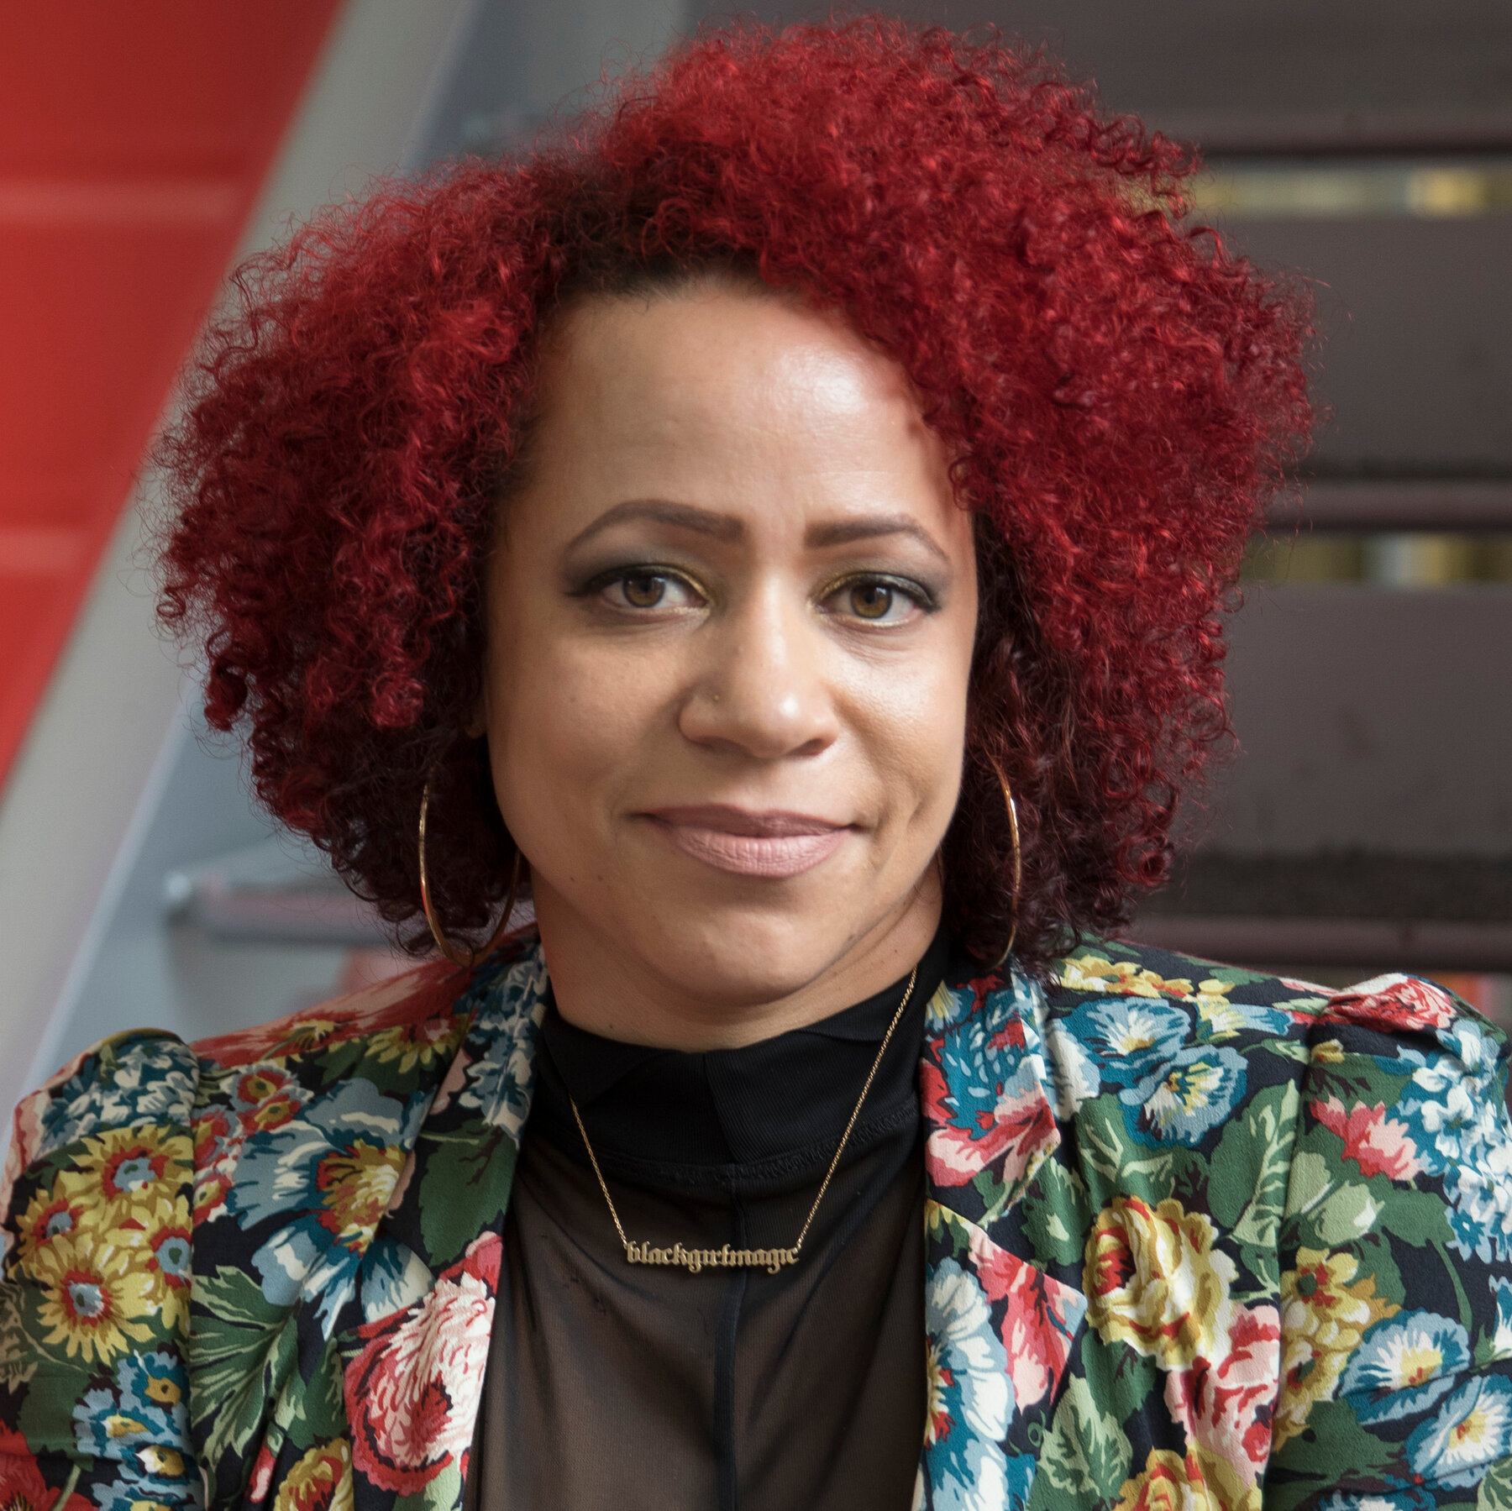
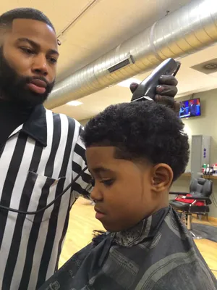
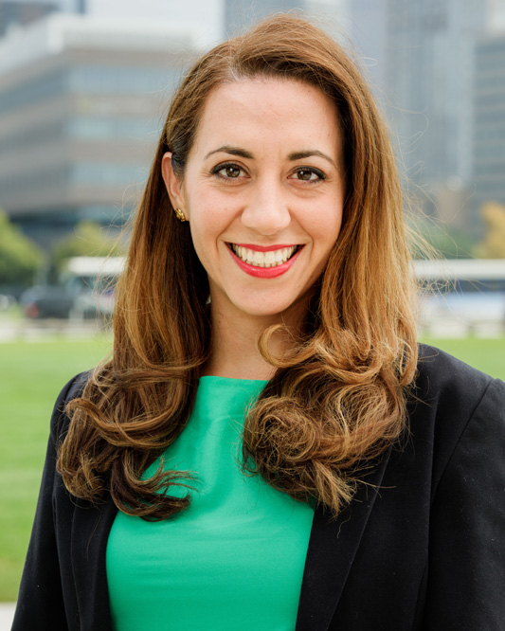
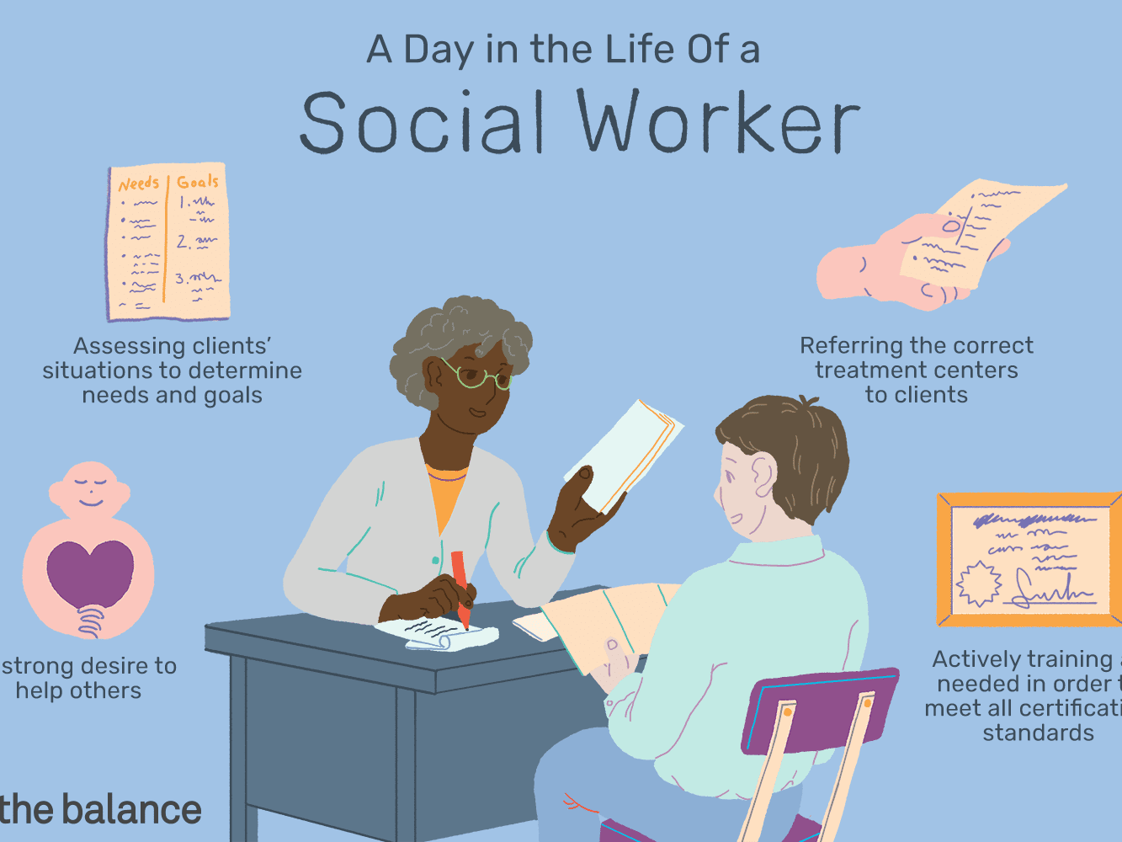
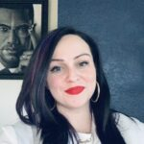
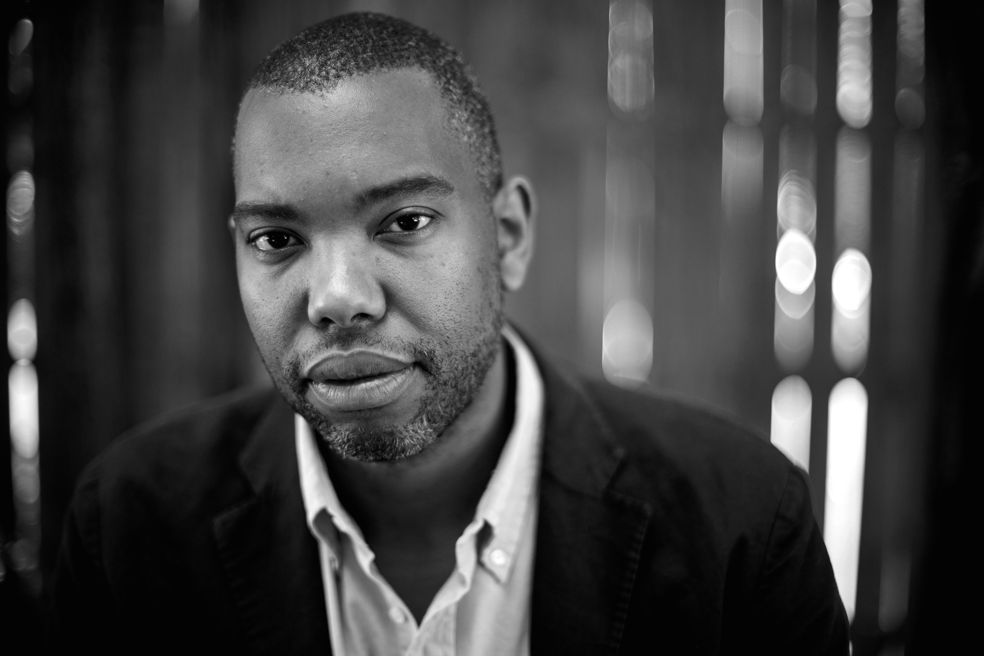
Are narrow visions/definitions of Black success making Black students unsuccessful

Slide 17
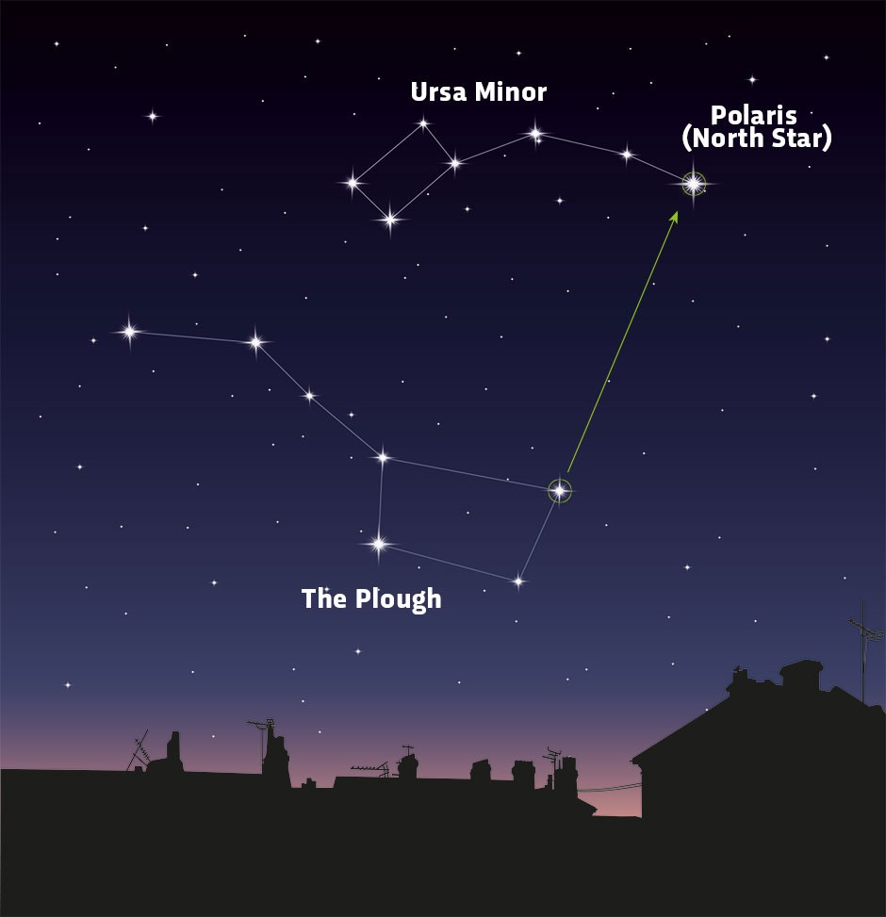
Finding the Success around us…Helping student to co-author/create what success is to them
Co-Authoring Success
Step 1:
Creating space to “do thing with NOT to Students
Ending Banking Models to education (Freire: Pedagogy of the Oppressed Ch. 2)
Step 2:
Find out what it is students “Want”
Help students develop their “Why”
Begin thinking about the “How” (step by step) starting with TODAY
Step 3:
Modeling the way
Providing a “North Star”
Celebrate the success
Step 4:
MAKE GETTING HELP COOL!

Slide 18
Finding the Success around us…Helping student to co-author/create what success is to them
Community is Key!

Slide 19
Assessment Questions
What are 3 examples of ways we use to success to make students feel unsuccessful?
How have schools not provided the examples needed for students to see clearer examples of success?
What are 3 ways that you can help students better picture and prepare for success?
Who are 3 people from your community that you could bring into your space to help demonstrate what success looks like for students? Why those 3?

Slide 20
CEE Affiliates
https://www.councilforeconed.org/resources/local-affiliates/

Slide 21
Thank You to Our Sponsors!

Slide 22
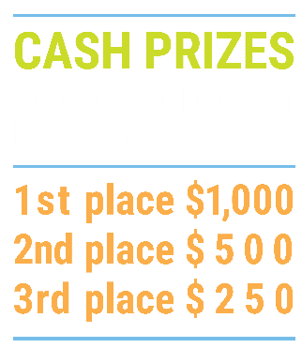
We’ve gone Virtual!
Teach Economics?
Your students may have what it takes to compete in the nation’s only high school economics competition!
Why Play?
• Fun team learning experience
• Great for college applications
• No other challenge like this
• Online participation makes access easy
• Chance for cash prizes
How it Works
Teams register
Teachers enroll team(s) of 3- 4 high school students from the same school. Multiple teams allowed.
Teams compete within their state
Compete to win your state competition for a chance to advance to the National Semi-Finals.
National Semi-Finals: May 3-20, 2021
Teams answer multiple-choice questions on macroeconomics, microeconomics, and international & current events.
National Finals: May 22-24, 2021
Teams analyze an economic issue and present their solution. Top teams engage in the Finals Quiz Bowl where they face-off answering questions to claim the National Title.
Two divisions based on experience level
David Ricardo for first-time competitors who have taken no more than one economics course.
Adam Smith for returning competitors, AP, International Baccalaureate, and honors students.
Register Today at NationalEconomicsChallenge.org

Slide 23
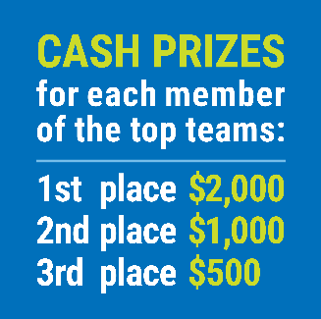
FIND YOUR LOCAL COMPETITION AND REGISTER TODAY!
The National Personal Finance Challenge is a competition that provides high school students with an exciting and motivating opportunity to build, apply, and demonstrate their knowledge of money management.
Through online exams and a personal finance simulation, teams showcase their expertise in earning income, buying goods and services, saving, using credit, investing, as well as protecting and insuring.
Teams of up to four students, with one teacher/coach, can qualify to represent their state at the National Personal Finance Challenge by winning their local competition.
NATIONALS
Semi-Finals: First round elimination via online multiple-choice questions.
Finals: Case study round virtually co-hosted by the Cleveland Fed on June 3.
personalfinancechallenge.org

